Slide 1
Digital System Design Using Verilog
Open ended
Team 23:
Yatirajgouda Patil 244
Pratham Naik 262
Gajanan NP 261

Slide 2
PROBLEM STATEMENT
Design and implement to find the square root of number
using Newton Raphson Method

Slide 3
INTRODUCTION
The square root of a number is a fundamental mathematical operation used in various applications, and finding an efficient and accurate method for its computation is crucial in digital design. The Newton-Raphson method offers an iterative approach to approximate the square root of a given number.

Slide 4
Working Principle
The working principle of finding the square root of a number using the Newton-Raphson method in Verilog involves starting with an initial guess for the square root. The method iteratively refines the guess using the formula
y = (x + (num / x)) / 2 , where ‘num’ is the input number and ‘x’ is the current estimate. This process is repeated for a fixed number of iterations, resulting in an efficient and accurate approximation of the square root.

Slide 5
VERILOG CODE
module root_newton(num,root);
input[15:0]num;
output reg [15:0]root;
real x,y;
always@(num)
begin
if(num==16'd0 |num==16'd1) root=num;
else
begin
x=num/2;
repeat(10)begin
y=(x+(num/x))/2;
x=y;
end;
root=y;
end
end
endmodule

Slide 6
VERILOG TESTBENCH
module root_newton_tb;
// Inputs
reg [15:0] num;
// Outputs
wire [15:0] root;
// Instantiate the Unit Under Test (UUT)
root_newton uut (
.num(num),
.root(root)
);
initial begin
num=16'd144;
#50;
num=16'd121;
#50;
num=16'd64;
#50;
num=16'd400;
#50;
num=16'd225;
#50;
end
endmodule

Slide 7
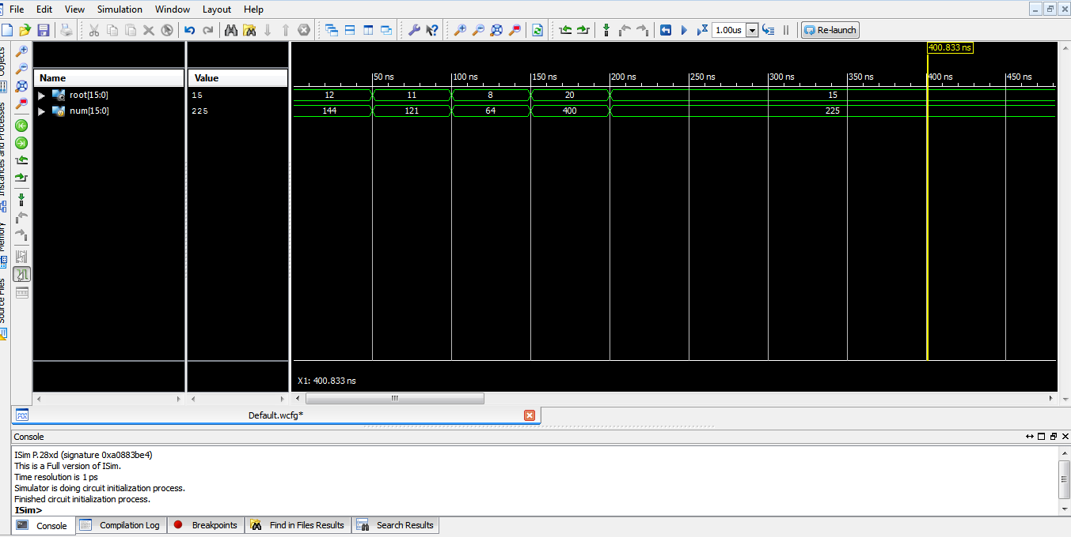
SIMULATION RESULTS

Slide 8
APPLICATIONS
*Digital Signal Processing (DSP): In DSP algorithms, calculating square roots is a common operation, especially in filtering, equalization, and modulation techniques. The Newton-Raphson method provides an efficient and accurate way to perform these computations in hardware.
*Mathematical Calculations: Numerous mathematical computations, such as solving equations, optimization problems, and numerical analysis, require square root calculations. The Newton-Raphson method is well-suited for these applications due to its iterative nature and fast convergence.
*Image and Audio Processing: Image and audio processing applications often involve complex mathematical operations that utilize square roots. Implementing the Newton-Raphson method in hardware accelerates these computations in real-time applications.
*Scientific and Engineering Simulations: In scientific simulations and engineering applications, square roots frequently appear in calculations involving physical properties like velocity, acceleration, and distance. The Newton-Raphson method enhances the efficiency of these simulations.
*Digital Control Systems: Control systems, such as PID (Proportional-Integral-Derivative) controllers, rely on mathematical operations, including square root computations. Utilizing the Newton-Raphson method in Verilog enables precise and high-speed control in hardware-based systems.

Slide 9
THANK YOU

