Slide 1

Digital Signal Processing: PBL approach
Theme : Biosignal Processing
Title : ECG signal processing
Course: Digital Signal Processing
Course Code: 23EECC303
Semester: V
Credits: 4 [2-0-2]
Hours/Week: 6
Faculty Mentor: Raghvendra Shet
Team Details
Sl.No. | Roll No. | Div | SRN | Name
1 | 242 | B | 01FE21BEC081 | Prateek R. Shettar
2 | 244 | B | 01FE21BEC083 | Yatirajgouda Patil
3 | 262 | B | 01FE21BEC103 | Pratham Naik

Slide 2
Title: ECG signal processing
Content
Problem Statement
Introduction
Literature Survey
Functional Block Diagram
Data Sets/Data Acquisition
Methodology
Results
References

Slide 3
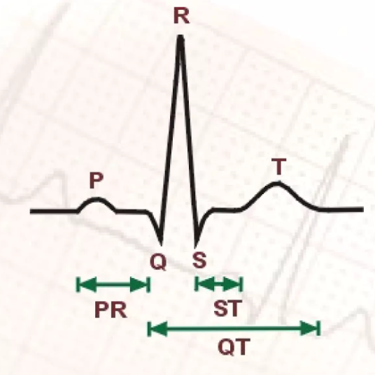
Title: ECG signal processing
Problem Statement
“ Design and implementation of ECG signal processing and denoising the signal and to predict the heartbeat rate ”

Slide 4
Title: ECG signal processing
Introduction
Electrocardiogram : Diagnostic tool that graphically measures and records the electrical activity of the heart in detail.
How does it differ from EKG : Derived from the German word Elektrokardiogramma First invented in the early 1900s.
ECG Operation : When an electrical potential is generated in a section of the heart, an electrical current is conducted to the body surface in a specific area.
Three pulses that completes the ECG wave :
l. P wave
2. QRS Complex —
3. T wave
Significance of ECG signal processing : used in the extraction of vital characteristic parameters.

Slide 5
Title: ECG signal processing
Literature Survey
Sl.No | Title | Methodology/ Algorithm | Merits | Demerits | Gaps
1 | ECG Signal Denoising By Wavelet Transform Thresholding | Adaptive impulse correlated filter (AICF), the time- sequence adaptive filter (TSAF) and the signal-input adaptive filter (SIF) | Effective ECG signal denoising achieved through wavelet transform thresholding. | Limited exploration of potential challenges in threshold determination and reconstruction impact on ECG morphology. | Limits the generalizable Denoising function.
2 | Performance Study of Different Denoising Methods for ECG Signals | Discrete wavelet transform (universal and local thresholds), adaptive LMS filtering, adaptive RLS filtering, and Savitzky-Golay filtering. | Comprehensive performance evaluation of various ECG signal denoising methods. | Potential lack of depth in analyzing specific signal characteristics and contextual application scenarios for denoising methods. | The research gap is the lack of investigation into the combined application of denoising methods.
3 | Denoising ECG signals using Adaptive filter algorithm | Adaptive Filter Algorithm | Provides effective denoising of ECG signals through an adaptive filter algorithm, enhancing signal quality. | Potential limitations may arise in handling non-stationary noise or adapting to varying ECG signal characteristics. | The research gap is the limited exploration of the RLS algorithm's performance under varying noise levels and types.

Slide 6
Title: ECG signal processing
Literature Survey
Sl.No | Title | Methodology/ Algorithm | Merits | Demerits | Gaps
4 | Study and Analysis of ECG Signal Using MATLAB & LABVIEW as Effective Tools | Adaptive filtering method,Non-adaptive filtering method. | Provides a comprehensive study and analysis of ECG signals using MATLAB and LABVIEW as effective tools. | Potential limitations in addressing the specificity and challenges of ECG signal analysis within the chosen software frameworks. | The research gap involves the lack of in-depth exploration into the limitations and potential drawbacks of using simulation tools.
5 | Analysis of Butterworth and Chebyshev Filters for ECG Denoising Using Wavelets | Daubechies wavelet decomposition, thresholding techniques, and Butterworth or Chebyshev filter for ECG denoising. | In-depth analysis of Butterworth and Chebyshev filters for ECG denoising through wavelet techniques. | Potential omission of comparative assessments with other denoising methods and limited exploration of filter parameter optimization. | The research gap exists in the absence of a comprehensive comparison of the proposed hybrid denoising technique.
6 | Denoising of Electrocardiogram Data with Methods of Wavelet Transform | Utilizes wavelet transform for denoising electrocardiogram data through wavelet decomposition. | Effective denoising of ECG data achieved through wavelet transform methods. | Potential limited exploration of the impact on specific ECG features and variations in signal characteristics. | Possible gaps in the research paper may involve insufficient exploration of optimal thresholding techniques for wavelet transform.

Slide 7
Title: ECG signal processing
Functional Block Diagram
Apply Discrete Fourier Transform OR FFT
Apply IDFT to convert back to time domain signal
ECG signal
Heart rate prediction Based on R-Peaks
Calculate the R-Peaks
Apply the filter to remove noise

Slide 8
Title:
Data Sets/Data Acquisition
Dataset name: ECG ID DATABASE
Signal length: 5000 data points of 10 seconds
Amplitude range: -100 to 250 mV
Sampling frequency: 500
Frequency range: 0 - 250 Hz

Slide 9
Title: ECG signal processing
Methodology
Using the Discrete Fourier Transform (DFT) involves transforming electrocardiogram (ECG) data into the frequency domain and then applying a mathematical approach to evaluate and filter specific frequency components.
This involves identifying noise frequencies, using the proper filtering techniques for denoising, and using the DFT algorithm to break down the ECG signal into its frequency components.

Slide 10
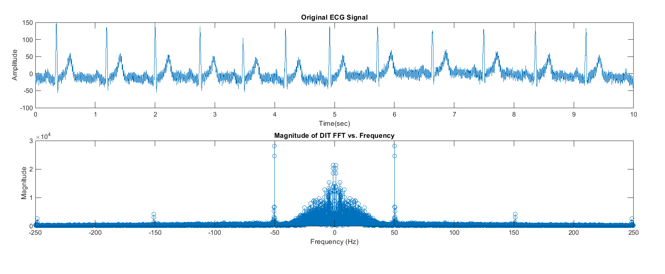
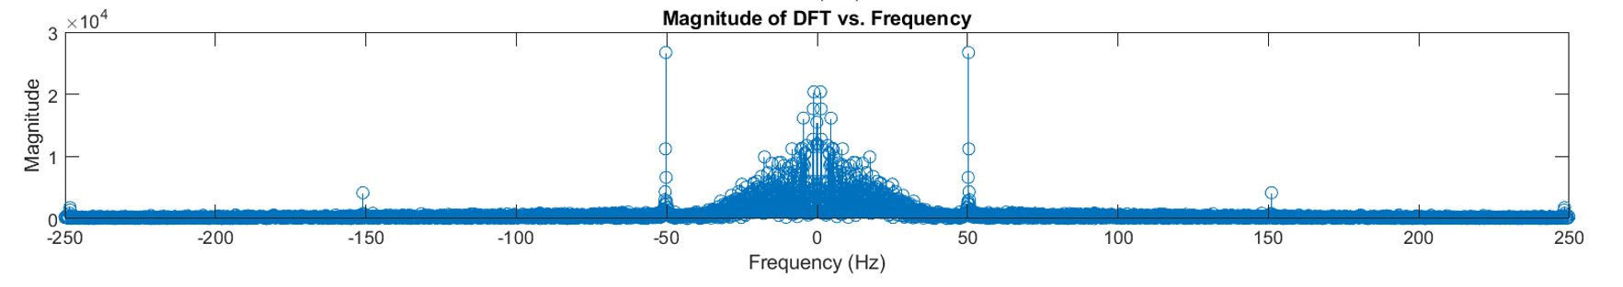
Title: ECG signal processing
Discrete Fourier Transform
Time domain sequence
Frequency Spectrum
Number of samples: 5000
Number of frequency coefficients (N): 5000
Computation time: 3.25s
Execution time: 6.35s

Slide 11
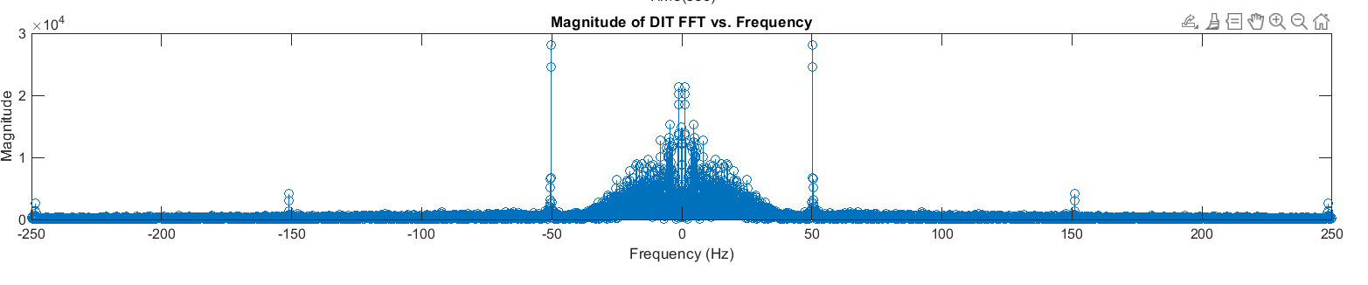
Title: ECG signal processing
Fast Fourier Transform
Time domain sequence
Frequency Spectrum
Number of samples: 5000
Number of frequency coefficients (N): 5000
Computation time: 0.42s
Execution time: 0.682s

Slide 12
Title: ECG signal processing
Comparison between DFT and FFT
Dimension | DFT | DIT FFT
Time complexity | 3.25 s | 0.42 s

Slide 13
Title: ECG signal processing
Digital Filter Design
Pass band edge frequency: 8,49 Hz
Stop band edge frequency: 7,50 Hz
Pass band ripple: -1 dB
Stop band ripple: -20 dB
Sampling frequency: 500 Hz

Slide 14
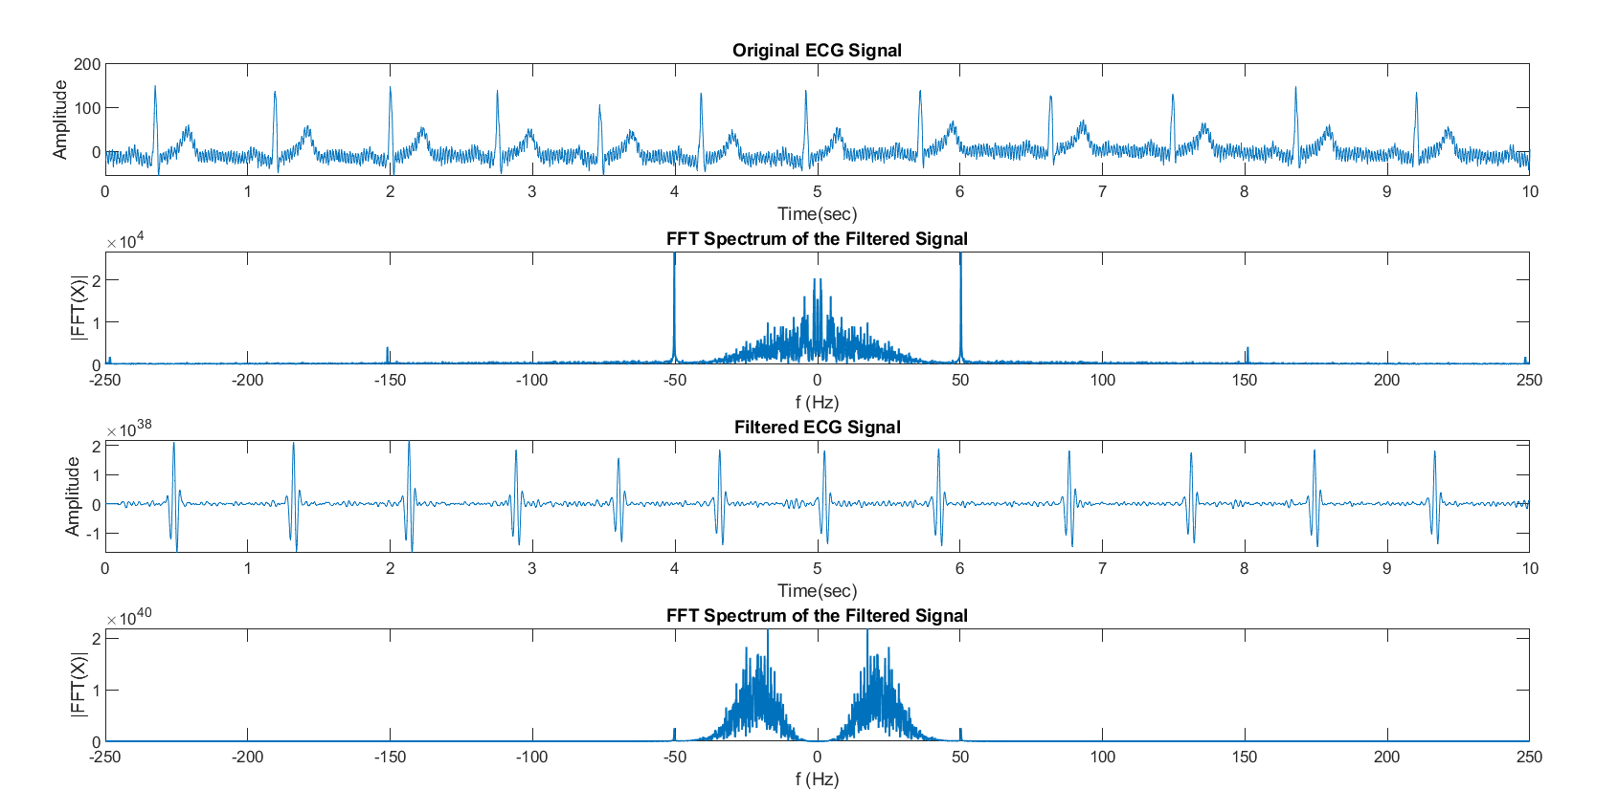
Title: ECG signal processing
Digital IIR Butterworth Filter Design
Frequency Response of the filter

Slide 15
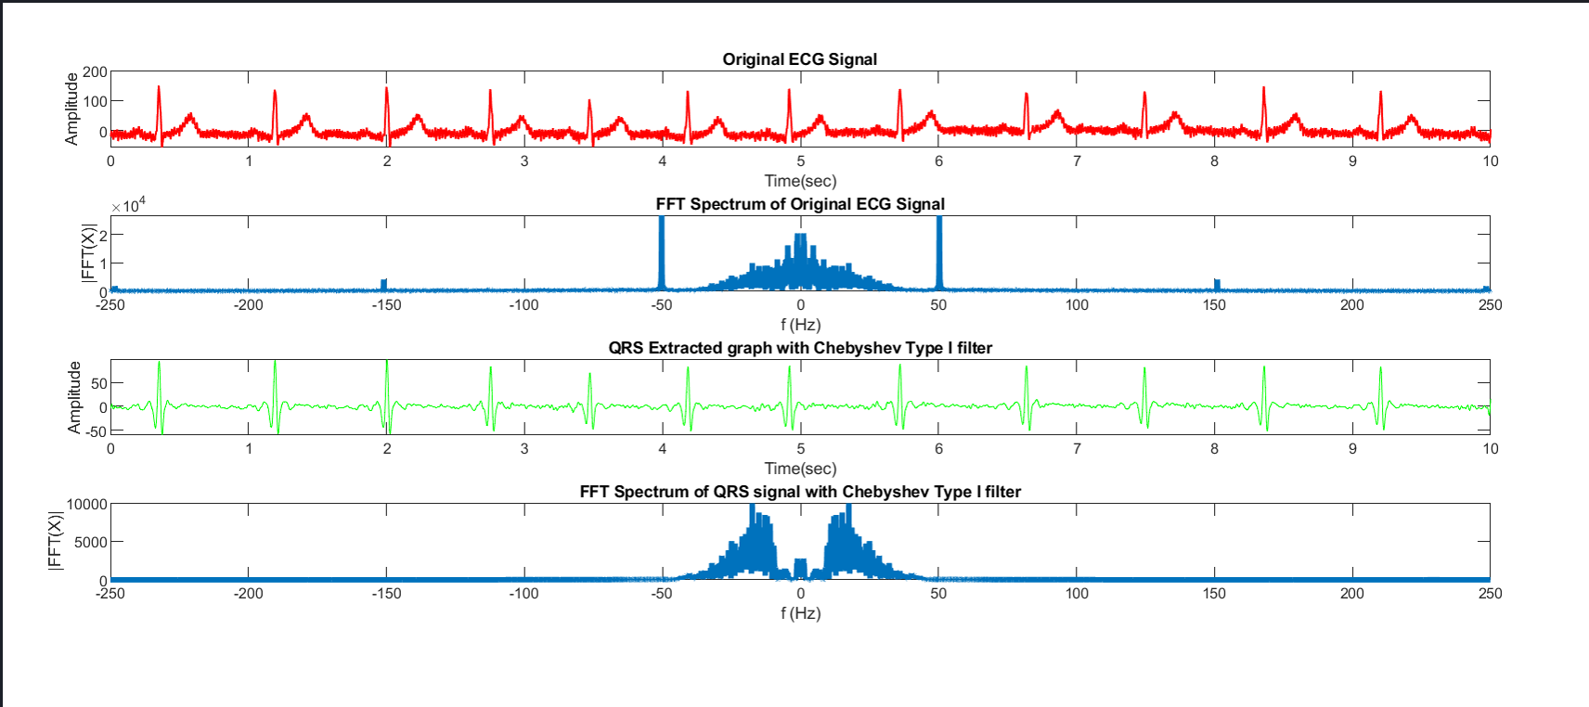
Title: ECG signal processing
Digital IIR Chebyshev Filter Design
Frequency Response of the filter

Slide 16
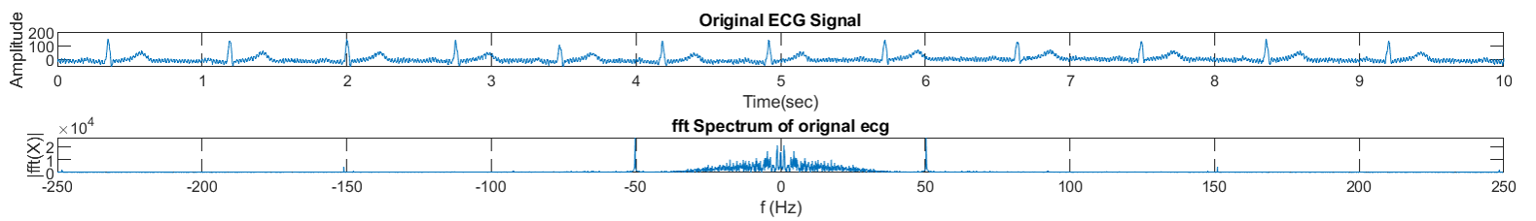
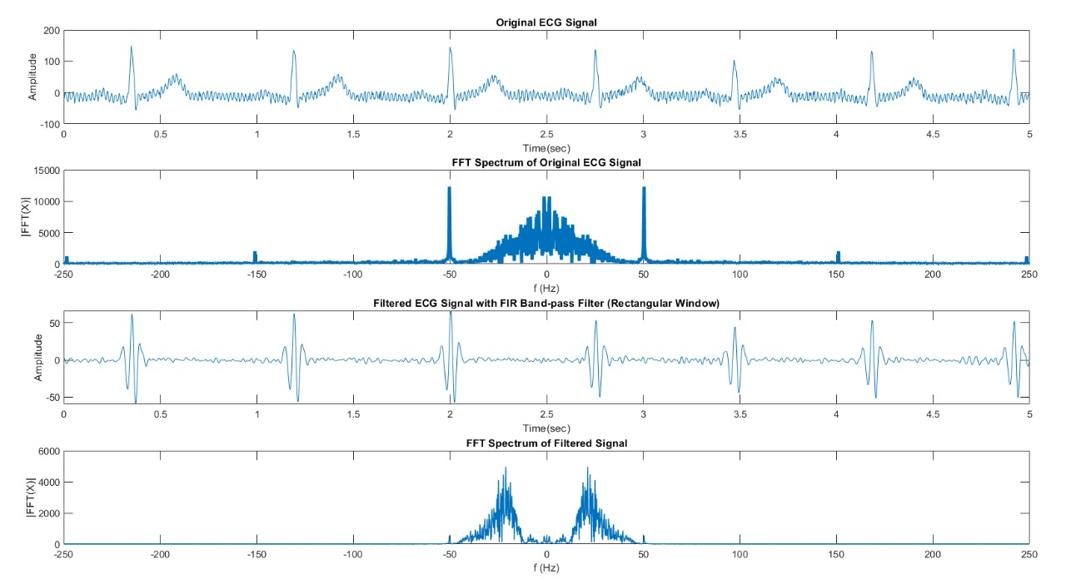
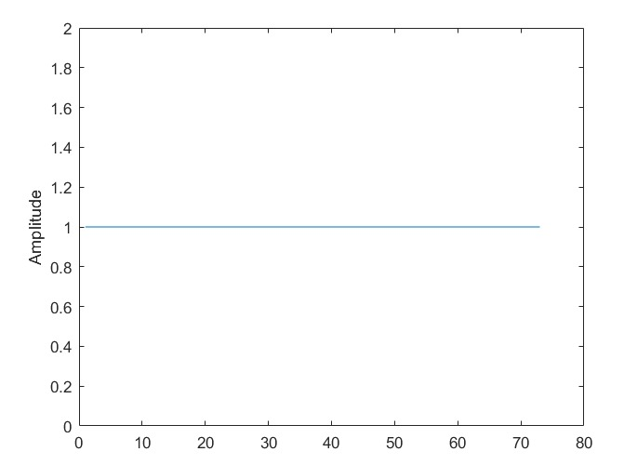
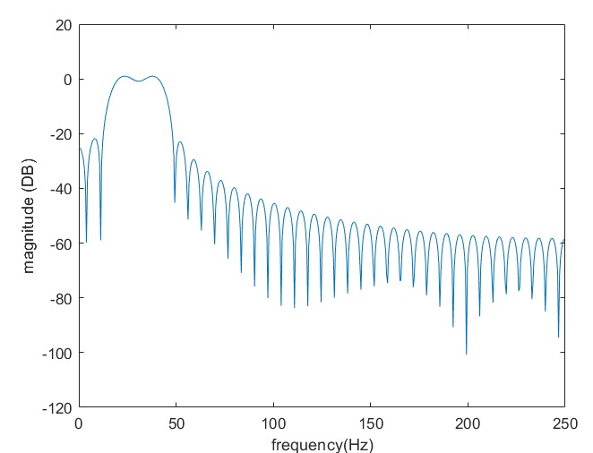
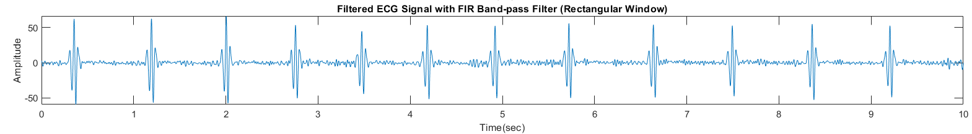
Title: ECG signal processing
Digital FIR Filter Design
Input Signal
Frequency Spectrum of Input
Rectangular window
Frequency Response of the filter
Output Signal
Frequency Spectrum of Output

Slide 17
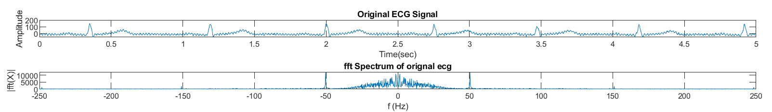
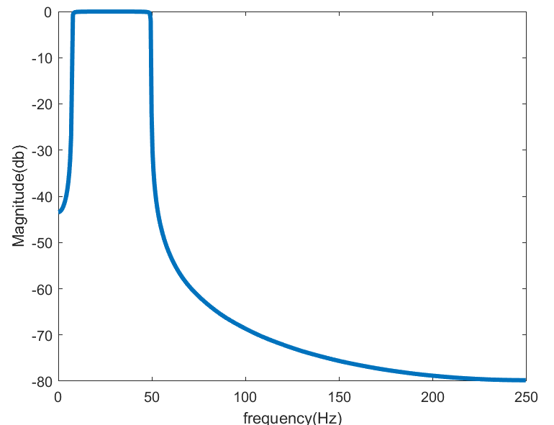
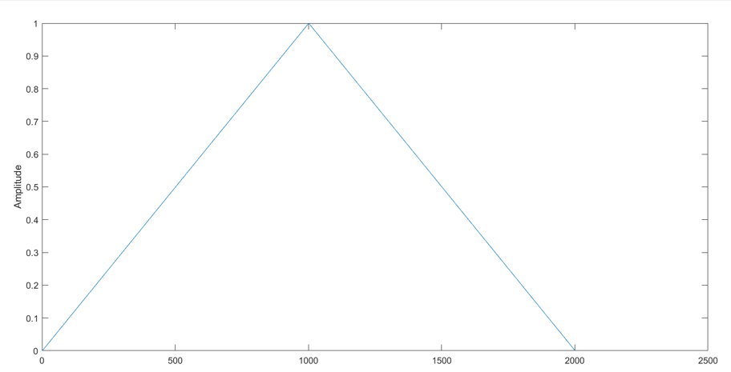
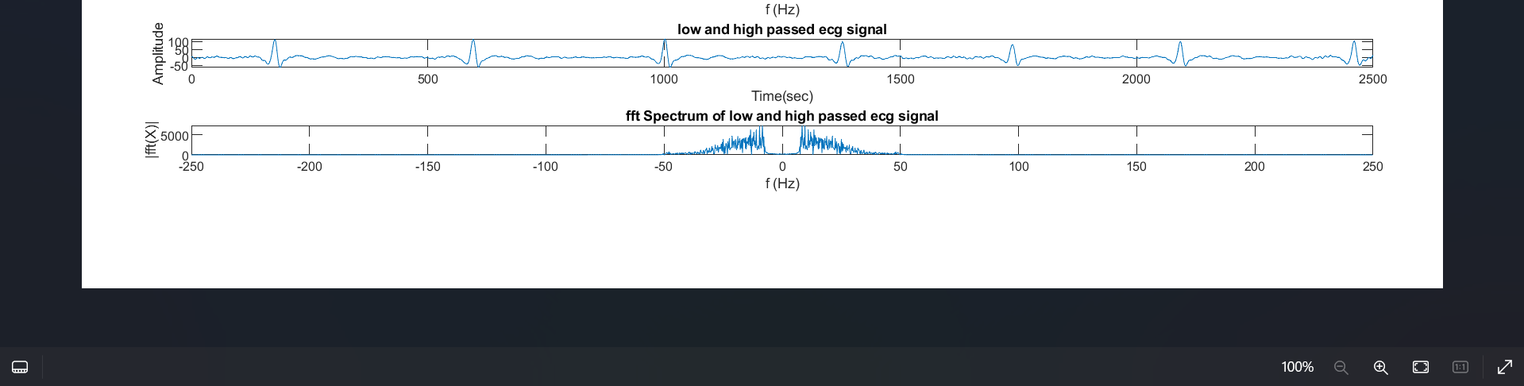
Title: ECG signal processing
Digital FIR Filter Design
Frequency Spectrum of Input
Input Signal
Frequency Response of the filter
Bartlett window
Output Signal
Frequency Spectrum of Output

Slide 18
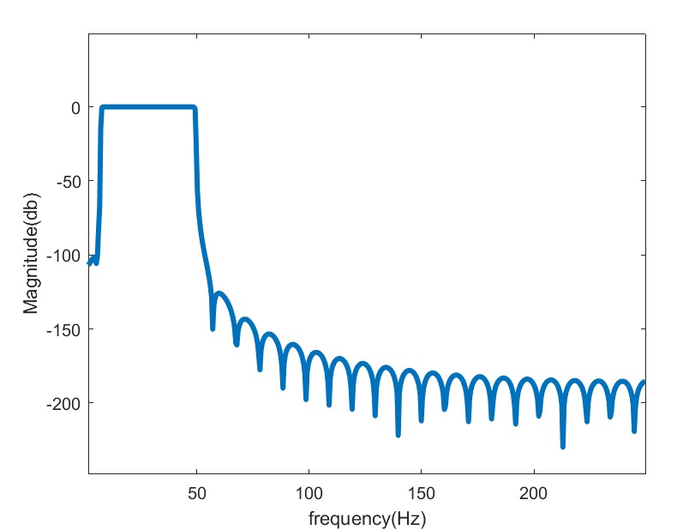
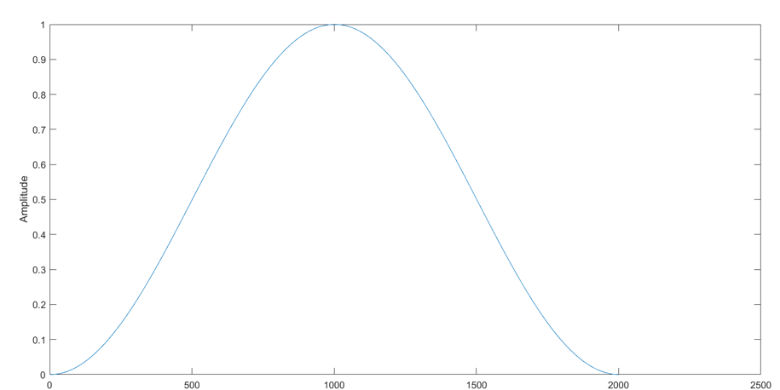
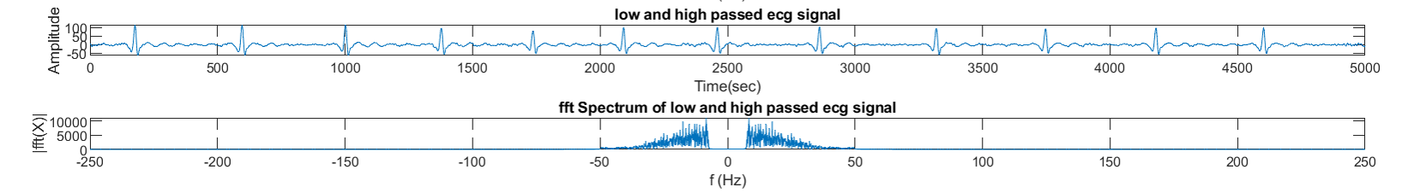
Title: ECG signal processing
Digital FIR Filter Design
Input Signal
Frequency Spectrum of Input
Frequency Response of the filter
Hanning window
Output Signal
Frequency Spectrum of Output

Slide 19
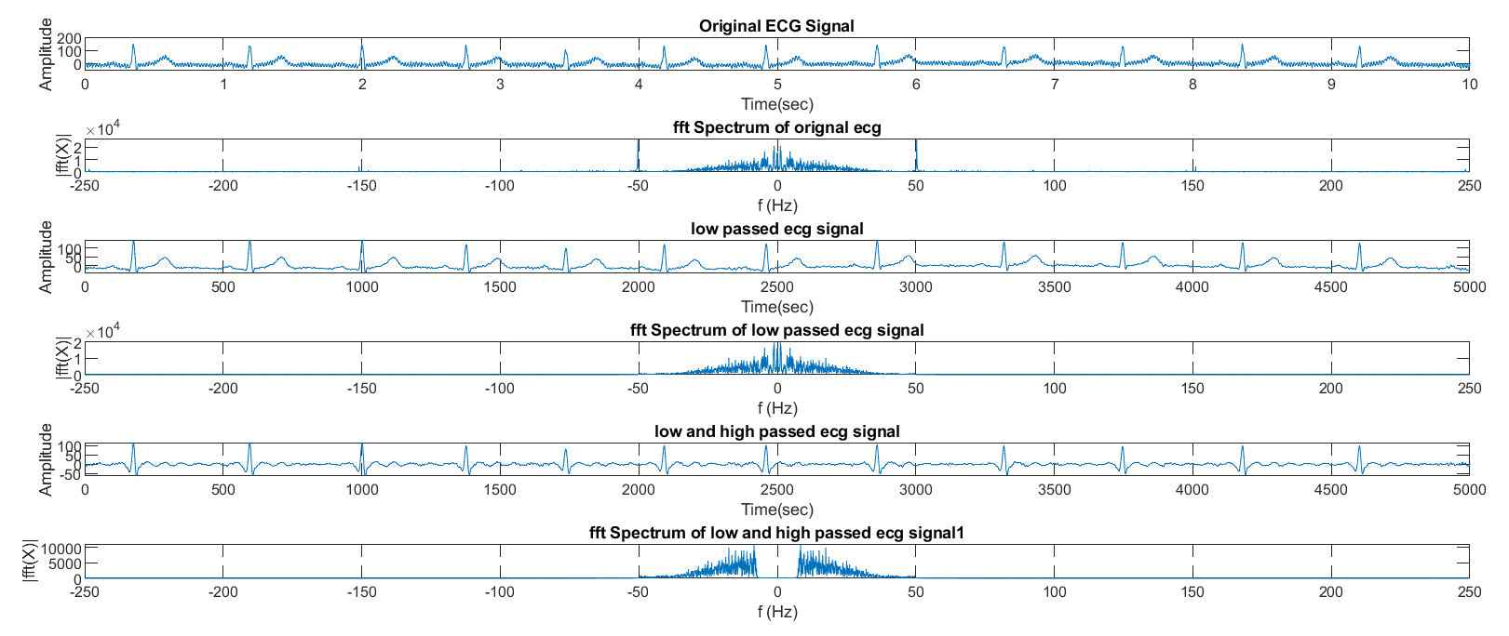
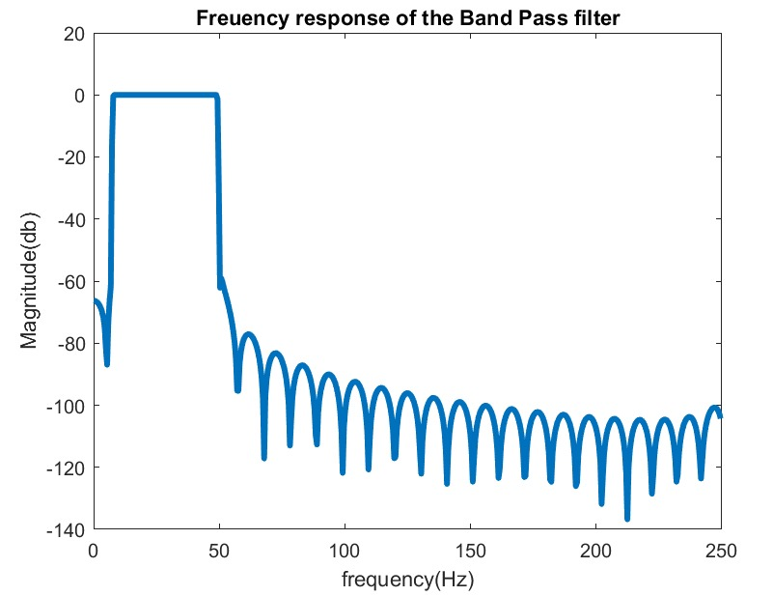
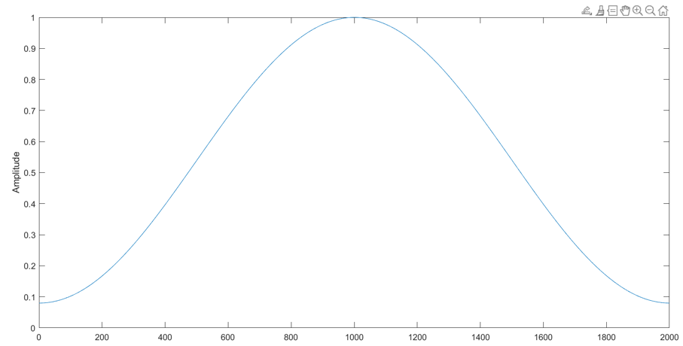
Title: ECG signal processing
Digital FIR Filter Design
Frequency Spectrum of Input
Input Signal
Frequency Response of the filter
Hamming window
Output Signal
Frequency Spectrum of Output

Slide 20
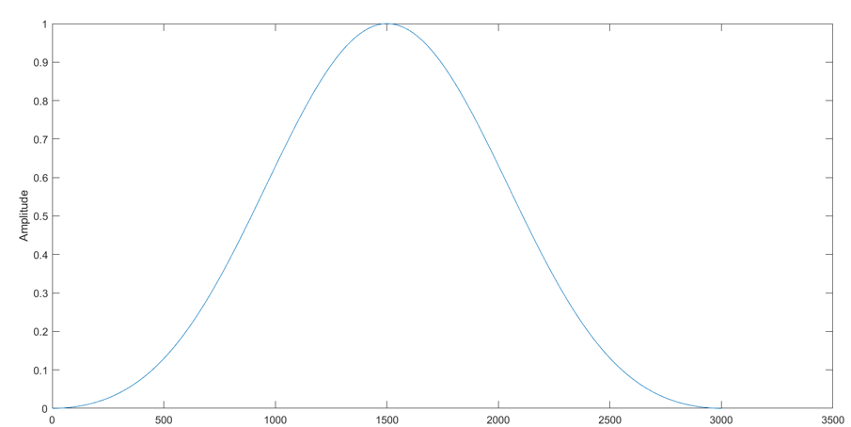
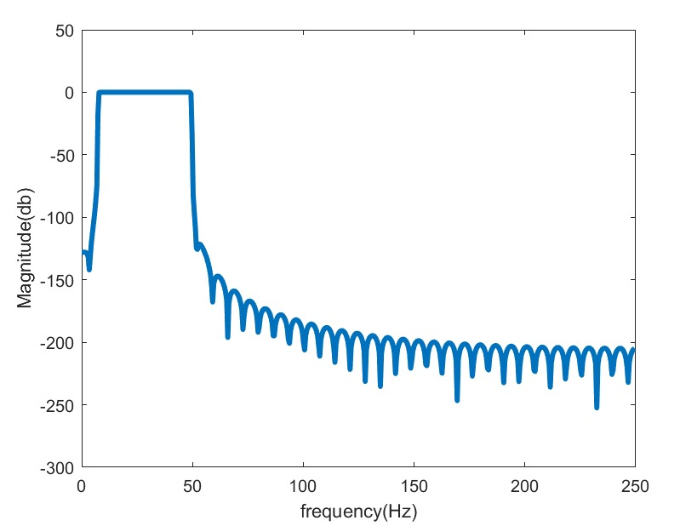
Title: ECG signal processing
Digital FIR Filter Design
Input Signal
Frequency Spectrum of Input
Blackmann window
Frequency Response of the filter
Output Signal
Frequency Spectrum of Output

Slide 21
Title: ECG signal processing
Results
In our project, we identified the precise R-peaks and heart rate using a bandpass filter with various window functions. We observed that all window techniques successfully extracted the exact R-peak.
When addressing noise concerns, the bandpass filter with a Blackmann window stood out, excelling in eliminating DC component noise and proving to be more effective than other window techniques.
Before filtering the heart rate was 105 bpm. After filtering the the calculated heart rate came to be 67 bpm

Slide 22
Title: ECG signal processing
References
[1] V.Almenar, A.Albiol, 1999. A new adaptive scheme for ECG enhancement, Signal Processing 75, pp: 253-265
[2] Mallat S. G., and S. Zhong, 1992. Characterisation of signals from Multiscale edges IEEE Transactions on pattern analysis and machine intelligence,Vol. 14, No. 7, pp. 710-732.
[3] P. S. Gokhale, “ECG Signal De-noising using Discrete Wavelet Transform for removal of 50Hz PLI noise,” Int. J. Emerg. Technol. Adv. Eng., vol. 2, no. 5, pp. 81–85, 2012.
[4] N. V. Thakor and Y.-S. Zhu,Applications of adaptive filtering to ECG analysis: noise cancellation and arrhythmia detection,”. IEEE Transactionson Biomedical Engineering, vol. 38, no. 8, pp. 785-794, 1991.
[5] J. A. Van Alste and T. S. Schilder, “Removal of base-line wander and power-line interference from the ECG by an efficient FIR filter with a reduced number of taps,” IEEE Transactions on Biomedical Engineering, Vol. 32, no. 12, pp. 1052–1060, 1985.
[6] Sonal K. Jagtap, M. D. Uplane, “A real time Approach: ECG Noise Reduction in Chebyshev Type II Digital Filter,” International Journal of Computer applications, Vol. 49, no. 9, July 2012.
[7] V.Almenar, A.Albiol, 1999. A new adaptive scheme for ECG enhancement, Signal Processing 75, pp: 253-265
[8] Harvard-MIT Division of Health Sciences and Technology Biomedical Engineering Center MIT-BIH Arrhythmia Database ( http://www.physionet.org/physiobank/database/ )

Slide 23
Thank You

