Slide 1

BiLink
Tool Comparison
Format Conversion
Workflow Creation
Yatish Jain
Michelle Toups
Notes:
MICHELLE
Webserver called BiLink –bioinfo. Link (short form blink)
-link all concepts together as bioinformatics is vast → BiLink or “blink”
-Tool comparison: platform to compare tools
-Format conversion: page to convert different formats
-Workflow creation: promote standardization and sharing of workflows

Slide 2

Bioinformatics Problems
Confusion:
Interoperability:
Lack of understanding:
many similar tools
on many different platforms
using many different algorithms
Notes:
MICHELLE
Why should you care about this? → going into industry. You will have many tasks and many options for tools to use and could be really confusing ….etc etc…
CONFUSION: There are many similar tools for different types of data and many different tools for similar types of data. → confusion!
INTEROPERABILITY:
-not all formats are supported for different tools
-tools are run on many platforms –OS, Linux, Microsoft—which tools work on my system?
LACK OF UNDERSTANDING:
-background algorithms unknown usually
-what type of data does it work best with?
-what outputs does it give?

Slide 3
Aims
Web based and downloadable tools.
How to use.
Comparison of tools.
Format conversions.
Workflow creation.
Notes:
MICHELLE
Here is what we propose to tackle the problems mentioned before:
-details of web-based and downloadable tools→extensive list of bioinf. Tools
-how to use each → utilization, input and output formats, and providing a visualization guide.
-compare any tool with any other tool→ will display that tools are used for different purposes (Sequence vs. similarity)
-compare similar tools
-format conversion
- Develop a user-friendly API to convert file formats that can potentially be used as an input for further use in another tool
-workflow creation
- allows user to customize and save a workflow to a database that will later be retrieved
1. Interactive workflow designer
2. Specified workflow –designed by users
3. Popular/Favorite workflows

Slide 4
Target Users
New Bioinformaticians
Experienced Bioinformaticians
Self-made Bioinformaticians
Notes:
YATISH
Target users for blink would mainly be budding bioinformaticians who wants to learn about the field.
But as we say learning process never stops no matter on which stage you are on in your career, any bioinformatician can use blink to update their learning.

Slide 5
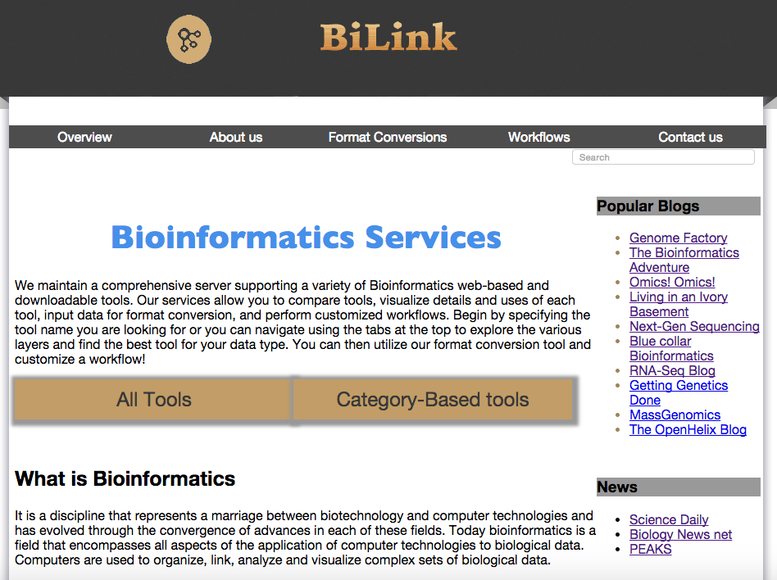
BiLink MAIN PAGE
BiLink
Notes:
YATISH

Slide 6
Demonstration
Tool Comparison
LAYER 1
Format Conversion
LAYER 2
Workflow Creation
LAYER 3
FREDA
Bioinformatician
FRED
Bioinformatician
In Training
Notes:
YATISH

Slide 7
FRED- (new user in field of Bioinformatics)
Employer gave him a set of 40 protein sequences
Task: Do a phylogenetic analysis
Data: Long N/C terminus (no other info.)
What can he do?
Go to our site!
Notes:
MICHELLE
Employer gives him this data. But he needs a little help getting started. Which tool is best for this data? What are his options? Where does he start? He begins with the interactive workflow designer

Slide 8
FRED- (new user in field of Bioinformatics)
Needs to make a
phylogeny tree
Interactive Workflow Designer
Demo
Notes:
MICHELLE
He uses the interactive workflow designer and finds out that he needs to first do an MSA! So he goes to category-based tools to find the best tool for his data.

Slide 9
FRED- (new user in field of Bioinformatics)
Doesn’t know which
tools to use.
Category Based Tools
Demo
Notes:
MICHELLE
Well fred was able to pinpoint the tool he want to use by seeing the advantages/disadvantages. But he don’t know how to use it!
Individual tool details page.

Slide 10
FRED- (new user in field of Bioinformatics)
Doesn’t know how to change formats.
Format Conversion Tool
Demo
Notes:
MICHELLE
Fred knows his file is in genbank format but discovered from the details page that this format is not supported by Clustal Omega. And he doesn’t know perl well enough to convert formats, so he uses the format conversion tool to convert the genbank file into a fasta
Fred is happy with his fasta output, uses Clustal Omega and then goes back to the interactive workflow designer to find the next step. Once he is done with his phylogenetic analysis, he saves his workflow, and is able to use it in the future or share it with his employer!

Slide 11
FREDA- (A Bioinformatician)
Employer gave her a set of 40 protein sequences
Task: Do a MSA
Data: Long N/C terminus (no other info.)
What can she do?
Go to our site
Notes:
YATISH
Freda is given the same task.

Slide 12
FREDA- (A Bioinformatician)
Knows which
tools to use.
ALL TOOLS
Demo
Notes:
YATISH
Freda goes to our page and goes straight to the all tools- She knows she wants downloadable tools- MUSCLE and clustalW. Etc….

Slide 13
FREDA- (A Bioinformatician)
Needs to make a standard procedure for a phylogeny tree
Specified Workflow Creation
Demo
Notes:
YATISH
Freda knows the workflow she wants but she wants to create a standard procedure for her colleagues to follow for future phylogeny uses. She creates a workflow and saves/shares it.

Slide 14
Implementation Design
Tool Details/Comparison
Research team→ Review papers and various trusted published sources
Science
Nature
Elsevier
Computational Molecular Biology etc..
All data from the research
will be stored in a database
Notes:
MICHELLE

Slide 15
Implementation Design …
Format Conversion
Pseudo Code
1. Pass input files and format of output as arguments
2. Identify the format of each input file with if/else conditions and capture this in a variable named $format- $format eq “FASTA” (for example, if file starts with “>”, it is a FASTA file.)
3. Provide a drop-down list option to the user to give the possible outputs, which the file can be converted to.
4. If BioPerl supports the input/output formats, BioPerl will be used to reformat. (Otherwise, the subroutine returns false and a second subroutine using Perl code will reformat the requested inputs/outputs.)
5. Return the output file/files to our page.
Notes:
MICHELLE

Slide 16
Implementation Design …
Workflow Creation
1. Interactive Workflow Designer
2. Specified Workflow Design by Users
3. Popular/Favorite Workflows
Database retrieval with primary key
Notes:
YATISH

Slide 17
Databases
Database for all tools
Advantages/Disadvantages.
Database for workflows
Database for users who can save their workflow
Notes:
YATISH

Slide 18
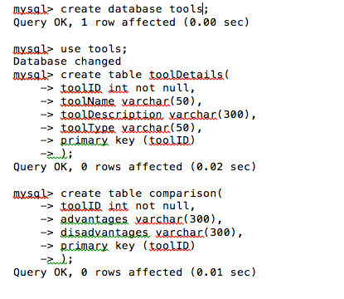
Database Creation
Notes:
YATISH

Slide 19
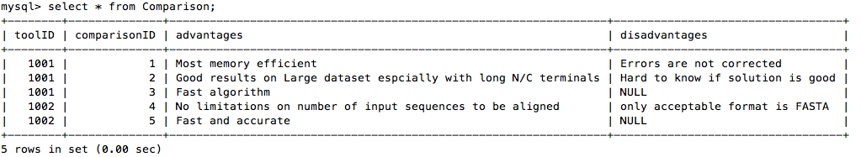
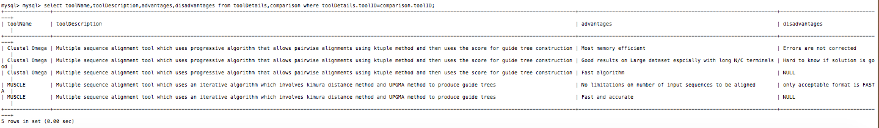
“tools” Database
toolDetails Table:
comparison Table:
Notes:
YATISH

Slide 20
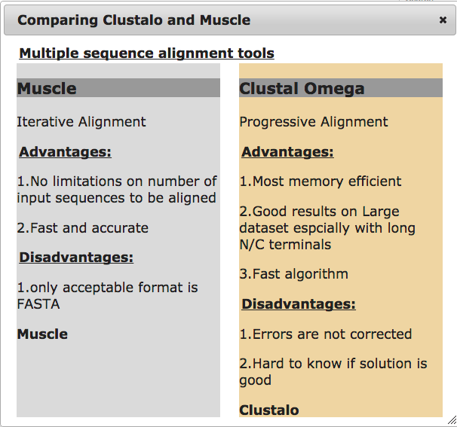
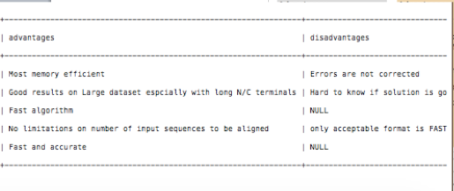
“comparison” Database
Screenshot of Comparison:
Query to fetch data:
Notes:
YATISH

Slide 21
Future pipeline for Fred users:
Multiple file format conversions.
Make interactive workflows robust and easy to understand.
Popular workflows
-Explanations
-Demonstration
Notes:
MICHELLE
For Fred users we want to demonstrate and explain the popular workflows in a tutorial to explain how the workflows work

Slide 22
Future pipeline for Freda users:
Login access on webservers
Platform based search/tab
Functionality to design workflows
-Save them
-Rate them
Notes:
YATISH

Slide 23
Challenges
PROTOTYPE→ Proof of concept
1. Finding information on different tools.
-pinpointing advantages/disadvantages
-Advantages/disadvantages are the same?
2. Identifying similar formats-input
3. Rarer file format details-output
4. Invalid formats
5. Methods to pass html arguments to Perl code
Notes:
MICHELLE
For example, with alignment, progressive alignments can have advantage in that it is faster than iterative. Whereas it could have a disadvantage in that once a gap, always a gap. Therefore, when giving details about the tool– how is progressive algorithm listed? As an advantage? Or as a disadvantage when comparing against other (perhaps iterative algorithm tools)
-to solve this, we will have to include in the comparison database the data types that the tool works best with which could be chosen from a drop-down on the comparison pop-up itself
Html to Perl code is a temporary problem because we don’t have a domain right now and Mac OS Yosemite has removed the option of web-sharing. This challenge should be solved once we get a domain.

Slide 24
Funding
1. Research database creation- important in all the layers of BiLink
-Tool Comparison
-Interactive Workflow Designer
2. Manual curation team to maintain new and updated tools
3. Need a domain
Notes:
MICHELLE

Slide 25
ViSION
Platform for the bioinformatics community and small start-ups to create profiles, interact, demonstrate their skills, and broadcast work
Attract employers
Endorse skills
Connect with colleagues/employers
A professional networking site for Bioinformatics!
Notes:
YATISH

Slide 26
References
Fabiano Sviatopolk-Mirsky Pais et.al.: “Assessing the efficiency of multiple sequence alignment programs”. Algorithms for Molecular Biology 2014, 9:4
Jurate Daugelaite et.al: “An overview of multiple sequence alignments and cloud computing in Bioinformatics”. ISRN Biomathematics, Volume 2013,615630:14
Rober C. Edgar: “MUSCLE: multiple sequence alignment with high accuracy and high throughput”. Nucl. Acids Res. (2004) 32 (5):1792-1797.
Sievers F, Wilm A et al: “Fast, scalable generation of high-quality protein multiple sequence alignments using Clustal Omega”.Molecular Systems Biology [2011, 7:539].

Slide 27
Thank you!
Notes:
YATISH

