Slide 1

PRESENTED BY: YATISHA RAJANALA G01419023 – HAP-670-001 – Assignment A3 Spring 2023
A3 DATA ANALYSIS PROJECT: HOSPITAL READMISSION REDUCTION PROGRAM

Slide 2
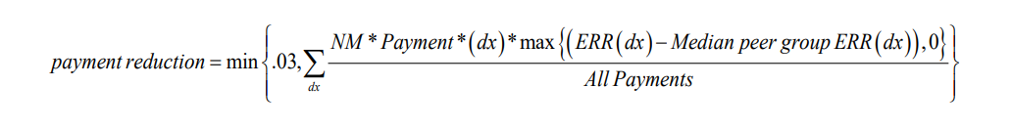
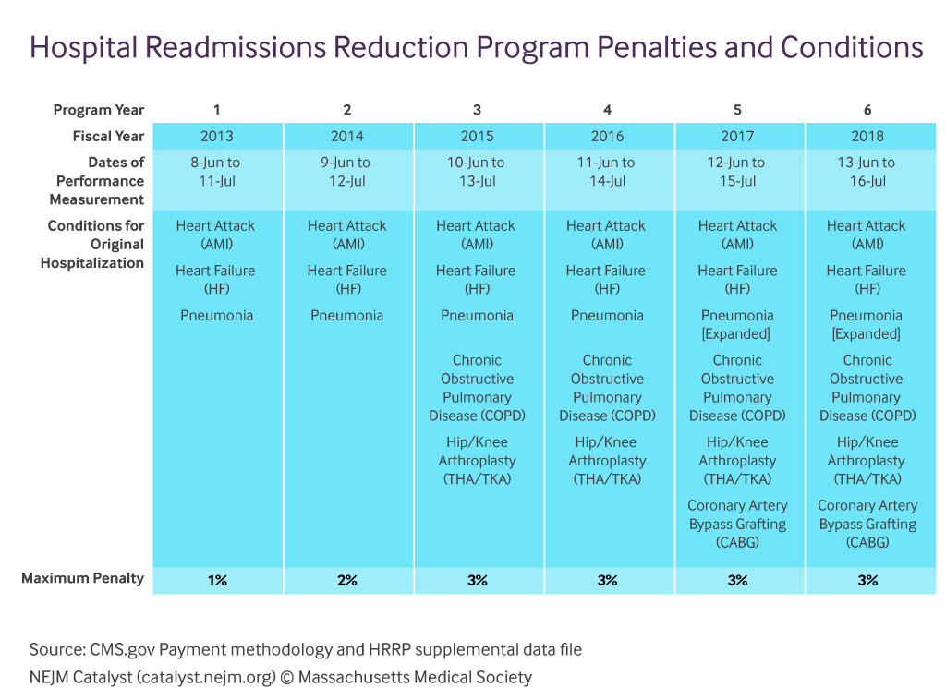

OVERVIEW OF HOSPITAL READMISSION REDUCTION PROGRAM
Based on the Affordable Care Act reform, Centers for Medicare and Medicaid Services (CMS) created the Hospital Readmissions Reduction Program (HRRP), which penalizes Acute-Care hospitals whose 30-day readmission rates are high, based on the Excess Readmission Ratio (ERR), which is the measure of a hospital's relative performance to other facilities.

Slide 3



ADDRESS: 1011 North Galloway Avenue Mesquite, TX - 75149
SALIENT FEATURES OF DALLAS REGIONAL MEDICAL CENTER:
Established in 1974
Owned by Prime Healthcare Services, since in 2012 (Proprietary)
202-Bed Acute Care Facility
Level IV trauma center
Recognized by Healthgrades as a Five-Star Recipient for the Treatment of Sepsis and Respiratory Failure
PROVIDER ID NUMBER:
450688
AVAILABLE SERVICES:
Emergency Care
Surgical Services
Cardiac Care
Diagnostic Imaging
Rehabilitation
Women's Health Services
Admissions | Inpatient Surgeries | Outpatient Visits | Emergency Room Visits | Physicians and Dentists | Registered Nurses | Licensed Practical Nurses
25,103 | 6,720 | 163,640 | 81,106 | 48 | 98 | 23

Slide 4
DATA ANALYSIS GOALS
Calculate the Average Excess Readmission Ratios for the different medical conditions.
Compare the Average Excess Readmission Ratios of the Dallas Regional Medical Center with other hospitals in the state/region and in the country.
Compare the Performance of the Dallas Regional Medical Center with other hospitals in the state/region and in the country.
Analyze the Correlation between the Total Discharges and the Average Excess Readmission Ratios for the different medical conditions.
Identify the root causes for Excess Readmissions and communicate logical and structured Recommendations.

Slide 5
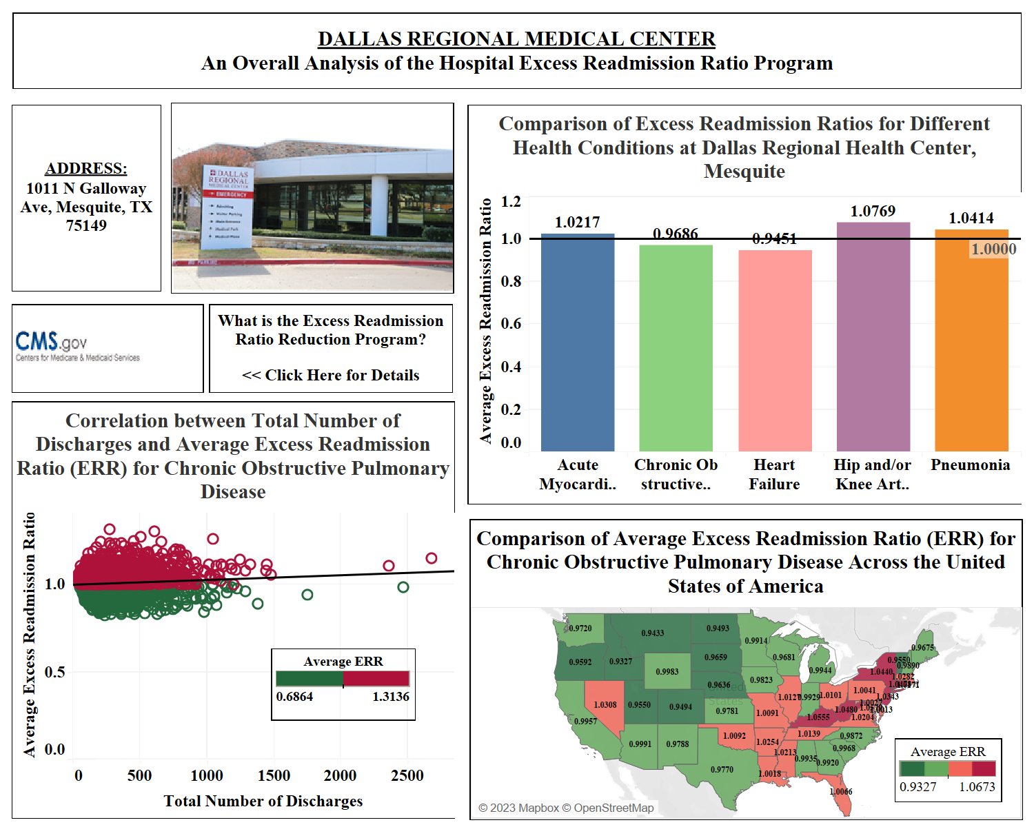
DASHBOARD

Slide 6
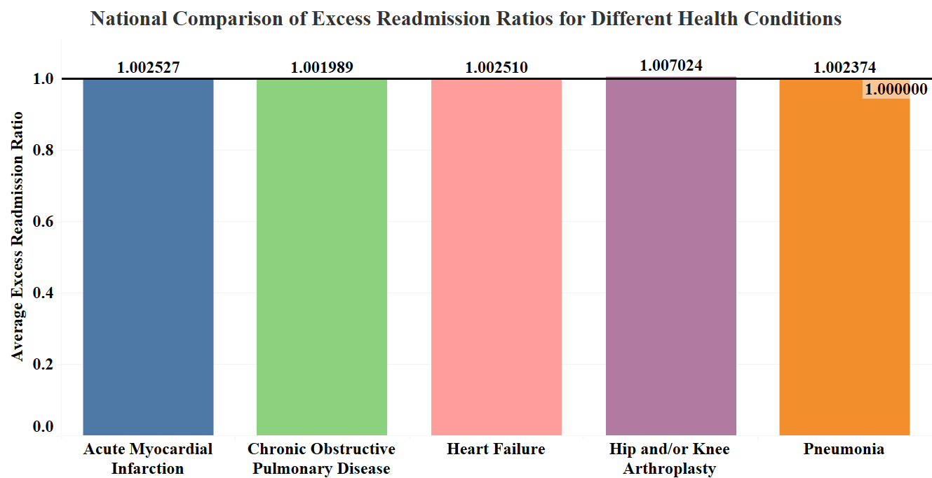
The Order of Excessive Readmission Ratio for the different health conditions is:
Hip and/or Knee Arthroplasty > Acute Myocardial Infarction > Heart Failure > Pneumonia > Chronic Obstructive Pulmonary Disease

Slide 7
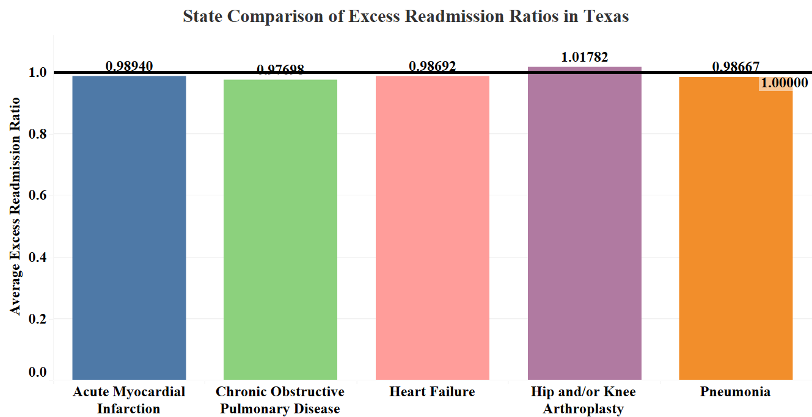
The Order of Excessive Readmission Ratio for the different health conditions is:
Hip and/or Knee Arthroplasty > Acute Myocardial Infarction > Heart Failure > Pneumonia > Chronic Obstructive Pulmonary Disease

Slide 8
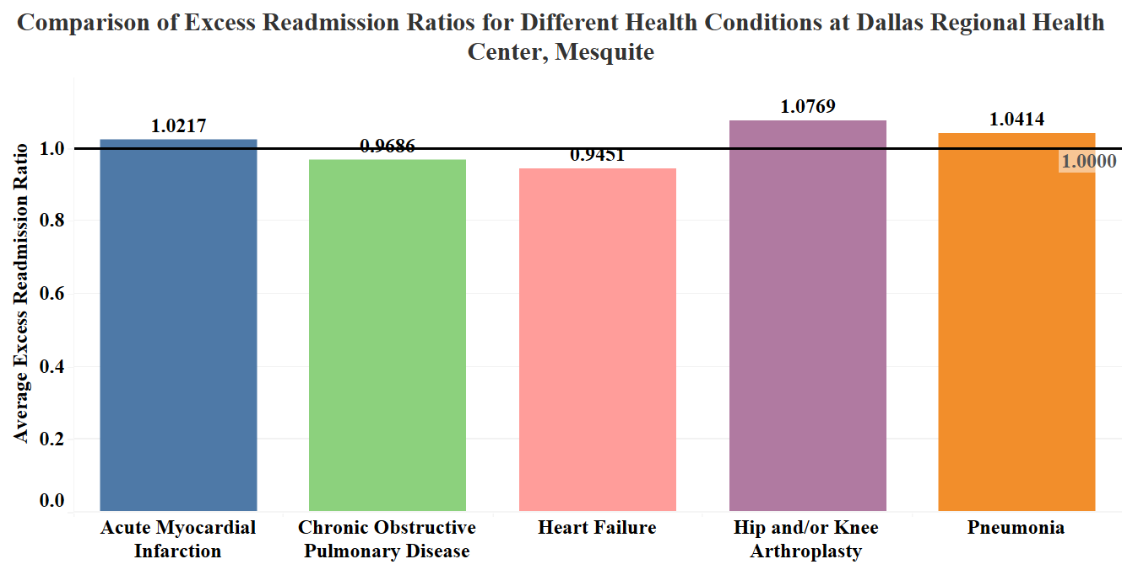
The Order of Excessive Readmission Ratio for the different health conditions is:
Hip and/or Knee Arthroplasty > Pneumonia > Acute Myocardial Infarction > Chronic Obstructive Pulmonary Disease > Heart Failure

Slide 9
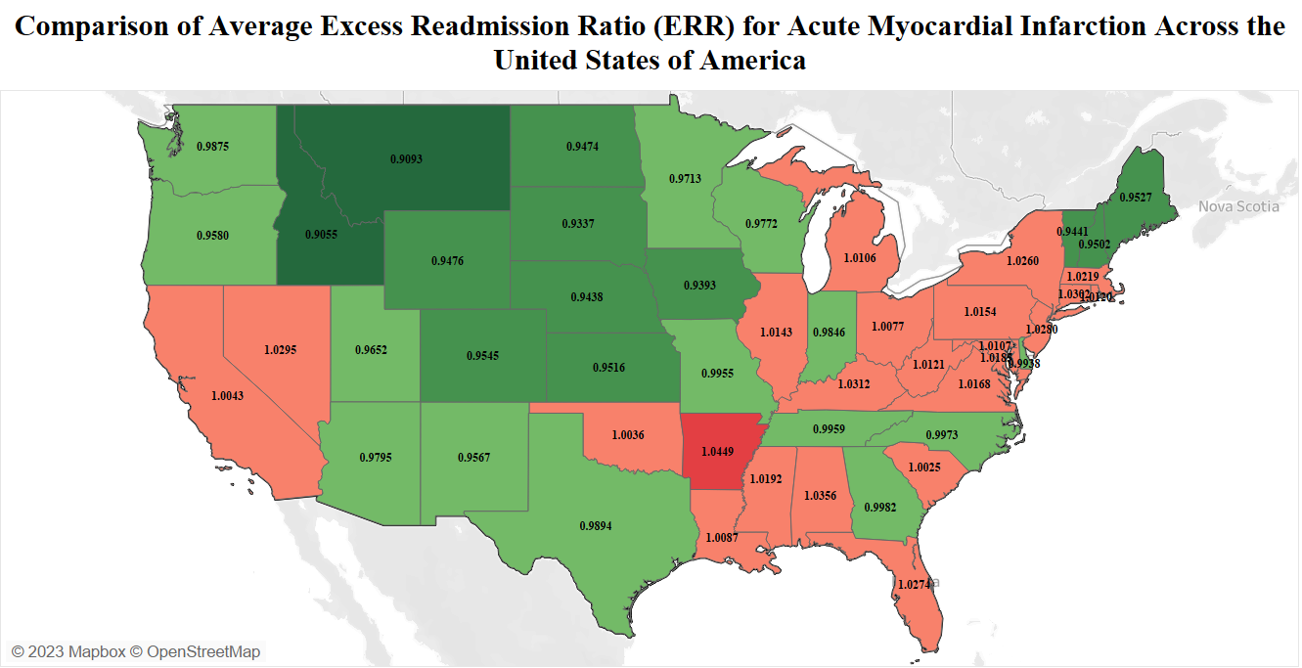
The Excessive Readmission Ratio (ERR) for Acute Myocardial Infarction of the hospital is MORE than the National and State Averages.

Slide 10
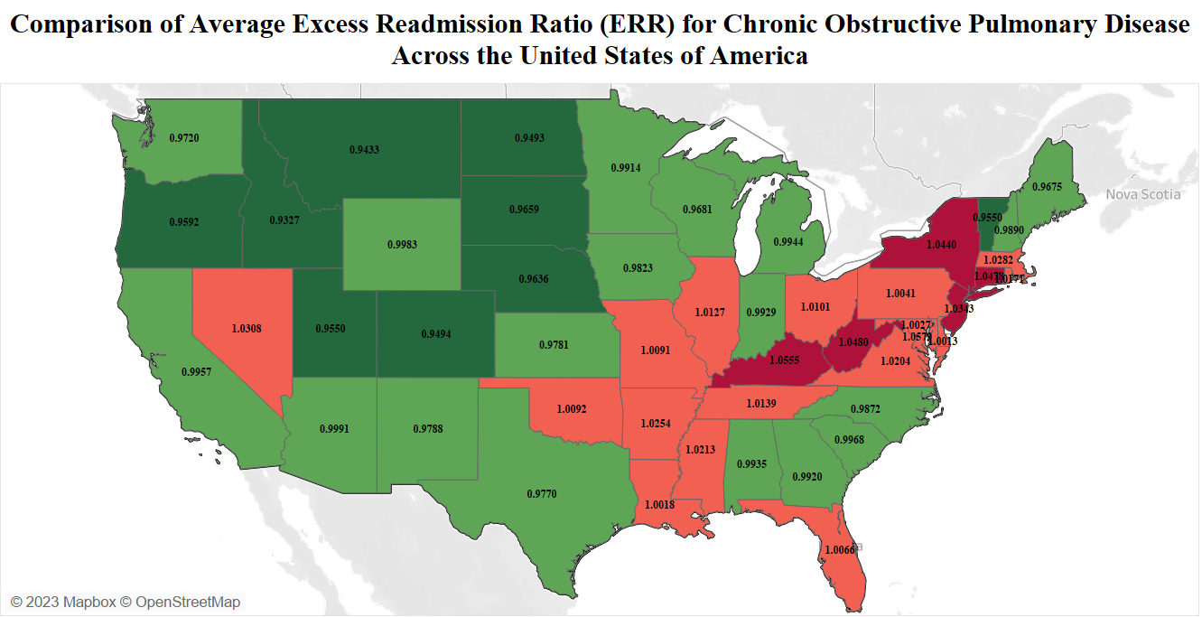
The Excessive Readmission Ratio (ERR) for Chronic Obstructive Pulmonary Disease of the hospital is LESS than the National and State Averages.

Slide 11
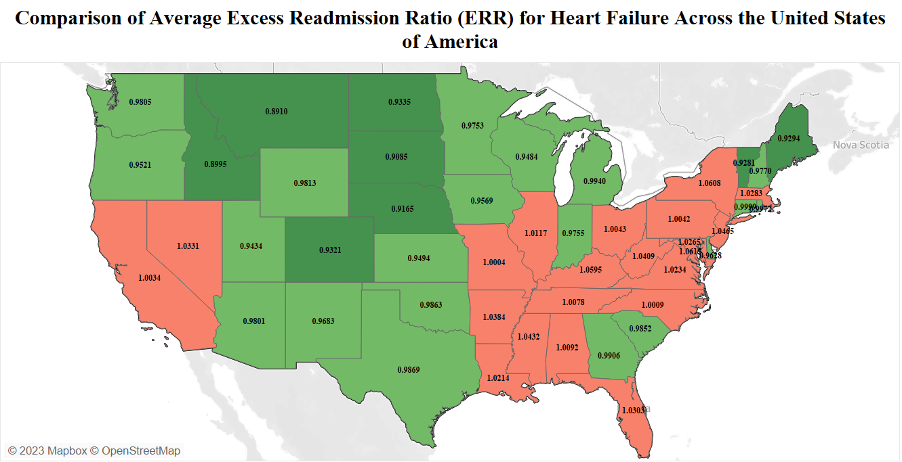
The Excessive Readmission Ratio (ERR) for Heart Failure of the hospital is LESS than the National and State Averages.

Slide 12
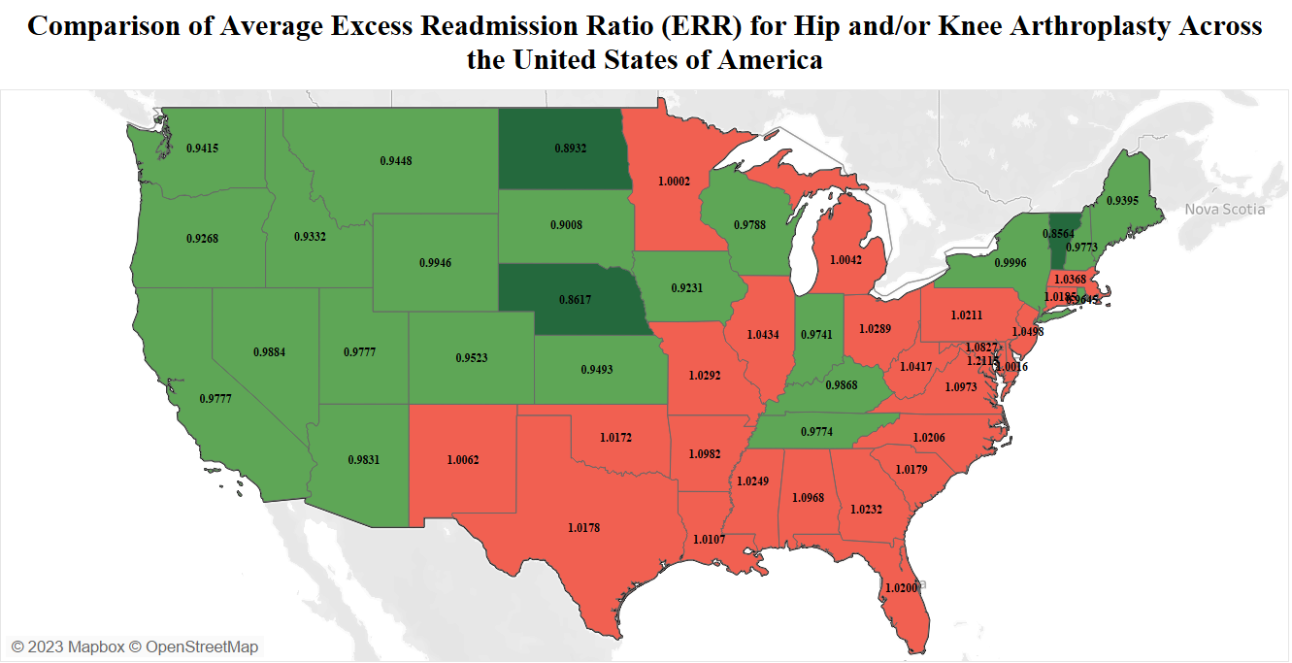
The Excessive Readmission Ratio (ERR) for Hip and/or Knee Arthroplasty of the hospital is MORE than the National and State Averages.

Slide 13
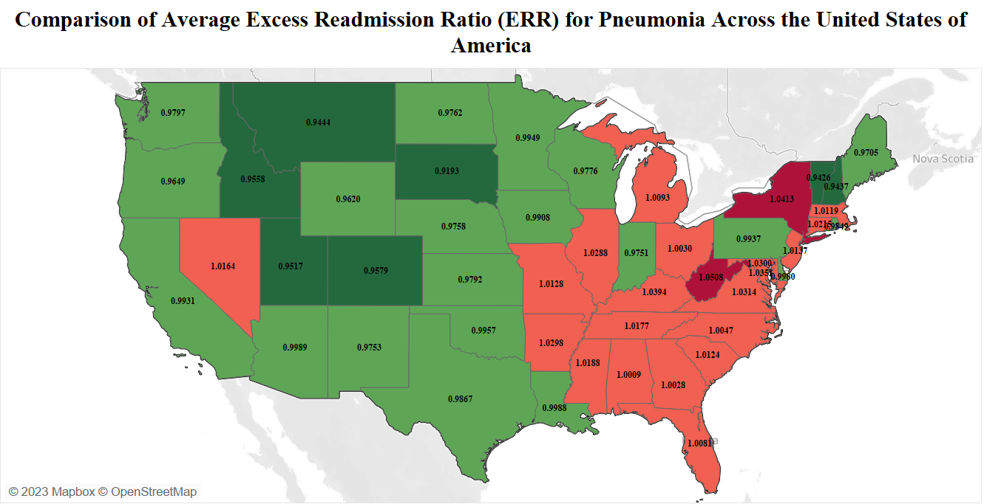
The Excessive Readmission Ratio (ERR) for Pneumonia of the hospital is MORE than the National and State Average.

Slide 14
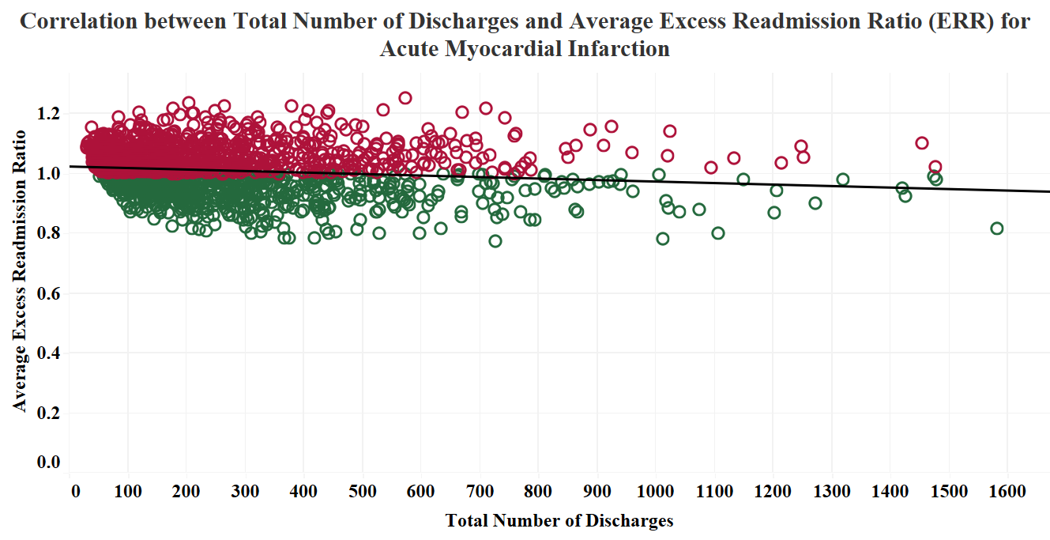
Number of Discharges = 53
Excess Readmission Ratio = 1.0217
The trend line depicts that there is an INVERSELY PROPORTIONAL relationship between the Total Number of Discharges and the Average Excess Readmission Ratio (ERR) for Acute Myocardial Infarction.

Slide 15
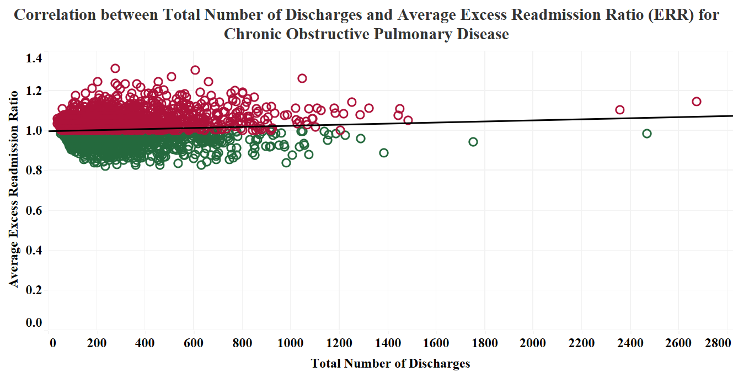
Number of Discharges = 321
Excess Readmission Ratio = 0.9686
The trend line depicts that there is a PROPORTIONAL relationship between the Total Number of Discharges and the Average Excess Readmission Ratio (ERR) for Chronic Obstructive Pulmonary Disease.

Slide 16
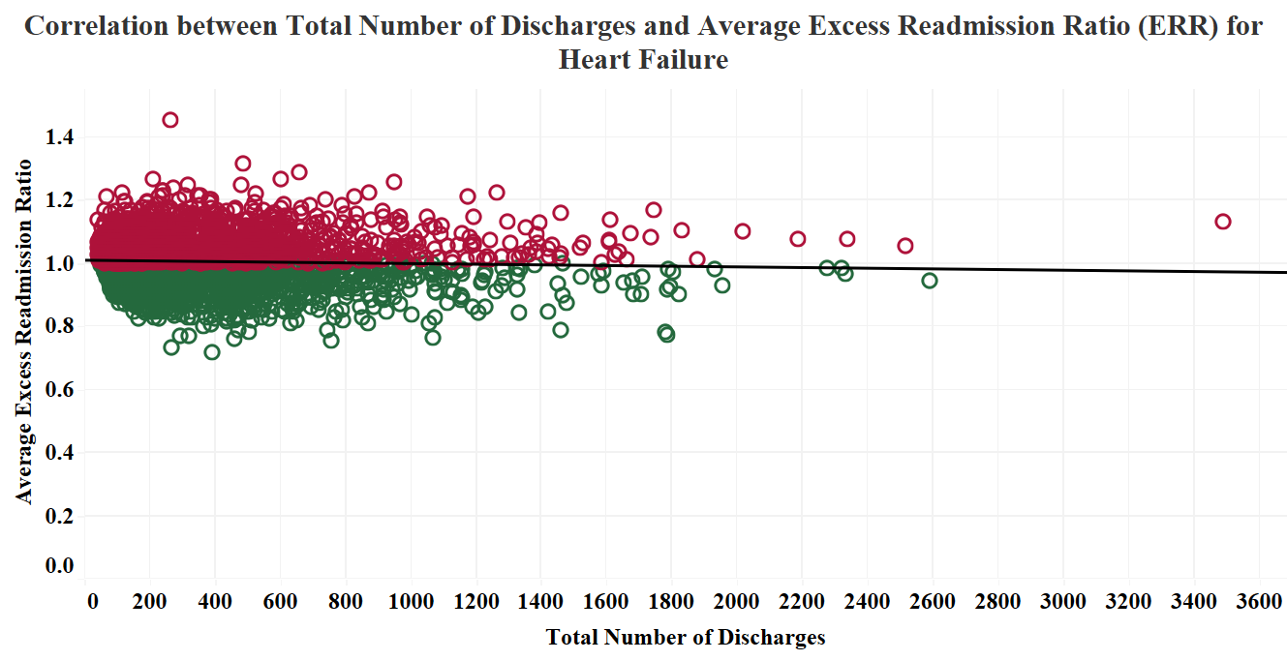
Number of Discharges = 324
Excess Readmission Ratio = 0.9451
The trend line depicts that there is an INVERSELY PROPORTIONAL relationship between the Total Number of Discharges and the Average Excess Readmission Ratio (ERR) for Heart Failure.

Slide 17
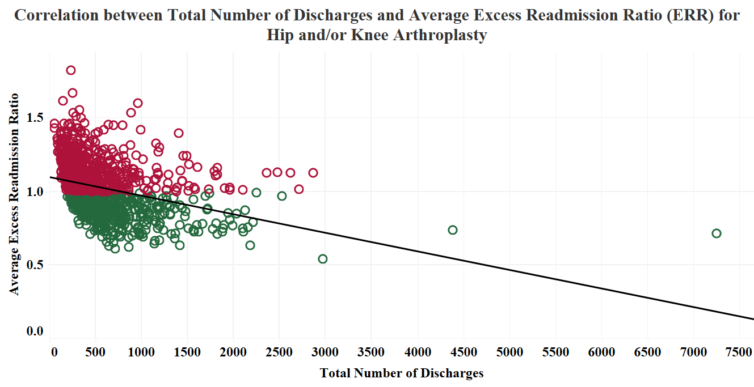
Number of Discharges = 318
Excess Readmission Ratio = 1.0769
The trend line depicts that there is an INVERSELY PROPORTIONAL relationship between the Total Number of Discharges and the Average Excess Readmission Ratio (ERR) for Hip and/or Knee Arthroplasty.

Slide 18
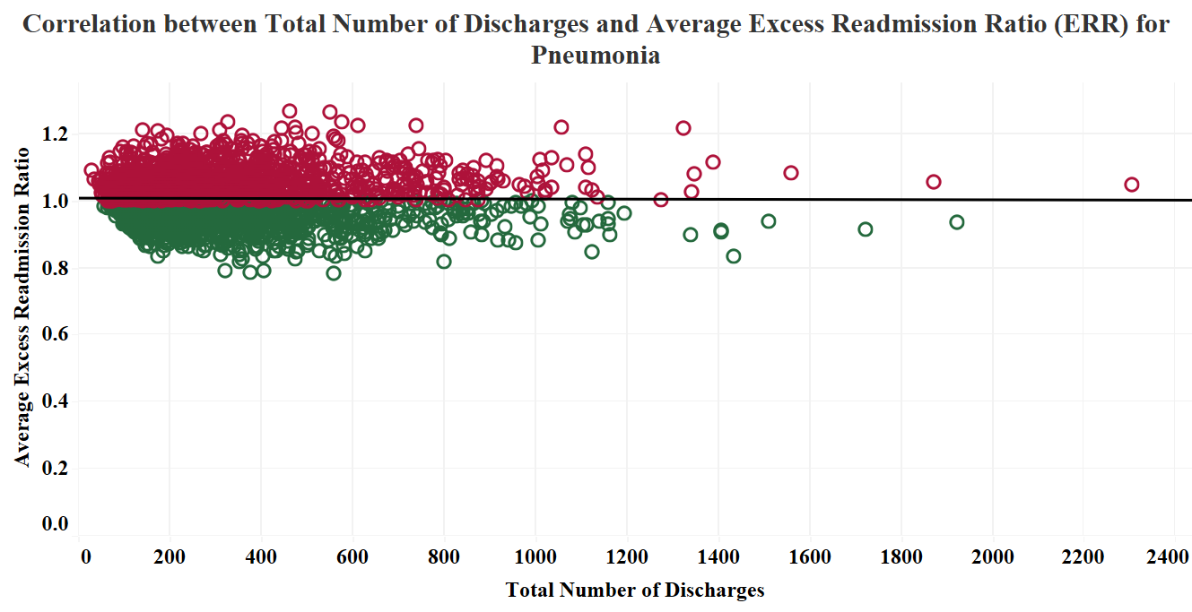
Number of Discharges = 363
Excess Readmission Ratio = 1.0414
The trend line depicts that there is CONSTANT relationship between the Total Number of Discharges and the Average Excess Readmission Ratio (ERR) for Pneumonia.

Slide 19
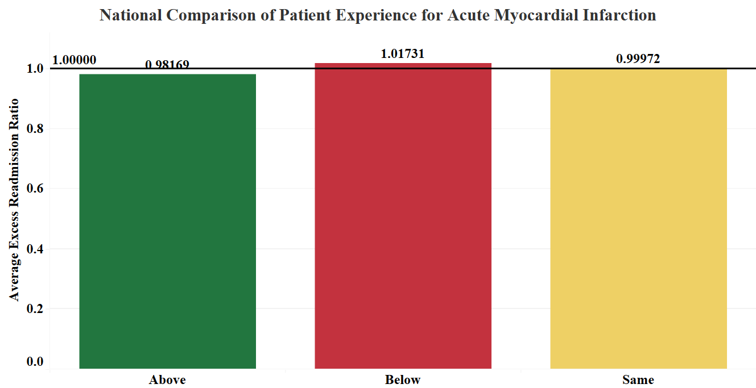
The Patient’s Experience at the hospital shows the result of BELOW the standards, similar to the results obtained in the National Comparison with the Average Excess Readmission Ratio (ERR) for Acute Myocardial Infarction.

Slide 20
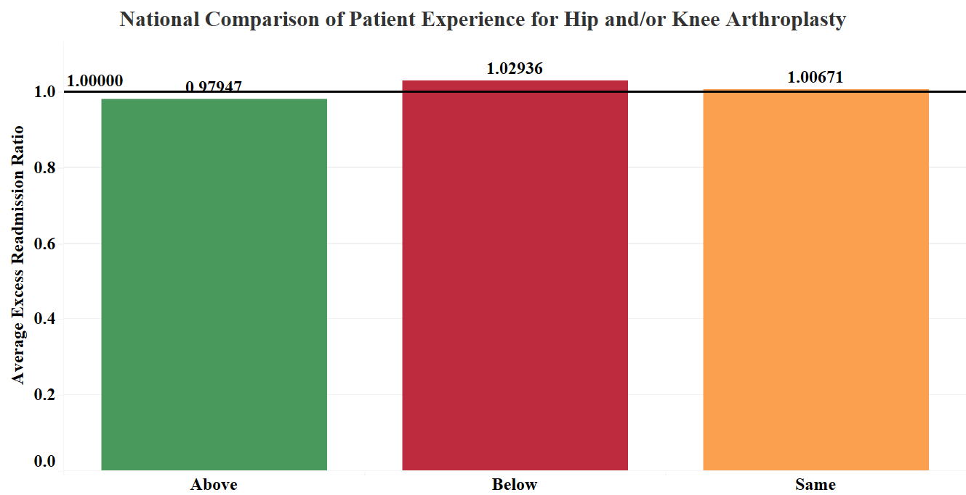
The Patient’s Experience at the hospital shows the result of BELOW the standards, similar to the results obtained in the National Comparison with the Average Excess Readmission Ratio (ERR) for Hip and/or Knee Arthroplasty.

Slide 21
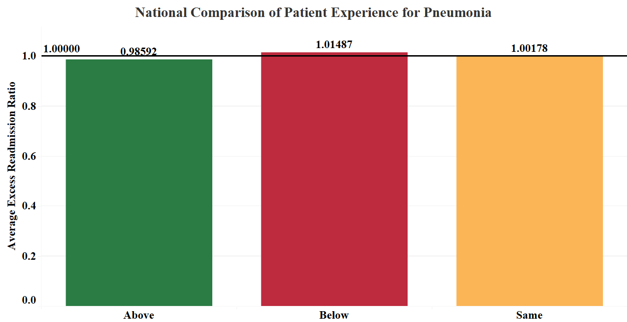
The Patient’s Experience at the hospital shows the result of BELOW the standards, similar to the results obtained in the National Comparison with the Average Excess Readmission Ratio (ERR) for Pneumonia.

Slide 22
INFERENCE
The Order of Excessive Readmission Ratio for the different health conditions in the National and State levels is:
Hip and/or Knee Arthroplasty > Acute Myocardial Infarction > Heart Failure > Pneumonia > Chronic Obstructive Pulmonary Disease
The Order of Excessive Readmission Ratio for the different health conditions is:
Hip and/or Knee Arthroplasty > Pneumonia > Acute Myocardial Infarction > Chronic Obstructive Pulmonary Disease > Heart Failure
The Excessive Readmission Ratio (ERR) of the hospital is MORE than the National and State Averages for Acute Myocardial Infarction, Hip and/or Knee Arthroplasty and Pneumonia.
The Correlation between the Total Number of Discharges and Excessive Readmission Ratio (ERR) is:
Inversely Proportional for Acute Myocardial Infarction, Heart Failure and Hip and/or Knee Arthroplasty.
Proportional for Chronic Obstructive Pulmonary Disease.
Constant for Pneumonia.
The Patient’s Experience at the hospital shows the result of BELOW the standards, similar to the results obtained in the National Comparison with the Average Excess Readmission Ratio (ERR) for Acute Myocardial Infarction, Hip and/or Knee Arthroplasty and Pneumonia.

Slide 23
RECOMMENDATIONS
ACUTE MYOCARDIAL INFARCTION
Implementation of “Transitions of Care” (TOC) program, requiring technology and service assistance from Patient Engagement Advisors (PEA).
Early prospective identification of high-risk patients using the parsimonious Acute Myocardial Infarction READMITS Index (Renal function, Elevated brain natriuretic peptide, Age, Diabetes mellitus, Nonmale sex, Intervention with timely percutaneous coronary intervention, and Low Systolic blood pressure) within the first 24 hours of hospitalization.

Slide 24
RECOMMENDATIONS
HIP AND/OR KNEE ARTHROPLASTY
Implementation of multi-component transitional care interventions like “Comprehensive Discharge Planning”, including services with an advanced practice nurse, structured assessment of needs and education to patient and caregiver, care coordination for up to two weeks after discharge, and interdisciplinary communication.
Implementation of “Care Transitions Intervention”, developed by Dr. Eric Coleman and colleagues at the University of Colorado School of Medicine, including personal health records and patient coaching models.
Increased implementation of “Project Reengineering Discharge” (RED) developed by Dr. Brian Jack and colleagues at Boston University School of Medicine, consisting of discharge advocates and teach-back methods for patient compliance.

Slide 25
RECOMMENDATIONS
PNEUMONIA
Utilization of the CURB-65 Score (Confusion, Urea, Respiratory rate, Blood pressure, Age) and Pneumonia Severity Score to describe disease type and severity.
Identifying patients at high risk of readmission, using LACE Index (Length of stay, Acuity of admission, Comorbidities, and Emergency department visits) or HOSPITAL Score (Hemoglobin level at discharge, Discharge from oncology service, Sodium level at discharge, Procedure during hospital stay, Index admission type as urgent or emergent, Number of admissions in previous year, and Length of stay) at the time of hospital stay.
Implementing active “Antimicrobial Stewardship” program, demonstrating adherence to nationally recognized guidelines to reduce the development and transmission of healthcare-associated infections (HAI) and antibiotic-resistant organisms.

Slide 26

THANK YOU
REFERENCES:
Bhandare, D., & Shimshak, T. (2020). Acute Myocardial Readmission Reduction Program: “Never Discharge A Patient.” Journal of Cardiology and Cardiovascular Sciences, 4(2). https://www.cardiologyresearchjournal.com/articles/acute-myocardial-readmission-reduction-program-never-discharge-a-patient.html
Centers for Medicare and Medicaid Services. (2022, August 8). Hosp. Readmission Reduction | CMS. Cms.gov. https://www.cms.gov/Medicare/Quality-Initiatives-Patient-Assessment-Instruments/Value-Based-Programs/HRRP/Hospital-Readmission-Reduction-Program
Dallas Regional Medical Center - Hospitals in Mesquite. (n.d.). Www.hospitals.net. Retrieved April 17, 2023, from http://www.hospitals.net/usa/tx/dallas-regional-medical-center/
Kripalani, S., Theobald, C. N., Anctil, B., & Vasilevskis, E. E. (2014). Reducing Hospital Readmission Rates: Current Strategies and Future Directions. Annual Review of Medicine, 65(1), 471–485. https://doi.org/10.1146/annurev-med-022613-090415
Nguyen, O. K., Makam, A. N., Clark, C., Zhang, S., Das, S. R., & Halm, E. A. (2018). Predicting 30‐Day Hospital Readmissions in Acute Myocardial Infarction: The AMI “READMITS” (Renal Function, Elevated Brain Natriuretic Peptide, Age, Diabetes Mellitus , Nonmale Sex , Intervention with Timely Percutaneous Coronary Intervention, and Low Systolic Blood Pressure) Score. Journal of the American Heart Association, 7(8). https://doi.org/10.1161/jaha.118.008882
Shorr, A. F., Zilberberg, M. D., Reichley, R., Kan, J., Hoban, A., Hoffman, J., Micek, S. T., & Kollef, M. H. (2013). Readmission Following Hospitalization for Pneumonia: The Impact of Pneumonia Type and Its Implication for Hospitals. Clinical Infectious Diseases, 57(3), 362–367. https://doi.org/10.1093/cid/cit254
Weinreich, M., Nguyen, O. K., Wang, D., Mayo, H., Mortensen, E. M., Halm, E. A., & Makam, A. N. (2016). Predicting the Risk of Readmission in Pneumonia. A Systematic Review of Model Performance. Annals of the American Thoracic Society, 13(9), 1607–1614. https://doi.org/10.1513/annalsats.201602-135sr
Williams, C. L., Pujalte, G., Li, Z., Vomer, R. P., Nishi, M., Kieneker, L., & Ortiguera, C. J. (2022). Which Factors Predict 30-Day Readmission After Total Hip and Knee Replacement Surgery? Cureus. https://doi.org/10.7759/cureus.23093

