Slide 1
CRITICAL LEARNING PERIODS IN DEEP NETWORKS PAPER BY: STEFANO SOATTO ALESSANDRO ACHILLE, MATTEO ROVERE
ML 74020 PAPER PRESENTATION
YAFFA ATKINS – TUGCE OZDEMIR

Slide 2
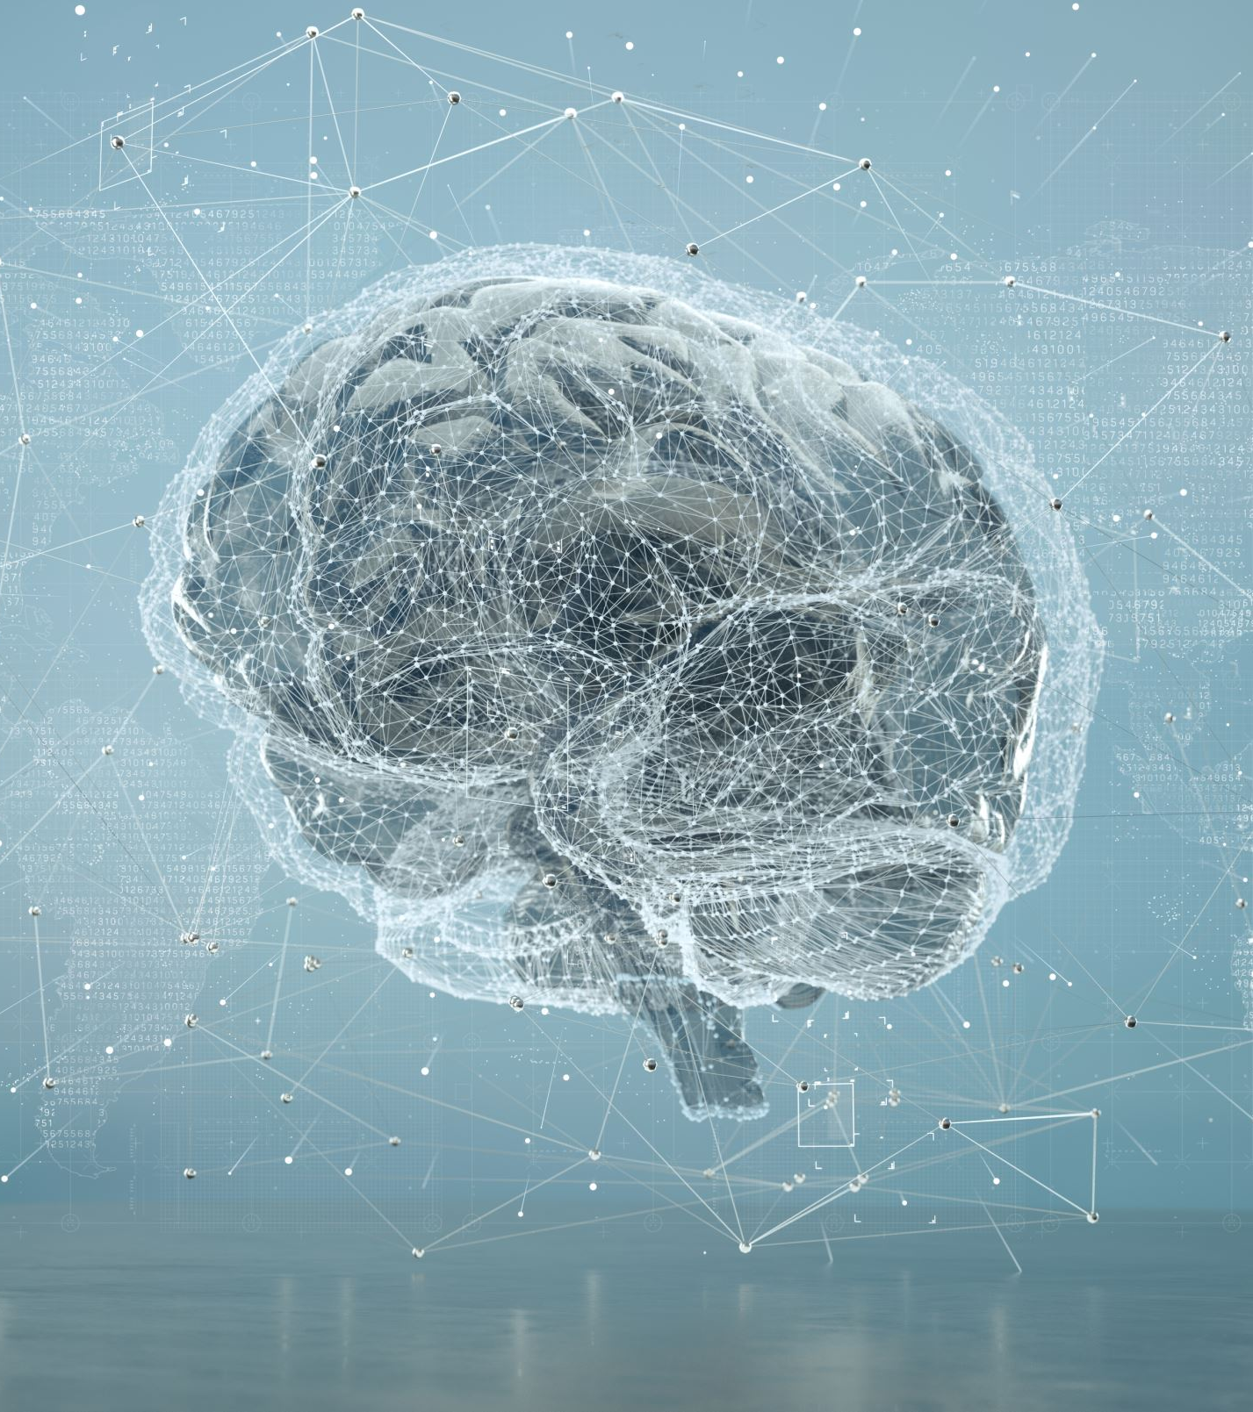
MAIN STEPS
WHAT PROBLEMS ARE BEING SOLVED?
Introduction
Experiments
Fisher Information Analysis
Discussion and Related Work
Conclusion
* Can "critical periods" arise from information processing, rather than biochemical?
* How to fulfill a technical requirement for "explainable" artificial intelligence systems whose behavior can be understood and anticipated?

Slide 3
WHAT PROBLEMS ARE BEING SOLVED?
* Can "critical periods" arise from information processing, rather than biochemical?
* How to fulfill a technical requirement for "explainable" artificial intelligence systems whose behavior can be understood and anticipated?

Slide 4
Paper Proposes that:
Studying critical period phenomena in DNNs, utilizing the information in the weights, as measured by an efficient approximation of the Fisher Information.
Information in the weights does not increase in a monotonic manner throughout training. Instead, a significant increase in “memorization” phase is followed by a decrease in information "reorganization” phase, even while classification performance continues to improve.

Slide 5
Paper also proposes that;
The initial few epochs are important for the establishment of strong connections across multiple layers, making the input data distribution optimum for processing. Once such strong connections are established, they do not appear to alter throughout further training.
The first learning transient, which is under-scrutinize compared to asymptotic behavior, is crucial in deciding the training process' outcome.
In representation learning, forgetting (a reduction in information in the weights) is crucial for establishing invariance and disentanglement.
Lastly, critical periods are not limited to biological systems; but may develop spontaneously in learning systems, whether biological or artificial, as a result of basic constraints originating from learning dynamics and information processing.

Slide 6
KEYWORDS
The term "critical period" refers to a period in brain development when the impacts of experience cause profound and permanent remodeling of neuronal networks.
The term "sensitive period" refers to a phase of increased, but reversible, flexibility in response to experience.

Slide 7
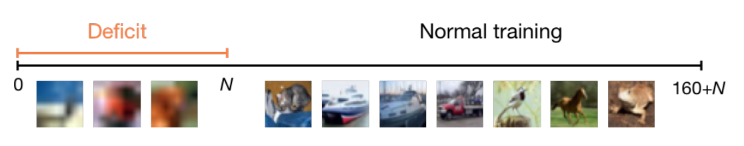
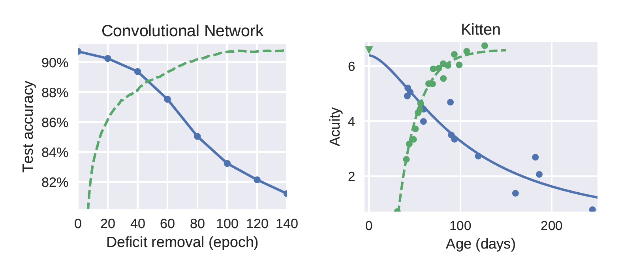

Experiment - Critical Learning Period
©knowyourcat.info

Slide 8
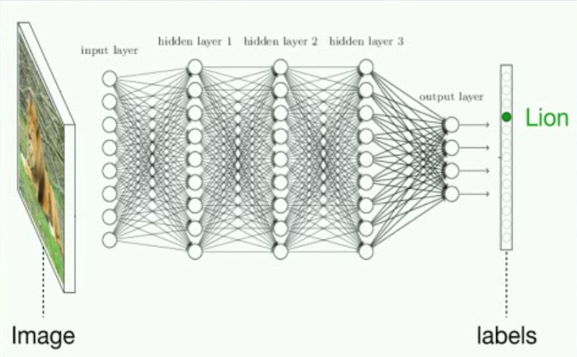
Experiment – DNNs exhibit Critical Learning Periods
© Jeff Clune’s 1-hour Deep Learning Overview on YouTube

Slide 9
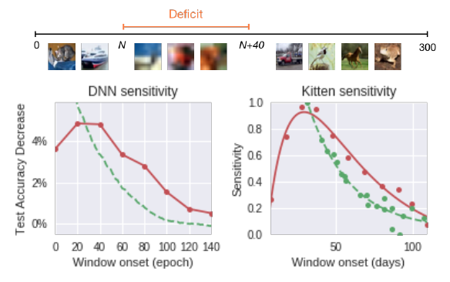
Experiment - Sensitivity During Learning
© Jeff Clune’s 1-hour Deep Learning Overview on YouTube

Slide 10

Fisher Information Analysis
Kullback-Leibler: Difference between old and new probability
FIM: Calculates how much the the perturbation of a single weight affects the output of a network.
Trace of the FIM

Slide 11
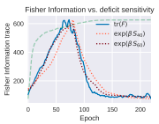
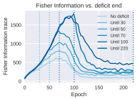
Two phases of Learning
First the network acquires a lot of information, increasing the strength of network connections. Once performance begins to plateau information quantity and connection strength decrease while performance keeps slowly improving.
When there is a deficit in training, FIM gets and remains even higher, this may be because the network is forced to memorize the labels when data is too corrupt to classify, increasing the quantity of information.

Slide 12
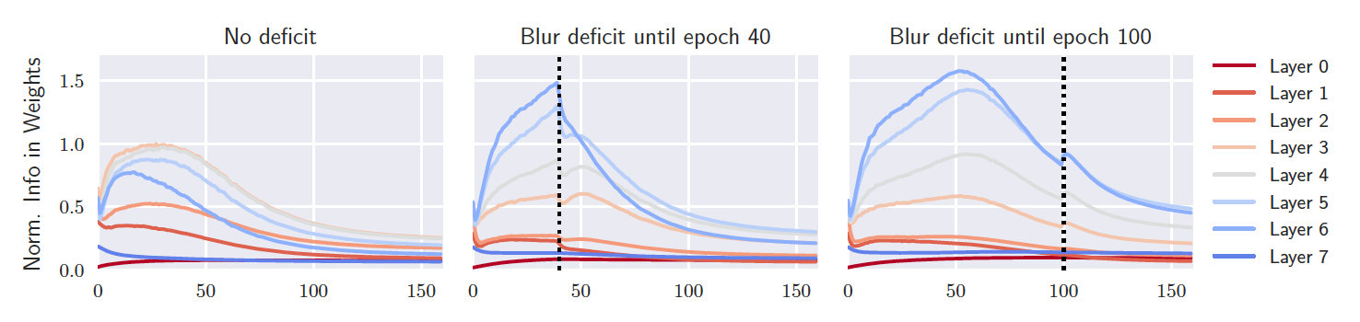
Layerwise Analysis
When the network trains without deficit, the most important connections are at the intermediate layer where the input data can be processed at the most informative level. But if the network is initially trained with deficits, the top layer is strongest since low and mid level structure of the data are destroyed making lower layers ineffective. But if deficits are removed early enough in training, the network can reorganize, reducing info in the last layer and increasing info in intermediate layers

Slide 13
RELATED WORK
Obviously this works related to studies on critical periods in biology even though computer networks are simpler than brains they behave similarly. Deficits of deprived animals come from abnormal issues in their pathway and those issues can be found if the pathway is treated like a DNN.

Slide 14
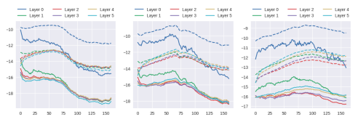
Shwartz-Ziv and Tishby - Two Phases
They discussed the existence of two distinct phases in DNN’s.
Their study links the two phases to a sudden increase in the gradient covariance.
It’s hard to compare results in this paper with results in their analysis because they used the Shannon information of activations rather than the fisher information of weights.
The graph below shows that covariance and norm of the gradients exhibit no clear trends during training with and without deficits, and, therefore, unlike the FIM, do not correlate with the sensitivity to critical periods.
Deficit
Blur deficit until epoch 70
Defific present until last epoch

Slide 15
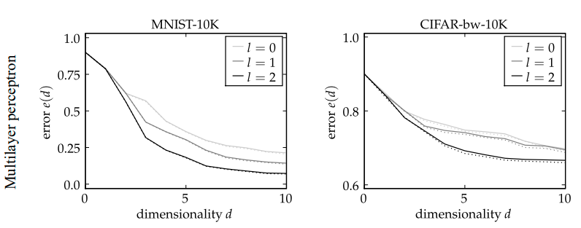
Montavon - Information Accessibility
Montavon showed that on multi layer perceptrons, task relevant information increasingly concentrates on the first principal components, implying the information is more accessible layer by layer, while noisy information is encoded in the remaining components.

Slide 16
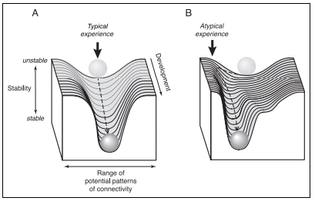
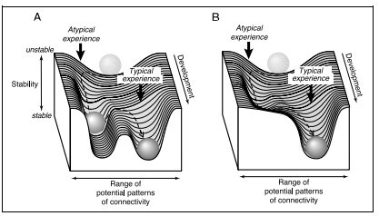
Knudsen - Network Stabilization
Knudsen explains initial connections in networks are unstable and easily modified, but as more samples are observed, the connections change and stabilize and are harder to modify.

Slide 17
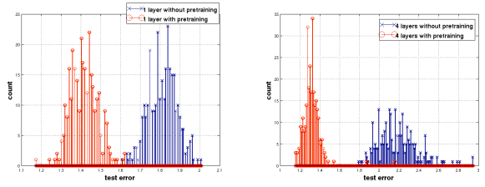
Erhan - Pre-training:
Earlier samples have a stronger effect on the weights so if you pre-train with deficits, there is a risk it will bring your weights in a bad direction and severely decrease performance.

Slide 18
STRENGTHS
WEAKNESSES
Other researchers may be inspired to create mathematical models based on the results of the trials on the various consequences of various types of deficiencies.
Good at demonstrating similarity between critical periods in biological neural systems and in artificial deep neural networks.
The authors establish a link between critical times and the amount of information that the weights
It is not certain that early training on blurred images prevents the initial convolutional filters from learning to discriminate high-frequency components
What would happen if a conventional regularizer, such as weight decay, was present?
Notes:
Strengths of the paper (novelties and innovations)
Weaknesses of the paper

Slide 19
Our Thoughts on the Paper
It is fascinating to compare learning in neural networks to the learning of humans and animals. The article is more relevant, interesting, and easier to understand because it is also about how we learn, not just about computers.

Slide 20
Conclusion
This paper seems to be the first to show that DNN’s have critical periods
And the first to highlight the importance of the network initially bouncing around so it touches all of the different data points in order to determine the network's final pattern.
Critical periods are brought on by change, within animals, that change is seen as change in brain development and with neural networks that change is seen as change in effective connectivity.

Slide 21
CONCLUSION/DISCUSSION?
(How to improve the current results, ideas, quality of the paper..)
Future works can be done:
Investigate methods for testing whether biological networks prune connections as a result of a loss of Information Plasticity rather than as a cause.
The principles governing network reconfiguration during learning and development might be an evolutionary result produced by fundamental information processing phenomena.

