Slide 1
Dallas Airbnb Revenue Prediction
Capstone Project – Mentor Presentation

Slide 2
Agenda
Problem Statement
Data Understanding & Cleaning
Feature Engineering
Exploratory Data Analysis
Modeling Approach & Performance
Key Insights & Recommendations
Limitations & Future Work

Slide 3
Problem Statement
Predict
Predict annual potential revenue for Dallas Airbnb listings.
Identify
Identify key drivers affecting listing performance.
Support
Support investors and hosts with data-driven insights.

Slide 4
Data Overview
Source: Inside Airbnb – Dallas Dataset
Includes price, availability, room type, location, reviews.
Engineered target: potential_revenue = price_weighted_roomtype × (365 - availability_365)

Slide 5
Data Cleaning
Handled missing values (median + 'Unknown').
Removed unrealistic outliers (e.g., price > $1000/night).
Filtered invalid minimum_nights and availability ranges.
Encoded categorical features and scaled numerics.

Slide 6
Feature Engineering
Derived target revenue proxy.
Created room_type_numeric + is_entire_home.
Neighbourhood encoding.
Distance-to-center feature (geo-based signal).

Slide 7
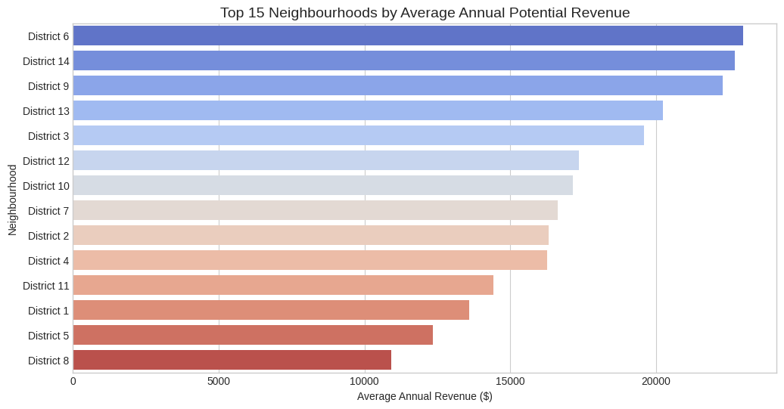
Top Neighbourhood Revenue

Slide 8
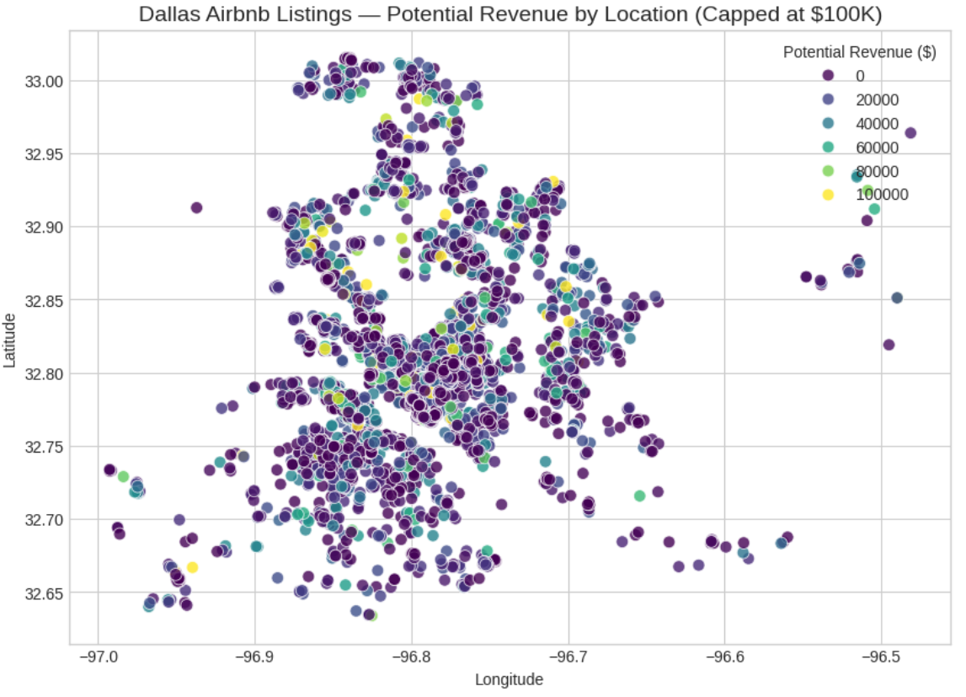
Listings On Map

Slide 9
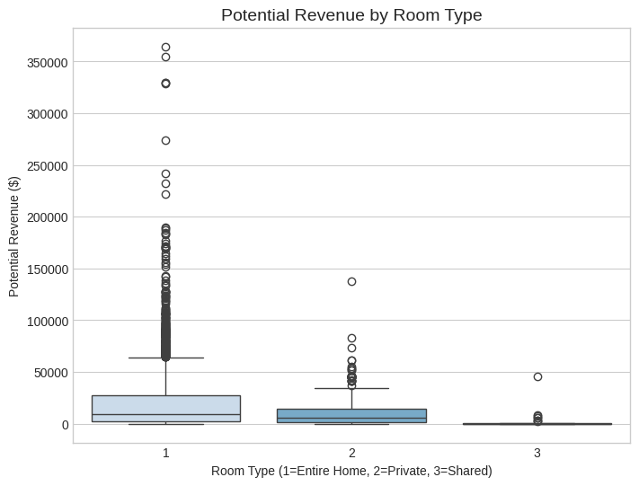
Room Type vs Revenue

Slide 10
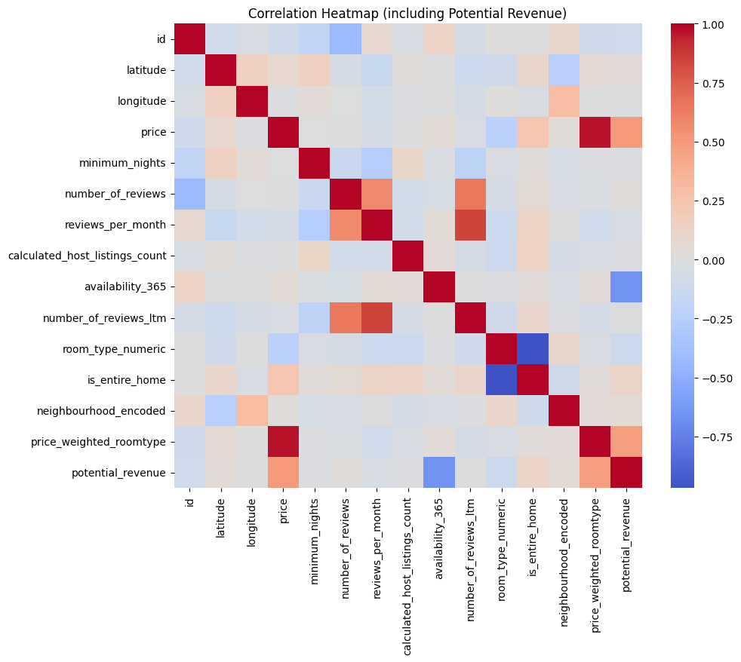
Correlation Heatmap
Revenue is strongly correlated with several key features:
Room type: Entire homes show a strong positive correlation with higher revenue, while private/shared rooms are less correlated.
Geographic location: Listings in certain neighborhoods (especially districts 6, 14, 9, and 13) are associated with higher revenue.
Availability: There is a notable correlation between availability and revenue, but availability was excluded from modeling to avoid data leakage.
Price: Nightly price has a moderate correlation with revenue, but optimizing occupancy (rather than just raising price) is more impactful.

Slide 11
Key EDA Insights
Districts 6, 14, 9 generate the highest revenue.
Entire homes outperform private/shared rooms.
Strong geographic clustering of high-revenue listings.
Availability correlates with revenue but excluded from modeling to avoid leakage.

Slide 12
Modeling Approach
Tried Ridge Regression, Random Forest, and XGBoost.
Used ColumnTransformer pipeline for preprocessing.
Train/Test split used for fair evaluation. (80-20)
Goal: maximize predictive accuracy while avoiding overfitting.

Slide 13
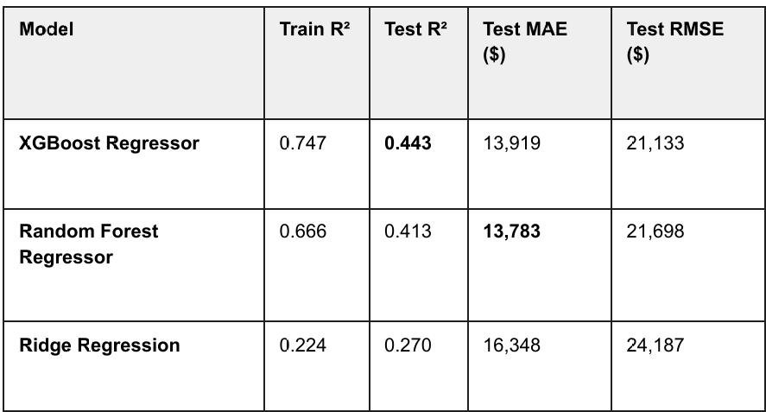
Model Performance

Slide 14
Recommendations
Invest in
Invest in high-revenue districts (6, 14, 9).
Prioritize
Prioritize entire-home listings.
Optimize
Optimize occupancy instead of raising nightly price.
Use
Use demand predictions to set competitive pricing.

Slide 15
Limitations
Revenue proxy—not true earnings due to missing occupancy data.
No seasonality or dynamic pricing included.
Reviews text not analyzed for sentiment.
No cleaning/extra fees or discount structure included.

Slide 16
Future Work
Add
Add seasonality and time-series forecasting.
Apply
Apply NLP to review text for quality scoring.
Integrate
Integrate ROI calculation for investors.
Deploy
Deploy interactive Streamlit tool for property valuation.

Slide 17
Thank You
Questions?
Project: Dallas Airbnb Revenue Prediction

