Slide 1
Big Mountain Resort Pricing Analysis
Executive Data-Driven Insights

Slide 2
Problem Identification
• Current ticket price: $81.
• Goal: Assess if pricing is optimal.
• Analyze resort's competitive positioning.

Slide 3
Recommendations & Key Findings
• Recommended optimal price range: $95-$100.
• Resort currently underpriced based on model predictions.
• Facilities and amenities justify a higher price point.

Slide 4
Modeling Approach
We tested two machine learning models:
Linear Regression
Random Forest Regression
Random Forest performed best on validation scores.
Main pricing recommendations are based on Random Forest model results.
Random Forest Regression had the highest accuracy, outperforming Linear Regression on validation data.
The model was able to explain a large portion of price variance across different resorts.

Slide 5
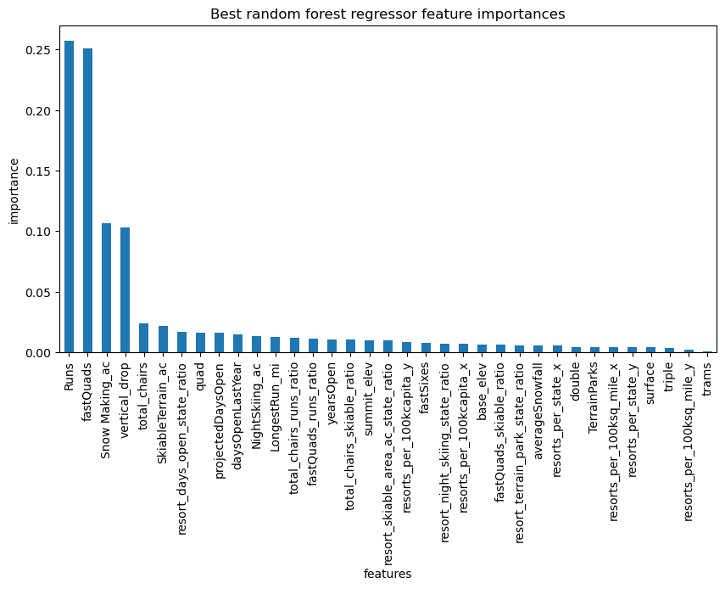
Feature Importance
The model identified the following features as most important for predicting optimal ticket price:
Top features driving price:
Number of ski lifts
Number of ski runs
Resort amenities (snowmaking, terrain parks, restaurants)
Annual snowfall
State/region

Slide 6
Actual vs Predicted Ticket Prices
The model predicted an optimal ticket price for Big Mountain Resort that is significantly higher than the current price.
This suggests an opportunity to raise prices while remaining competitive.
Insights:
Resorts with more lifts, runs, and amenities consistently charge higher prices.
There is a clear relationship between the level of investment in resort features and the price customers are willing to pay.

Slide 7
Summary & Conclusion
• Increase ticket prices gradually to recommended levels.
• Emphasize high-value amenities in marketing.
• Continue data collection for further insights and adjustments.

