Slide 1
Web & App Development
Documentation
Yatusan Selvaranjan iAMDT 1620

Slide 2
According to my assignment I have to revamp the existing website of our college which ‘AMDT’
For that I have used coding assets such as HTML, CSS & JS and MySQL database.
According to the existing AMDT website to be honest I personally didn’t like the look and feel of it at
all.
This assignment gave me an opportunity to revamp it.

Slide 3
To be honest I didn’t want to put too much wordings inside this document. I didn’t create any hand
drawn wireframes because I had a confident that I can create a digital wireframe straight away without
wasting any time. I got that confident since I practiced it for nearly 2 months with my lecturer of how to
create wireframes and designs.

Slide 4


According to the website I kept a header part as other websites do. Added AMDT icon as a favicon which is displayed at the top in the TAB bar
Favicon New
Their existing icon – which I didn’t like, because it’s like Microsoft copy icon

Slide 5
Header of my revamped website
By clicking this the site user will be
directed to the Testimonial section
Where people can input their details
By clicking this the site user will be
directed to the Register now form
Section Where people register their
New intakes.
By clicking this the site user will be
directed to the Courses section
Where people find the courses available here
By clicking this the site user will be
directed to the About the developer
Section where people can get to know about
Site developer

Slide 6
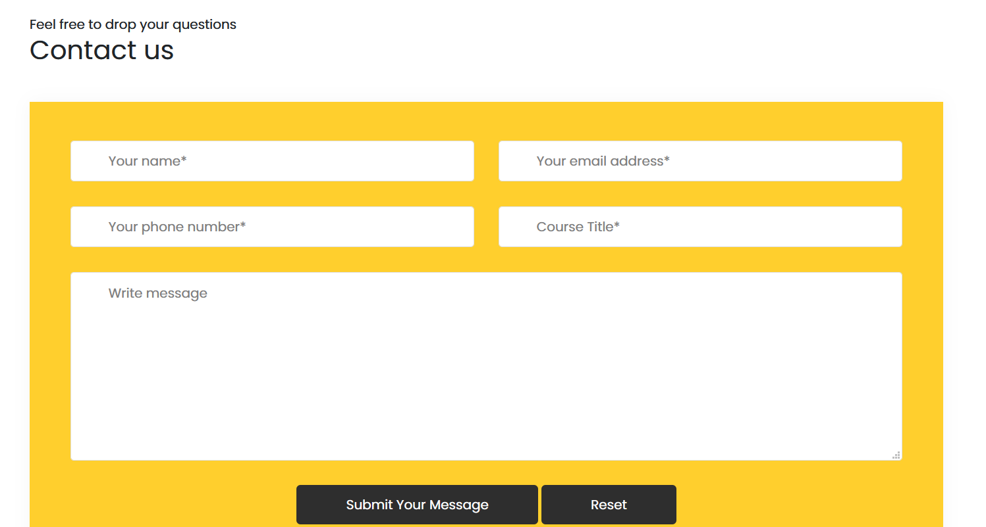
Contact Us Section
In this section site user can send inquiries regarding the courses, and about university details.
Yatusan Selvaranjan
yatusanranjan@gmail.com
0768730999
Interactive Multimedia
How long the courses conducted

Slide 7
What is usability testing?
Usability testing is a method of testing the functionality of a website, app, or other digital product by observing real users as they attempt to complete tasks on it. The goal is to reveal areas of confusion and uncover opportunities to improve the overall user experience.
According to my assignment I’ve used Clarity principle for my site.
The core of web usability is creating clear sites. By cluttering a website and filling it with all sorts of elements that are irrelevant for a user, you only make things worse. Instead of making your site’s visitors confused by adding distractions on the site, try to keep everything clear and guide users towards engaging in specific activities on it. Clarity is the only way to design a website properly and to give people the needed guidelines when navigating it. Stick to this principle no matter what other rules you choose to respect.

Slide 8
According to my assignment I’ve given my completed site and the existing AMDT page to 3 of my friends & got their feedbacks (due to the pandemic situation I couldn’t get much feedbacks so chosen 3 friends who are closer to me)
Which are as follows;
Brijoy : Mchn, the site looks awesome compare to the existing one, good job
Nishy : Adei, this site is clean and easy to navigate
Dheepan : Nice da, the existing website is not that great, your one is awesome, good start
To be honest these are the feedback I got from my friends and there were no refining in my site

