Slide 1
GPIO – general purpose IO

Slide 2
General Purpose Input/Output (GPIO) is a generic pin on a integrated circuit chip whose behavior (including whether it is an input or output pin) can be controlled / programmed by the user at run time.
GPIO pins have no special purpose defined. It could be cofigured as a digital input or output.

Slide 3
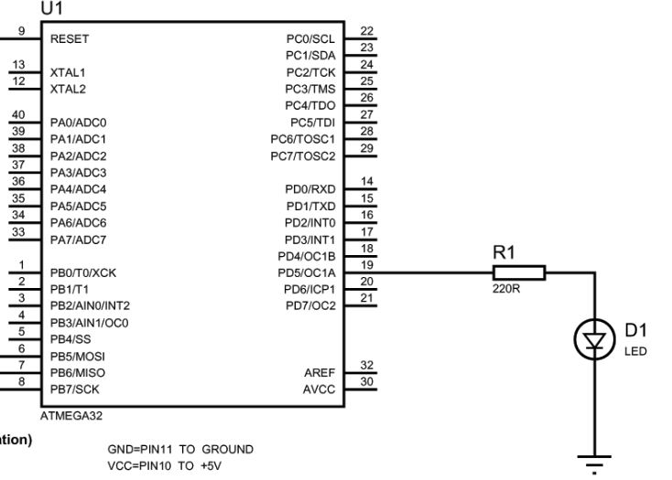
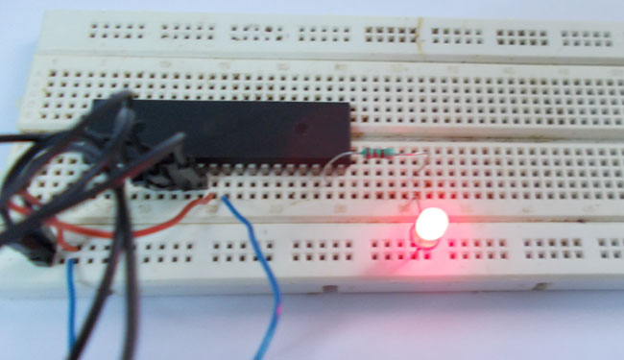
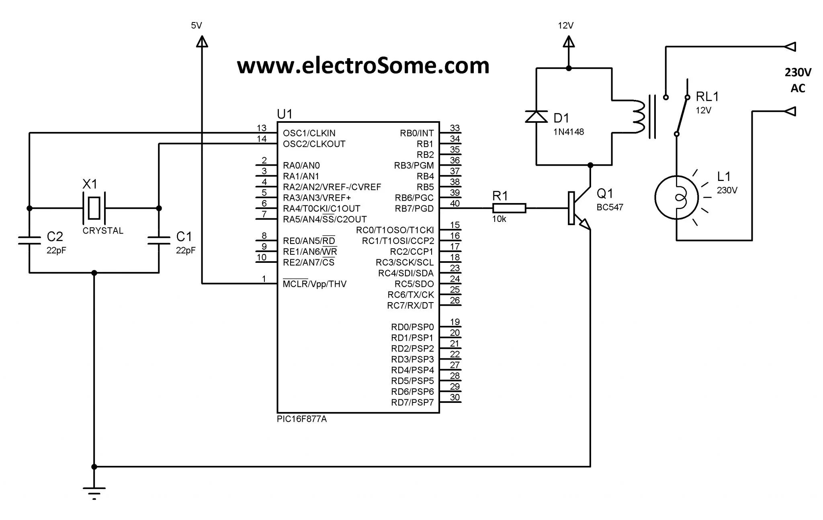
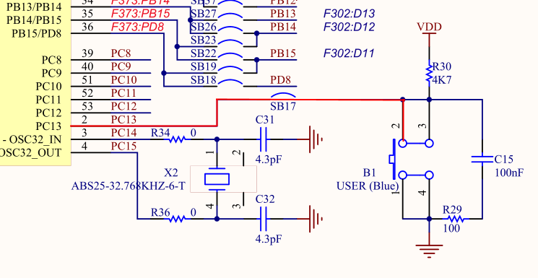
Examples:
a) Indicator
b) Relay driver
c) Button listener

Slide 4
Logic level is one of a finite number of states that a digital signal can inhabit. Logic levels are usually represented by the voltage difference between the signal and ground, although other standards exist.
In binary logic the two levels are logical high and logical low, which generally correspond to binary numbers 1 and 0 respectively.

Slide 5
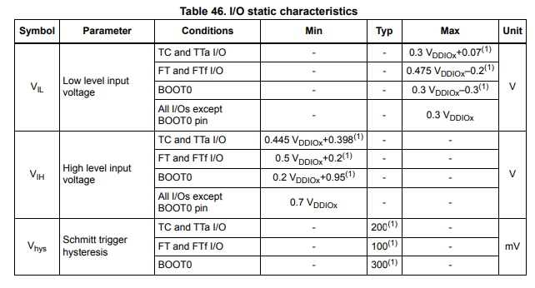
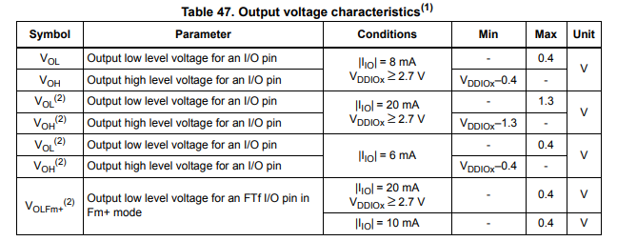
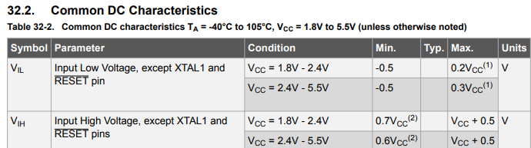
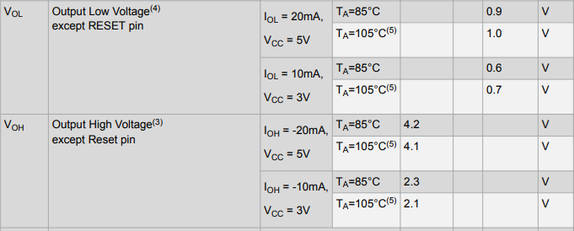
a) STM32
b) Atmega328

Slide 6
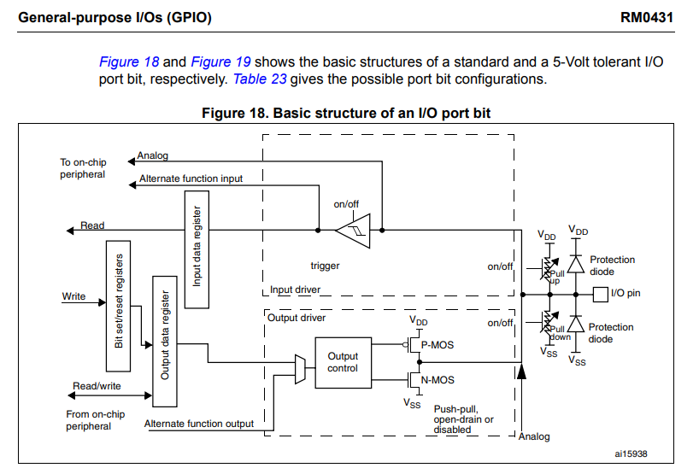
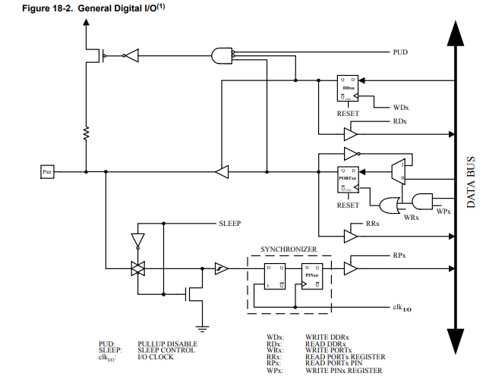
IO port structure:
a)STM32
b)AVR

Slide 7
Registers:-------

