Slide 1

Analysis for GameCo
GameCo‘s analysis from 1980-2020
This Photo by Unknown Author is licensed under CC BY-SA

Slide 2
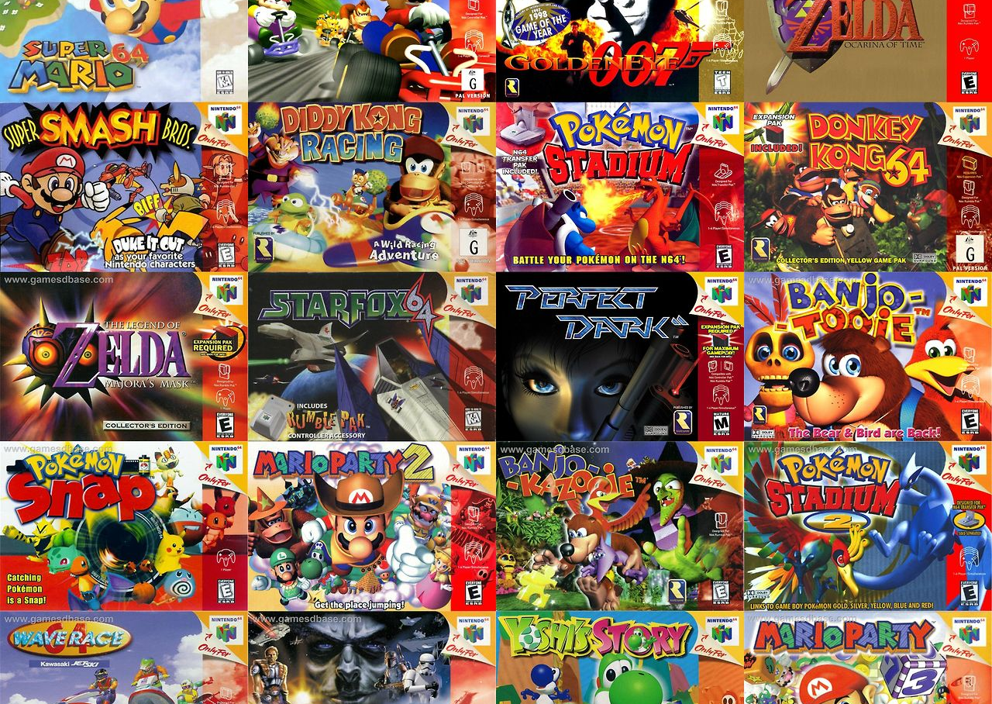
To the executives of GameCo
Video games has been existing for 4 decades now and GameCo has been one of the leading companies in the gaming industry and has been performing quite good over the years and let´s see how they’ve been keeping up in the industry and on their opponents..!
Is GameCo still one of the best in the game?
How are they keeping up with the new games and prices due to high inflation?
How is the performance going to be at the up coming Olympics and how is it going to shape up the future f the company
Let’s find out in the next pages
This Photo by Unknown Author is licensed under CC BY-SA

Slide 3
Historical trend from 1980-2020

Slide 4
Sales in percentages from all regions

Slide 5
This graphic above represents the platforms in sales from the year 1980-2020 highlighting the ones with most sales

Slide 6
from the chart above,seems like strategic games,adventure games and puzzle games DECREASING in sales in all region with the exception of North America INCREASING in sales..! From far left of the chart above,starting from far left we have North America followed by Europe, Japan,Other and the last is Global Sales

Slide 7
Taking a look at the major three regions of the company from a percentage perspective ,it’s clear to see how it was thriving plus the other region and years has been eliminated due to lack of info or data

Slide 8
The Global chart
From the charts above, we can clearly see sales in all regions started pretty WELL with the exception of North America and Europe dropping in sales after just three years but on the other hand, Japan and other parts of the world has kept a study growth in sales which I find quite interesting
All the charts above shows the historical trend highlighting growth
We can also see the company that did PERFORM well in all regions when it comes to sales especially from the year 2003 making it the best years of the company till 2008
For 5 years straight, the gameco had a GOOD margin in PROFIT which can be invested in other sectors lacking growth
i´m quite surprise shooting is not the highest in North America due to the high rate in gun violence and how easy it is to own a gun

Slide 9
Current situation
After 5 years of GOOD margin in profit,we can see a MASSIVE DECLINE in sales from 2009 which might be due to lack of investment to betters sales

Slide 10
Let’s narrow it down to from 2016 and see how we can make things better for the next coming years

Slide 11

Close up in 2016
As seen in the chart above, the year 2016 was GOOD a year in total years thanks to both the American and European marketing sustaining them
Japanese market on the other hand needs to be looked into to be able to keep up for the upcoming years
Other sales also needs attention and investment like the Japanese market cause games are evolving
I wasn’t really expecting the DECLINE of video games after 2016 moreover covid hit and we were focused to stay at home which made me guess people will be spending time playing games but hey clearly did the opposite

Slide 12
The Downfall
Good years
The year 2009 started off pretty bad for the company.
Here’s where we need to dive in and found out what happened after a five year streak.
revive
Even though the company had such a decline in the past, this time was a bit different
reasons
The competition was getting strong and new games were been introduced
Could it be the cost of shipping to each city for different game type?
Suddenly sales started dropping in all regions.!
Lets say it wasn’t a good year for GameCo for obvious reasons
The graph shows average sales peaked in 1989 at 2.66 units
From 2.66 units in 1989, average sales fell sharply to 0.31 units by 1991
After 1992 average sales have failed to reach over 0.50 units
Preferences in demographic in game genres across locations?
Consumer preference?
Pricing?
Or bad marketing?

Slide 13

The break down
While the North American had its best period in sales , it shows declination sales in the last decade. The Europe market Demonstrates consistent sales growth, indicating a receptive market with great upside. The Japan Market, experiences a sales slump, hitting an all-time low. This can be a unique opportunity for them to go back to the drawing board and figure out what is the disconnect. Identifying and addressing the root cause of this decline could unlock a significant market share increase.

Slide 14

Conclusions
I can see a shift in the sales behavior between regions, but that depends on the type of new game that comes out and if it is popular.
01
Things that challenge my expectations are that EU sales have been steadily increasing through the decades, Why Japan took a huge decline after 1995, and why did North American sales begin to decline after 1990 and then spike back up in 1997
03
Throughout the years the sales in games between regions have not been consistent and I expect it to keep not being consistent. Everything will depend on the type of game its popular, what regions have and allow access to it and some games can only be played on certain consoles.
02

Slide 15

Recommendations
Reassessing the Japan marketing, conducting a deep analysis on why there is a decline throughout the last several years, maybe its religion maybe its games not being available in that region, maybe its cost. There could also be a genre of games that are just more popular in Japan than North America and Europe.
Identify what is working in Europe through market research. Start pumping more funds into marketing campaigns to penetrate the Europe market that may not have been established yet.
Figuring out what areas in North America are being underserved to cause sales to decline. Through market research we can determine where the disconnect is and decide whether to pump more funds into to marketing campaigns or determine to put more somewhere else to make up for decline.
Also determining cost of games based on geographic location. Games maybe to costly throughout certain regions
Distributing more funds into Japan's marketing campaigns

