Slide 1


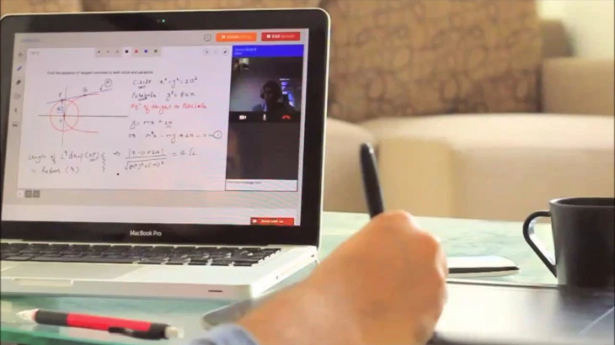




Online tutoring
Online help tutor
Online practice room
www.tutorshubgh.com
The New App
Online tutorials
(with videos)
Online study groups
Online academic challenge

Slide 2


Slide 3


+
Hub Student
Combo Student
Pseudo Student
Online tutoring
Online tutorials
Online help tutor
Online study groups
Online practice rooms
Academic challenges
Join customized groups
Monthly payments/subscription
Online help tutor
Online tutorials
Online study groups
Online practice rooms
Academic challenges
Join customized groups
Annual or Bi-annual payments/subscription
Online tutoring
Online tutorials
Join customized groups
Monthly payments/subscription
NB: There is also a special package for siblings up to 3 who will be taught the same subjects to choose any of the above packages at a discounted offer.

Slide 4

Tutor Subscription
Register as either a ‘Hub Tutor’ or a ‘Help Tutor’ or both
Pay subscription fee to complete registration (annual or bi-annual subscription)
Link bank account or MOMO account to registration details
Remunerated monthly via the app in “TUT COINS”
Every payout the tutor makes, the app retains a %

Slide 5

Online Tutoring
Tutor engages student via google classroom (hangout) linked to the app
Length of every session is between 60 to 90 minutes
After every session, student is supposed to score tutor in points from 20 – 100 points
Tutor is also supposed to score student monthly in points from 0 – 10 points

Slide 6

Online Help Tutor
A ‘combo student’ or a ‘pseudo student’ can require the service of a help tutor.
They can submit assignments and essay to get help from the help tutor
This can be done via a google classroom either by a video interaction or without
Duration for this is maximum of 30 minutes
Student can require the service again for another 30 minutes if the first engagement is not enough. This will be considered as another session for the help tutor.
Students are expected to score the help tutor in points from 5 – 30 points
A particular help tutor can only be engaged 2x by the same student each day

Slide 7
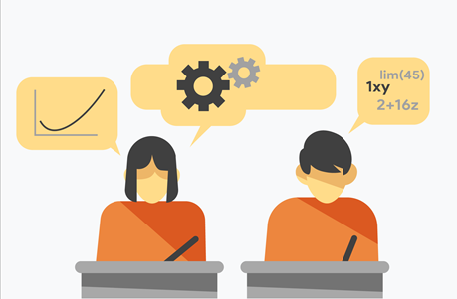
Online Academic Challenge
Students can engage in healthy quizzes or tests competitions with their mates in their schools or different schools
Online tutors can also use this platform to test students they have been teaching
Any student that wins any challenge is awarded points up to 5
The more winning the more points

Slide 8

Online Practice Room
Students will have access to past questions, trial questions, sample examination questions as well as some aptitude test questions on any subject they select
They can solve these questions and get feedbacks

Slide 9

Online Tutorial Session
Students can get access to videos on any subject topic which they can use to teach themselves at their own pace.

Slide 10

Online Study Group
Students can connect to other subscribed students on the app to discuss subjects or have an academic interactions
This platform could also be used to host meetings and debate sessions

Slide 11

Essence of Points
Points are converted into “TUT COINS,” which can be redrawn as cash from the app or used to defray subscription costs.
Tutors or students who score more points over a period of time gain a star
When a tutor gains more stars, their ranking increases. He/she appears in more searches, and also, students can’t score them below a particular cut-off
Students who gain more stars are offered the position of ‘help student’. They can also help some students and gain more points.

Slide 12

TUT COINS (TK)
It is the official currency for the app
All payments would be made in TUT COINS
Points are also converted into TUT COINS: 1 point = 20 TK; 1 TK = 50 pesewas (as an example)

Slide 13


Payments
Any payment made into the app is automatically converted into TUT COINS
Hence, the TUT COIN is the only medium for any transaction in the app
Students can pay into the app using any VISA card or MOMO by following the instructions under ‘PAYMENTS’ section
Tutors would be paid by converting their accrued points into TUT COINS which they can redraw as cash into their MOMO or bank accounts

