Slide 1

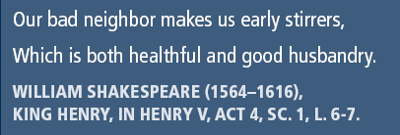
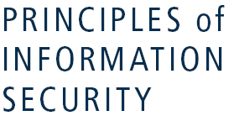

Slide 2
Learning Objectives
Upon completion of this material, you should be able to:
Recognize that organizations have a business need for information security
Understand that a successful information security program is the responsibility of both an organization’s general management and IT management
Identify the threats posed to information security and the more common attacks associated with those threats, and differentiate threats to the information within systems from attacks against the information within systems
Describe the issues facing software developers, as well as the most common errors made by developers, and explain how software development programs can create software that is more secure and reliable
Principles of Information Security, 3rd Edition
Notes:
Upon completion of this chapter, you should be able to:
Understand the business need for information security
Understand a successful information security program is the responsibility of an organization’s general management and IT management
Understand the threats posed to information security and the more common attacks associated with those threats
Differentiate threats to information systems from attacks against information systems

Slide 3
Introduction
Primary mission of information security is to ensure systems and contents stay the same
If no threats, could focus on improving systems, resulting in vast improvements in ease of use and usefulness
Attacks on information systems are a daily occurrence
Principles of Information Security, 3rd Edition
Notes:
Introduction
Information security is unlike any other aspect of information technology. It is an arena where the primary mission is to ensure things stay the way they are.
If there were no threats to information and systems, we could focus on improving systems that support the information, resulting in vast improvements in ease of use and usefulness.
The first phase, investigation, provides an overview of the environment in which security must operate and the problems that security must address.

Slide 4
Business Needs First
Information security performs four important functions for an organization
  Protects ability to function
  Enables safe operation of applications implemented on its IT systems
  Protects data the organization collects and uses
  Safeguards technology assets in use
Principles of Information Security, 3rd Edition
Notes:
Business Needs First, Technology Needs Last
Information security performs four important functions for an organization:
1. Protects the organization’s ability to function
2. Enables the safe operation of applications implemented on the organization’s IT systems
3. Protects the data the organization collects and uses
4. Safeguards the technology assets in use at the organization

Slide 5
Protecting the Functionality of an Organization
Management (general and IT) responsible for implementation
Information security is both management issue and people issue
Organization should address information security in terms of business impact and cost
Principles of Information Security, 3rd Edition
Notes:
Protecting the Ability of the Organization to Function
Both general management and IR management are responsible for implementing information security to protect the ability of the organization to function.
“Information security is a management issue in addition to a technical issue, it is a people issue in addition to the technical issue.”
To assist management in addressing the needs for information security, communities of interest must communicate in terms of business impact and the cost of business interruption and avoid arguments expressed only in technical terms.

Slide 6
Enabling the Safe Operation of Applications
Organization needs environments that safeguard applications using IT systems
Management must continue to oversee infrastructure once in place—not defer to IT department
Principles of Information Security, 3rd Edition
Notes:
Enabling the Safe Operation of Applications
Today’s organizations are under immense pressure to create and operate integrated, efficient, and capable applications.
The modern organization needs to create an environment that safeguards applications using the organization’s IT systems, particularly the environment of the organization’s infrastructure.
Once the infrastructure is in place, management must understand it has not abdicated to the IT department its responsibility to make choices and enforce decisions, but must continue to oversee the infrastructure.

Slide 7
Protecting Data that Organizations Collect and Use
Organization, without data, loses its record of transactions and/or ability to deliver value to customers
Protecting data in motion and data at rest are both critical aspects of information security
Principles of Information Security, 3rd Edition
Notes:
Protecting Data that Organizations Collect and Use
Many organizations realize that one of their most valuable assets is their data, because without data, an organization loses its record of transactions and/or its ability to deliver value to its customers.
Protecting data in motion and data at rest are both critical aspects of information security.
An effective information security program is essential to the protection of the integrity and value of the organization’s data.

Slide 8
Safeguarding Technology Assets in Organizations
Organizations must have secure infrastructure services based on size and scope of enterprise
Additional security services may be needed as organization expands
More robust solutions may be needed to replace security programs the organization has outgrown
Principles of Information Security, 3rd Edition
Notes:
Safeguarding the Technology Assets in Organizations
To perform effectively, organizations must add secure infrastructure services based on the size and scope of the enterprise.
When an organization grows and more capabilities are needed, additional security services may have to be provided locally.
Likewise, as the organization’s network grows to accommodate changing needs, more robust technology solutions may be needed to replace security programs the organization has outgrown.

Slide 9
Threats
Threat: an object, person, or other entity that represents a constant danger to an asset
Management must be informed of the different threats facing the organization
By examining each threat category, management effectively protects information through policy, education, training, and technology controls
Principles of Information Security, 3rd Edition
Notes:
Threats to Information Security
To make sound decisions about information security, create policies, and enforce them, management must be informed of the various kinds of threats facing the organization, its applications, data and information systems.
A threat is an object, person, or other entity that represents a constant danger to an asset.
To better understand the numerous threats facing the organization, a categorization scheme has been developed allowing us to group threats by their respective activities.
By examining each threat category in turn, management can most effectively protect its information through policy, education and training, and technology controls.

Slide 10
Threats (continued)‏
The 2006 CSI/FBI survey found:
  72 percent of organizations reported cyber security breaches within the last 12 months
  52 percent of respondents identified unauthorized computer use
Principles of Information Security, 3rd Edition
Notes:
Threats to Information Security (continued)
The 2002 Computer Security Institute/Federal Bureau of Investigation (CSI/FBI) survey on Computer Crime and Security Survey found:
90% of organizations responding, primarily large corporations and government agencies, detected computer security breaches within the last year.
80% of these organizations lost money to computer breaches, totaling over $455,848,000, up from $377,828,700 reported in 2001.
The number of attacks that came across the Internet rose from 70% in 2001 to 74% in 2002.
Only 34% of organizations reported their attacks to law enforcement.

Slide 11
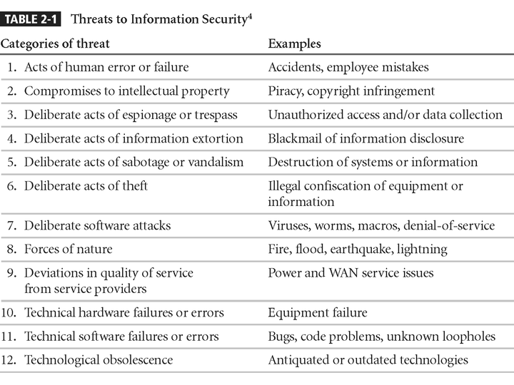
Threats to Information Security
Principles of Information Security, 3rd Edition
Notes:
1. Potential Acts of Human Error or Failure
2. Compromises to Intellectual Property
3. Deliberate Acts of Espionage or Trespass
4. Deliberate Acts of Information Extortion
5. Deliberate Acts of Sabotage or Vandalism
6. Deliberate Acts of Theft
7. Deliberate Software Attacks
8. Forces of Nature
9. Potential Deviations in Quality of Service from Service Providers
10. Technical Hardware Failures or Errors
11. Technical Software Failures or Errors
12. Technological Obsolescence

Slide 12
Acts of Human Error or Failure
Includes acts performed without malicious intent
Causes include:
  Inexperience
  Improper training
  Incorrect assumptions
Employees are among the greatest threats to an organization’s data
Principles of Information Security, 3rd Edition
Notes:
Potential Acts of Human Error or Failure
This category includes the possibility of acts performed without intent or malicious purpose by an individual who is an employee of an organization.
Inexperience, improper training, the making of incorrect assumptions, and other circumstances can cause problems.
Employees constitute one of the greatest threats to information security, as the individuals closest to the organizational data.
Employee mistakes can easily lead to the following: revelation of classified data, entry of erroneous data, accidental deletion or modification of data, storage of data in unprotected areas, and failure to protect information.
Many threats can be prevented with controls, ranging from simple procedures, such as requiring the user to type a critical command twice, to more complex procedures, such as the verification of commands by a second party.

Slide 13
Acts of Human Error or Failure (continued)‏
Employee mistakes can easily lead to:
  Revelation of classified data
  Entry of erroneous data
  Accidental data deletion or modification
  Data storage in unprotected areas
  Failure to protect information
Many of these threats can be prevented with controls
Principles of Information Security, 3rd Edition

Slide 14
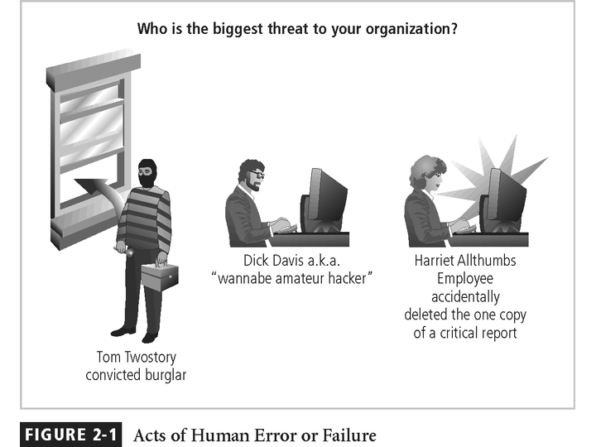
Figure 2-1 – Acts of Human Error or Failure
Principles of Information Security, 3rd Edition

Slide 15
Compromises to Intellectual Property
Intellectual property (IP): “ownership of ideas and control over the tangible or virtual representation of those ideas”
The most common IP breaches involve software piracy
Two watchdog organizations investigate software abuse:
  Software & Information Industry Association (SIIA)
  Business Software Alliance (BSA)‏
Enforcement of copyright law has been attempted with technical security mechanisms
Principles of Information Security, 3rd Edition
Notes:
Compromises to Intellectual Property
Many organizations create or support the development of intellectual property as part of their business operations.
Intellectual property is defined as “the ownership of ideas and control over the tangible or virtual representation of those ideas.”
Intellectual property for an organization includes trade secrets, copyrights, trademarks, and patents.
Once intellectual property (IP) has been defined and properly identified, breaches to IP constitute a threat to the security of this information.
Most common IP breaches involve the unlawful use or duplication of software-based intellectual property, known as software piracy.
In addition to the laws surrounding software piracy, two watchdog organizations investigate allegations of software abuse: Software & Information Industry Association (SIIA), formerly the Software Publishers Association, and the Business Software Alliance (BSA).
Enforcement of copyright violations, piracy, and the like has been attempted through a number of technical security mechanisms, including digital watermarks, embedded codes.

Slide 16
Deliberate Acts of Trespass
Access of protected information by unauthorized individuals
Competitive intelligence (legal) vs. industrial
espionage (illegal)‏
Shoulder surfing can occur anywhere a person accesses confidential information
Controls let trespassers know they are encroaching on organization’s cyberspace
Hackers use skill, guile, or fraud to bypass controls protecting others’ information
Principles of Information Security, 3rd Edition
Notes:
Deliberate Acts of Espionage or Trespass
This threat represents a well-known and broad category of electronic and human activities that breach the confidentiality of information.
When an unauthorized individual gains access to the information an organization is trying to protect, that act is categorized as a deliberate act of espionage or trespass.
When information gatherers employ techniques that cross the threshold of what is legal and/or ethical, they enter the world of industrial espionage.
Instances of shoulder surfing occur at computer terminals, desks, ATM machines, public phones, or other places where a person is accessing confidential information.
The threat of trespass can lead to unauthorized real or virtual actions that enable information gatherers to enter premises or systems they have not been authorized to enter.
Controls are sometimes implemented to mark the boundaries of an organization’s virtual territory.
These boundaries give notice to trespassers that they are encroaching on the organization’s cyberspace.
The classic perpetrator of deliberate acts of espionage or trespass is the hacker.
In the gritty world of reality, a hacker uses skill, guile, or fraud to attempt to bypass the controls placed around information that is the property of someone else. The hacker frequently spends long hours examining the types and structures of the targeted systems.

Slide 17
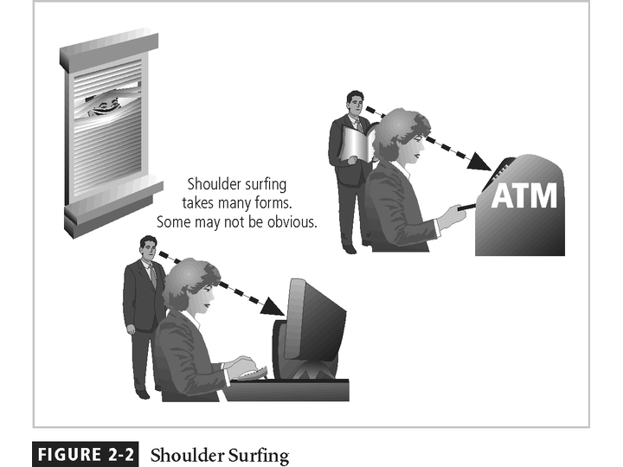
Principles of Information Security, 3rd Edition

Slide 18
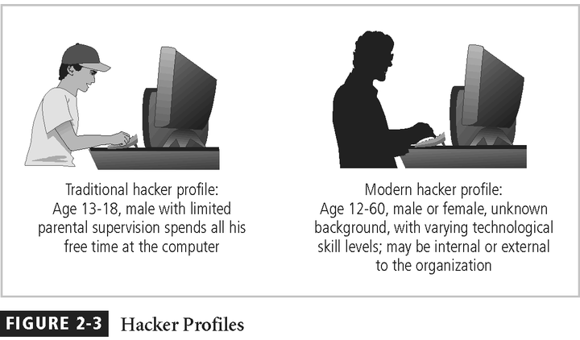
Principles of Information Security, 3rd Edition

Slide 19
Deliberate Acts of Trespass (continued)‏
Expert hacker
  Develops software scripts and program exploits
  Usually a master of many skills
  Will often create attack software and share with others
Principles of Information Security, 3rd Edition
Notes:
Deliberate Acts of Espionage or Trespass (continued)
There are generally two skill levels among hackers.
The first is the expert hacker, who develops software scripts and codes exploits used by the second category, the novice, or unskilled hacker.
The expert hacker is usually a master of several programming languages, networking protocols, and operating systems and also exhibits a mastery of the technical environment of the chosen targeted system.
However, expert hackers have now become bored with directly attacking systems and have turned to writing software.
The software they are writing are automated exploits that allow novice hackers to become script kiddies, hackers of limited skill who use expert-written software to exploit a system but do not fully understand or appreciate the systems they hack.
As a result of preparation and continued vigilance, attacks conducted by scripts are usually predictable and can be adequately defended against.
There are other terms for system rule breakers:
The term cracker is now commonly associated with an individual who “cracks” or removes the software protection from an application designed to prevent unauthorized duplication.
A phreaker hacks the public telephone network to make free calls, disrupt services, and generally wreak havoc.

Slide 20
Deliberate Acts of Trespass (continued)‏
Unskilled hacker
  Many more unskilled hackers than expert hackers
  Use expertly written software to exploit a system
  Do not usually fully understand the systems they hack
Principles of Information Security, 3rd Edition

Slide 21
Deliberate Acts of Trespass (continued)‏
Other terms for system rule breakers:
  Cracker: “cracks” or removes software protection designed to prevent unauthorized duplication
  Phreaker: hacks the public telephone network
Principles of Information Security, 3rd Edition
Notes:
Deliberate Acts of Espionage or Trespass (continued)
There are generally two skill levels among hackers.
The first is the expert hacker, who develops software scripts and codes exploits used by the second category, the novice, or unskilled hacker.
The expert hacker is usually a master of several programming languages, networking protocols, and operating systems and also exhibits a mastery of the technical environment of the chosen targeted system.
However, expert hackers have now become bored with directly attacking systems and have turned to writing software.
The software they are writing are automated exploits that allow novice hackers to become script kiddies, hackers of limited skill who use expert-written software to exploit a system but do not fully understand or appreciate the systems they hack.
As a result of preparation and continued vigilance, attacks conducted by scripts are usually predictable and can be adequately defended against.
There are other terms for system rule breakers:
The term cracker is now commonly associated with an individual who “cracks” or removes the software protection from an application designed to prevent unauthorized duplication.
A phreaker hacks the public telephone network to make free calls, disrupt services, and generally wreak havoc.

Slide 22
Deliberate Acts of Information Extortion
Attacker steals information from computer system and demands compensation for its return or nondisclosure
Commonly done in credit card number theft
Principles of Information Security, 3rd Edition
Notes:
Deliberate Acts of Information Extortion
The threat of information extortion is the possibility of an attacker or formerly trusted insider stealing information from a computer system and demanding compensation for its return or for an agreement to not disclose the information.
Extortion is common in credit card number theft.

Slide 23
Deliberate Acts of Sabotage or Vandalism
Attacks on the face of an organization—its Web site
Threats can range from petty vandalism to organized sabotage
Web site defacing can erode consumer confidence, dropping sales and organization’s net worth
Threat of hacktivist or cyberactivist operations rising
Cyberterrorism: much more sinister form of hacking
Principles of Information Security, 3rd Edition
Notes:
Deliberate Acts of Sabotage or Vandalism
Equally popular today is the assault on the electronic face of an organization, its Web site.
This category of threat addresses the individual or group of individuals who want to deliberately sabotage the operations of a computer system or business, or perform acts of vandalism to either destroy an asset or damage the image of the organization.
These threats can range from petty vandalism by employees to organized sabotage against an organization.
Organizations frequently rely on image to support the generation of revenue, so if an organization’s Web site is defaced, a drop in consumer confidence is probable, reducing the organization’s sales and net worth.
Compared to Web site defacement, vandalism within a network is more malicious in intent and less public.
Today, security experts are noticing a rise in another form of online vandalism in what are described as hacktivist or cyberactivist operations. A more extreme version is referred to as cyberterrorism.

Slide 24
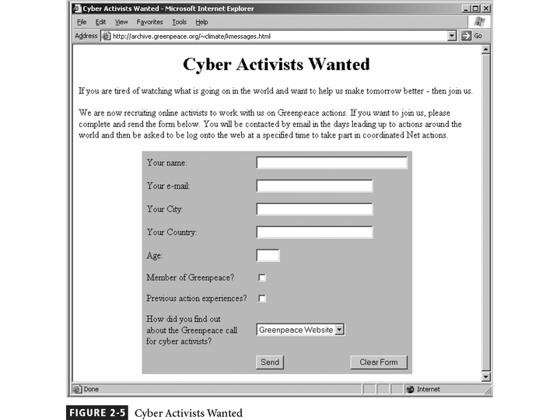
Figure 2-5 - Cyber Activists Wanted
Principles of Information Security, 3rd Edition

Slide 25
Deliberate Acts of Theft
Illegal taking of another’s physical, electronic, or intellectual property
Physical theft is controlled relatively easily
Electronic theft is more complex problem; evidence of crime not readily apparent
Principles of Information Security, 3rd Edition
Notes:
Deliberate Acts of Theft
Theft is the illegal taking of another’s property. Within an organization, that property can be physical, electronic, or intellectual.
The value of information suffers when it is copied and taken away without the owner’s knowledge.
Physical theft can be controlled quite easily. A wide variety of measures can be used from simple locked doors to trained security personnel and the installation of alarm systems.
Electronic theft, however, is a more complex problem to manage and control. Organizations may not even know it has occurred.

Slide 26
Deliberate Software Attacks
Malicious software (malware) designed to damage, destroy, or deny service to target systems
Includes viruses, worms, Trojan horses, logic bombs, back doors, and denial-of-service attacks
Principles of Information Security, 3rd Edition
Notes:
Deliberate Software Attacks
Deliberate software attacks occur when an individual or group designs software to attack an unsuspecting system. Most of this software is referred to as malicious code or malicious software, or sometimes malware.
These software components or programs are designed to damage, destroy, or deny service to the target systems.
Some of the more common instances of malicious code are viruses and worms, Trojan horses, logic bombs, back doors, and denial-of-services attacks.
Computer viruses are segments of code that perform malicious actions.
This code behaves very much like a virus pathogen attacking animals and plants, using the cell’s own replication machinery to propagate and attack.
The code attaches itself to the existing program and takes control of that program’s access to the targeted computer.
The virus-controlled target program then carries out the virus’s plan by replicating itself into additional targeted systems.
The macro virus is embedded in the automatically executing macro code, common in office productivity software like word processors, spread sheets, and database applications.
The boot virus infects the key operating systems files located in a computer’s boot sector.
Worms - Malicious programs that replicate themselves constantly without requiring another program to provide a safe environment for replication. Worms can continue replicating themselves until they completely fill available resources, such as memory, hard drive space, and network bandwidth.
Trojan horses - Software programs that hide their true nature and reveal their designed behavior only when activated. Trojan horses are frequently disguised as helpful, interesting, or necessary pieces of software, such as readme.exe files often included with shareware or freeware packages.
Back door or Trap door - A virus or worm can have a payload that installs a back door or trap door component in a system. This allows the attacker to access the system at will with special privileges.
Polymorphism - A threat that changes its apparent shape over time, representing a new threat not detectable by techniques that are looking for a preconfigured signature. These threats actually evolve, changing their size and appearance to elude detection by antivirus software programs, making detection more of a challenge.
Virus and Worm Hoaxes - As frustrating as viruses and worms are, perhaps more time and money is spent on resolving virus hoaxes. Well-meaning people spread the viruses and worms when they send e-mails warning of fictitious or virus laden threats.

Slide 27
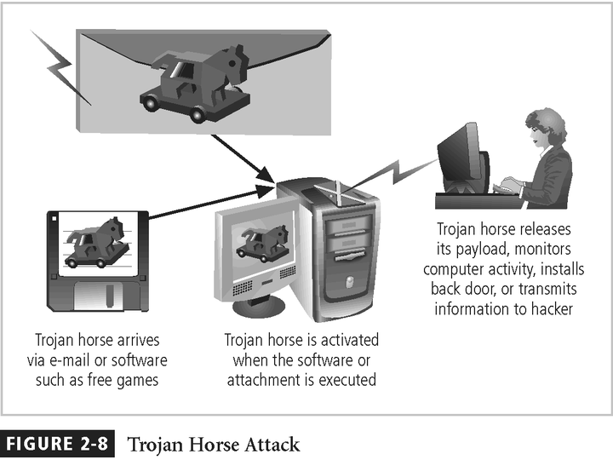
Principles of Information Security, 3rd Edition

Slide 28
Forces of Nature
Forces of nature are among the most dangerous threats
Disrupt not only individual lives, but also storage, transmission, and use of information
Organizations must implement controls to limit damage and prepare contingency plans for continued operations
Principles of Information Security, 3rd Edition
Notes:
Forces of Nature
Forces of nature, force majeure, or acts of God pose the most dangerous threats, because they are unexpected and can occur with very little warning.
These threats can disrupt not only the lives of individuals, but also the storage, transmission, and use of information.
These include fire, flood, earthquake, and lightning as well as volcanic eruption and insect infestation.
Since it is not possible to avoid many of these threats, management must implement controls to limit damage and also prepare contingency plans for continued operations.

Slide 29
Deviations in Quality of Service
Includes situations where products or services are not delivered as expected
Information system depends on many interdependent support systems
Internet service, communications, and power irregularities dramatically affect availability of information and systems
Principles of Information Security, 3rd Edition
Notes:
Potential Deviations in Quality of Service by Service Providers
This category represents situations in which a product or services are not delivered to the organization as expected.
The organization’s information system depends on the successful operation of many interdependent support systems including power grids, telecom networks, parts suppliers, service vendors, and even the janitorial staff and garbage haulers.
Internet service, communications, and power irregularities are three sets of service issues that dramatically affect the availability of information and systems.

Slide 30
Internet Service Issues
Internet service provider (ISP) failures can considerably undermine availability of information
Outsourced Web hosting provider assumes responsibility for all Internet services as well as hardware and Web site operating system software
Principles of Information Security, 3rd Edition
Notes:
Internet Service Issues
For organizations that rely heavily on the Internet and the Web to support continued operations, the threat of the potential loss of Internet service can lead to considerable loss in the availability of information.
Many organizations have sales staff and telecommuters working at remote locations.
When an organization places its Web servers in the care of a Web hosting provider, that outsourcer assumes responsibility for all Internet services as well as for the hardware and operating system software used to operate the Web site.

Slide 31
Communications and Other Service
Provider Issues
Other utility services affect organizations: telephone, water, wastewater, trash pickup, etc.
Loss of these services can affect organization’s ability to function
Principles of Information Security, 3rd Edition
Notes:
Communications and Other Service Provider Issues
Other utility services can impact organizations as well.
Among these are telephone, water, wastewater, trash pickup, cable television, natural or propane gas, and custodial services.
The threat of loss of these services can lead to the inability of an organization to function properly.

Slide 32
Power Irregularities
Commonplace
Lead to fluctuations such as power excesses, power shortages, and power losses
Organizations with inadequately conditioned power are susceptible
Controls can be applied to manage power quality
Principles of Information Security, 3rd Edition
Notes:
Power Irregularities
The threat of irregularities from power utilities is common and can lead to fluctuations such as power excesses, power shortages, and power losses.
In the U.S., buildings are “fed” 120-volt, 60-cycle power usually through 15 and 20 amp circuits.
Voltage levels can:
spike – momentary increase or surge – prolonged increase
sag – momentary low voltage, or brownout – prolonged drop
fault – momentary loss of power, or blackout – prolonged loss
Since sensitive electronic equipment, especially networking equipment, computers, and computer-based systems are susceptible to fluctuations, controls can be applied to manage power quality.

Slide 33
Technical Hardware Failures or Errors
Occur when manufacturer distributes equipment containing flaws to users
Can cause system to perform outside of expected parameters, resulting in unreliable or poor service
Some errors are terminal; some are intermittent
Principles of Information Security, 3rd Edition
Notes:
Technical Hardware Failures or Errors
Technical hardware failures or errors occur when a manufacturer distributes to users equipment containing a known or unknown flaw.
These defects can cause the system to perform outside of expected parameters, resulting in unreliable service or lack of availability.
Some errors are terminal, in that they result in the unrecoverable loss of the equipment. Some errors are intermittent, in that they only periodically manifest themselves, resulting in faults that are not easily repeated.

Slide 34
Technical Software Failures or Errors
Purchased software that contains unrevealed faults
Combinations of certain software and hardware can reveal new software bugs
Entire Web sites dedicated to documenting bugs
Principles of Information Security, 3rd Edition
Notes:
Technical Software Failures or Errors
This category of threats comes from purchasing software with unknown, hidden faults.
Large quantities of computer code are written, debugged, published, and sold only to determine that not all bugs were resolved.
Sometimes, unique combinations of certain software and hardware reveal new bugs.
Sometimes, these items aren’t errors but are purposeful shortcuts left by programmers for honest or dishonest reasons.

Slide 35
Technological Obsolescence
Antiquated/outdated infrastructure can lead to unreliable, untrustworthy systems
Proper managerial planning should prevent technology obsolescence; IT plays large role
Principles of Information Security, 3rd Edition
Notes:
Technological Obsolescence
When the infrastructure becomes antiquated or outdated, it leads to unreliable and untrustworthy systems.
Management must recognize that when technology becomes outdated, there is a risk of loss of data integrity to threats and attacks.
Ideally, proper planning by management should prevent the risks from technology obsolesce, but when obsolescence is identified, management must take immediate action.

Slide 36
Attacks
Act or action that exploits vulnerability (i.e., an identified weakness) in controlled system
Accomplished by threat agent that damages or steals organization’s information
Principles of Information Security, 3rd Edition
Notes:
Attacks
An attack is the deliberate act that exploits vulnerability.
It is accomplished by a threat agent to damage or steal an organization’s information or physical asset.
An exploit is a technique to compromise a system. Vulnerability is an identified weakness of a controlled system whose controls are not present or are no longer effective. An attack is then the use of an exploit to achieve the compromise of a controlled system.

Slide 37
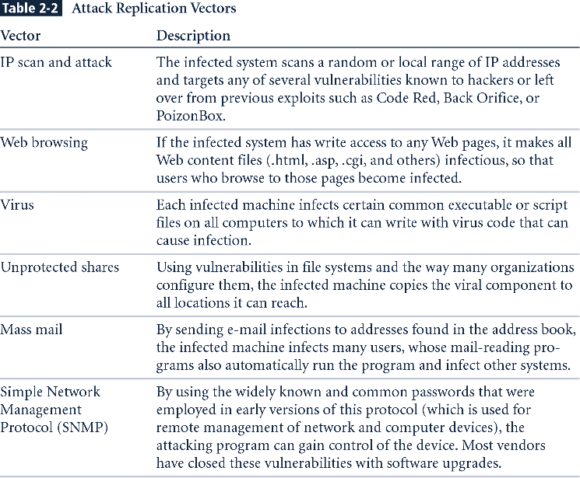
Table 2-2 - Attack Replication Vectors
New Table
Principles of Information Security, 3rd Edition

Slide 38
Attacks (continued)‏
Malicious code: includes execution of viruses, worms, Trojan horses, and active Web scripts with intent to destroy or steal information
Hoaxes: transmission of a virus hoax with a real virus attached; more devious form of attack
Back door: gaining access to system or network using known or previously unknown/newly discovered access mechanism
Principles of Information Security, 3rd Edition
Notes:
Malicious Code
This kind of attack includes the execution of viruses, worms, Trojan horses, and active Web scripts with the intent to destroy or steal information.
The state of the art in attacking systems in 2002 is the multivector worm.
These attack programs use up to six known attack vectors to exploit a variety of vulnerabilities in commonly found information system devices.

Slide 39
Attacks (continued)‏
Password crack: attempting to reverse calculate a password
Brute force: trying every possible combination of options of a password
Dictionary: selects specific accounts to attack and uses commonly used passwords (i.e., the dictionary) to guide guesses
Principles of Information Security, 3rd Edition
Notes:
Attack Descriptions
Back Doors - Using a known or previously unknown and newly discovered access mechanism, an attacker can gain access to a system or network resource.
Password Crack - Attempting to reverse calculate a password.
Brute Force - The application of computing and network resources to try every possible combination of options of a password.
Dictionary - The dictionary password attack narrows the field by selecting specific accounts to attack and uses a list of commonly used passwords (the dictionary) to guess with.

Slide 40
Attacks (continued)‏
Denial-of-service (DoS): attacker sends large number of connection or information requests to a target
  Target system cannot handle successfully along with other, legitimate service requests
  May result in system crash or inability to perform ordinary functions
Distributed denial-of-service (DDoS): coordinated stream of requests is launched against target from many locations simultaneously
Principles of Information Security, 3rd Edition
Notes:
Attack Descriptions (continued)
Denial-of-Service (DoS) - The attacker sends a large number of connection or information requests to a target. So many requests are made that the target system cannot handle them successfully along with other, legitimate requests for service. This may result in a system crash or merely an inability to perform ordinary functions.
Distributed Denial-of-Service (DDoS) - An attack in which a coordinated stream of requests is launched against a target from many locations at the same time.

Slide 41
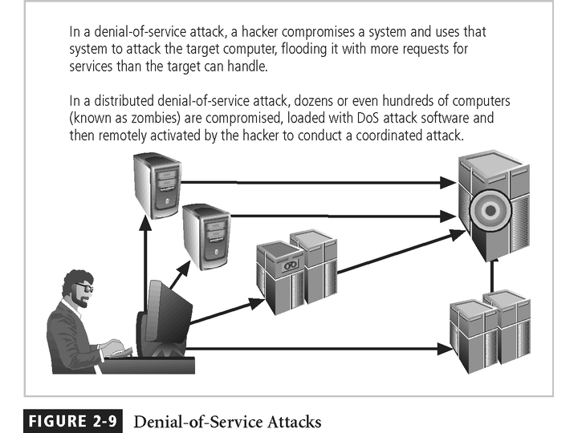
Figure 2-9 - Denial-of-Service Attacks
Principles of Information Security, 3rd Edition

Slide 42
Attacks (continued)‏
Spoofing: technique used to gain unauthorized access; intruder assumes a trusted IP address
Man-in-the-middle: attacker monitors network packets, modifies them, and inserts them back into network
Spam: unsolicited commercial e-mail; more a nuisance than an attack, though is emerging as a vector for some attacks
Principles of Information Security, 3rd Edition
Notes:
Attack Descriptions (continued)
Spoofing - A technique used to gain unauthorized access to computers, whereby the intruder sends messages to a computer with an IP address indicating that the message is coming from a trusted host.
Man-in-the-Middle - In the man-in-the-middle or TCP hijacking attack, an attacker sniffs packets from the network, modifies them, and inserts them back into the network.
Spam - Unsolicited commercial e-mail. While many consider spam a nuisance rather than an attack, it is emerging as a vector for some attacks.

Slide 43
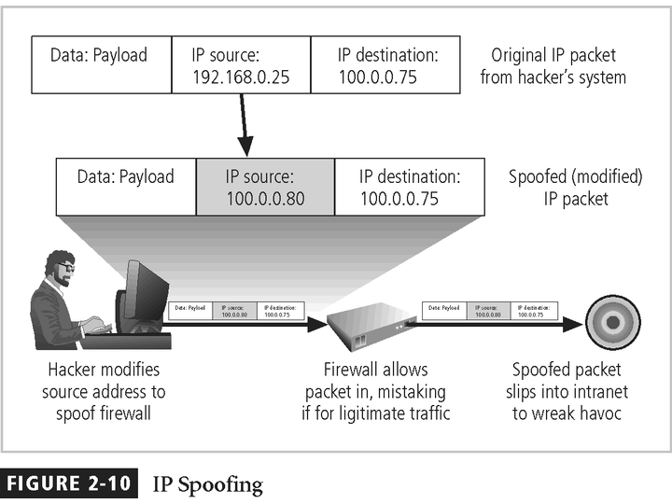
Principles of Information Security, 3rd Edition

Slide 44
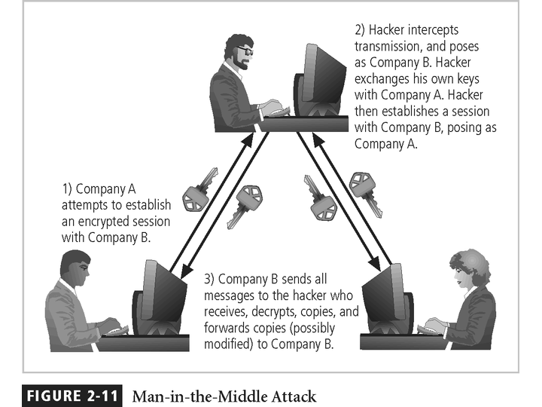
Figure 2-11 - Man-in-the-Middle
Principles of Information Security, 3rd Edition

Slide 45
Attacks (continued)‏
Mail bombing: also a DoS; attacker routes large quantities of e-mail to target
Sniffers: program or device that monitors data traveling over network; can be used both for legitimate purposes and for stealing information from a network
Social engineering: using social skills to convince people to reveal access credentials or other valuable information to attacker
Principles of Information Security, 3rd Edition
Notes:
Attack Descriptions (continued)
Mail Bombing - Another form of e-mail attack that is also a DoS, in which an attacker routes large quantities of e-mail to the target.
Sniffers - A program and/or device that can monitor data traveling over a network. Sniffers can be used both for legitimate network management functions and for stealing information from a network.
Social Engineering - Within the context of information security, the process of using social skills to convince people to reveal access credentials or other valuable information to the attacker.

Slide 46
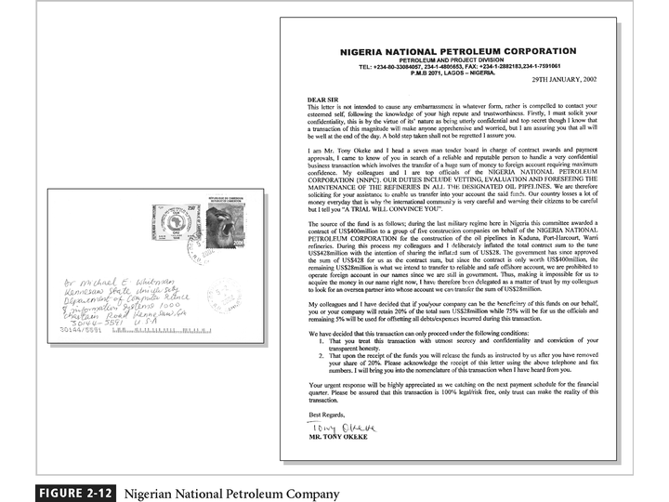
Principles of Information Security, 3rd Edition

Slide 47
Attacks (continued)‏
“People are the weakest link. You can have the best technology; firewalls, intrusion-detection systems, biometric devices ... and somebody can call an unsuspecting employee. That's all she wrote, baby. They got everything.” — Kevin Mitnick
Phishing: an attempt to gain personal/financial information from individual, usually by posing as legitimate entity
Principles of Information Security, 3rd Edition
Notes:
Attack Descriptions (continued)
“People are the weakest link. You can have the best technology; firewalls, intrusion-detection systems, biometric devices...and somebody can call an unsuspecting employee. That's all she wrote, baby. They got everything.”
Brick Attack – The best configured firewall in the world can’t stand up to a well placed brick.

Slide 48
Attacks (continued)‏
Pharming: redirection of legitimate Web traffic (e.g., browser requests) to illegitimate site for the purpose of obtaining private information
Timing attack: relatively new; works by exploring contents of a Web browser’s cache to create malicious cookie
Principles of Information Security, 3rd Edition
Notes:
Attack Descriptions (continued)
Buffer Overflow - An application error that occurs when more data is sent to a buffer than it can handle. When the buffer overflows, the attacker can make the target system execute instructions, or the attacker can take advantage of some other unintended consequence of the failure.
Timing Attack - Relatively new, works by exploring the contents of a Web browser’s cache. This could allow the designer to collect information to access to password-protected sites. Another attack by the same name involves attempting to intercept cryptographic elements to determine keys and encryption algorithms.

Slide 49
Secure Software Development
Many information security issues discussed here are caused by software elements of system
Development of software and systems is often accomplished using methodology such as Systems Development Life Cycle (SDLC)‏
Many organizations recognize need for security objectives in SDLC and have included procedures to create more secure software
This software development approach known as Software Assurance (SA)‏
Principles of Information Security, 3rd Edition

Slide 50
Software Assurance and the SA Common Body of Knowledge
National effort underway to create common body of knowledge focused on secure software development
US Department of Defense and Department of Homeland Security supported Software Assurance Initiative, which resulted in publication of Secure Software Assurance (SwA) Common Body of Knowledge (CBK)‏
SwA CBK serves as a strongly recommended guide to developing more secure applications
Principles of Information Security, 3rd Edition

Slide 51
Software Design Principles
Good software development results in secure products that meet all design specifications
Some commonplace security principles:
  Keep design simple and small
  Access decisions by permission not exclusion
  Every access to every object checked for authority
  Design depends on possession of keys/passwords
  Protection mechanisms require two keys to unlock
  Programs/users utilize only necessary privileges
  Minimize mechanisms common to multiple users
  Human interface must be easy to use so users routinely/automatically use protection mechanisms
Principles of Information Security, 3rd Edition

Slide 52
Software Development Security Problems
Problem areas in software development:
  Buffer overruns
  Command injection
  Cross-site scripting
  Failure to handle errors
  Failure to protect network traffic
  Failure to store and protect data securely
  Failure to use cryptographically strong random numbers
  Format string problems
  Neglecting change control
  Improper file access
Principles of Information Security, 3rd Edition

Slide 53
Software Development Security Problems (continued)‏
Problem areas in software development (continued):
  Improper use of SSL
  Information leakage
  Integer bugs (overflows/underflows)‏
  Race conditions
  SQL injection
  Trusting network address resolution
  Unauthenticated key exchange
  Use of magic URLs and hidden forms
  Use of weak password-based systems
  Poor usability
Principles of Information Security, 3rd Edition

Slide 54
Summary
Unlike any other aspect of IT, information security’s primary mission to ensure things stay the way they are
Information security performs four important functions:
  Protects organization’s ability to function
  Enables safe operation of applications implemented on organization’s IT systems
  Protects data the organization collects and uses
  Safeguards the technology assets in use at the organization
Principles of Information Security, 3rd Edition

Slide 55
Summary (continued)
Threat: object, person, or other entity representing a constant danger to an asset
Management effectively protects its information through policy, education, training, and technology controls
Attack: a deliberate act that exploits vulnerability
Secure systems require secure software
Principles of Information Security, 3rd Edition

