Slide 1
feature
input
encoder₁
feature
classiffier
or
decoder
feature
encoder₂
feature
...
...
...
...
...
encoder_{n}
feature
feature

Slide 2
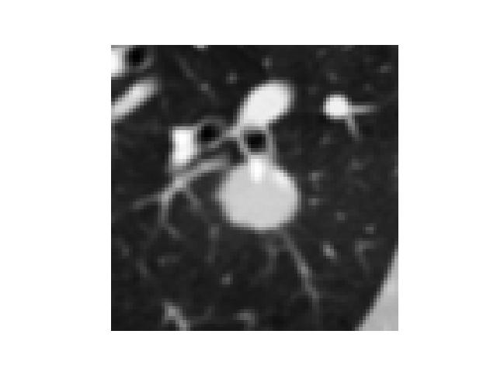
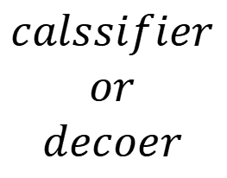





$${encoder}_{1}$$
$${encoder}_{2}$$
$$calssifier$$
$$or$$
$$decoer$$
$$inputs$$
...
...
...
...
...
$${encoder}_{n}$$
$$features$$

Slide 3








$$⋮$$
$$⋮$$
$$⋮$$
$$⋮$$
$${encoder}_{1}$$
$$inputs$$
$${encoder}_{1}$$
$${encoder}_{1}$$
$${encoder}_{i}$$
$$features$$
$$decoder$$
$$extracte features$$

Slide 4

+
decoder loss
encoder loss
$$⋮$$
x
$$⋮$$
$$decoder$$
$$encoder$$

Slide 5
client₁’s classifier
personalize part
client₂’s classifier
personalize part
generalize
part
personalize part
personalize part
client₃’s classifier
client₄’s classifier

Slide 6

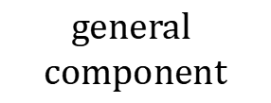




$${client}_{1}$$
$${client}_{2}$$
$$personal$$
$$component$$
$$personal$$
$$component$$
$$general$$
$$component$$
$$personal$$
$$component$$
$$personal$$
$$component$$
$${client}_{4}$$
$${client}_{3}$$
client’s decoder/classifier

Slide 7
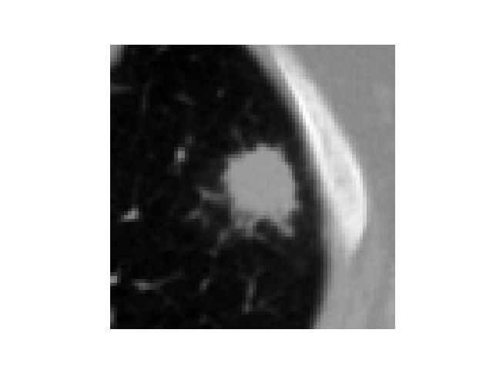
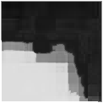
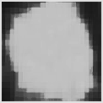
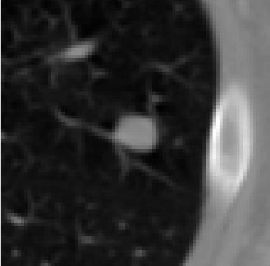
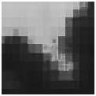













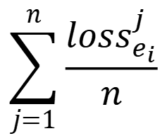

$$⋯$$
$$F_{: ,1}$$
$${loss}_{e_{i}}^{1}=D({feature}_{1}^{i})$$
$$⋯$$
$$F_{: ,2}$$
$$\sum_{j=1}^{n}{\frac{{loss}_{e_{i}}^{j}}{n}}$$
$${loss}_{e_{i}}^{2}=D({feature}_{2}^{i})$$
...
...
$$input$$
$$∅_{i}(θ_{i};x)$$
$$⋯$$
$$F_{: ,N−1}$$
$${loss}_{e_{i}}^{n−1}=D({feature}_{n−1}^{i})$$
forward
backward
$$⋯$$
$i th$ encoder
$$F_{: ,N}$$
$${loss}_{e_{i}}^{n−1}=D({feature}_{n}^{i})$$

Slide 8














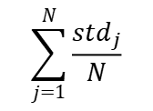





$$⋯$$
x
$$F_{: ,1}$$
$$β_{i}(l_{1})F_{1,1}$$
$$⋯$$
$$β_{i}(l_{B})F_{B,1}$$
$${std}_{1}$$
$$⋯$$
x
$$F_{: ,2}$$
$$β_{i}(l_{1})F_{1,2}$$
$$⋯$$
$$β_{i}(l_{B})F_{B,2}$$
$${std}_{2}$$
...
...
$$\sum_{j=1}^{N}{\frac{{std}_{j}}{N}}$$
...
$$inputs$$
$$∅_{i}(θ_{i};x)$$
$$⋯$$
x
$$F_{: ,N−1}$$
$$β_{i}(l_{1})F_{1,N−1}$$
$$⋯$$
$$β_{i}(l_{B})F_{B,N−1}$$
forward
$${std}_{N−1}$$
backward
$$⋯$$
$i th$ encoder
x
x
Hadamard product
$$F_{: ,N}$$
$$β_{i}(l_{1})F_{1,N}$$
$$⋯$$
$$β_{i}(l_{B})F_{B,N}$$
$${std}_{N}$$

Slide 9
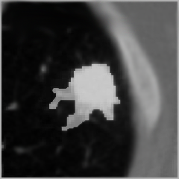
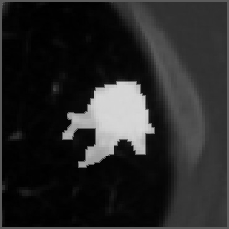


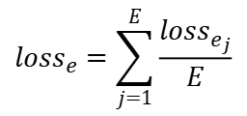



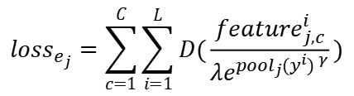










$$⋯$$
$$∅_{i}(θ_{i};x)$$
$$input$$
$$F_{1,1}$$
$${feature}_{j}^{i,c}$$
$$d_{1,1}×d_{1,2}$$
$$d_{j,1}×d_{j,2}$$
$${loss}_{e_{1}}=F_{1,1}e$$
$${loss}_{e_{j}}=\sum_{c=1}^{C}{\sum_{i=1}^{L}{D(\frac{{feature}_{j,c}^{i}}{λe^{{{pool}_{j}(y^{i}) }^{γ}}})}}$$
$${loss}_{e}=\sum_{j=1}^{E}{\frac{{loss}_{e_{j}}}{E}}$$
$$d_{1,1}×d_{1,2}$$
$$d_{j,1}×d_{j,2}$$
$i th$ encoder
$$p_{i,1}(y_{i})$$
$$p_{i,j}(y_{i})$$
$$label y_{i}$$
$i th$ pool
backward
$$⋯$$
$$p_{i,:}(y_{i})$$
forward

Slide 10
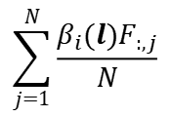










$$⋯$$
$$∅_{i}(θ_{i};x)$$
$$input$$
$$F_{:,1}$$
$$F_{:,N}$$
$$B×d_{1,1}×d_{1,2}$$
$$B×d_{j,1}×d_{j,2}$$
$$\sum_{j=1}^{N}{\frac{β_{i}(l)F_{:,j}}{N}}$$
x
$$β_{i}(l)F_{:,1}$$
$$⋯$$
x
$$β_{i}(l)F_{:,N}$$
$$B×d_{1,1}×d_{1,2}$$
$$B×d_{j,1}×d_{j,2}$$
$i th$ encoder
$$p_{i,1}(l)$$
$$p_{i,j}(l)$$
average pooling
$$label$$
backward
$$⋯$$
$$p_{i,:}(l)$$
forward

Slide 11







$${client}_{1}$$
$${client}_{1}$$
classifier’s
or
decoser’s
parameters
$$average$$
$${client}_{2}$$
$${client}_{2}$$
predictions
communicate
$$personalize$$
$${client}_{3}$$
$${client}_{3}$$
$$local$$
$$server$$
$$local$$

Slide 12





sub-encoders
weighted
partial
average
personalize
encoder/extractor
assign
assign
decoder/classifier
$$server$$
$${client}_{1}$$
$${client}_{2}$$
$${client}_{3}$$
$${client}_{4}$$

