Slide 1

Will LOL player buy boots first?
MACS 33002 Project 2
Yawei Li
Notes:
Hello everyone.

Slide 2



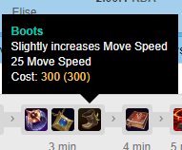


Task
Predicting: In a League of Legends match, will a player choose to buy boots as their first buy? (Binary)
True: Player buys boots as (part of) their first buy
False: Player buys other items in their first buy but not boots.
Background:
Boots is a cheap must-have item, yet a situational first buy.
League of Legends is 5v5 game where we play as champions, earn gold and buy items to win against enemy player team in a match.
“First Buy” = buy on their first batch of purchase, after starting purchase.
Players only get to buy when they return to base, so they buy in batches.
TRUE
FALSE
Notes:
In League of Legends we play as champions. We earn gold to buy items to win. We buy in batches, and we’re predicting if the item boots is in the first batch (after starting buy)
This is a binary task.

Slide 3
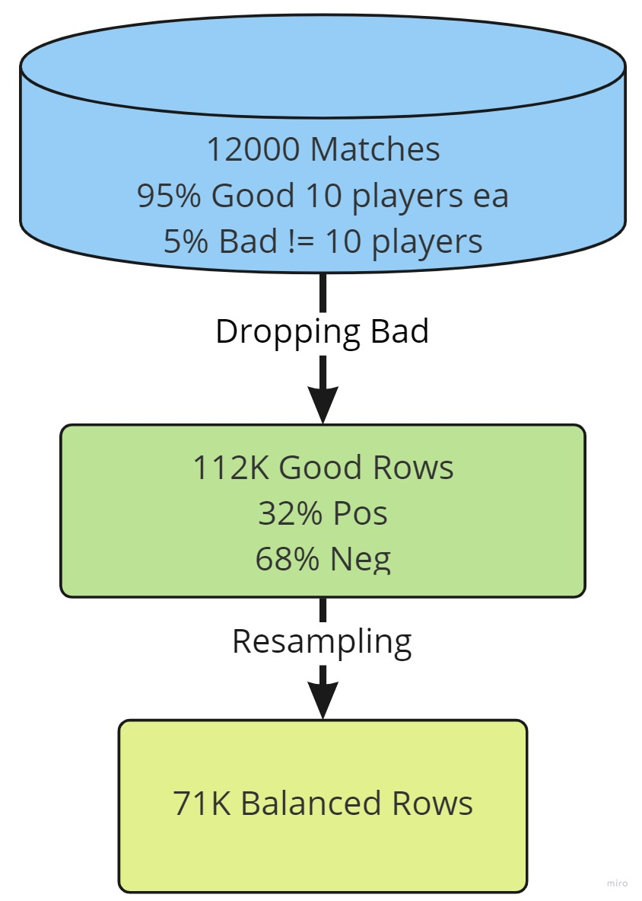
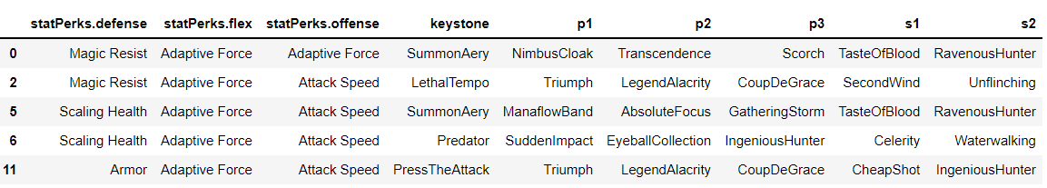
Data and Preprocessing
Source: Kaggle set for matchIDs, Riot API (loldata.ipynb) for match details, 12000 matches
Size: 71114 rows (119K – drop ‘missing’ – 112K – resample – 71114) of player-match
Features: 40 (17 numeric, 11 binary, 12 multinomial) – 508 after OHE, details next
Distribution: Balanced (35557 True, 35557 False)
Preprocessing: Drop ‘missing’, Resample, One hot encoding, Standardization, Polynomial, 70/30 split
Summoner Spells:
Order doesn’t matter
‘perks’: Nested json-like String
{'statPerks': {'defense': 5003, 'flex': 5008, 'offense': 5008}, 'styles': [{'description': 'primaryStyle', 'selections': [{'perk': 8214, 'var1': 1666, 'var2': 0, 'var3': 0}, {'perk': 8275, 'var1': 7, 'var2': 0, 'var3': 0}, {'perk': 8210, 'var1': 12, 'var2': 0, 'var3': 0}, {'perk': 8237, 'var1': 629, 'var2': 0, 'var3': 0}], 'style': 8200}, {'description': 'subStyle', 'selections': [{'perk': 8139, 'var1': 1126, 'var2': 0, 'var3': 0}, {'perk': 8135, 'var1': 2190, 'var2': 5, 'var3': 0}], 'style': 8100}]}
Index | Summoner1Id | Summoner2Id
2 | 4 | 14
…
5 | 14 | 4
Wrangling Mapping
Wrangling Mapping
Index | Flash | … | Ignite | …
2 | True | False | True | False
…
5 | True | False | True | False
Notes:
We start from 12k matches. 5% of the matches have missing or extra player and are of questionable qualify so I dropped them.
We then have 112 thousand rows unbalanced, after resampling we have 71 thousand.
I then did pre processing mainly one hot encoding. Two of the examples shown here are really tricky to wrangle.
We then have 508 features after one hot encoding and I did a 70/30 train test split. I also did standardizations and polynomial for some model specifications.

Slide 4

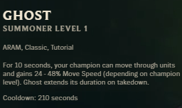
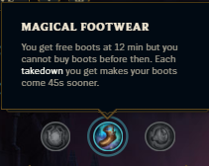






Features: almost all gainable & representable
1.Champion
Representable Attributes
Names (140+) for hard-to-represent attrs
E.g/: Yuumi
2.Role
Decides what you do early game
E.g.: As jungler, Elise moves around more
4. Setup
Summoner Spells Perks
3.Enemy Champion
Strategize against
5. Early Game
Gold collected
Minute on first buy, etc
Notes:
My last feedback wants me to elaborate more on how I choose these features and what they are.
Basically, I included everything I can. Some of data are unaviable or beyond my skills to represent. Everything I can work with is in.
These 40 features can be categorized in 5 groups. First your champion. Numeric features are easy, but uniquesness of champion are very hard to represent. For example Yuumi is a champion cat that attaches to friendly champions. Meaning she doesn’t walk herself and usually don’t buy boots. I feed the machine champion name, so maybe it can figure it out.
2, role, Elise is a jungle here, and she moves a lot early game as a jungle. 3. Enemy jungler, Taliyah, that I also included representables and name. 4. Setup, mainly summoner spells and perks. For example, summoner spell ghost makes you run faster, and you can double down faster by buying boots early. For perks, magical footwear perk gifts you a free boots at minute 12 but you can’t buy it normally. Fith, how the early game is going, how much gold you have and what time it is when you make your first buy.

Slide 5
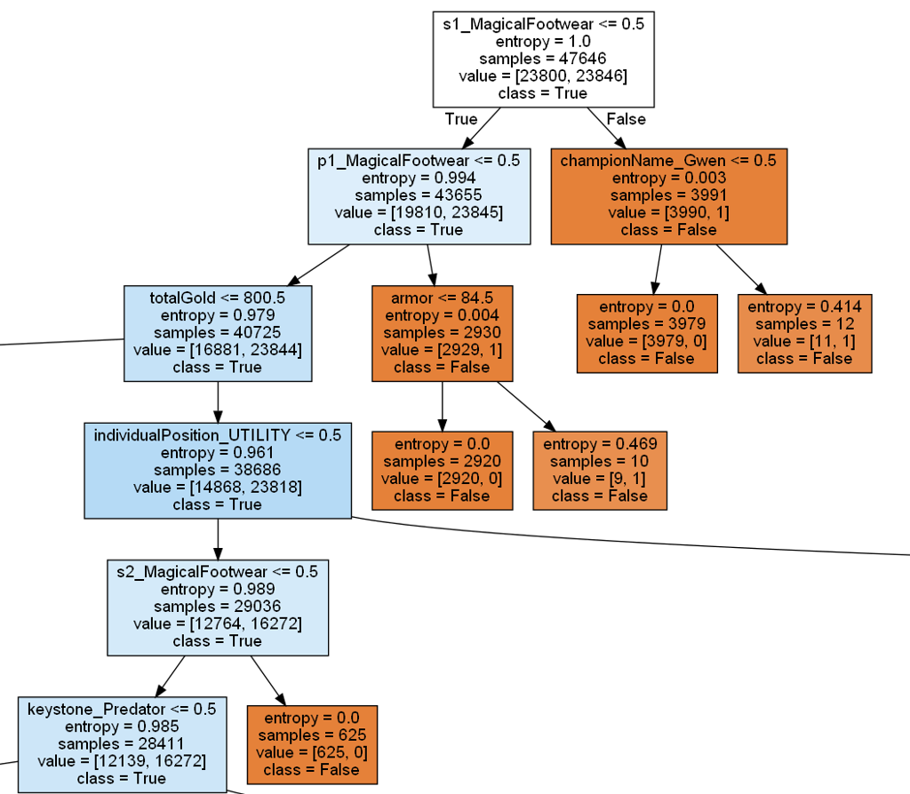
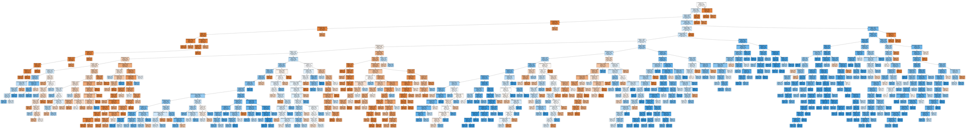
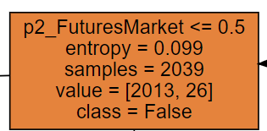
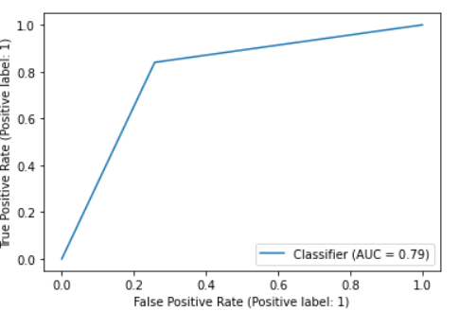
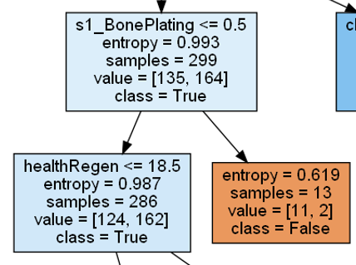
Decision Tree with GS CV
Tuning: depth, criterion, leaf size, split size
Accuracy: 79.1% test, 79.3% train
Best Params: 20 depth, 10 min leaf, 200 min split
Cost: 10s per fit
 | Precision | Recall | F1-Score | Support
False | 0.82 | 0.74 | 0.78 | 11757
True | 0.76 | 0.84 | 0.80 | 11711
Predicted Actual | False | True
False | 8727 | 3030
True | 1875 | 9836
Notes:
With these knowledge on features, let’s take a look at this tree visualization.
On first split, do you have magical footwear at secondary perk? S means secondary. If you do, FALSE.
Then it asks do you have it on primary? If you do, same FALSE.
Then it asks do you have enough money to buy it? (800 is the typical amount of total money to buy boots). If you don’t,
Then it moves on to ask about your position, are you playing UTILITIY? And so on.
I found everything shown here makes sense and explainable, but interestingly, many great splits are beyond my understanding. Like this ones splist on secondary perk, BonePlating. I can’t think of how it has anything to do with boots or speed, but it has good information gain.
The whole tree is shown here, I’ll say reasonably big for this complicated problem.
I got this tree by tuning 4 parameters using grid search, and best parameters are putting medium limitation on complexity.
It has 79% accuracy on both training and test meaning we’re not overfitting.
For errors, we have much more false positive than false negative. We’re also making unnecessary splits, like here, 4000:1 still splitting.

Slide 6
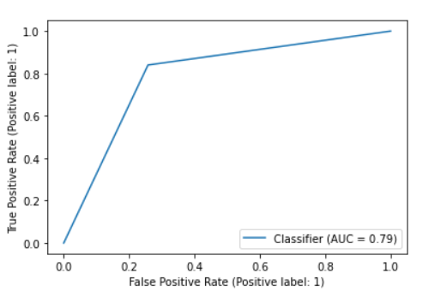
Logistic Regression (polynomial)
LR is affected by Multicollinearity
LR emphasizes hidden knowledge I can’t explain
Tree Features | coef | LR Features | coef
totalGold | 0.21 | s1_MagicalFootwear | -5.44
s1_MagicalFootwear | 0.19 | s2_MagicalFootwear | -3.12
p1_MagicalFootwear | 0.16 | powerMax | -2.34
attackDamage | 0.08 | championName_Viego | 2.25
individualPosition_UTILITY | 0.05 | attackDamage | -1.62
s2_MagicalFootwear | 0.04 | s1_BiscuitDelivery | 1.28
powerMax | 0.03 | level | 1.25
keystone_Predator | 0.03 | totalGold | 1.14
healthMax | 0.03 | p1_MagicalFootwear | -1.05
championName_Yuumi | 0.03 | healthMax | -0.89
cattackrange | 0.01 | xp | -0.68
xp | 0.01 | p1_PerfectTiming | 0.65
armor | 0.01 | championName_Cassiopeia | -0.63
statPerks.offense_AttackSpeed | 0.01 | s1_CosmicInsight | 0.59
SummonerTeleport | 0.01 | s2_CosmicInsight | -0.55
championName_Jhin | 0.01 | championName_Yuumi | -0.52
cmovespeed | 0.01 | SummonerSmite | -0.47
lifesteal | 0.01 | s1_FuturesMarket | 0.45
SummonerHaste | 0.01 | s1_HextechFlashtraption | 0.44
healthRegen | 0.01 | s1_PerfectTiming | 0.44
Tuning: Penalty, Solver, C
Accuracy: 78.3% test, 78.4% train
Cost: 30s per fit
 | Precision | Recall | F1-Score | Support
False | 0.81 | 0.75 | 0.78 | 11757
True | 0.76 | 0.82 | 0.79 | 11711
Predicted Actual | False | True
False | 8800 | 2957
True | 2125 | 9586
Better
Worse
Notes:
My seoncd model is Logistic Regression.
I tuned penalty solver and C and the overall performance is 1% lower accuracy than trees. It performs slightly better in false cases but much worse in true cases.
I also find it suffers from multicolinarity much worse than trees. For example, LR thinks biscuit delivery and prefect timing is good predicitor, but they only work in this way because taking biscuit or perfect timing makes you more likely to have magical footwear, the best predictor. And these two aren’t seen in trees, only in LR.
However, LR brings some light to knowledge I don’t know. Like Powermax and Viego, model thinks they are best predictors only second to magical footwear. If model isn’t wrong, there must be something I don’t know because this totoally makes no sense to me.

Slide 7
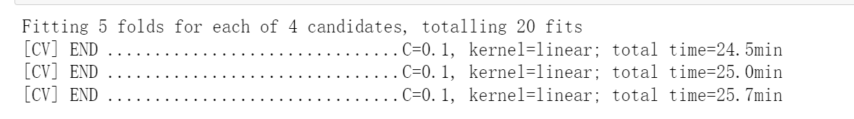
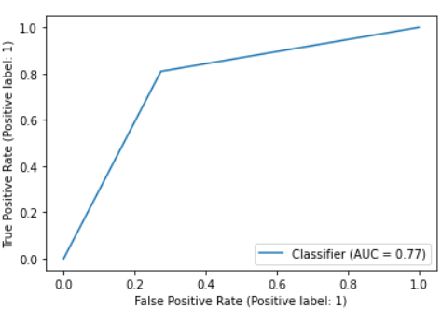
Support Vector Machine (rbf kernel)
‘Tuning’: C (0.1, 1, 10)
Accuracy: 76.7% test
Best Params: C = 1
Cost: 20min – 150+ min per fit
 | Precision | Recall | F1-Score | Support
False | 0.79 | 0.73 | 0.76 | 11757
True | 0.75 | 0.81 | 0.78 | 11711
Predicted Actual | False | True
False | 8541 | 3216
True | 2125 | 9480
Better
Worse
Notes:
SVM is a sad story. I had high expectations for it, but optimizing it on my laptop is simply too much. My fit takes 20 minutes to two hours per fit, forcing me to give up on grid search tuning.
This very far from optimal model performs worse than tree in all metrics.

Slide 8

Comparison
Tree best
computationally inexpensive
Interpretable and Visualizable
Highest accuracy, do well in all metrics
Errors: False cases,
Potential to improve with random forest
Logistic Regression Interesting
Brings light to new knowledge (or errors)
Suffers from multicollinearity
Better at false cases than Tree
SVM unfeasible
Couldn’t optimize because of limited computational power
Fair/unfair comparison?
Notes:
Because some LR specifications didn’t converge within default limits, and SVM wasn’t optimized at all.
But I say it’s fair and I’m actually giving more computation resources to LR and SVM.

Slide 9
Conclusion
Satisfying performance, huge improvement compared to P1
P1： 71% accuracy when predicting all false gives 68%
P2: 79% accuracy for a very complicated problem
Deployment:
Read data from in-game then do predictions to gain advantage in game
Experience gained:
‘names’ (140+ unique) is good when data is big enough (70000+) in trees
Re-sampling is hugely helpful, compared to P1
Computational power becomes an issue around this size/complexity, make plans
Errors / Improvements:
Better presentation (‘magical footwear’ multiple versions)
Closer look into false cases where all my models performs worse
More Computational Power (cloud/GPU/multicore)

Slide 10

Thank you

