Slide 1
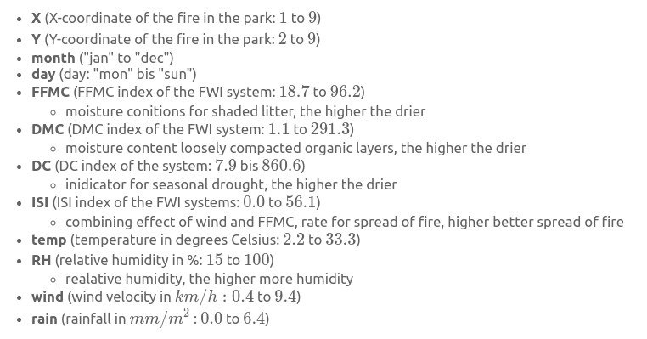
FWI – Fire Weather Index
Notes:
Which Methods? :
- > Linear Regression as basline model
- > Random Forests
Which Methods? :
- > Linear Regression as basline model
- > Random Forests

Slide 2
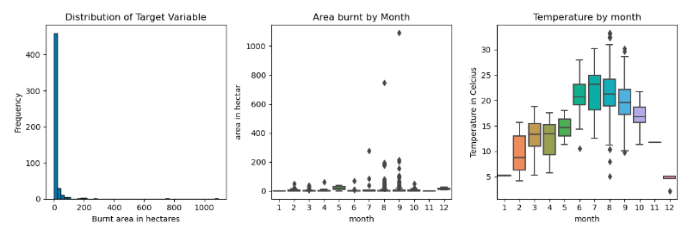
Cartegorical Features, Target
Notes:
- Imbalanced Target: Burnt Area
- annual trend month and temp
- categorical feature, day and month might be important
### Data Exploration: Numeric Summary
- distribution types
- area non-uniformly : area'= log(1 + area) logarithmic scaling, use with exponential grow patterns
- Z-score normalization, for linear regression w/ L2 regularizer

Slide 3
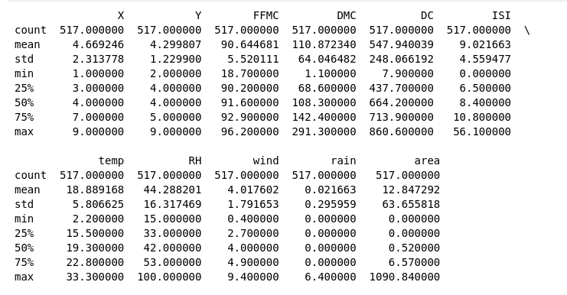
Numerical Features
Notes:
DIFFERENT SCALES,
Target
imballanced,
Distribution skewed, most value small,
outliers

Slide 4
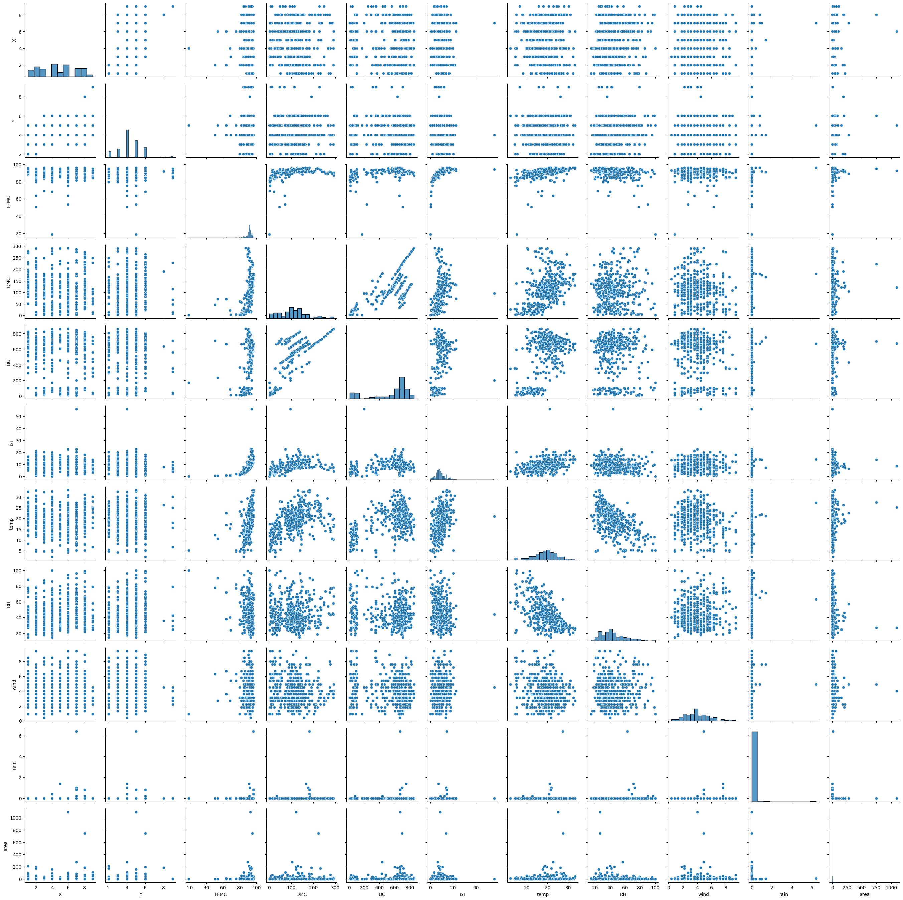
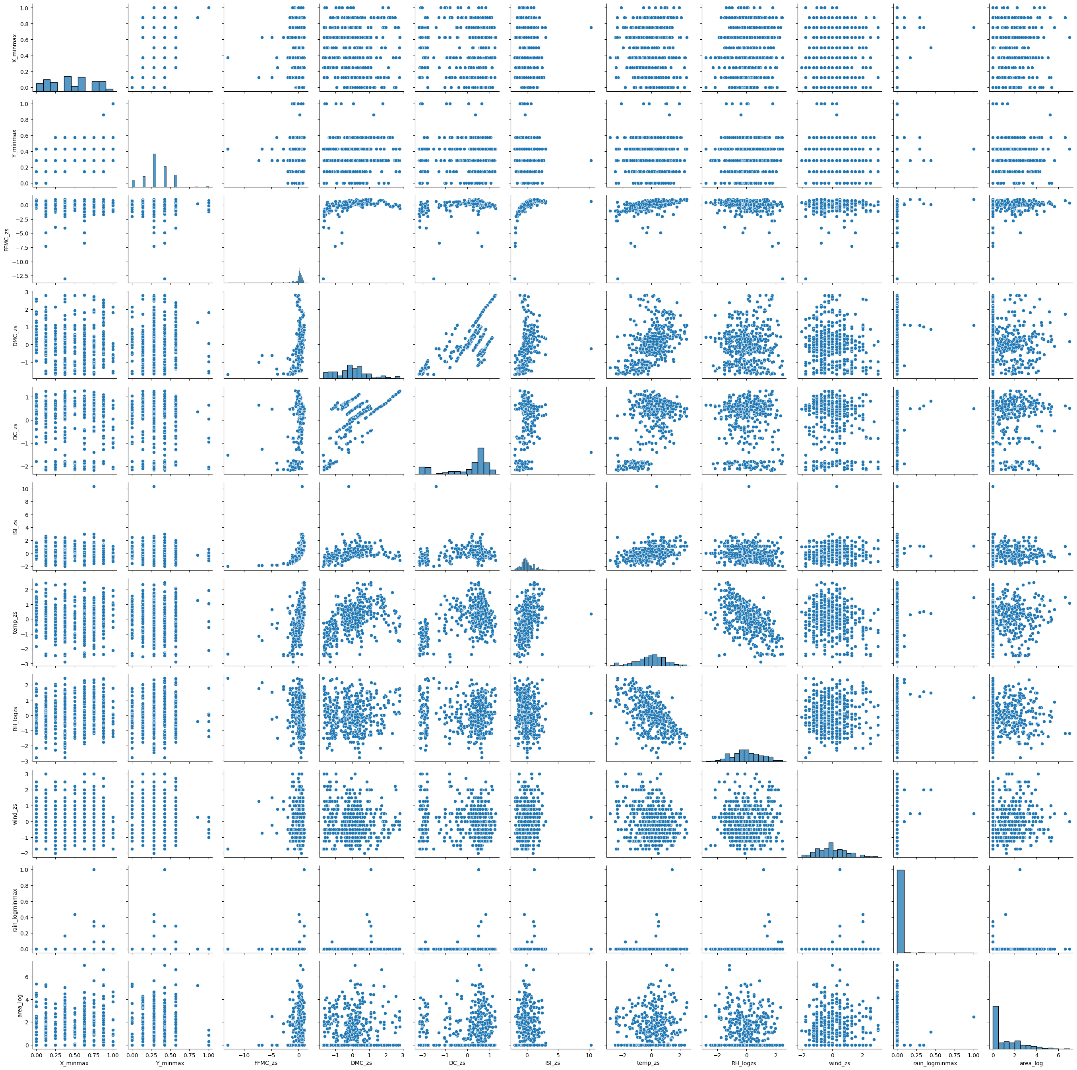
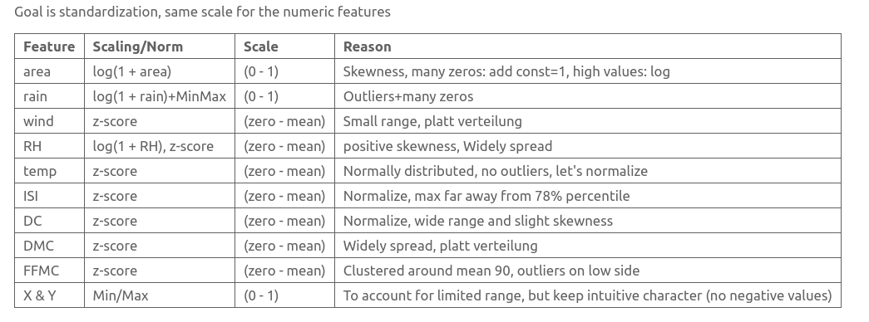
Numerical Features

Slide 5

Preprocessing
Notes:
Goal Standardization, scaling
Z-scoring,
Area, scaling log(1+area) -> to account for zeros
#### One-Hot-Encoding
Avoid ordinal Relationshipt : Jan lt Feb. Mo lt Tuesday
Expanding feature space, making dataset sparse -> increase computation
"day" and "month" cardinality would increase.
We would increase coloumn count by 19 (7 + 12)

Slide 6
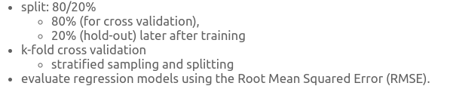
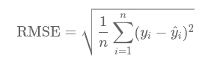
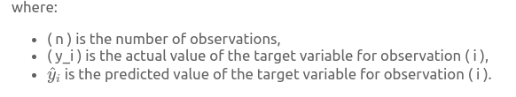
Training and Evaluation
Notes:
RMSE
- keeps error in the original units of the target variable.
> area was log transformed, so RMSE will be in this scale
- consider higher weight to larger errors due to squaring
StratKfold, CV
Because of imballance area (sampling with same distribution in each fold)
F-fold CV:
-splitting in multiple subsets (kfolds)
k times ->
10% training 90% test
90% train -> 10 % testing

Slide 7
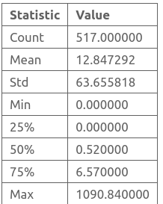
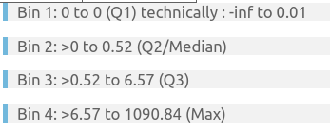
Creating 80/20% Hold-Out Set
Notes:
Many zero values (skewed) use stratified sampling to ensure same distribution in splits
Basing bin edges for stratified sampling on the distribution of area (target)

Slide 8

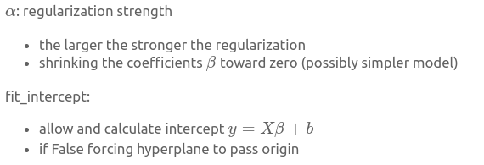
Hyperparameter
Notes:
Folie

Slide 9
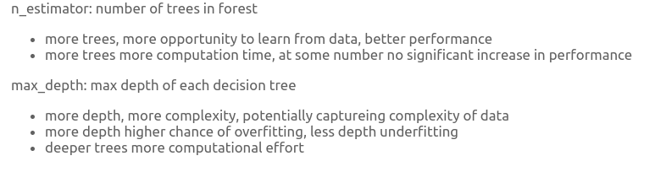
Hyperparameter:
Notes:
Folie

Slide 10
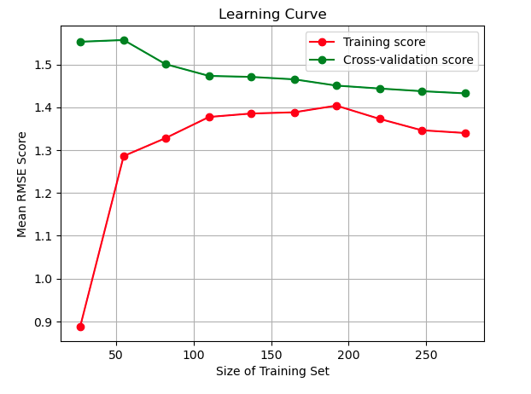
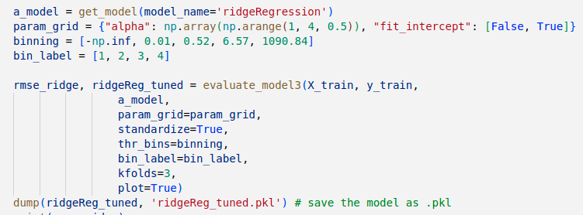
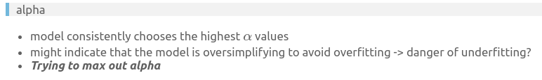
Training: Ridge Regressor
Notes:
Folie

Slide 11
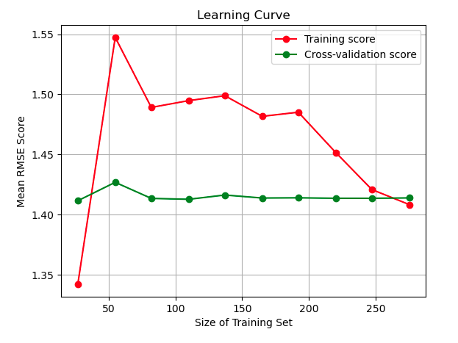
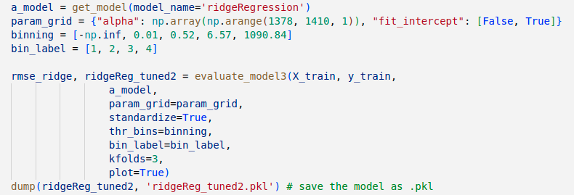
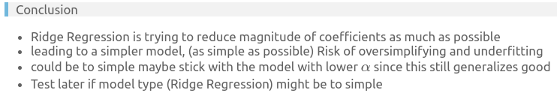
Training: Ridge Regressor
Notes:
training curve:
- initially shoots up and then start to decrease indicating that model is initially too complex (high variance)
- then becomes more generalized with more training data added.
Cross-Validation Curve:
- remains stable around 1.42, adding more data might not be improving model
Convergence:
- model still generalizes relatively good
> Conclusion
- Ridge is trying to reduce magnitude of coefficients as much as possible
- > simpler model, (as simple as possible) Risk of oversimplifying and underfitting
- could be to simple maybe stick lower alpha
- Test later if be to simple

Slide 12
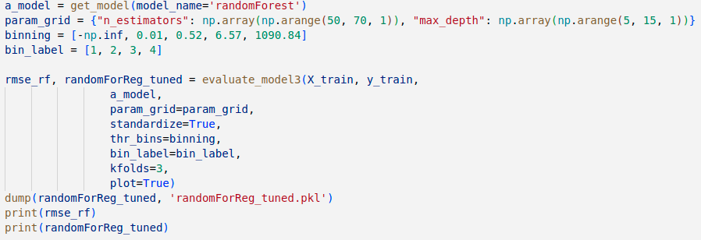
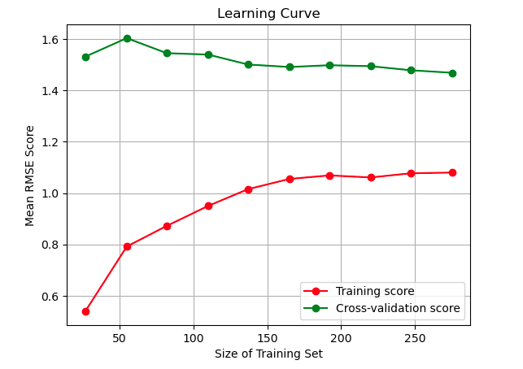
Training, Random Forest
Notes:
> Training curve:
- model is learning from Data (thats good)
- mean RMSE rises when model is exposed to more Data (successively less overfitting) (thats good)
> Validation curve:
- mean RMSE falling, curve falls down, model generalizes well to unseen data
> Curves converging:
- do not converge completely -> model could benefit from more data (but to which extend ?)
- RMSE reasonable, like the Ridge model cross-validation curve stabilizes around 1.42 mean RMSE
- performance seems ok (to be tested on validation set)
pipline tends to choose low max_depth values, might mean less complex model benefit from data with danger underfitting

Slide 13
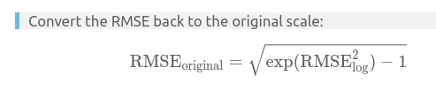

1st Conclusion
Notes:
- Converted mean RMSE 2.55 hectar
- seems big in the context 2.55 hectar burnt more or less ..
- but given the unballanced data it is still reasonable, since many zero values
- another performance metric like mean absolute error (MEA) could be applied since RSME could be outlier sensitive
- here another preprocessing strategy could be considered
- models might benefit from outlier removal, feature engineering, maybe feature scaling could be adjusted
> Both models converge towards Hyperparameters that create simpler models
- could mean a less regularized models would tend to overfit the data
- simpler models could suffice
- could mean that that only a few features contribute to the prediction
> lets check feature importance for RandomForest Regressor

Slide 14
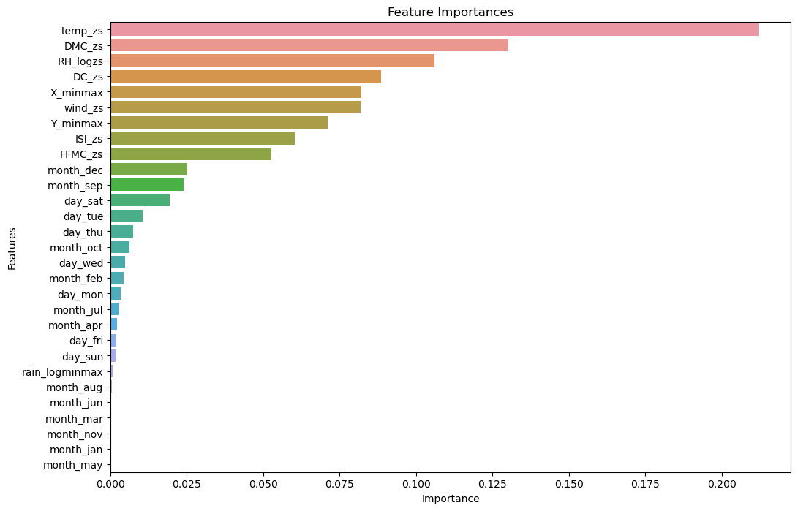
Feature Importance
Notes:
- continuous features (e.g., temp_zs, DMC_zs, DC_zs, etc.) are contributing more to the predictions than the one-hot-encoded categorical features (from day and month).
- makes sense considering the highly regularized models (high $\alpha$ for Ridge, shallow max_depth for Random Forest)
- shallow trees cannot capture complex interaction of categorical features (cannot explore interaction between so many one-hot encoded features)
- stratification for each fold each class in target should be represented equally (influenced by binning)
- requires enough samples in each bin
- there was a warning that there where less samples than folds so binning was not suitable try different binning

Slide 15

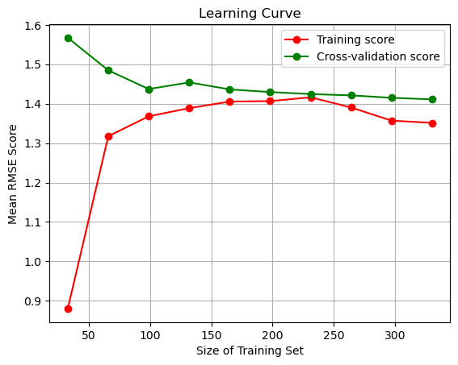
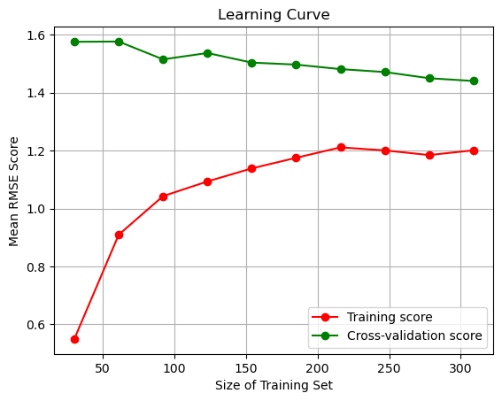
Different Binning, Ridge & RF
Notes:
- performance comparable to the training before with different binning
- convergence of curves is good sign, model seems to generalize better with different binning and new set hyperparameter range
#### 2nd Conclusion
- with different binning no warning
- feature importance and performance during training are the comparable
- feature engineering startegies could be explored
- less important features could be dropped
- for the underlying data, a threshold of 0.7 could be reasonable

Slide 16
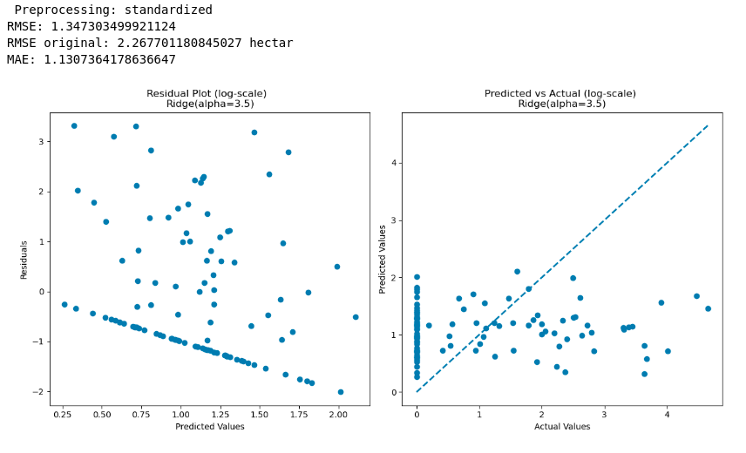
Testing, Ridge
Notes:
Patterns!
RidgeRegression $\alpha=3.5$ seems
not to be able to capture the underlying trend in the Data.
lacks the ability to predict higher values
does not capture feature dynamics leading to zero values.
As baseline model could suggest that model is not complex enough by assuming linear relation &
might underfitting data especially for higher values.
might be possible that colinearity is affecting the model
since I used all features > detrimental to model performance?

Slide 17
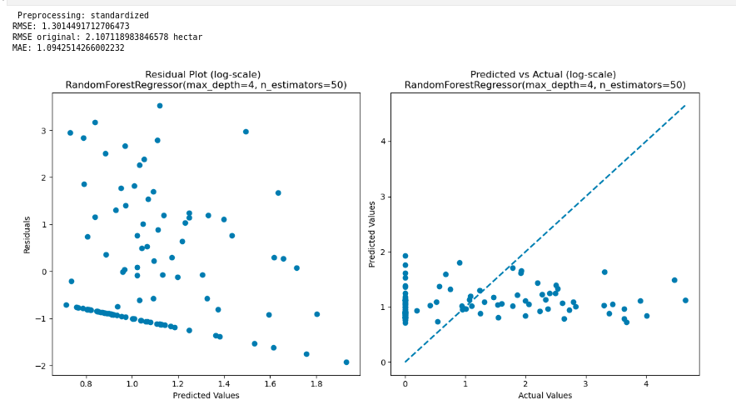
Testing, RF
Notes:
Since both models exhibit the same Patterns
might be due to the preprocessing.
Further can be beneficial to check for correlation
develop a feature Engineering strategy.
Applying a complexer

Slide 18
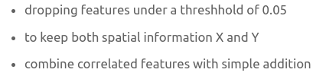
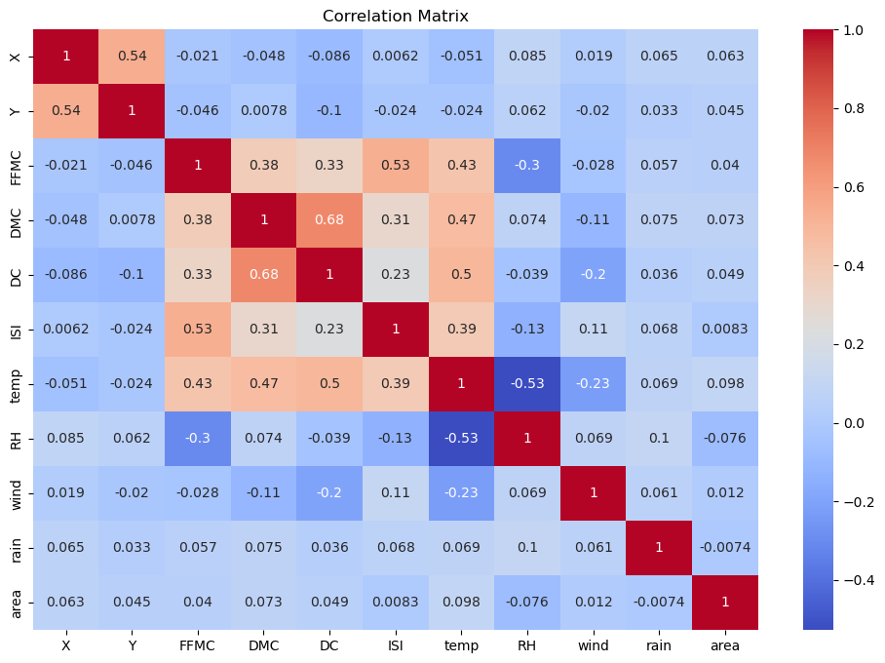
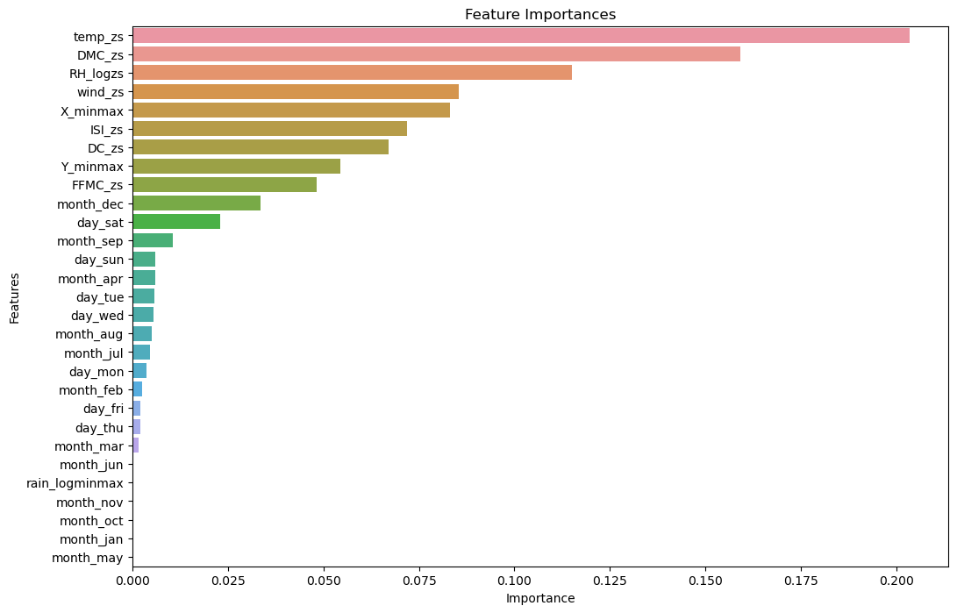
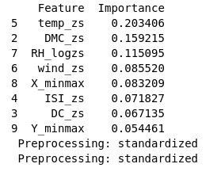
Feature Importance, Correlation
Notes:
- temp has highest correlation with target
- all features have low correlation with target → none of them is a strong predictor alone
- FFMC, ISI, DMC, DC have high correlation and could introduce colinearity
- rain has low correlation with all other feature and might not be important, backed up by feature importance
- temp and RH have a stronger negative correlation, could be combined and created as new feature

Slide 19
Feature Importance, Correlation
Notes:
> domain knowledge
- temperature and RelativeHumidity: environmental variables with impact on likelihood and spread of a fire
- DC and DMC: indicators of moisture content but in different types of fuel, "how dry is the ground"

Slide 20

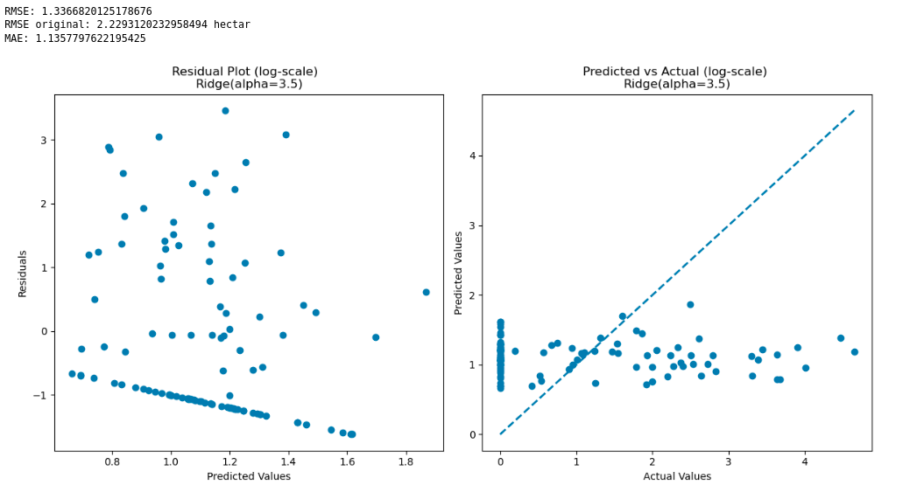
Ridge: Now, Before
Notes:
A BIT BETTER
But same pattern

Slide 21

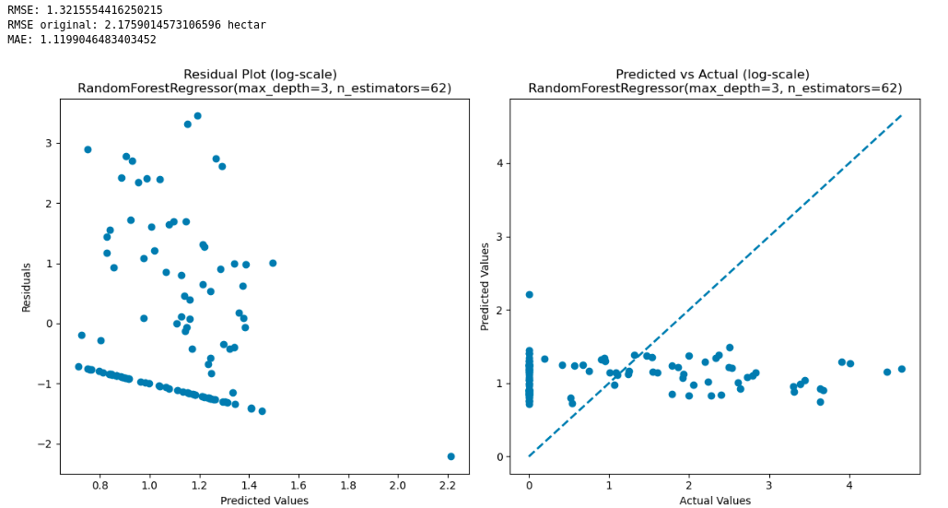
RF: Now, Before
Notes:
A bit not so good
But same pattern

Slide 22
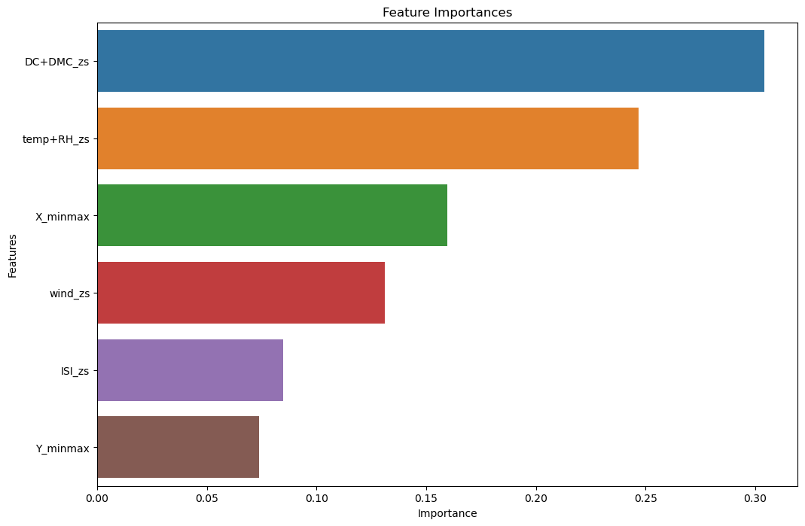
RF, Feature Importance
Notes:
Conitnous feature dominate
Combining seems to yeild higher importance
Spatial pattern could apply.
Conclusion →
Both do not capture complexity and underlying trend
Could be due to simplicity of the models and
Hyperparameter combination,
Both regularize harder and to not overfit
Smaller fires, zero datapoints are over estimated
Big fire points underestimated
Small to mid range fires are predicted in similar values but still, ~2,5h
Preprocessing , and Hyperparameter tuning
Or Complexer model

