Slide 1

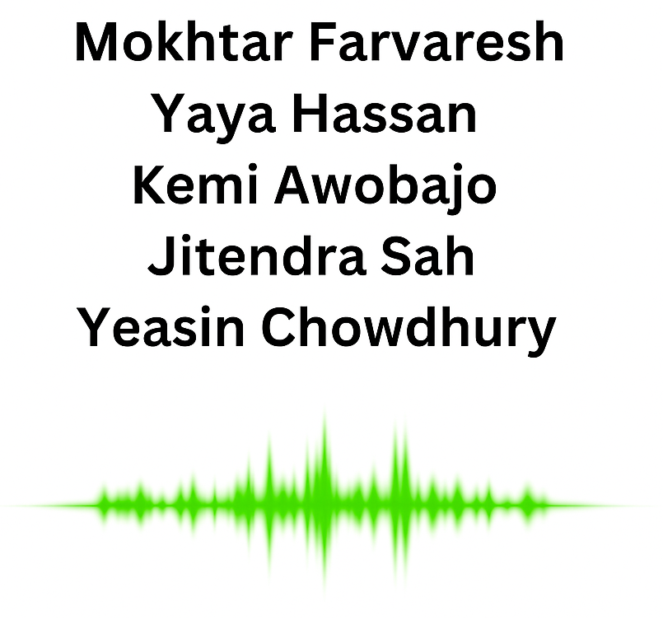
Big Data Analysis of Spotify Music
Harnessing Apache Spark and Pandas
Group 2 – Big Data Module
29 July 2025

Slide 2

Agenda
Data Loading & Initial Assessment
Data Cleaning & Feature Engineering:
Trends & Exploratory Data Analysis (EDA)
Key Insights & Visualizations:
Optimization & Final Output

Slide 3
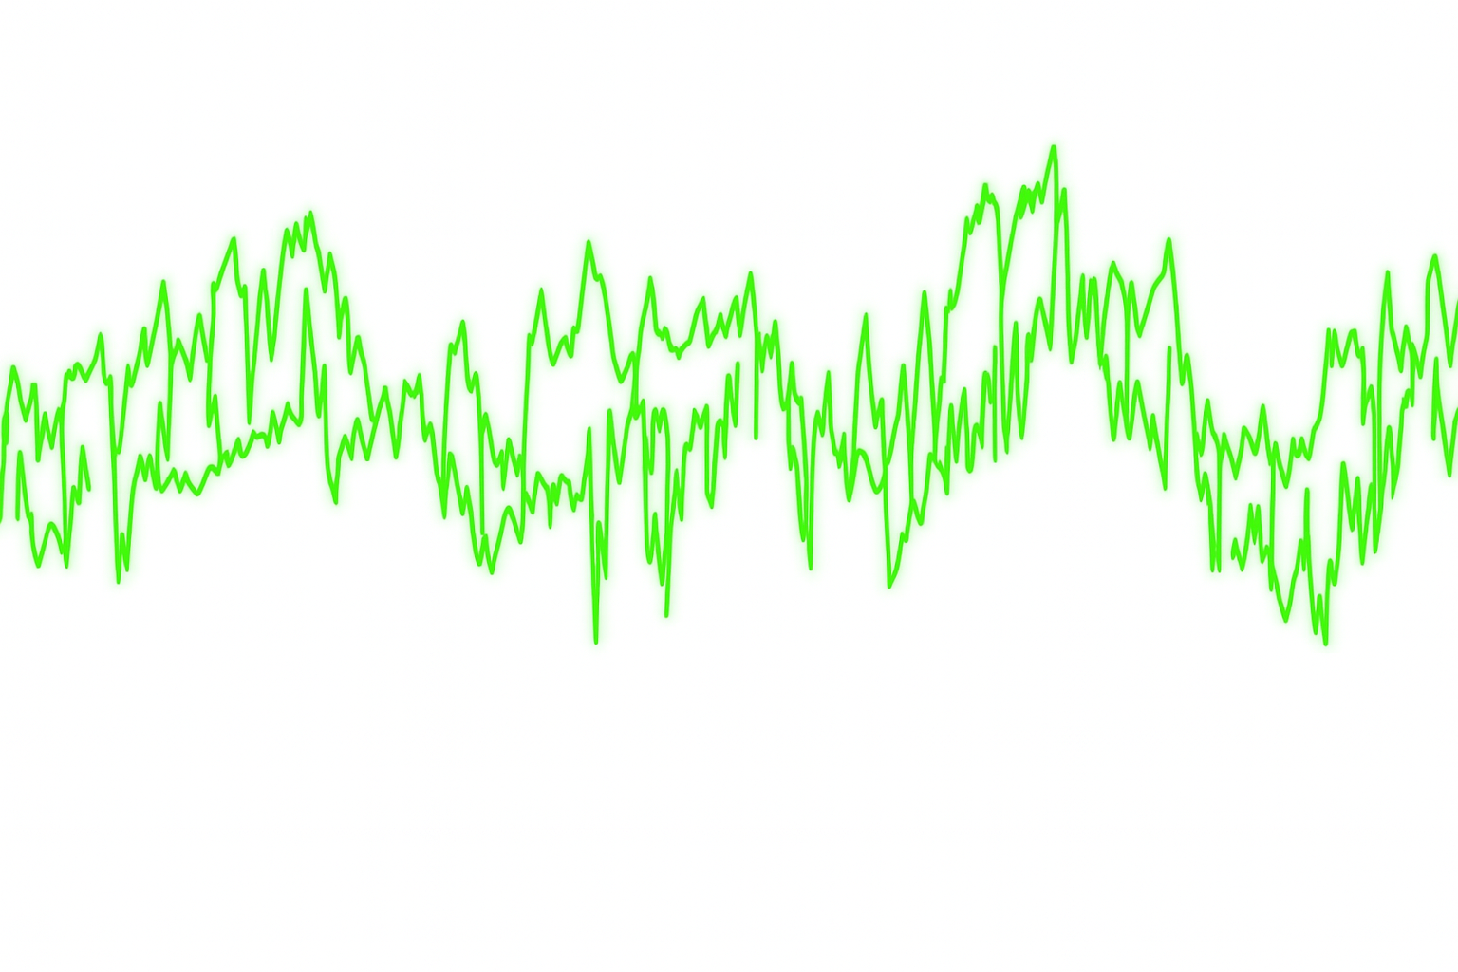
Data Contents
artists.csv
(popularity metrics of artists, 1.1M rows, 5 attributes)
id (Id of artist)
name (Name of artist)
followers (Total number of followers of artist)
popularity (Popularity of given artist based on all his/her tracks)
genres (Genres associated with this artist)
tracks.csv
(audio features of tracks, 600k rows, 20 attributes)
id: Unique Spotify track identifier
name: Track title
popularity: Track popularity score (0-100)
duration_ms: Track length in milliseconds
explicit: Boolean for explicit content
artists: List of artist names
id_artists: List of artist IDs (foreign key relationship)
release_date: Track release date
Audio Features:
danceability: How suitable for dancing
energy: Perceptual measure of intensity and activity
key: Musical key (0-11)
loudness: Overall loudness in decibels
mode: Major (1) or minor (0)
speechiness: Presence of spoken words
acousticness: Confidence measure of acoustic sound
instrumentalness: Predicts if track contains no vocals
liveness: Presence of audience in recording
valence: Musical positivity conveyed
tempo: Beats per minute
time_signature: Meter of the track

Slide 4
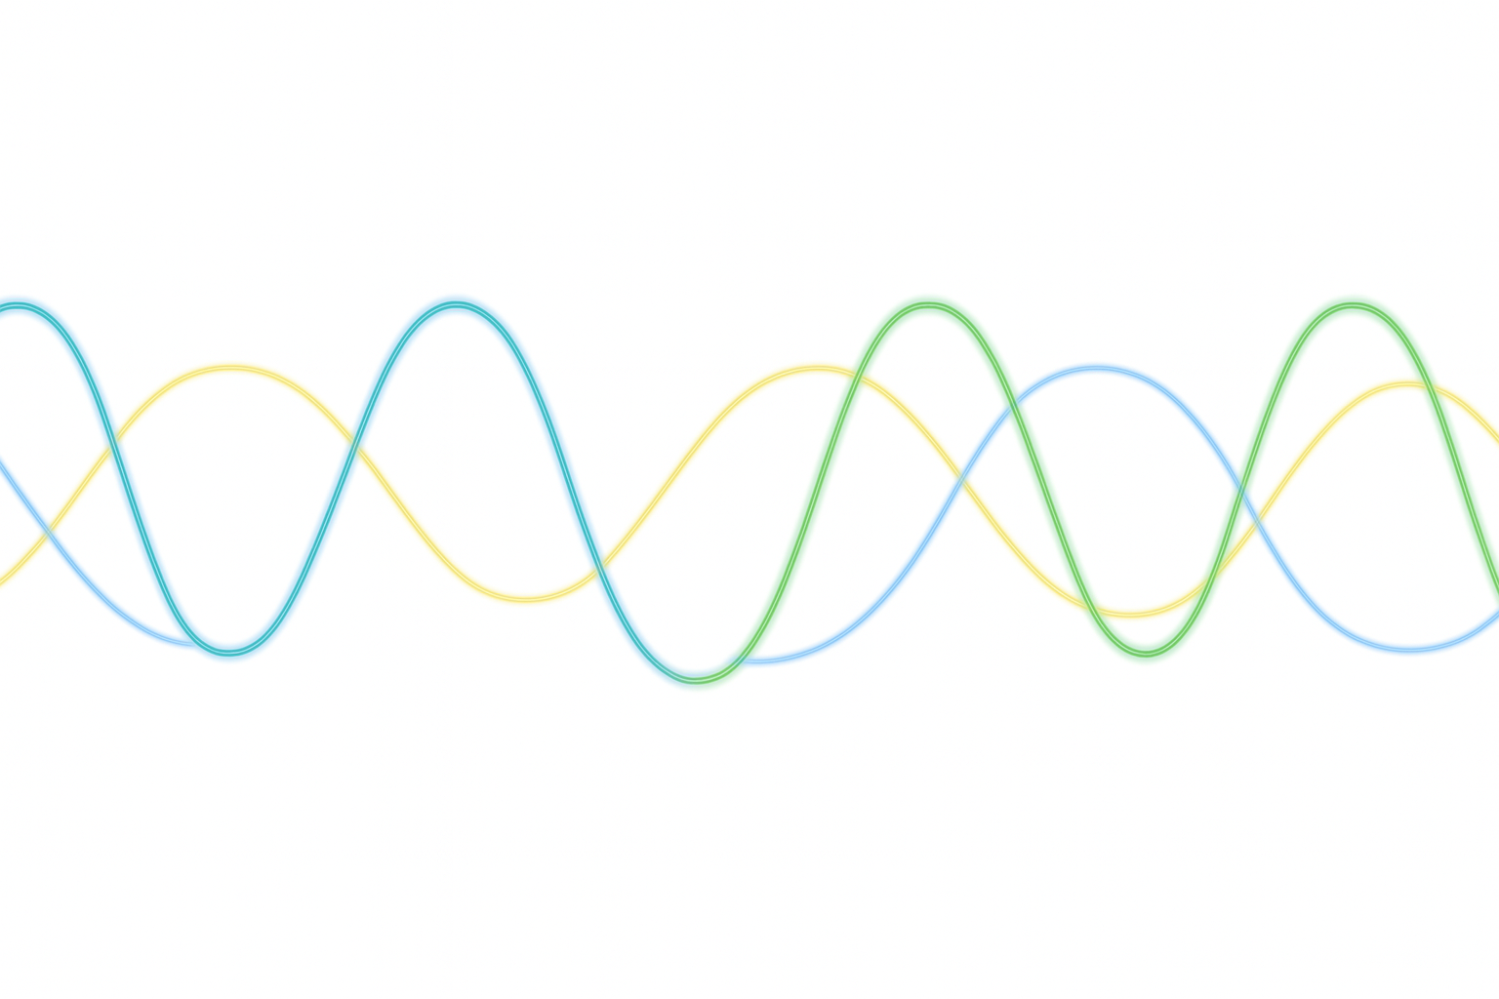
Goals:
1. Primary Technical Goal:
To process and clean a large-scale Spotify dataset using PySpark, transforming raw, messy data into a structured and analysis-ready format.
3. Key Insight Goal:
To identify the core audio characteristics that differentiate popular songs from unpopular ones, providing data-driven insights into what attributes might contribute to a track's success.
5. Final Outcome Goal:
To produce a clean, optimized, and partitioned dataset that is ready for more advanced analytics or machine learning applications.
2. Primary Analytical Goal: To uncover key trends in music over the decades by analyzing the evolution of audio features like energy, danceability, and valence.
4. Temporal Trend Analysis
Performing time-series analysis on "track.csv" data. Work on visualizations or statistical analysis

Slide 5
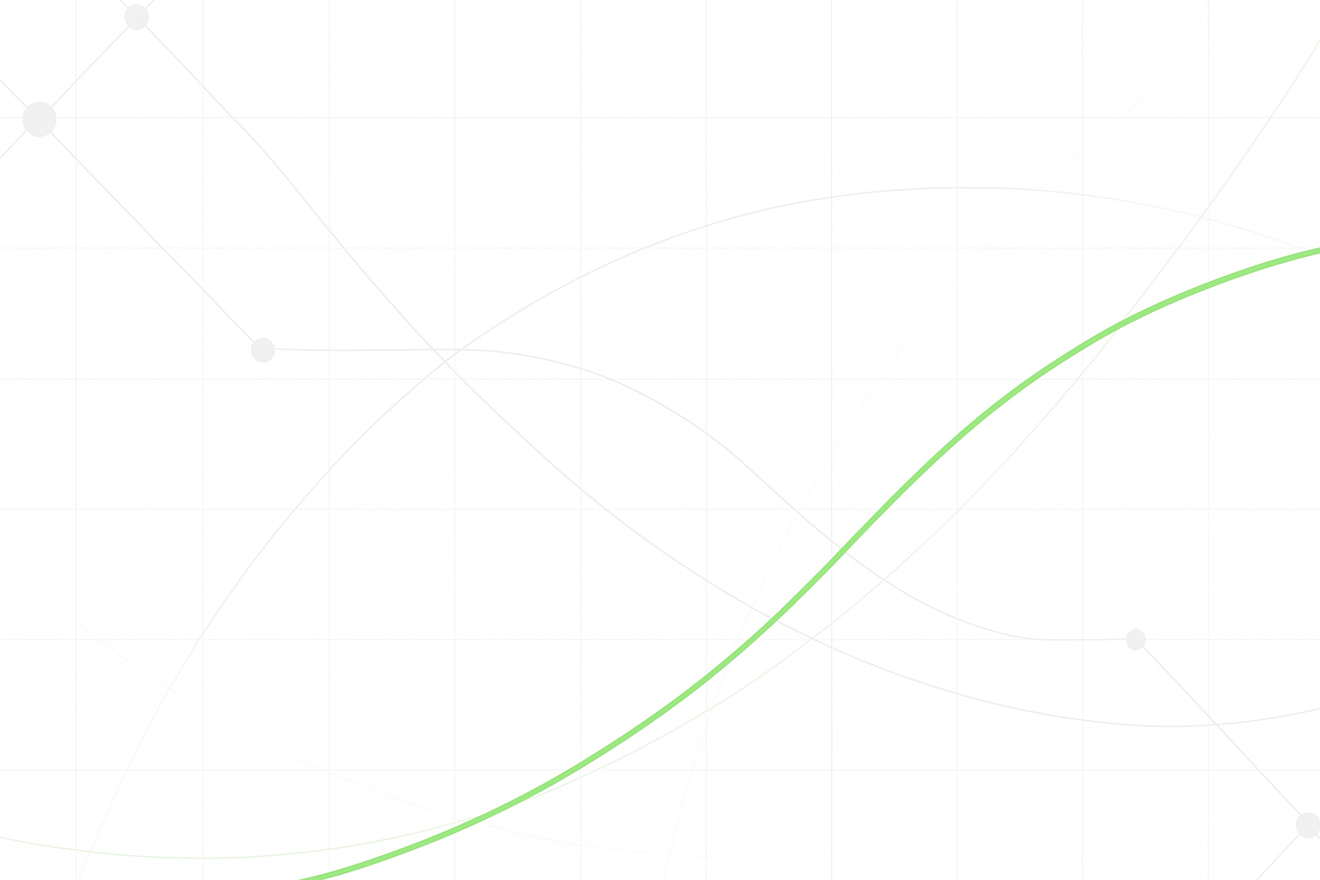
Introduction & The Data Challenge
Objective:
To process and clean a large-scale, raw Spotify dataset (tracks.csv) and transform it into a clean, analysis-ready format using PySpark.
Initial State: Incorrect Data Types: All 20 columns, including numerical features like popularity and dates, were initially read as string types.
Messy Data Formats: Data required significant cleaning, including parsing nested string arrays (e.g., ['Artist Name']) and handling inconsistent date formats.
Scale: The dataset contains nearly 500,000 tracks, necessitating a distributed framework like Spark.
Python
# Read the CSV and display schema
tracks_df = spark.read \
.option("header", "true") \
.csv("tracks.csv")
tracks_df.printSchema()
Root
|-- id: string (nullable = true)
|-- name: string (nullable = true)
|-- popularity: string (nullable = true)
|-- duration_ms: string (nullable = true)
|-- explicit: string (nullable = true)
... (and so on for all columns)

Slide 6

Data Cleaning & Feature Engineering in PySpark
Objective:
To process and clean a large-scale, raw Spotify dataset (tracks.csv) and transform it into a clean, analysis-ready format using PySpark.
Corrected Data Types: Cast over 15 columns from their initial string format to appropriate types like Integer, Float, and Date to enable numerical and temporal analysis.
Advanced Date & String Parsing: Implemented robust parsing for inconsistent data. For example, used a coalesce strategy to handle multiple date formats and regexp_replace to clean nested artist strings like ['Artist Name’].
Feature Engineering: Enriched the dataset by creating new, analysis-friendly columns:
Converted track duration to minutes.
Extracted release_year and created a release_decade for trend analysis.
Binned numerical features into categories (e.g., energy_category: Low, Medium, High).
Handled Missing Values: Filled the small number of nulls in numeric audio features using median imputation, a method robust to outliers.
Python
# Convert to date type using a robust, multi-format approach
tracks_clean = tracks_clean.withColumn(
"release_date_formatted",
coalesce(
to_date(col("release_date_parsed"), "yyyy-MM-dd"),
to_date(col("release_date_parsed"), "M/d/yyyy"),
to_date(col("release_date_parsed"), "MM/dd/yyyy")
)
)

Slide 7
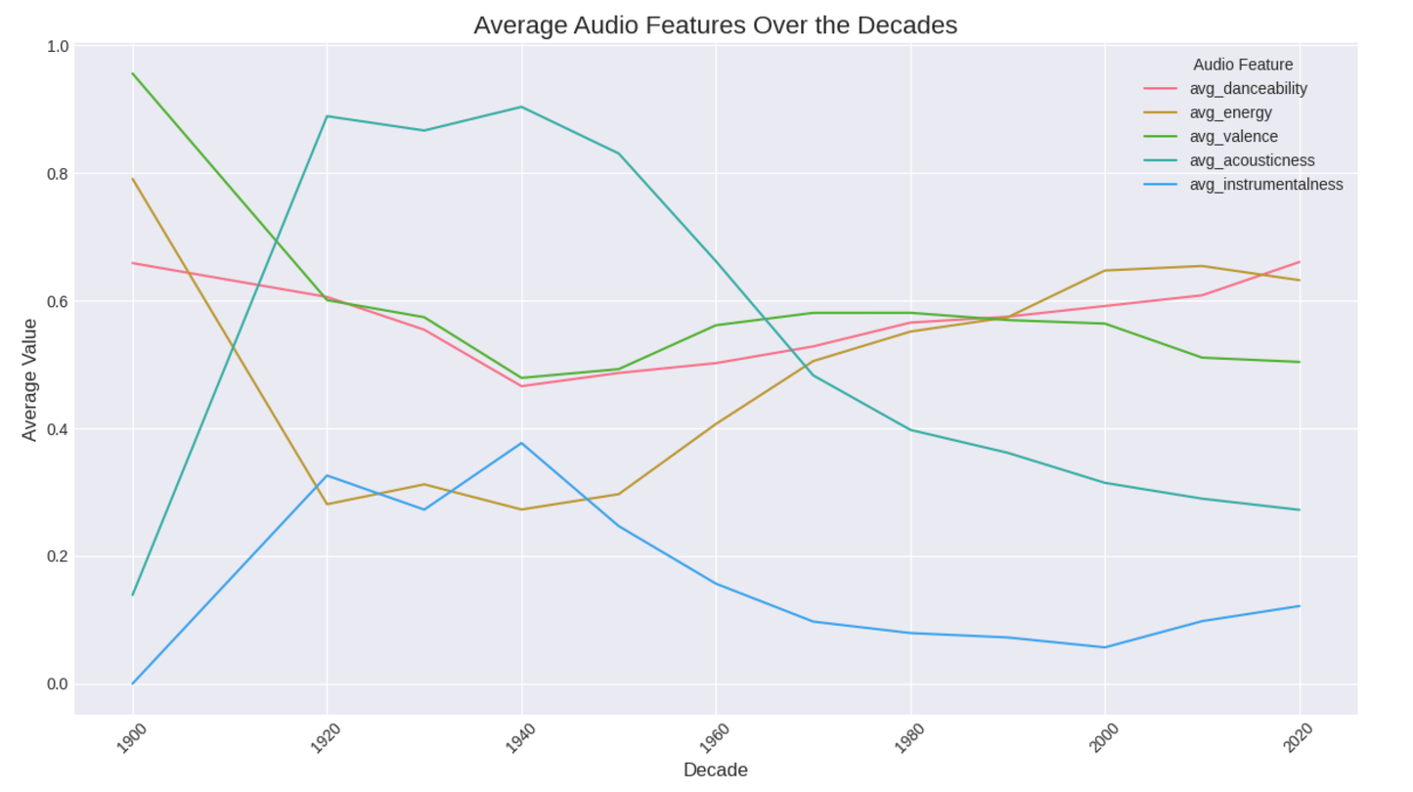
How Has Music Evolved Over Time?
Key Findings:
A significant shift from acoustic to electric and electronic music is visible, with average acousticness dropping sharply after the 1950s.
Music has become consistently more energetic and danceable over the decades.
The overall "happiness" of music, or valence, has remained relatively stable throughout the years.
The volume of track releases grew massively from the 1950s onwards.
Python
# Aggregate average audio features by decade
decade_audio_features = tracks_clean \
.filter(col("release_decade").isNotNull()) \
.groupBy("release_decade") \
.agg(
avg("danceability").alias("avg_danceability"),
avg("energy").alias("avg_energy"),
avg("valence").alias("avg_valence"),
avg("acousticness").alias("avg_acousticness")
) \
.orderBy("release_decade") \
.toPandas()

Slide 8
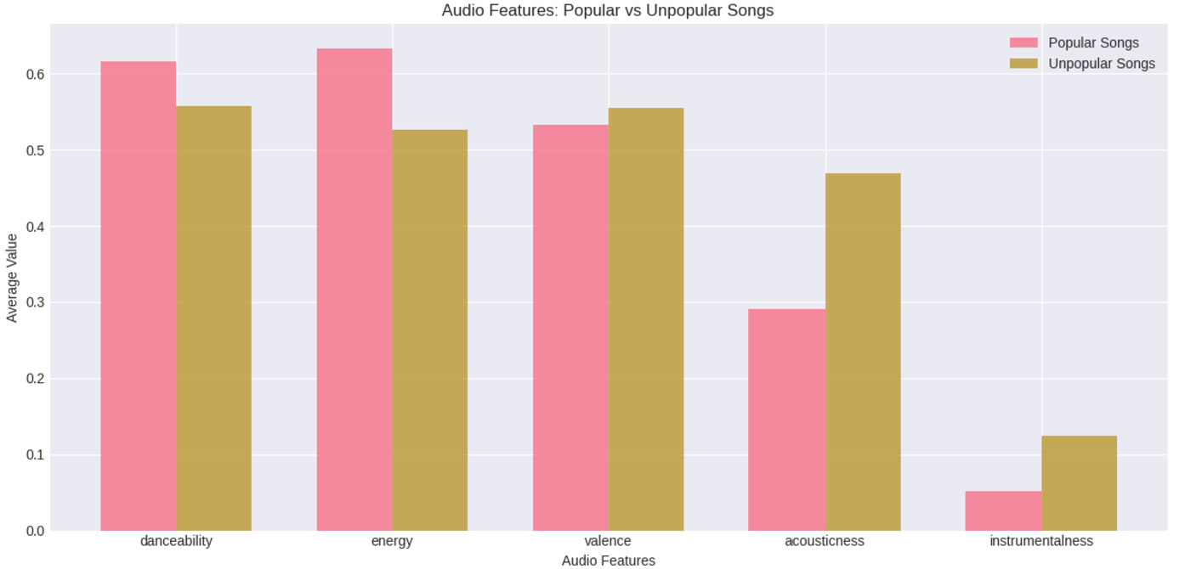
Key Insight: What is the DNA of a Hit Song?
Method: To find the characteristics of a hit, tracks were segmented into "Popular" (score > 50) and "Unpopular," and their average audio features were compared.
Key Findings:
Popular songs are significantly more energetic and danceable than unpopular ones.
They are also far less acoustic and instrumental, suggesting a preference for vocal-driven, electronic production.
The "happiness" (valence) of a song is nearly identical between both groups, indicating that emotional tone is not a primary factor in determining popularity.
# Segment the data based on popularity score
popular_songs = tracks_clean.filter(col("popularity") > 50)
unpopular_songs = tracks_clean.filter(col("popularity") <= 50)

Slide 9
Conclusion: A Cleaned & Optimized Dataset
Performance Optimization: Leveraged Spark's capabilities by repartitioning the data by release_year to speed up temporal queries and caching the cleaned DataFrame in memory for faster iterative analysis.
Efficient Storage: Saved the final dataset in Parquet format, a highly efficient columnar storage that is superior to CSV for analytical workloads and faster reads.
Data Partitioning: The output data was partitioned on disk by decade. This is a key optimization that allows Spark to skip reading unnecessary data, dramatically speeding up any future analysis that filters by a specific time period.
Final Product: A clean, enriched, and optimized dataset of nearly 500,000 tracks, ready for advanced analytics or machine learning models.
Python
# Save as a partitioned Parquet file for efficient reads
output_path = "spotify_tracks_cleaned"
tracks_final.write \
.mode("overwrite") \
.partitionBy("release_decade") \
.parquet(output_path)

Slide 10


Business Impact & Future Work
Business Impact • Data‑driven A&R: identify emerging artists • Marketing: optimise release timing & collaborations • Product: enhance recommendation engines
Future Work • Real‑time analytics for viral songs • Graph analysis of artist networks • Deep learning for genre & mood classification
Thank you! Questions?

