Slide 1
PLAYHACK ML TRACK 2026 · IIT GUWAHATI
Athlete Injury Risk Prediction
A leak-safe ML pipeline that turns 30 days of wearable data into injury risk, onset timing, and recovery-length predictions.
Leak-safe by design
97% of metric ceiling closed
Tuned to the official metric
Round 1 Submission · Machine Learning Track

Slide 2
THE PROBLEM
30 days of sensor data. Three questions about the next 30.
OBSERVATION WINDOW
RISK WINDOW
Days 1 – 30
Days 31 – 60
Hourly heart rate, steps, calories, intensity
injured_in_risk_window
Daily sleep duration & quality
→
Binary — does an injury occur?
Training session logs
onset_day_offset
Athlete metadata (sport, age, prior injuries)
Which day, 1–30, does it happen?
recovery_duration
How many days to recover, 5–20?
Available in BOTH train and test
Only TRAIN has the answers — test stops at Day 30
02

Slide 3
DATASET
10 relational tables. Hundreds of millions of readings.
3,000
1,100
60 / 30
training athletes
test athletes
days: train / test
10
~660 MB
Hourly
relational CSV tables
raw training data
HR, steps, calories, intensity
Signal families: activity (steps/calories), heart rate, sleep, training sessions, body composition, and athlete metadata.
03

Slide 4
METHODOLOGY · TRAP #1
The training CSV secretly contains the future
"Average steps over all 60 training days" quietly reads into the injury period itself — the model memorizes rather than predicts.
✕
Naive — Data Leakage
✓
Leak-Safe — Ours
feature = avg_steps(all 60 days)
feature = avg_steps(Days 1–30 only)
CV score
Real test score
CV score
Real test score
0.99 AUC
0.52 AUC
0.76 AUC
0.77 AUC
(memorizing the future)
(barely above random)
(honest estimate)
(matches expectation)
Most teams will fall into this trap without realizing it.
Guarded by an automated assert_no_leakage() check that runs before every training run.
04

Slide 5
KEY DISCOVERY
Injuries follow two separate biological mechanisms
Background hazard
Deciles 1–8 · ~Day 21.9 (late, random)
Irreducible noise
Transition zone
Decile 9 · Day 12.4 (mid-window)
Overload emerging
Overload hazard
Decile 10 · Day 5.0 (immediate)
Deterministic
05

Slide 6
FEATURE SPOTLIGHT
ACWR — the single most important signal
Acute : Chronic Workload Ratio
ACWR = avg load (last 7 days)
÷ avg load (prior 23 days)
≈ 0.8
≈ 1.0
≈ 1.1
> 1.13
Under-training
Sustainable
Slight overreach
Danger zone
"How does my recent training compare to what my body is used to?"
All ACWR variants (steps, HR, calories, intensity, composite load) correlate at r ≈ 0.99 — one underlying overload signal seen through five instruments.
Detrained
Low risk
Elevated risk
94–100% injury
06

Slide 7
FEATURE ENGINEERING
223 signals engineered — only 35 make the model better
35
optimal feature count
(K = 35 / 35 / 20 for classifier / onset / recovery)
Selected in-fold, by LightGBM gain — never contaminated by the held-out fold.
More features hurt here: redundant ACWR variants (r ≈ 0.99) cause trees to split across near-duplicate columns and overfit. All-223 scores below even a single raw feature.
07

Slide 8
MODEL ARCHITECTURE
Three gradient-boost families, blended with AutoGluon
LightGBM
Non-negative
OOF blend
PER-HEAD BEST
AUC 0.7601
Classifier
35 leak-safe
features
AutoGluon 95% blend
→
→
→
XGBoost
AUC 0.7633
Onset
Blend 78 / 22
AutoGluon 1.6.1
best_quality
(2-layer stack)
CatBoost
Recovery
AUC 0.7621
AutoGluon solo
3 seeds × 5-fold CV each
+ Sport × Gender group median folded into the Recovery head at 62% weight — simple beats complex where the signal is genuinely weak.
08

Slide 9
WHY NOT A PERFECT SCORE
We proved the ceiling — and closed 97% of it
100 athletes, identical sensor data, true injury probability p = 0.70 → nature still flips a biased coin. Even a God-mode oracle cannot say which 30 dodge it, so no model reaches a perfect score. We derived that limit for the metric we are actually scored on, then measured our distance to it.
GAP CLOSED
97.0%
ANALYTIC BAYES CEILING PIPELINE
1 — PCA over the tight ACWR family (r ≈ 0.99) → 1-D load-ramp latent
Head | Ours | Ceiling
Task A — F1 | 0.5210 | 0.5246
Task B — onset skill | 0.6541 | 0.6647
Task B — recovery skill | 0.1075 | 0.1329
2 — Cross-fitted isotonic regression → honest p̂ᵢ per athlete
3 — Bayes-optimal F1 and skill scores under the official rule
Metric ceiling 0.4407 Ours 0.4275 (ROC-AUC 0.7625 vs 0.7702, diagnostic)
09

Slide 10
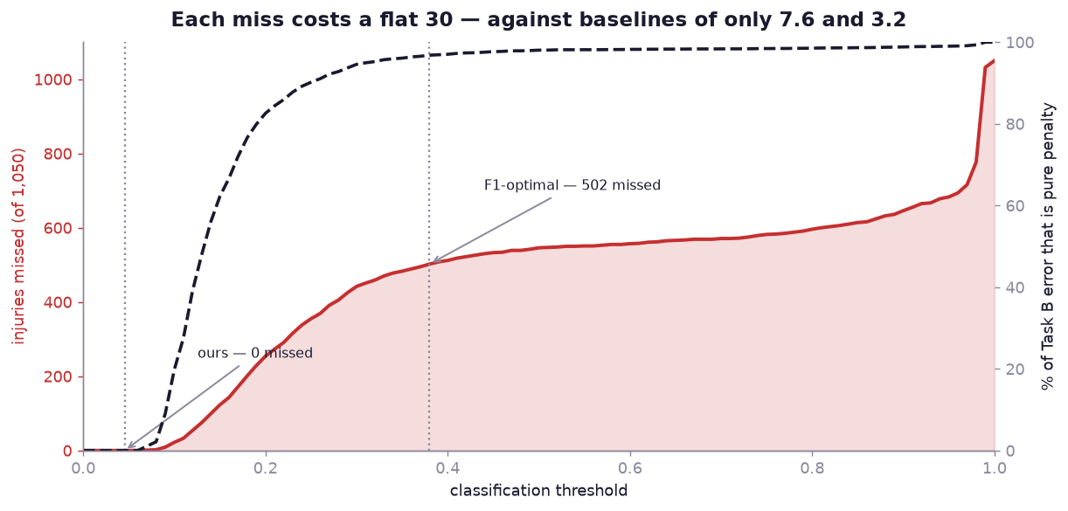
THE SCORING RULE
A missed injury costs 30. The baseline scores 3.2.
BREAK-EVEN RECALL
0.82
onset skill
0.99
recovery skill
TASK B SCORE, BY THRESHOLD
Tuned for F1
0.000
Our threshold
0.762
Task B is scored only over athletes who are truly injured. A false positive is not in that population, so it costs Task B nothing — but a miss costs a flat 30 on both timing heads, against baselines of just 7.61 and 3.24. One miss wipes out roughly nine good recovery predictions.
Same models, same predictions — only the cut-off differs. It roughly doubles the combined score.
10

Slide 11
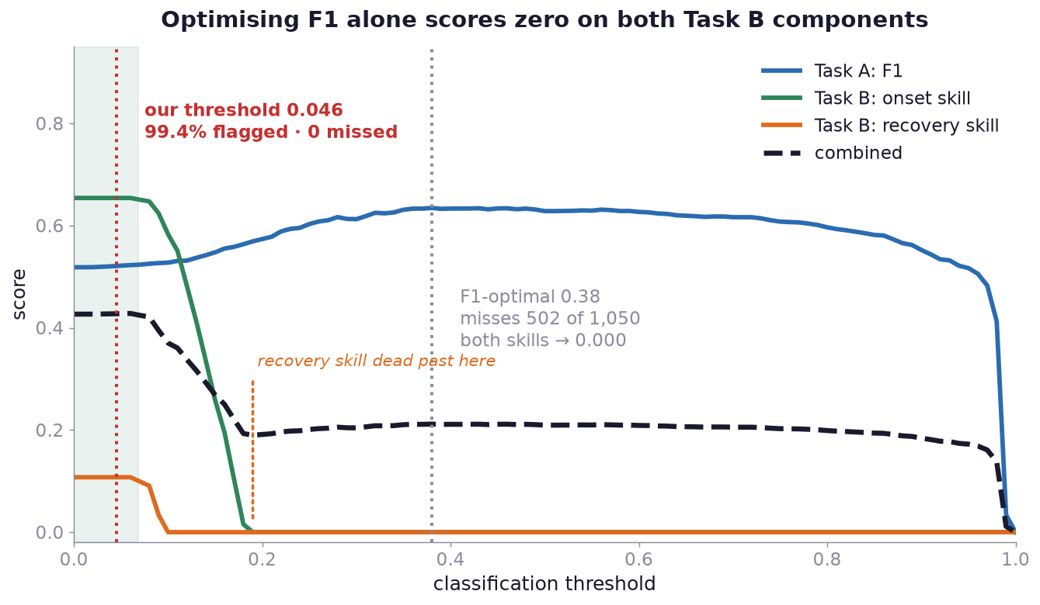
DECISION THRESHOLD
Why we flag 99.4%, not the F1 optimum
0.38
F1-optimal
Misses 502 of 1,050 injuries — both skills 0.000
0.046
Ours — shipped
Flags 99.4%, misses zero, pays no penalty
3rd
of 102 thresholds
Best or within 0.001 under 6 of 7 weightings
102 thresholds swept out-of-fold · one missed injury measurably dents recovery skill · 22 misses zero it
11

Slide 12
RESULTS
Final numbers vs. baseline and the theoretical ceiling
Task | Scored quantity | Baseline | Ours | Ceiling | Closed
Task A | F1 | — | 0.5210 | 0.5246 | 99.3%
Task B | skill — onset | 0.000 | 0.6541 | 0.6647 | 98.4%
Task B | skill — recovery | 0.000 | 0.1075 | 0.1329 | 80.9%
Combined | mean of three | — | 0.4275 | 0.4407 | 97.0%
Decision threshold: 0.046 (rank-quantile) · Test flagged: 99.4% · OOF recall on injured: 1.000 · Features per head: 35 / 35 / 20
ROC-AUC 0.7625 (ceiling 0.7702) is a diagnostic, not a scored quantity. F1 of 0.52 is not a weak classifier: at full recall F1 is pinned by prevalence to 2p/(1+p) = 0.5185, and the Bayes optimum under this metric is 0.5226.
12

Slide 13
NEGATIVE RESULTS
What didn't work — and why that matters
✕
AFT Survival Model
Lost on both heads against the tuned ensemble. A single parametric hazard curve cannot represent two distinct biological mechanisms.
Treat injured + healthy as one censored time T (right-censored at Day 30 for healthy athletes).
✕
Using All 223 Features
206 features scored 0.7497 AUC — below a single raw hr_acwr column (0.7583). The ACWR family's r ≈ 0.99 redundancy makes trees overfit near-identical splits. 35 features scored best, at 0.7572.
More information should mean better predictions.
✕
TabPFN Foundation Model
Blocked — its package requires an interactive browser license click-through that can't run headlessly. Documented for transparency.
A pretrained tabular transformer, claimed SOTA for small-sample regimes.
Knowing when not to use ML is as important as knowing how to use it.
13

Slide 14
KEY TAKEAWAYS
Rigor over raw horsepower
1
Leak-safety first
An automated guard rejects any feature that crosses Day 30 — before it can inflate a CV score.
2
We measured the ceiling
We derived the Bayes optimum for the organisers' own rule — and from the data generating process independently — to show 0.52 F1 is 99.3% of what is achievable, not a weak model.
3
Simple beats complex, sometimes
Recovery duration has near-zero correlation with any wearable signal — a cross-fitted group median beats every tree model we tried.
4
Negative results, documented
AFT survival, all-223-features, and TabPFN all failed — and we explain exactly why, not just that they did.
github.com/YayaBud/playhack-ml-track-2026
Team YayaBud · PlayHack ML Track 2026

