Slide 1


Digital Freelancer:
Managing Freelancing Projects
Project: Working with a Mock Client

Slide 2
Part 1
Project Listing

Slide 3
Sample Project Listing #1: Web Development
Web application development support needed for healthcare application.
Posted 2 hours ago
Hourly: $35.00 - $65.00 Based on experience.
Project Time: 3 months, 25 hours a week.
Project Description:
We are a web development company working with a healthcare client looking to connect patients directly with their doctors. We need someone to be able to take PSD mockup files from our designer and convert them into custom code using HTML, CSS, and JavaScript. We have not decided on which JavaScript library to use, but will be open to working with the one you’re most familiar with. We have the designs for 10 pages and will need them to be completed in 3 months. We are open to working with all levels of experience, but the pay will be adjusted based on your experience.

Slide 4
Part 2
Expression of Interest

Slide 5
Expression of Interest (Provided)
Which Sample Project Listing did you select to respond to?
Answer: Sample Project Listing Number. 1
Expression of Interest:
Dear Sir,
Greetings,
I have found your job announcement for the healthcare application development and I am very interested and happy to help with making your web app- looks like you need to convert PSD mockup files from your designer into custom code using HTML, CSS, and JavaScript.
I decided to use Javascript library React.js because of the following reasons: ReactJS is remarkably flexible and it’s extremely intuitive to work with and provides interactivity to the layout of any UI.
ReactJS enables significant data changes that result in automatic alteration in the selected parts of user interfaces.
ReactJS trails one-way data binding. This means that absolutely anyone can track all the changes made to any particular segment of the data. This is a symbol of its simplicity and finally
ReactJS is a perfect combination of JavaScript and HTML tags. The usage of the HTML tags and JS codes, make it easy to deal with a vast set of data containing the document object model. I am a web app developer with 6 years of experience with 40+ clients in Egypt and worldwide. Let me know if you would like to chat.
At the end I hope all of these knowledge and working experience are good enough to have your interest and trust to work with me.
Waiting for your feedback.
Thanks and best regards.

Slide 6
Part 3
Project Management Process

Slide 7
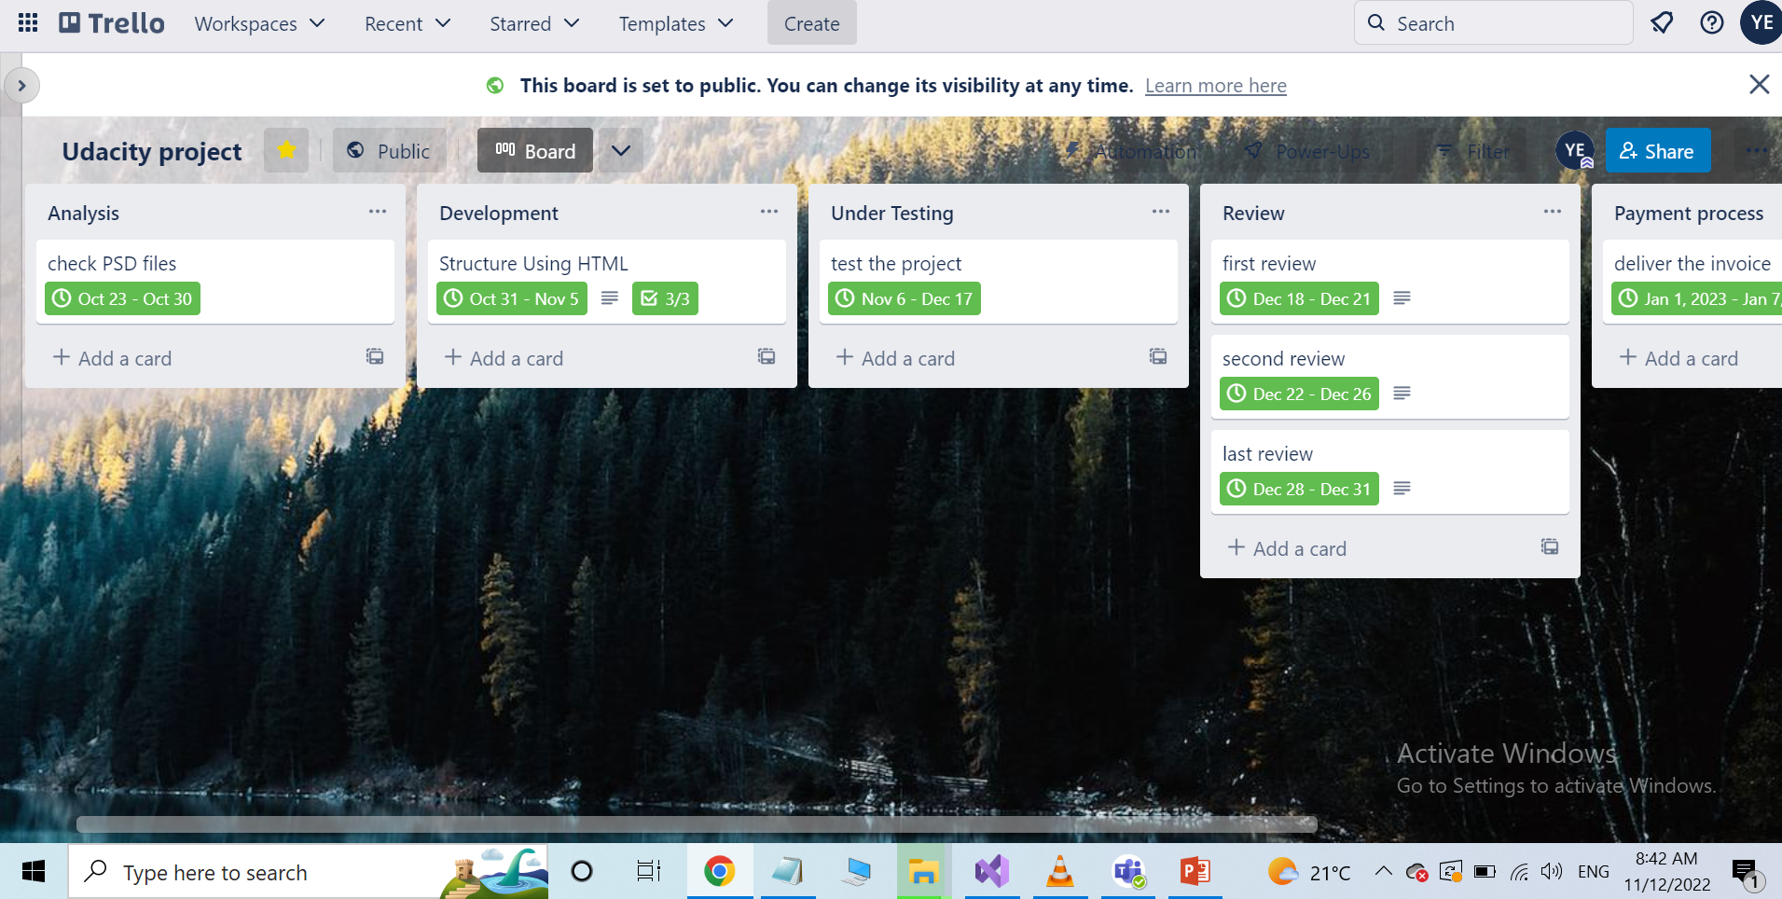
Trello Board
Please include the following information for your Trello board:
A link to your public Trello board should be provided here:
[https://trello.com/b/aCZs7Ars/udacity-project]
Include a screenshot of the board below:
Paste screenshot here

Slide 8
Part 4
Invoice and Payment Options

Slide 9
[Yahia Elkhashab]
[Alexandria, Egypt]
Invoice
Recipient:
[Itdesign GMBH]
[9, Ahroweng street]
Invoice #: [11724]
Date issued: [1.11.2022]
Date due: [two weeks before invoice receiving]
Services Rendered (Continue on next page)
Service | Description of Work Done | Hours Spent | Amount Per Hour | Total
[HTML | [Create pages using HTML] | [25] | [$60] | ($1500]
[Java script library] | [Using ReactJS library ] | [10] | [$60] | ($600]
[PSD] | [Break the PSD into parts] | [25] | [$60] | ($1500]
[Development] | [Generate Directions] | [15] | [$60] | ($900]

Slide 10
[Yahia Elkhashab]
[Alexandria, Egypt]
Invoice
Service | Description of Work Done | Hours Spent | Amount Per Hour | Total
[Development] | [Add Extra Responsive Features] | [20] | [$60] | ($1200]
[Development] | [Web Design Set Arrangement] | [10] | [$60] | ($600]
[Development] | [[test all features inside this projecte] | [10] | [$60] | ($600]
[Development] | [Generate style files] | [25] | [$60] | ($1500]
Services Rendered (continued)
Total Payment Due: [$8400]
Payment Options:
Bank Transfer:
CIB: commercial international bank
Account Number: 2924823029393
Paypal Account: Y.elkhashab@paypal.com

