Slide 1




Tech Insights: Unveiling Current Trends, Future Projections, and Demographic Perspectives
Rahman Momoh
2nd September 2023

Slide 2

OUTLINE
EXECUTIVE SUMMARY
INTRODUCTION
METHODOLOGY
RESULTS
VISUALIZATION – CHARTS
DASHBOARD
DISCUSSION
FINDINGS & IMPLICATIONS
CONCLUSION
APPENDIX

Slide 3

EXECUTIVE SUMMARY
To determine the current and upcoming technological trends among different age groups, a modified subset of Stack Overflow data made up of two data sets based on the demographics and technologies used was examined.
The outcomes were analysed and displayed using the IBM Cognos Dashboard Embedded (CDE) platform.
According to the Current Technologies Dashboard:
MySQL was the most often used database, while JavaScript was the most widely used language.
The chosen operating systems to use were Linux and Windows, and jQuery was the preferred web frame.
Future Technology Trend:
The most sought-after languages and databases to learn were PostgreSQL and JavaScript, respectively.
The recommended platforms and web frames for the future year were Linux and React.js, respectively.
The Demographics Dashboard states:
The majority of the respondents (93.5%), who were male and aged 21 to 43, lived in the USA and India.
The vast majority of respondents to this study held a master's or bachelor's degree.

Slide 4

INTRODUCTION
This presentation offers a concise exploration of current technology trends, future projections, and demographic insights within the tech industry. Throughout this presentation, you'll gain valuable knowledge to stay informed, adapt to evolving trends, and leverage technology for success

Slide 5
METHODOLOGY
The two datasets were scraped from a customised subset of data on Stack Overflow that included the demographics of survey respondents and present and future technological developments.
Due to the fact that these datasets were parts of the IBM Data Analysis Capstone Project, they only needed to be filtered so that null values would not be displayed in our visualisations.
The many dashboards in this investigation were made using the IBM Cognos Dashboard Embedded (CDE) technology.

Slide 6
RESULTS
OBDl: Open Database Licence was used to collect the data from a survey on a Stack Overflow blog.
There were two sets of data in it. :
Survey data technologies normalized consisted of approximately 75,000 respondents querying them about the present and future technology interests.
Survey data demographics was a more clustered dataset involving around 11,000 respondents answering questions about various demographics such as country, age, education level, ethnicity, gender, etc.
The important findings from the datasets for current and future technology, as well as the demographics of the respondents, will be covered in the following few slides..

Slide 7
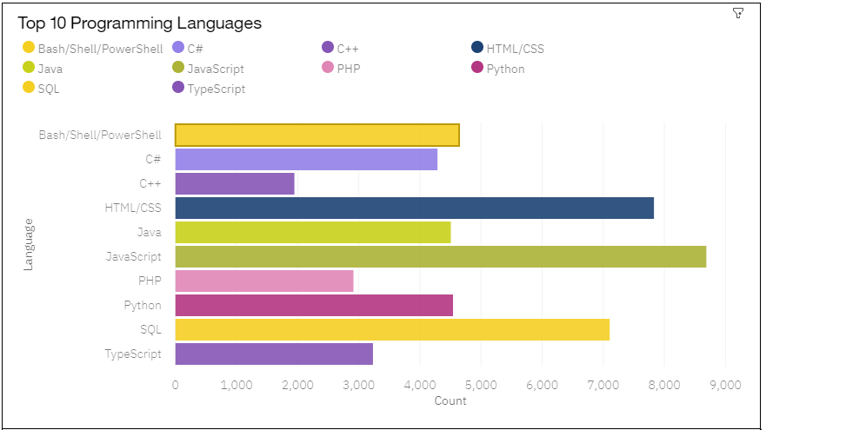
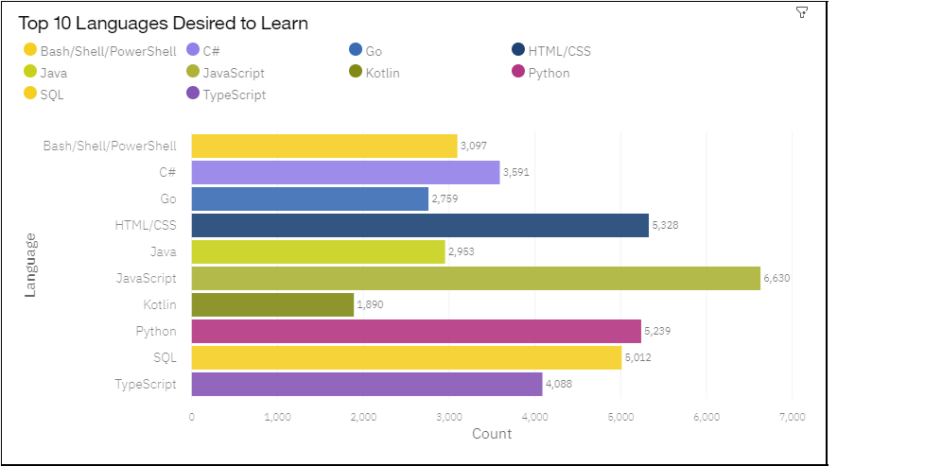
PROGRAMMING LANGUAGE TRENDS
Current Year:
Next Year:

Slide 8
PROGRAMMING LANGUAGE TRENDS - FINDINGS & IMPLICATIONS
Findings Implications
The most popular programming languages were JavaScript and HTML, followed by SQL, PowerShell, and Python.
The top five languages that people want to study next year are all those mentioned above.
JavaScript and HTML engineers could enter the labour market in greater numbers, which could reduce the current strong demand for these workers.

Slide 9
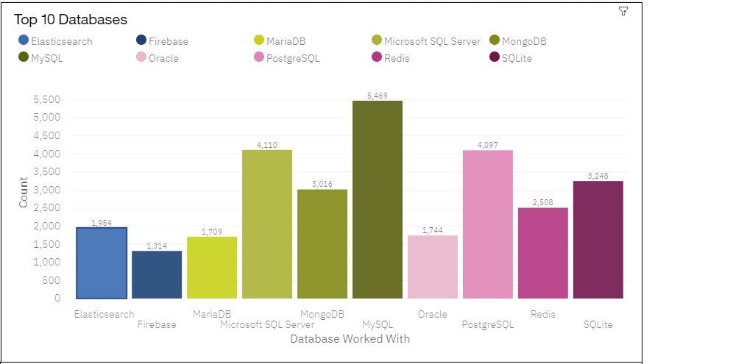
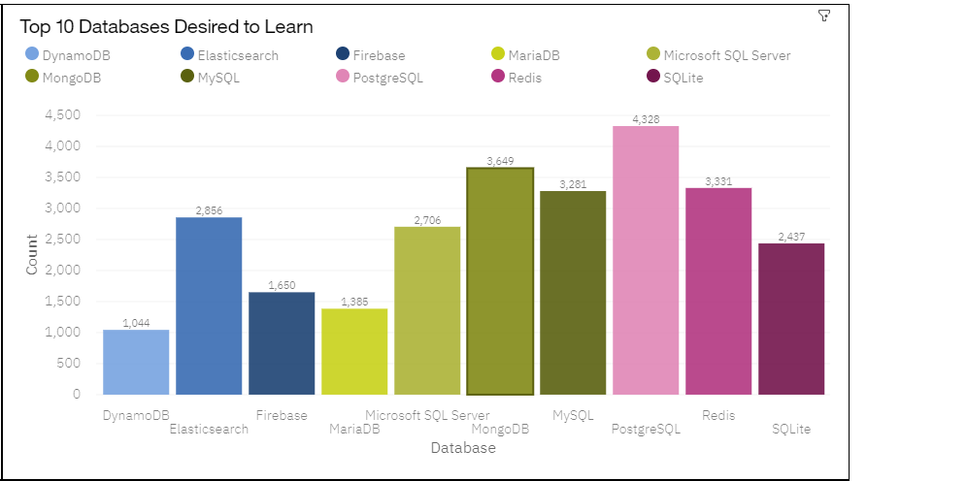
DATABASE TRENDS
Current Year:
Next Year:

Slide 10
DATABASE TRENDS - FINDINGS & IMPLICATIONS
Findings Implications
Among developers, MySQL was the most popular database to use; but, over the coming years, we might observe a reduction in this preference.
The second most popular database among developers and the most sought-after database to learn in the upcoming years is PostgreSQL.
The most popular database to learn in the upcoming year is MongoDB, which was placed fifth among those that are presently in use.
As PostgreSQL and MongoDB gain popularity over the next few years, more businesses may decide to use them.
MySQL might approach a limit and become insufficient to provide you an advantage over others in terms of abilities.

Slide 11

DASHBOARD
Link:
Dashboard

Slide 12
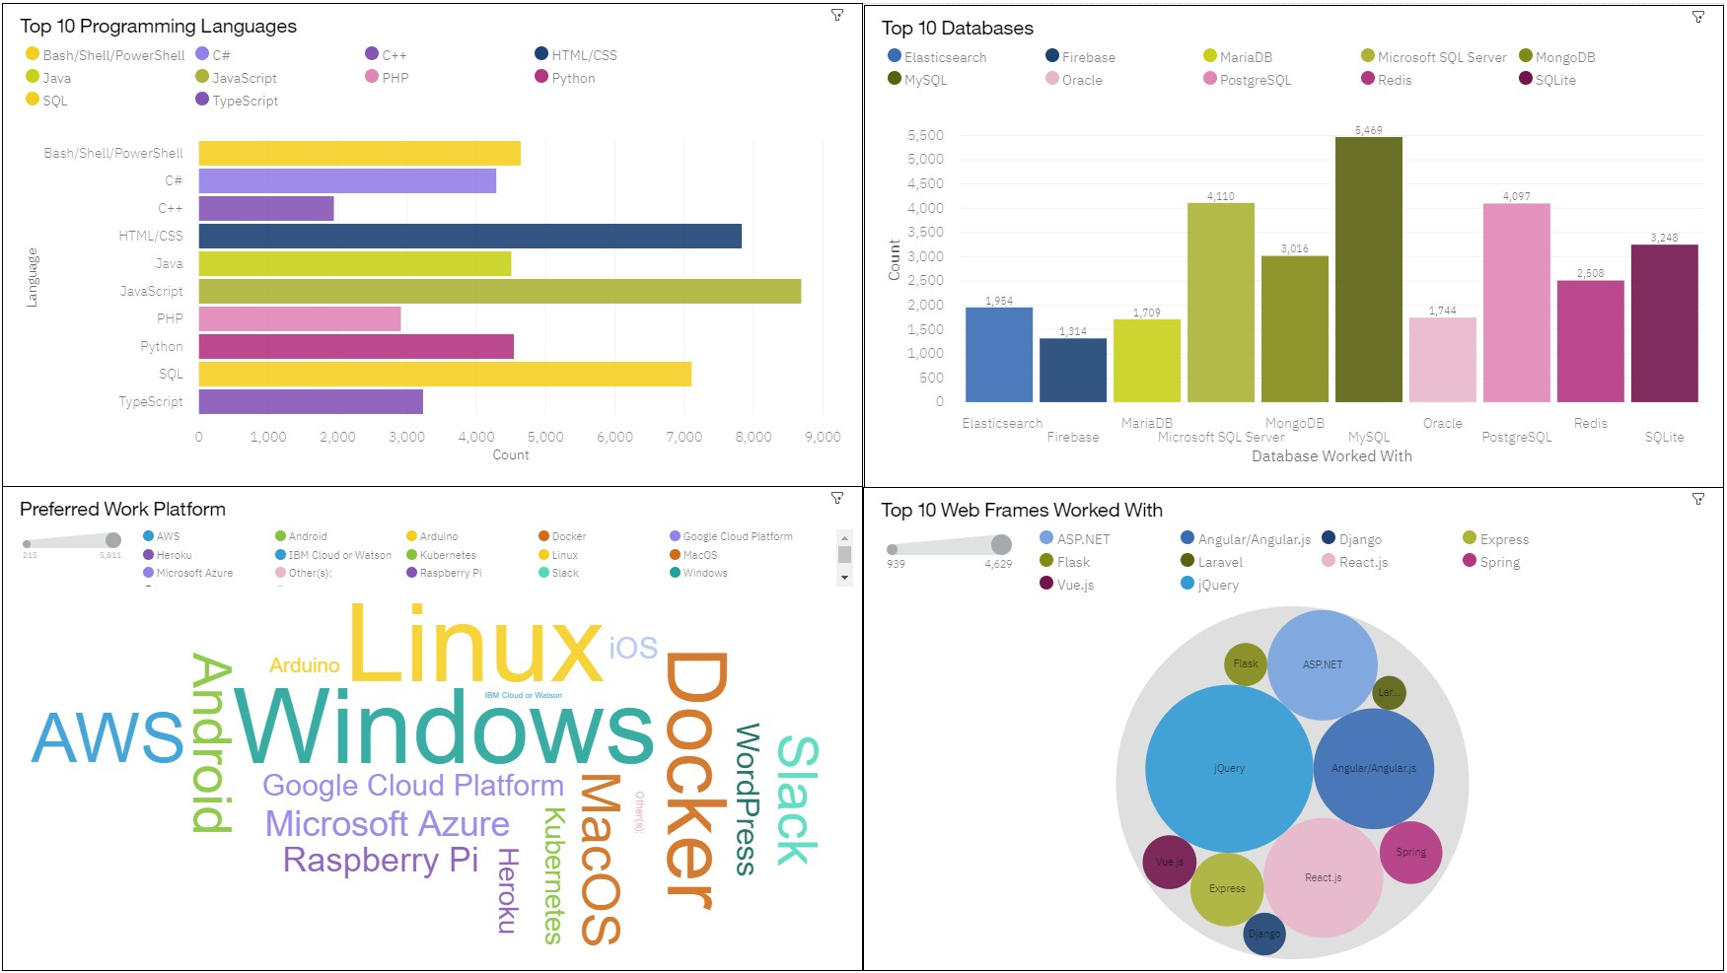
DASHBOARD TAB 1

Slide 13
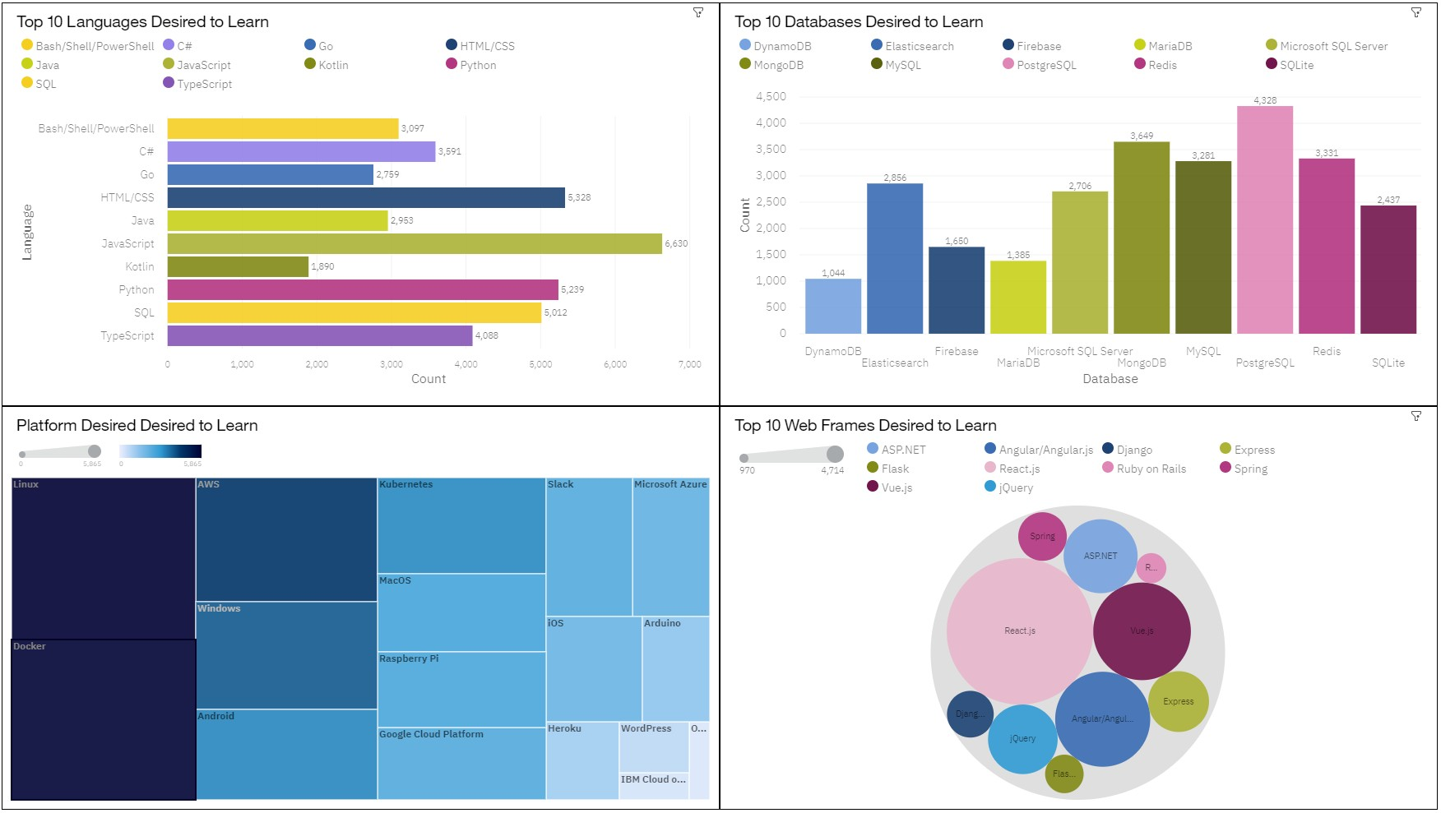
DASHBOARD TAB 2

Slide 14
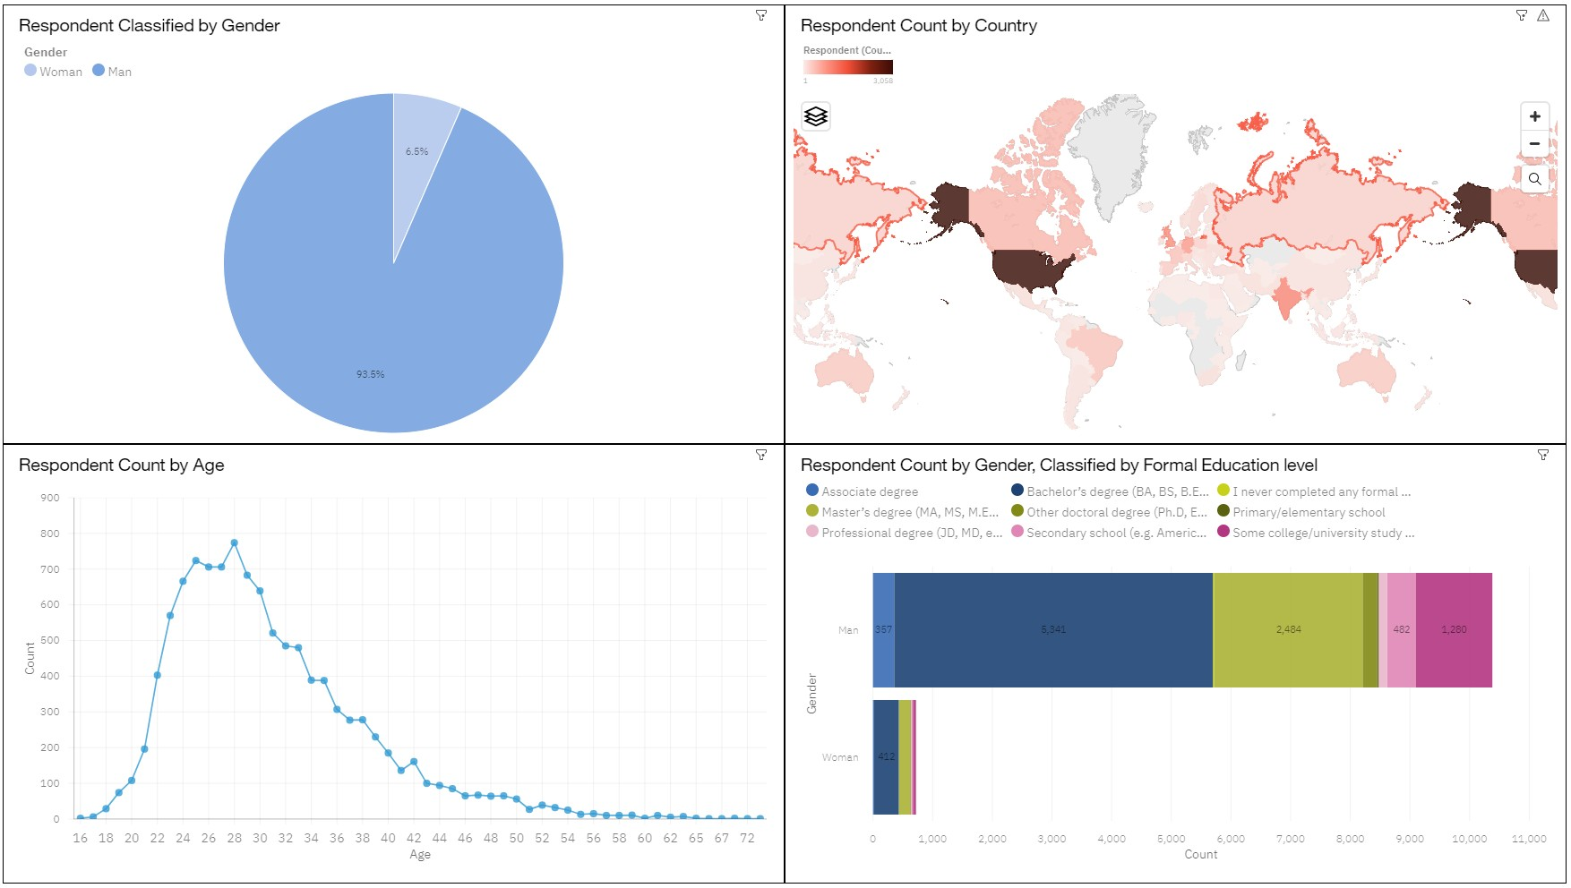
DASHBOARD TAB 3

Slide 15
DISCUSSION
LANGUAGES:
Will alternative languages gain popularity in the next years, causing SQL and Python to lose their hegemony?
DATABASES:
Will PostgreSQL and MongoDB eventually supplant MySQL as the preferred database to work with?
Why is MySQL's popularity dwindling so quickly?

Slide 16
OVERALL FINDINGS & IMPLICATIONS
FINDINGS IMPLICATIONS
The bulk of the male respondents to the technology poll were from the USA, followed by those between the ages of 21 and 43 from India.
Students with a bachelor's or master's degree strongly recommended specialising in data technology.
Observing the popularity among young people may encourage the establishment of more bootstrap camps to broaden their skill sets.
As more multinational corporations diversify into this industry, the popularity trends could also increase in other nations.

Slide 17

CONCLUSION
We sought to examine the dataset for the desired present and next technological developments while also taking into account the respondents' demographics.
The visualisations make it evident that the age groups between 21 and 43 prefer the technology developments.
The most widely used programming languages are HTML and JavaScript, and future technology trends predict that this will continue in the years to come.
We might observe a decline in MySQL's popularity and a rise in PostgreSQL and MongoDB among the databases we can use.
As multinational corporations expand into this market to stay competitive, we might observe an increase in the employment of these technologies there.

Slide 18

APPENDIX
Resources:
Data was scraped from a Stack Overflow survey under an OBDl: Open Database License
IBM Cognos was used for creating the Dashboards and
various visualizations
BeatifulSoup library in Python was used to scrape GitHub job postings along with their average salaries
Acknowledgements:
Thanks to Coursera for making this course accessible.
Thanks to Stack Overflow for providing survey data for study.

Slide 19
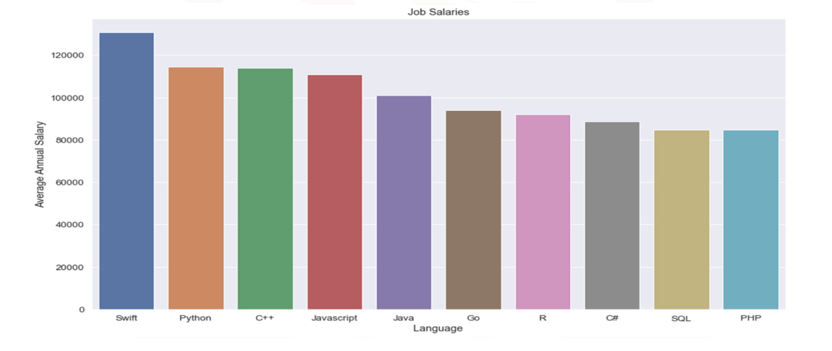
AVERAGE SALARIES

Slide 20
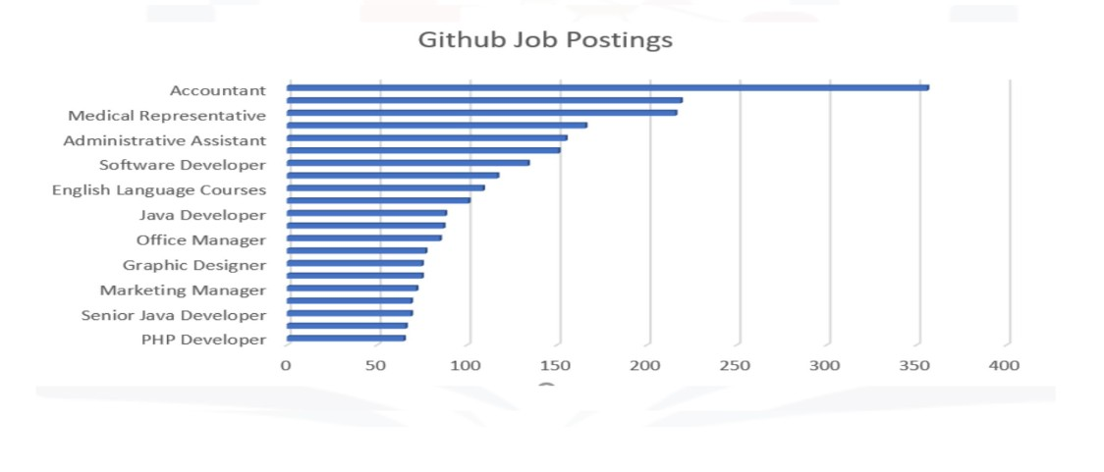
GITHUB JOB POSTINGS

