Slide 1
Ground Truth
State
Image
User Interaction
Cross-Entropy based Relative Gain
Pixels as Agents
Reward
Previous Seg. Prob.
FCN-based Actor Network
Current Seg. Prob.
User Hint based on Error Regions
Action
Hint Map
Hint Transformation by Euclidean Distance

Slide 2
Quantum Centralized Critic
Quantum Actor Critic Trainer
Quantum
Actor(1)
Quantum
Actor(n)
Quantum
Actor(n)
Experience Replay
Single-Hop Offloading Environment

Slide 3
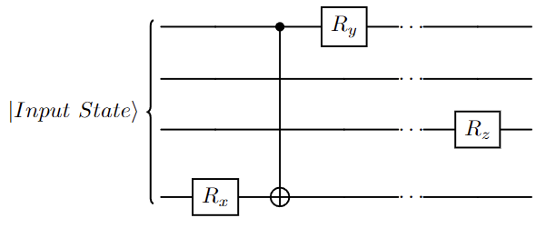
L1
L2
L3
Lm

