Slide 1

Understanding Entanglement Swapping Protocol
Yayu Mo
Master’s in Computer Engineering
Haojing Zhai
Master’s in Datacenter System Engineering
Liping Tang
Master’s in Computer Science

Slide 2
Agenda
PartⅠ
Introduction
Part Ⅱ
Motivation
Part Ⅲ
Self-taught Part
Part Ⅳ
Tools Description
Part Ⅴ
Methodology
Part Ⅵ
Analysis and outcomes
Part Ⅶ
Summary and conclusion

Slide 3
1-1 Introduction

Slide 4
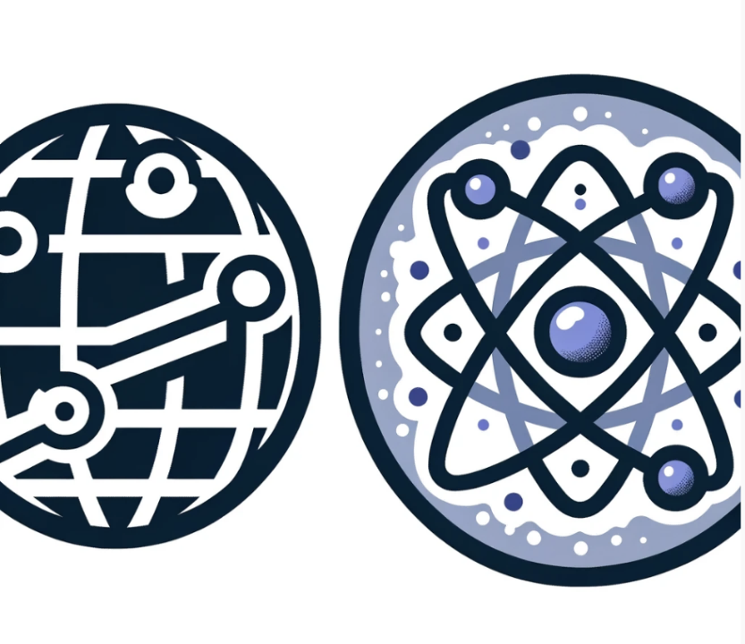
2-1 Motivation
Traditional Networks
Quantum Networks
●Wired
●Use routers to
transmitdata over a
long distance
●Packets can be
captured by tools
such as Wireshark
●Wireless
●Quantum repeaters
●Safer and
Longer transmission
distance

Slide 5
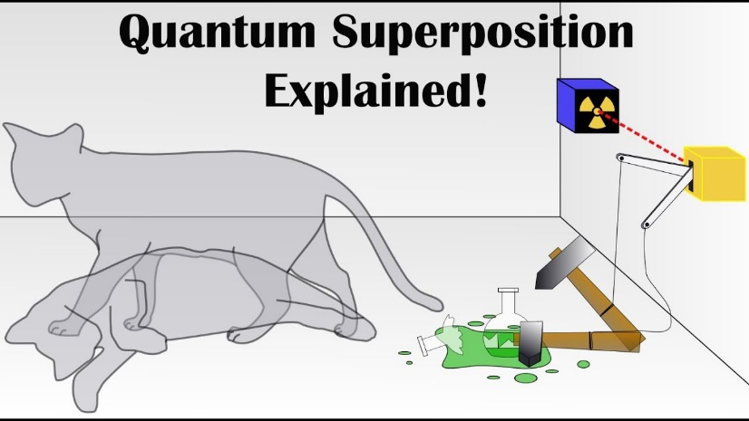
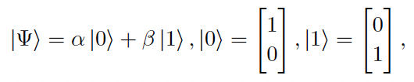

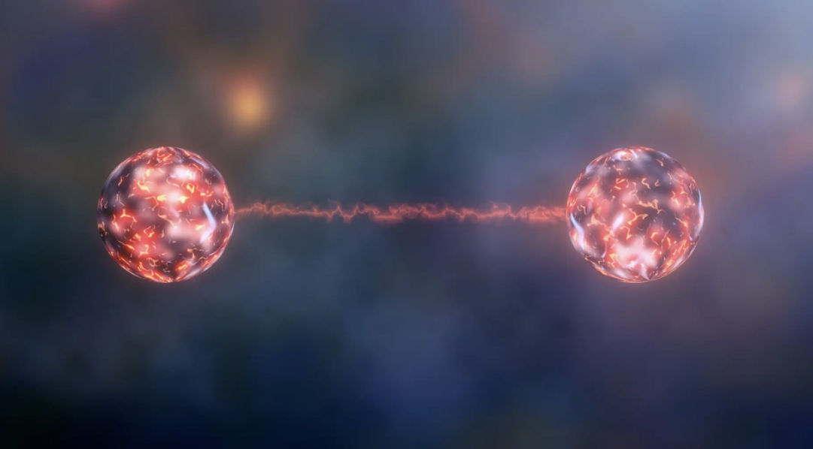
3-1 Quantum Bits
1. Superposition
Superposition of basis (1 and 0) states:
where
2. Entanglement
Picture Source: https://www.youtube.com/watch?v=hkmoZ8e5Qn0
In the entangled state, two or more qubits, no
matter how far apart, are measured on one qubit
immediately affects the state of the other qubits.
Picture Source: https://newatlas.com/telecommunications/quantum-entanglement-atoms-distance-record/

Slide 6



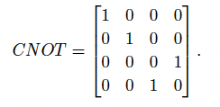

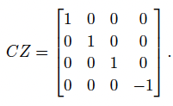
3-2 Quantum Gates
1. Hadamard Gate
The function of the H-gate is to create a superposition of qubits.
Specifically, H-gate maps the basic states |0> and |1> to their superposition states.
2. Controlled-NOT Gate
Controlled-NOT gate is a controlled gates in quantum computing, which is used to
implement conditional logical operations between qubits.
If the control bit is in state |1>, then it performs an CX-gate on the target bit.
3. Controlled-Z Gate
Controlled-Z Gate is another important type of controlled quantum gate, which
imposes a CZ-gate on the target bit under the condition that the control bit is |1>.

Slide 7
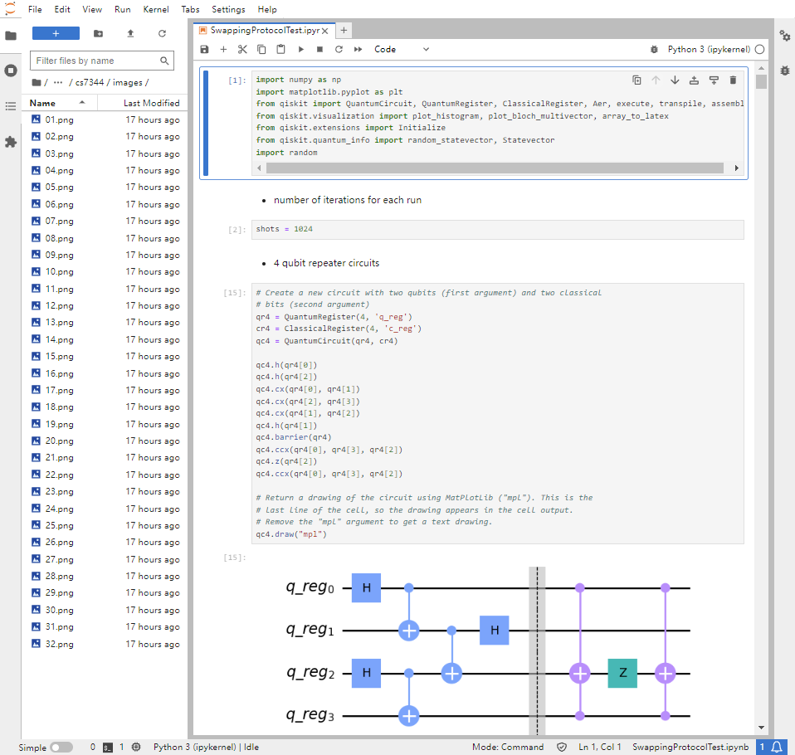
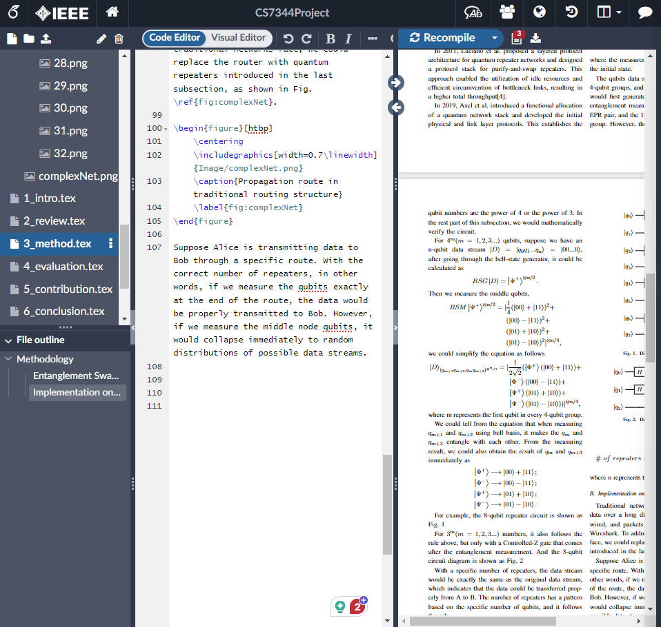
4-1 Tools
Coding and Experiments
Python
Jupyter lab
Qiskit, matplotlib
Paper Orgnization
Overleaf (Latex)

Slide 8
5-1 Entanglement Swapping Repeaters
Station A
Station B
A
A*
B*
B
Entanglement Measuring
Entanglement

Slide 9
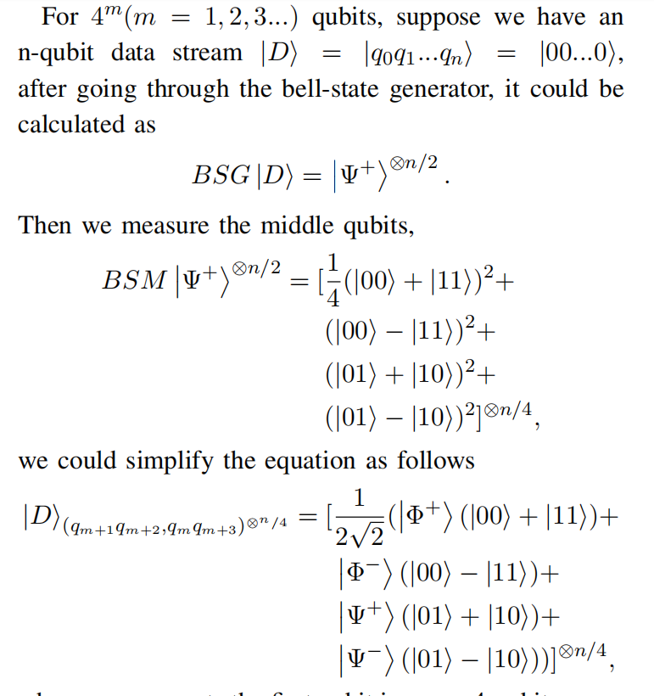
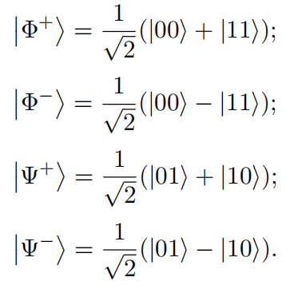
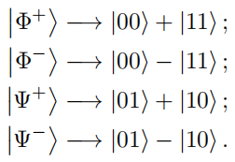
5-2 Mathematical Verification
Bell State:
Measure Result:

Slide 10
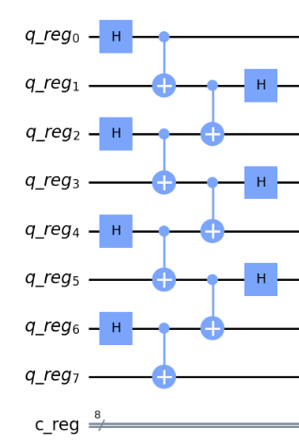
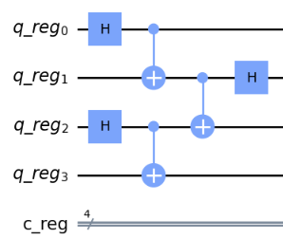
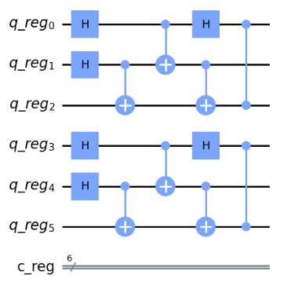
5-3 Repeater Circuits
4 qubit circuit
6 qubit circuit
8 qubit circuit

Slide 11
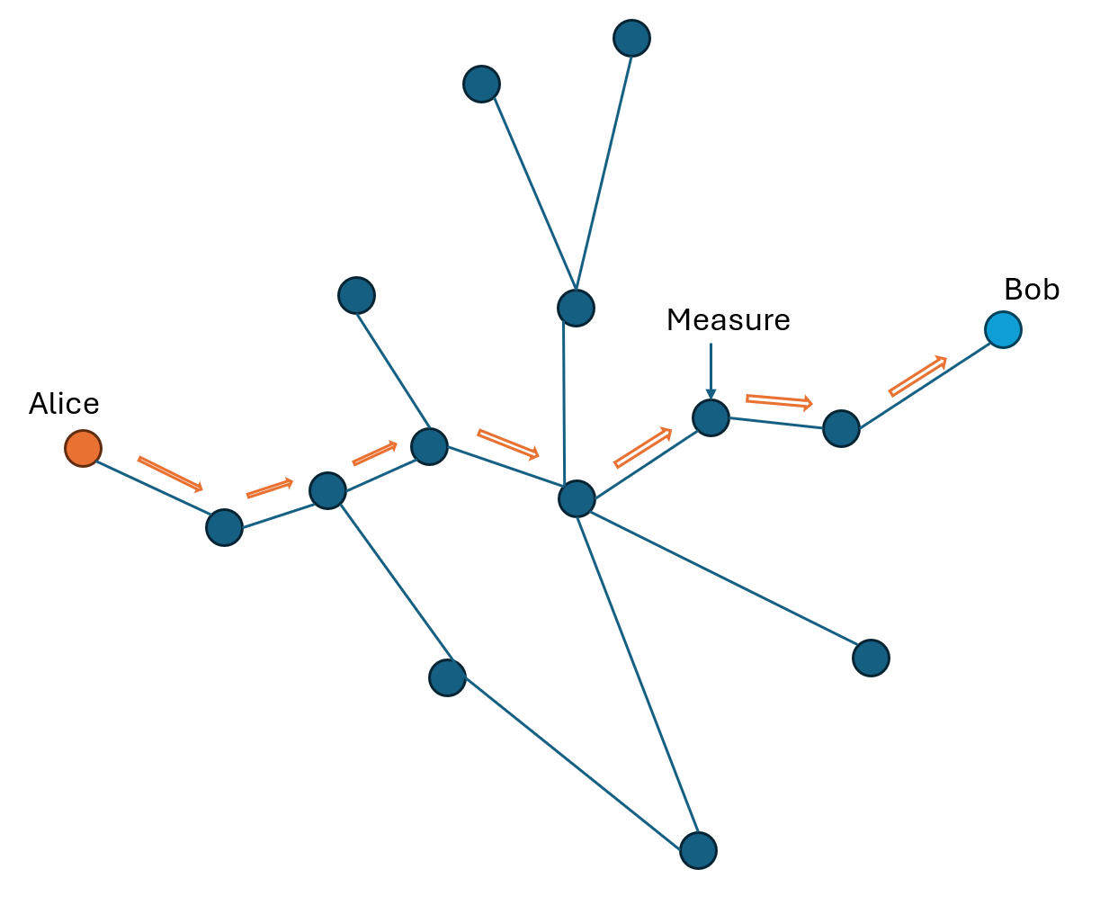
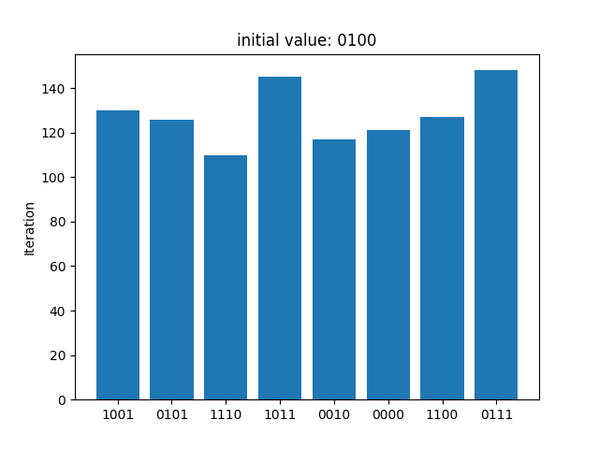
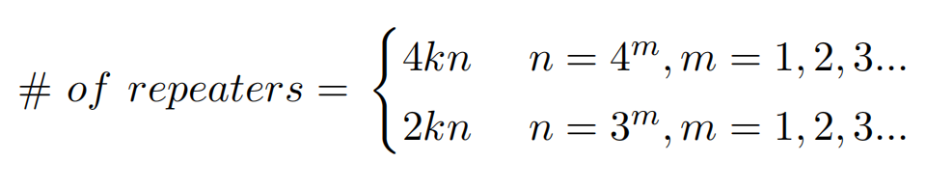
5-4 Implementation on Traditional Networks

Slide 12
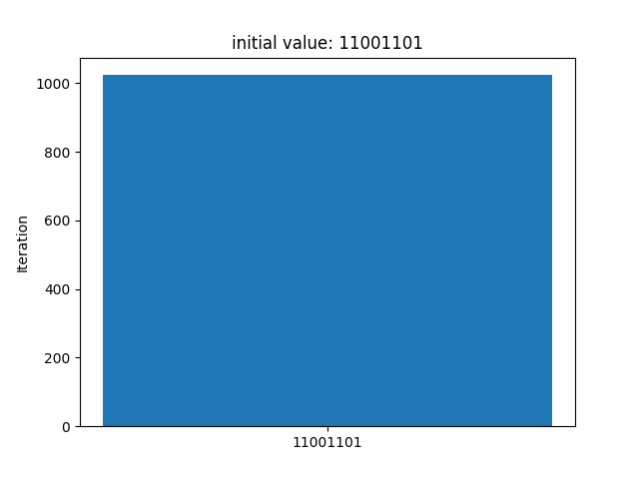

6-1 Protocol Effectiveness Experiments
8-qubit circuit result with 32 repeaters
3-qubit circuit result with 6 repeaters

Slide 13
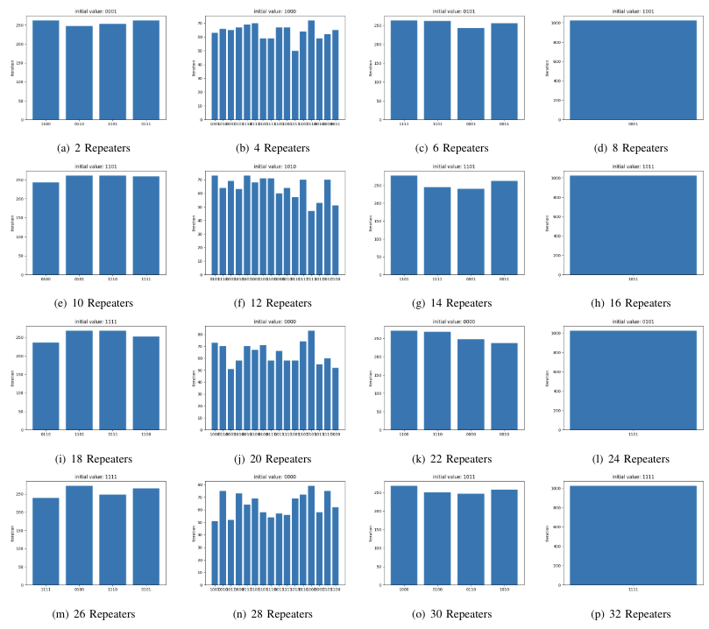
6-2 Measurement on Middle node

Slide 14
7-1 Contribution
Wireless
Teleportation wirelessly over long distance
Fast Transmission
Property of EPR pairs
High Security
Measurements to middle nodes would cause immediate collapse

Slide 15
7-2 References
1] V. N. Medhi, V. N. Deka, B. K. Behera, and P. K. Panigrahi, “One layer demonstration of quantum internet on the ibm q system,” 2019.
[2] M. A. Nielsen and I. L. Chuang, Quantum Computation and Quantum Information, 10th ed. Cambridge University Press, 2010. [Online]. Available: http://www.cambridge.org/9781107002173
[3] S. W. Wojciech Kozlowski, Axel Dahlberg, “Designing a quantum network protocol,” arXiv preprint quant-ph/1903.10685, 2020.
[4] L. Aparicio, R. Van Meter, and H. Esaki, “Protocol design for quantum repeater networks,” in Proceedings of the 7th Asian Internet Engineering Conference, 2011, pp. 73–80.
[5] A. Dahlberg, M. Skrzypczyk, T. Coopmans, L. Wubben, F. Rozpedek, M. Pompili, A. Stolk, P. Pawełczak, R. Knegjens, J. de Oliveira Filho et al., “A link layer protocol for quantum networks,” in Proceedings of the ACM special interest group on data communication, 2019, pp. 159– 173.
[6] M. Sasaki, “Quantum networks: where should we be heading?” Quantum Science and Technology, vol. 2, no. 2, p. 020501, 2017.
[7] N. Yu, C.-Y. Lai, and L. Zhou, “Protocols for packet quantum network intercommunication.(2019),” arXiv preprint quant-ph/1903.10685, 2019.
[8] Z. Li, K. Xue, J. Li, L. Chen, R. Li, Z. Wang, N. Yu, D. S. Wei, Q. Sun, and J. Lu, “Entanglement-assisted quantum networks: Mechanics, enabling technologies, challenges, and research directions,” IEEE Communications Surveys & Tutorials, 2023.

