Slide 1

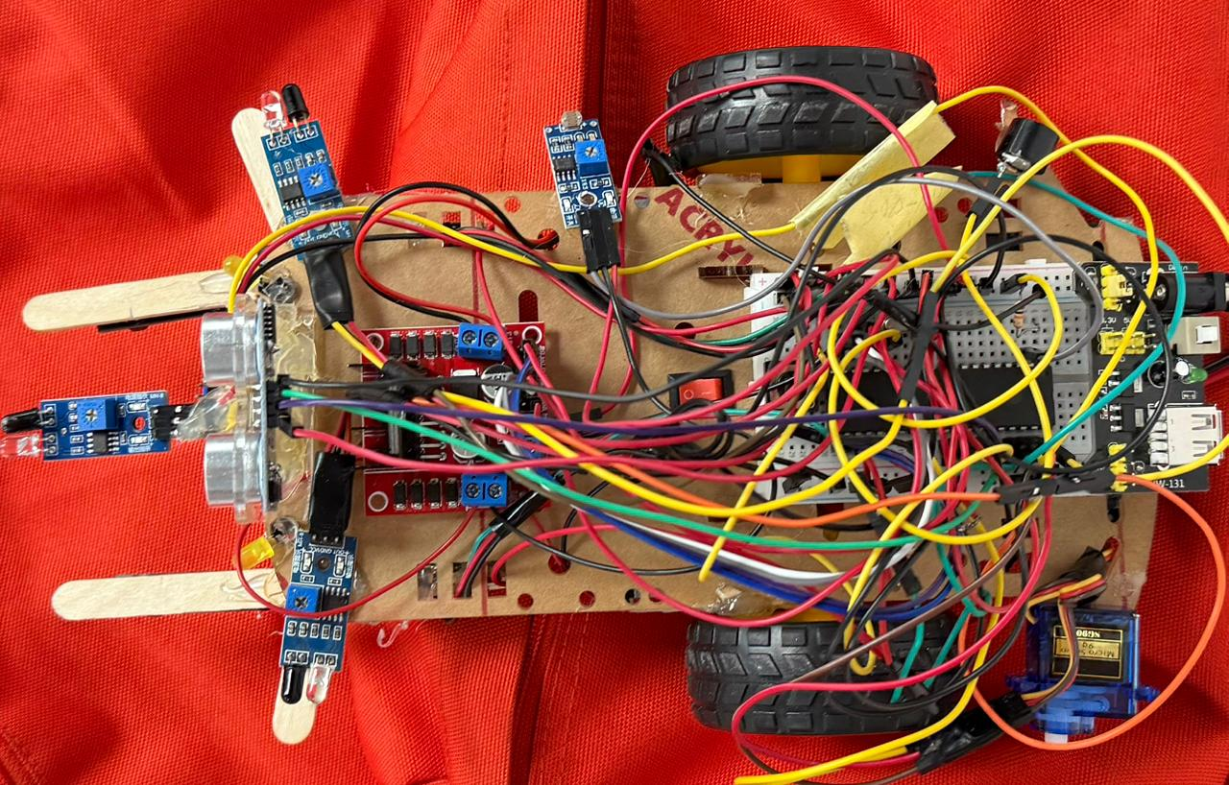
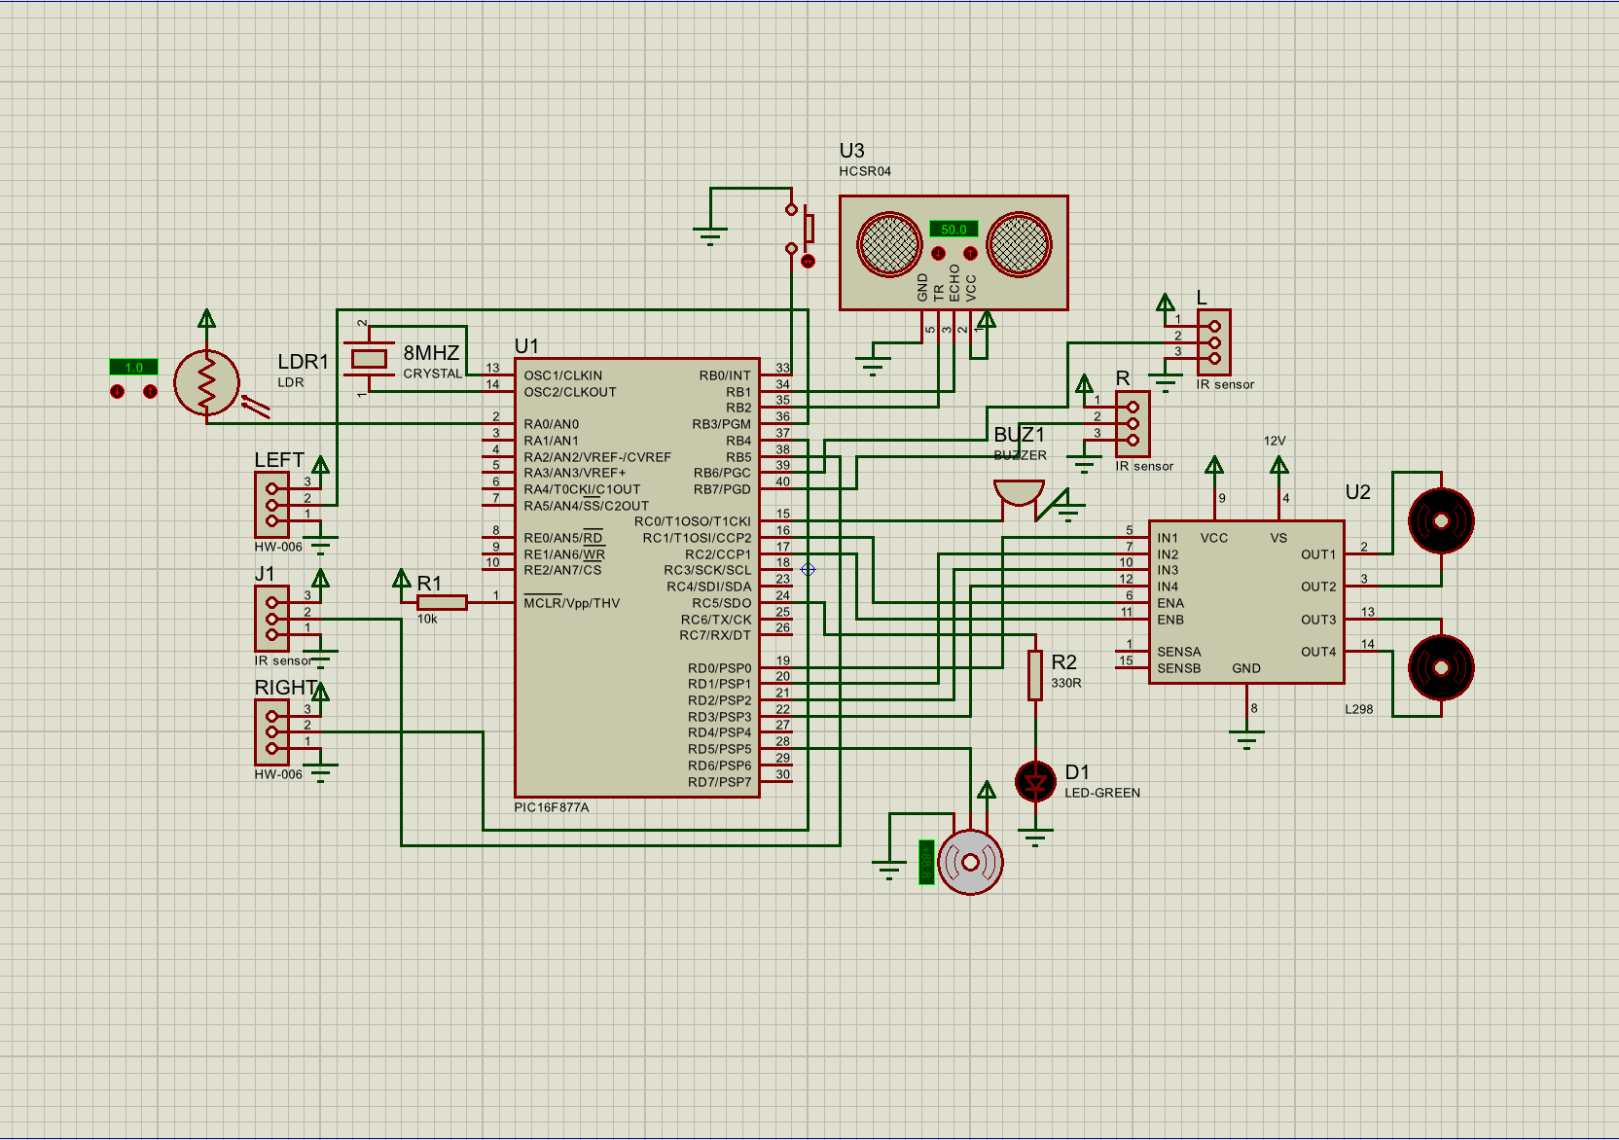
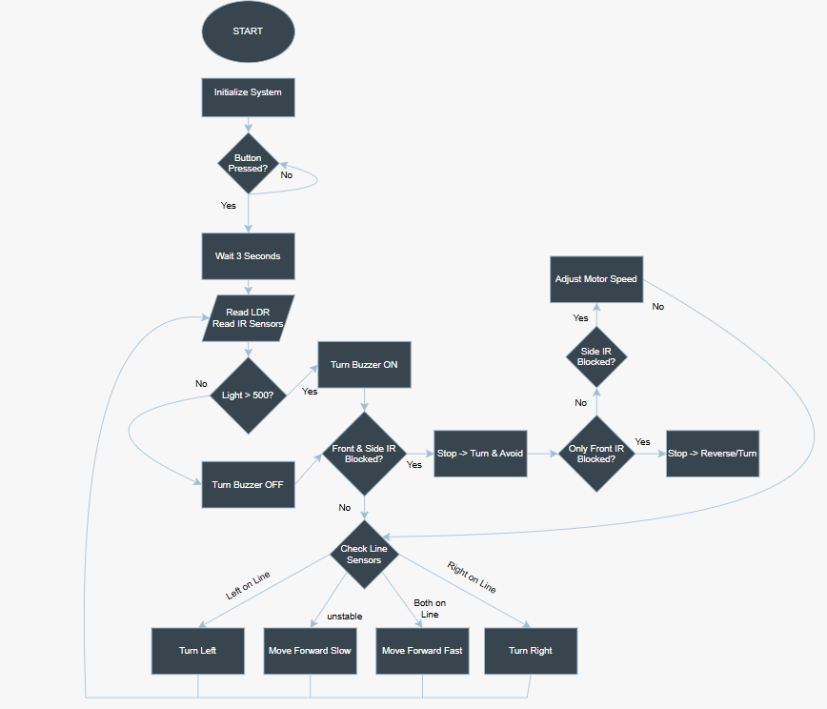
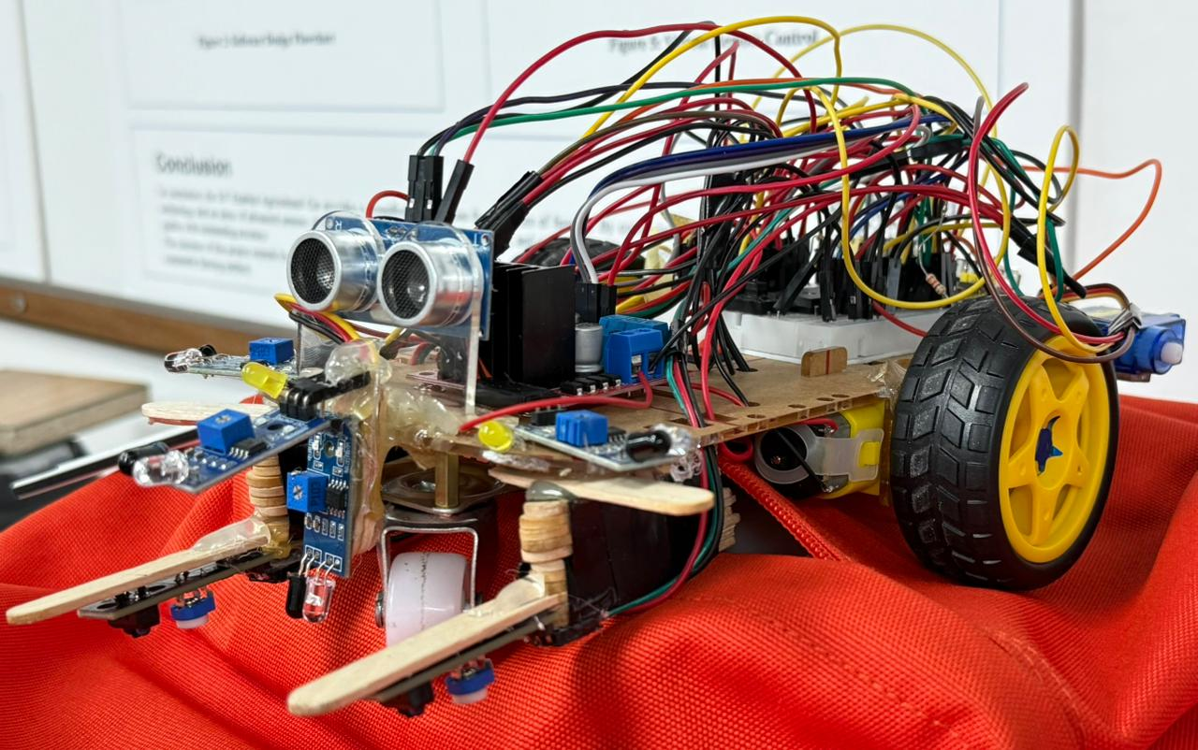
Autonomous Mobile Robots Challenge
Yazan Al-Naimat, Ayham Ismail, Rakan Al-Shishani
Supervisor: Dr. Belal H. Sababha
Embedded Systems Final Design Project, Fall 2025
King Abdullah II School of Engineering
Princess Sumaya University for Technology
Introduction
For our Autonomous Mobile Robots course, we designed and programmed a robot car capable of navigating multiple zones completely on its own. We set up the operation to begin with a simple button press, which launches the robot through various stages like line following, tunnel navigation, obstacle avoidance, and parking. throughout the track, our robot uses sensors and actuators to read its surroundings and make real-time decisions.
Results
Our robot successfully navigated the entire track autonomously. Because we were not allowed to use standard libraries, we wrote our own driver in C to control the sensors and motors directly. This made the robot react much faster to changes on the track.
We met every stage of the challenge :
Start : The robot waits exactly 3sec after the button press before moving
Tunnel : The light sensor instantly detects the dark zone and turns on the buzzer
Obstacle : It switches modes when the line ends , detects the obstacles and find its path
Parking : it correctly identifies the parking spot
Figure 3: hardware implementation of the robot.
Figure 4: Side view of the robot showing sensor placement.
Design
We built the robot around a PIC microcontroller. To handle the track, we used three-line sensors for accurate pathing and an ultrasonic sensor mounted on a servo to scan for obstacles. Movement is powered by DC motors with an H-bridge, giving us a differential-drive system for precise turning. We also integrated an LDR for light detection in the tunnel, a buzzer for alerts, and basic buttons for operation.
Figure 1: Circuit diagram.
Figure 2 : FlowChart
Conclusion
This project allowed us to demonstrate the design and implementation of a fully autonomous robot using embedded systems principles. By combining multiple sensors with precise motor control, we built a system that adapted well to different environments and challenges. The project gave us valuable hands-on experience in hardware interfacing, real-time decision-making, and programming. In the future, we believe we could improve the robot with better speed control algorithms and additional sensors for higher accuracy.

