Slide 1
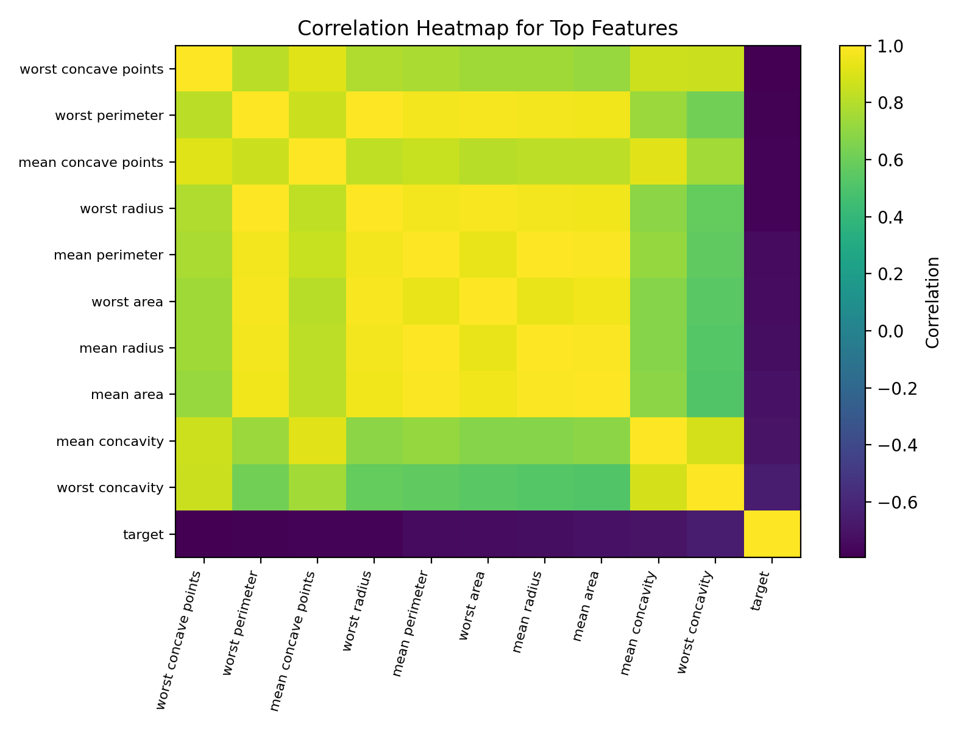
AI-Based Disease
Prediction System
Breast Cancer Diagnosis Prediction Using Machine Learning
AHMAD YOUSEF NEMER AYAAD
Student ID: 243039
Instructor: Dr. Abdullah AlQammaz

Slide 2
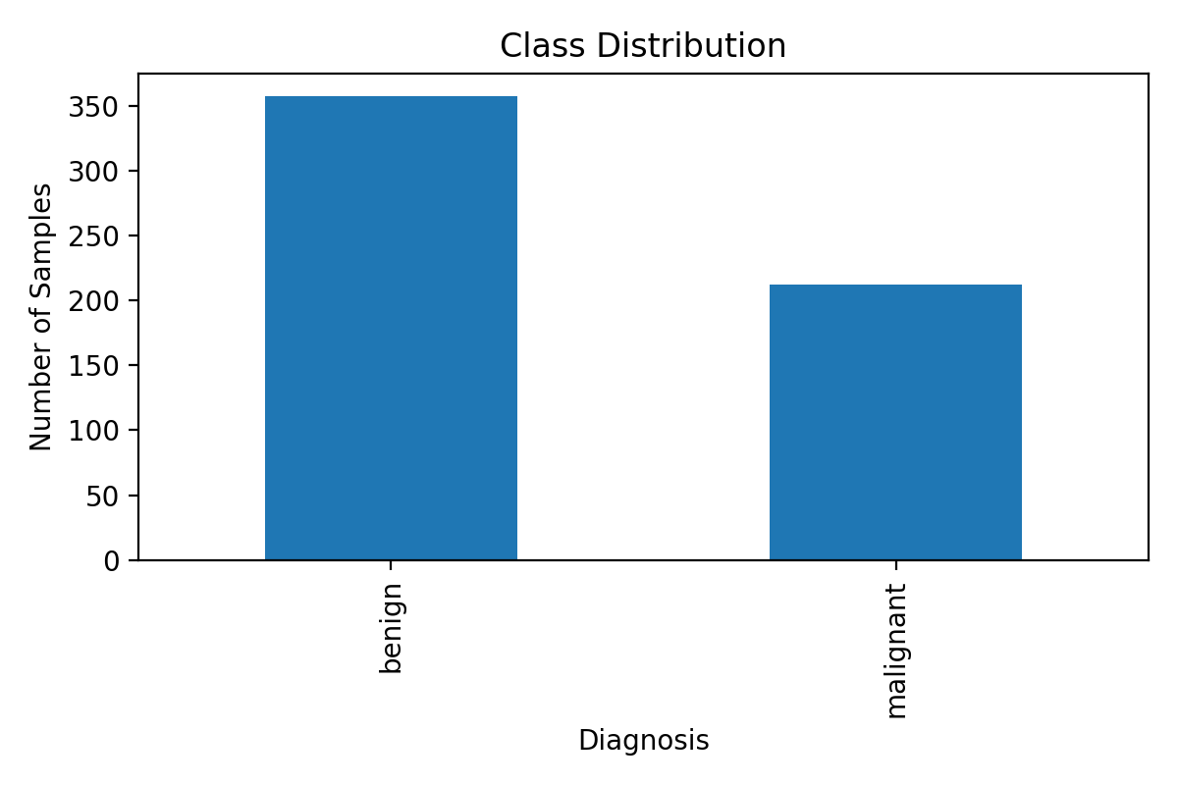
Problem & Objective
Build a supervised ML system that predicts benign vs. malignant diagnosis
Problem statement
Classify breast tumors using 30 diagnostic measurements extracted from cell nuclei. The model is a decision-support demonstration, not a medical replacement.
Project objectives
Load a trusted dataset
Explore patterns and class balance
Preprocess and split the data
Train and compare 3 models
Evaluate with metrics and confusion matrices
AI Course Project | 243039 | 2

Slide 3
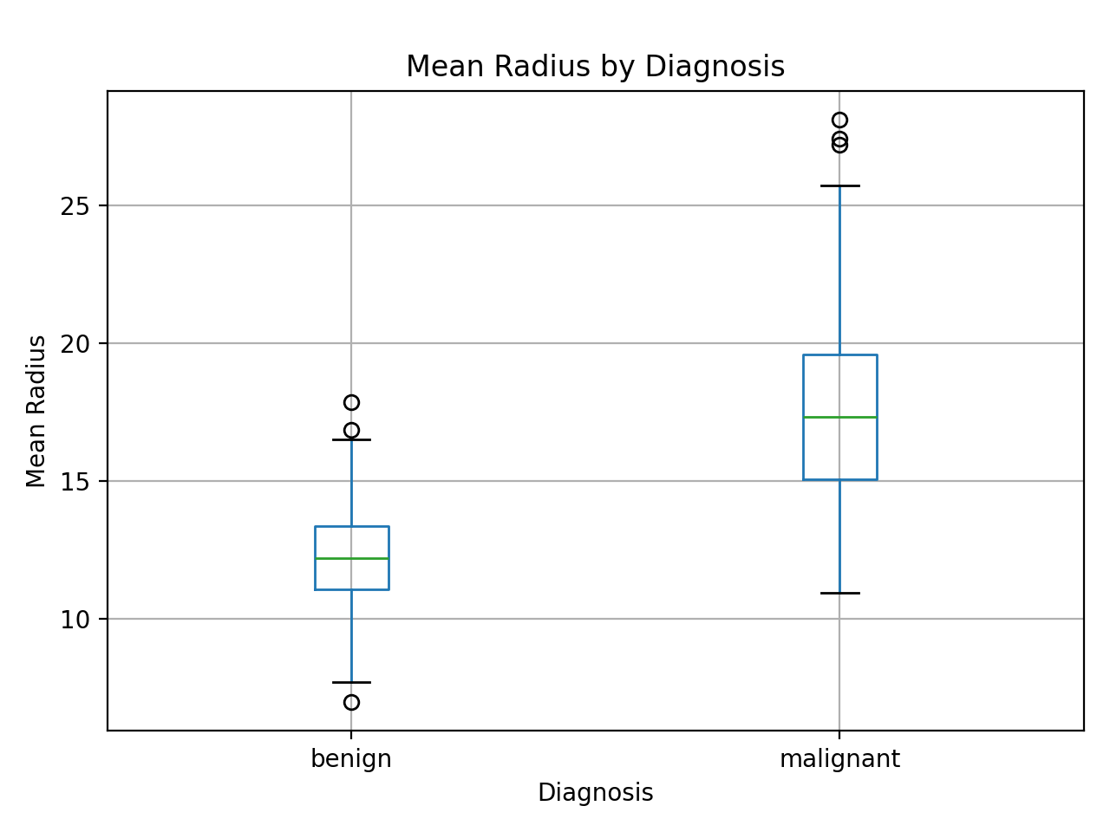
Dataset & Features
Breast Cancer Wisconsin Diagnostic dataset from scikit-learn / UCI
569 samples
30 numeric features
2 diagnosis classes
Main feature groups: radius, texture, perimeter, area, smoothness, compactness, concavity, concave points, symmetry, and fractal dimension.
AI Course Project | 243039 | 3

Slide 4
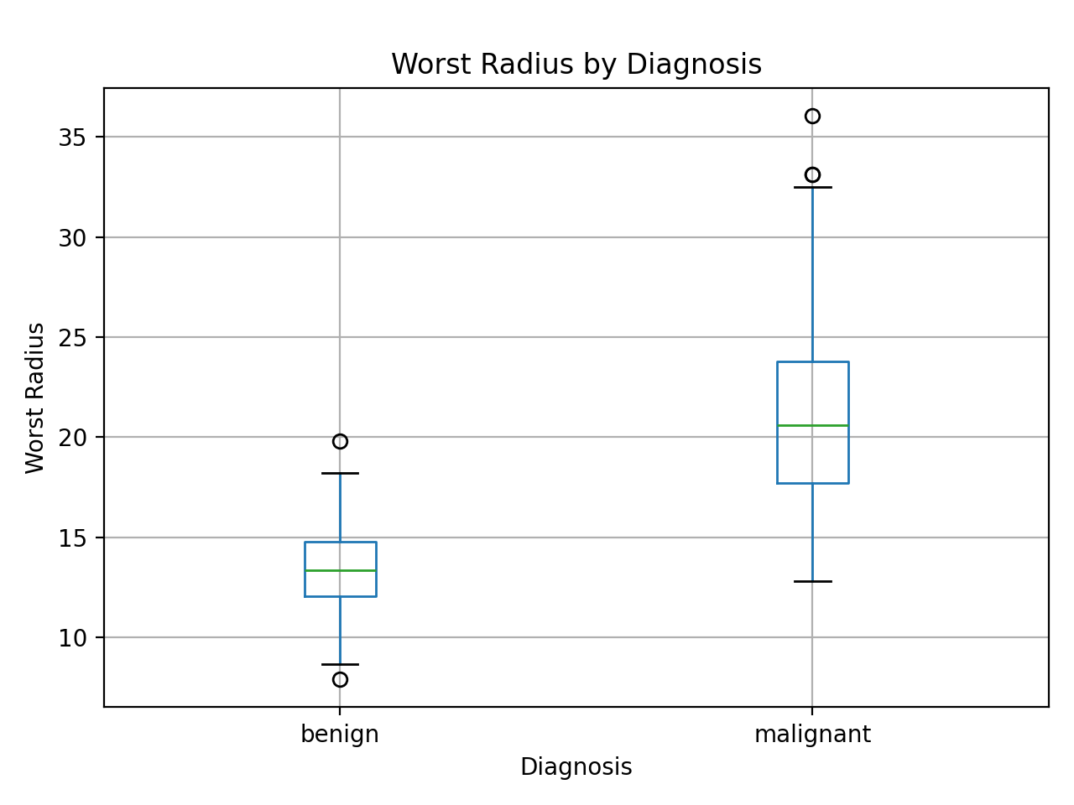
Exploratory Data Analysis
What the data shows before training
Findings: no missing values; benign class is more common; radius, perimeter, area, concavity, and concave-point features are highly informative.
AI Course Project | 243039 | 4

Slide 5
Machine Learning Workflow
Full AI pipeline implemented in Python
1. Load dataset
2. Explore data
3. Preprocess
4. Train models
5. Evaluate
Models compared
Preprocessing choices
Logistic Regression
Random Forest Classifier
Support Vector Machine
80/20 stratified train-test split
StandardScaler for Logistic Regression and SVM
5-fold cross-validation using F1 score
AI Course Project | 243039 | 5

Slide 6
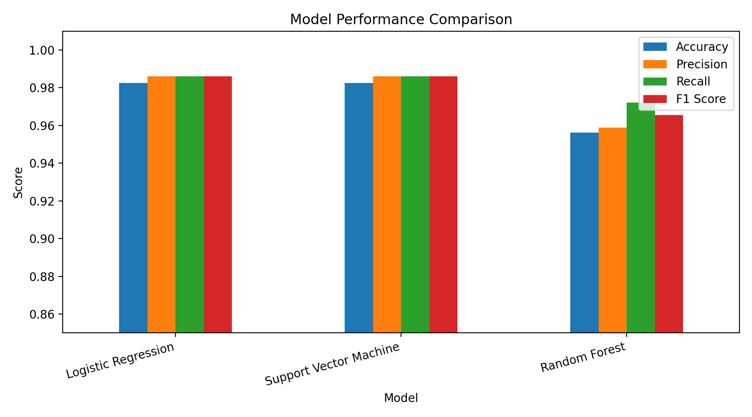
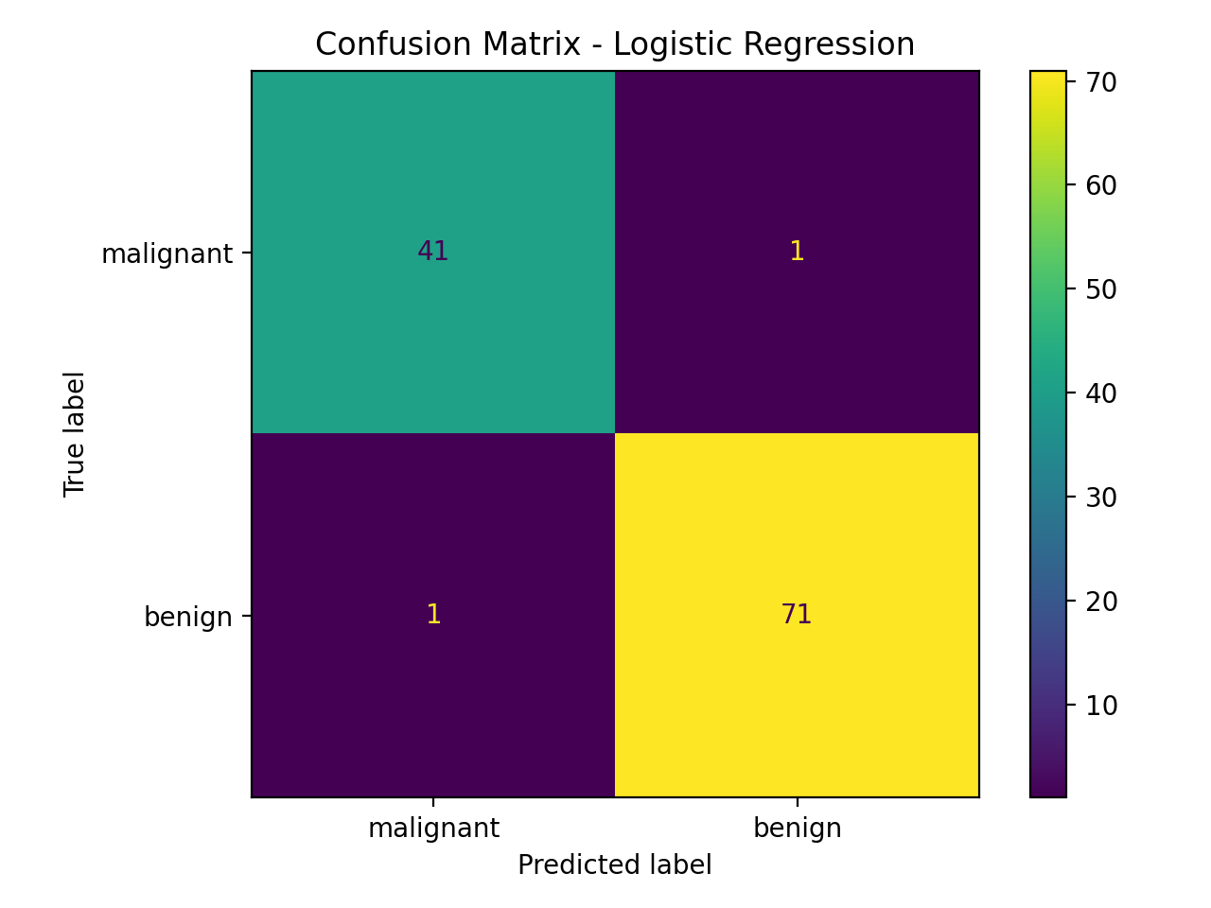
Experimental Results
Logistic Regression and SVM achieved the best F1 score
Best model: Logistic Regression
Accuracy: 0.982 | F1 score: 0.986
AI Course Project | 243039 | 6

Slide 7
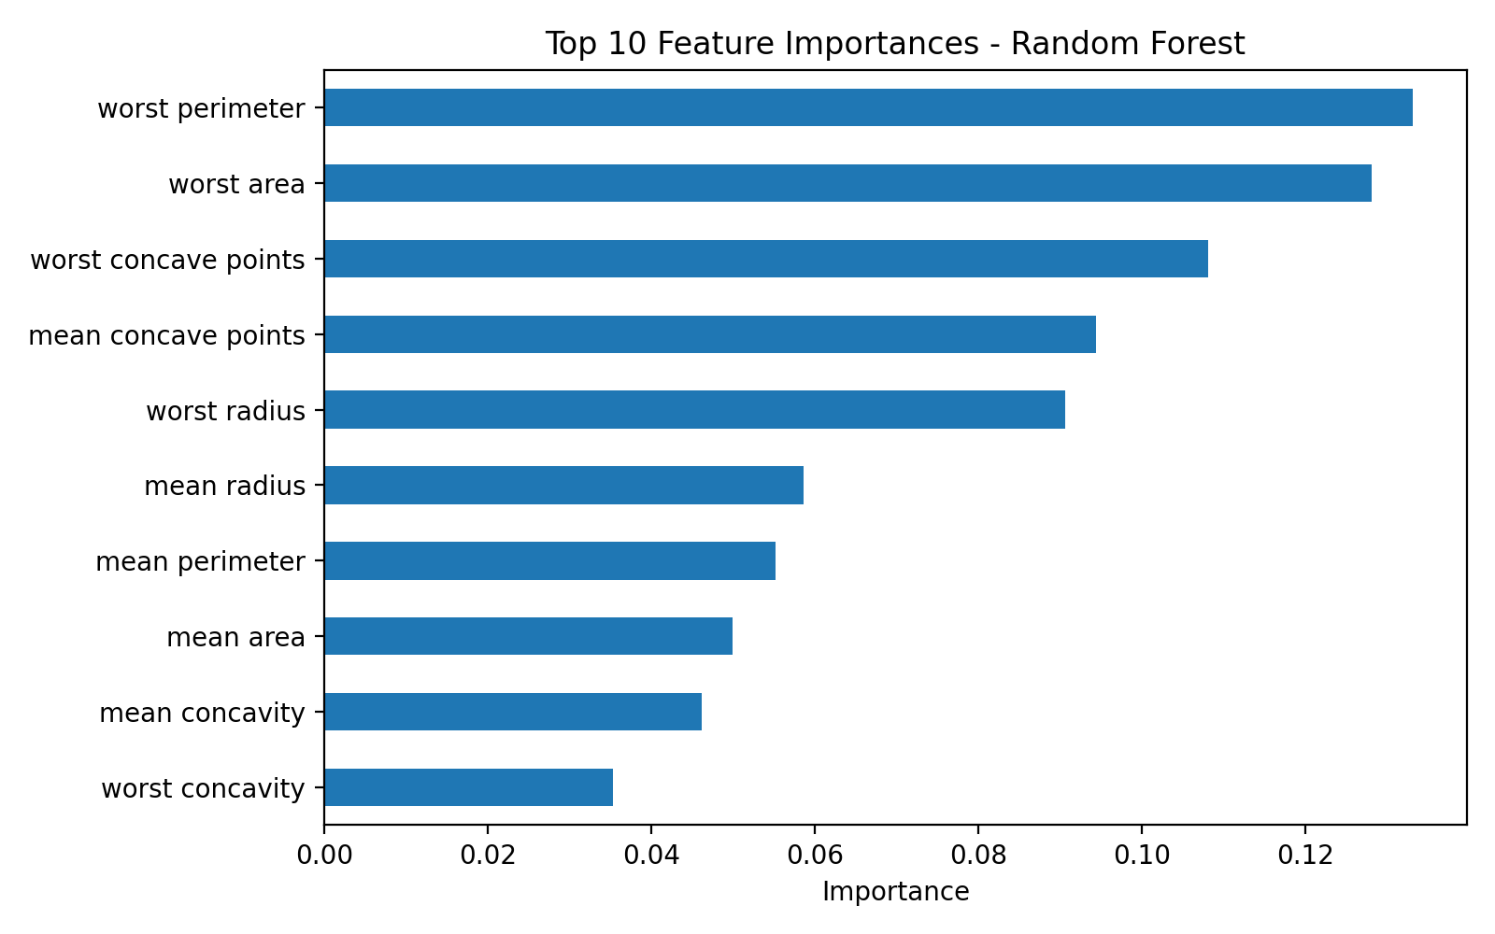
Discussion
What the results mean
Key observations
The dataset contains strong diagnostic patterns.
Scaling improved linear and margin-based models.
F1 score is important because medical errors have high cost.
Random Forest added feature-importance insight.
The system is for learning and support, not clinical diagnosis.
Main limitation: results are based on a clean benchmark dataset; real hospital data would require external validation.
AI Course Project | 243039 | 7

Slide 8
Conclusion & Future Work
Complete ML pipeline delivered
Conclusion
Future work
The system successfully predicts breast cancer diagnosis using supervised machine learning. Logistic Regression and SVM achieved the best F1 score of 0.986.
Hyperparameter tuning
Additional algorithms
Simple user interface
External medical validation
Focus on minimizing false negatives
Thank you
AHMAD YOUSEF NEMER AYAAD | 243039

