Slide 1


Your money,
clearly.
Personal finance for everyday life
Team 4 / Project presentation
01
Notes:
Suggested time: 20 seconds.
Finora is our personal finance project. It helps people connect the money they earn and spend with a clear monthly plan. We will start with a familiar problem, show how the app addresses it, and explain who it is useful for.
Transition to the next slide: Let’s start with the question many people ask at the end of the month.
Sources: finora-template/README.md, finora-template/src/App.tsx, finora-template/src/data.ts and finora/client/README.md. Prototype figures are fictional sample data in USD, not measured user outcomes.

Slide 2
Where did my
money go?
Small purchases add up
Daily spending can be
easy to lose track of.
A balance alone cannot explain
your spending.
Limits need context
It helps to see what is
left in each category.
02
Notes:
Suggested time: 35 seconds.
A balance tells us how much money remains, but not which purchases used it or whether a category is over its limit. Rent is easy to remember. Smaller purchases can be harder to follow. The result is missing context when we make our next spending decision.
Transition to the next slide: Here is a simple example of how that missing context shows up.
Sources: finora-template/README.md, finora-template/src/App.tsx, finora-template/src/data.ts and finora/client/README.md. Prototype figures are fictional sample data in USD, not measured user outcomes.

Slide 3
A small overspend can be easy to miss
An everyday example: entertainment spending
THE MONTHLY PLAN
WHAT WAS SPENT
$200
$225
The missing signal: $25 over budget
Without a category total, the gap can go unnoticed.
Illustrative scenario / Fictional sample data in USD
03
Notes:
Suggested time: 35 seconds.
Imagine setting 200 dollars aside for entertainment. A concert costs 125 dollars, then dinner and cinema cost another 100. Each purchase has a reason, but together they reach 225 dollars. Without reviewing the category total, it is easy to miss the 25-dollar gap. This is an illustrative scenario based on the prototype’s sample entries.
Transition to the next slide: Finora addresses that gap by connecting records, budgets and the monthly report.
Sources: finora-template/README.md, finora-template/src/App.tsx, finora-template/src/data.ts and finora/client/README.md. Prototype figures are fictional sample data in USD, not measured user outcomes.

Slide 4
How Finora solves the problem
THE EVERYDAY QUESTION
FINORA’S ANSWER
Where did it go?
One searchable transaction list
Income and spending stay together.
Am I over budget?
Category limits with clear status
The amount left or over is visible.
How did the month go?
A readable monthly report
Totals and categories explain the month.
04
Notes:
Suggested time: 35 seconds.
Finora answers the three questions directly. The transaction list shows what happened. Category budgets show how spending compares with a chosen limit. The monthly report explains the overall result. The user records the entries, and the app calculates the totals.
Transition to the next slide: First, let’s look at the whole month before looking at individual purchases.
Sources: finora-template/README.md, finora-template/src/App.tsx, finora-template/src/data.ts and finora/client/README.md. Prototype figures are fictional sample data in USD, not measured user outcomes.

Slide 5

Your month at a glance
Income, expenses and what remains in one view.
$2,386 left this month
In this example: $5,250 income minus $2,864 expenses.
Prototype view / Fictional October 2026 data in USD
05
Notes:
Suggested time: 35 seconds.
In the sample month, recorded income is 5,250 dollars and expenses are 2,864 dollars. Their difference is 2,386 dollars, which the template calls monthly savings. This is the difference between recorded income and expenses, not proof of money held in a separate savings account. The dashboard image shows the intended prototype experience.
Transition to the next slide: That overview depends on the everyday entries behind it.
Sources: finora-template/README.md, finora-template/src/App.tsx, finora-template/src/data.ts and finora/client/README.md. Prototype figures are fictional sample data in USD, not measured user outcomes.

Slide 6
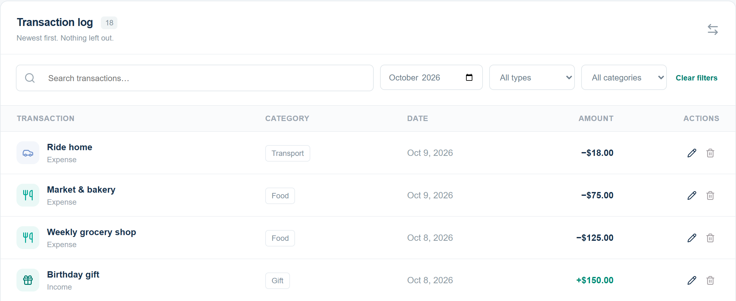
Every transaction, easy to find
Record income or spending. Filter by month, type or category.
Prototype view / Fictional sample data in USD
06
Notes:
Suggested time: 35 seconds.
Users record an income or expense with an amount, date and category. The list keeps the entries together. Search and filters help find a transaction by month, type or category. Users can edit an incorrect entry or remove it. This makes it possible to trace a total back to its underlying purchases.
Transition to the next slide: Once the spending is recorded, Finora can compare it with the plan.
Sources: finora-template/README.md, finora-template/src/App.tsx, finora-template/src/data.ts and finora/client/README.md. Prototype figures are fictional sample data in USD, not measured user outcomes.

Slide 7

Am I staying within my budget?
A monthly limit for
each spending category
Finora shows when spending
is near a limit or over it.
$25 over
Entertainment: $225 spent
against a $200 budget.
Prototype view / Fictional sample data in USD
07
Notes:
Suggested time: 40 seconds.
Return to the entertainment example. The budget is 200 dollars, and recorded spending is 225 dollars. Finora shows Exceeded and states that the category is 25 dollars over. Near-limit status appears from 80 percent through 100 percent, and spending above the limit is exceeded. The app reveals the situation so the user can review the next purchase. It does not guarantee savings or prevent spending.
Transition to the next slide: The next question is what the complete month tells us.
Sources: finora-template/README.md, finora-template/src/App.tsx, finora-template/src/data.ts and finora/client/README.md. Prototype figures are fictional sample data in USD, not measured user outcomes.

Slide 8

What can I learn from this month?
A category breakdown explains where the money went.
Housing accounts for 48.9% of this example’s spending.
Prototype view / Fictional October 2026 data in USD
08
Notes:
Suggested time: 35 seconds.
The report shows the spending categories for the selected month. Housing is the largest in this fictional example: 1,400 dollars, or 48.9 percent of total spending. This helps the user understand the pattern and review next month’s budget. The totals describe the recorded data and do not prescribe what someone should spend.
Transition to the next slide: These features lead to a practical question: why would someone choose Finora?
Sources: finora-template/README.md, finora-template/src/App.tsx, finora-template/src/data.ts and finora/client/README.md. Prototype figures are fictional sample data in USD, not measured user outcomes.

Slide 9
Why choose Finora?
01
Easy to understand
Clear totals and category labels make the month easier to read.
02
You stay in control
Edit entries and adjust category budgets as your plans change.
03
Useful for everyday decisions
See remaining budgets before deciding on the next purchase.
For people who want to actively track and review their spending.
09
Notes:
Suggested time: 40 seconds.
The reasons are clarity, control and a connection to daily choices. Clear totals and category names make the information easier to follow. Editable entries and budgets let users maintain their own plan. Showing the remaining amount or overspend gives context for the next purchase. Finora is a fit for people who want to actively record and review everyday spending. These are reasons to use this project, not claims that it outperforms every other finance app.
Transition to the next slide: Let’s finish by following one expense through the app.
Sources: finora-template/README.md, finora-template/src/App.tsx, finora-template/src/data.ts and finora/client/README.md. Prototype figures are fictional sample data in USD, not measured user outcomes.

Slide 10
Your spending, understood.
Your next step, clearer.
Finora connects each expense to its budget
and to the bigger picture of your month.
Live demo & questions
Team 4
10
Notes:
Suggested time: 20 seconds, then demo or questions.
For the live demonstration, record a food expense, check the category budget, and open the monthly report. That short journey shows how one entry becomes useful context. If asked about readiness, connected transactions, budgets and monthly reports are present in the main app. Dashboard and Income pages remain in progress. The server retains data through browser refresh but resets when it restarts. The standalone design template resets on reload and has no bank connection or authentication.
Transition to the next slide: Thank you. We’re ready for your questions.
Sources: finora-template/README.md, finora-template/src/App.tsx, finora-template/src/data.ts and finora/client/README.md. Prototype figures are fictional sample data in USD, not measured user outcomes.

