Slide 1


Your money,
clearly.
Personal finance for everyday life
Team 4 / Project presentation
01
Notes:
Suggested time: 20 seconds.
Finora is our personal finance project. It helps people understand the money they earn, the money they spend, and what remains at the end of the month. Today we will show the experience through a simple example.
Project sources: finora-template/README.md, finora-template/src/App.tsx, finora-template/src/data.ts. Original brand artwork: finora-template/public/finora-icon.svg and finora-wordmark.svg.
Presentation references: https://www.monarch.com/ and https://www.ynab.com/ (accessed 12 October 2026). These informed the plain-language, benefit-first product narrative. No competitor statistics or features are attributed to Finora.

Slide 2
Where did my
money go?
Small purchases add up
Daily spending can be
easy to lose track of.
A balance alone cannot explain
your spending.
Limits need context
It helps to see what is
left in each category.
02
Notes:
Suggested time: 30 seconds.
Think about payday. Money arrives, then rent, groceries and smaller purchases follow. Looking only at a balance does not tell us which categories used the money or whether we are close to a limit. This is the everyday problem our project addresses. These are problem scenarios, not research statistics.
Source: README.md project problem statement.

Slide 3

Your month at a glance
Income, expenses and what remains in one view.
$2,386 left this month
In this example: $5,250 income minus $2,864 expenses.
Prototype view / Fictional October 2026 data in USD
03
Notes:
Suggested time: 35 seconds.
Here is the starting point in the Finora template. Income is 5,250 dollars, expenses are 2,864 dollars, and the difference is 2,386 dollars. Finora calls that monthly savings. This is a calculated difference in recorded transactions, not a claim about a separate bank savings account.
Finora prototype. Fictional sample data in USD for October 2026. Screens demonstrate the design template, not completed production screens.
Project sources: finora-template/README.md, finora-template/src/App.tsx, finora-template/src/data.ts. Original brand artwork: finora-template/public/finora-icon.svg and finora-wordmark.svg.
Implementation status: finora/client/README.md says the integrated Dashboard page is currently a placeholder. This slide presents the intended experience from the working frontend template.

Slide 4
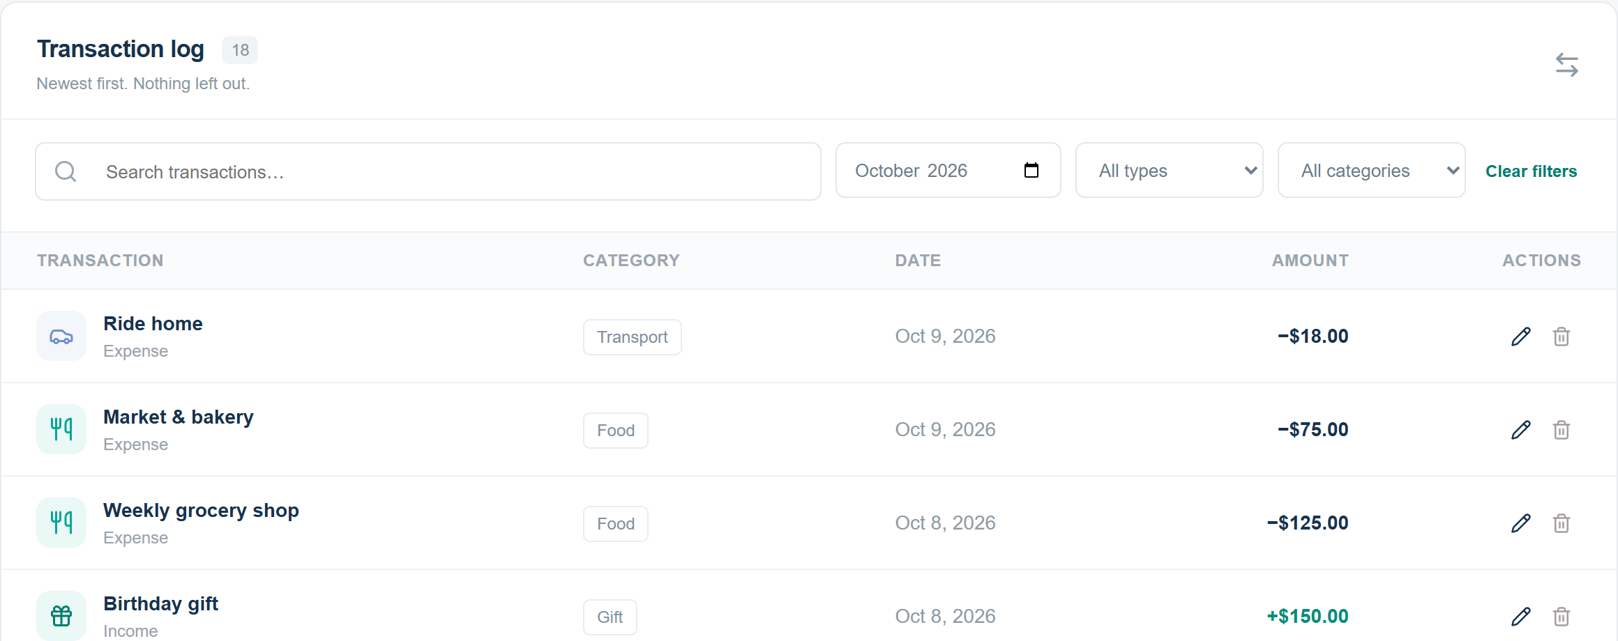
Every transaction, easy to find
Record income or spending. Filter by month, type or category.
Prototype view / Fictional sample data in USD
04
Notes:
Suggested time: 40 seconds.
A user adds an income or expense entry with an amount, date and category. The transaction list keeps those entries together, and the filters help find a particular month or kind of spending. Users can edit mistakes or remove an entry. For a live demonstration, add a small food expense and then filter to Food.
Finora prototype. Fictional sample data in USD for October 2026. Screens demonstrate the design template, not completed production screens.
Project sources: finora-template/README.md, finora-template/src/App.tsx, finora-template/src/data.ts. Original brand artwork: finora-template/public/finora-icon.svg and finora-wordmark.svg.
Current implementation: finora/client/README.md documents connected transaction filters and create, edit and delete dialogs.

Slide 5

Budget limits with context
A monthly limit for
each spending category
Finora shows when spending
is near a limit or over it.
$25 over
Entertainment: $225 spent
against a $200 budget.
Prototype view / Fictional sample data in USD
05
Notes:
Suggested time: 40 seconds.
Users choose a monthly budget for a category. Finora compares recorded spending with that limit. In the template, under 80 percent is on track, 80 to 100 percent is near the limit, and more than 100 percent is exceeded. Here entertainment spending is 225 dollars against a 200-dollar limit, so the warning explains that it is 25 dollars over. This gives a concrete reason to review the next purchase.
Finora prototype. Fictional sample data in USD for October 2026. Screens demonstrate the design template, not completed production screens.
Project sources: finora-template/README.md, finora-template/src/App.tsx, finora-template/src/data.ts. Original brand artwork: finora-template/public/finora-icon.svg and finora-wordmark.svg.
Current implementation: budgets and their status displays are connected in the main app. The alert panel shown here comes from the prototype dashboard.

Slide 6

A monthly report you can understand
A category breakdown explains where the money went.
Housing accounts for 48.9% of this example’s spending.
Prototype view / Fictional October 2026 data in USD
06
Notes:
Suggested time: 35 seconds.
The monthly report puts the spending categories in context. In this sample month, housing is the largest category at 1,400 dollars, or 48.9 percent of total spending. That is a description of the example, not advice to change a particular expense. The template also offers Excel export so users can keep a copy of the report.
Finora prototype. Fictional sample data in USD for October 2026. Screens demonstrate the design template, not completed production screens.
Project sources: finora-template/README.md, finora-template/src/App.tsx, finora-template/src/data.ts. Original brand artwork: finora-template/public/finora-icon.svg and finora-wordmark.svg.
Current implementation: monthly report summary, category breakdown and read-only budgets are connected in the main app. Do not promise template-only features as production features.

Slide 7
A clearer picture of
everyday money
Finora brings spending and monthly budgets
together, so the numbers are easier to understand.
Live demo & questions
Team 4
07
Notes:
Suggested time: 20 seconds, then demo or questions.
Our goal is to make everyday finances easier to understand. The short demo follows one expense: add it to Transactions, check its category budget, then open the Monthly Report.
If asked about readiness: the repository documents connected transactions, budgets and monthly reports with a NestJS backend. Dashboard and Income pages are still in progress. The backend keeps changes through browser refreshes but resets when the server restarts. The standalone template resets on browser reload and has no bank connection or authentication.
Sources: finora/client/README.md, api/README.md and finora-template/README.md.

