Slide 1


A game plan for
your money
Spend with a plan. Know where you stand.
Team 4 / Project presentation
01
Notes:
Suggested time: 20 seconds.
You work for your money. Keeping track of it should not feel like a second job. Meet Finora: a personal finance project that connects everyday spending with a monthly plan.
Bridge: But first, a familiar magic trick.
Project sources: finora-template/README.md, finora-template/src/App.tsx, finora-template/src/data.ts and finora/client/README.md. Screens use fictional prototype data in USD. Finora helps users understand recorded transactions. No bank connection, guaranteed savings, public release or measured customer outcome is claimed.

Slide 2
Payday arrives.
Then… poof.
It all feels small
One coffee. One ride.
One more night out.
A few small purchases later,
you’re investigating your own money.
Then the total hits
Your balance has a plot twist.
Your budget wasn’t ready.
02
Notes:
Suggested time: 30 seconds.
Payday arrives and, for a moment, we all feel rich. Then come a coffee, a ride, another night out. Suddenly we are detectives trying to solve the case of our own missing money. The money did not vanish. We lost track of the small decisions behind the total.
Bridge: And the phrase that gets us into trouble? It’s only five dollars.
The disappearance and detective language are humorous exaggerations, not factual claims about user losses.
Project sources: finora-template/README.md, finora-template/src/App.tsx, finora-template/src/data.ts and finora/client/README.md. Screens use fictional prototype data in USD. Finora helps users understand recorded transactions. No bank connection, guaranteed savings, public release or measured customer outcome is claimed.

Slide 3
“It’s only $5” adds up fast
One small extra purchase, repeated every day.
$5
30
$150
×
=
each day
days
in one month
Small enough to ignore. Big enough to notice later.
Illustrative example / $5 per day for 30 days in USD
03
Notes:
Suggested time: 30 seconds.
Five dollars sounds harmless. Repeat one extra five-dollar purchase for thirty days and the total reaches 150 dollars. This is an illustrative calculation, not a coffee price, customer average or promised saving. The point is how easily the monthly total can hide behind a small daily amount. Finora makes recorded spending visible so the user can decide whether that purchase is worth it.
Bridge: Now imagine that same blind spot inside a monthly budget.
Project sources: finora-template/README.md, finora-template/src/App.tsx, finora-template/src/data.ts and finora/client/README.md. Screens use fictional prototype data in USD. Finora helps users understand recorded transactions. No bank connection, guaranteed savings, public release or measured customer outcome is claimed.

Slide 4
Two good nights. One busted budget.
The fun was real. So was the overspend.
THE MONTHLY PLAN
WHAT WAS SPENT
$200
$225
The plan was $200. The plot twist was $25 over.
The purchases made sense. The total needed attention.
Illustrative scenario / Fictional sample data in USD
04
Notes:
Suggested time: 30 seconds.
Here is our fictional entertainment example: 125 dollars for concert tickets, then 100 dollars for dinner and cinema. Two enjoyable nights add up to 225 dollars, but the monthly plan was 200. Nothing mysterious happened. The total simply needed attention.
Bridge: That is exactly the gap Finora is designed to close.
Project sources: finora-template/README.md, finora-template/src/App.tsx, finora-template/src/data.ts and finora/client/README.md. Screens use fictional prototype data in USD. Finora helps users understand recorded transactions. No bank connection, guaranteed savings, public release or measured customer outcome is claimed.

Slide 5
Finora puts the clues in one place
THE EVERYDAY QUESTION
FINORA’S ANSWER
Where did it go?
One searchable transaction list
Income and spending stay together.
Am I over budget?
Category limits with clear status
The amount left or over is visible.
How did the month go?
A readable monthly report
Totals and categories explain the month.
05
Notes:
Suggested time: 30 seconds.
Finora connects the everyday questions with clear answers. What did I spend? The transaction list shows the entries. Am I over budget? Category status shows the difference. How did the month go? The report explains the full picture. Users record their spending, and Finora brings those records together.
Bridge: First, the view we all want after payday: where do I stand?
Project sources: finora-template/README.md, finora-template/src/App.tsx, finora-template/src/data.ts and finora/client/README.md. Screens use fictional prototype data in USD. Finora helps users understand recorded transactions. No bank connection, guaranteed savings, public release or measured customer outcome is claimed.

Slide 6

Your month at a glance
Income, expenses and what remains in one view.
$2,386 left this month
In this example: $5,250 income minus $2,864 expenses.
Prototype view / Fictional October 2026 data in USD
06
Notes:
Suggested time: 35 seconds.
In the sample month, recorded income is 5,250 dollars and expenses are 2,864 dollars. Their difference is 2,386 dollars, which the template calls monthly savings. This is the difference between recorded income and expenses, not proof of money held in a separate savings account. The dashboard image shows the intended prototype experience.
Transition to the next slide: That overview depends on the everyday entries behind it.
Sources: finora-template/README.md, finora-template/src/App.tsx, finora-template/src/data.ts and finora/client/README.md. Prototype figures are fictional sample data in USD, not measured user outcomes.

Slide 7
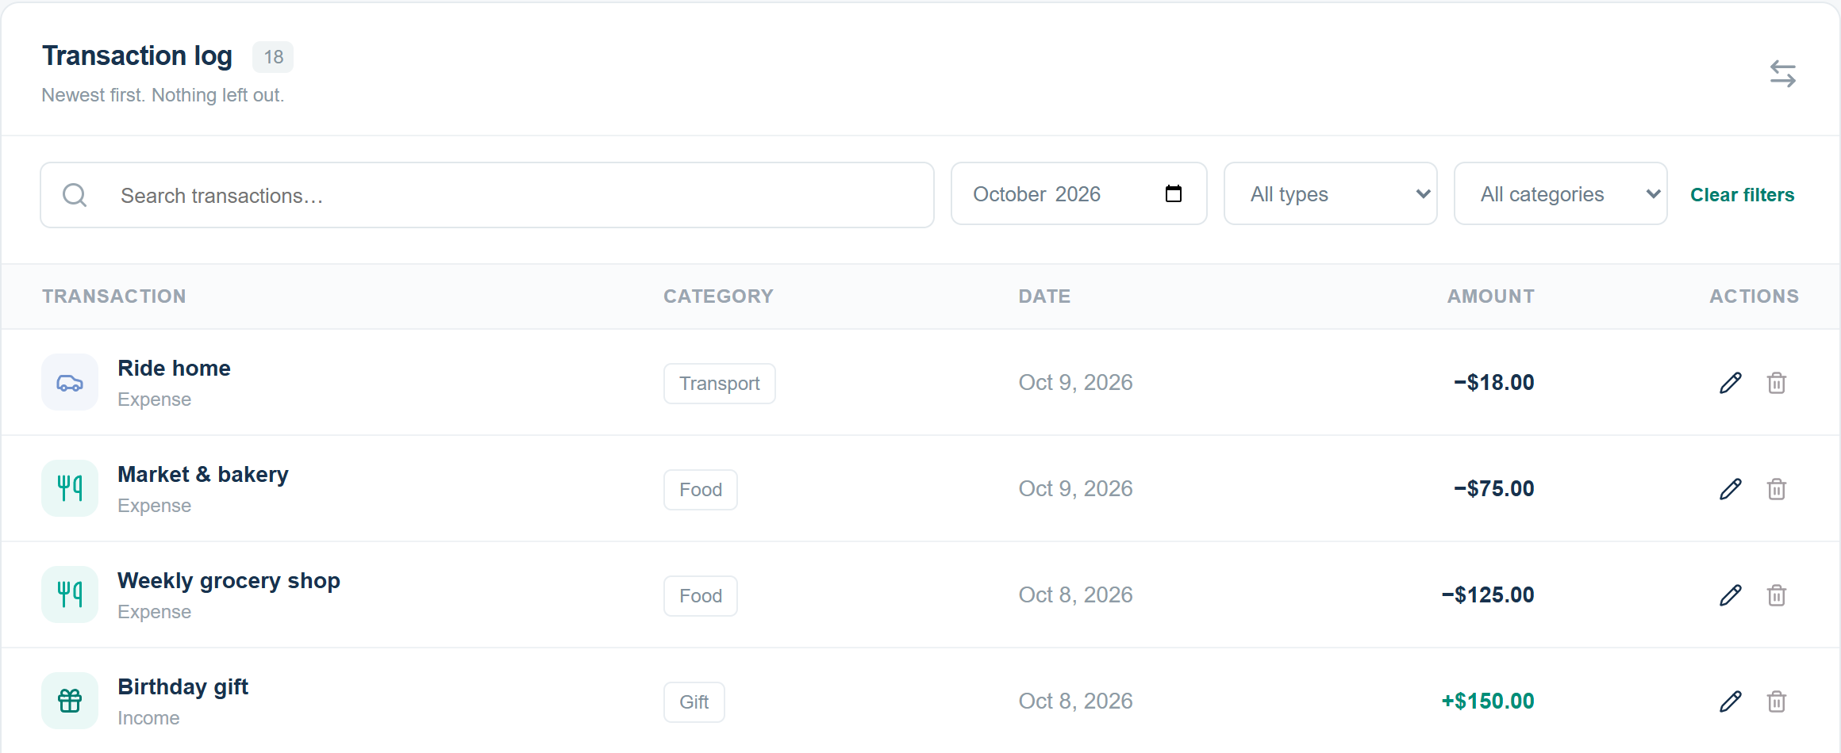
Every transaction, easy to find
Record income or spending. Filter by month, type or category.
Prototype view / Fictional sample data in USD
07
Notes:
Suggested time: 35 seconds.
Users record an income or expense with an amount, date and category. The list keeps the entries together. Search and filters help find a transaction by month, type or category. Users can edit an incorrect entry or remove it. This makes it possible to trace a total back to its underlying purchases.
Transition to the next slide: Once the spending is recorded, Finora can compare it with the plan.
Sources: finora-template/README.md, finora-template/src/App.tsx, finora-template/src/data.ts and finora/client/README.md. Prototype figures are fictional sample data in USD, not measured user outcomes.

Slide 8

Am I staying within my budget?
A monthly limit for
each spending category
Finora shows when spending
is near a limit or over it.
$25 over
Entertainment: $225 spent
against a $200 budget.
Prototype view / Fictional sample data in USD
08
Notes:
Suggested time: 40 seconds.
Return to the entertainment example. The budget is 200 dollars, and recorded spending is 225 dollars. Finora shows Exceeded and states that the category is 25 dollars over. Near-limit status appears from 80 percent through 100 percent, and spending above the limit is exceeded. The app reveals the situation so the user can review the next purchase. It does not guarantee savings or prevent spending.
Transition to the next slide: The next question is what the complete month tells us.
Sources: finora-template/README.md, finora-template/src/App.tsx, finora-template/src/data.ts and finora/client/README.md. Prototype figures are fictional sample data in USD, not measured user outcomes.

Slide 9

What can I learn from this month?
A category breakdown explains where the money went.
Housing accounts for 48.9% of this example’s spending.
Prototype view / Fictional October 2026 data in USD
09
Notes:
Suggested time: 35 seconds.
The report shows the spending categories for the selected month. Housing is the largest in this fictional example: 1,400 dollars, or 48.9 percent of total spending. This helps the user understand the pattern and review next month’s budget. The totals describe the recorded data and do not prescribe what someone should spend.
Transition to the next slide: These features lead to a practical question: why would someone choose Finora?
Sources: finora-template/README.md, finora-template/src/App.tsx, finora-template/src/data.ts and finora/client/README.md. Prototype figures are fictional sample data in USD, not measured user outcomes.

Slide 10
Why Finora belongs in your day
01
Less detective work
Find the entry behind the total with search and filters.
02
More say in your spending
Set your own limits and see how much room is left.
03
A plan you can keep adjusting
Edit an entry, change a budget, and review the month.
A small habit today can make next month easier to understand.
10
Notes:
Suggested time: 35 seconds.
Why bring Finora into your day? Because it gives a practical job to the numbers. Search helps you find the purchase behind a total. Budgets make your own limits visible. Editing and monthly review let the plan evolve with your life. You keep the choices. Finora supplies context.
Bridge: So, before we finish, one message from your money.
Project sources: finora-template/README.md, finora-template/src/App.tsx, finora-template/src/data.ts and finora/client/README.md. Screens use fictional prototype data in USD. Finora helps users understand recorded transactions. No bank connection, guaranteed savings, public release or measured customer outcome is claimed.

Slide 11
Your money called.
It wants a game plan.
Ready to give it one?
Try Finora. Start with your next expense.
Ask our team to try the demo
Team 4
11
Notes:
Suggested time: 25 seconds, then invite the audience to the demo.
Your money called. It wants a game plan. Pause, smile, and ask: Ready to give it one? Invite the audience to try Finora with one expense, check the category budget, and see the monthly result.
No confirmed download or public demo URL was provided. The on-slide invitation directs people to the team demo. If asked about readiness: the main app has connected transactions, budgets and monthly reports. Dashboard and Income pages remain in progress. The standalone template resets on reload, and backend data resets on server restart.
Project sources: finora-template/README.md, finora-template/src/App.tsx, finora-template/src/data.ts and finora/client/README.md. Screens use fictional prototype data in USD. Finora helps users understand recorded transactions. No bank connection, guaranteed savings, public release or measured customer outcome is claimed.

