Slide 1

Histogram Equalization and Histogram Diagram

Slide 2

Introduction
Histogram Equalization && Histogram digram is a process used to improve the contrast of images and increase their optical quality. This process is
based values
on the distribution of color in the image and aims to
all
distribute them evenly across possible values.
When we talk about images, a histogram is a graph that reflects the distribution of colors in an image. The histogram consists of two axes: the horizontal axis represents the possible luminance values or colors, and the vertical axis represents the frequency or relative number of each value in the image.

Slide 3
applications in image processing, and among its main uses are:
Contrast enhancement: Histogram Equalization helps improve contrast in an image. When we have an image with abuildup of values in specific areas, the adjustment process can be used to increase contrast and distribute colors more evenly.
Improve brightness and color balance: Can be used to improve image brightness and color balance.
Improve information detection: When there are small or weak details in an image, it can be used to enhance those details and improve the detection of important information.
Night scene image enhancement: It is effective in improving night or low-light images

Slide 4
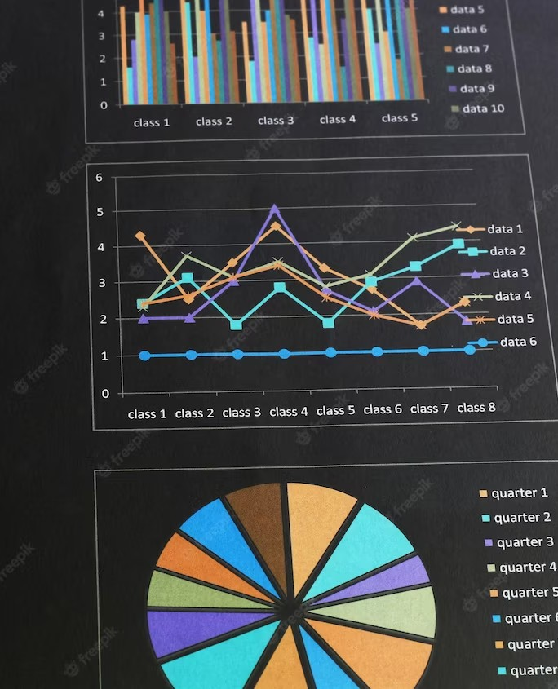
Medical Image Processing: It is used to improve X-ray images and other medical images. The adjustment process can help clarify important details and improve medical diagnosis.
Medical Image Processing: It is used to improve X-ray images and other medical images. The adjustment process can help clarify important details and improve medical diagnosis.

Slide 5

The process of modifying the spectral distribution (Histogram Equalization) is carried out through the following steps:
Histogram calculation: The histogram of the image is calculated, the presence of each value in each brightness or color.
Select a transform function: Select a transform function to modify the color distribution in the image. The transform function is to apply a new parsing pattern to the original histogram.

Slide 6
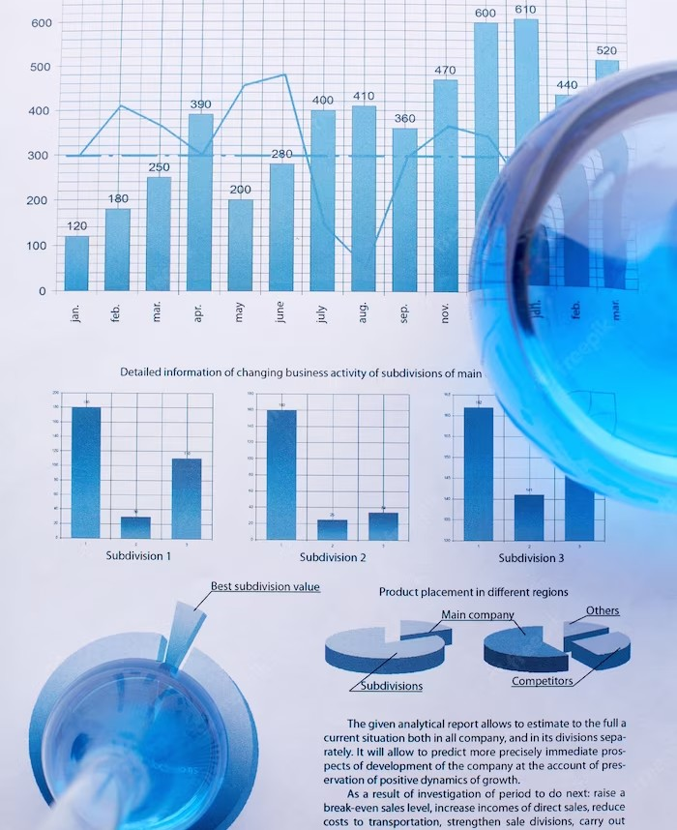
Transform application: The transform function is applied to the original histogram of the image. The process is as simple as redistributing the values.
Applying the adjustment to the image: The adjustment resulting from the previous step is applied to the original image to adjust the color distribution in it. Using the adjustment process, the image
contrast is improved and the color distribution is more even and realistic.

Slide 7
Thanks!
Member team :
1-yazan moqanasa
2-ameer sousa

