Slide 1

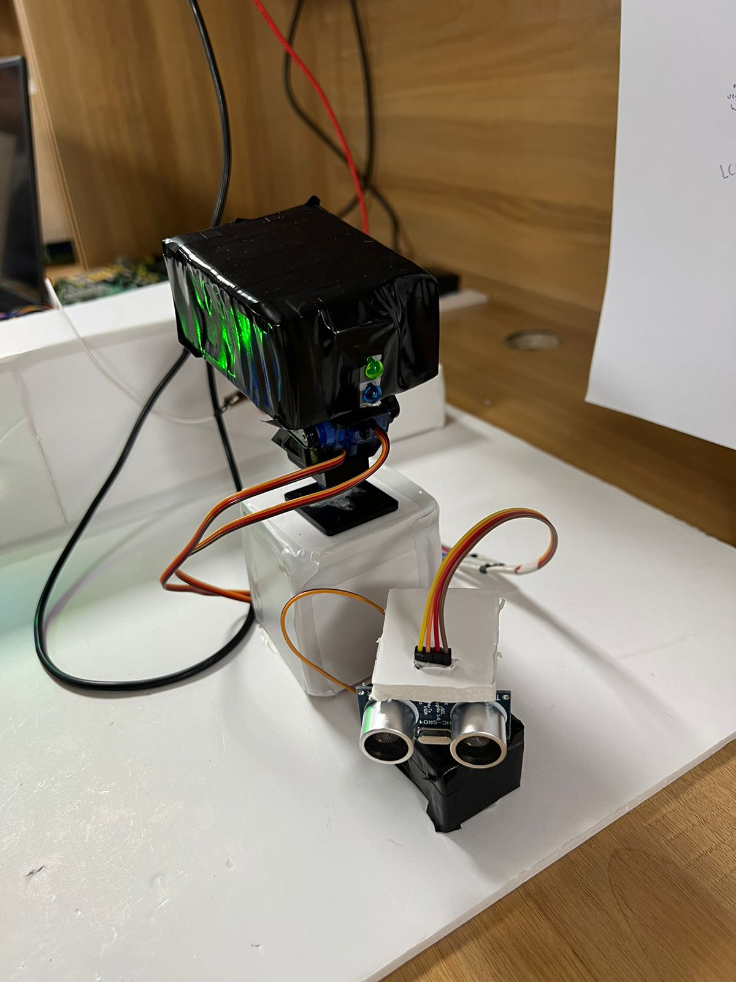
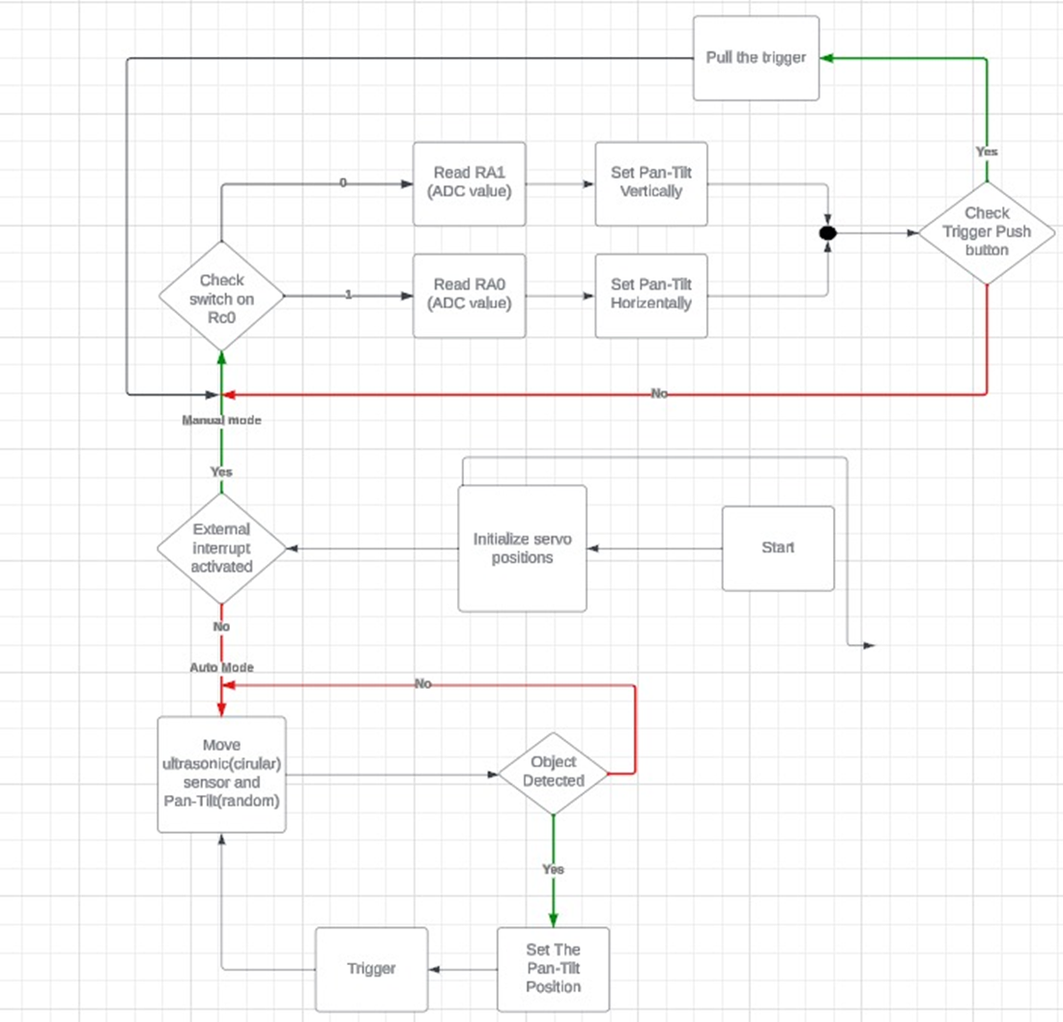
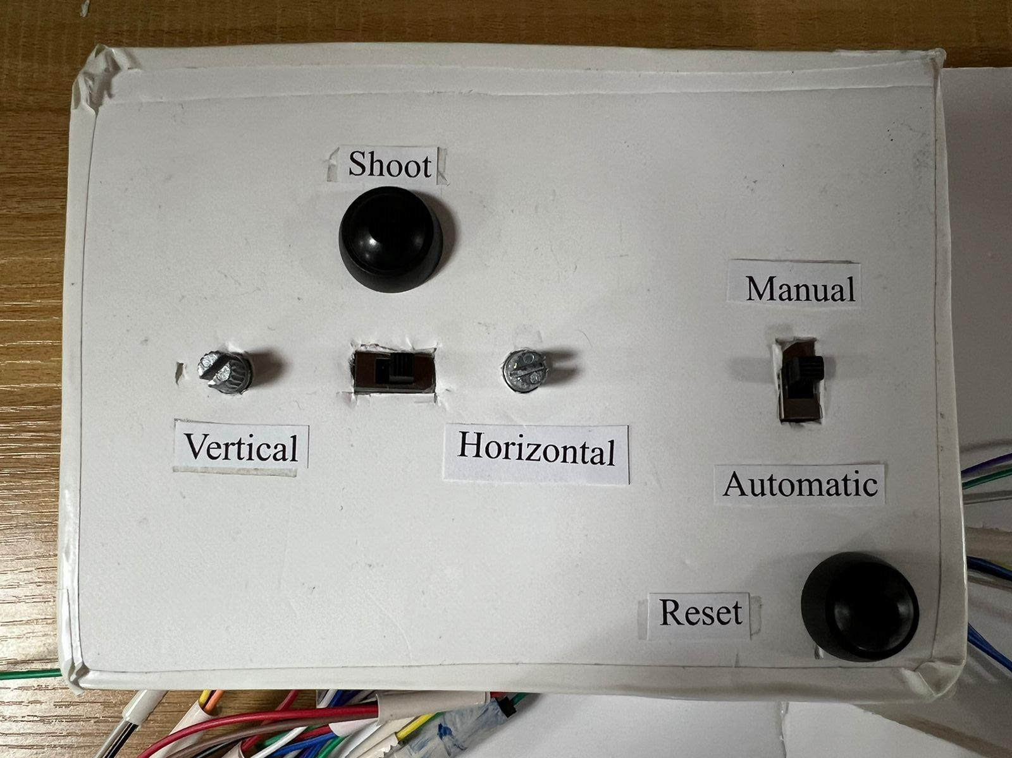
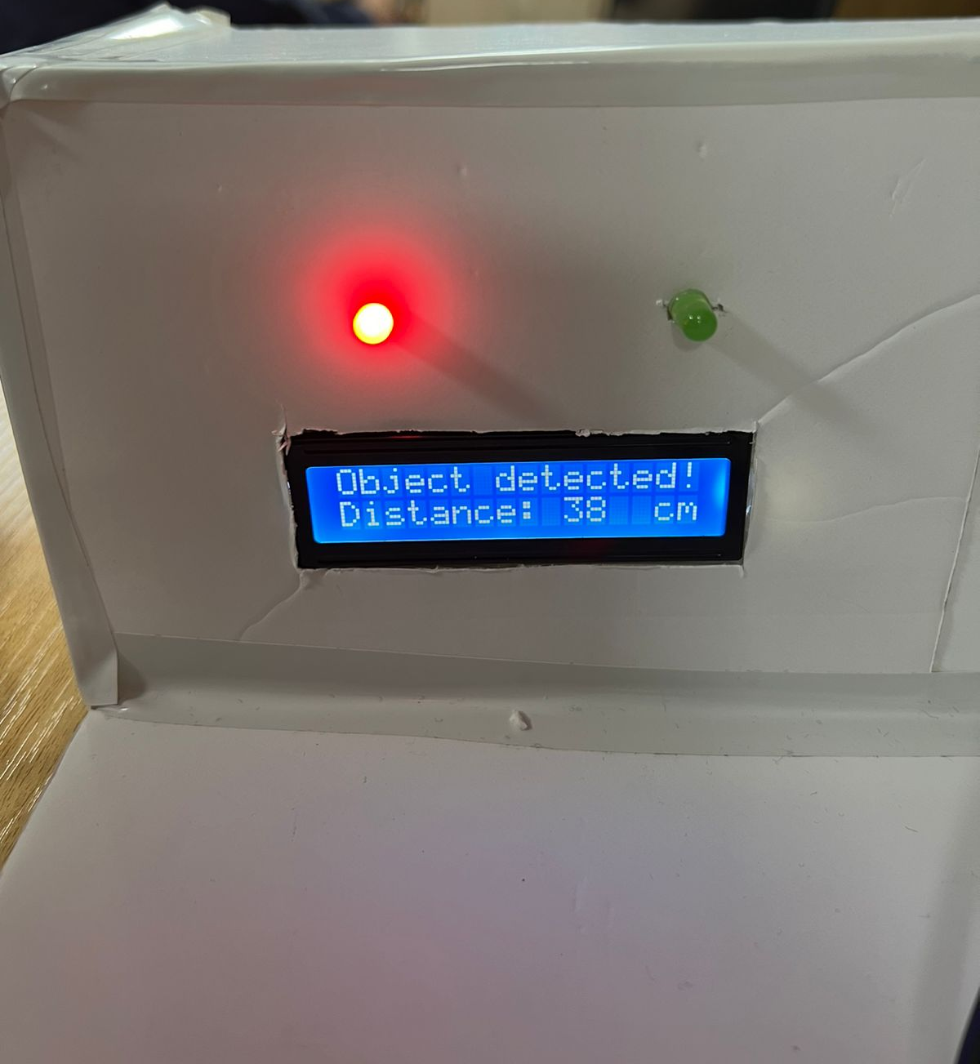
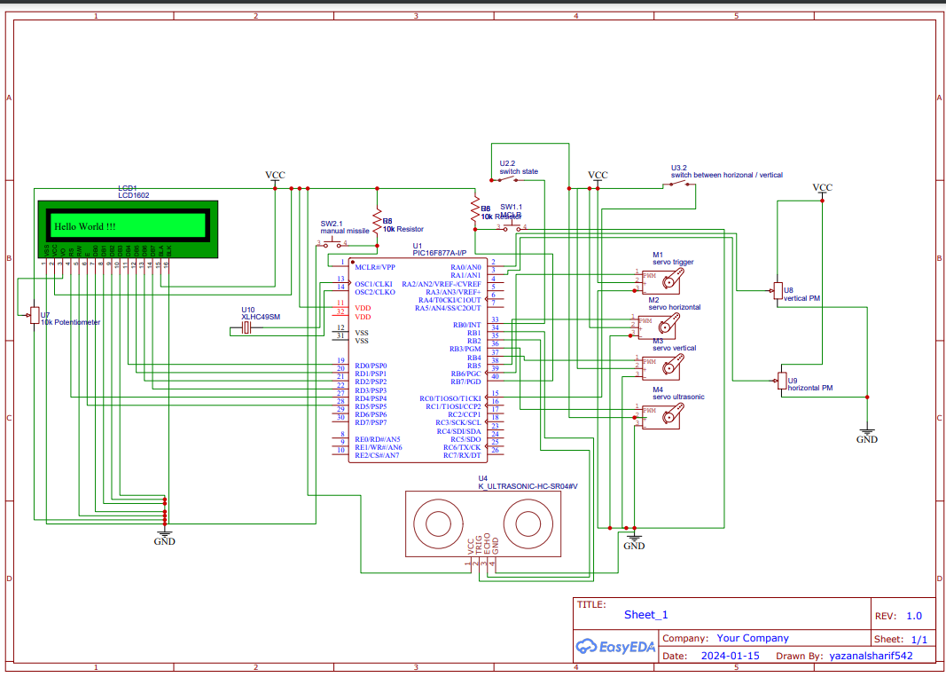
Missile Defence System
B. Unsal, O. Tubeileh, Y. AL-Sharif
Supervisor: Dr. Belal Sababha
Embedded Systems Final Design Project, Fall 2023
King Abdullah II School of Engineering
Princess Sumaya University for Technology
Introduction
Our Missile Defense System features a cutting-edge autodetection mechanism and a precision-guided missile shooter, incorporating advanced sensors, actuators, and electronic components. Operating in two distinct modes – Autodetection and Manual Control – the system offers adaptability and flexibility in diverse defense scenarios.
Manual Control State:
Transitioning to Manual Control mode grants the operator direct control over the missile shooter. Two potentiometers govern the circular and vertical motions of the system, enabling precise targeting. A push-button trigger engages the missile launch.
Autodetection State: In the Autodetection state, an ultrasonic sensor, under the control of a servo motor, scans its surroundings in a circular motion until a potential threat is identified. Visual cues, provided through LEDs, guide the Missile Shooter to align itself with the detected target. The missile shooting device, equipped with servo motors for horizontal and projectile motion, ensures accurate targeting based on the detected object's distance.
Results
The implementation of our Missile Defense System yielded promising outcomes, showcasing the effectiveness of our embedded systems approach. Here are key results from our project:
Figure 3: Prototype
The missile base is strategically lifted to a secure height, ensuring a clear trajectory for missile launches without the risk of collision with the ultrasonic sensor.
Figure 4: Circuit’s controllers
One slide switch was used to change the system’s mode, the other was to choose between the circular and vertical motions.
Figure 5: Detecting objects
Design
In the following, the flowchart of this project that demonstrates how our missile defense system works according to our code flow:
Figure 1: Flowchart
What follows, is the designed circuit of the system we are seeking to construct:
Figure 2: Schematic Design
Conclusion
In essence, our Missile Defense System represents a pinnacle achievement in embedded systems engineering. The seamless synchronization between sophisticated sensors and the microcontroller lies at the heart of our project, showcasing a robust integration that optimizes the detection and targeting processes. As we navigate the intricate landscape of defense technology, this system not only fortifies national security but also exemplifies the power of embedded systems in addressing contemporary defense challenges. By pushing the boundaries of sensor-microcontroller synergy, our project sets a precedent for future innovations in embedded systems, reinforcing their pivotal role in advancing the precision and adaptability of defense mechanisms.

