Slide 1
Gap2Idea: An Idea Mining Platform
for Research Acceleration
Bachelor Thesis Defense by:
Yazan Alnakri
Under the supervision of [Supervisor name]

Slide 2
Agenda
● Introduction
● Research Objective
● Related Work
● Proposed Pipeline
● Extraction with provenance
● Theme mining + Bridge score
● Three idea-generation modes
● Multi-agent quality layer
● Paper drafter
● Evaluation
● Conclusion
2

Slide 3
Introduction
● More than 100,000 ML preprints are uploaded to arXiv every year, and the rate keeps growing.
● No individual researcher can read this volume — promising directions are simply missed.
● The most valuable signal of what remains undone — the Limitations and Future Work sections that authors write — is scattered across thousands of PDFs.
● There is currently no production tool that harvests these sections at scale and turns them into actionable research ideas.
3

Slide 4
Introduction: the buried signal
● Authors of a paper know their own work better than any external observer.
● Their Limitations / Future Work / Open Problems sections are an authoritative annotation of "what is still missing".
● Yet this signal lives at the end of each PDF — rarely indexed, rarely searched, never aggregated.
● Consider a graduate student starting a thesis on graph neural networks: hundreds of future-work paragraphs hint at extensions — dynamic edges, distribution shift, multimodal — but they are not collectable today.
4

Slide 5
Research Objective
Design, implement, and evaluate an end-to-end pipeline that converts a corpus of academic papers into clustered research gaps, multi-mode idea proposals, and conference-paper drafts — with every artefact traceable to the verbatim source text that motivated it.
5

Slide 6
Related Work
● SciMuse — couples knowledge graphs with LLMs to suggest broad research directions.
● CHIMERA — mines recombination patterns from paper abstracts.
● LiveIdeaBench — evaluates open-ended LLM creativity on idea-generation prompts.
● Ramón Llull Thinking Machine — generates ideas along predefined conceptual axes.
● None of them extract author-acknowledged gaps verbatim, ground generated ideas in those gaps, or expose the full process to user inspection.
6

Slide 7
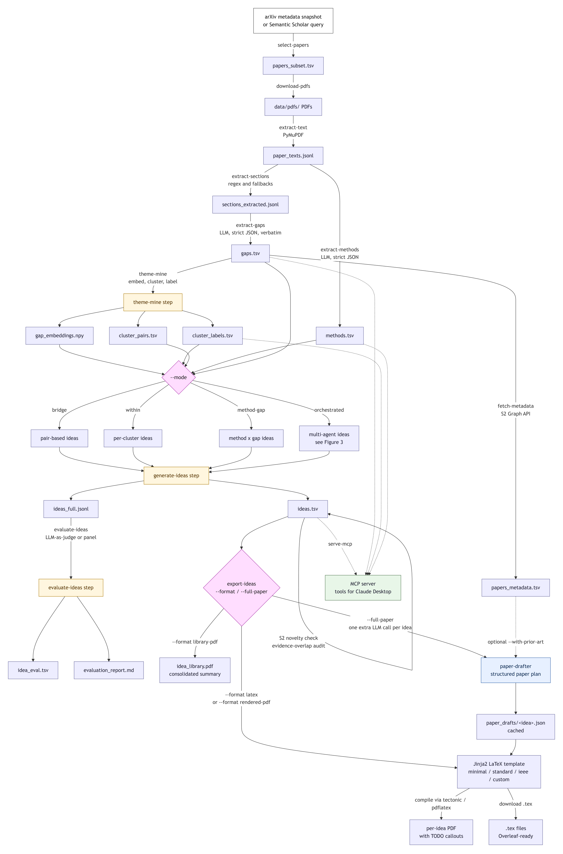
Proposed Pipeline
● Stage A — Acquisition and extraction.
● Stage B — Theme mining (cluster + label).
● Stage C — Idea generation in three modes.
● Stage D — Multi-agent evaluation.
● Stage E — Export and paper drafter.
Every artefact stays traceable to the verbatim source text.
7

Slide 8
Extraction with provenance
● PDF → text via PyMuPDF; every page read (limitations sometimes appear mid-paper).
● Three-strategy section finder:
● Structured headings — numbered, Roman, or all-caps.
● Keyword-window fallback — "future directions", "open problems"…
● Tail-window fallback — last 900 tokens before References.
● Strict JSON-schema LLM call per paper: at most two gap items, each with verbatim sentence, verbatim paragraph, type ∈ {limitation, future_work, open_problem}, and a self-reported confidence.
● Post-hoc filters: confidence ≥ 0.5, sentence length ≥ 20 chars, de-duplicate on (paper_id, sentence).
8

Slide 9
Theme mining
● Embed every gap sentence with all-MiniLM-L6-v2 (384-d, L2-normalised).
● Clusterer adapts to corpus size:
● K-Means with silhouette-swept k when |F| < 150.
● HDBSCAN for larger corpora, noise cluster tolerated.
● Each cluster receives two labels:
● TF-IDF keywords — deterministic, robust.
● LLM noun-phrase theme — human-readable.
● Both kept, because keywords are robust but stilted, and LLM labels are readable but stochastic.
9

Slide 10
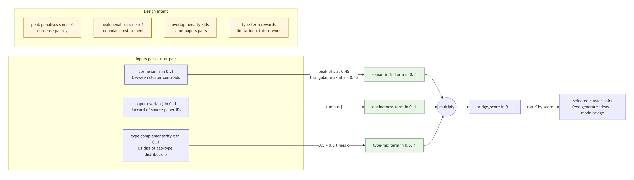
Bridge score
bridge(A, B) = peak(cos(μA, μB), 0.45) · (1 − J(PA, PB)) · (0.5 + 0.5·τ(A, B))
● Peak at moderate similarity (0.45) — identical themes restate; distant themes do not combine.
● Penalise paper overlap — pairs drawn from the same sources go to 0.
● Reward type complementarity — limitations × future_work is more interesting than two limitations.
10

Slide 11
Idea generation — three modes
● Within-theme — for each cluster, synthesise one idea from its recurring evidence.
● Bridge — combine two related-but-distinct themes selected by the bridge score.
● Method-gap — retrieve method-claim sentences from a separately-mined library, propose their application to unmet gaps (explicit X-solves-Y semantics).
● All three share one schema — title, research question, method sketch, evaluation plan (named metric + baseline), evidence used, confidence.
● Post-hoc evidence-overlap filter strips hallucinated paper IDs from the LLM's claimed evidence list.
11

Slide 12
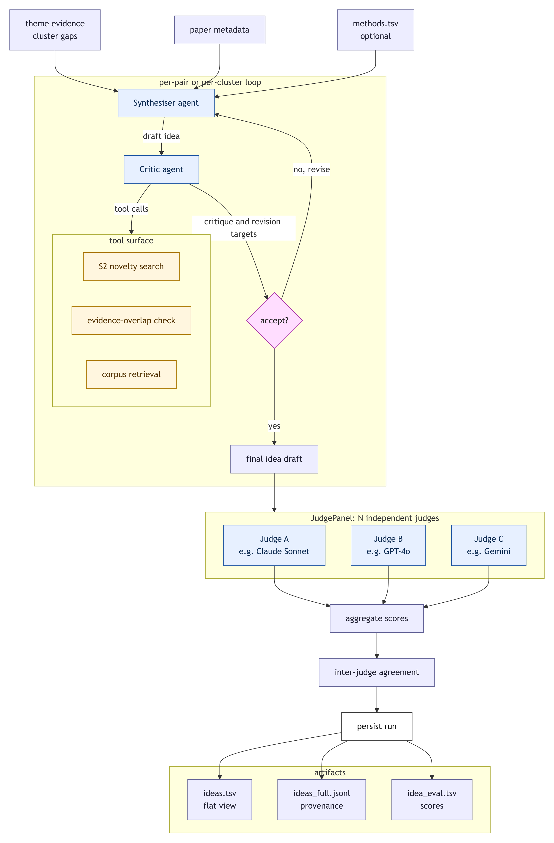
Multi-agent quality layer
● A single LLM call cannot inspect its own output against external facts.
● Critic — issues live tool calls for novelty (Semantic Scholar) and evidence overlap, proposes targeted revisions.
● Revisor — re-renders the idea addressing each issue; bounded loop (typically 2 iterations).
● Judge panel — independent models from three providers (Anthropic, OpenAI, Google) score on a 4-axis rubric.
● Cross-provider agreement statistic α surfaces consistency as an interpretable signal.
12

Slide 13
Critic diagnostics
● Novelty score ν = 1 − maxₕ cos(eᵢdₑₐ, eₐbₛₜrₐcₜ)
● Embed (title + research question). Search Semantic Scholar. Cosine against top-k abstracts.
● Hard rule: ν < 0.4 → critic must request revision.
● Evidence overlap |used ∩ fed| / |used|
● Deterministic, no LLM call. Compare each (paper_id, gap_sentence) against the fed evidence.
● Hard rule: overlap < 0.8 → critic must request revision.
● Critic and synthesiser default to different providers (Claude critic, GPT synthesiser) to mitigate self-evaluation bias.
13

Slide 14
Judge panel
● Three judges, three providers:
● Anthropic Claude Sonnet
● OpenAI GPT-4o
● Google Gemini Flash
● Each judge scores on a 1–5 Likert rubric:
● Novelty — beyond rebranding existing work?
● Specificity — method, dataset, metric, baseline named concretely?
● Feasibility — could a graduate student start in two weeks?
● Evidence grounding — does the idea trace back to the fed gaps?
● Inter-judge agreement α = 1 − σ̄ / 4 (σ̄ = mean per-axis std-dev). α = 1 ⇒ unanimous.
14

Slide 15
Paper drafter
● Any saved idea can be expanded by one further LLM call into a full paper plan.
● Output conforms to PAPER_DRAFT_SCHEMA — abstract, introduction, related work, four-subsection method, experimental setup, expected results (qualitative), discussion, conclusion.
● Three protections keep the draft honest:
● Prompt forbids fabricated numbers; expected_results is marked as a plan, not measurement.
● Post-hoc filter strips any related-work entry whose paper_id was not in the input evidence.
● LaTeX template renders "Human work required" as a visually distinct callout box.
● Rendering: three bundled templates (minimal / standard / IEEE) or a user-supplied custom template.
15

Slide 16
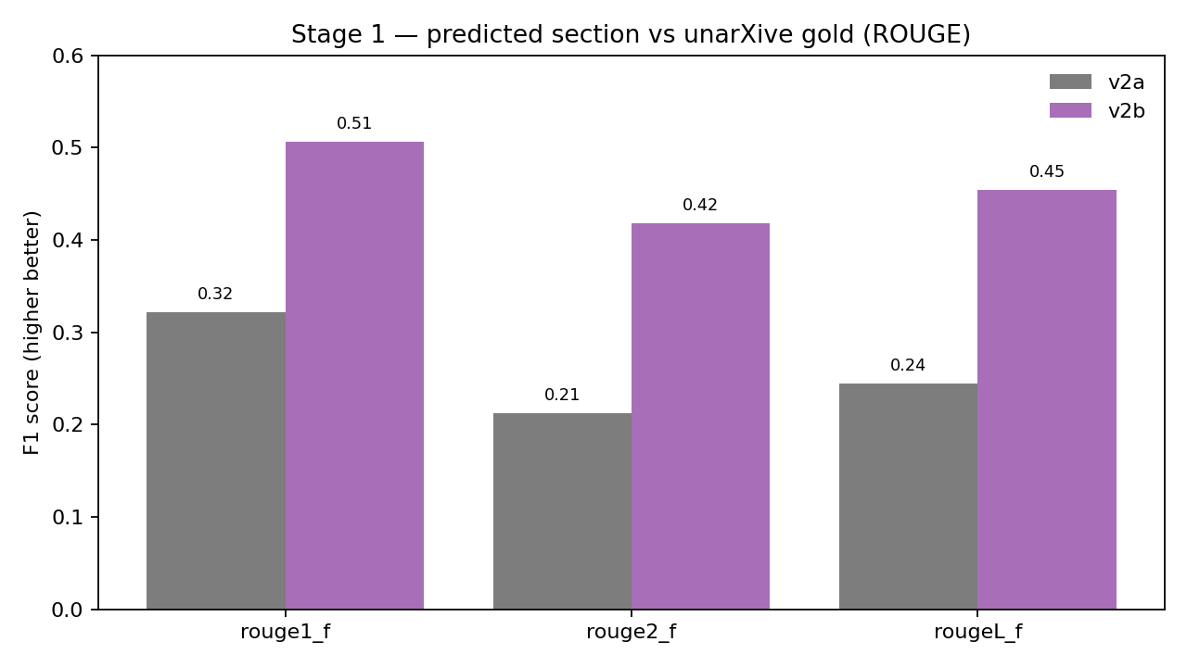
Extraction quality
● Bench: stratified sample of N = 100 papers from unarXive 2023 with labelled section spans.
● v2a (flat-text regex) → v2b (PDF style-aware extractor):
● ROUGE-1 F1: 0.322 → 0.506 ( +57% )
● ROUGE-2: +97% · ROUGE-L: +85%
● Same Stage-2 LLM both runs — the lift comes from heading recovery only.
16

Slide 17
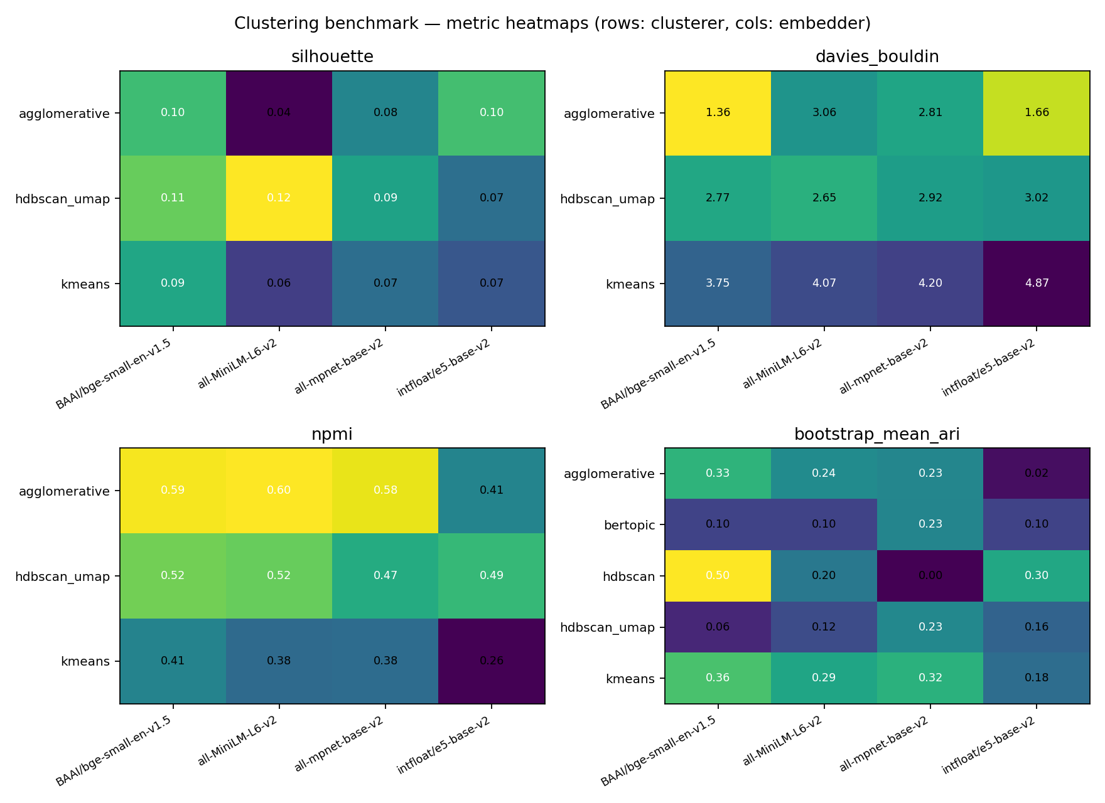
Clustering quality
● 5 clusterers × 4 encoders on 161 verbatim gap sentences from 98 papers.
● Five intrinsic metrics:
● Silhouette ↑ Davies-Bouldin ↓ Calinski-Harabasz ↑
● NPMI ↑ — semantic coherence proxy
● Bootstrap ARI ↑ — stability under 80% resamples
● NPMI matters because the downstream consumer cares about theme coherence, not geometry alone.
17

Slide 18
Idea quality
Three-judge panel scores per axis (1–5 Likert).
Numbers below to be filled from idea_eval.tsv before the defence.
Mode | Novelty | Specificity | Feasibility | Grounding | Composite | α
within-theme | — | — | — | — | — | —
bridge | — | — | — | — | — | —
method-gap | — | — | — | — | — | —
Alongside the panel scores, the evidence_overlap is reported deterministically — catches hallucinated citations even when the panel gives 5/5.
18

Slide 19
Contributions
● A reproducible gap-mining pipeline from PDF to verbatim gap sentences, with paper-level provenance.
● A bridge-score mechanism that ranks cluster pairs by similarity sweet-spot × paper diversity × type complementarity.
● Three idea-generation modes (within-theme, bridge, method-gap) sharing one schema and an evidence-overlap audit.
● A multi-agent quality layer — critic with tool-derived diagnostics, revisor, and cross-provider judge panel with α.
● A paper drafter that expands any saved idea into a structured LaTeX paper plan with a visible "Human work required" callout.
19

Slide 20
Limitations and future work
● Bench scale — N = 100 unarXive papers is small in absolute terms; would need to grow for publication.
● No human gold standard for idea quality — inter-judge α serves as a proxy.
● Ideas can be noun-phrase novel without being experimentally novel — LLMs are plausible without being correct.
● Future work:
● Structural graph bridges (edge-betweenness) over individual gaps instead of centroid pairs.
● An experimental sanity stage — does the method actually run on toy data?
● Force every idea to carry a falsifiable quantitative prediction and a named baseline.
● Scale to N = 1000 with author co-citation as an additional signal.
20

Slide 21
Conclusion
● Gap2Idea harvests the author-acknowledged research gaps that every paper contains but no one aggregates.
● It turns them into evidence-grounded research ideas in three complementary modes, with full traceability back to the verbatim source.
● A multi-agent quality layer with tool-derived diagnostics and a cross-provider judge panel surfaces consistency as an interpretable signal.
● Any accepted idea can be expanded into a structured paper plan ready for human refinement.
● Released as an installable Python package with a CLI, a web dashboard, and an MCP server.
21

Slide 22
Thank you.
Questions?
github.com/Yazangthb/Gap2Idea

Slide 23
Appendix
Extra detail — bridge score, anti-hallucination, benchmarks, deployment.

Slide 24
Bridge score — factor detail
peak(s, p) = s/p for s ≤ p, (1 − s) / (1 − p) otherwise. J(A,B) is Jaccard overlap of source-paper sets; τ(A,B) is the half-L₁ distance between gap-type distributions.
24

Slide 25
Anti-hallucination machinery
● Schema enforcement — strict JSON-schema on every LLM call; robust parser strips markdown fences for non-OpenAI providers.
● Verbatim requirement — gap_sentence and paragraph_text must come verbatim from input; items < 20 chars or confidence < 0.5 dropped.
● Post-hoc evidence filter — evidence_used (paper_id, gap_sentence) pairs checked against fed evidence; unknown paper_ids stripped.
● Critic novelty check — ν = 1 − max cos(idea, S2 abstracts); ν < 0.4 forces revision.
● Critic overlap check — fraction of evidence_used actually fed; < 0.8 forces revision.
● Paper-drafter filter — drafter prompt and post-filter both restrict citations to input evidence or retrieved prior art.
25

Slide 26
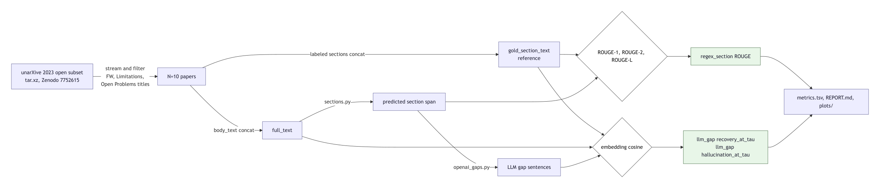
Bench methodology
● Gold reference: unarXive 2023's annotated Limitations / Future Work / Open Problems spans.
● Stage-1: ROUGE-1, ROUGE-2, ROUGE-L F1 vs gold section text.
● Stage-2: recovery rate at τ and hallucination rate at τ for τ ∈ {0.5, 0.6, 0.7}.
● Oracle ceiling — feed gold section straight into the LLM; bounds the Stage-2 LLM in isolation.
26

Slide 27
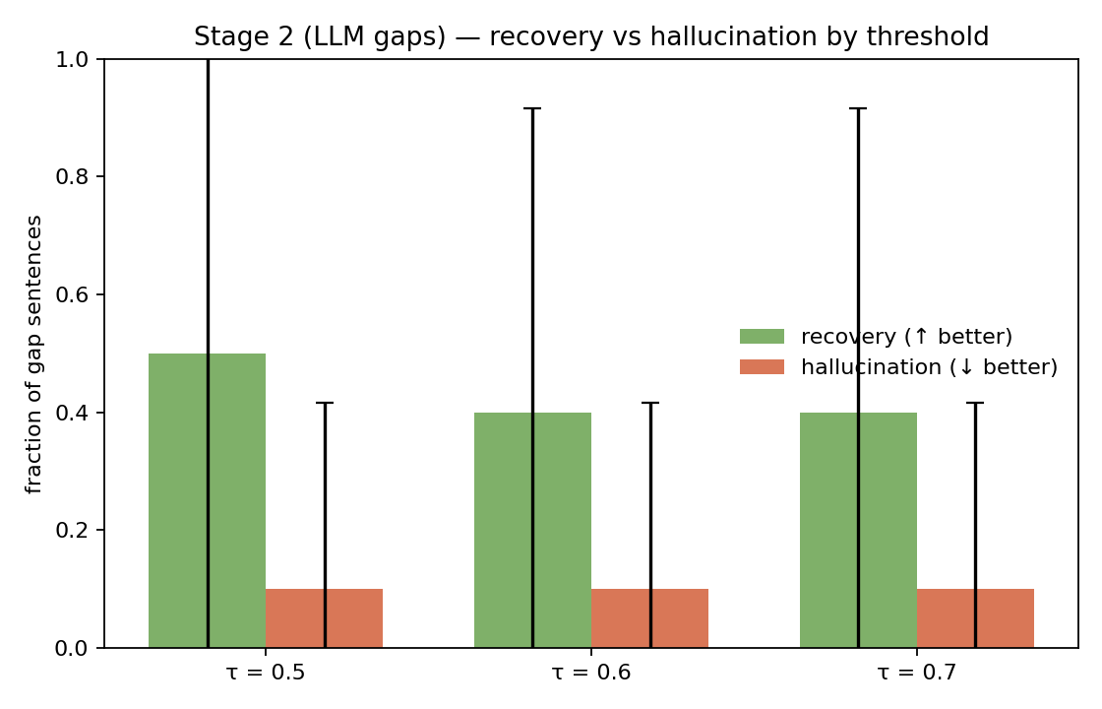
Recovery vs hallucination
● recovery(τ) ↑ — fraction of extracted gaps matching a gold-section sentence at cosine ≥ τ.
● halluc(τ) ↓ — fraction whose max cosine vs any sentence anywhere in the paper falls below τ.
● Together: confidence the LLM points at real future-work content, not inventing it.
27

Slide 28
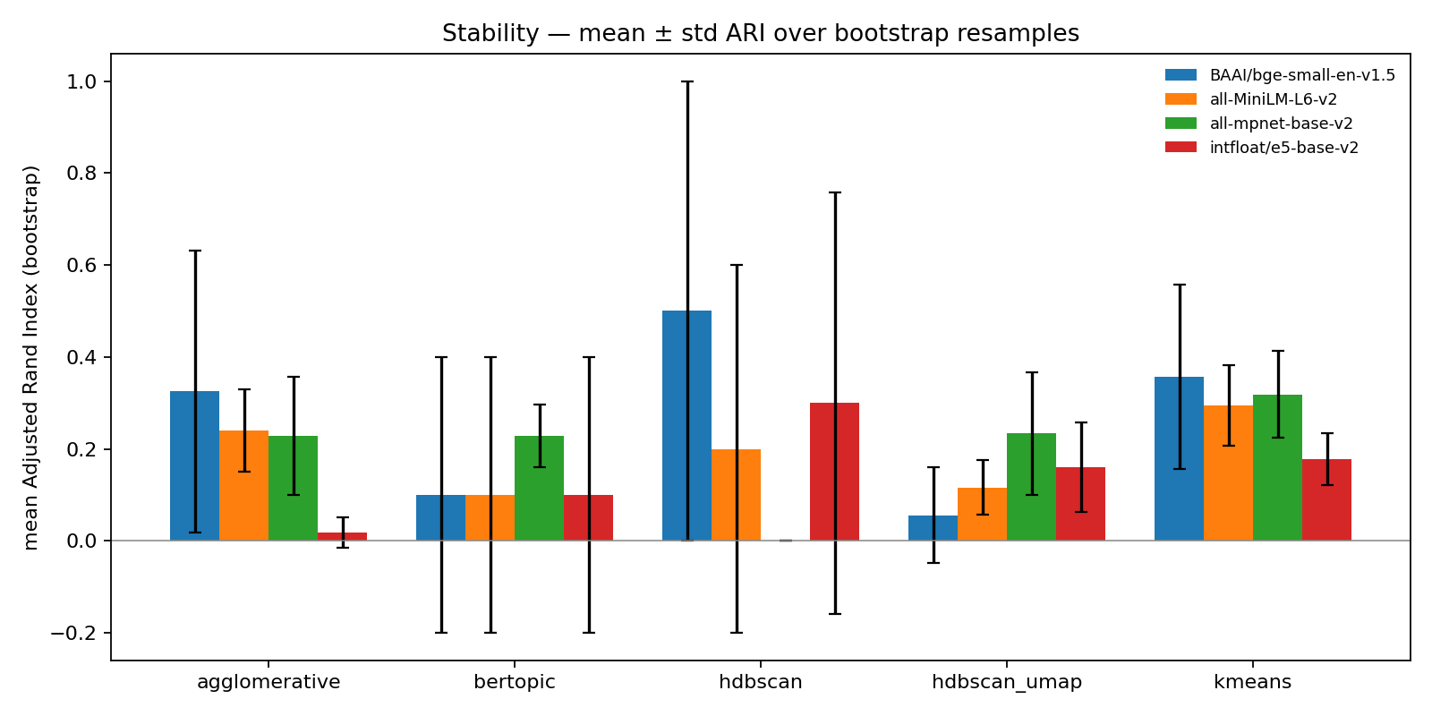
Clustering stability
● Bootstrap ARI over B = 10 80%-resamples per (clusterer × encoder) cell.
● ARI = 1 ⇒ same partition recovered; ARI = 0 ⇒ random.
● A clustering that flips between two resamples is not a clustering — stability is the thesis-defensible axis.
28

Slide 29
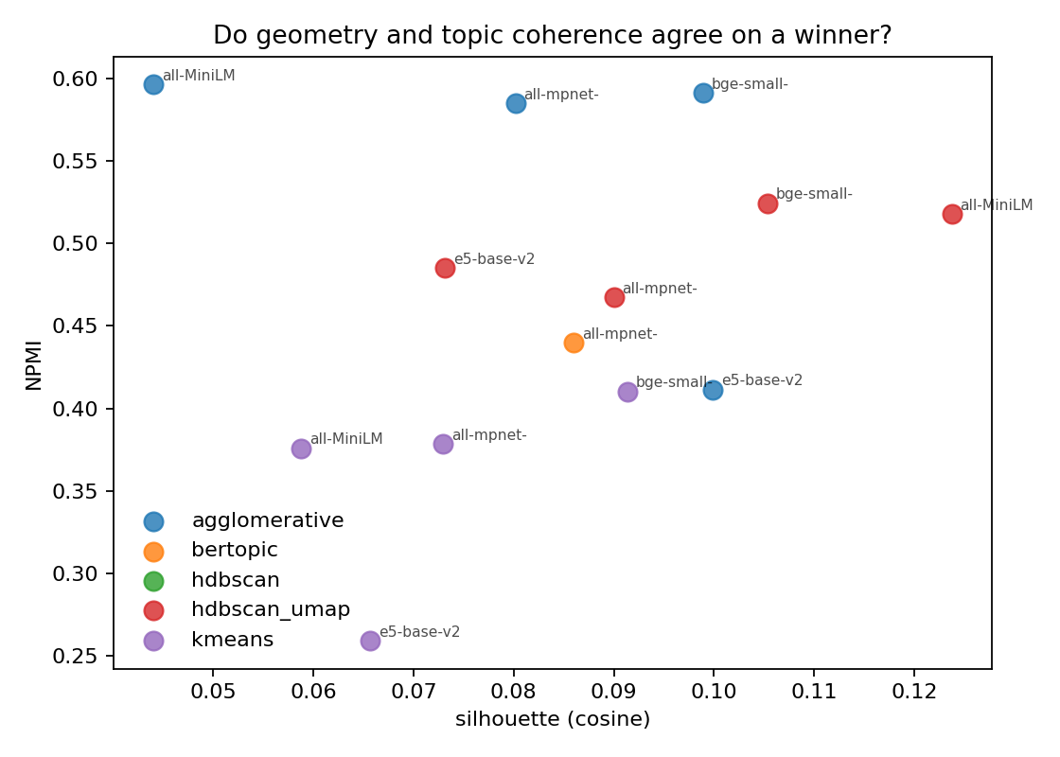
Geometry vs coherence
● Silhouette measures embedding-space tightness vs separation.
● NPMI measures whether top tokens co-occur — proxy for human-readable theme coherence.
● The downstream idea generator cares about coherence, not geometry alone.
29

Slide 30
Deployment surfaces
● CLI — deterministic, scriptable. select-papers · extract-text · extract-sections · extract-gaps · theme-mine · generate-ideas · evaluate-ideas · export-ideas.
● Streamlit dashboard — six tabs to browse themes, gaps, bridge pairs, ideas, judge agreement, and paper-drafter output.
● MCP server — read tools (list_themes, get_theme, get_evidence, retrieve_methods, search_prior_art, score_novelty, check_evidence_overlap, list_ideas) and one write tool (save_idea), usable from Claude Desktop or any MCP-aware client.
● All LLM calls route through OpenRouter — a single-flag provider swap (OpenAI, Anthropic, Google, open-source).
30

Slide 31
Walkthrough — one idea, end-to-end
Template — fill from artifacts/ideas_full.jsonl when ready.
● Title — «…»
● Research question — «…»
● Method sketch — «…»
● Evaluation plan — «…»
● Critic — verdict accept, ν = «…», evidence_overlap = «…», iterations = «…»
● Judge panel — novelty «…», specificity «…», feasibility «…», grounding «…», α = «…»
31

