Slide 1
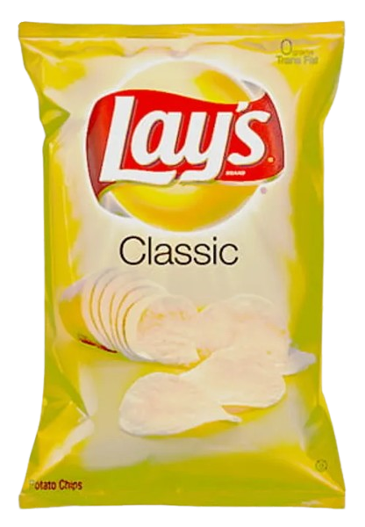


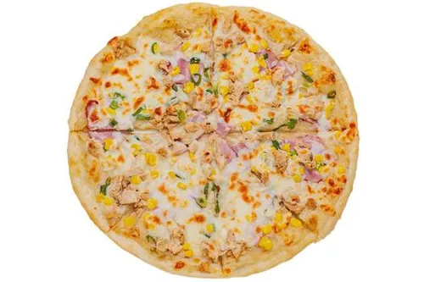
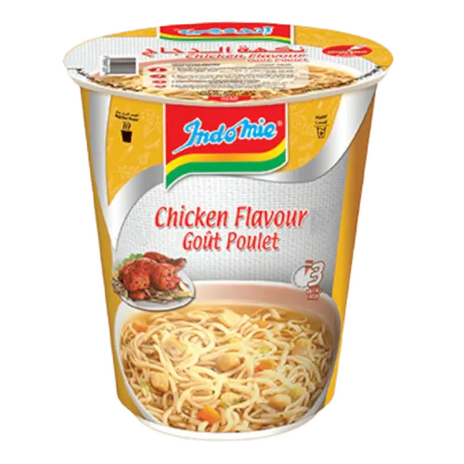

Campus Mini Mart
Web-based mini market prototype for campus users
Yazan Hijazi • Yazan Zaghlol

Slide 2
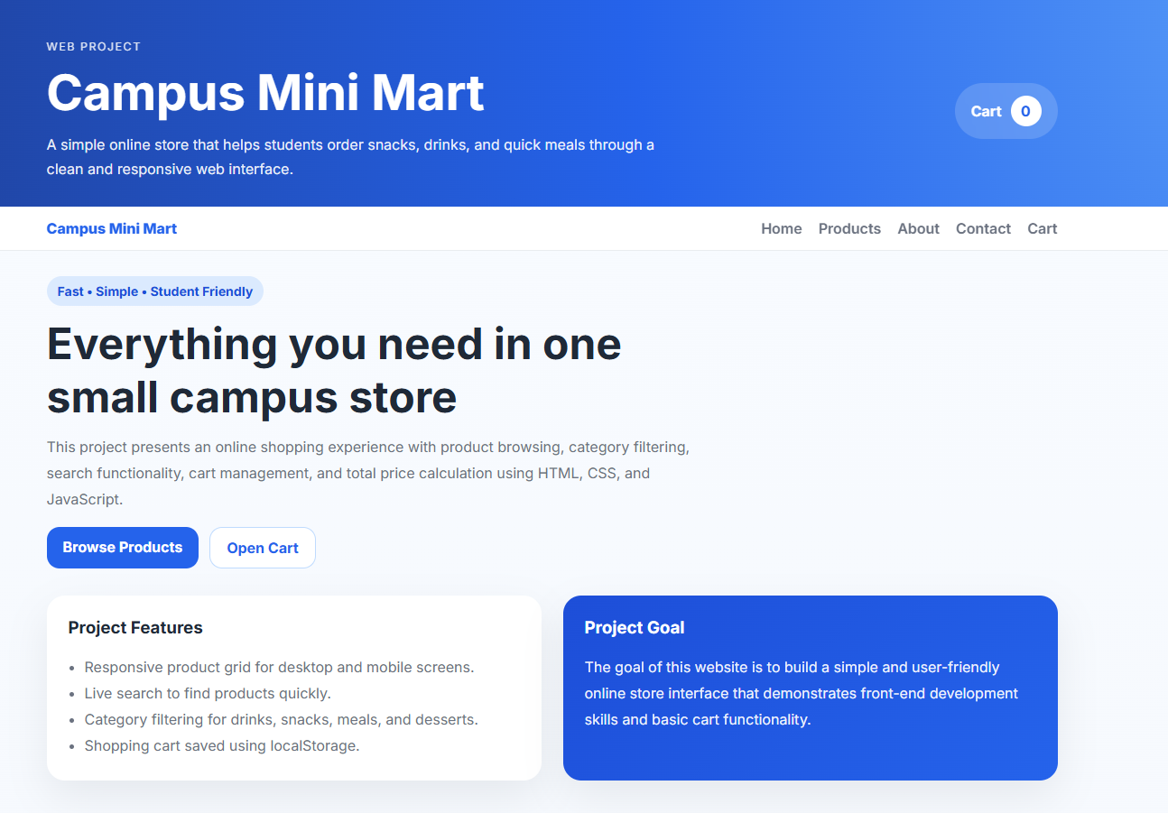
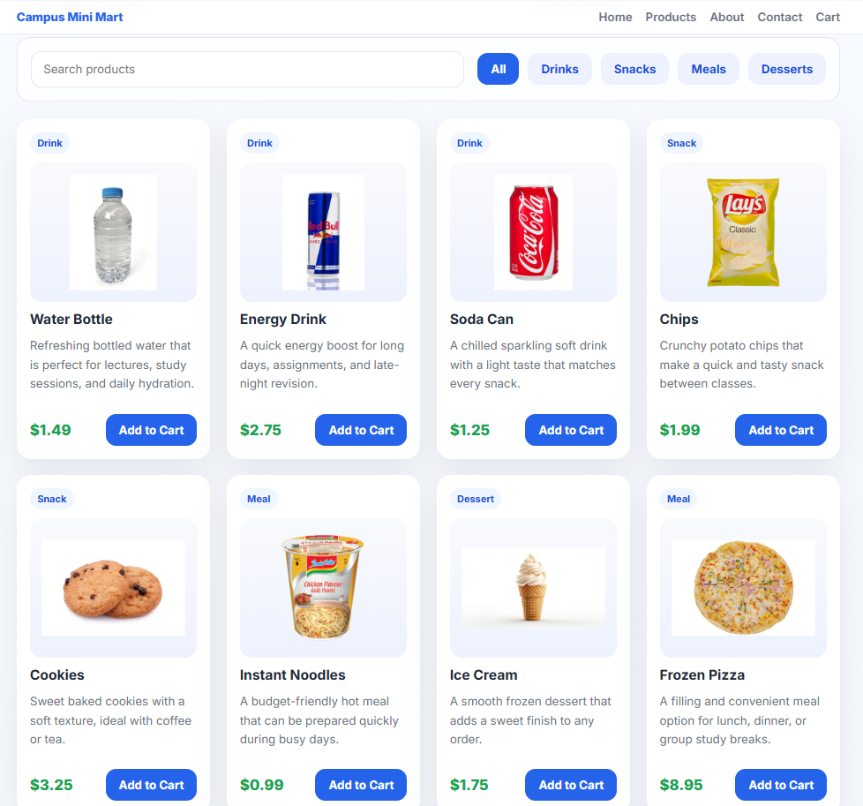
Project Idea & Problem
Problem
Solution
Students have short breaks and need quick access to campus products.
Traditional browsing inside small stores can waste time.
Users need search, filtering, cart control, and simple checkout feedback.
Campus Mini Mart provides a fast product catalog for snacks, drinks, meals, and desserts.
The current version is a front-end MVP focused on the customer shopping flow.
Front-End MVP
HTML • CSS • JS
localStorage

Slide 3
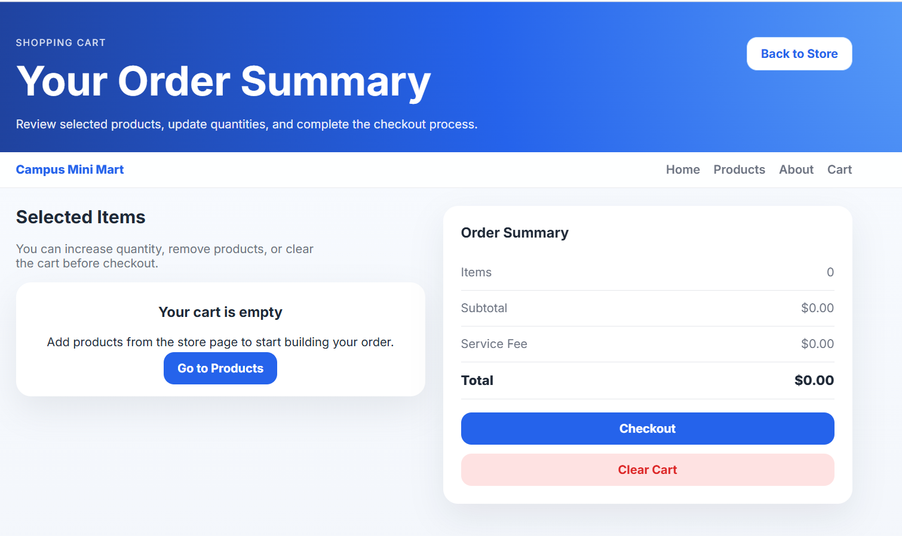
Key Requirements & Scope
Display available products with details and images.
Search products by product name.
Filter catalog by category.
Add items to cart and store cart data locally.
Update quantities, remove items, clear cart, and calculate totals.
Complete a simulated checkout process.
Core Functional Requirements
12
7
8
Functional
requirements
Non-functional
requirements
User stories

Slide 4
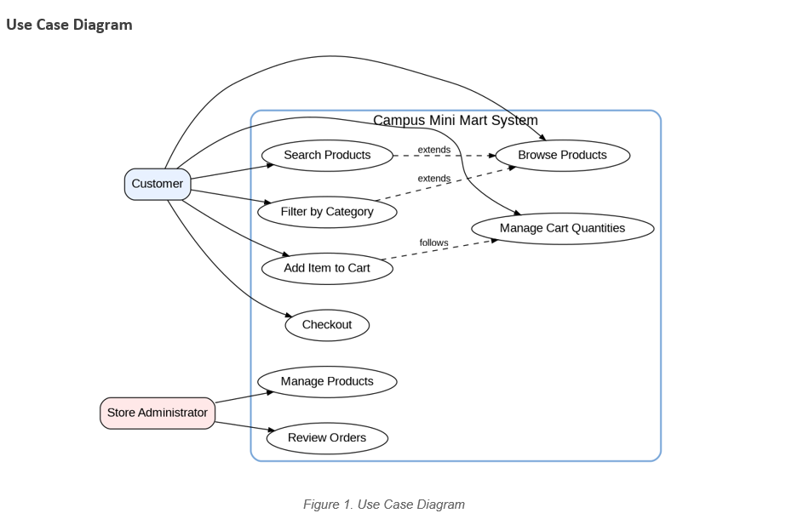
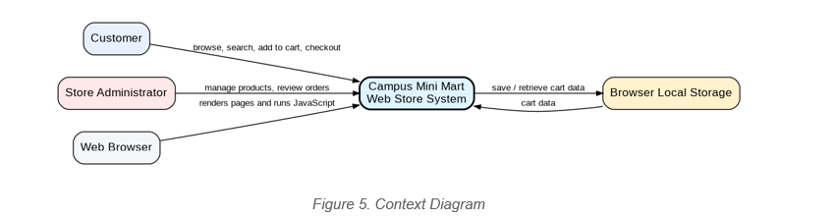
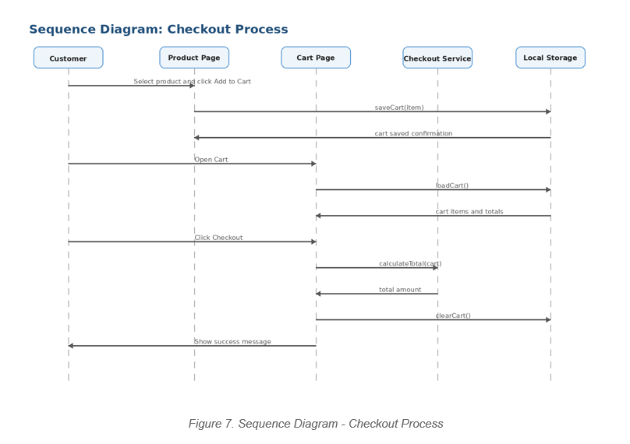
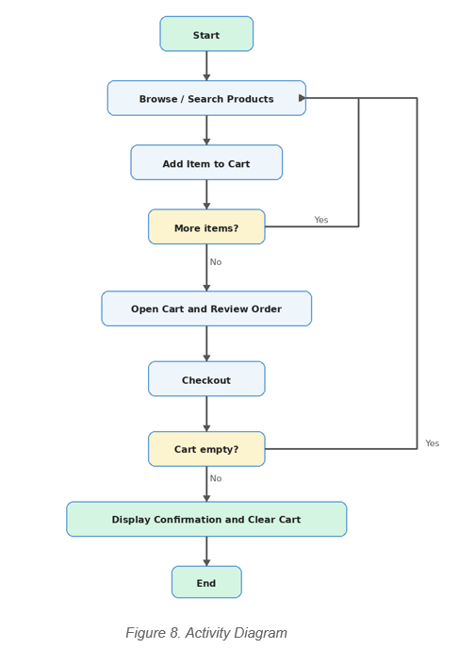
Design & Modeling Summary
Consistent with MVP

Slide 5
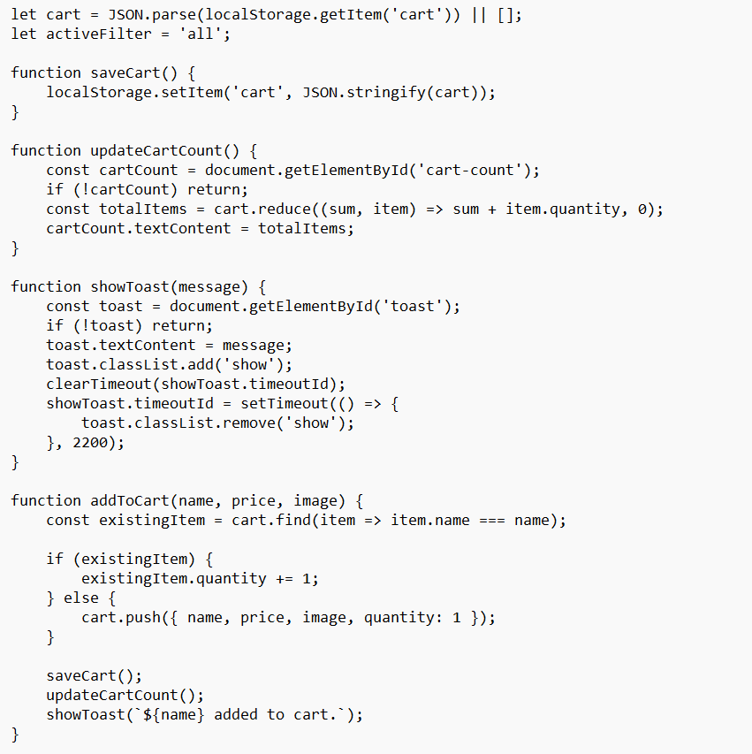
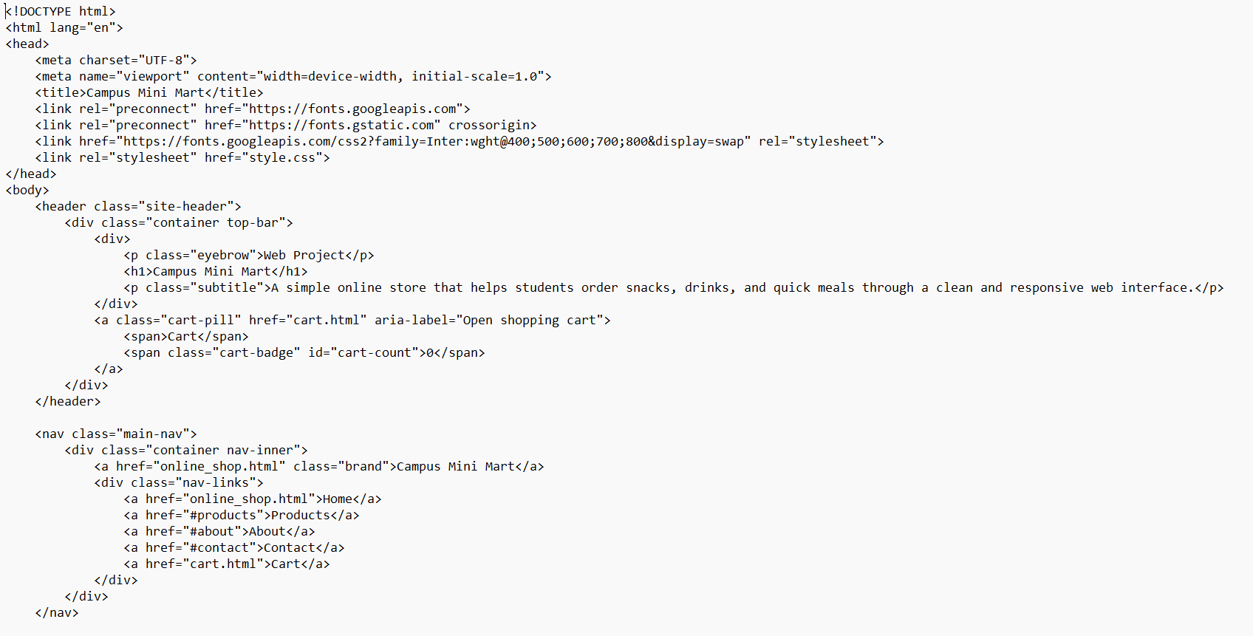
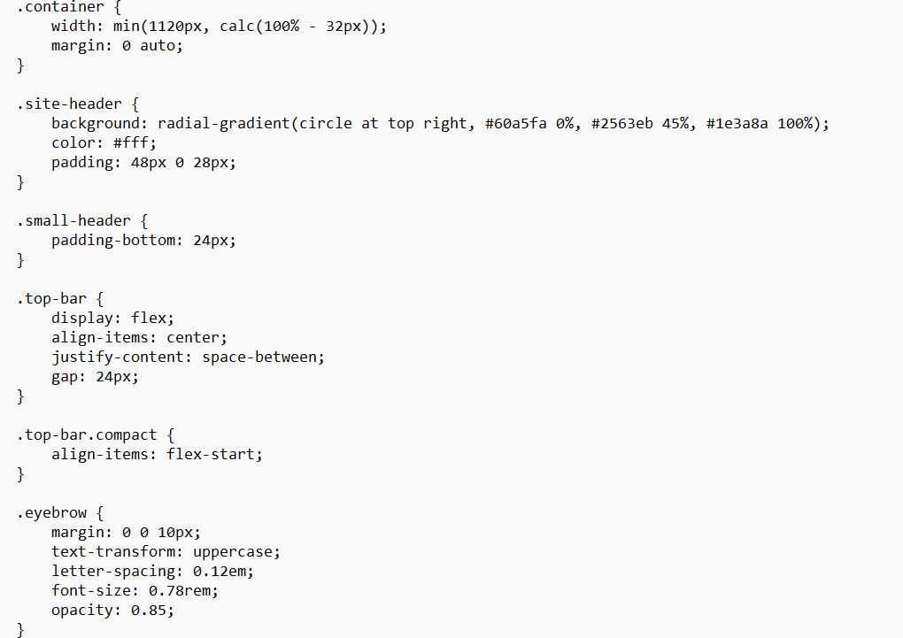
Implementation Overview
The working prototype was implemented using front-end web technologies.
HTML was used to build the structure of the web pages.
CSS was used to design the layout, colors, cards, buttons, and responsive interface.
JavaScript was used to implement search, filtering, cart management, quantity updates, total calculation, and checkout.
localStorage was used to save cart data in the browser.
The system includes a main store page and a shopping cart page.
The user can browse products, add items to the cart, review the order, update quantities, and complete checkout.

Slide 6
Testing Summary
15
11
3
1
test cases
functional requirements
covered
test types:
normal / edge / negative
traceability
matrix
Main tested features
Product
display
Search &
filter
Cart
updates
Total
calculation
Checkout
simulation
FR-1 to FR-11 are covered by related test cases in the traceability matrix.
FR-12 is marked as future scope because administrator features are not implemented in the current MVP.
The testing approach uses black-box testing with basic JavaScript review.
Coverage note

Slide 7
Risks & Lessons Learned
Top project risks
Lessons learned
Late requirement changes could affect consistency.
Cart data may not persist correctly between pages.
Broken image paths may affect product display.
Total price calculations must stay accurate after quantity changes.
Final ZIP may contain missing or unnecessary files.
Keep report, UML diagrams, test cases, and prototype aligned.
Test from a clean extracted folder before submission.
Use localStorage carefully for front-end state persistence.
Clearly separate implemented MVP features from future scope.
Main takeaway: consistency between requirements, models, testing, and code is the most important quality factor.

Slide 8
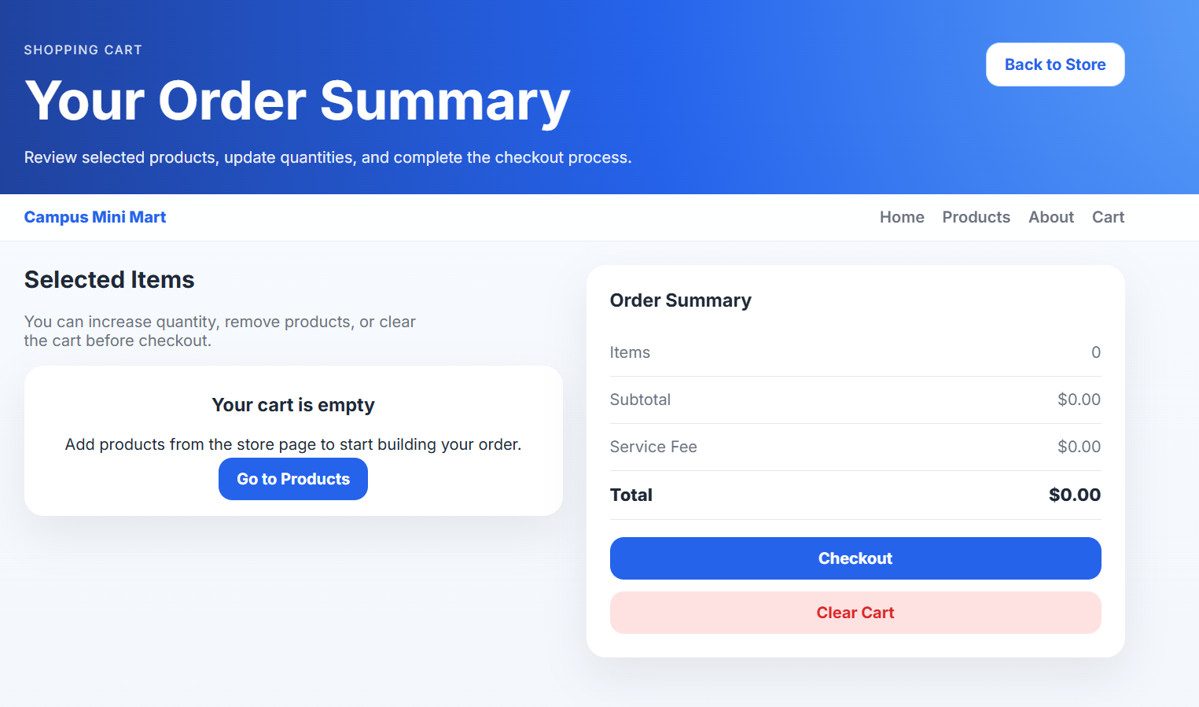
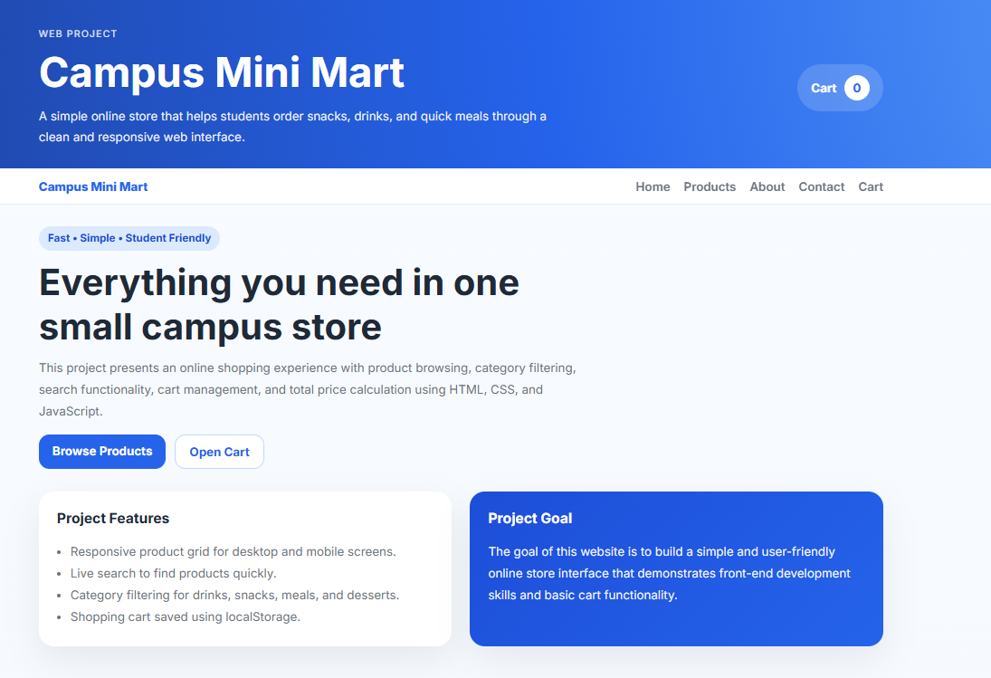
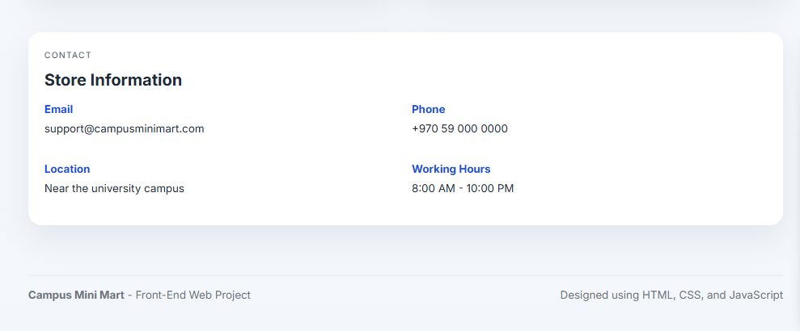
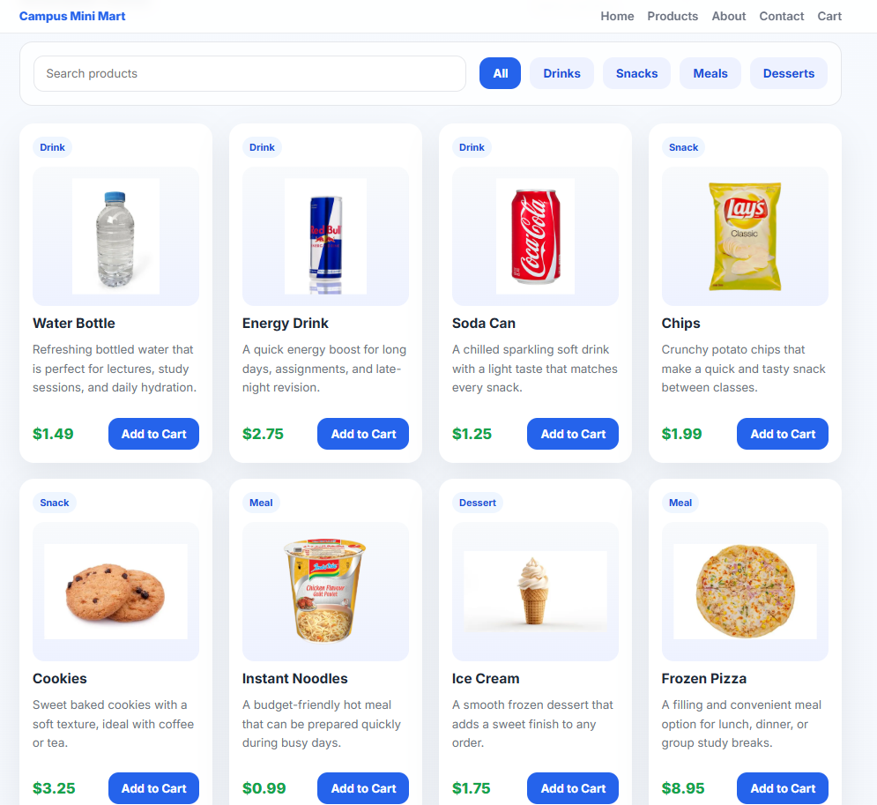
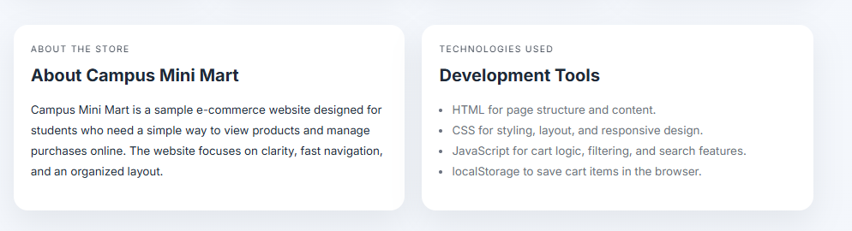
Results
Ready for final package

