Slide 1



Food Delivery Time
Yazeed Khalid Alharthi

Slide 2
objective
Introduction
Design
Data
Algorithms
Tools

Slide 3
Introduction
This contains data on different cuisines including Italian, Indian and Chinese as well as fast food.

Slide 4
Design
The highest rated restaurants in terms of delivery speed ?
The least expensive restaurants for dinner ?
What is the most requested cuisine ?
What is the average delivery order ?

Slide 5
Data
The data was taken from the Kaggle website
The data contains 9 columns, 11094 rows:
Restaurant
Location
Cuisines
Average _Cost
Minimum Order
• Rating
• Votes
• Reviews
• Delivery _Time

Slide 6
challenges
I faced some challenges null value , and out layer.
Of course, there are problems and there must be a solution for every problem.

Slide 7
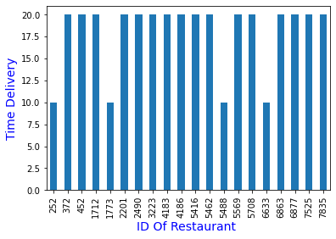
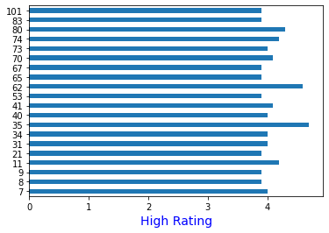
Algorithms
The highest rated restaurants in terms of delivery speed?

Slide 8
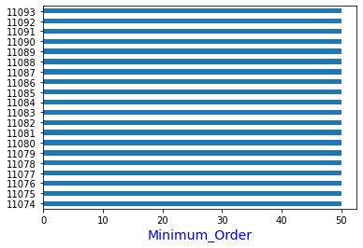
Algorithms..
The least expensive restaurants for dinner?

Slide 9
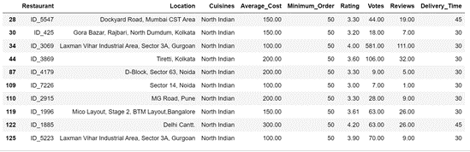
Algorithms..
What is the most requested cuisine?

Slide 10

Algorithms..
What is the average delivery order?

Slide 11
Tools
There are tools that will be used to achieve the goal of the study, such as:
NumPy , pandas , matplotlib ,seaborn, It will be worked on by Jupyter, PowerPoint.

Slide 12


Thank you

