Slide 1
Summer Training Management System (STMS)
Implementation & Tools Summary

Slide 2
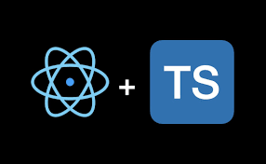
System Implementation Overview (Chapter 5)
Frontend: React with TypeScript

Slide 3



System Implementation Overview (Chapter 5)
Backend:
Express.js with Drizzle ORM
Database:
PostgreSQL

Slide 4



Tools
React Hook Form (Forms) Tailwind CSS (Styling) Shadcn UI (components)

Slide 5
Testing & Results (Chapter 6)
Testing tools:
Jest: For backend logic and unit testing
Supertest: For HTTP endpoint testing
Validation Testing
Zod used in backend to validate request schemas
Prevented malformed data from reaching the database

Slide 6
Key Implementation Features
User Role Management (Student, Supervisor, Representative)
File Handling (Reports, Presentations)
Scheduling System (Presentation Dates)
Applications Management (Submission, Review, Status Update)

