Slide 1
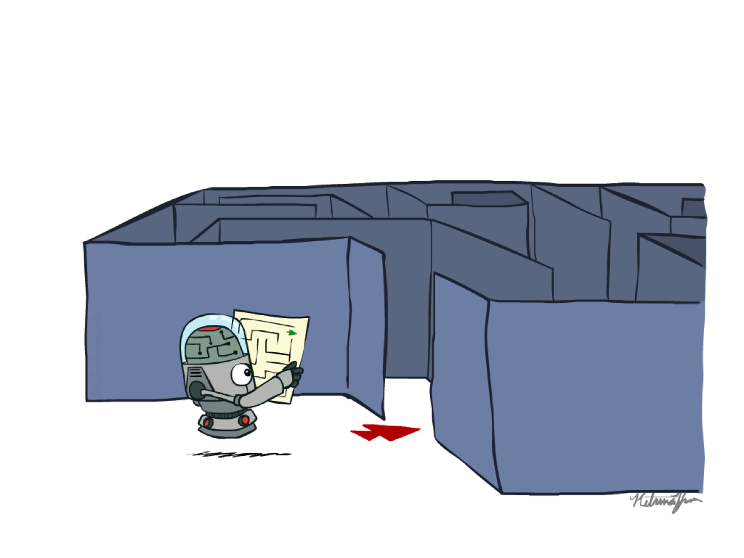
CS 432: Artificial Intelligence
Search
Slides Adapted from Nikita Kitaev, University of California, Berkeley
[Further adapted from Dan Klein and Pieter Abbeel]
Notes:
Please retain proper attribution, including the reference to ai.berkeley.edu. Thanks!

Slide 2
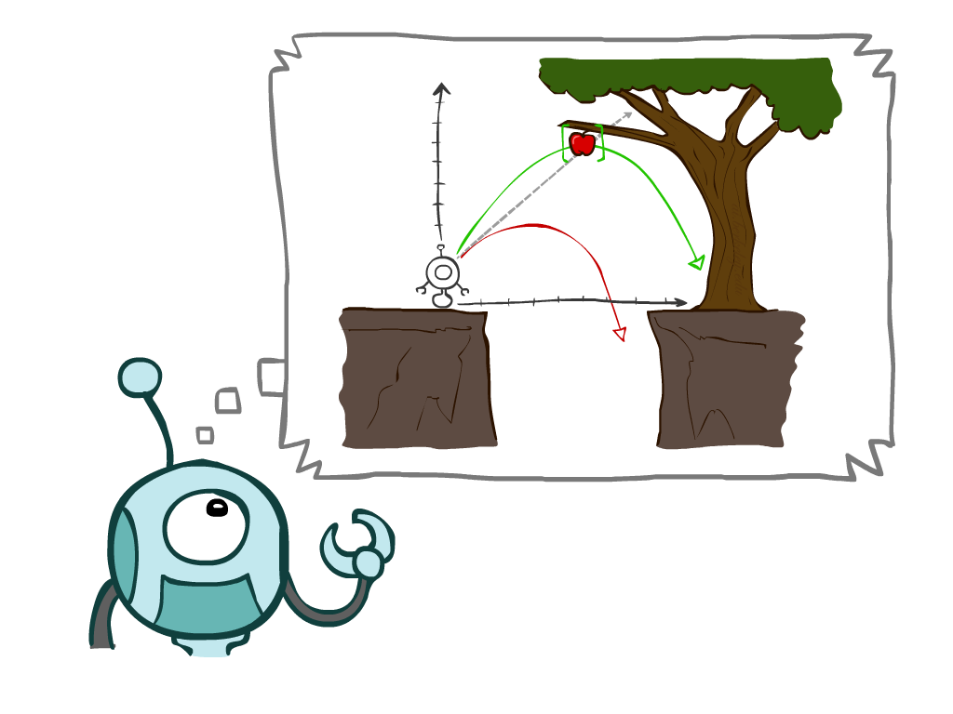
Today
Agents that Plan Ahead
Search Problems
Uninformed Search Methods
Depth-First Search
Breadth-First Search
Uniform-Cost Search

Slide 3
Agents that Plan

Slide 4

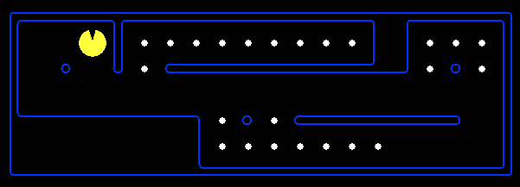
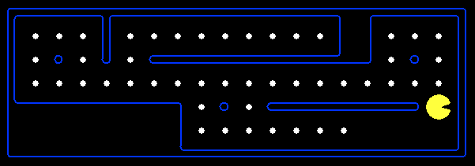
Reflex Agents
Reflex agents:
Choose action based on current percept (and potentially memory)
May have memory or a model of the world’s current state
Do not consider the future consequences of their actions
Consider how the world IS
Can a reflex agent be rational?

Slide 5
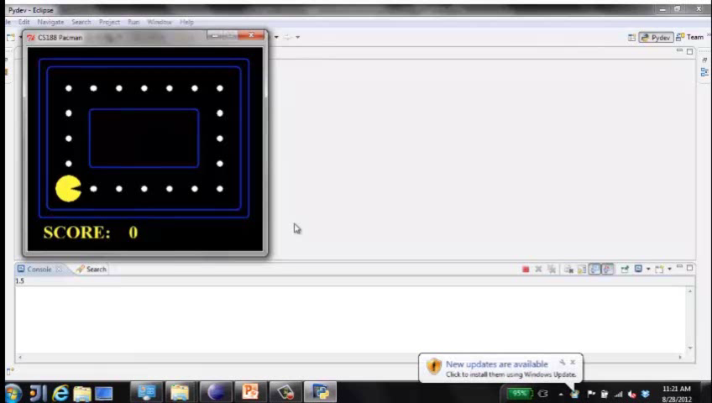
Video of Demo Reflex Optimal

Slide 6
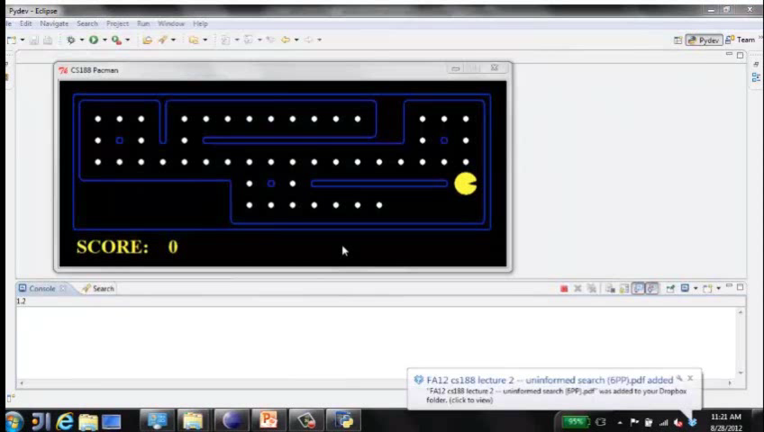
Video of Demo Reflex Odd

Slide 7
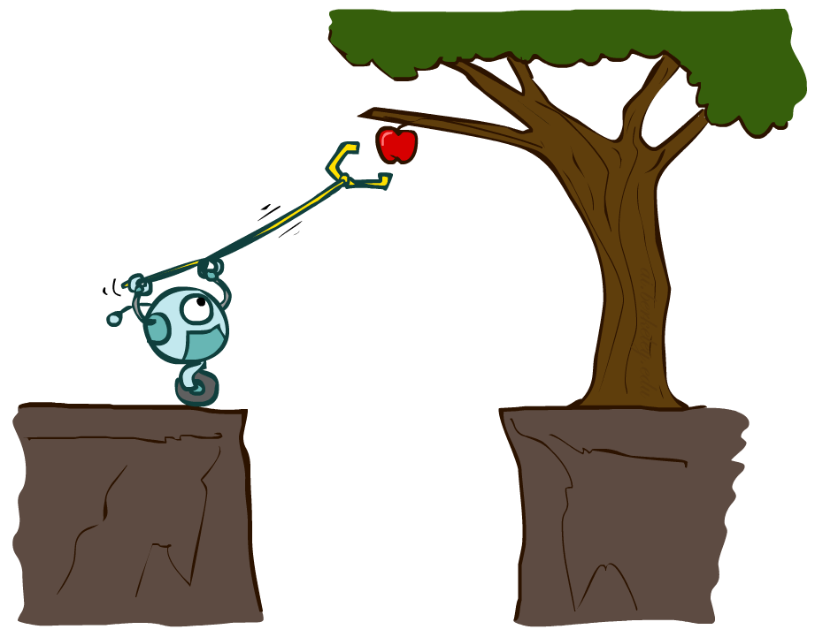
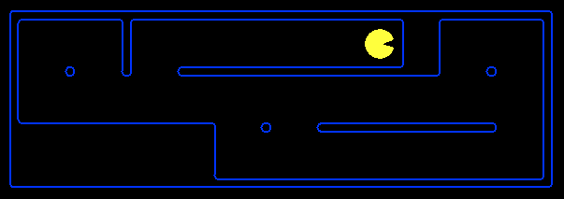
Planning Agents
Planning agents:
Ask “what if”
Decisions based on (hypothesized) consequences of actions
Must have a model of how the world evolves in response to actions
Must formulate a goal (test)
Consider how the world WOULD BE
Optimal vs. complete planning
Planning vs. replanning

Slide 8
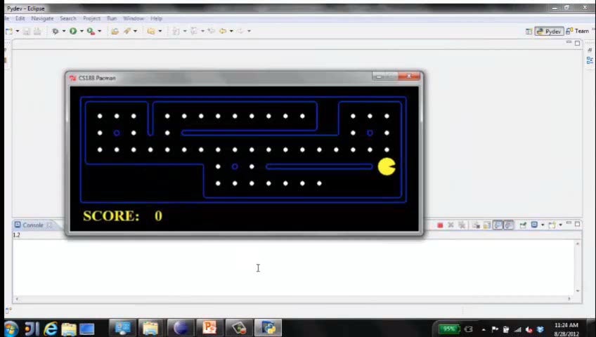
Video of Demo Replanning

Slide 9
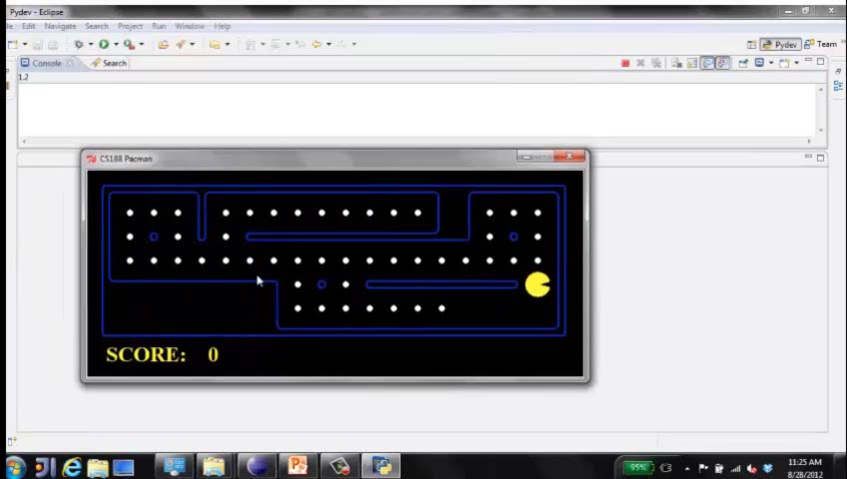
Video of Demo Mastermind

Slide 10

Search Problems

Slide 11

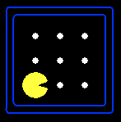





Search Problems
A search problem consists of:
A state space
A successor function
(with actions, costs)
A start state and a goal test
A solution is a sequence of actions (a plan) that transforms the start state into a goal state
“N”, 1.0
“E”, 1.0

Slide 12

Search Problems Are Models

Slide 13
Example: Traveling in Romania
State space:
Cities
Successor function:
Roads: Go to adjacent city with cost = distance
Start state:
Arad
Goal test:
Is state == Bucharest?
Solution?

Slide 14
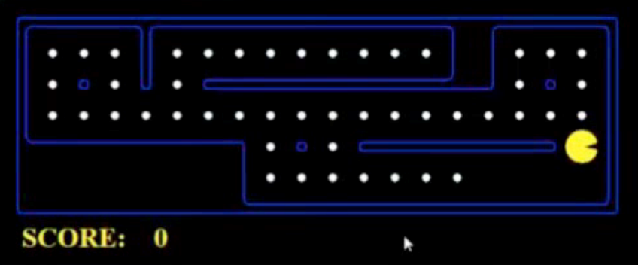
What’s in a State Space?
The world state includes every last detail of the environment
A search state keeps only the details needed for planning (abstraction)
Problem: Pathing
States: (x,y) location
Actions: NSEW
Successor: update location only
Goal test: is (x,y)=END
Problem: Eat-All-Dots
States: {(x,y), dot booleans}
Actions: NSEW
Successor: update location and possibly a dot boolean
Goal test: dots all false

Slide 15
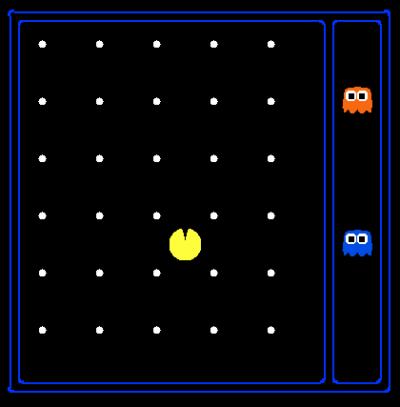
State Space Sizes?
World state:
Agent positions: 120
Food count: 30
Ghost positions: 12
Agent facing: NSEW
How many
World states?
120x(2³⁰)x(12²)x4
States for pathing?
120
States for eat-all-dots?
120x(2³⁰)

Slide 16
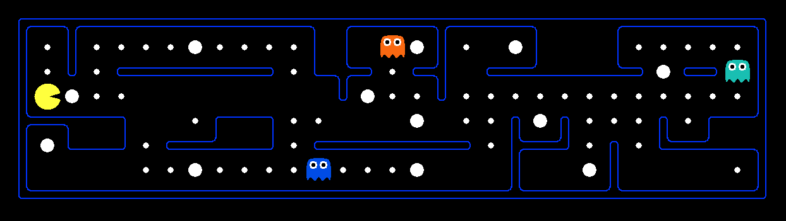
Quiz: Safe Passage
Problem: eat all dots while keeping the ghosts perma-scared
What does the state space have to specify?
(agent position, dot booleans, power pellet booleans, remaining scared time)

Slide 17
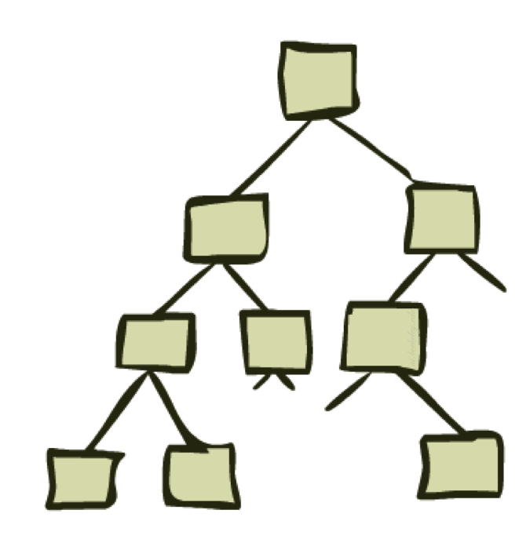
State Space Graphs and Search Trees

Slide 18
State Space Graphs
State space graph: A mathematical representation of a search problem
Nodes are (abstracted) world configurations
Arcs represent successors (action results)
The goal test is a set of goal nodes (maybe only one)
In a state space graph, each state occurs only once!
We can rarely build this full graph in memory (it’s too big), but it’s a useful idea

Slide 19
State Space Graphs
State space graph: A mathematical representation of a search problem
Nodes are (abstracted) world configurations
Arcs represent successors (action results)
The goal test is a set of goal nodes (maybe only one)
In a state space graph, each state occurs only once!
We can rarely build this full graph in memory (it’s too big), but it’s a useful idea
a
G
b
c
e
d
f
S
h
p
q
r
Tiny state space graph for a tiny search problem

Slide 20
Search Trees
This is now / start
“N”, 1.0
“E”, 1.0
Possible futures
A search tree:
A “what if” tree of plans and their outcomes
The start state is the root node
Children correspond to successors
Nodes show states, but correspond to PLANS that achieve those states
For most problems, we can never actually build the whole tree

Slide 21
State Space Graphs vs. Search Trees
State Space Graph
Each NODE in in the search tree is an entire PATH in the state space graph.
Search Tree
S
a
G
d
e
p
b
c
q
b
c
e
h
r
d
e
f
a
a
h
r
p
q
f
S
h
We construct both on demand – and we construct as little as possible.
p
q
f
q
c
G
p
q
r
q
c
G
a
a

Slide 22

Quiz: State Space Graphs vs. Search Trees
Consider this 4-state graph:
How big is its search tree (from S)?
a
S
G
b

Slide 23
Quiz: State Space Graphs vs. Search Trees
Consider this 4-state graph:
How big is its search tree (from S)?
a
s
a
b
S
G
b
G
a
G
b
a
G
b
G
…
…
Important: Lots of repeated structure in the search tree!

Slide 24
Tree Search

Slide 25
Search Example: Romania

Slide 26
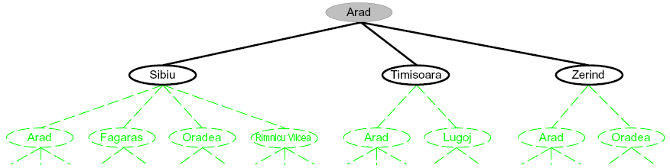
Searching with a Search Tree
Search:
Expand out potential plans (tree nodes)
Maintain a fringe of partial plans under consideration
Try to expand as few tree nodes as possible

Slide 27
General Tree Search
Important ideas:
Fringe
Expansion
Exploration strategy
Main question: which fringe nodes to explore?

Slide 28
Example: Tree Search
a
G
b
c
d
e
f
S
h
p
q
r

Slide 29
Example: Tree Search
a
G
b
c
e
d
e
d
f
f
S
h
p
r
q
r
S
s
s → d
s → e
s → p
s → d → b
s → d → c
s → d → e
s → d → e → h
s → d → e → r
s → d → e → r → f
s → d → e → r → f → c
s → d → e → r → f → G
d
e
p
b
c
e
h
r
q
a
a
h
r
p
q
f
p
q
f
q
c
G
q
c
G
a
a

Slide 30
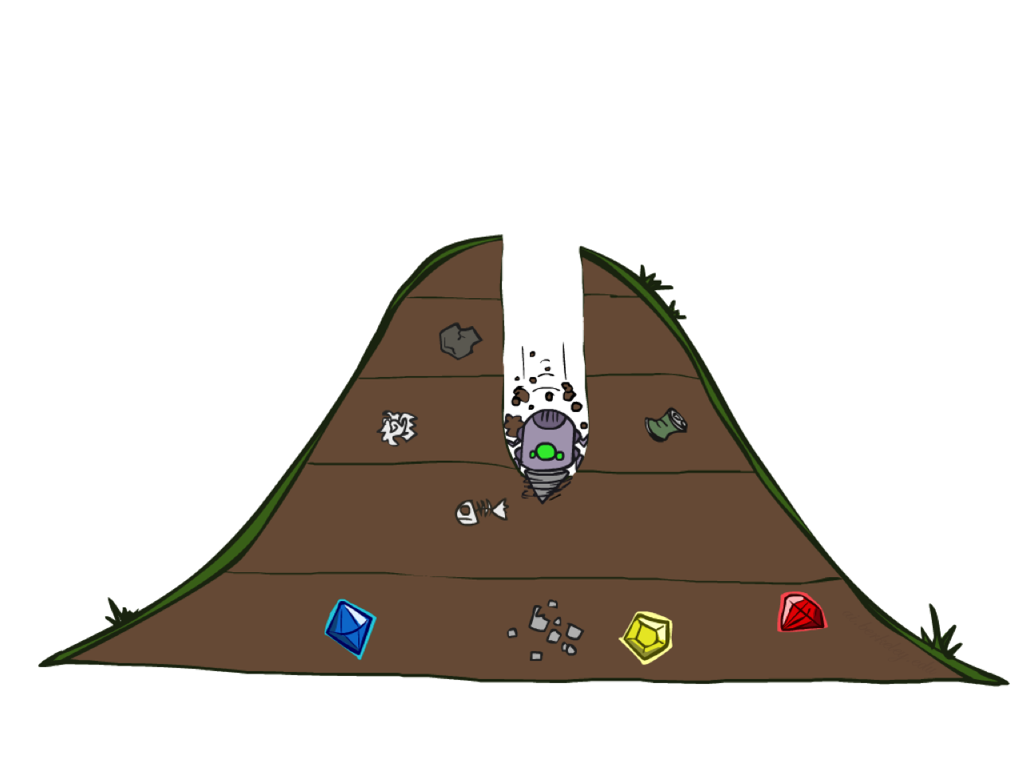
Depth-First Search

Slide 31
Depth-First Search
Strategy: expand a deepest node first
Implementation: Fringe is a LIFO stack
a
G
a
c
b
c
b
e
d
e
d
f
f
S
h
h
p
p
r
q
r
q
S
d
e
p
b
c
e
h
r
q
a
a
h
r
p
q
f
p
q
f
q
c
G
q
c
G
a
a

Slide 32
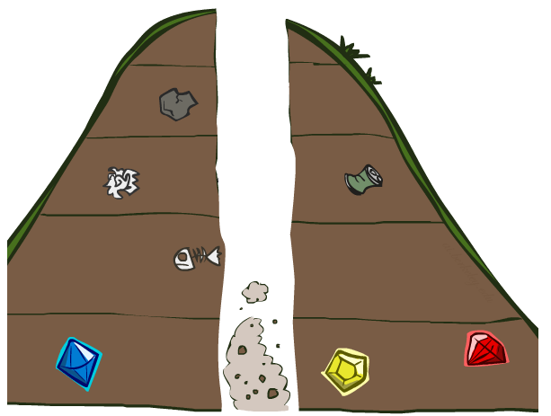
Search Algorithm Properties

Slide 33
Search Algorithm Properties
Complete: Guaranteed to find a solution if one exists?
Optimal: Guaranteed to find the least cost path?
Time complexity?
Space complexity?
Cartoon of search tree:
b is the branching factor
m is the maximum depth
solutions at various depths
Number of nodes in entire tree?
1 + b + b² + …. b^{m} = O(b^{m})
1 node
b
…
b nodes
b² nodes
m tiers
b^{m} nodes

Slide 34
Depth-First Search (DFS) Properties
What nodes DFS expand?
Some left prefix of the tree.
Could process the whole tree!
If m is finite, takes time O(b^{m})
How much space does the fringe take?
Only has siblings on path to root, so O(bm)
Is it complete?
m could be infinite, so only if we prevent cycles (more later)
Is it optimal?
No, it finds the “leftmost” solution, regardless of depth or cost
1 node
b
…
b nodes
b² nodes
m tiers
b^{m} nodes

Slide 35
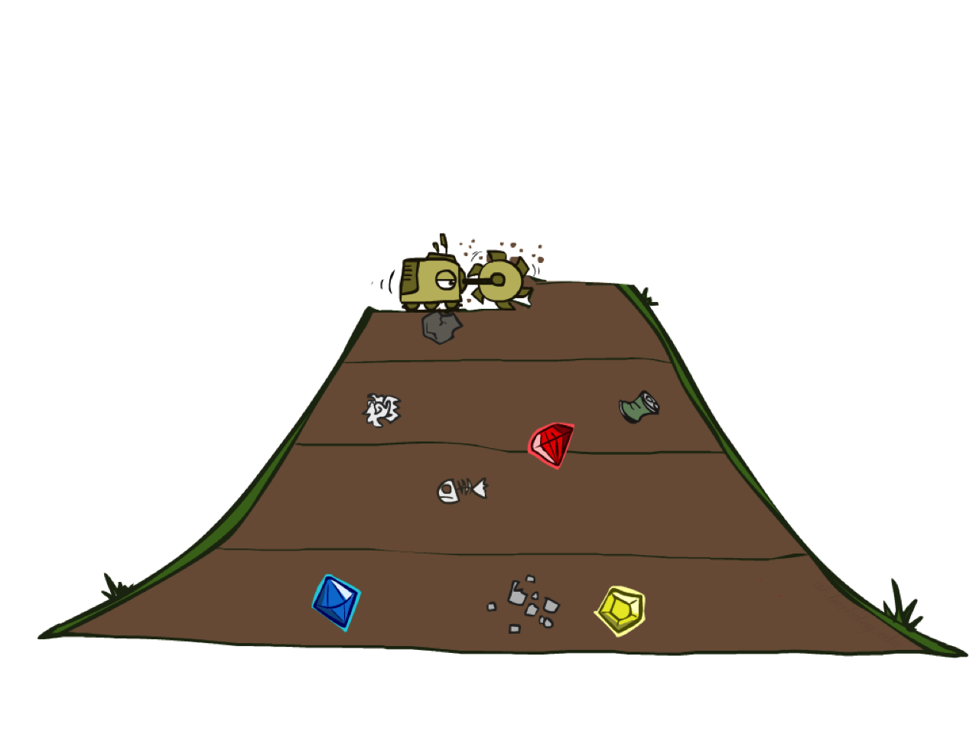
Breadth-First Search

Slide 36
Breadth-First Search
Strategy: expand a shallowest node first
Implementation: Fringe is a FIFO queue
a
G
b
c
d
e
f
S
h
p
q
r
S
d
e
p
Search
Tiers
b
c
e
h
r
q
a
a
h
r
p
q
f
p
q
f
q
c
G
q
c
G
a
a

Slide 37
Breadth-First Search (BFS) Properties
What nodes does BFS expand?
Processes all nodes above shallowest solution
Let depth of shallowest solution be s
Search takes time O(b^{s})
How much space does the fringe take?
Has roughly the last tier, so O(b^{s})
Is it complete?
s must be finite if a solution exists, so yes!
Is it optimal?
Only if costs are all 1 (more on costs later)
1 node
b
…
b nodes
s tiers
b² nodes
b^{s} nodes
b^{m} nodes

Slide 38
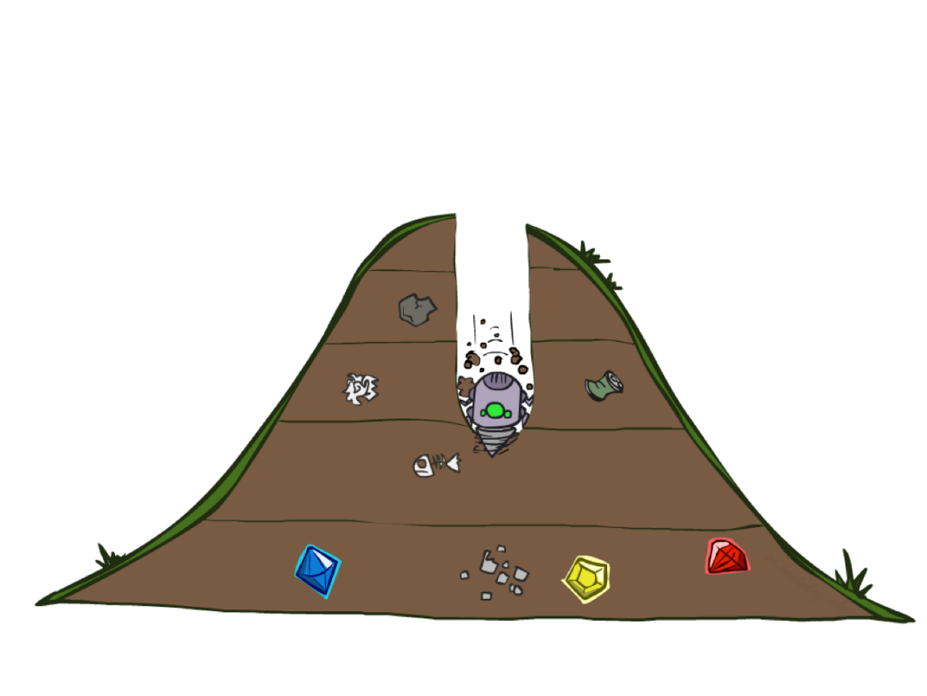
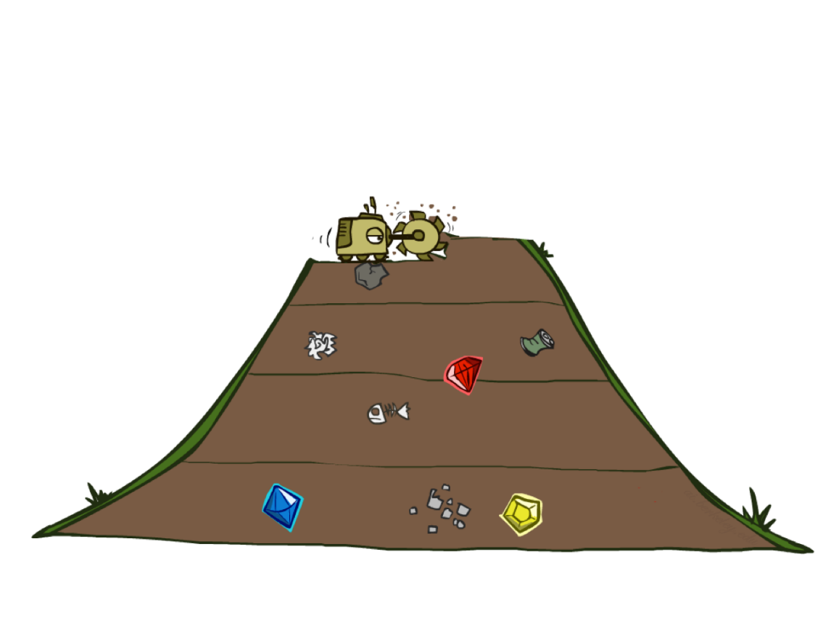
Quiz: DFS vs BFS

Slide 39

Video of Demo Maze Water DFS/BFS (part 1)

Slide 40
Video of Demo Maze Water DFS/BFS (part 2)

Slide 41
Quiz: DFS vs BFS
When will BFS outperform DFS?
When will DFS outperform BFS?

Slide 42
Iterative Deepening
Idea: get DFS’s space advantage with BFS’s time / shallow-solution advantages
Run a DFS with depth limit 1. If no solution…
Run a DFS with depth limit 2. If no solution…
Run a DFS with depth limit 3. …..
Isn’t that wastefully redundant?
Generally most work happens in the lowest level searched, so not so bad!
b
…

Slide 43
Cost-Sensitive Search
a
GOAL
2
2
b
c
3
2
1
8
2
e
d
f
3
9
8
2
START
h
1
4
2
p
4
r
15
q
BFS finds the shortest path in terms of number of actions.
It does not find the least-cost path. We will now cover
a similar algorithm which does find the least-cost path.

Slide 44
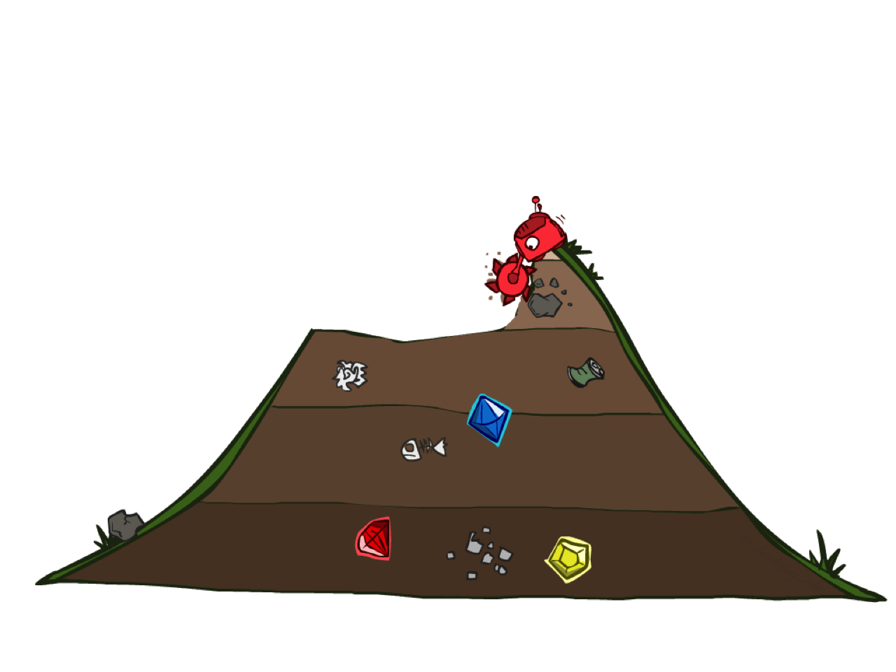
Uniform Cost Search

Slide 45
Uniform Cost Search
2
G
a
Strategy: expand a cheapest node first:
Fringe is a priority queue (priority: cumulative cost)
b
c
1
8
2
2
e
3
d
f
9
8
2
S
h
1
1
p
q
r
15
0
S
d
3
e
9
p
1
b
4
e
5
h
17
r
11
q
16
c
11
Cost contours
a
6
a
h
13
r
7
p
q
f
p
q
f
8
q
c
G
q
c
a
11
G
10
a

Slide 46
Uniform Cost Search (UCS) Properties
What nodes does UCS expand?
Processes all nodes with cost less than cheapest solution!
If that solution costs C* and arcs cost at least ε , then the “effective depth” is roughly C*/ε
Takes time O(b^{C*/ε}) (exponential in effective depth)
How much space does the fringe take?
Has roughly the last tier, so O(b^{C*/ε})
Is it complete?
Assuming best solution has a finite cost and minimum arc cost is positive, yes!
Is it optimal?
Yes! (Proof next lecture via A*)
b
c ≤ 1
…
C*/ε “tiers”
c ≤ 2
c ≤ 3

Slide 47
Uniform Cost Issues
Remember: UCS explores increasing cost contours
The good: UCS is complete and optimal!
The bad:
Explores options in every “direction”
No information about goal location
We’ll fix that soon!
…
c ≤ 1
c ≤ 2
c ≤ 3
Start
Goal

Slide 48
Video of Demo Empty UCS

Slide 49
Video of Demo Maze with Deep/Shallow Water --- DFS, BFS, or UCS? (part 1)

Slide 50
Video of Demo Maze with Deep/Shallow Water --- DFS, BFS, or UCS? (part 2)

Slide 51
Video of Demo Maze with Deep/Shallow Water --- DFS, BFS, or UCS? (part 3)

Slide 52

The One Queue
All these search algorithms are the same except for fringe strategies
Conceptually, all fringes are priority queues (i.e. collections of nodes with attached priorities)
Practically, for DFS and BFS, you can avoid the log(n) overhead from an actual priority queue, by using stacks and queues
Can even code one implementation that takes a variable queuing object

Slide 53
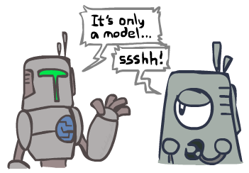
Search and Models
Search operates over models of the world
The agent doesn’t actually try all the plans out in the real world!
Planning is all “in simulation”
Your search is only as good as your models…

Slide 54
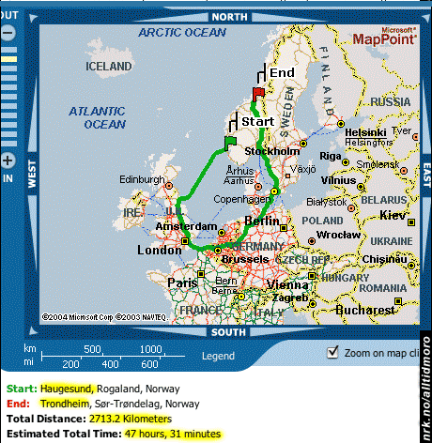
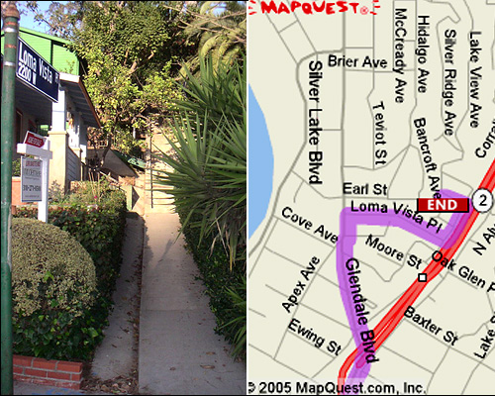

Search Gone Wrong?

