Slide 1

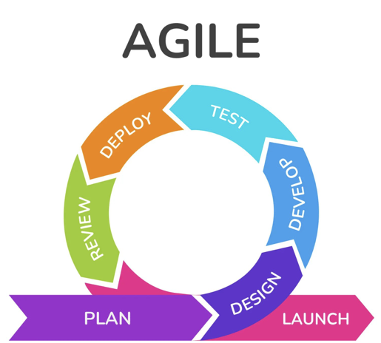
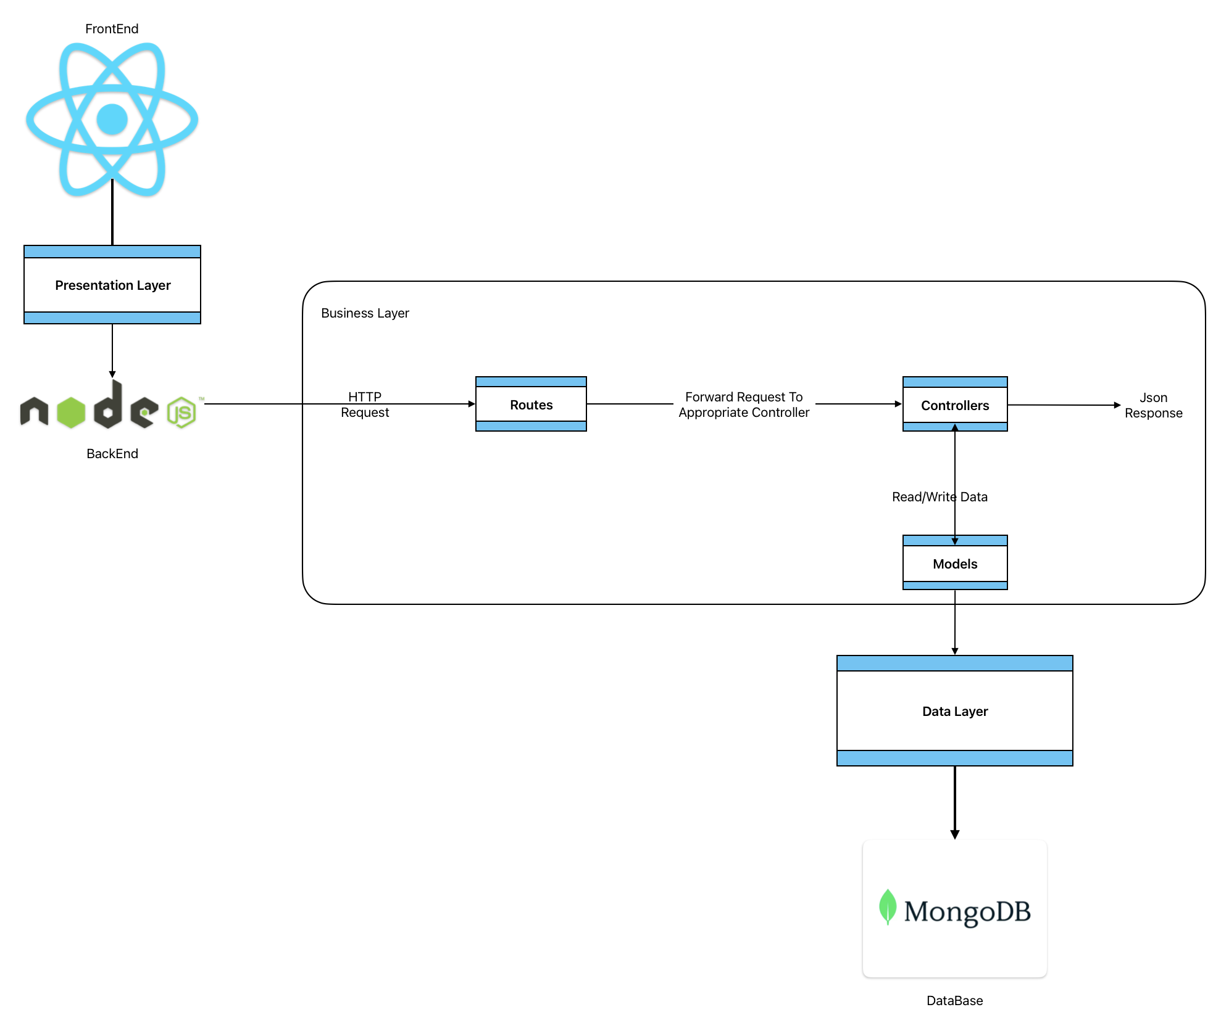
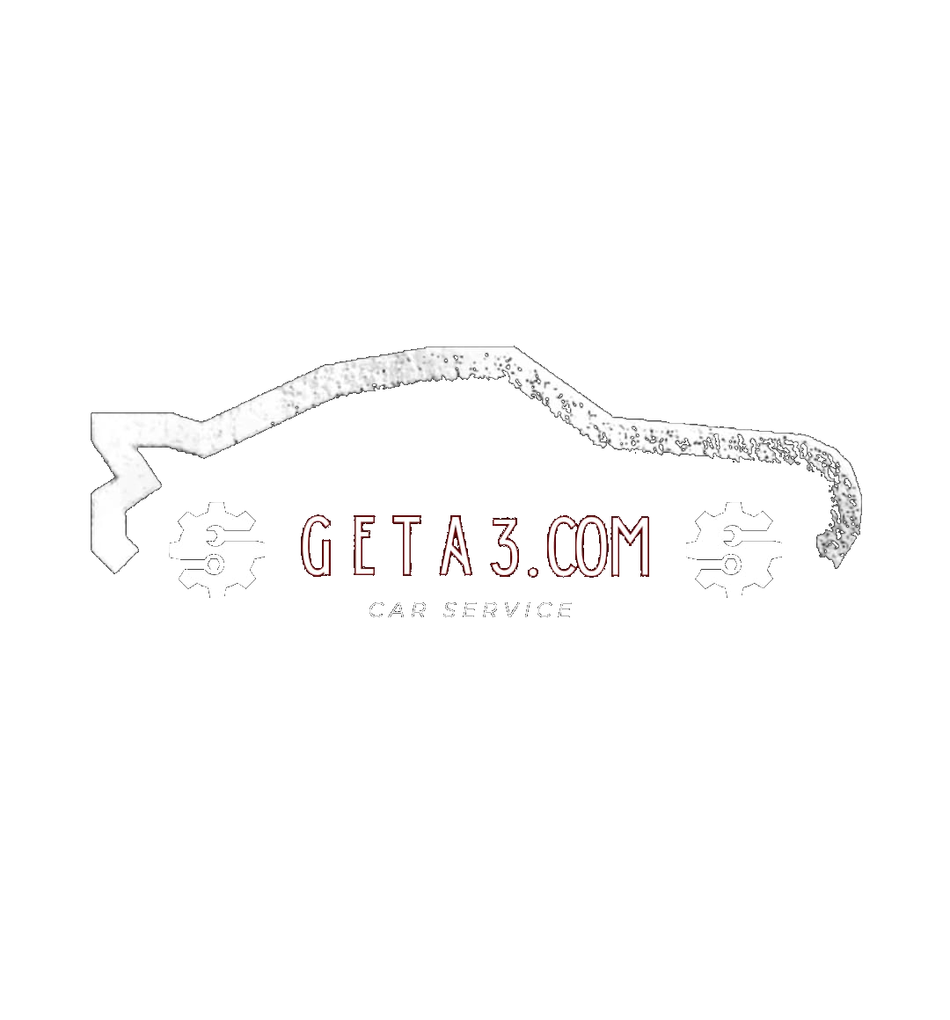
كلية تكنولوجيا المعلومات Faculty of Information Technology
FREE DISTRIBUTED RESOURCE SYSTEM (FDRS)
Supervisor: Dr. Ashraf Odeh
Yazeed Mwafi, Laith Jaber
PROBLEM DESCRIPTION
ANALYSIS
The online car parts sales industry faces several challenges:
Limited Accessibility: Many platforms require user accounts before accessing listings.
Inventory Management Issues: Retailers struggle with outdated and inefficient tools.
Quality Control: Ensuring the authenticity and quality of car parts listings remains a challenge.
Methodology: Agile methodology is used, emphasizing flexibility, iterative development, and user feedback.
System Architecture: Three-tier structure:Frontend: Developed using React.js for a responsive user interface.
Backend: Powered by Node.js and Express.js for business logic and handling requests.
Database: MongoDB is used for efficient data storage and retrieval.
STATE OF THE ART
Comparing with existing platforms:
eBay Motors: Extensive listings but requires user accounts and can be cumbersome for inventory management.
AutoZone: Strong online presence, mainly serving its inventory with less flexibility for independent retailers.
RockAuto: Comprehensive listings but limited in retailer management features.
PROPOSED SOLUTION
EXPECTED RESULTS
A user-friendly car parts sales website offering:
Open Access: Users can search and view listings without needing an account.
Retailer Tools: Retailers can manage inventory efficiently with tools for uploading, updating, and deleting listings.
Admin Oversight: Admins ensure quality control by approving or rejecting listings.
The project aims to:
Democratize Access: Improve access to car parts for all users.
Enhance User Experience: Provide a streamlined, intuitive interface for all users.
Maintain Robustness: Offer a scalable and reliable platform for growing market needs.
OBJECTIVES
CONCLUSION
Develop an advanced search system for easy discovery.
Create a lightweight, multi-platform compatible application.
Ensure high standards for security, scalability, and usability.
Geta3.com is expected to significantly improve the car parts sales market by providing a more accessible, user-driven platform that encourages efficient inventory management and quality control.

