Slide 1
Foodyltics
Trusted analysis to improve your restaurant!
T5 DATA SCIENCE BOOTCAMP
By:
Yazeed Musallam

Slide 2

Introduction
What is Foodlytics?
Problem Statement
- Value of Foodyltics company:
Is the review positive or negative?
From user reviews, how we can enhance our restaurant?

Slide 3
Example of reviews
افضل مطعم بالرياض .. الاكل غير جيد لا اعرف المطعم
Rate:
5
2
1
The best restaurant in Riyadh
The food was bad
I don’t know the restaurant
Outlier!

Slide 4









Foodyltics Architecture
Web scraping
Offline Data & EDA
Data preparation &
feature engineering
Model training &
Evaluation
Amazon Food Reviews
Testing data
Trained model
Deployment
Training data
Translate to English

Slide 5
Dataset Description and
Google Maps Dataset (scraped):
270 restaurants
100k reviews
Amazon Food Reviews (Kaggle):
- Food product reviews
100k reviews
Web scraping
Amazon Food Reviews

Slide 6
Data Preparation & Cleaning
Things removed:
Duplicates: 5k
Deconcatenation: won't ==> will not
Special character: $#@
HTML tags: </br>
Stop words: why, how ..
Scoring:
More than 3: Positive review
less than 3: Negative review

Slide 7
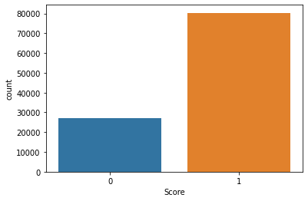
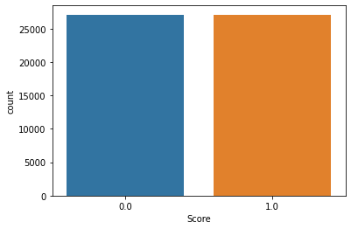
Feature Engineering & Data Balancing
Features added:
Number of: words, unique words, characters …
Data Balancing:

Slide 8
Model Training & Evaluation
Data split:
Training: 65% of Google maps reviews + Kaggle dataset
Validation: 15% of Google maps reviews
Testing: 20% of Google maps reviews

Slide 9
Model training & Evaluation
Model | F1-SCORE
Naive Bayes (Baseline) | 81
Linear regression | 81
Decision Tree | 74
RandomForest | 82
XGboost | 81
Long short-term memory | 82
BERT (The best)! | 83
Tested models:

Slide 10
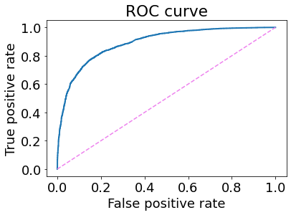
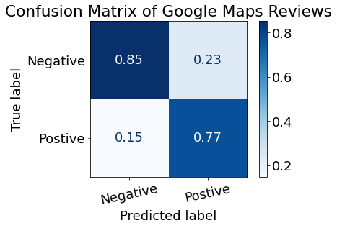
BERT
Results:
Training accuracy : 80%
Validation accuracy : 81.3%
Testing accuracy : 81.2%
F1 Score: 83%
ROC-AUC score: 89

Slide 11



Foodyltics
Foodyltics cloud environment
User
Prediction
Foodyltics website
Trained model
Database

Slide 12

Demo
*Please try it with us

Slide 13
Future works
*Please try it with us
1- Connect to Twitter, Hungerstation, etc..
2- Enhance the performance

Slide 14
Thank you !
Any Questions?

