Slide 1

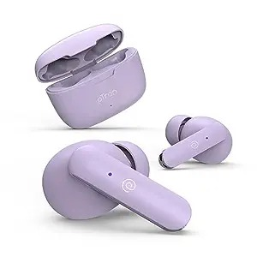
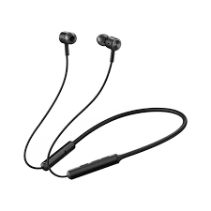

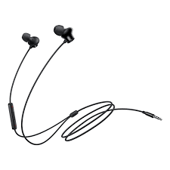
Exclusive offer
-79% M.R.P. Rs.549
M.R.P. Rs.2,599
Inclusive of all taxes
Exclusive offer
-80% M.R.P. Rs. 700
M.R.P Rs. 3000
Inclusive of all taxes
Shop Now
Shop Now
Exclusive offer
-45% M.R.P. Rs. 1000
M.R.P. Rs.5000
Inclusive of all taxes
Exclusive offer
-50% M.R.P. Rs. 150
M.R.P. Rs. 300
Inclusive of all taxes
Shop Now
Shop Now

