Slide 1




IoT • OPERATING SYSTEMS • CYBER SECURITY • DBMS
Secure Smart Laboratory
Equipment Management System
A Raspberry Pi based platform for RFID-authenticated, mutex-safe equipment allocation with encrypted audit logging
Harinilekha R - CH.SC.U4CYS25011
Nandika Yazhini – CH.SC.U4CYS25021
RFID Auth
Raspberry Pi 4
AES Encrypted Logs
SQLite DBMS

Slide 2


Project Objectives
Security & automation, working together
CORE MISSION
To revolutionize laboratory resource management by integrating IoT, OS principles, cybersecurity, and database management into one seamless, secure system.
RFID Authentication
Smart Resource Allocation
Encrypted Audit Trails
Restrict access to authorized personnel only using secure RFID UID verification.
Automate equipment distribution and prevent conflicts using OS-level Mutex and Scheduling.
Maintain tamper-proof logs with AES encryption for comprehensive usage monitoring.
Secure Smart Laboratory Equipment Management System
2

Slide 3



System Components
Hardware organized by function, plus the software stack that ties it together
Core Processing
Security Actuators
SOFTWARE
Raspberry Pi 4 — the central brain
Servo Motor — electronic lock
Raspberry Pi OS (Linux)
RC522 RFID Reader — user ID module
Buzzer — unauthorized-access alert
Python
RFID Tags/Cards — unique UIDs
SQLite Database
VS Code / Thonny IDE
User Interface
Infrastructure
Git (version control)
16×2 LCD with I2C — status display
Breadboard & jumper wires
LED Indicators — green / red feedback
Power adapter — stable 5V/3A supply
SUBJECTS INTEGRATED
IoT · Operating Systems · Cyber Security · DBMS
Secure Smart Laboratory Equipment Management System
3

Slide 4





Operating System Concepts in Action
Every equipment request is handled like a classic OS resource-management problem
Process Management
Process Scheduling
Mutual Exclusion
Resource Allocation
PROJECT APPLICATION
PROJECT APPLICATION
PROJECT APPLICATION
PROJECT APPLICATION
Each RFID request is treated as an incoming process handled by the Pi.
Requests are scheduled and serviced in a defined, fair order.
A mutex lock ensures only one student can hold a given item at a time.
Equipment is allocated only when free — mirrors OS resource management.
Synchronization
Queue Scheduling
Interrupt Handling
RESULT
PROJECT APPLICATION
PROJECT APPLICATION
PROJECT APPLICATION
Safe, conflict-free equipment sharing among many students, using proven OS fundamentals.
Allocation, DB update, and locking stay consistent under concurrent access.
Students wait in a FIFO queue when equipment is unavailable.
Unauthorized scans trigger an immediate buzzer/LED interrupt response.
Secure Smart Laboratory Equipment Management System
4

Slide 5
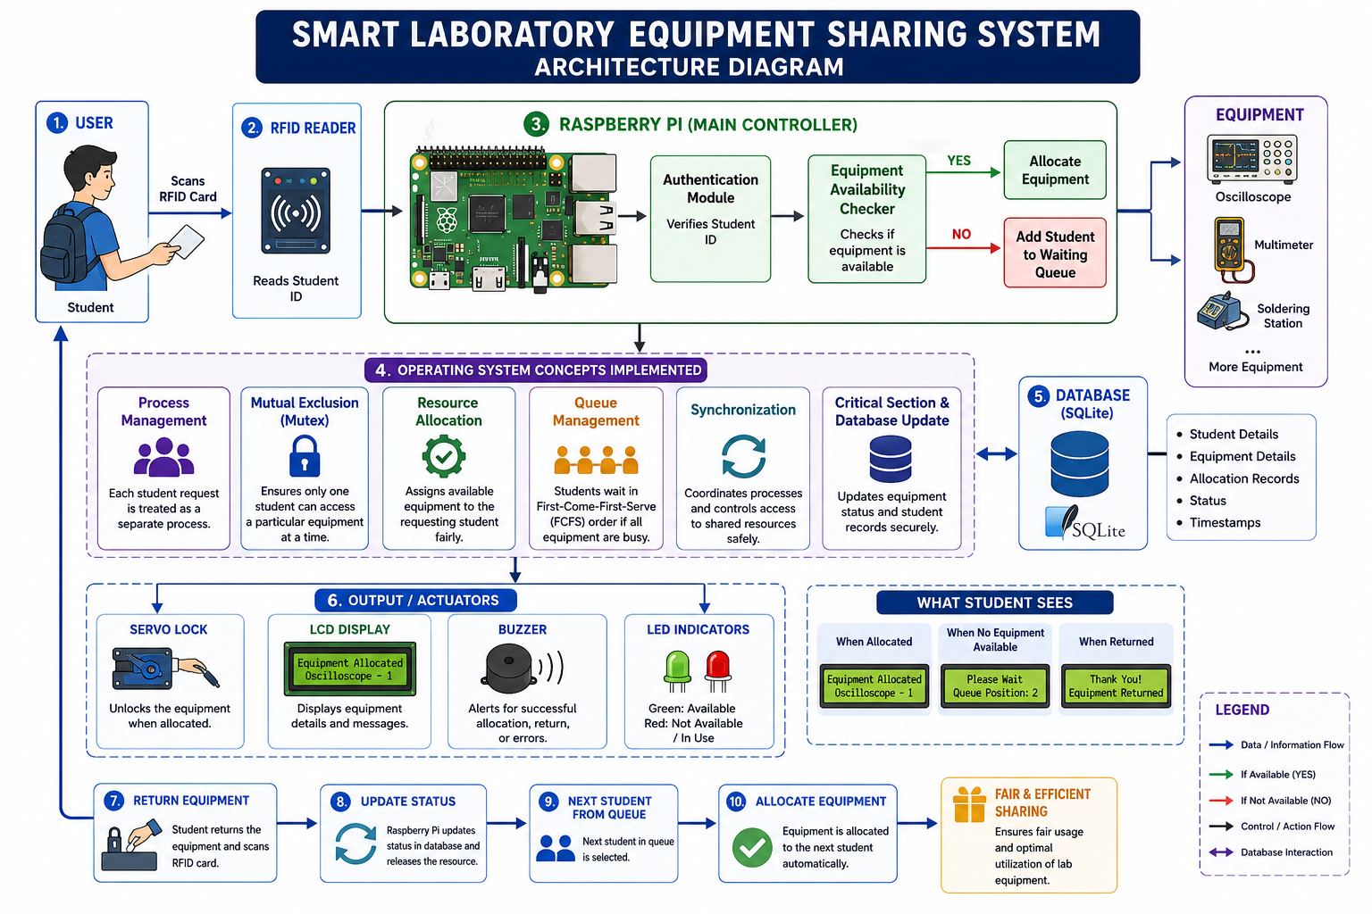

1
USER LAYER
Student Scans RFID Card — Card UID is sent to the Pi as a new access request.
Raspberry Pi (Linux)
2
PROCESSING LAYER
Raspberry Pi (Linux OS) — Validates the UID against the student database.
3
DATA LAYER
SQLite DB stores every record · AES Encryption seals each log entry so it cannot be altered.
Servo Lock
LCD
Buzzer+LED
4
ACTION LAYER
Servo unlocks the item · LCD shows the equipment number · Buzzer/LED alert on denied access.
Between Processing and Data: Scheduling, Mutex & Resource Allocation run inside the Pi (see previous slide).
Secure Smart Laboratory Equipment Management System
5

Slide 6




Methodology: The Smart Workflow
Each step shows the component responsible and exactly what it does
Identification
1
Allocation
4
Component: RC522 RFID Reader
Component: OS Mutex Lock
Student scans their RFID card at the reader; the system captures the unique UID.
Applies mutex to prevent double allocation, updates the DB, and encrypts the log.
Authentication
2
Physical Access
5
Component: Raspberry Pi + SQLite
Component: Servo Motor + LCD
The Pi verifies the UID against the database to confirm identity and permissions.
Servo unlocks the equipment station; LCD displays the specific equipment ID.
Validation
3
Completion
6
Component: SQLite Database
Component: Queue Manager
Checks equipment availability. If occupied, the student joins the FCFS queue.
On return, the system updates status and automatically notifies the next student.
Secure Smart Laboratory Equipment Management System
6

Slide 7



Demo Scenario
Real-world application — three situations the system must handle correctly
SUCCESSFUL ACCESS
CONFLICT HANDLING
SECURITY BREACH
1
Student A scans RFID card.
1
Student B requests occupied oscilloscope.
1
Unauthorized RFID card is scanned.
2
System verifies UID and checks availability.
2
System adds Student B to the FCFS queue.
2
Red LED flashes and buzzer activates.
3
Mutex applied; servo unlocks equipment.
3
Auto-allocated when Student A returns item.
3
Event logged in the AES-encrypted database.
RESULT: Access Granted & Logged
RESULT: Fair Resource Sharing
RESULT: Access Denied & Alerted
Secure Smart Laboratory Equipment Management System
7

Slide 8

Thank You
RFID Auth
Raspberry Pi 4
AES Encrypted Logs
SQLite DBMS

