Slide 1


ATM SIMULATION SYSTEM
PRESENTED BY
2303811710422185 - YAZHINI P
SUPERVISOR
Mr.A.Malarmannan,M.E.,AP/CSE

Slide 2

PRESENTATION OVERVIEW
Objective
Project Introduction
Problem Statement
Methodologies (Programming concepts relevant to problem statement)
Architecture of the proposed system
List of Modules
Merits
Results and Discussion
Queries

Slide 3
OBJECTIVE
The objective of This project presents a console-based ATM simulation that enables users to perform essential banking transactions, including withdrawals, deposits, and balance inquiries. It incorporates features like real-time balance updates, error handling for insufficient funds, and transaction confirmations. Designed with a modular code structure, the project offers adaptability for future enhancements. Serving as a practical educational tool, this simulation provides a foundational understanding of ATM operations using basic programming constructs and logical flow.

Slide 4
PROJECT INTRODUCTION
Automated Teller Machines (ATMs) have become an integral part of modern banking, providing users with quick and convenient access to essential financial services. This project simulates a basic ATM system through a console-based application, allowing users to perform essential banking tasks like withdrawals, deposits, and balance inquiries. It ensures secure access using account number and PIN authentication. The design emphasizes simplicity, error handling, and modularity, making it both functional and educational for understanding core banking operations.

Slide 5
PROBLEM STATEMENT
In today's fast-paced world, ATMs play a crucial role in providing convenient access to banking services. However, understanding and simulating the functionality of an ATM system is essential for developing secure and efficient financial applications. The challenge lies in creating a system that securely performs key operations like withdrawals, deposits, and balance inquiries, while ensuring user authentication, real-time balance updates, and error handling for situations like insufficient funds. This project addresses the need for a simple, console-based ATM simulation to demonstrate core banking functionalities and provide an educational tool for learning software development practices.

Slide 6
i
Methodologies (Programming concepts relevant to problem statement)
Object-Oriented Programming (OOP)
Encapsulation: The program groups account details (e.g., account number, PIN) and operations (e.g., withdraw, deposit) in a BankAccount class.
Abstraction: The simplifies functionalities like authentication into methods like authenticate().
Inheritance: It enables creating specialized accounts (e.g., SavingsAccount) from a base Account class.
Polymorphism: It allows methods like performTransaction() to handle different operations dynamically.

Slide 7
Methodologies (Programming concepts relevant to problem statement)
Variables and Data Types
Integer variables: It store key information such as accountNumber, balance, and transaction amounts. Variables like withdraw and deposit are declared within methods to optimize memory usage.
Control Structures
If-Else: It validates user credentials for security.
Switch-Case: It handles menu options like Withdraw, Deposit, and Exit efficiently.
While Loop: It ensures the menu is displayed repeatedly until the user exits.

Slide 8
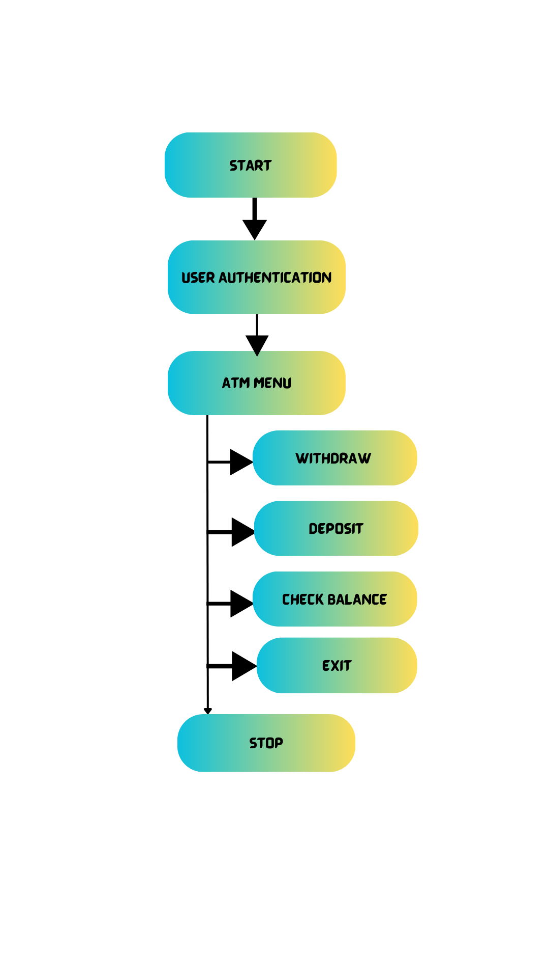
FLOW DIAGRAM

Slide 9
MODULE DESCRIPTION
Authentication:
User inputs account number and PIN for verification.
Only authorized users can proceed to the next step.
ATM Menu:
After successful login.
A menu offers options: Withdraw, Deposit, Check Balance, and Exit.
Withdraw:
Checks if the balance is sufficient for withdrawal.
If sufficient, balance is updated, and cash is dispensed.
If insufficient, an error message is displayed.
Deposit:
Adds the deposited amount to the balance.
Confirms successful deposit.
Check Balance:
Displays the current account balance to the user.
Exit:
The user can exit the program, ending the session.

Slide 10
MERITS
Educational Value:
Teaches core Java concepts like OOP, control structures.
Simulates real-world banking operations for better understanding.
User-Friendly Design:
Menu-driven interface for easy operation.
Allows multiple transactions in one session.
Modularity and Scalability:
Easy to add features like database integration or GUI.
Supports enhancements for multi-user systems.

Slide 11
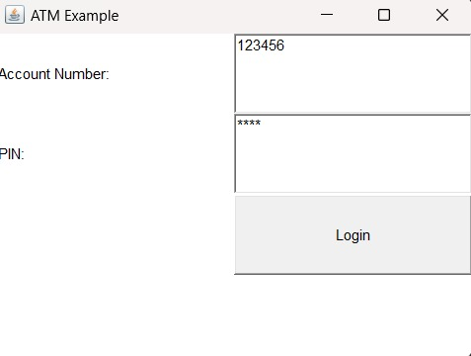
RESULT AND DISCUSSION
1. USER AUTHENTICATION

Slide 12
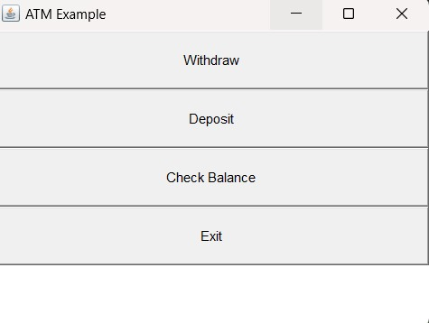
RESULT AND DECISION
2. ATM MENU

Slide 13
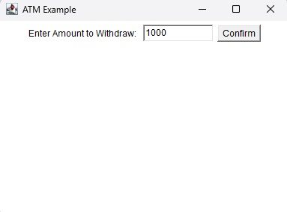
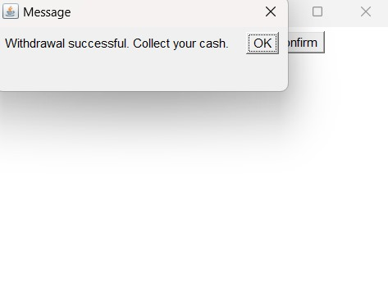
RESULT AND DECISION
3. WITHDRAW

Slide 14
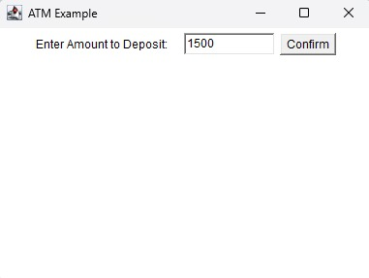
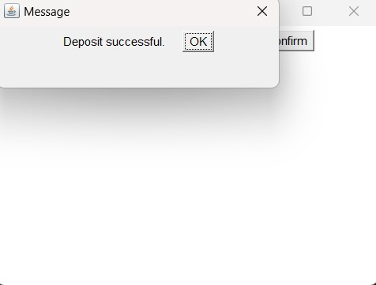
RESULT AND DECISION
4. DEPOSIT

Slide 15
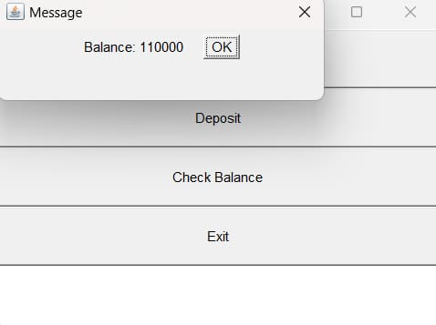
RESULT AND DECISION
5. CHECK BALANCE

Slide 16
RESULT AND DECISION
6. EXIT

Slide 17
ANY QUERIES ?

Slide 18
THANK YOU

