Slide 1
KEYLOGGER
CAPSTONE PROJECT
Presented By:
Yazhiny M - Jeppiaar Institute of Technology – B.E/ CSE

Slide 2
OUTLINE
Problem Statement
Proposed System/Solution
System Development Approach
Algorithm & Deployment
Result
Conclusion
Future Scope
References

Slide 3
PROBLEM STATEMENT
The increasing concerns about unauthorized access to personal or sensitive information have highlighted the need for monitoring and tracking user activities on a system. Current solutions often lack user-friendly interfaces and customizable options, making it challenging for users to manage and interpret the collected data effectively. There is a clear demand for a more accessible and customizable keylogging solution that can address these concerns and provide users with greater control over their monitoring activities.

Slide 4
PROPOSED SOLUTION
To address these challenges, we propose the development of a Python-based keylogger using the tkinter library for the graphical user interface (GUI), the pynput library for keyboard monitoring, and JSON for data storage. This solution aims to offer a simple and user-friendly interface that allows users to easily start and stop the keylogging process. Additionally, the keylogger will provide options to save the logged data in both text and JSON formats, giving users flexibility in managing and analyzing the collected information according to their preferences.

Slide 5
SYSTEM APPROACH
Technology Stack:
GUI: tkinter
Keyboard Monitoring: pynput
Data Storage: JSON
Key Components:
start_keylogger(): Starts the keylogging process and updates the GUI.
stop_keylogger(): Stops the keylogging process and updates the GUI.
on_press(): Handles key press events and logs them.
on_release(): Handles key release events and logs them.

Slide 6
ALGORITHM & DEPLOYMENT
Initialize global variables and empty lists (keys_used, flag, keys).
Define on_press() function to handle key press events.
Define on_release() function to handle key release events.
Define generate_text_log() and generate_json_file() functions to save logs.
Define start_keylogger() and stop_keylogger() functions to control keylogging.
Deployment:
Package the Python script into an executable or distribute it as a standalone application.
Ensure compatibility with different operating systems and provide installation instructions.

Slide 7
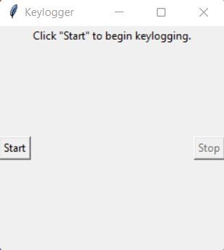
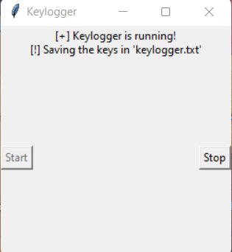
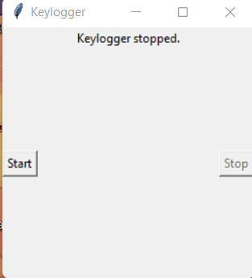
RESULT
The GUI presents "Start" and "Stop" buttons to control the keylogging process
Upon execution, the keylogger application will run in the background, capturing all keystrokes made by the user. The captured data will be stored in both text and JSON formats for later analysis.
The GUI will provide user-friendly controls to initiate and terminate the keylogging process, along with status updates.

Slide 8
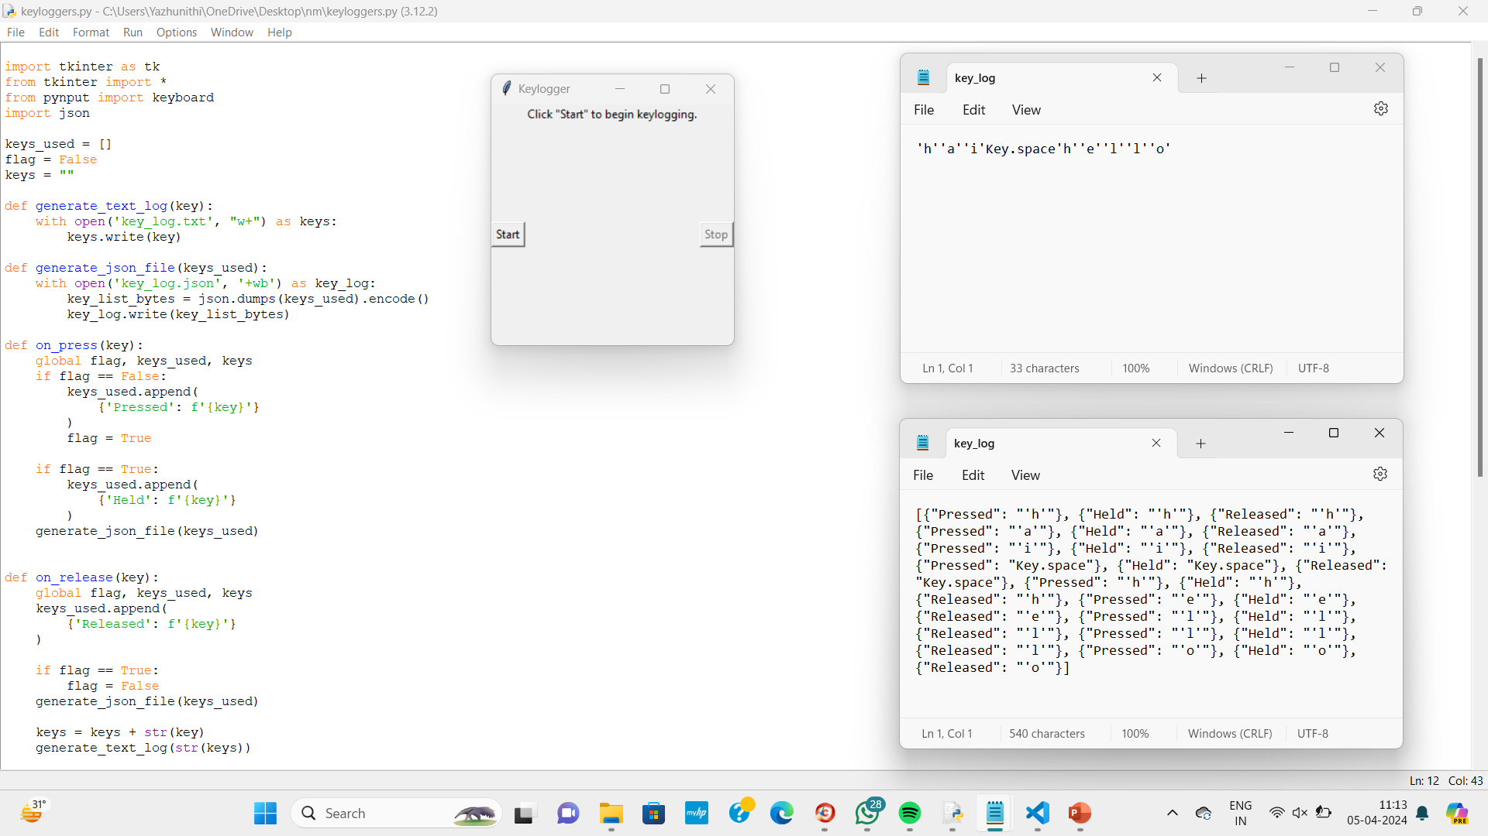
OUTPUT

Slide 9
CONCLUSION
The developed keylogger application provides a simple yet effective tool for monitoring keystrokes on a system. While primarily intended for security purposes, it can also serve as a learning tool for understanding keyboard events in Python programming. However, it's crucial to use such tools responsibly and ethically, respecting user privacy and legal boundaries.

Slide 10
FUTURE SCOPE
Enhance security features to protect logged data from unauthorized access.
Implement advanced filtering and analysis options for key logs.
Extend functionality to capture and log other types of user activities (e.g., mouse clicks, application usage).
Develop a more robust and scalable version for enterprise-level monitoring.

Slide 11
REFERENCES
A Survey on Keylogger and its Detection Techniques by Vishal Bharti, Aditya Kumar Gupta, and Shailendra Mishra https://www.ijcaonline.org/archives/volume75/number5/12835-1514
Analysis of Keylogger Attacks and Countermeasures by Hongliang Liu, Ruiying Du, and Quansheng Zhuang https://www.semanticscholar.org/paper/Analysis-of-Keylogger-Attacks-and-Countermeasures-Liu-Du/54c7255bace229c82e4a5fd812ba8dd8829180c1
Detection of Keyloggers: A Review by Shukor Abd Razak, Ku Ruhana Ku-Mahamud, and Ramlan Mahmod https://www.researchgate.net/publication/220955239_Detection_of_Keyloggers_A_Revie

Slide 12
THANK YOU

