Slide 1
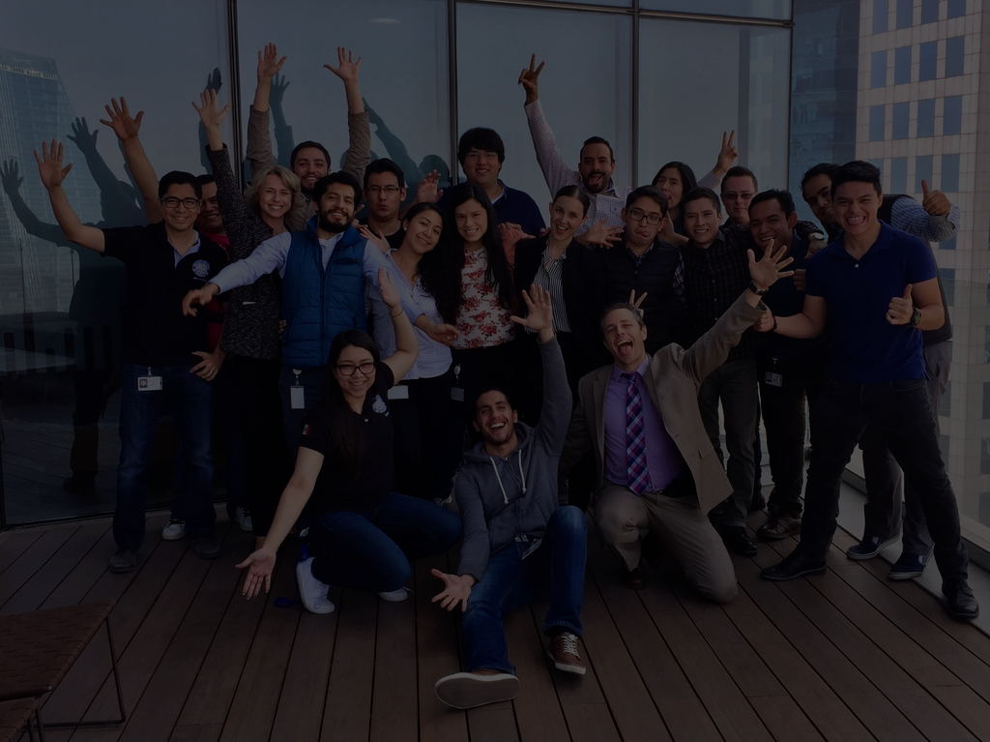
Overview Demo About the App Contact
The Talent Retention Predicter App ™
Identify who is at risk BEFORE it’s too late
Fueled by machine learning, tuned to your organization’s data, to predict who is at risk of leaving
TRY THE DEMO
Talent flight costs large corporations a zillion dollars per year¹. The TRP can reduce your costs:
ICON
ICON
ICON
Predicts with up to 90% accuracy which employees are at risk of leaving so that you can intervene first
Adaptable to your organization’s employee base and organizational goals
Gets smarter over time as the machine learning algorithm improves with experience and additional data
Contact us to learn more
(¹ full citation here)
Copyright 2021

Slide 2
Overview Demo About the App Contact
The ML Model
Data deep dive visualization
The data source
The Talent Retention Predicter App ™
Identify who is at risk BEFORE it’s too late
Fueled by machine learning, tuned to your organization’s data, to predict who is at risk of leaving
TRY THE DEMO
Talent flight costs large corporations a zillion dollars per year¹. The TRP can reduce your costs:
ICON
ICON
ICON
Predicts with up to 90% accuracy which employees are at risk of leaving so that you can intervene first
Adaptable to your organization’s employee base and organizational goals
Gets smarter over time as the machine learning algorithm improves with experience and additional data
Contact us to learn more
(¹ full citation here)
Copyright 2021

Slide 3
Overview Demo About the App Contact
Demo
This demo is based on IBM’s public data set ¹ on employee retention.
Instructions: Enter data from the profile of a hypothetical manager at IBM:
6. Data point 6:
7. Data point 7:
8. Data point 8:
9. Data point 9:
10. Data point 10:
Age:
Gender:
Data point 3:
Data point 4:
Data point 5:
Results:
(¹ full citation here)
Copyright 2021

Slide 4
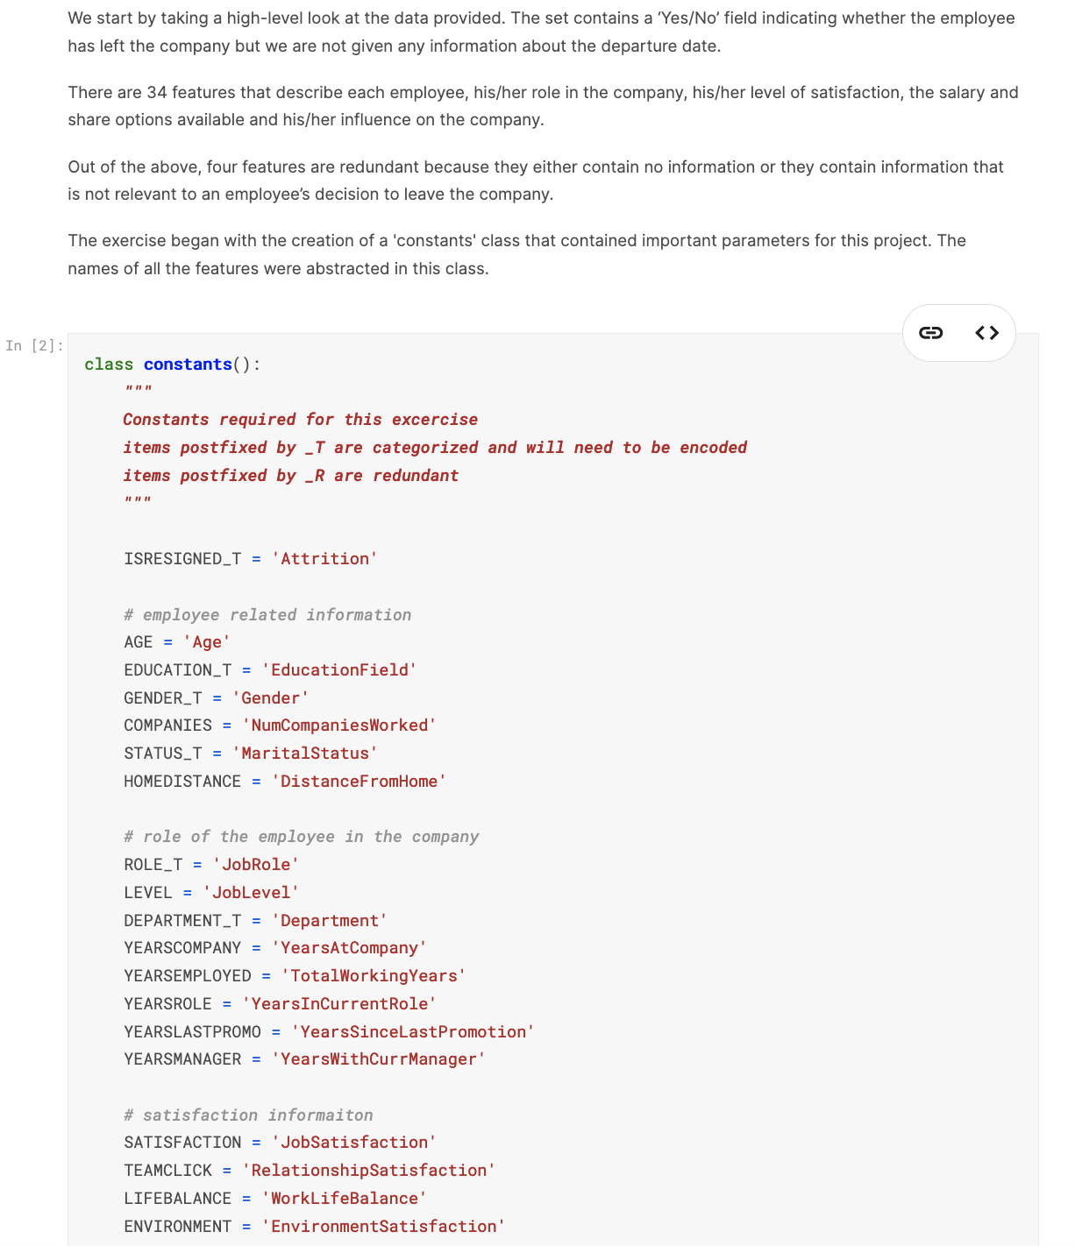
Overview Demo About the App Contact
The Machine Learning Model
Ken Note: Ideally, this is the Google Colab embedded directly into the site, if that can be done, a little like the example we saw in Kaggle. If not, I’ll build it with screen shots. We’ll need the Colab doc to be well documented with explanations etc.
(¹ full citation here)
Copyright 2021

Slide 5
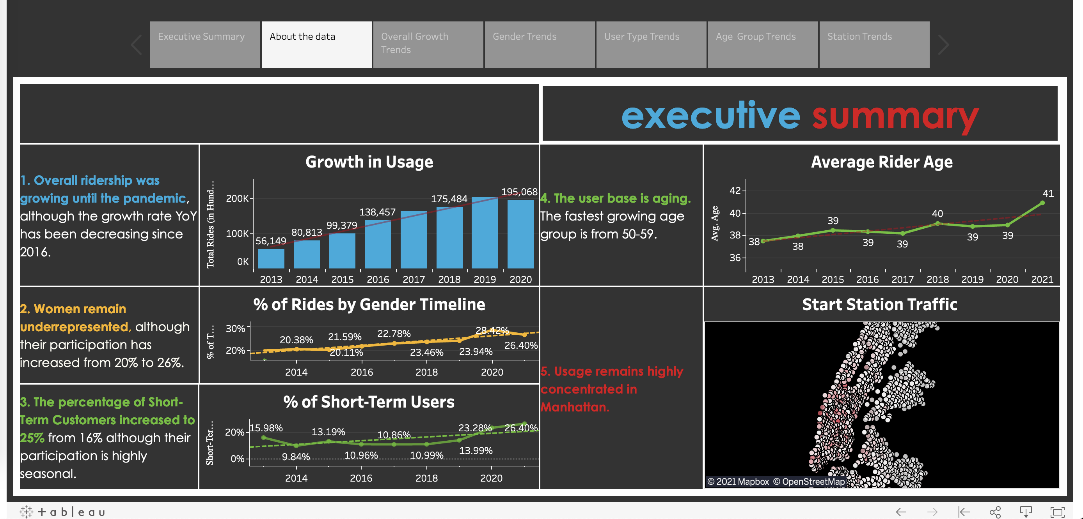
Overview Demo About the App Contact
Data Deep Dive Visualization
Ken Note: the tableau story embedded here. Summary text is built into the tableau story
Copyright 2021

Slide 6
Overview Demo About the App Contact
The IBM Data Source
Ken Note: simple page. Presents the data source in a table, with a link to download.
(¹ full citation here)

Slide 7
Overview Demo About the App Contact
Contact
Talk to one of our developers to learn how the TRP App™ can help retain your best talent:
Head
shot
Head
shot
Head
shot
Head
shot
Head
shot
Fueled by machine learning, tuned to your organization’s data, to predict who may leave
Bio
Bio
Bio
Bio
Bio

