Slide 1
Panel Sizing: Appointment Management, Patient Access, and Finances
Collaborator update
Carri W. Chan, PhD; Jing Dong, PhD; Kevin Wang (PhD Candidate). Columbia Business School.
Tracy Yang (MS Candidate). Statistics, Columbia University.
Joseph P. Alukal, MD, MBA. Professor of Urology, CUIMC; Medical Director, Access-to-Care, ColumbiaDoctors.

Slide 2
Agenda
1. Overview
  Context, focus on patient access & appointment management, and our approach
2. Scheduling insights from simulation
  How delay-sensitive no-show and balking behavior shape access, and which scheduling policies help
3. Empirical evidence
  Early results from the data

Slide 3
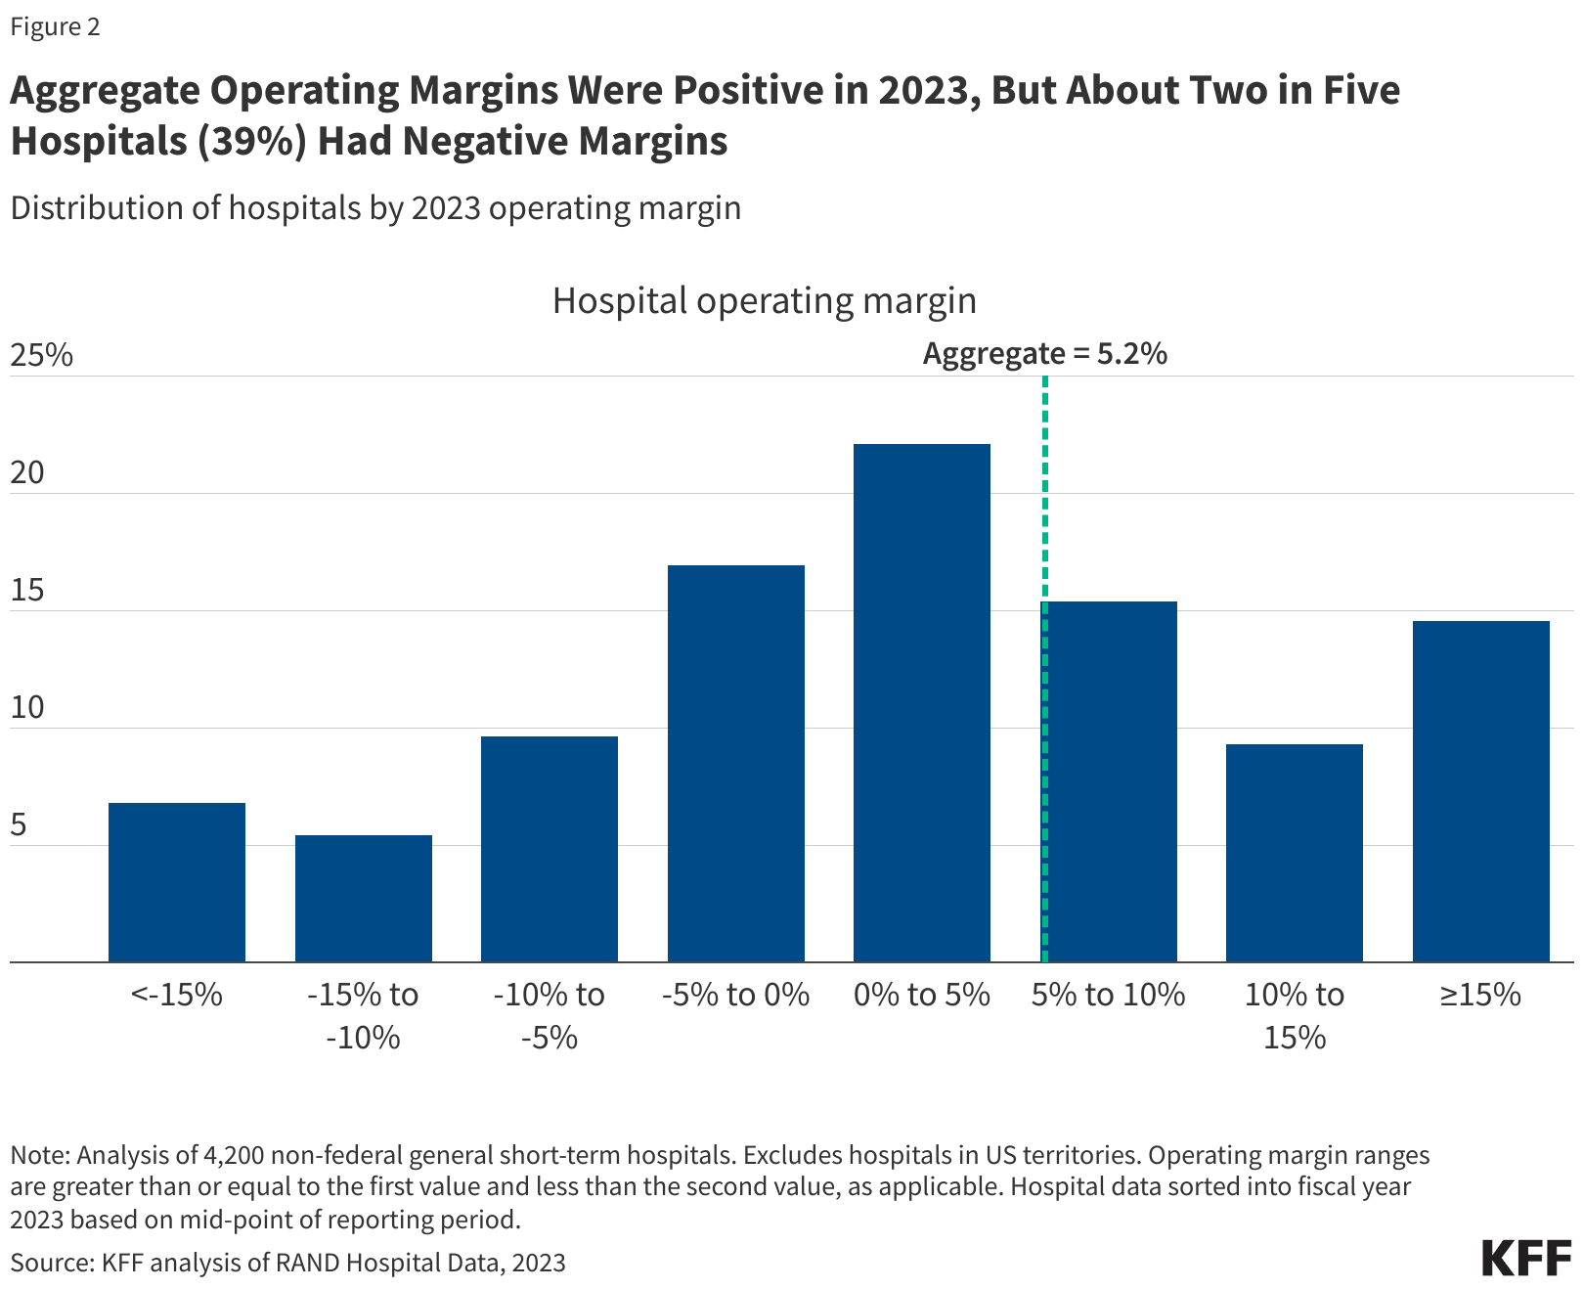
Distribution of hospitals by 2023 operating margin
Notes:
https://www.kff.org/health-costs/issue-brief/hospital-margins-rebounded-in-2023-but-rural-hospitals-and-those-with-high-medicaid-shares-were-struggling-more-than-others/

Slide 4
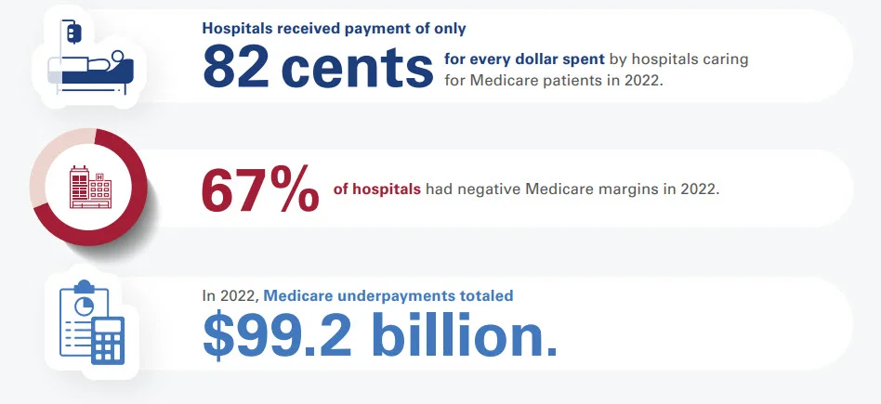
Hospitals are losing 18¢ per dollar in Medicare
Notes:
https://www.aha.org/2024-01-10-infographic-medicare-significantly-underpays-hospitals-cost-patient-care

Slide 5



Focus: Appointment Management
Scheduling practices impact:
  Patient access
    Timeliness & desirability of slots
  Provider utilization
    Number of available slots, no shows & cancellations
  Payer mix
    Appointment patterns differ across payer groups​
    Booking and no‑show behavior influences financial performance

Slide 6
Approach 1: Simulation Analysis
Patient arrivals
Multiple types
Policies
Length of booking window
Reservation policies
Constraints
Number of slots
Overbooking limit
Same-day versus future slots
Overbooking strategy
Arrival rates
Seasonality
Payer mix
Delay tolerance
Simulate
Output Metrics
Access: Wait time, fill rate
Utilization
Financial
Sensitivity results
Chronic disease burden

Slide 7


Approach 2: Panel Sizing Optimization
Data analysis
  Estimate delay sensitivity (no-show/no-booking) based on age, type of appointment, payer type, chronic disease burden, etc.
Mathematical modeling
  Model of panel sizing, access metrics, financial outcomes
  Optimization algorithm to derive optimal panel size
    How does this depend on scheduling strategies?
    How does this depend on payer mix?

Slide 8
Scheduling Insights from Simulation
Carri W. Chan, Tracy Yang

Slide 9
Standard scheduling approaches lead to long waits and idle capacity
Patients react to long waits, leading to no-shows, cancellations, and balking.
These behaviors can lower the overall served rate and waste capacity.
Question: How does patient sensitivity to appointment delay affect patient access and efficiency?
We focus on three metrics:
  Average utilization: the average fraction of appointment capacity that becomes completed visits.
  Served rate: the fraction of arriving patients who receive care.
  Waiting time: the average delay of all appointments offered.

Slide 10
Patient delay-sensitive behaviors
Balking
The patient is offered an appointment but declines it because the wait is too long.
No-show
The patient books an appointment but does not show up because the wait is too long.

Slide 11
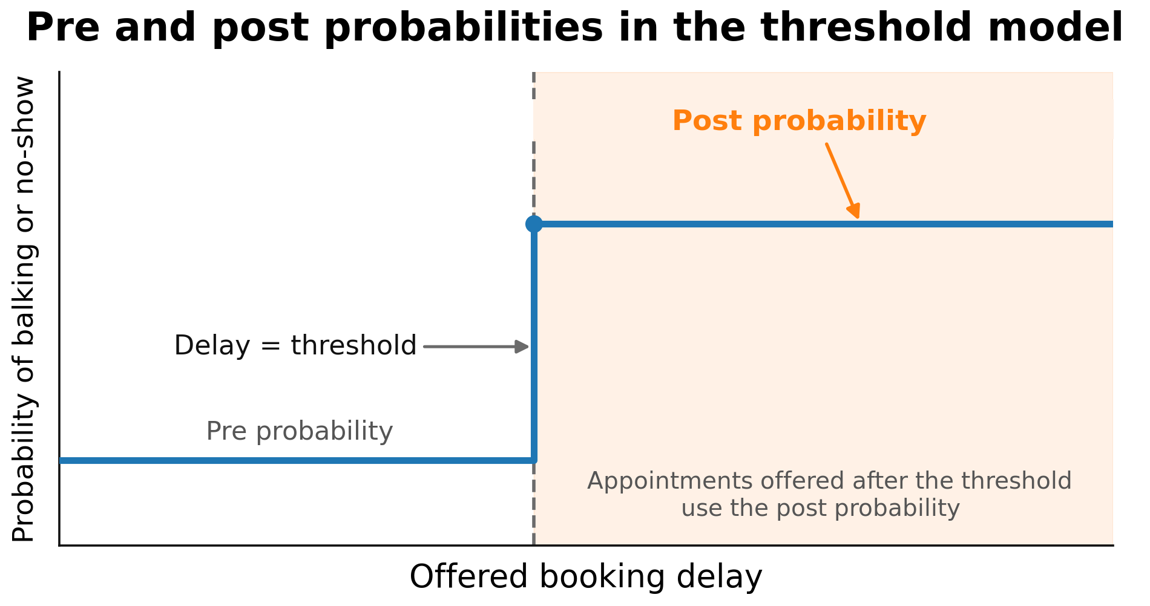
Model of delay sensitivity: Threshold transitions
Applies to both no-show and balking, for both patient classes.

Slide 12
Structure of the simulation study
Alternative scheduling policies
Reservations and booking horizon
Standard scheduling
FCFS (first-come, first-served)
Baseline: how no-shows, balking, and cancellations affect access and efficiency
Pareto improvements
Improve Class 1 access without hurting Class 2
Trade-offs
Allow a limited Class 2 loss for a larger Class 1 gain

Slide 13
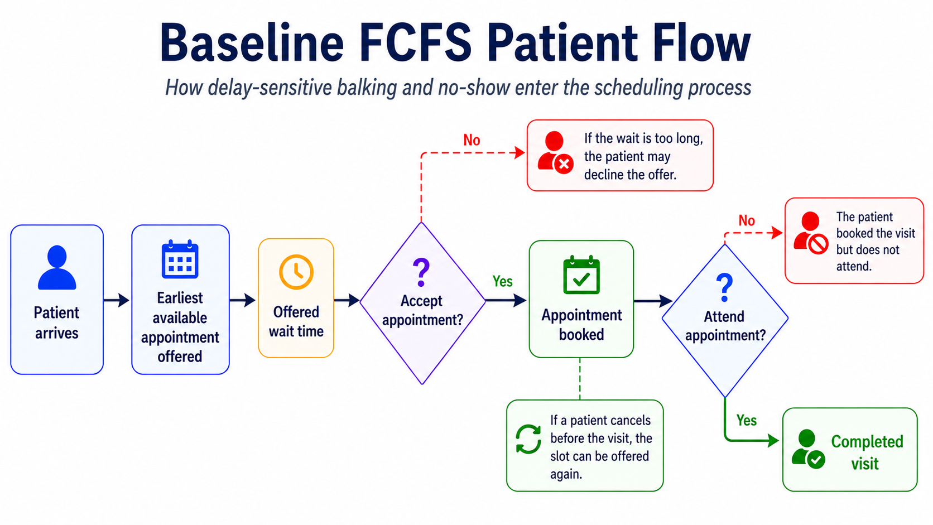
Simulation setup: 30-day burn-in → 365-day measurement period → 10-day cooldown
Notes:
Appointment offered instead of earliest
Change ttile
Specify fcfs

Slide 14
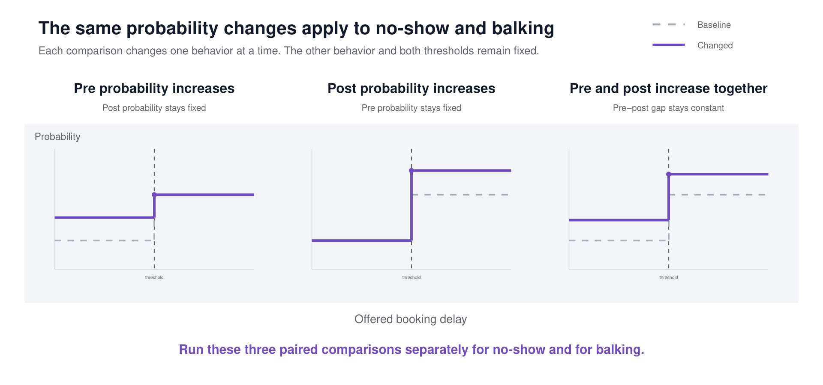
No-show vs. balking: how do they affect served rate?
Experiment design
Notes:
REVIEW QUESTION: Check the thin picture strip at the very bottom of this slide (0.4" tall). Is it meant to be there?
No-show results graph - Two post probabilities moving together -> wrong label
Add class 2
See pre and post tgt graph

Slide 15
Summary: no-show, balking, and cancellation effects
No-show
Balking
Cancellation
Minimal impact on the other class’s served rate.
When demand is low (unlikely to see high waits), the pre-probability has the biggest impact on served rate.
Effects spill over positively to the other class.
When demand is low (unlikely to see high waits), the pre-probability has the biggest impact on served rate.
Changes in post-probability has minimal impact on served rate.
Under high demand (long waits), little change in pooled outcomes.
Higher cancellation rates can improve utilization and waiting time.
Notes:
REVIEW QUESTION: The no-show column says effects come from the POST probability, but then says the biggest impact is from the PRE probability. Which is it? Reconcile the two bullets.
no-show is the most impactful on served rate when pre-probability is high while demand is low. The post probability insight should be overlooked.
Should we prepare the specific numbers

Slide 16
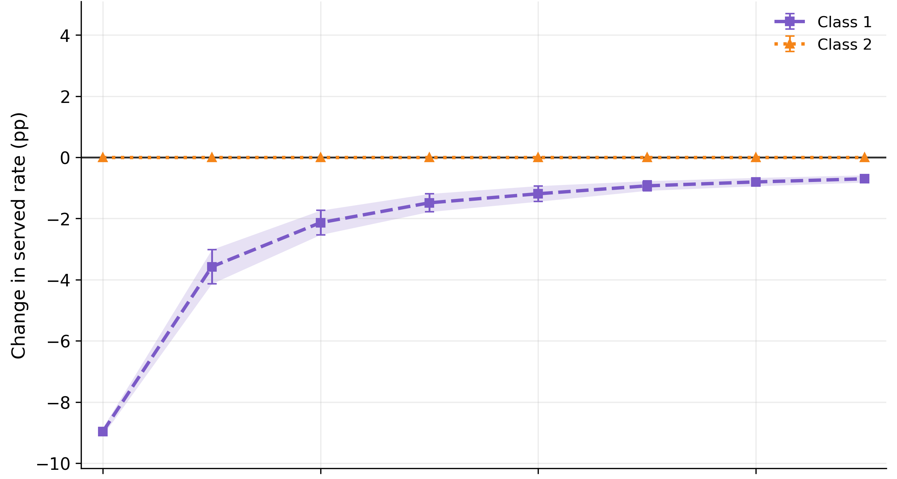
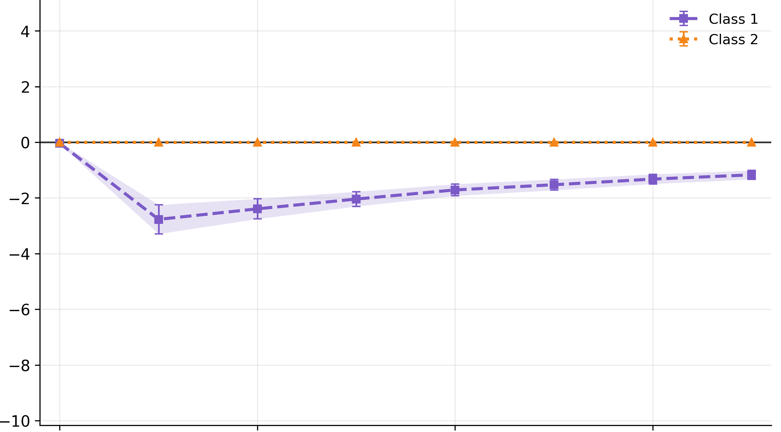
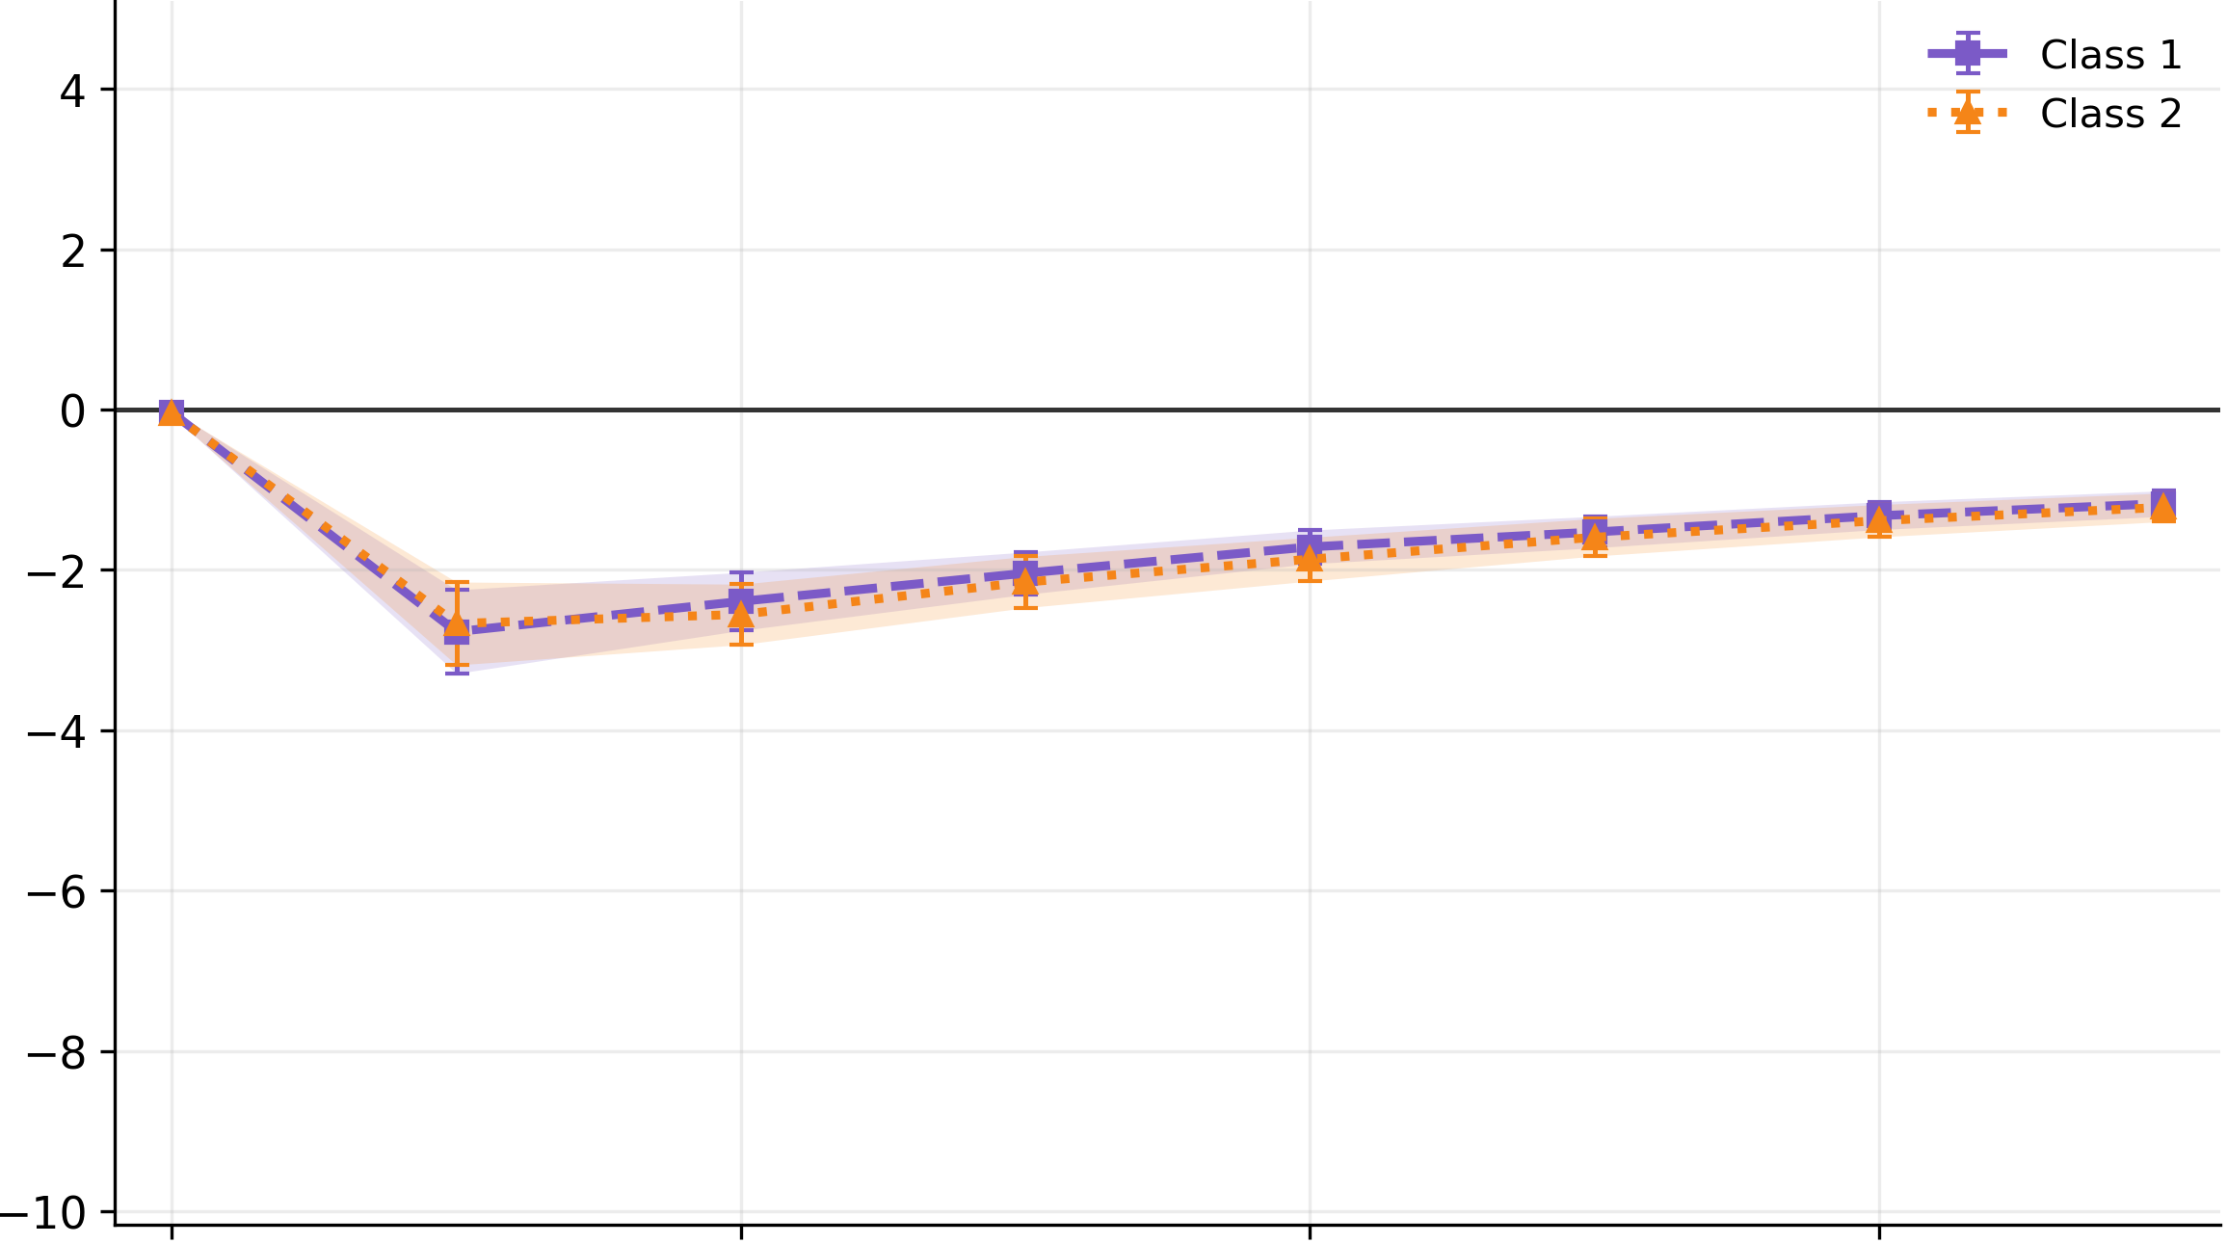
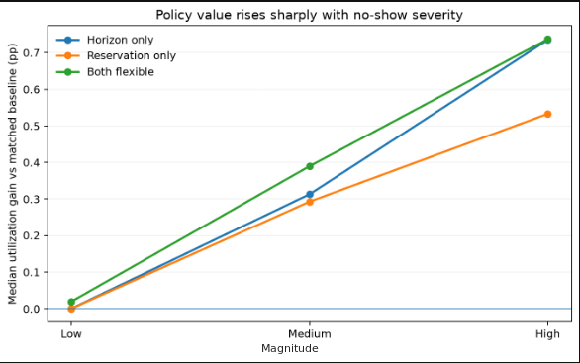
No-show mainly affects the class’s own served rate
No-show effects come from each class’s own post probability; the other class’s served rate is not affected.
The largest effect comes from raising the pre probability at low demand.
Demand

Slide 17
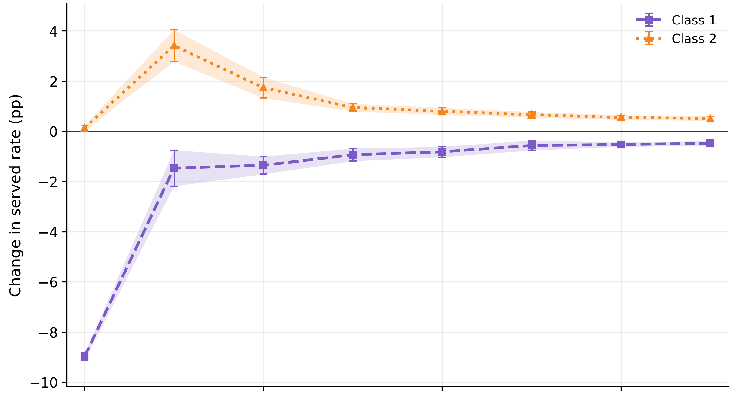
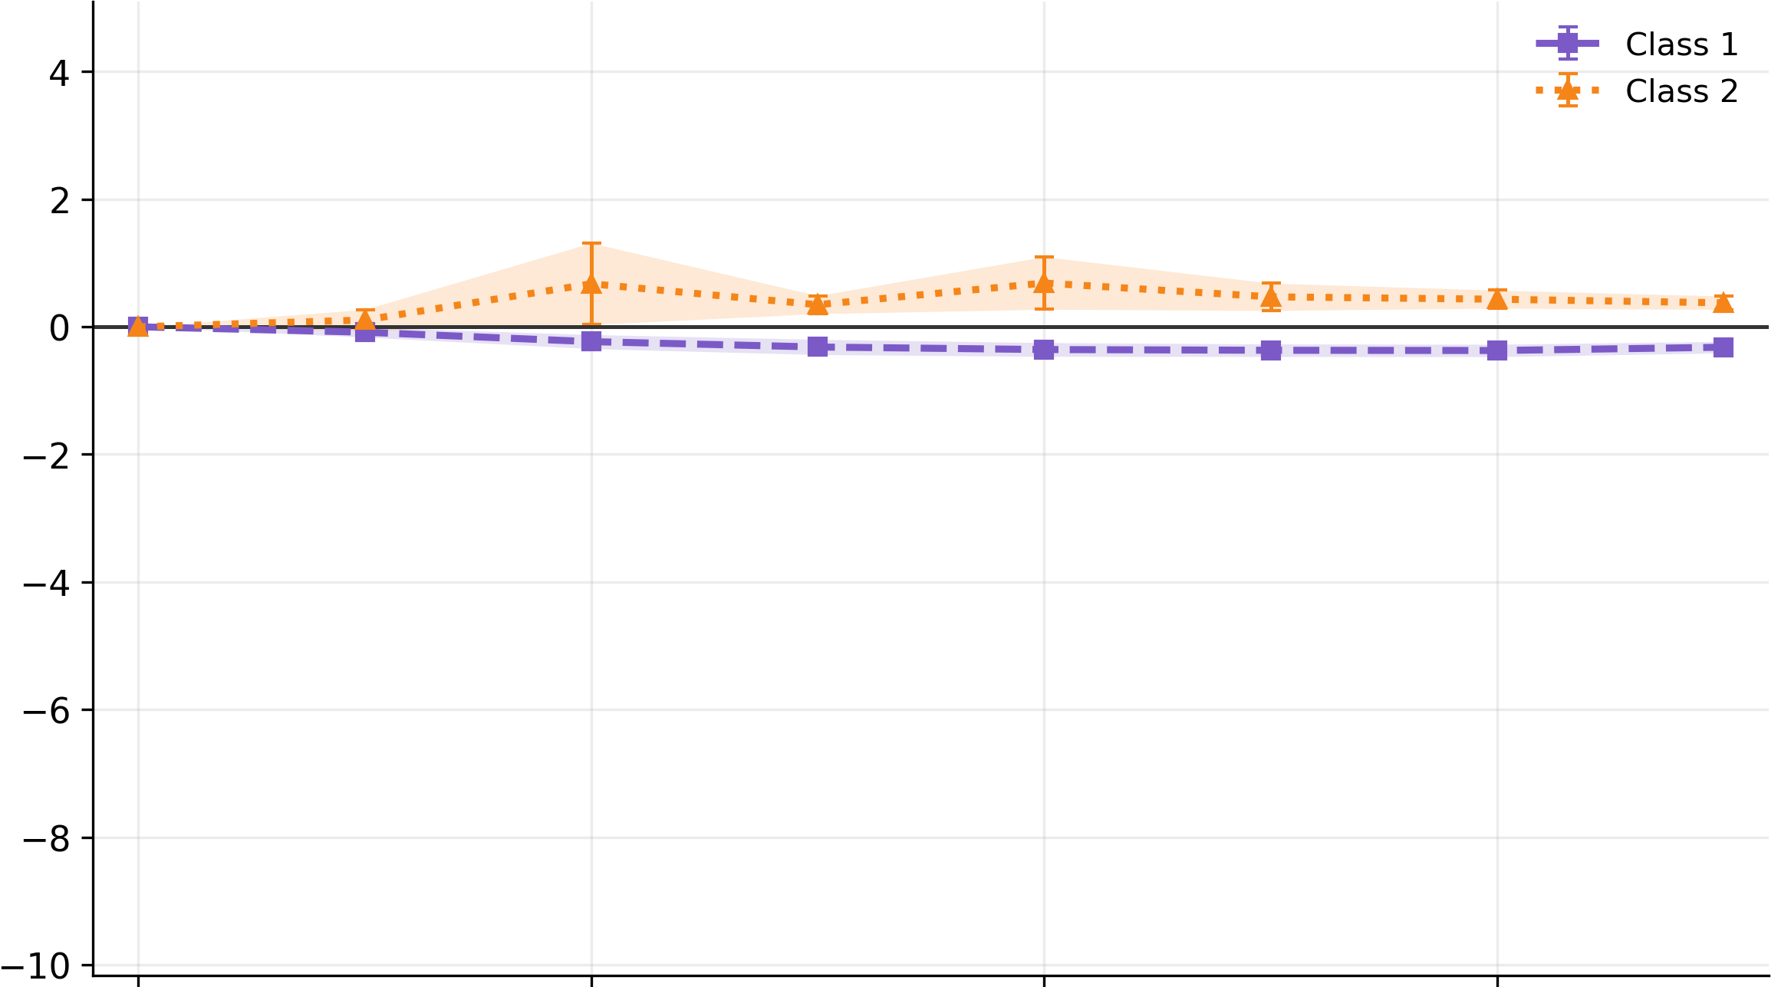
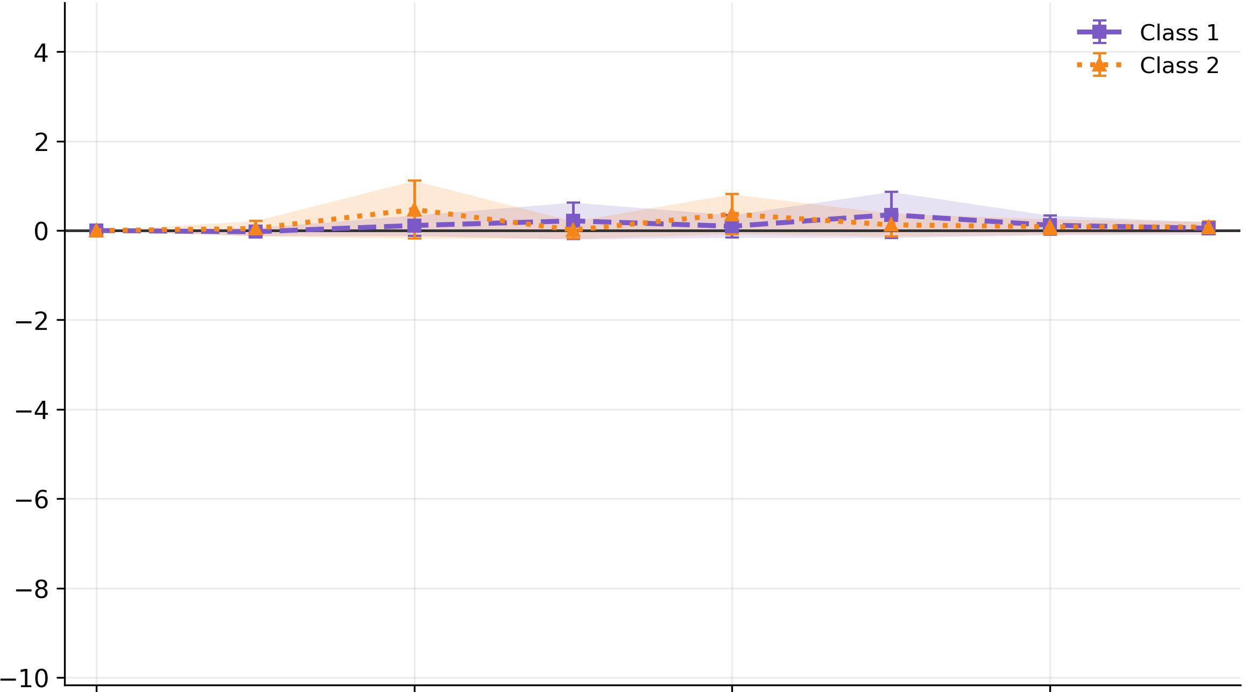
Balking affects both classes’ served rates
Class 1 balking increases Class 2’s served rate.
This effect peaks with pre-threshold balking at low to moderate demand.
Demand

Slide 18
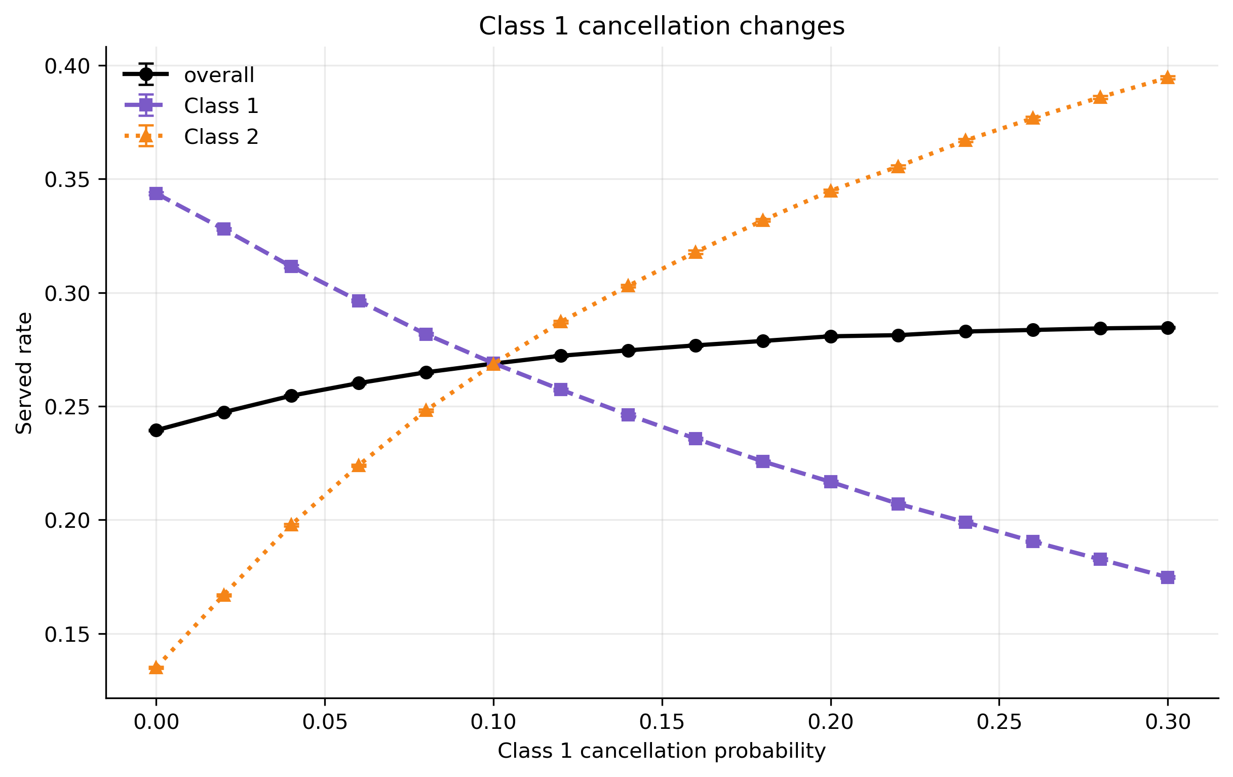
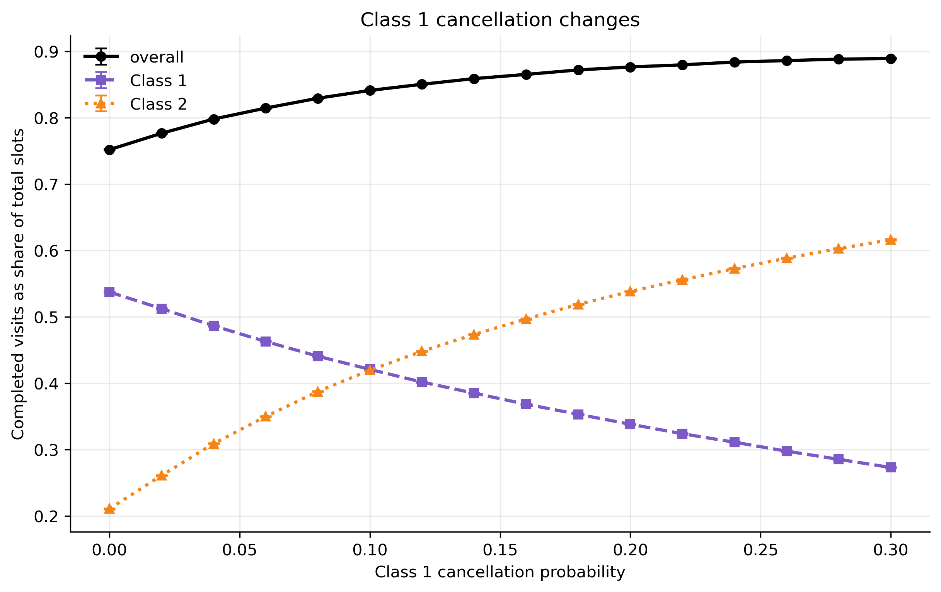
Cancellation redistributes access and does not waste capacity
Under high demand, cancellations transfer access from one class to the other with little change in pooled outcomes.
Higher cancellation rates can improve utilization and waiting time by freeing slots that are rebooked before behavior thresholds.

Slide 19
Summary
Demand is a big driver of served rate, compounded by no-shows.
Balking post probability mainly redistributes access away from the delay-sensitive class.
No-shows cause unrecoverable loss and waste capacity.
The delay sensitivity threshold matters, not just the post probability because it impacts what delays (and what demand profiles) matter.
Balking affects both classes’ served rates, while no-show affects only its own class.
Balking post probability has minimal effect on overall served rate.
Cancellation redistributes access between classes.
Notes:
REVIEW QUESTION: Define ‘threshold gap’ (point 6). It is not defined anywhere earlier in the deck.
Check summary again

Slide 20
Next step: can scheduling policies reduce harm relative to FCFS?
Goals
Policies under consideration
Explore how patient behavior affects utilization, served rate, and waiting time when the booking horizon is flexible.
Learn how to optimize these metrics by choosing reserved slots and the reservation period.
Find win-win situations for class access and efficiency when policies become flexible.
1. Booking horizon
How far ahead patients can book. Available appointments after this time are not offered.
2. Reservation
Gives one class priority for certain appointments.
The policy chooses both the reserved slots per day and the number of days slots are reserved.
Once the reservation slots are all booked, remaining slots are allocated FCFS
Unbooked same-day slots are released from reservation
3. Combination of reservation and booking horizon
Notes:
REVIEW QUESTION: This slide asks ‘can scheduling policies reduce harm?’ but no later slide answers it directly. Add a closing summary of the policy results at the end of Part 2 that answers this question.
- The answer is yes but need to add comparative slides. Should earlier figures also come from 3x3 design?

Slide 21
Experimental Design
Varying parameters and fixed pre probabilities | Values
No-show pre probability | 5% (both classes)
Balking pre probability | 5% (both classes)
Class 1 no-show post probability | 5%, 15%, 25%
Class 1 balking post probability | 10%, 20%, 30%
Demand / capacity (ρ) | 1.2, 1.4, 1.7, 2, 2.5, 3
Class 1 arrival share | 10%, 30%, 50%, 60%, 70%, 80%, 90%
System size (slots/day) | 30, 40, 50
Planned design: 1,134 scenarios; currently 972 in the frontier dataset
Notes:
Correct total scenarios after adding new simulations
REVIEW QUESTION: Notes say ‘correct total scenarios’: the table says 1,134 planned but 972 in the frontier dataset. Update once the new simulations are in.

Slide 22
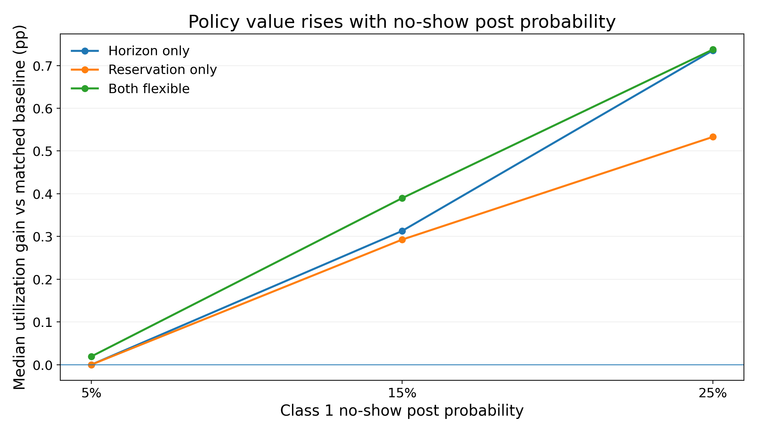
No-show post probability determines how much policies improve utilization
A higher no-show post probability increases the utilization gain from booking-horizon policies, reservation policies, and both combined.
Notes:
REVIEW QUESTION: The utilization gain tops out around 0.7 pp. Is that practically meaningful? Say so explicitly for the audience.

Slide 23
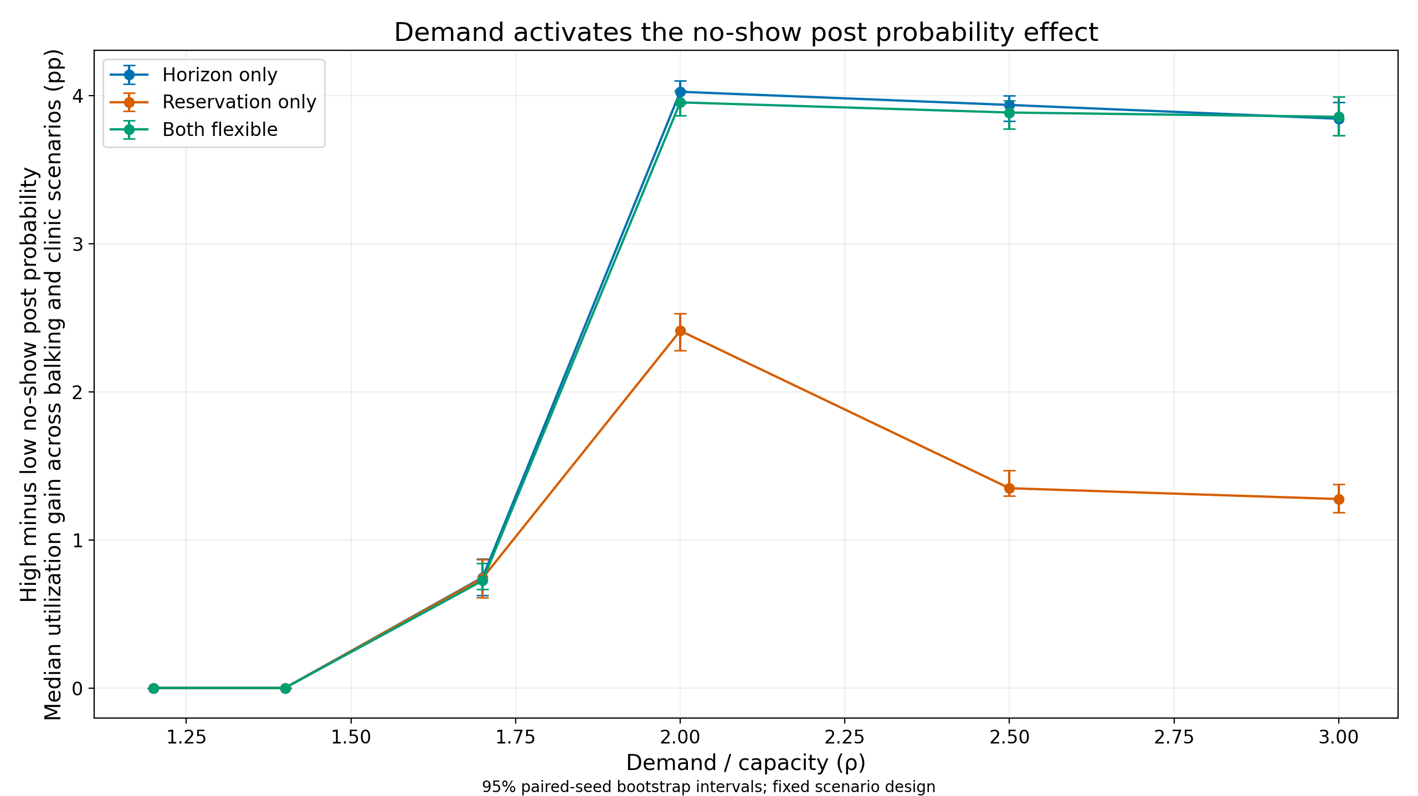
Demand activates the no-show effect on utilization
Demand is needed for no-show post probability to drive policies’ utilization gains.
Reservation is less effective because the inflexible horizon pushes patients past the no-show threshold at higher demand.

Slide 24
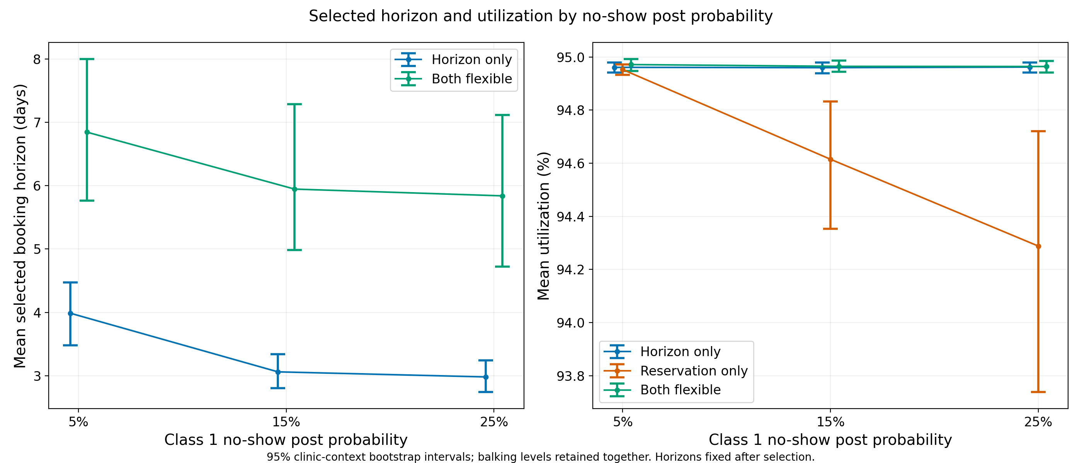
When optimizing utilization, the booking horizon is usually cut short to prevent no-shows
A higher no-show post probability shortens the optimized horizon.
The selected horizon is longer on average when reservation is added to the policy.
Horizon flexibility regulates no-show risk more effectively than reservation alone.

Slide 25
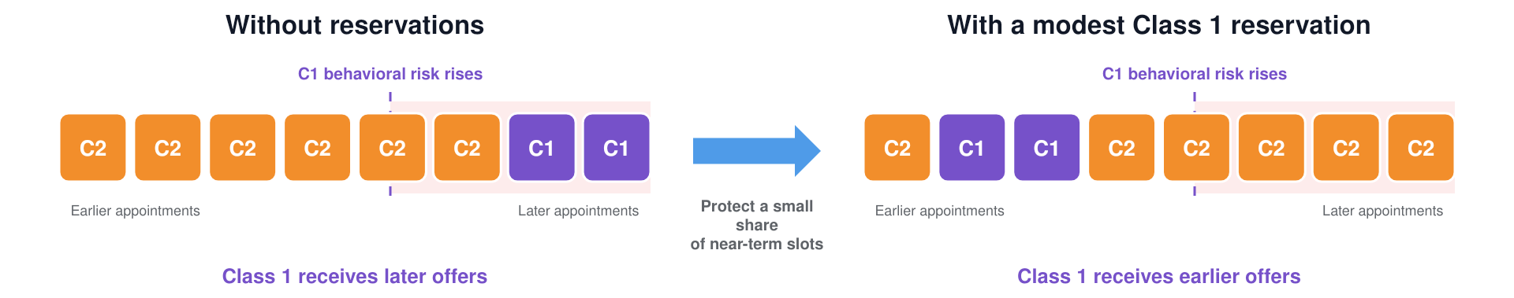
When can reservations improve Class 1 access without hurting Class 2?
We look for reservation policies that improve served rate relative to FCFS.
A representative example:
Let Class 1 be the reservation class and the most delay-sensitive class.
Notes:
REVIEW QUESTION: The text says ‘within 0.5% of optimized UTILIZATION’, but the next slide tests ΔSR₂ ≥ −0.5 pp of SERVED RATE. Which tolerance is used, on which metric, and is it percent or percentage points?

Slide 26
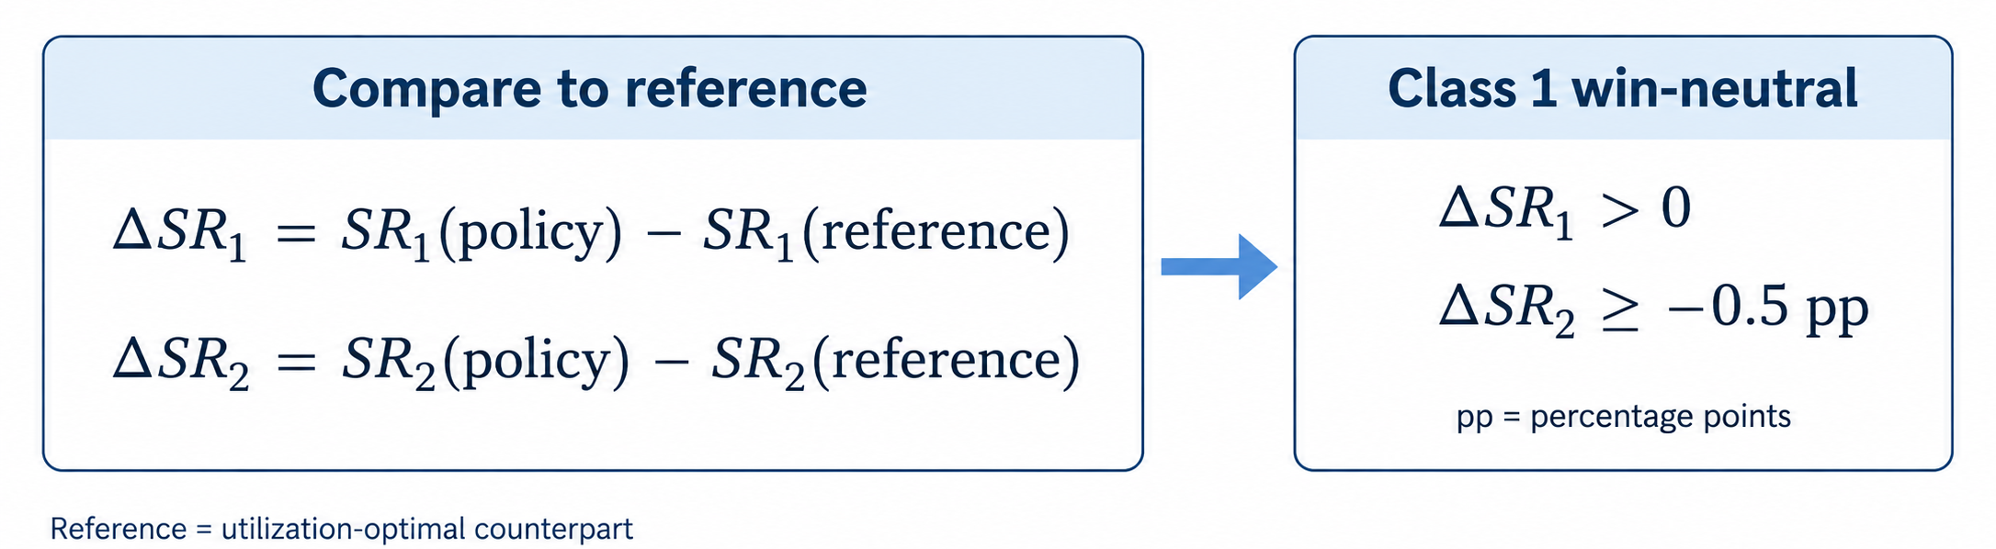
When can reservations improve Class 1 access without hurting Class 2?
No validated cases improve both classes meaningfully.
However, while utilization is maximized, we can improve Class 1’s served rate without meaningfully hurting Class 2.
Notes:
REVIEW QUESTION: Define ‘validated’ (used here and on the Pareto slides) and ‘win-neutral’. Same tolerance question as the previous slide (0.5% utilization vs. −0.5 pp served rate).
Old analysis reference explanation – incorrect
Change reference to FCFS

Slide 27
When do win-neutral reservation cases occur?
Reservation-only
The policy with the largest Class 1 gain among favorable cases.
Win-neutral happens:
  When Class 1 is a small share of the queueing population.
  When there is moderate to heavy demand.
  More often with higher no-show severity.
Both-flexible
Win-neutral happens:
  When Class 1 is a small share of the queueing population.
  When there is heavy demand.
  With no clear behavioral-severity trend.
Class 2 is more delay-tolerant in this design, which allows win-neutral cases to occur.

Slide 28
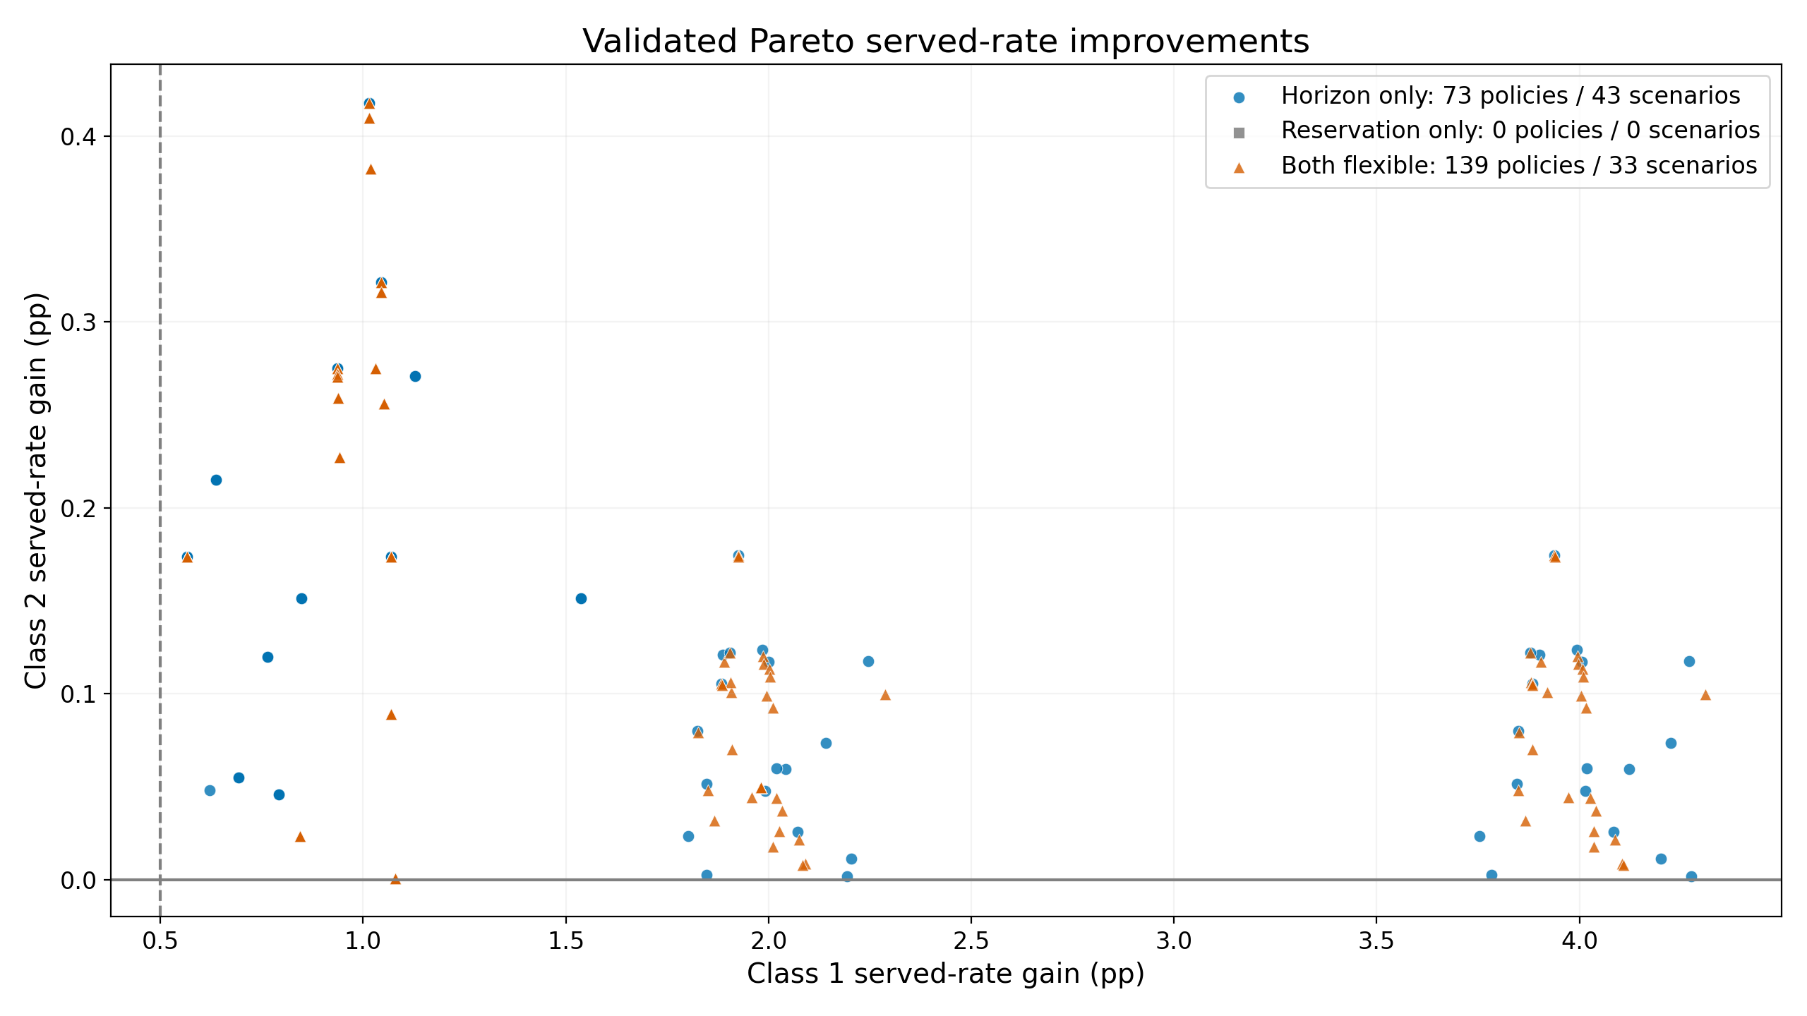
Gains in served-rate relative to FCFS
Reservation only cannot be Pareto improving
Notes:
REVIEW QUESTION: Define ‘Pareto improvement’ in this setting (both classes’ served rates no worse than FCFS?) and ‘validated’.

Slide 29
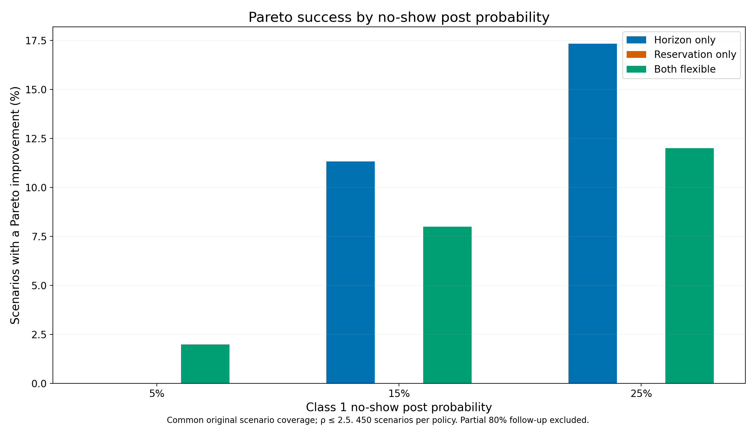
No-show post probability drives Pareto opportunities
Higher no-show post probability for Class 1 leads to more Pareto improving opportunities when Class 2 is more delay-tolerant.
Notes:
REVIEW QUESTION: The original title said ‘no-show matters more than balking’, but the chart only shows no-show. Add the balking comparison if we want to make that claim.
Add bullet point that balking showed no improvement

Slide 30
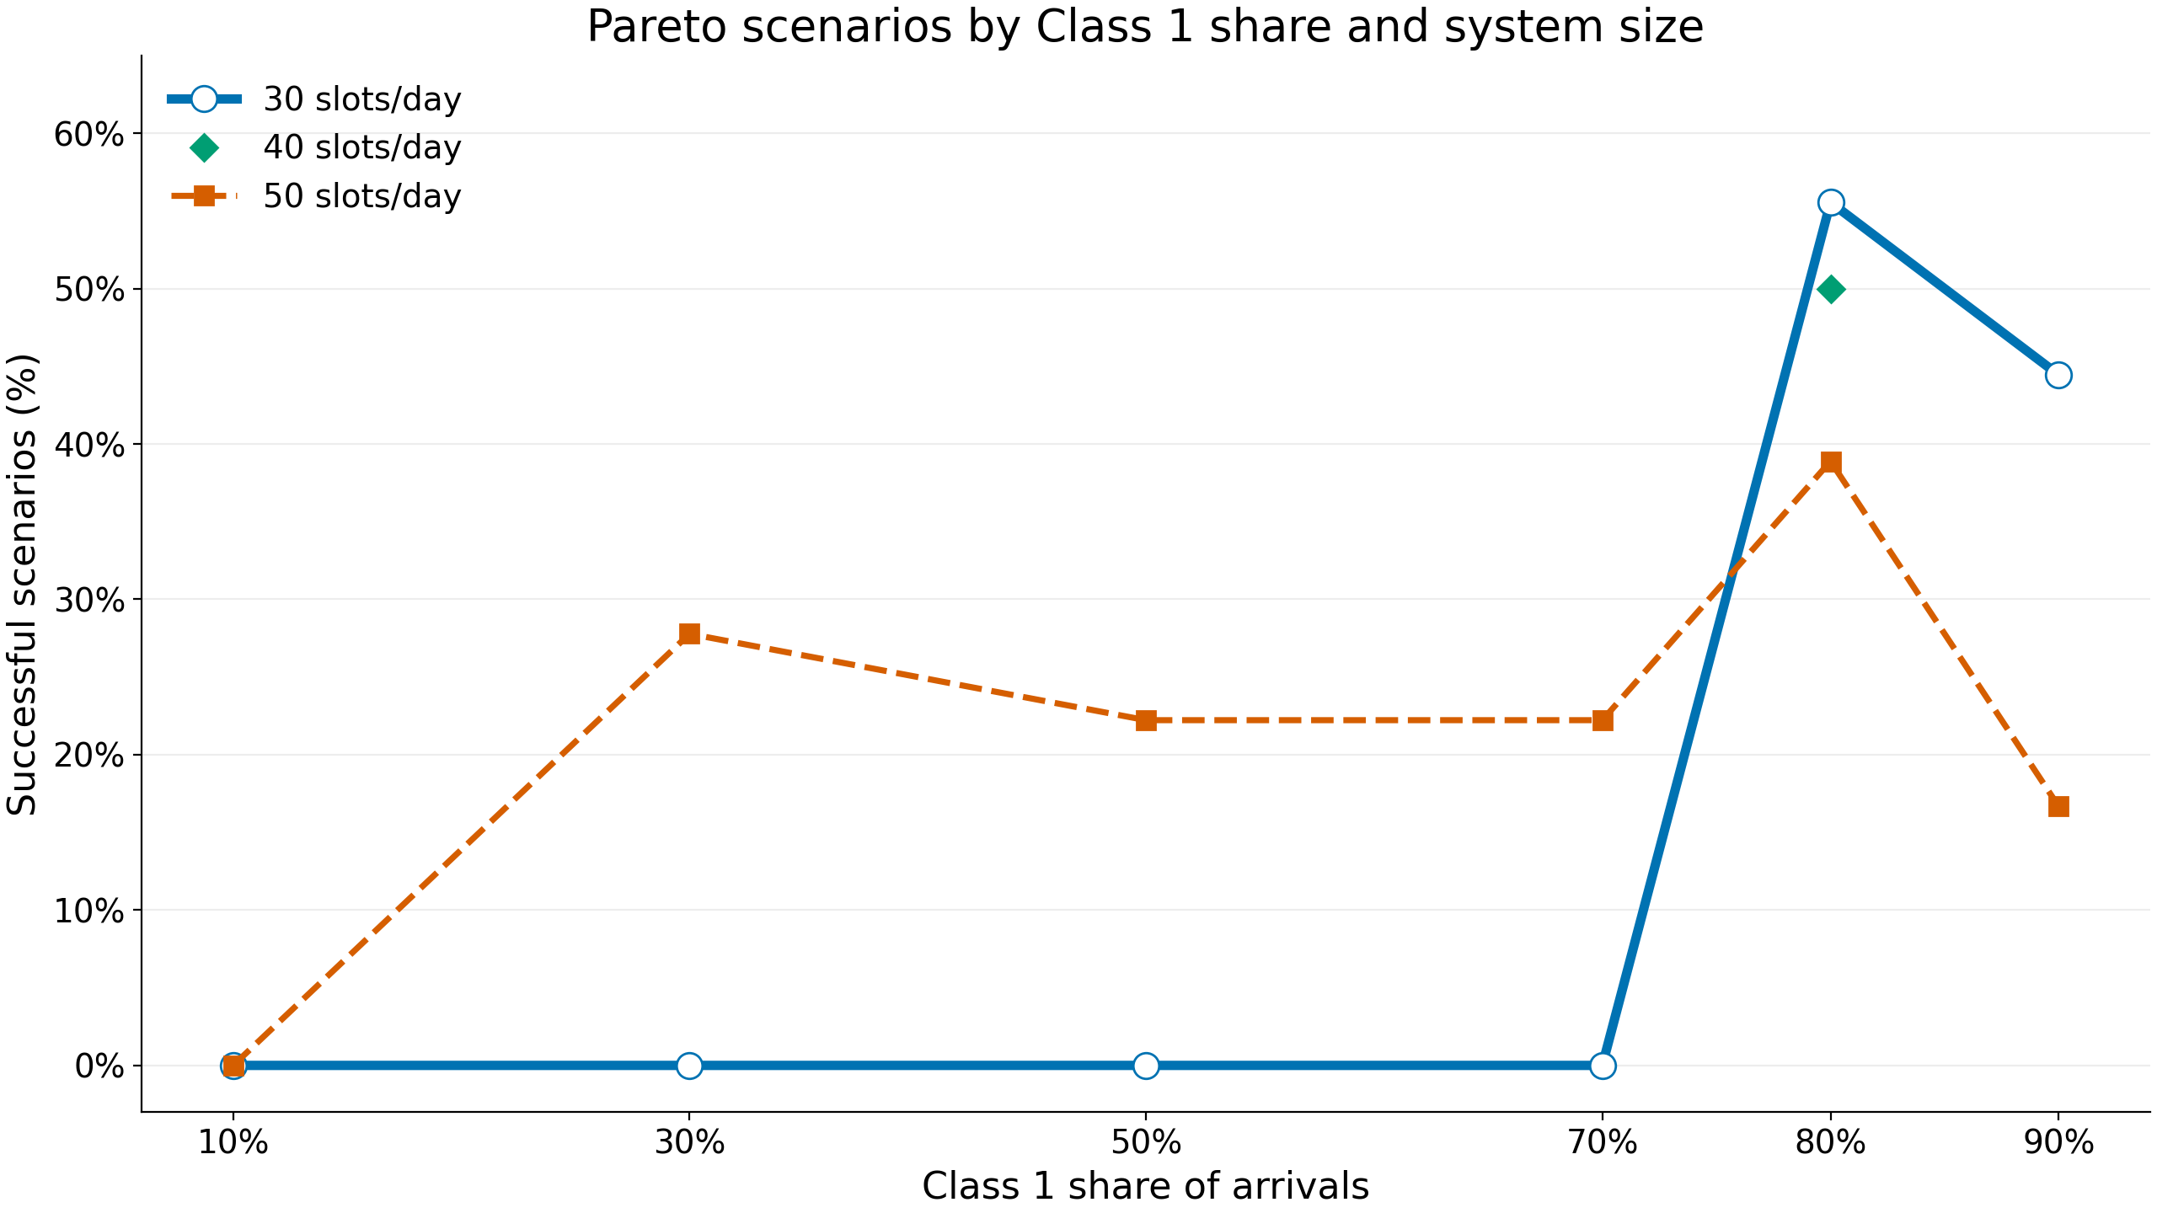
Larger systems have more Pareto scenarios at low Class 1 share; the reverse at high share
At lower Class 1 shares, larger systems look more favorable; as Class 1 becomes dominant, the favorable region shifts toward smaller or intermediate systems.
Note: ρ is held constant across system sizes.

Slide 31
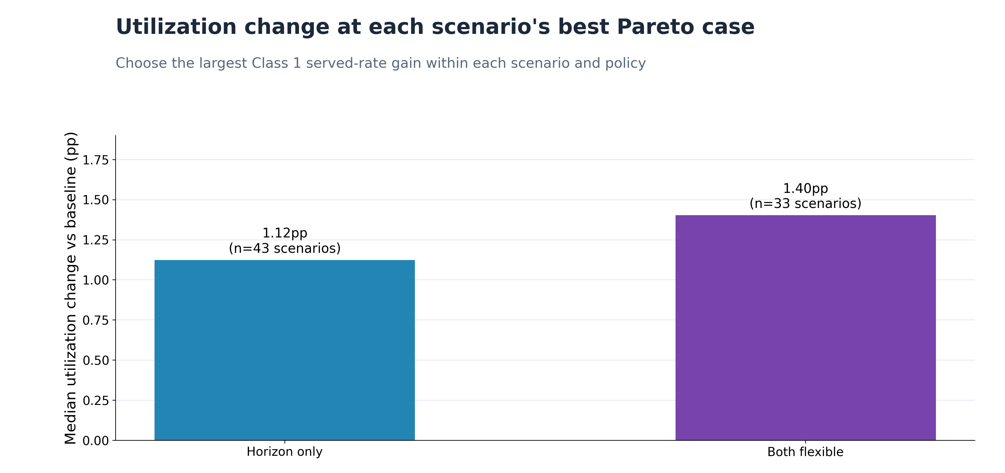
Pareto served-rate policies still raise utilization above FCFS
The both-flexible policy has a higher median utilization gain than horizon-only in the Pareto scenarios.

Slide 32
Pareto improvement summary
There are no validated Pareto improvements for reservation-only.
Higher Class 1 no-show creates more opportunities for Pareto improvements when Class 2 is more delay-tolerant.
Smaller systems yield Pareto policies when Class 1 arrivals dominate; larger systems can when Class 1’s arrival share is lower.
Policies that give Pareto served-rate improvements also raise utilization.
Next: what if we allow some Class 2 served-rate loss to raise Class 1 served rate with reservation and horizon policies?

Slide 33
Trade-off search in served rate
Search for policies that meaningfully improve Class 1 served rate, with at most a 10% Class 2 served-rate loss vs. baseline.
Keep the policy with the lowest Class 2 loss that achieves at least a 5 percentage-point Class 1 gain.
Notes:
Better explanation
REVIEW QUESTION: The rule allows a ‘10%’ Class 2 loss, but the charts on later slides measure loss in pp. Is it 10% or 10 pp? Also pick one term: ‘budget’ (slide 33) vs. ‘loss allowed’ (slides 30, 34, 35).

Slide 34
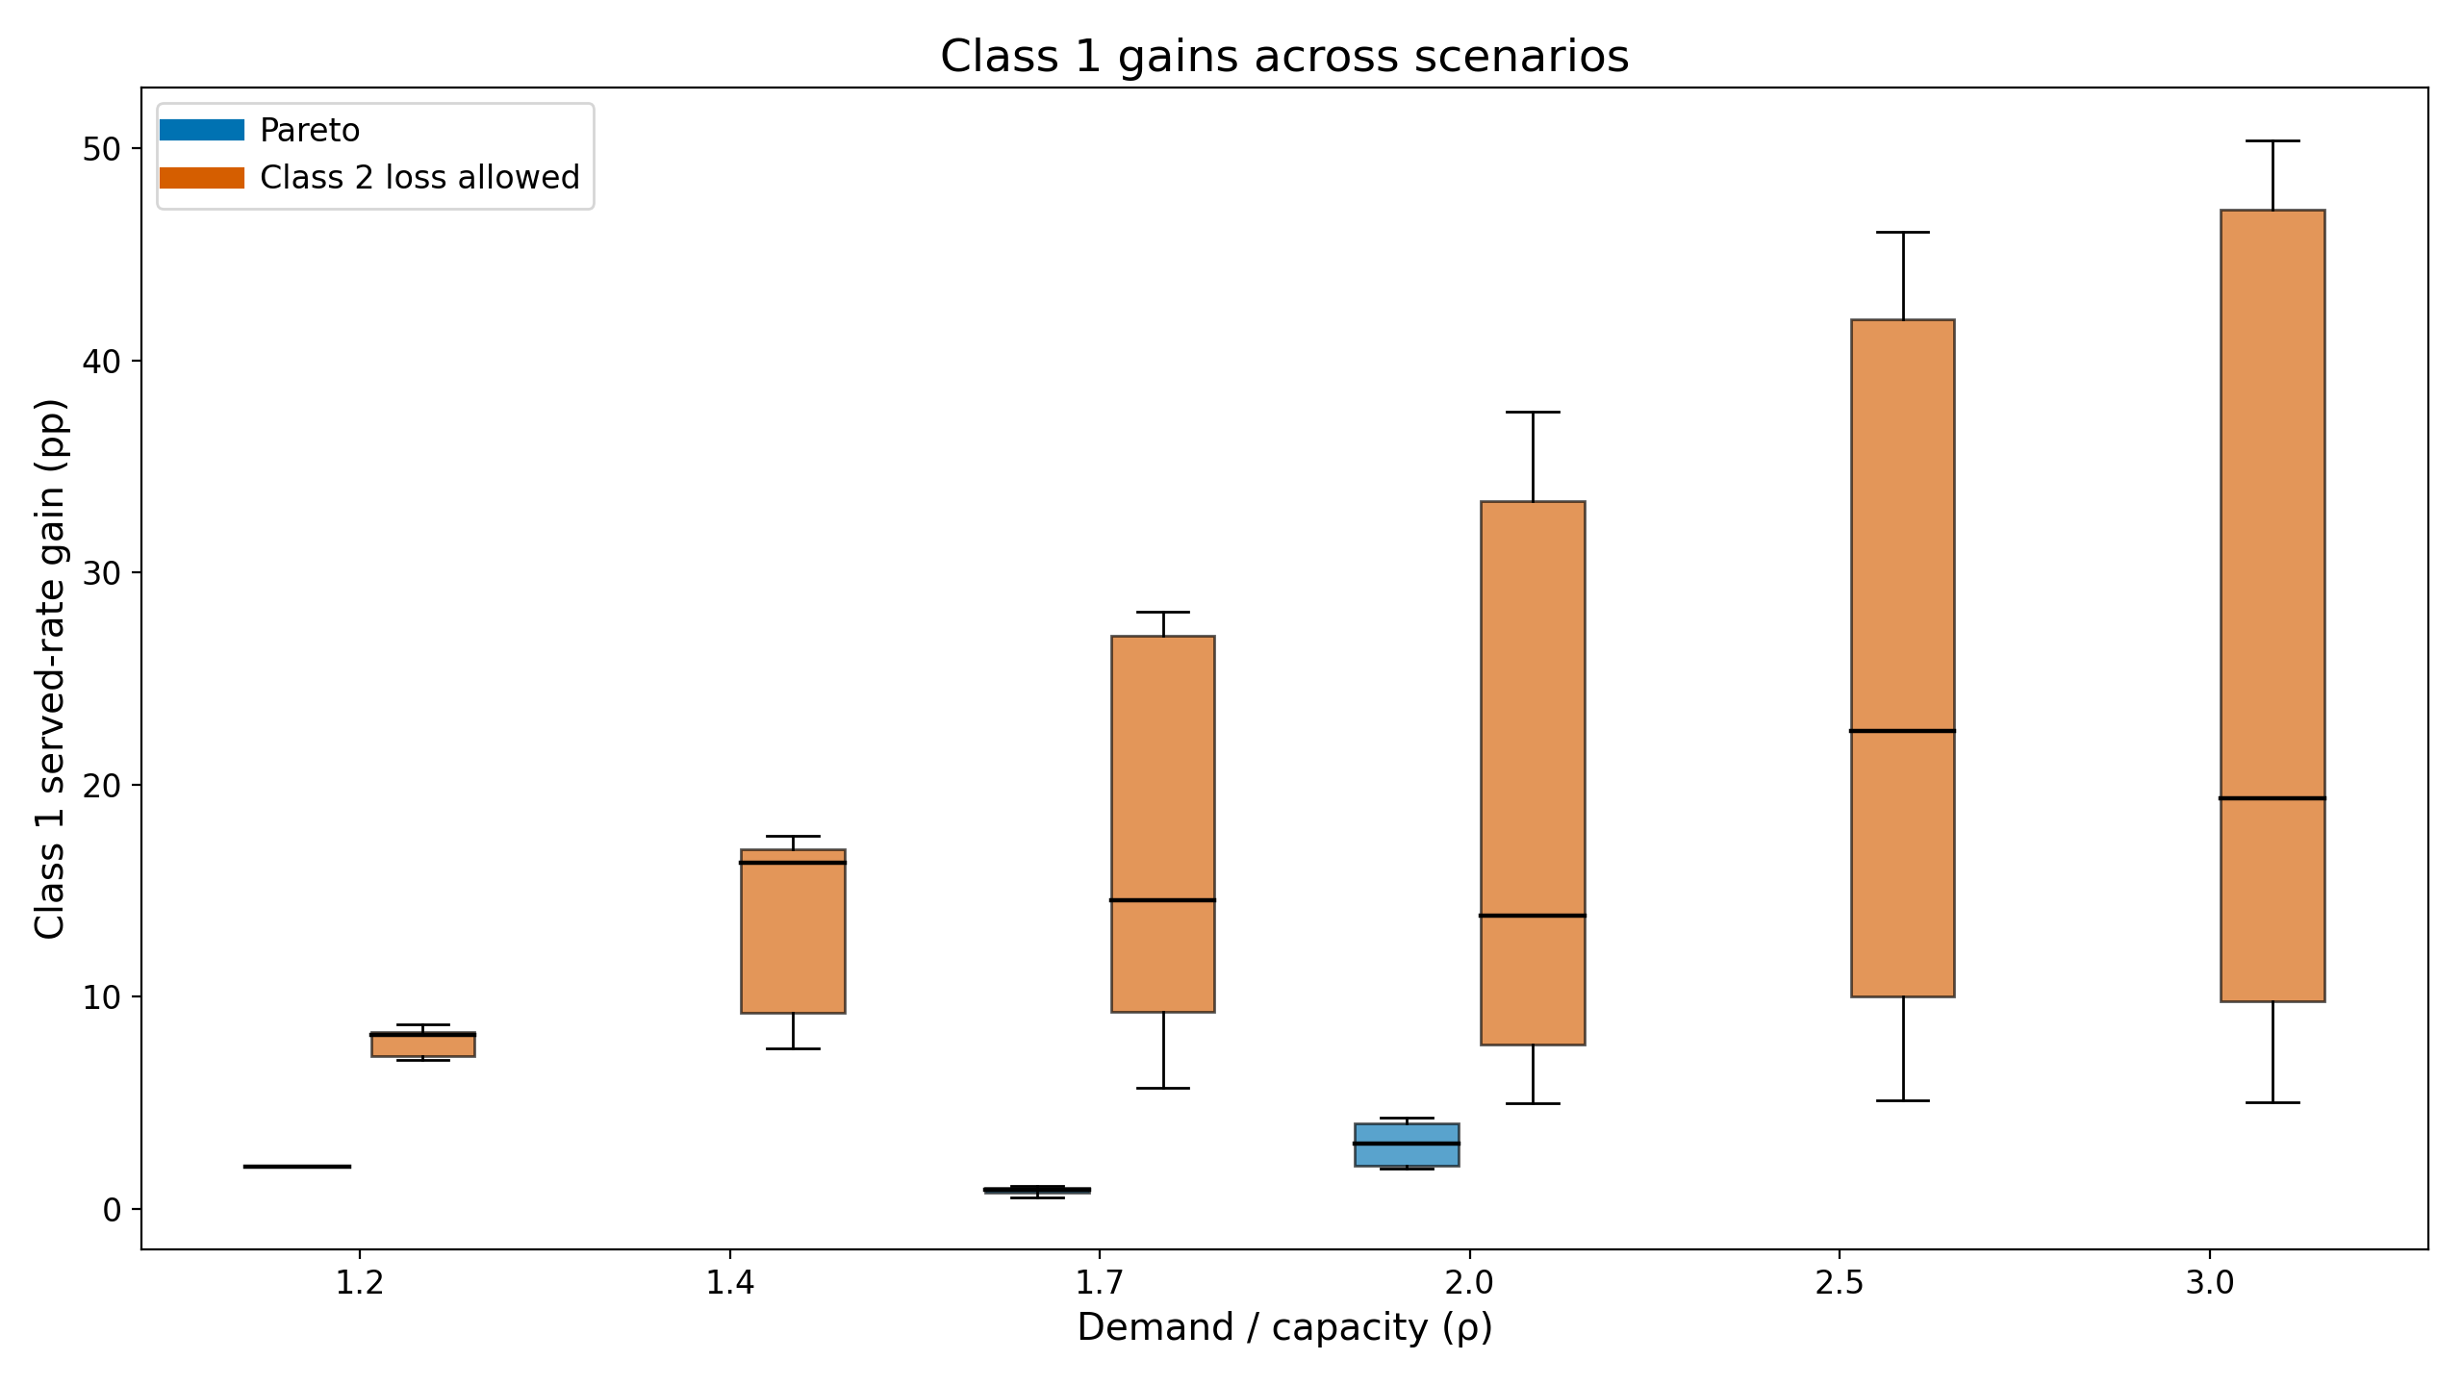
Class 1 served-rate gains: Pareto vs. trade-off
Notes:
look into why there aren’t pareto cases for higher demand
REVIEW QUESTION: No takeaway on this slide. Add one. Also explain why there are no Pareto cases at higher demand.

Slide 35
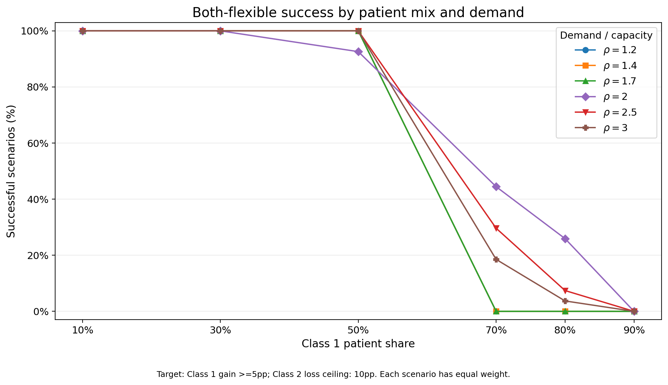
Share of scenarios that succeed in the trade-off search
Fewer scenarios meet the criteria at higher Class 1 shares; those that do have heavier demand.
Notes:
Maybe add 60%

Slide 36
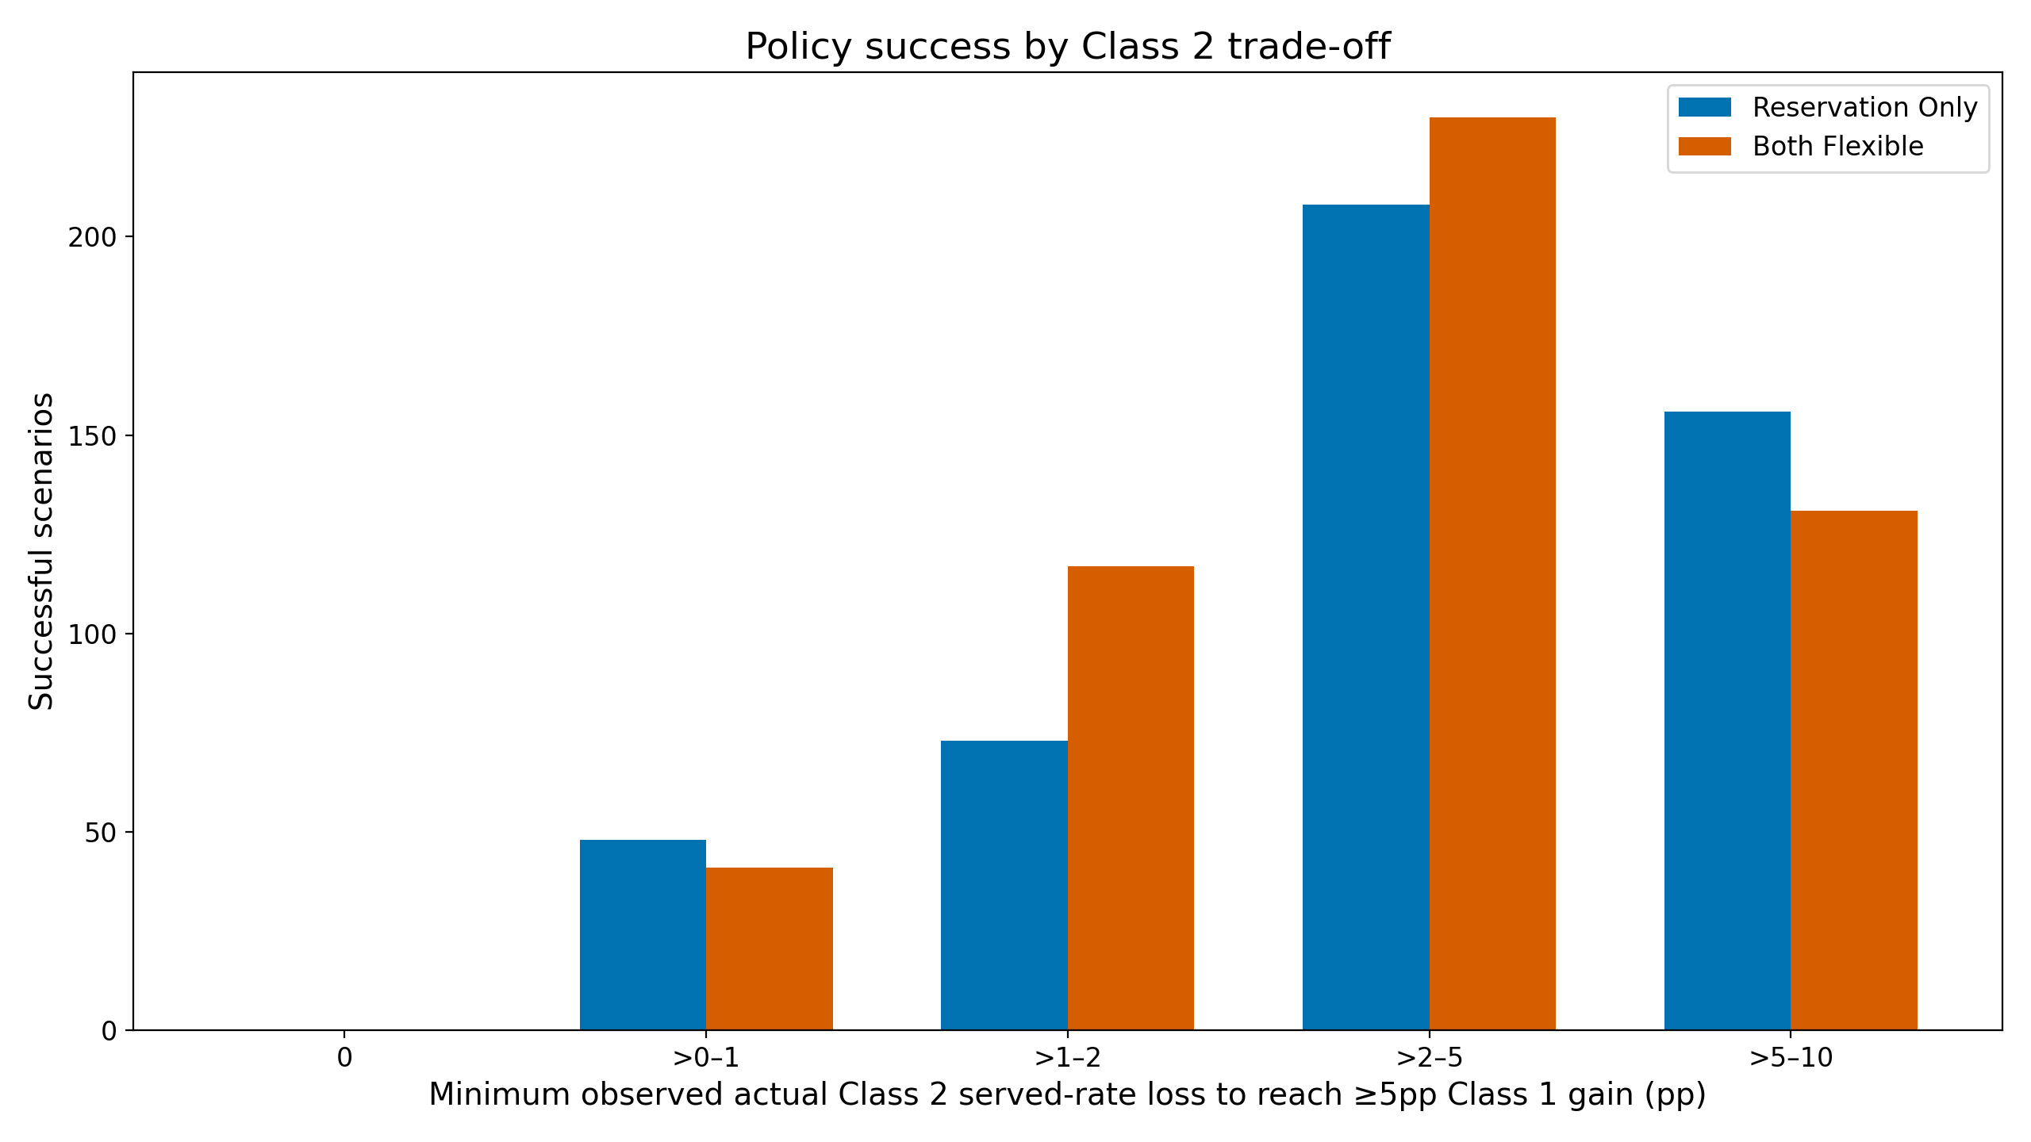
Policy success by Class 2 trade-off
Notes:
REVIEW QUESTION: No takeaway on this slide. What should the audience conclude?

Slide 37
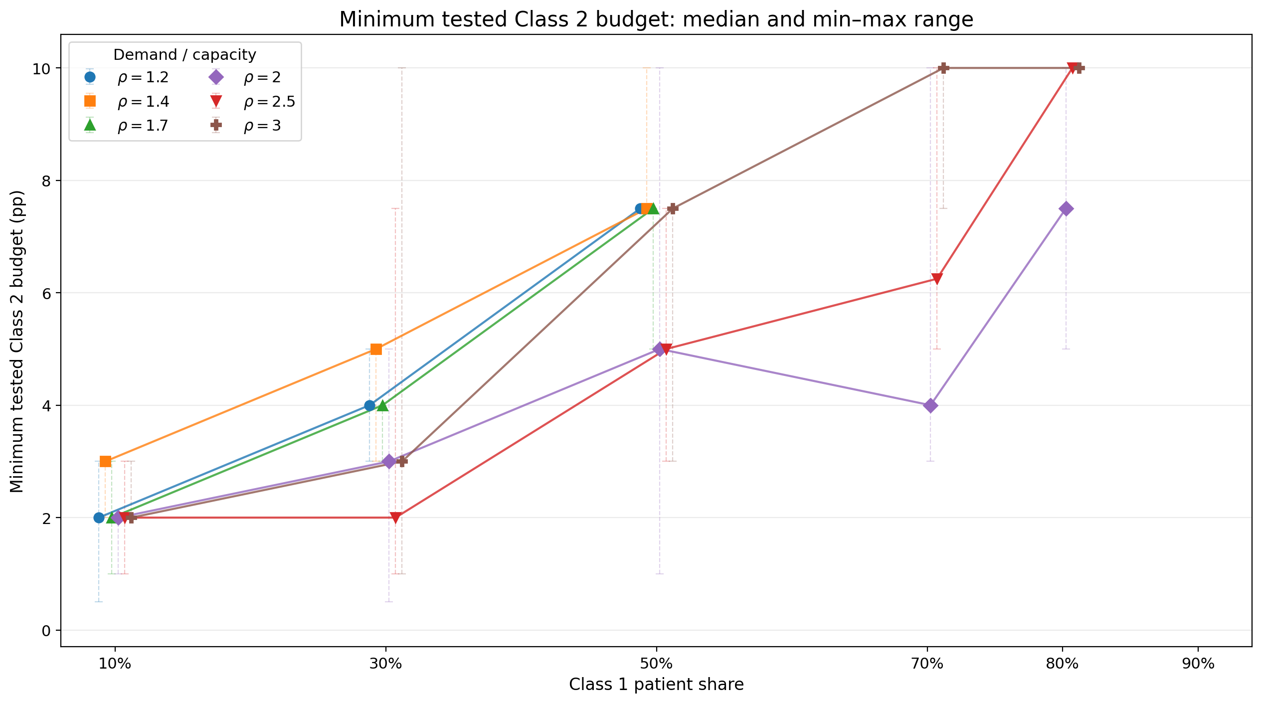
Median Class 2 budget among chosen scenarios, by Class 1 share
Notes:
REVIEW QUESTION: No takeaway on this slide. ‘Budget’ is undefined; same term as ‘Class 2 loss allowed’?

Slide 38
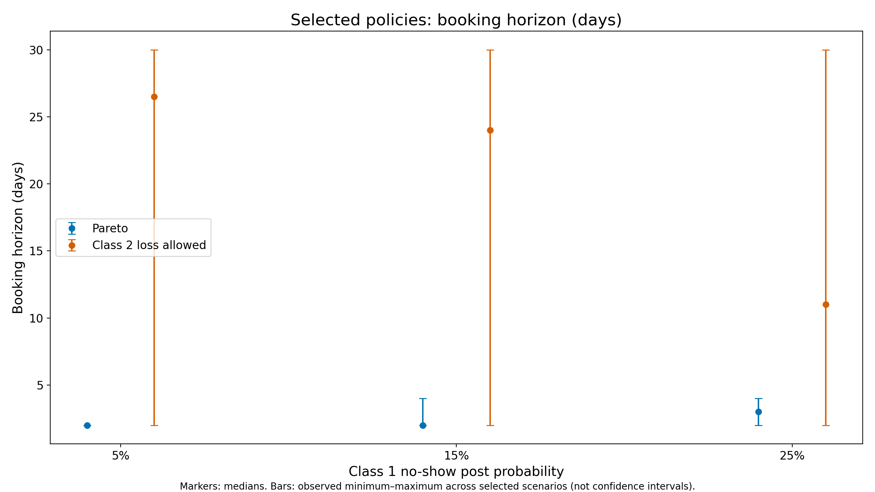
Booking horizons chosen: Pareto vs. trade-off
Pareto policies often shorten the horizon, especially at low demand.
Median booking horizons are much longer when Class 2 loss is allowed, and fall as no-shows rise.
Notes:
REVIEW QUESTION: The original text said horizons are shortened ‘to avoid cancellations’. Elsewhere shortening is about preventing no-shows. Confirm the reason; the bullet was reworded neutrally.

Slide 39
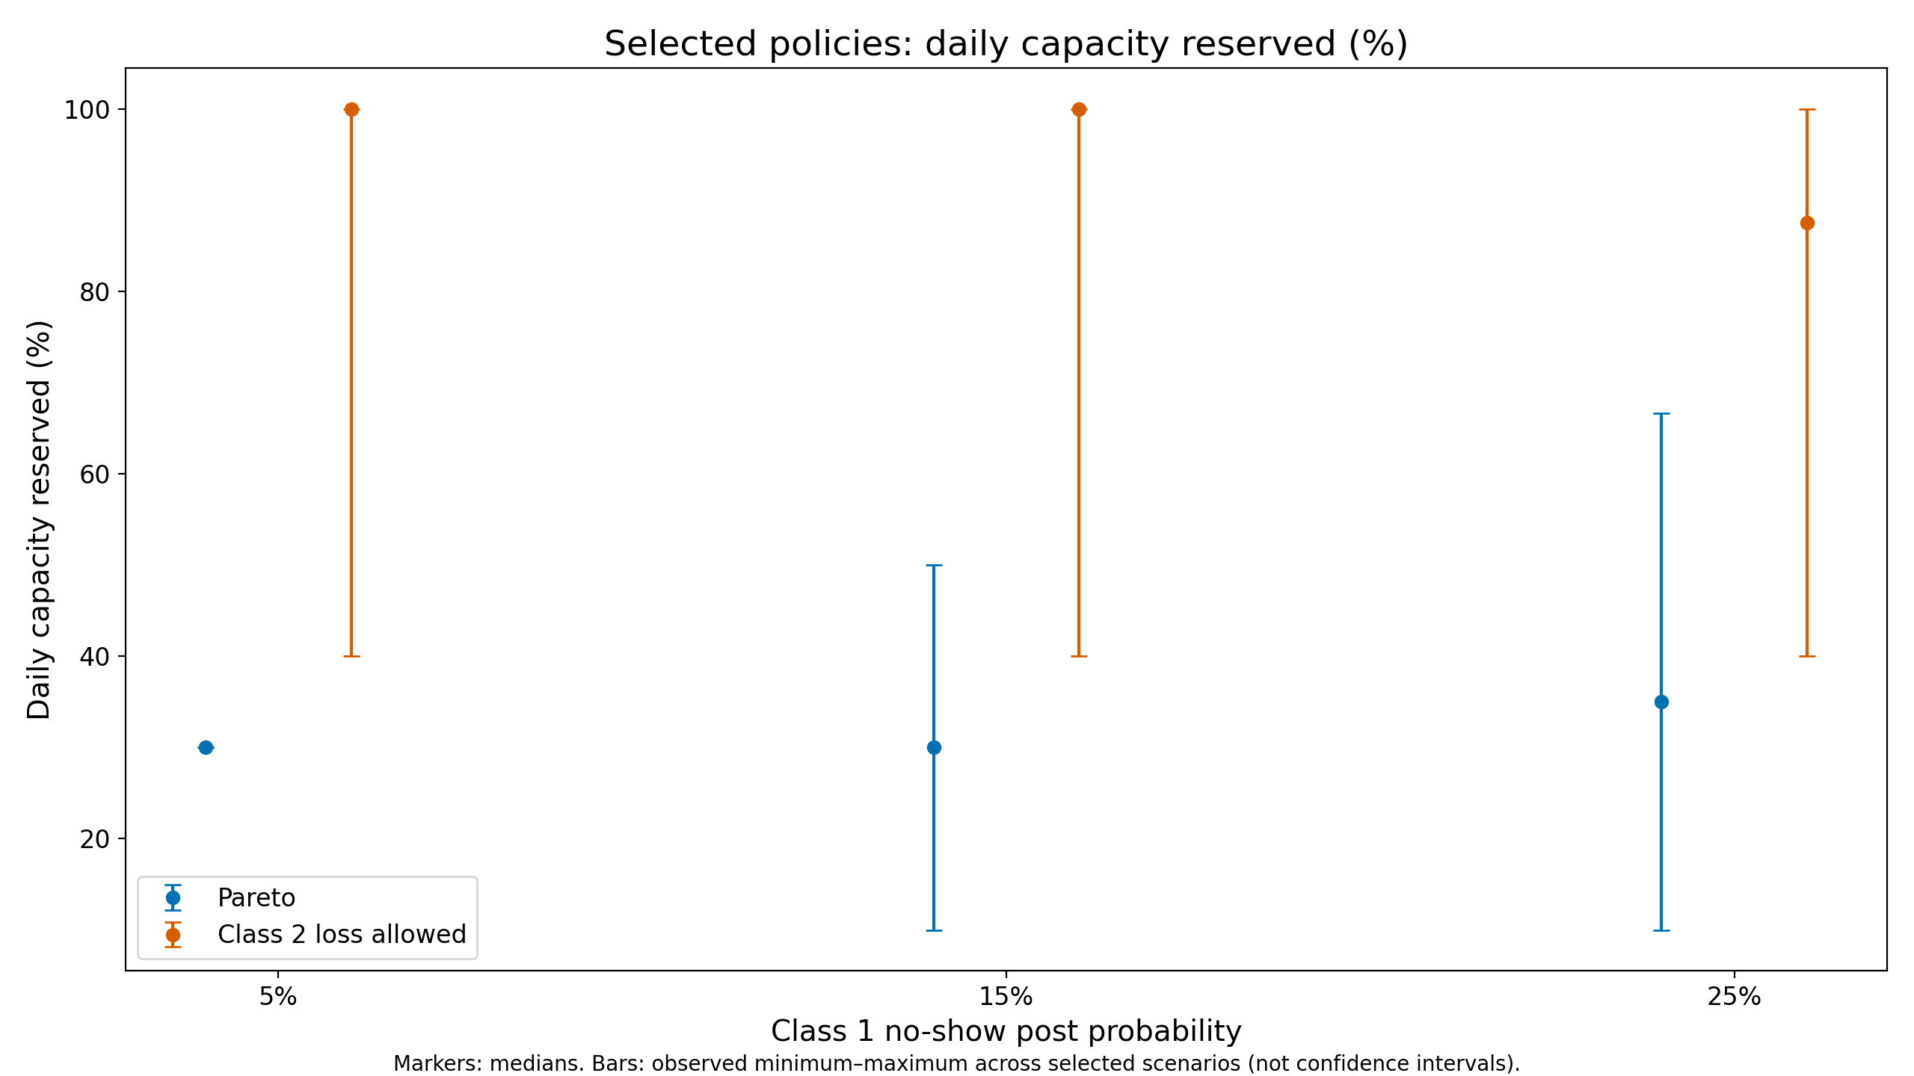
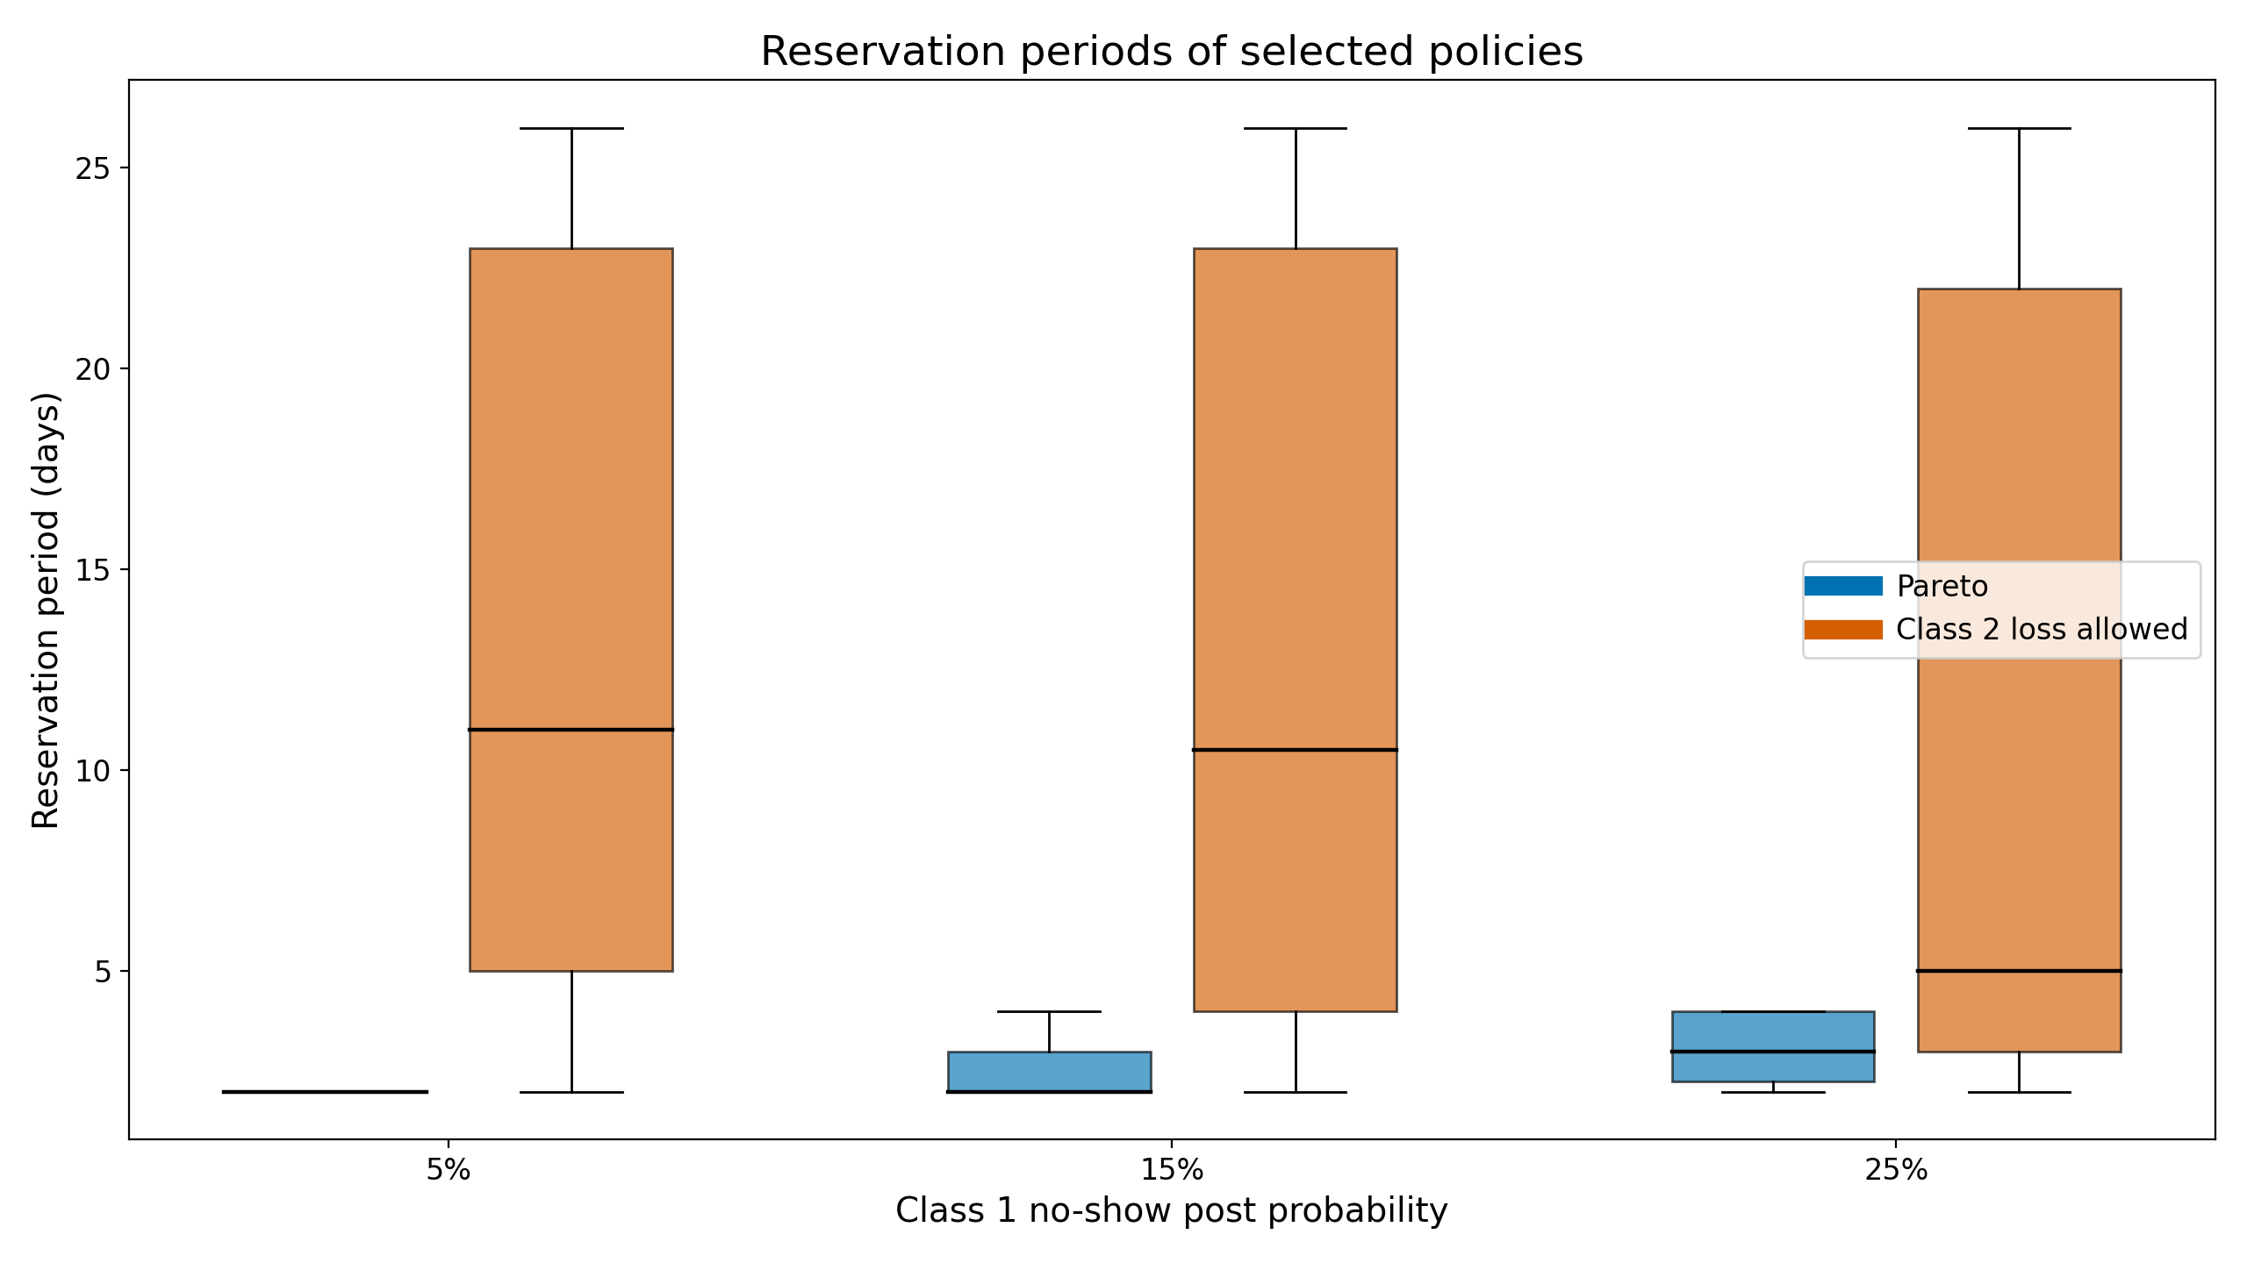
Reserved slots and reservation periods: Pareto vs. trade-off
Trade-off policies reserve a larger share of daily slots, for longer reservation periods, over a longer booking horizon.
Notes:
Add reservation period
Clarify the figure – what is reservation percentage
REVIEW QUESTION: Existing note asks to clarify ‘daily capacity reserved (%)’ and how it differs from the reservation period. Part 2 also ends here with no summary slide; add one before Part 3.

Slide 40
Part 3
Empirical Evidence

Slide 41
Empirical Evidence
Carri W. Chan, Jing Dong, Kevin Wang

Slide 42
Empirical evidence
[Placeholder — Kevin Wang to add slides]
Notes:
Placeholder for Part 3. Kevin to add the empirical-evidence slides here.

Slide 43
Appendix

