Slide 1
What Change History Tells us
About Thread Synchronization
Presentor: Yulin Che, 20292673

Slide 2
Content
1、Overview
2、Background
3、Contribution
4、Methodology
5、Observation
6、Conclusion
2

Slide 3



Overview
Basics
Conference : FSE 2015
Title : What Change History Tells Us about Thread Synchronization
Concepts :
Concurrency Analysis
Repository Mining
Over-Synchronization
Concurrency Bugs (Lack-of-Synchronization)
2

Slide 4





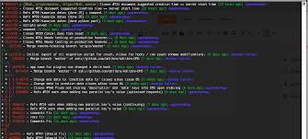
Overview
Detail
Key words: Locks, Empirical Study, Repository Mining, Concurrency Bugs, Performance Bugs, Multi-Threaded Software
Research Type: Empirical Study
Input: Repository information(Version Control Tool), Bug Report, Revision Log
Output: Relationship of Concurrency Bugs, Performance Bugs and Code Revisions(Statistical & Empirical)
Regular Expression Analysis
Manual Checking

Slide 5
Content
1、Overview
2、Background
3、Contribution
4、Methodology
5、Observation
6、Conclusion
2

Slide 6

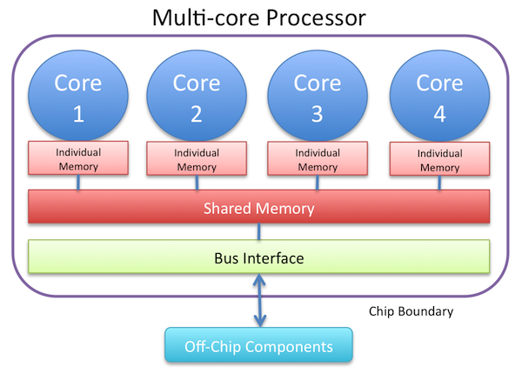
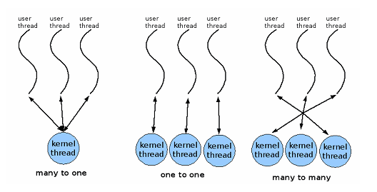
Background
Concurrency
Physically
Shared Variable Access
Critical Section
1) Race Condition
Logically
2) Other Synchronization
Iteration Dependency
Barrier

Slide 7


Background
Motivation & Challenge
Motivation: documents are not complete…
Bug report is not able to cover all things
Bug information is scattered throughout the multiple versions of code repositories
Bug information is hidden in the long repositories' commit log, issues, some pull-requests
Challenge: millions of lines of codes for one snapshot

Slide 8
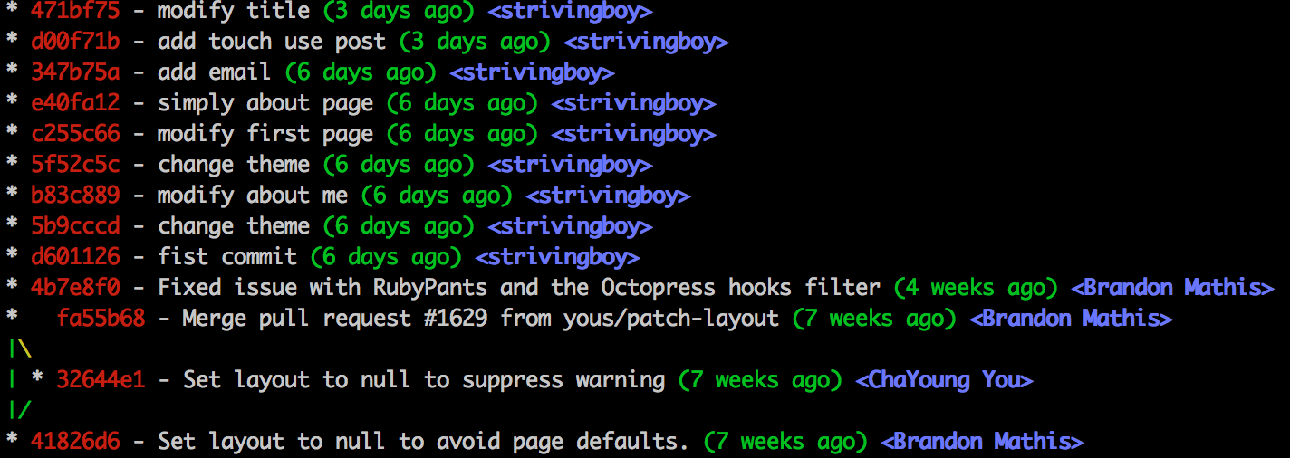

Background
Opportunity
Opportunity:
Commitment logs or revision logs consist of much smaller number of code lines
History is important for our concurrency bug analysis
Case Studies:
Mysql
Mplayer
Mozilla
Apache HttpServer
Incremental Analysis

Slide 9
Background
Key Problem
The key problem consists of two parts
how critical sections are changed to solve performance problems (i.e. over-synchronization issues)
how software changes lead to synchronization-related correctness problems (i.e. concurrency bugs).

Slide 10
Content
1、Overview
2、Background
3、Contribution
4、Methodology
5、Observation
6、Conclusion
2

Slide 11
Contribution
Summary
Work: Empirical General Study, Repository Mining
Observations:
Frequent modifications of critical sections
Changes of critical sections become stable with aging
Fixing correctness bugs are more frequent than fixing over-synchronization to improve performance
Case Studies:
Over-synchronization & Concurrency-bug
Significance of incremental revision analysis, 50% bugs introduced under old context & 50% bugs introduced with new introduced shared variables

Slide 12
Content
1、Overview
2、Background
3、Contribution
4、Methodology
5、Observation
6、Conclusion
2

Slide 13
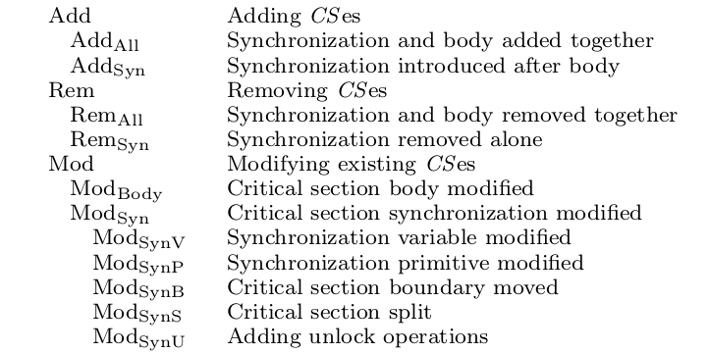
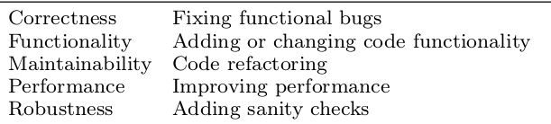
Methodology
Concepts
Structural Pattern Category
Addition
Removal
Modification
Purpose Category
Correctness
Performance

Slide 14
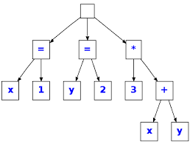
Methodology
Approach
Approach:
Regular expression tools,
  simply keyword search lock, latch, mutex, special case dealing with: C++ RAII
Manually Read Bug Reports
None of these:
No AST
No control-flow, No pointer-alias
e.g, not deal with : lock(p1) unlock(p2), lock in this, unlock in another invoked function
Arguments:
even thought it is not sound
false negatives, not much 5%

Slide 15
Content
1、Overview
2、Background
3、Contribution
4、Methodology
5、Observation
6、Conclusion
2

Slide 16
Observation
Critical Section Changes
Observations(Structural Pattern Oriented)
How many changes happen: frequent modifications of critical sections
When did changes happen: changes of critical sections become stable with aging
Why did changes happen: fixing correctness bugs(31%) are more frequent than fixing over-synchronization(8.5%) to improve performance, extracted from the structural pattern and sampled cases manually checking
Critical Section Changes
Arguments:
History is important…

Slide 17
Observation
Over-Synchronization
Observations(Structural Pattern Oriented)
ModSync Split
  Split Scopes of Critical Section Body
ModSync Variable
  Introduce New Variables
ModSync Boundary(Scope)
  Shrink Scopes
Arguments:
Feasible to develop tools to automate part of over-synchronization detection and fix it
history is useful

Slide 18
Observation
Concurrency-Bugs
Content:
Focus:
  shared variables
  instructions access them
  synchronization-context, i.e, locked body and preceding barriers
Manually check in this part
  bug reports(28 reports)
  part of sampled revision logs

Slide 19
Observation
Concurrency-Bugs
Observations
with old synchronization context information, 50% of studies bugs would require no new synchronization analysis to be detected
memory-access analysis be simplied, 50% for new bugs, only analyze the changed codes
Arguments:
History is important…

Slide 20
Content
1、Overview
2、Background
3、Contribution
4、Methodology
5、Observation
6、Conclusion
2

Slide 21
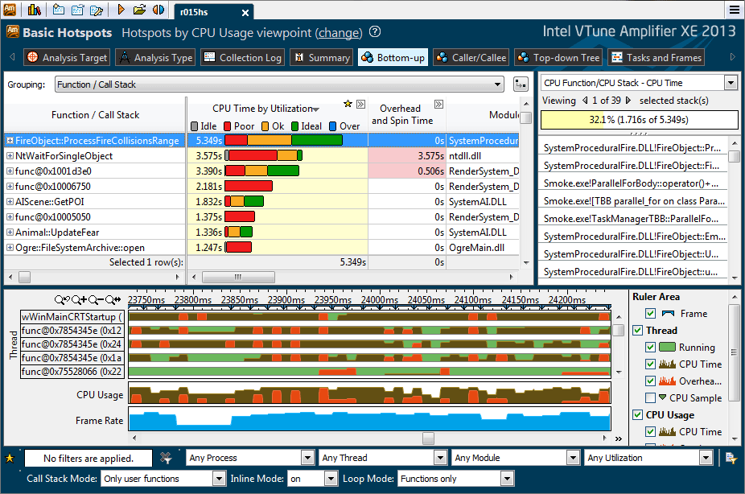
Conclusion
Suggestions
Please keep trace of code-revision history
Need tool to analyze over-synchronization feasible
Require more work on history analysis and propose more sound but efficient algorithms

Slide 22


Q & A
2

Slide 23
Appendix
Citation & Abstract
Gu R, Jin G, Song L, et al. What change history tells us about thread synchronization[C]//Proceedings of the 2015 10th Joint Meeting on Foundations of Software Engineering. ACM, 2015: 426-438.
Abstract
Multi-threaded programs are pervasive, yet difficult to write. Missing proper synchronization leads to correctness bugs and over synchronization leads to performance problems. To improve the correctness and efficiency of multi-threaded software, we need a better understanding of synchronization challenges faced by real-world developers. This paper studies the code repositories of open-source multi-threaded software projects to obtain a broad and indepth view of how developers handle synchronizations. We first examine how critical sections are changed when software evolves by checking over 250,000 revisions of four representative open-source software projects. The findings help us answer questions like how often synchronization is an afterthought for developers; whether it is difficult for developers to decide critical section boundaries and lock variables; and what are real-world over-synchronization problems. We then conduct case studies to better understand (1) how critical sections are changed to solve performance problems (i.e. over-synchronization issues) and (2) how software changes lead to synchronization-related correctness problems (i.e. concurrency bugs). This in-depth study shows that tool support is needed to help developers tackle over-synchronization problems; it also shows that concurrency bug avoidance, detection, and testing can be improved through better awareness of code revision history
2

Slide 24
Appendix
Preliminaries (1/2)
Brief Introduction
Several basic concepts about the parallel programming are briefly introduced to provide a background of parallel program testing. First, the two major concepts parallel and concurrency are introduced, there are different actually. Second, the concurrent program discussed in this report is built for the shared memory setting, e.g, multicore machines with ram as the shared memory for the communication between different threads. Third, the synchronization is introduced, which is the major topic of the paper reported in this report.
Parallel vs Concurrency
The parallel lies in the setting where you have multicore machine, GPU, or other co-processors that gives the ability to run the instructions in parallel, no matter the task-level parallel or data-level parallel. However, concurrency does not mean that the have some many cores to help you conducting computations, there is a typical setting, where you are stuck with network communication or disk input output, then you can release the occupation of computing cores. Here the scheduling policy gives you concurrency.
2

Slide 25
Appendix
Preliminaries(2/2)
Shared-Memory
In modern processors, there are multiple cores there, which gives us the ability to bind threads, the logical concepts of computing components to. They may load different instructions, but sometimes, they need to acquire others processing status. This could be done with the shared ram memory. Critical-Section Critical sections are the pieces of instructions issued by multiple threads that wants to acquire the limited number of resources, just as many boys and girls, e.g, 10 wants to compete for 5 seats. To deal with the race condition, in critical section, threads need to use lock or other synchronization techniques to solve the problem.
Synchronization
The instructions executed on each core may have some dependencies on the data stored in shared memory, e.g, thread 0 wants to get the intermediate result of thread 1 which is stored on the shared ram memory, then thread 0 should be idle, and scheduled out and notified after the data is ready. This could simply be done with the pthread library or win32 thread library with interfaces of mutex and spin lock, condition variable, semaphore, etc. If you are interested in these technologies, please google them.
2

Slide 26
Appendix
Introduction
Introduction Part
They summarize three common things about real-world big projects. First, there is information that goes beyond bug reports. Second, there is information derives from code revisions. Third, there is information that hides within the whole revision history. And intuitively, it is rather hard to collect the above three information. Thus, the authors study how lock-protected critical sections are changed when software evolves, for which they design a hierarchical taxonomy for all critical section changes, based on their structural patterns and purposes. Besides, they conduct case studies to better understand over-synchronization issues (i.e., unnecessary synchronization degrades execution performance) and concurrency bug issues(i.e., lack of or incorrect synchronization hurts execution correctness), the two parts over-synchronization and concurrency bug issues are well elaborated in the paper.
2

Slide 27
Appendix
Related Work
Related Work Part
There are work on concurrency bugs finding and new synchronization primitives evaluation based study, the authors argue that the paper complements them by checking software code repositories, which reveals real-world code development information unavailable in bug databases. Different from previous research, where specifically, two findings are made: (1) the number of racy variables remains high over time; (2) variables may go in and out of being racy over the course of a project, they argue that the difference between their work and others lies in that their study collects different types of software change information and answers different types of questions, including over-synchronization issues and concurrency-bug origin issues, from previous work. Besides, they argue that their study benefits the developing of profiling tools and over-synchronization solving tools.
2

Slide 28
Appendix
Synchronization Experiments
Concept
Over-synchronization happens when unnecessary synchronization is added to the software. It would overly constrain software interleaving and lead to performance degradation. Over-synchronization is a real problem, and is cared by developers. Developers change synchronization primitives to enable lock-contention profiling in MySQL and Mozilla, and sometimes relieve over synchronization at the cost of code readability or functionality.
Discussion
Their study demonstrates that discovering and fixing over-synchronization take a lot of manual effort and are error prone. (1) All three types of changes/fixes discussed can potentially introduce concurrency bugs and demand non-trivial synchronization correctness reasoning. (2) Many new lock variables are introduced during these fixes. The ad-hoc way of introducing these variables can easily lead to correctness and/or maintenance problems. (3) The code movement during these fixes.
2

Slide 29
Appendix
Concurrency Bug Experiments
Concept
Facing large real-world multi-threaded software, it is critical to improve the performance and accuracy of existing concurrency-bug analysis techniques.
Discussion
First, synchronization analysis can be significantly simplified for many bugs through history awareness. With old synchronization-context information, about half of the studied bugs would require no new synchronization analysis to be detected, because their buggy code is inside completely old synchronization contexts. Second, memory-access analysis can be significantly simplified for many bugs through history awareness. About half of the studied bugs only involve new variables accessed by new instructions with pointers propagated through new instructions. Therefore, detecting them only requires memory-access analysis for the changed code, instead of the whole Program. Third, about a quarter of the studied bugs can benefit from both almost-no synchronization analysis and revision-local memory-access analysis discussed, and hence would require extremely simple analysis to discover.
2

Slide 30
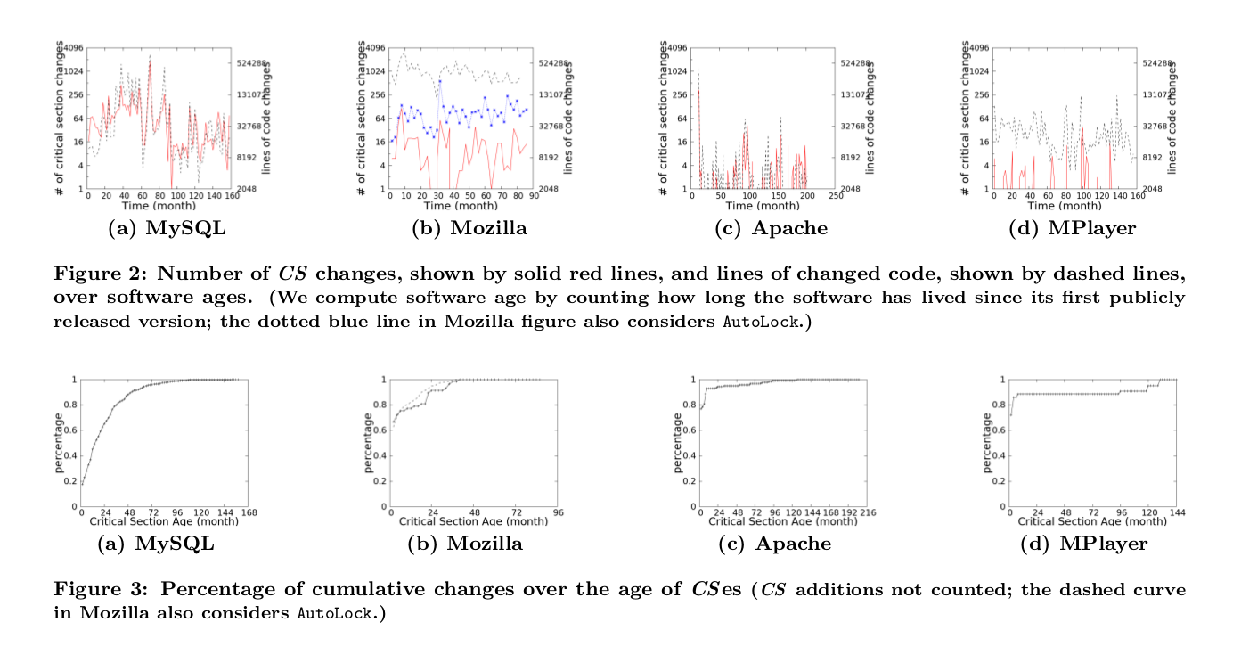
Appendix
Evaluation Example (1/2)
2

Slide 31
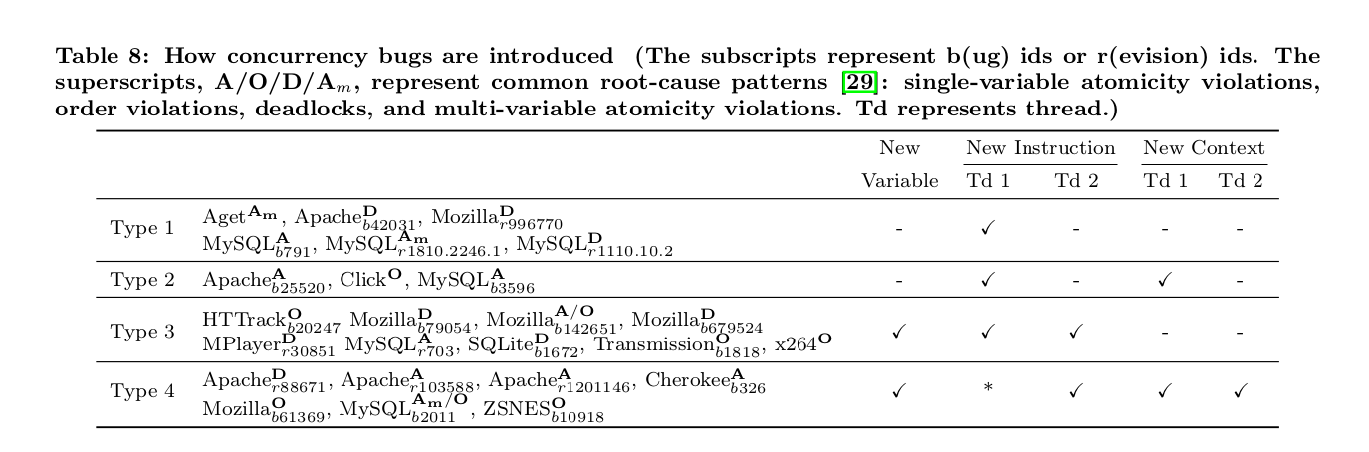
Appendix
Evaluation Example (2/2)
2

Slide 32
Appendix
Links
Author-Github-Repo
https://github.com/ruigulala/ConAnalysis
https://github.com/ruigulala/concurrency-exploits
Open-Source-Projects-Mirror
https://github.com/apache/httpd
https://github.com/mozilla/gecko-dev
https://github.com/mpv-player/mpv
https://github.com/MariaDB/server
2

