Slide 1
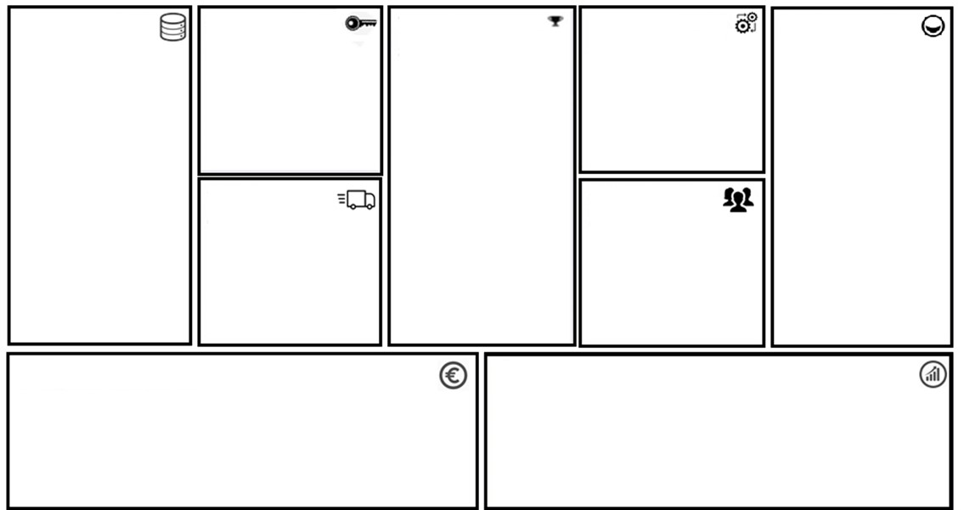
Project Canvas
More info
Data
Which data do you need?
Data about the volunteering of
thousands of volunteers.
Preferably in an SQL database
or JSON format.
Skills
Which skills do you need for development?
SQL, Angular, Typescript, HTML and .Net Core
Or
R and Shiny
Value Proposition
What is the value added by your project?
To allow for effective decision making regarding more accurate resource allocation, such as funding, and more efficient organisation of different volunteering projects within the Philips Foundation. This is done by acquiring a deeper insight of specific project topics/scopes and expertise of huge amounts of volunteers, as well as by tracing progresses dynamically during different processes.
Integration
How will the project be integrated?
By using a simple webserver that allows for HTML hosting. As we are using a web dashboard, only HTML hosting and a connection to the data is needed.
Customers
Who are the end customers?
The Philips Foundation and Royal Philips.
FAIR-maturity
Inidicate the FAIR-ness your
data
Output
Which key metric are
you optimizing for?
Easy interpretability and tracing of the volunteering of the thousands of volunteers within the Philips foundation using a web dashboard.
Stakeholders
Who are the key stakeholders?
The Philips Foundation and Royal Philips.
Cost
What costs the project incur?
Programming costs
Deployment costs
Maintaining costs
Revenue
How will the project (results) generate revenue?
Optimizing hidden cost of redundant processes and inproper personnel appointment throughout the whole projects.
Notes:
<number>

