Slide 1
Task 1000 – Predictive Analytics: Multi-Horizon Forecasting
Tesla, Google, Bitcoin, Ethereum
Yude Li 2025-9-6

Slide 2
Contents
Overview
Data Collection & Preparation
Feature Engineering
Modeling Approach
Model Evaluation
Forecast Results
Interpretation
Future Evaluation

Slide 3
Contents
Overview
Data Collection & Preparation
Feature Engineering
Modeling Approach
Model Evaluation
Forecast Results
Interpretation
Future Evaluation

Slide 4
Overview
Objective:
Forecast TSLA, GOOGL, BTC, ETH prices across 7 horizons (30D → 10Y).
Horizons:
30D, 3M, 6M, 1Y, 3Y, 5Y, 10Y
Approach:
SARIMAX
GBM Monte Carlo
Data
Features
Models
Forecasts
Evaluation

Slide 5
Contents
Overview
Data Collection & Preparation
Feature Engineering
Modeling Approach
Model Evaluation
Forecast Results
Interpretation
Future Evaluation

Slide 6
Data Collection: Assets & Macros
Category | Ticker
Stock | TSLA (Tesla Inc.)
Stock | GOOGL (Google)
Crypto | BTC-USD (Bitcoin)
Crypto | ETH-USD (Ethereum)
Source:
Yahoo Finance (2015–2025, daily frequency)
Assets:
Key stocks + major cryptocurrencies
Macros:
Market indices, volatility, interest rates, currency, energy
Purpose:
Provide exogenous variables for forecasting models
Factor | Ticker
SP500 | ^GSPC (S&P 500 Index)
NASDAQ | ^IXIC (NASDAQ Composite Index)
VIX | ^VIX (Volatility Index)
US10Y | ^TNX (10-Year Treasury Yield)
DOLLAR | UUP (US Dollar Index ETF)
OIL | CL=F (Crude Oil Futures)

Slide 7
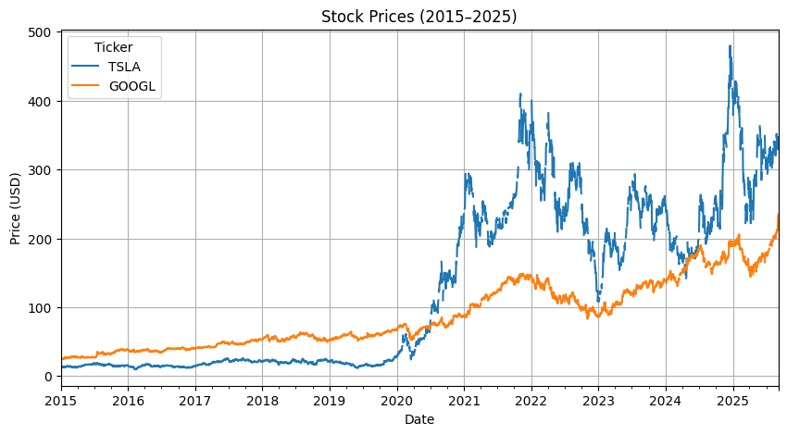
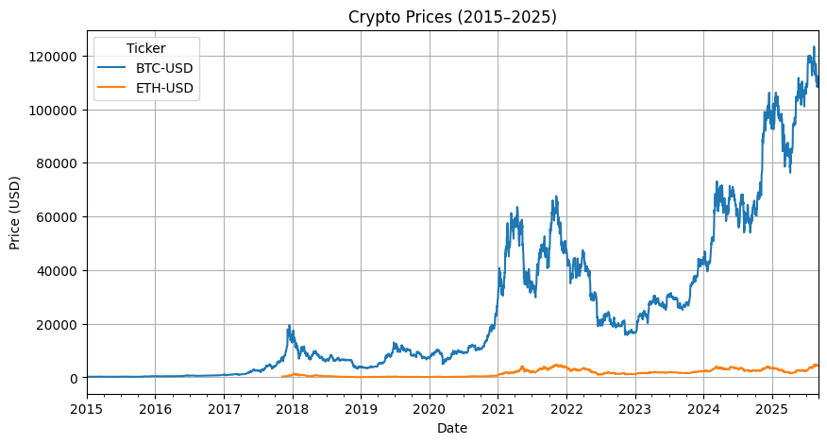
Data Collection: Prices (2015–2025)
Historical Stock Prices
(TSLA, GOOGL)
Historical Crypto Prices
(BTC, ETH)

Slide 8
Data Preparation
Frequency Alignment:
Stocks → Business day (B)
Cryptos → Calendar day (D)
Handling Missing Data:
Forward-fill macro features to align with crypto trading days.
Final Dataset:
A unified panel of assets + macro factors, daily resolution.
Quick Environment Check
Ticker | TSLA | BTC-USD | ^GSPC | ^VIX | …
2025-09-02 | 329.36 | 111200.59 | 6415.54 | 17.17 | …
2025-09-03 | 334.09 | 111723.21 | 6448.26 | 16.35 | …
2025-09-04 | 338.53 | 110723.60 | 6502.08 | 15.30 | …

Slide 9
Contents
Overview
Data Collection & Preparation
Feature Engineering
Modeling Approach
Model Evaluation
Forecast Results
Interpretation
Future Evaluation

Slide 10
Feature Engineering – Overview
Price
Indicators
Volatility
Macro
Cross-Asset
Final Feature Set
Lags

Slide 11
Feature Engineering – Indicators & Factors
Feature Type | Example(s) | Purpose
Trend | MA(20), MA(60) | Capture long-term price trend
Momentum | RSI(14), MACD | Detect momentum shifts
Volatility | 20-day vol | Measure market risk
Macro Factors | VIX_ret, Oil_ret | Reflect external market shocks
Cross-Asset | BTC_ret, GOOGL_ret | Capture interdependence
Lags | lag_ret_5, lag_px_20 | Incorporate past dependency
Technical Indicators: MA(5/20/60), RSI(14), MACD & Signal
Volatility: 20-day rolling annualized log-return volatility
Lags: Price/return lags (1, 5, 20)
Macro Factors: S&P500, NASDAQ, VIX, US10Y, Dollar, Oil
Cross-Asset Returns: Incorporating TSLA, GOOGL, BTC, ETH dependencies

Slide 12
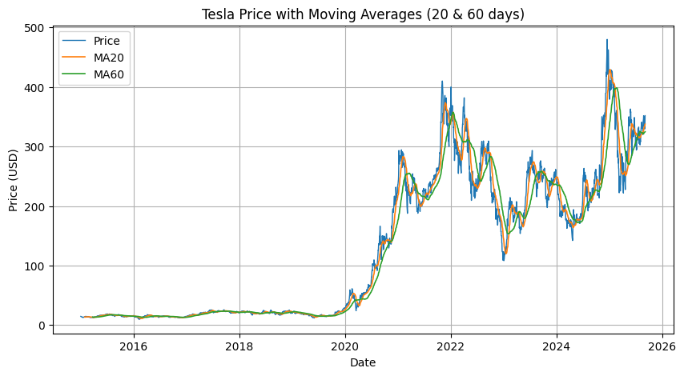
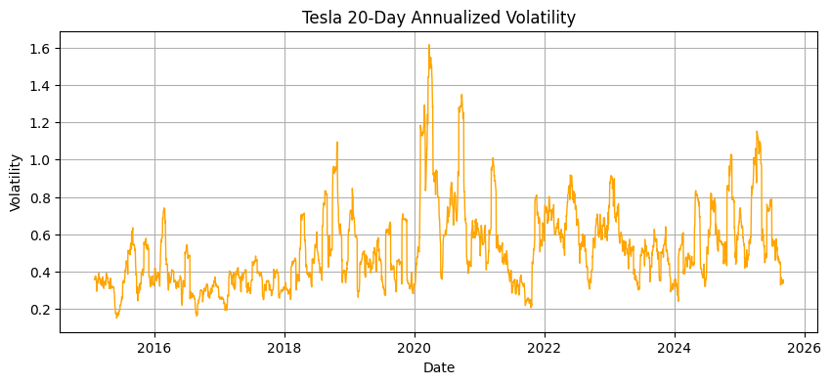
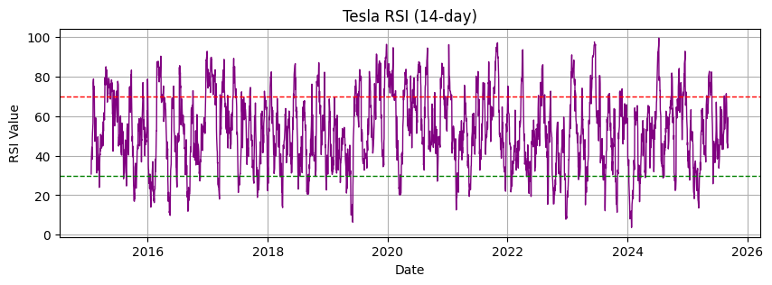
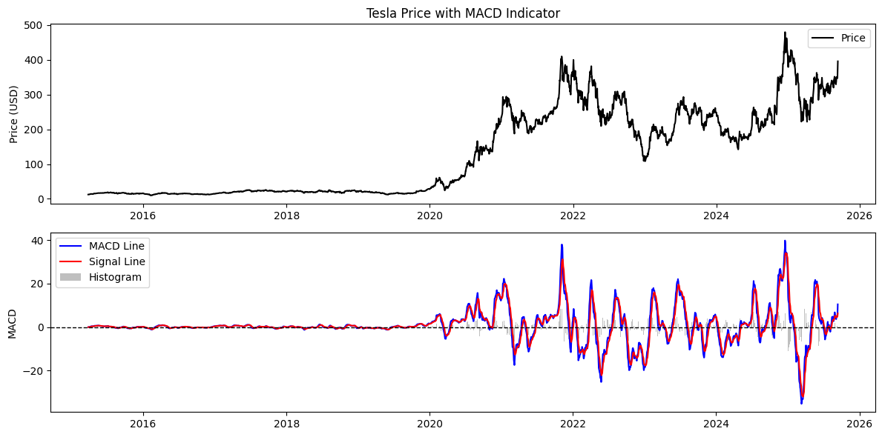
Technical Indicators — Tesla Example

Slide 13
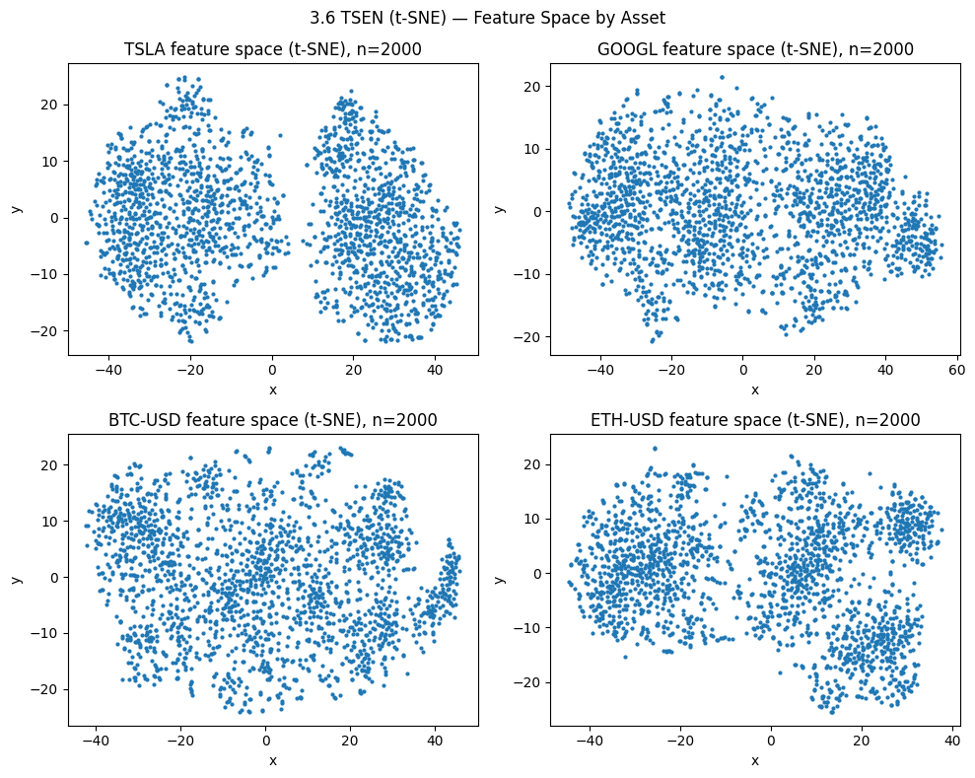
Feature Space Visualization & Summary
Reduced ~42 engineered features into 2D for visualization, t-SNE shows clusters in feature space
Suggests potential market regimes
Cryptos more dispersed, stocks more stable
Highlights nonlinear structure not visible in raw features
Asset | Rows | Columns | Start | End
TSLA | 2725 | 42 | 2015-03-27 | 2025-09-04
GOOGL | 2725 | 42 | 2015-03-27 | 2025-09-04
BTC-USD | 3840 | 42 | 2015-03-02 | 2025-09-04
ETH-USD | 2797 | 42 | 2018-01-08 | 2025-09-04

Slide 14
Contents
Overview
Data Collection & Preparation
Feature Engineering
Modeling Approach
Model Evaluation
Forecast Results
Interpretation
Future Evaluation

Slide 15
Modeling Approach – Models
Short-term (30D–6M):
SARIMAX (with exogenous features), Random Forest, LSTM
Long-term (1Y–10Y):
Geometric Brownian Motion (GBM) with GARCH-smoothed volatility
Volatility modeling:
GARCH(1,1) with t-distribution, used to refine σ for GBM
Ensemble:
Robust median / equal-weight combination for stable forecasts
Features
Preprocessing
Models (SARIMAX, RF, LSTM, GBM)
Ensemble
Forecasts

Slide 16
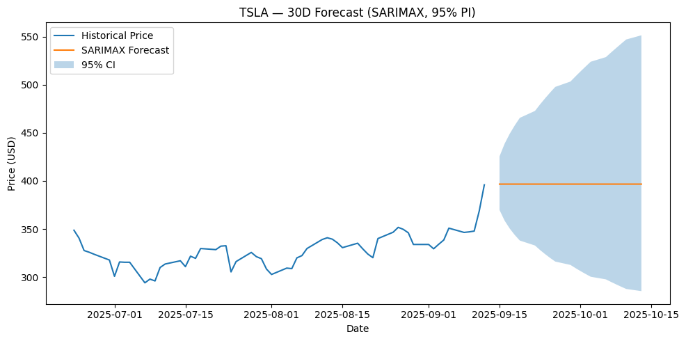
SARIMAX with Exogenous Features
Exogenous features:
lag-1 versions of macro factors, cross-asset returns, lagged prices/returns
Preprocessing:
StandardScaler + 1%/99% clipping (outlier control)
Order selection:
lowest AIC among (1,1,0), (0,1,1), (1,1,1)
Steps:
30D ≈ 21 trading steps for stocks, 30 steps for crypto
Results (30D, lowest AIC models):
TSLA: (1,1,0), AIC = –10347.34
GOOGL: (1,1,0), AIC = –14185.35
BTC-USD: (1,1,0), AIC = –14760.93
ETH-USD: (1,1,0), AIC = –9355.14

Slide 17
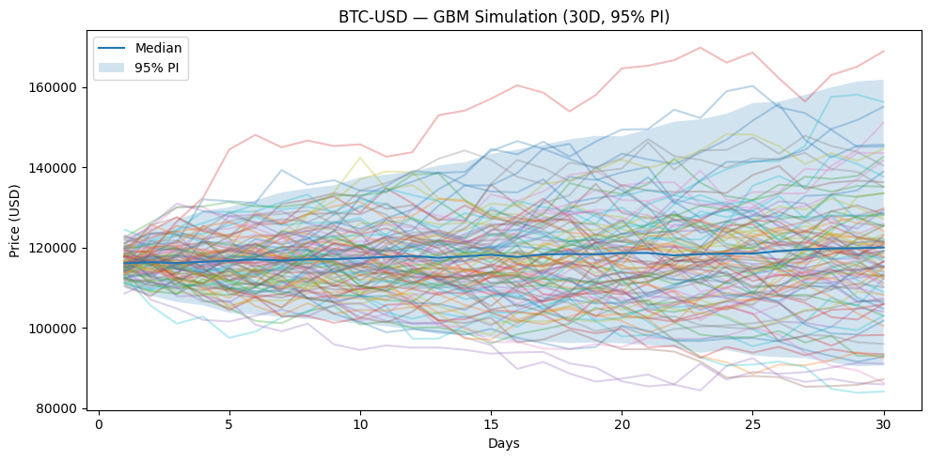
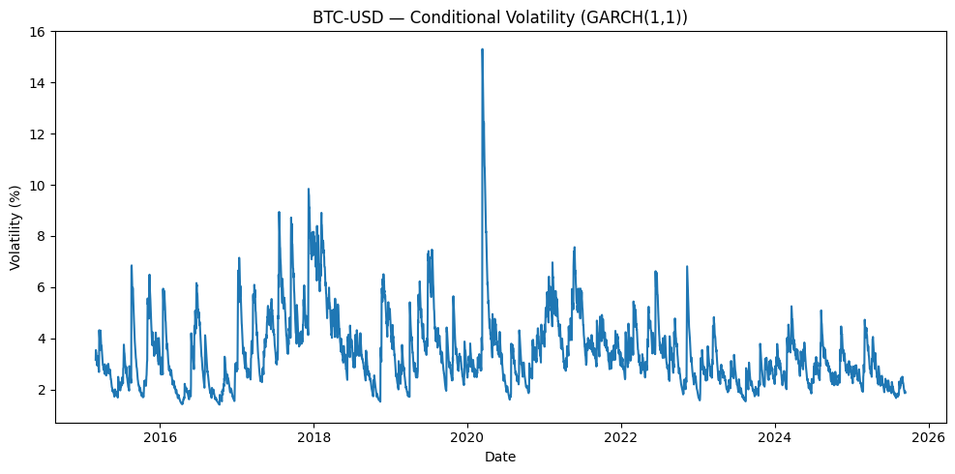
GBM with GARCH-informed Volatility
Parameters:
annualized μ and σ estimated from log returns; σ refined by GARCH(1,1) conditional volatility
Robust constraints:
horizon-dependent caps on μ and σ (e.g., μ ≤ 25% for ≤1Y, ≤7% for 10Y)
Simulation:
2000 paths → median, 2.5%, 97.5% quantiles
GARCH diagnostics:
persistence (α+β ≈ 1)
t-distribution ν ≈ 3–4

Slide 18
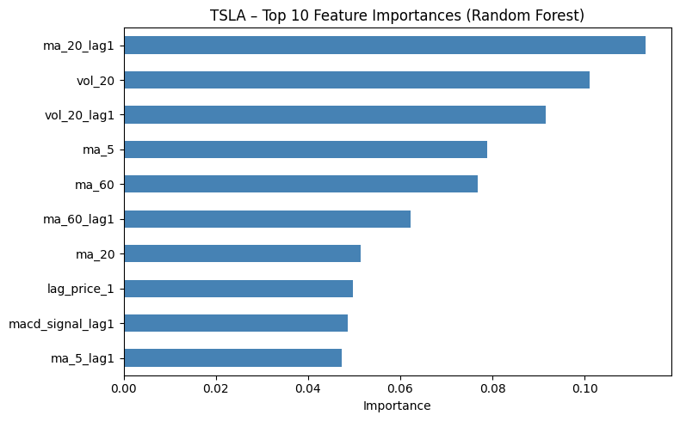
ML Models & Feature Selection
Random Forest (eg: 30D)
TSLA:
MAE = 0.234, RMSE = 0.287, Forecast ≈ 351.54
GOOGL:
MAE = 0.137, RMSE = 0.153, Forecast ≈ 255.81
BTC-USD:
MAE = 0.348, RMSE = 0.405, Forecast ≈ 106,572
ETH-USD:
MAE = 0.343, RMSE = 0.410, Forecast ≈ 4,590
LSTM (eg: 30D)
TSLA:
val_loss = 0.0346, Forecast ≈ 347.19
GOOGL:
val_loss = 0.00581, Forecast ≈ 230.08
BTC-USD:
val_loss = 0.0144, Forecast ≈ 115,144
ETH-USD:
val_loss = 0.0622, Forecast ≈ 4,334
Top Features (Correlation Ranking, eg: 30D)
TSLA:
ma20_lag1, ma20, lag_price_5...
GOOGL:
rsi14, lag_price_1, ma5...
BTC-USD:
ma60_lag1, ma60, lag_price_20...
ETH-USD:
lag_price_20, ma20_lag1, ma20...

Slide 19
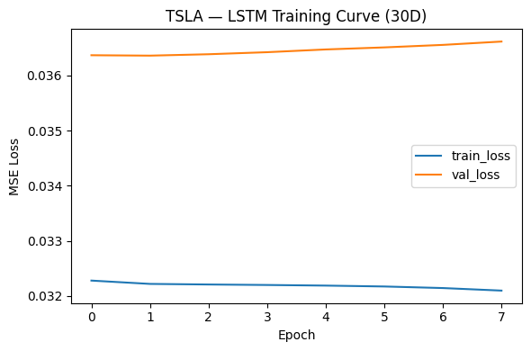
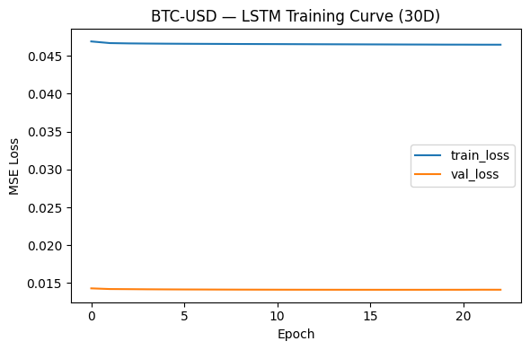
ML Models - LSTM
LSTM Model Design (30D Example)
Input sequence:
30-day rolling window of daily returns
Architecture:
1 LSTM layer (32 units) + Dense output
Training setup:
Adam optimizer (lr = 0.001), batch size = 64, epochs = 60
Regularization:
Early stopping (patience = 6, restore best weights)
Validation:
90/10 time-based split (no shuffle)
Output:
Point forecasts of log-return sum → converted to price

Slide 20
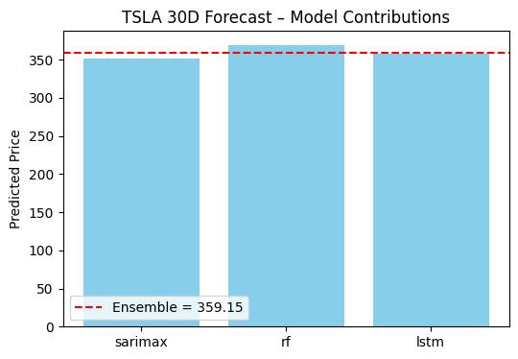
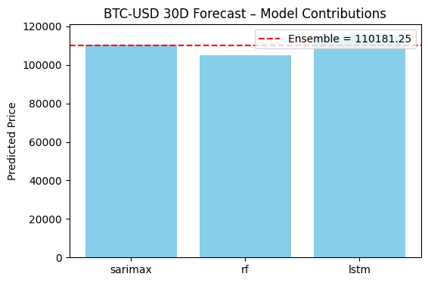
Ensembling (30D Forecast Examples)
Robust median across SARIMAX, GBM, RF, and LSTM
Reduces model-specific bias and improves stability
Example results (30D):
TSLA:
359.15 (SARIMAX 336.05, RF 351.54, LSTM 347.19)
GOOGL:
237.98 (SARIMAX 228.05, RF 255.81, LSTM 230.08)
BTC-USD:
110,181.25 (SARIMAX 109,564, RF 106,572, LSTM 115,144)
ETH-USD:
4,410.71 (SARIMAX 4,308, RF 4,590, LSTM 4,334)

Slide 21
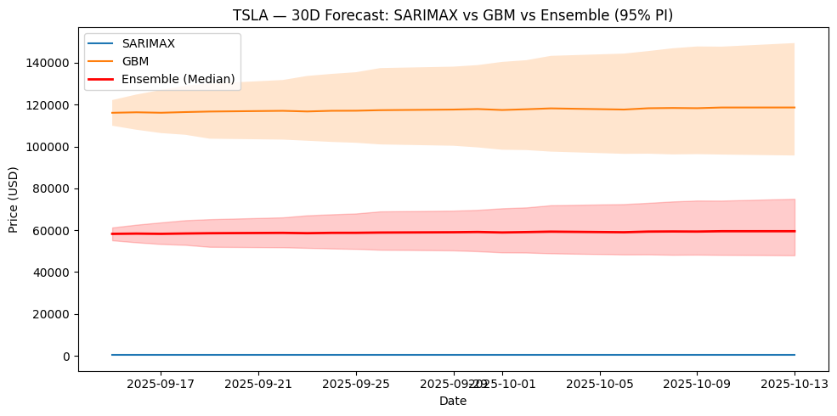
Ensemble Forecasting — Robust Median (TSLA 30D Example)
Why Ensemble:
Individual models vary across horizons (SARIMAX better short-term, GBM better long-term).
Method:
Take the median of model forecasts; intervals aggregated by median of bounds.
Benefit:
Stabilizes forecasts, reduces outlier bias, and provides more robust risk bands.

Slide 22
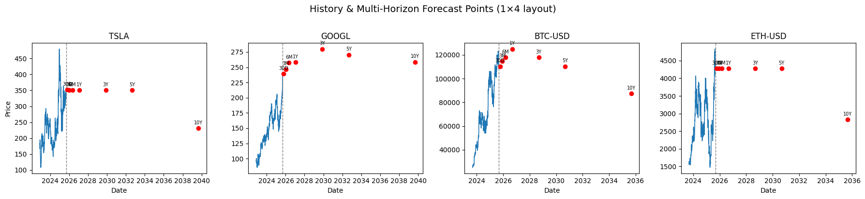
Multi-Horizon Forecasts (30D → 10Y)
Asset | 30D | 3M | 6M | 1Y | 3Y | 5Y | 10Y
TSLA | 351.72 | 350.93 | 350.93 | 350.93 | 350.93 | 350.93 | 231.18
GOOGL | 239.29 | 246.73 | 257.26 | 258.44 | 279.98 | 270.53 | 258.69
BTC-USD | 110,308.29 | 114,621.99 | 117,754.23 | 124,938.73 | 117,765.60 | 110,308.29 | 87,325.80
ETH-USD | 4,273.63 | 4,273.63 | 4,273.63 | 4,273.63 | 4,273.63 | 4,273.63 | 2,830.82

Slide 23
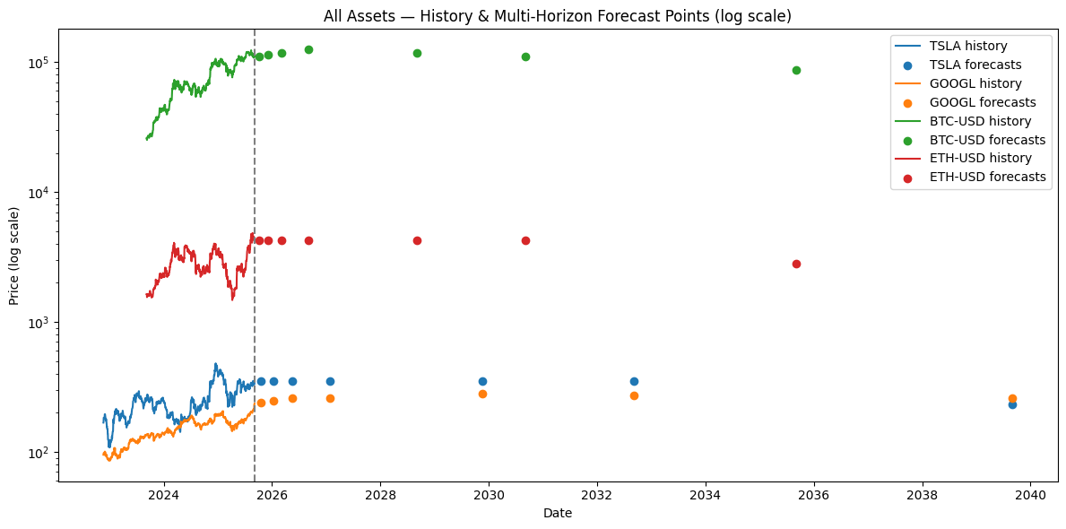
Multi-Horizon Forecasts (30D → 10Y)
Log scale is applied to compare assets with very different price levels (stocks vs. crypto).
Forecast points show ensemble predictions at multiple horizons.

Slide 24
Contents
Overview
Data Collection & Preparation
Feature Engineering
Modeling Approach
Model Evaluation
Forecast Results
Interpretation
Future Evaluation

Slide 25
Evaluation Framework
Data Splits
Metrics for Points and Intervals
Rolling backtests across 7 horizons: 30D, 3M, 6M, 1Y, 3Y, 5Y, 10Y
Train/test indices via expanding windows
Exogenous features scaled (z-score) with 1–99% clipping to reduce leakage/outliers
Future exog = “last-known snapshot” for SARIMAX; GBM uses μ/σ from recent returns or GARCH
Models compared: SARIMAX, GBM, RF (direct-H); LSTM used for 30D sanity check
Point: RMSE, MAE, MAPE, Directional Accuracy (DA)
Interval: 95% Coverage and Interval Score (proper scoring rule)
Short horizons prioritize point errors; long horizons emphasize coverage & interval score
All metrics computed per model × horizon × asset

Slide 26
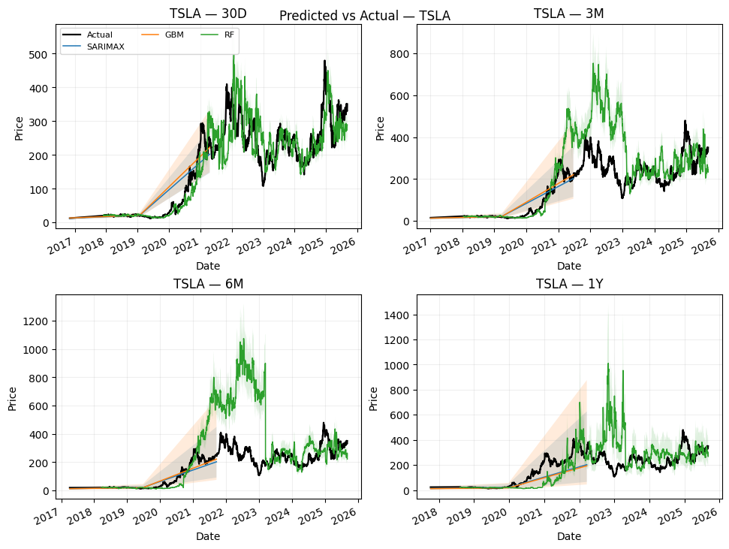
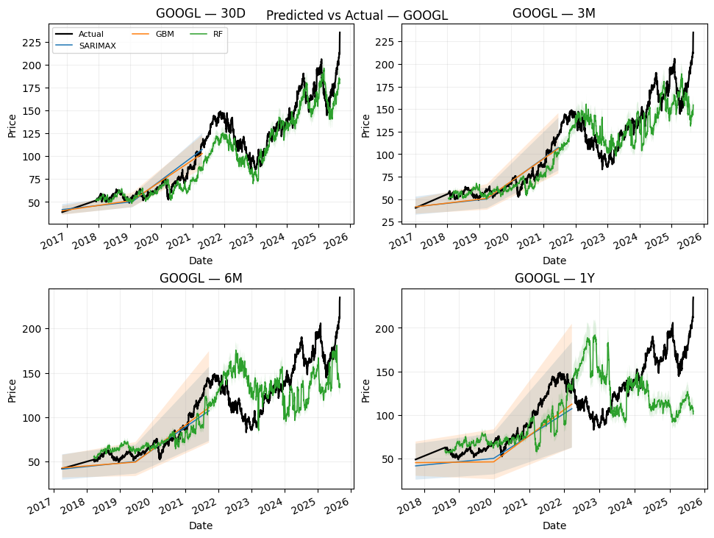
Backtest Examples (Equities)
Predicted vs. Actual — Equities (TSLA, GOOGL)
Short-horizon behavior: SARIMAX tracks local mean-reverting moves well
Medium term: GBM helps when drift dominates; SARIMAX catches cycles with exog
Intervals illustrate uncertainty growth with horizon

Slide 27
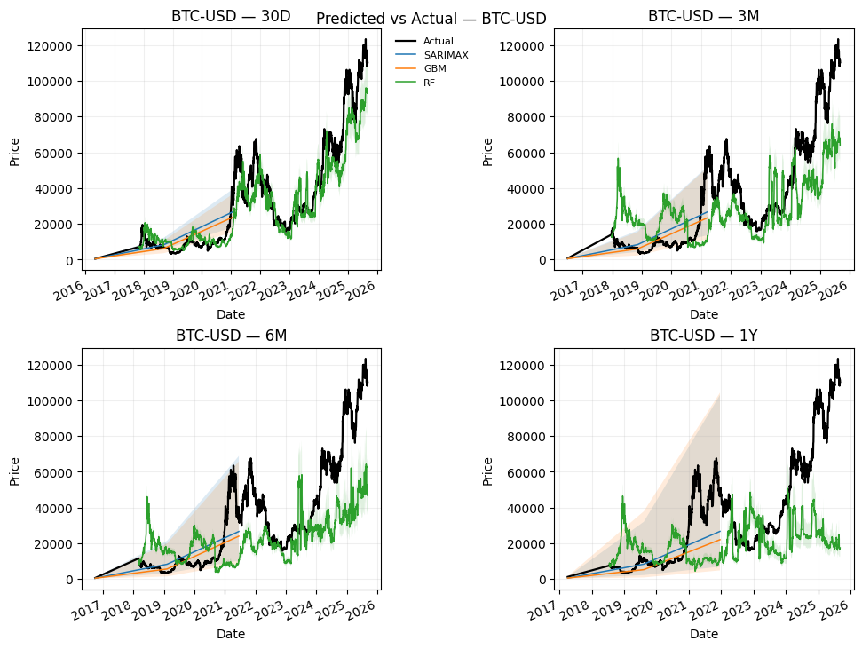
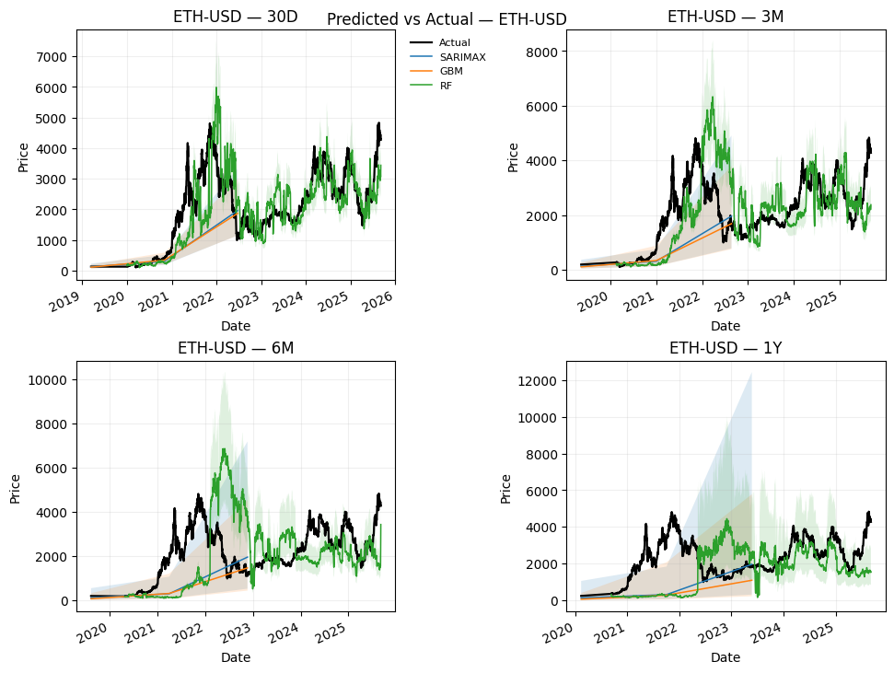
Backtest Examples (Crypto)
Predicted vs. Actual — Crypto (BTC, ETH)
Higher volatility and weekend trading challenge point forecasts
GBM captures trend-like moves; SARIMAX helpful when regimes stabilize
Uncertainty bands widen faster vs. equities

Slide 28
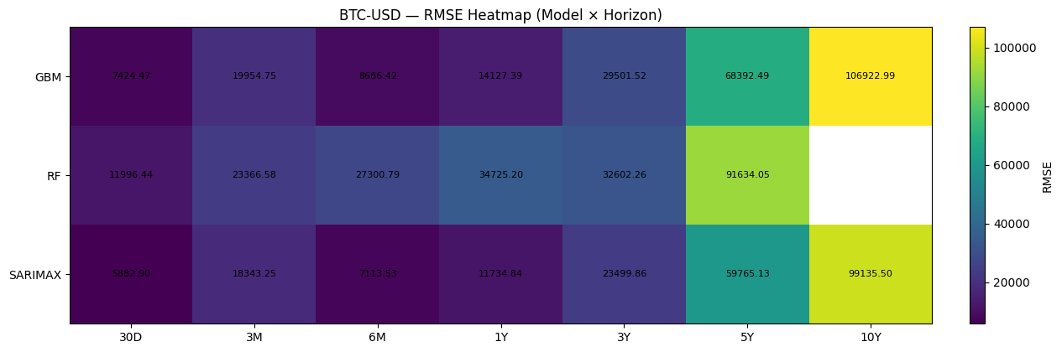
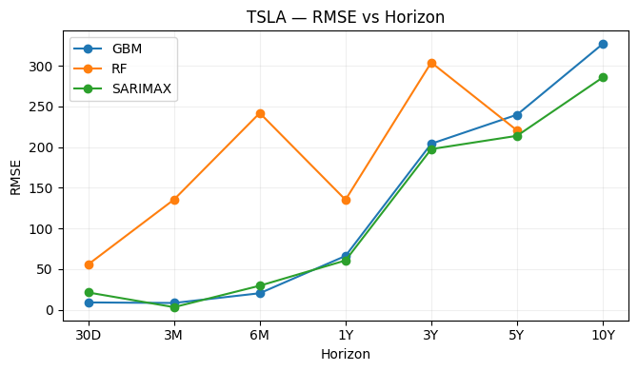
Comparative Errors
Short-term (30D–3M): leadership flips — 30D often GBM, 3M tends to SARIMAX
1Y: SARIMAX generally most stable (lower RMSE/MAE)
Long horizons (3Y–10Y): GBM more competitive; RF sporadic wins (e.g., 5Y for TSLA)

Slide 29
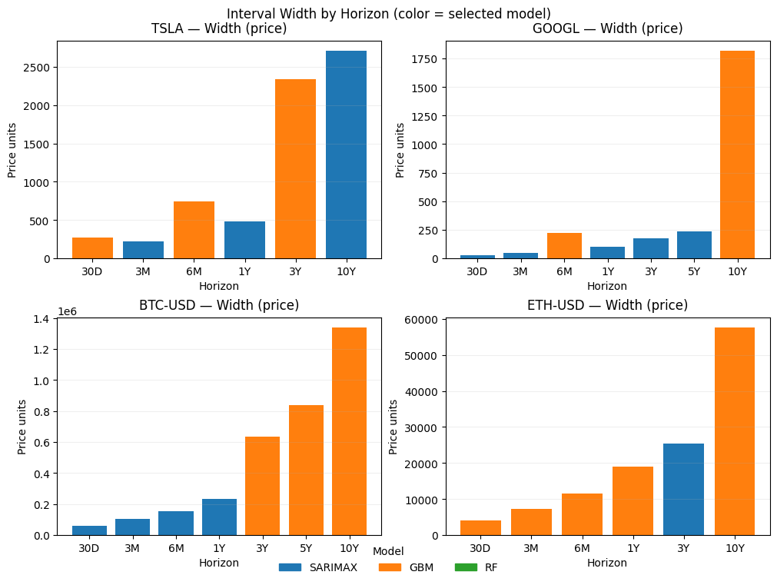
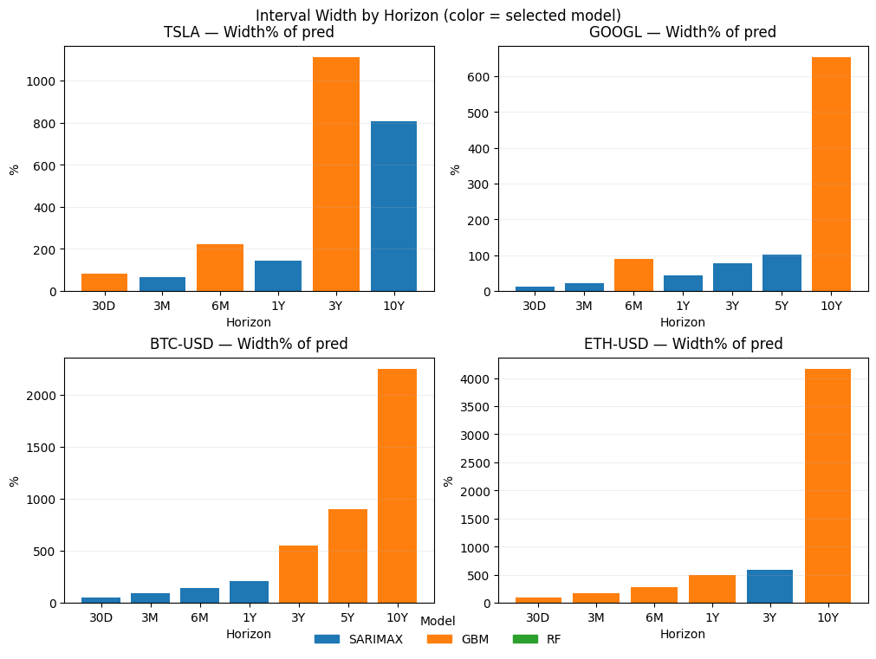
Forecast Interval Width Across Horizons
Interval Width by Horizon (Price units)
Interval Width by Horizon (% of prediction)
Forecast intervals naturally widen as horizon increases.
Equities (TSLA, GOOGL): relatively moderate widening.
Cryptos (BTC, ETH): significantly larger intervals → higher long-term uncertainty.
Percentage view highlights relative uncertainty; price-unit view shows absolute exposure.

Slide 30
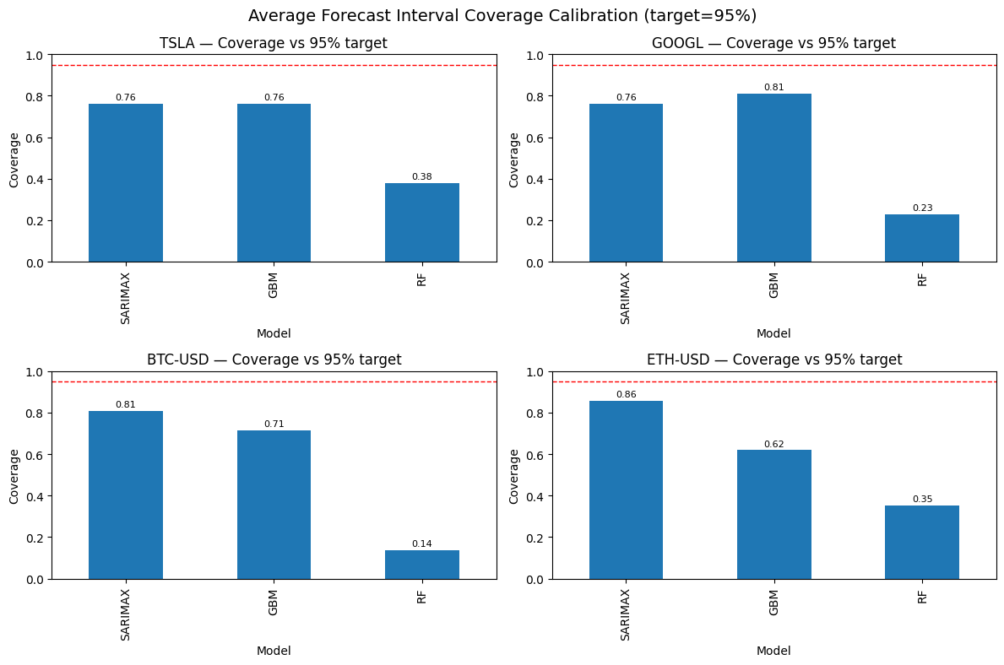
Interval Calibration
SARIMAX intervals are best aligned with 95% target on average
GBM slightly under/over-covers depending on μ/σ caps
RF needs conformal/quantile calibration for reliable bands

Slide 31
Best Model by Asset × Horizon
Heuristic:
short horizons prioritize point errors; long horizons prioritize coverage & interval score
Champions:
TSLA: SARIMAX vs GBM trade-off; RF wins at 5Y once
GOOGL: SARIMAX dominates across horizons
BTC: 30D/3M/6M/1Y → mostly SARIMAX; 10Y → GBM
ETH: short–mid → mostly GBM; 5Y RF appears once
 | 30D | 6M | 1Y | 5Y | 10Y
TSLA | GBM | GBM | SARIMAX | RF | SARIMAX
GOOGL | SARIMAX | GBM | SARIMAX | SARIMAX | GBM
BTC-USD | SARIMAX | SARIMAX | SARIMAX | GBM | GBM
ETH-USD | GBM | GBM | GBM | RF | GBM

Slide 32
Key Takeaways & Playbook
Short/medium term:
SARIMAX is the workhorse; blend GBM under strong drift
1Y:
prefer SARIMAX; cross-check with GBM when intervals disagree
3Y+:
median ensemble of SARIMAX+GBM balances stability vs. trend
RF:
keep as calibrated secondary (direct-H) component
Report SARIMAX intervals by default; post-adjust GBM coverage; conformal for RF

Slide 33
Contents
Overview
Data Collection & Preparation
Feature Engineering
Modeling Approach
Model Evaluation
Forecast Results
Interpretation
Future Evaluation

Slide 34
Forecast Results
Intro
Forecasting Framework
Forward-looking forecasts with best model per asset × horizon
Short-term (30D–6M) vs Long-term (1Y–10Y)
Results presented mainly in tables with key insights
Convert horizons into trading steps (daily vs business days)
Hold-last scenario for exogenous variables
Model dispatch: SARIMAX / GBM / RF
Output: point forecasts + 95% intervals

Slide 35
Short-Term Forecasts (30D–6M)
TSLA: ~335 (GBM/SARIMAX) with widening bands at 6M
GOOGL: ~229 (SARIMAX) stable, 251 at 6M (GBM)
BTC-USD: ~110k (SARIMAX), intervals widen rapidly
ETH-USD: ~4k (GBM), very wide uncertainty
Asset | 30D | 3M | 6M
TSLA | GBM: 350 (234–530) | SARIMAX: 348 (251–483) | GBM: 348 (130–914)
GOOGL | SARIMAX: 237 (222–252) | SARIMAX: 237 (212–264) | GBM: 258 (165–409)
BTC-USD | SARIMAX: 110,821 (85,436–143,749) | SARIMAX: 110,821 (70,201–174,945) | SARIMAX: 110,821 (57,984–211,805)
ETH-USD | GBM: 4,214 (2,675–6,744) | GBM: 4,137 (1,835–9,332) | GBM: 3,942 (1,320–13,365)

Slide 36
Long-Term Forecasts (1Y–10Y)
TSLA: stable medians (~335), wide bands at 10Y
GOOGL: SARIMAX up to 5Y, GBM at 10Y (~278, wide)
BTC-USD: ~110k at 1Y, GBM dominates 3–10Y with extreme ranges
ETH-USD: ~3.9k at 1Y, GBM/RF mix with large uncertainty
Asset | 1Y | 3Y | 5Y | 10Y
TSLA | SARIMAX: 348 (179–678) | GBM: 220 (20–2,440) | RF: 844 (point) | SARIMAX: 348 (42–2,865)
GOOGL | SARIMAX: 237 (190–295) | SARIMAX: 237 (161–347) | SARIMAX: 237 (144–388) | GBM: 286 (42–1,997)
BTC-USD | SARIMAX: 110,821 (43,992–279,169) | GBM: 116,427 (20,680–627,325) | GBM: 94,990 (10,970–849,446) | GBM: 62,565 (2,994–1,316,006)
ETH-USD | GBM: 3,897 (815–19,181) | SARIMAX: 4,302 (713–25,957) | RF: 52,032 (point) | GBM: 1,401 (35–55,639)

Slide 37
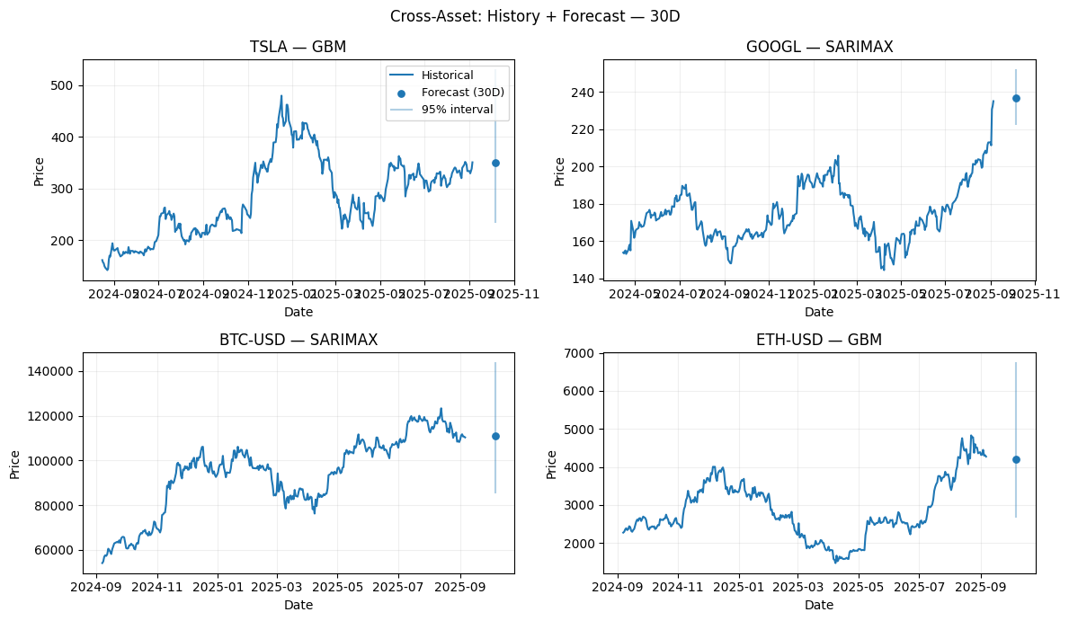
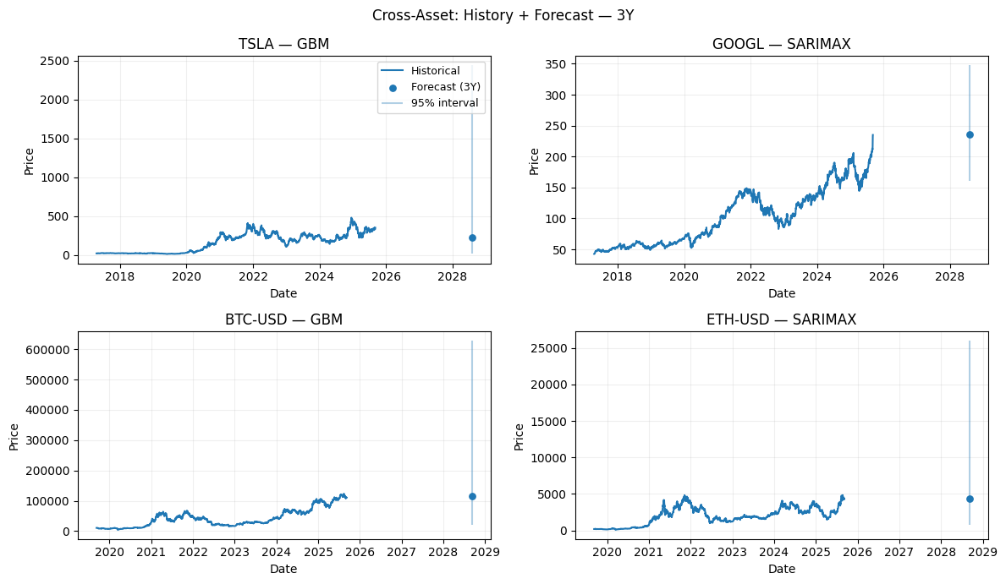
Cross-Asset Comparison
Compare assets side by side at 30D and 1Y horizons:
Stocks: tighter ranges, more predictable; Crypto: wider ranges, higher risk

Slide 38
Stress Testing — SARIMAX & GBM
SARIMAX stress: macro shocks on exogenous variables (e.g., VIX ↑)
VIX Stress Test (TSLA, 30D)
GBM stress: scale volatility σ to show uncertainty ballooning
Volatility Stress Test (BTC, 1Y)
Scenario | Forecast
VIX +0% | 335 (278–404)
VIX +1% | 335 (278–404)
VIX +2% | 335 (278–404)
VIX +5% | 335 (278–404)
σ Multiplier | Forecast
σ ×1.0 | 122,960 (46,896–324,571)
σ ×1.25 | 116,083 (35,104–392,377)
σ ×1.5 | 105,346 (22,995–474,362)
σ ×2.0 | 85,213 (11,886–590,298)
Equities (SARIMAX) show stable near-term forecasts under macro shocks, while Crypto (GBM) exhibits ballooning uncertainty as volatility rises.

Slide 39
Insights & Takeaways
Short-term (30D–6M):
SARIMAX provides tighter, well-calibrated intervals → reliable for equities
Crypto forecasts much wider (BTC ~110k, ETH ~4k) → high short-term risk
Long-term (1Y–10Y):
GBM dominates; intervals balloon with horizon
Equities show moderate widening; crypto uncertainty extreme (e.g., BTC 10Y [3k–1.3M])
RF gives point-only signals (not risk-aware)
Stress tests:
SARIMAX macro shocks (e.g., VIX ↑) → minimal short-term shifts
GBM volatility scaling → median stable but risk bands widen significantly
Key takeaway:
Focus on intervals, not just points
Blend models: SARIMAX for near-term guidance, GBM for long-term risk envelopes

Slide 40
Contents
Overview
Data Collection & Preparation
Feature Engineering
Modeling Approach
Model Evaluation
Forecast Results
Interpretation
Future Evaluation

Slide 41
Interpretation
Model Insights
Short vs Long & Cross-Asset
SARIMAX:
Best 30D–1Y, interpretable, calibrated; weaker in regime shifts
GBM:
Best 3–10Y, captures compounding vol; bands widen fast
RF:
Nonlinear short-term signals; point-only, no bands
LSTM:
Sequential learner; data-hungry, optional satellite
Short-term (30D–6M):
actionable, SARIMAX/RF preferred
Long-term (1Y–10Y):
uncertainty dominates, GBM for risk envelopes
Stocks:
narrower, macro-sensitive but stable
Crypto:
much wider even at 30D; long-term bands extreme

Slide 42
Risk & Takeaways
Interval widening = main signal; SARIMAX calibrated, GBM conservative
No model captures black swans → stress testing essential
For Investors: SARIMAX short-term, GBM long-term, re-estimate often
For Risk Managers: run macro (SARIMAX) & vol (GBM) stress; use blended narrative

Slide 43
Contents
Overview
Data Collection & Preparation
Feature Engineering
Modeling Approach
Model Evaluation
Forecast Results
Interpretation
Future Evaluation

Slide 44
Future Evaluation
Intro
Validation Process
Forecasting is iterative, not one-time
Build a feedback loop: Forecast → Validate → Improve → New Forecast
Ensure models adapt to changing markets
Compare forecasts with realized prices at horizon endpoints
Track performance per asset and horizon (30D → 10Y)
Identify biases, calibration gaps, interval accuracy

Slide 45
Data & Feature Expansion
Category | Examples | Integration
Macroeconomic | CPI, interest rates, unemployment (FRED, OECD, World Bank) | Low-frequency → forward-filled to daily; used as exogenous features
Market Sentiment | Google Trends, news sentiment, Twitter/X indices | Short-term behavioral signals; noisy but timely; merged as predictors
On-chain (Crypto) | Active addresses, exchange flows, hash rate (Glassnode, CryptoQuant) | Provides unique BTC/ETH signals; integrated with price & technical indicators

Slide 46
Closing Note
Forecast
Validate
Improve
New Forecast
Current forecasts = baseline
Validation reveals strengths & weaknesses
External features improve robustness
Continuous cycle keeps framework adaptive

Slide 47
THANKS

