Slide 1
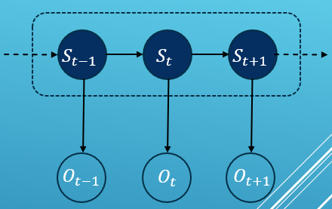
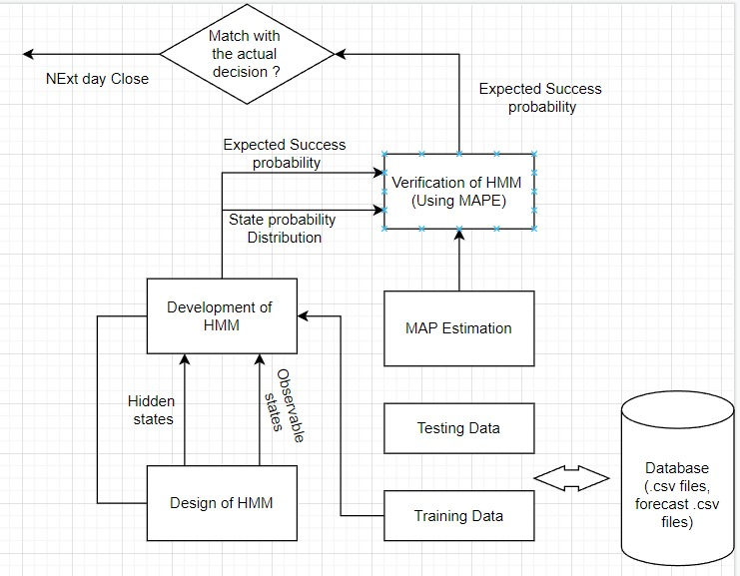
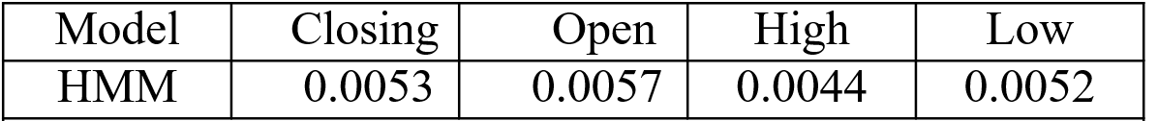
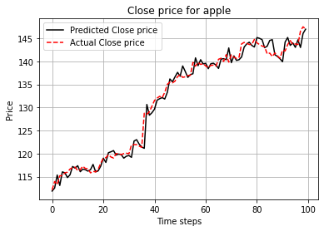
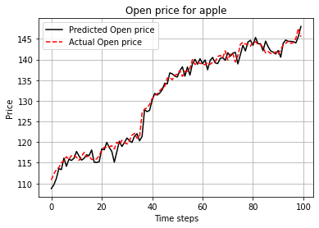
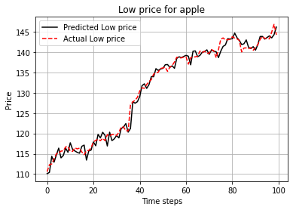
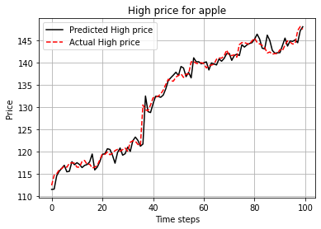
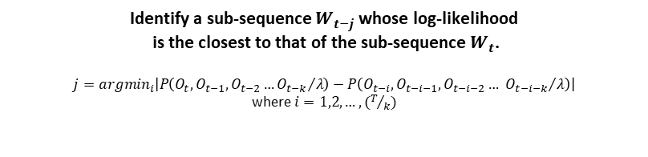
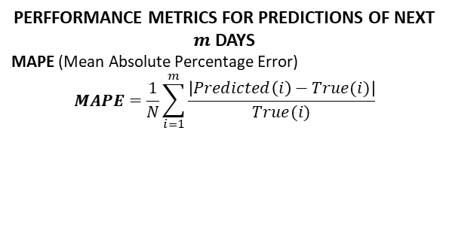
STOCK FORECASTING USING HIDDEN MARKOV MODELS
PREDICTION OF STOCK PRICES
SYSTEM ARCHITECTURE
ABSTRACT
Predicting & comparing stock prices using probabilistic model(HMM)
OBJECTIVE
Extract important information of stocks from their past prices to predict future trends.
DATASETS USED
apple.csv
cmcst.csv
google.csv
qcom.csv
CALCULATING AIC, BIC
𝐴𝐼𝐶 = −2 log (𝑃(𝑂_{𝑡𝑟𝑎𝑖𝑛 | 𝜆})) − 2𝑝
𝐵𝐼𝐶 = −2 log (𝑃(𝑂_{𝑡𝑟𝑎𝑖𝑛 | 𝜆})) − 𝑝. log(𝑇)
𝑤ℎ𝑒𝑟𝑒, 𝑝 = 𝑁² + 2𝑁 − 1
Identify a sub-sequence $W_{t−j}$ whose log-likelihood
is the closest to that of the sub-sequence $W_{t}$.
$$j={argmin}_{i}\left|P\left({O_{t},O_{t−1},O_{t−2}…O_{t−k}}/λ\right)−P\left({O_{t−i},O_{t−i−1},O_{t−i−2}…{ O}_{t−i−k}}/λ\right)\right|$$
where $i=1,2,…,(T/k)$
PERFFORMANCE METRICS FOR PREDICTIONS OF NEXT $m$ DAYS
MAPE (Mean Absolute Percentage Error)
$$MAPE=\frac{1}{N}\sum_{i=1}^{m}{\frac{\left|Predicted\left(i\right)−True(i)\right|}{True(i)}}$$
MAPE values for APPLE
RESULT
We have observed that the predicted values for Open, Close, High, Low closely follow the trends exhibited by its corresponding true values in HMM implementation and the MAPE values were found to be closely negligible.
IMPLEMENTATION / VISUALIZATION
CONCLUSIONS
-> Though in general, the observations will be greatly affected by the choice of model i.e the number of states in Hidden Markov Models, it does not make significant difference when applied to Stocks.
-> The predictions diverge when prices are predicted for more than one day.

