Slide 1
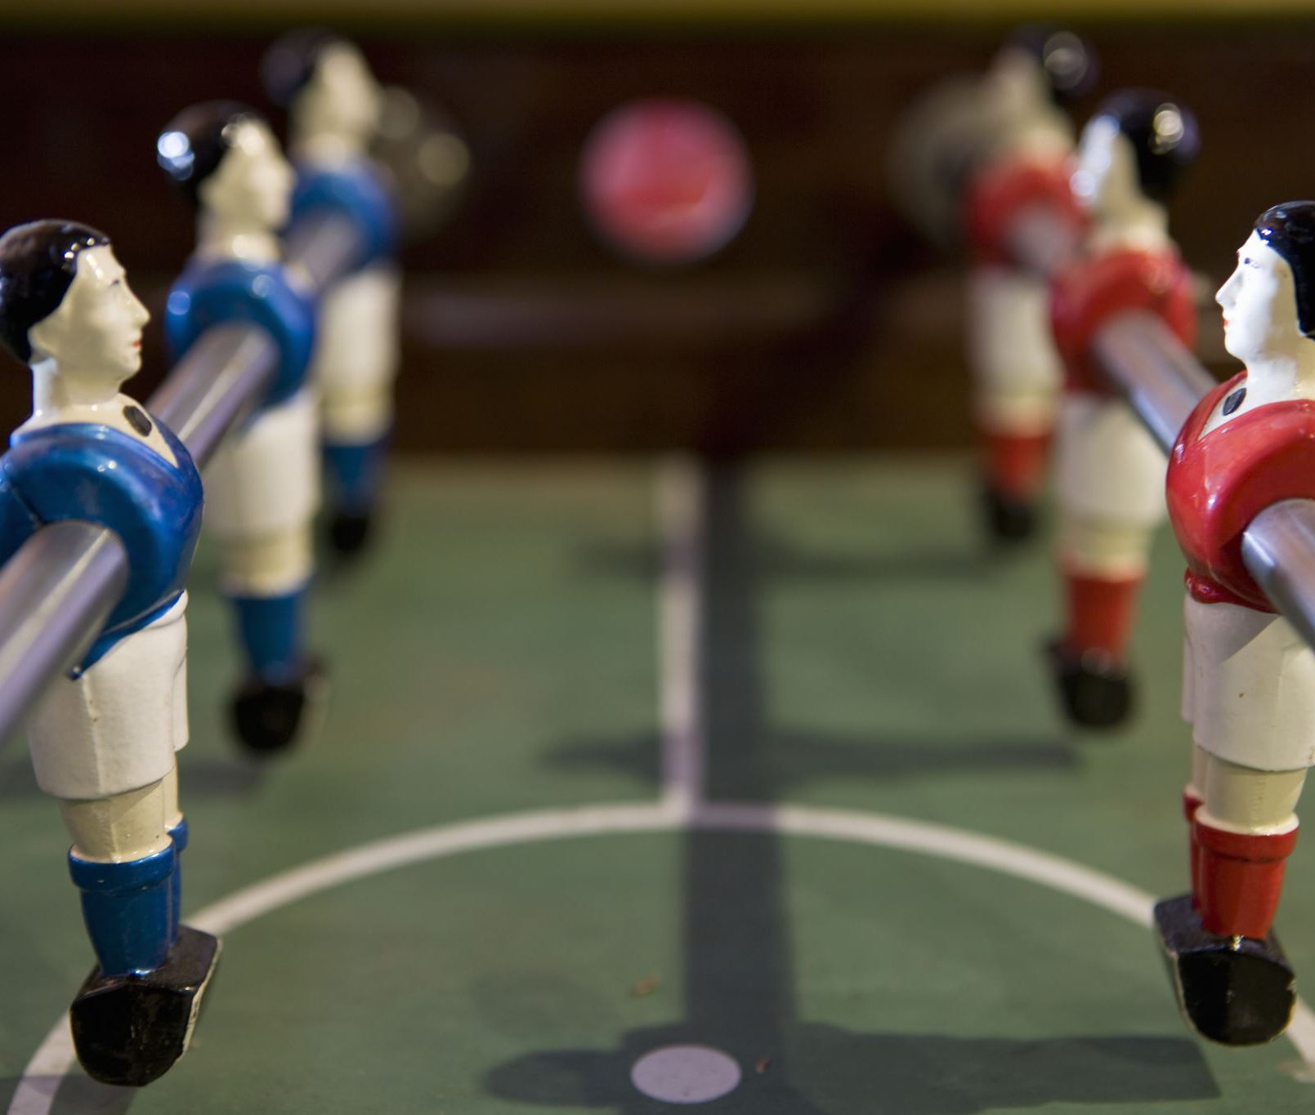
Workshop Your First Finish Game !
Mathias Ressort

Slide 2
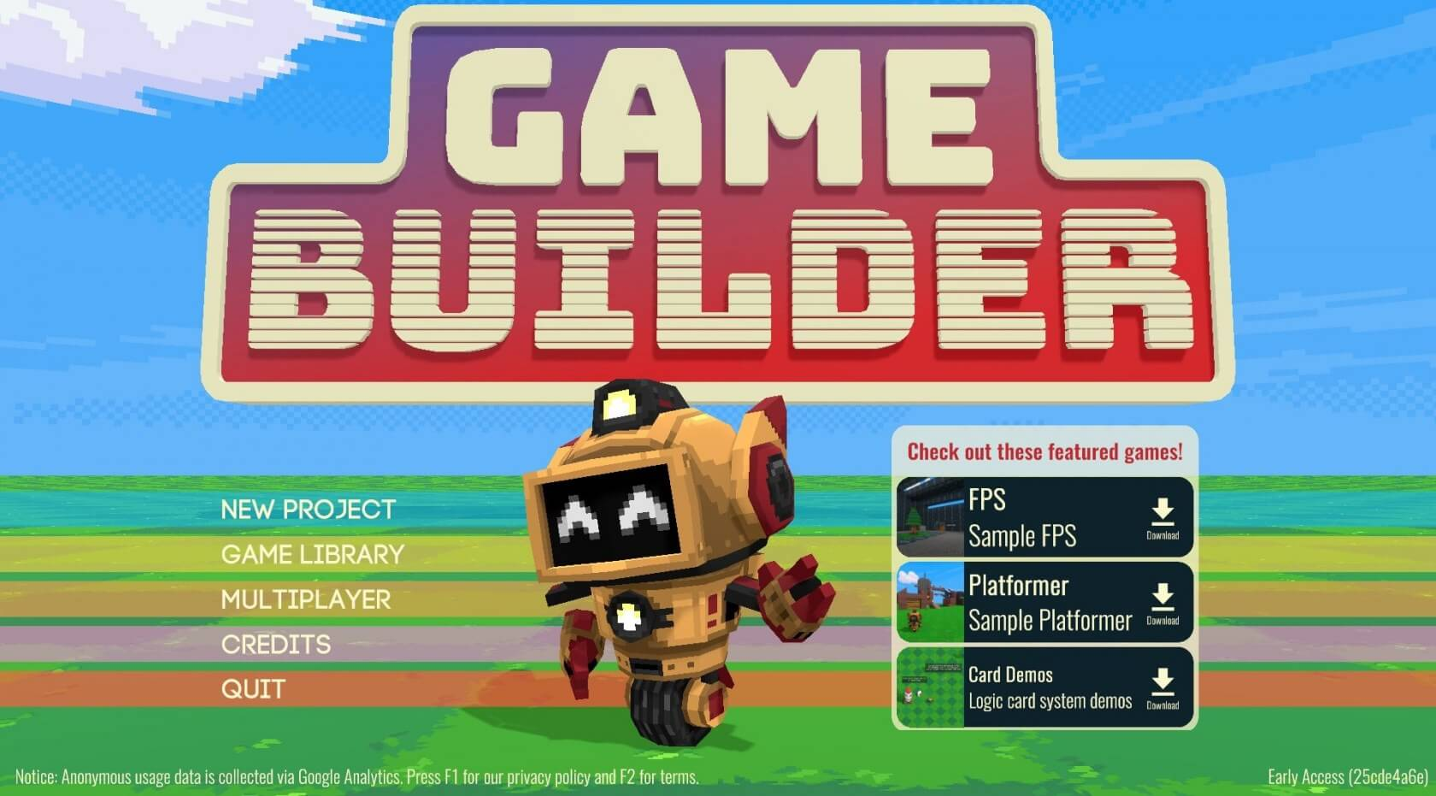
3D

Slide 3
Description du workshop
30min - Mise en place et découverte des ressources
40min - Player
20min - Enemy
20min - Intéraction des éléments
Bonus

Slide 4
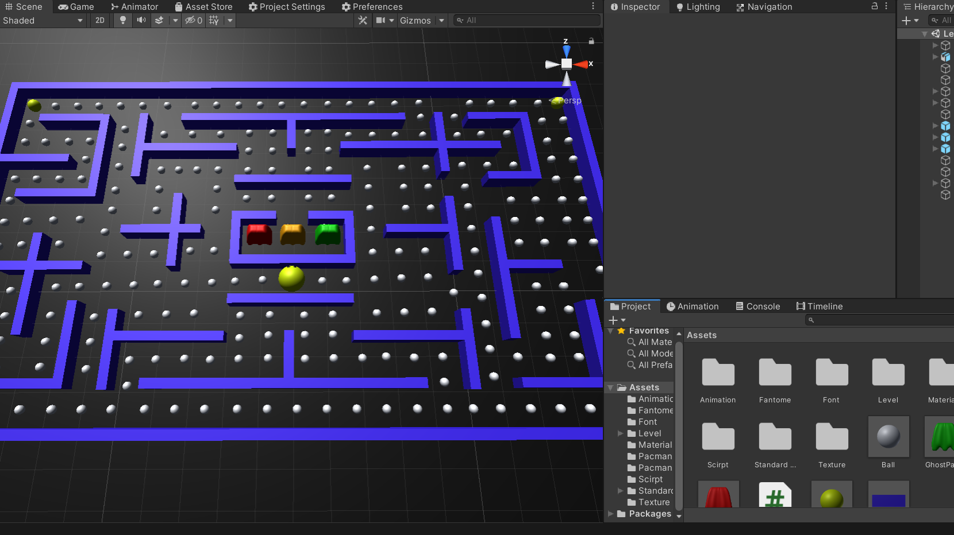
Ressources

Slide 5
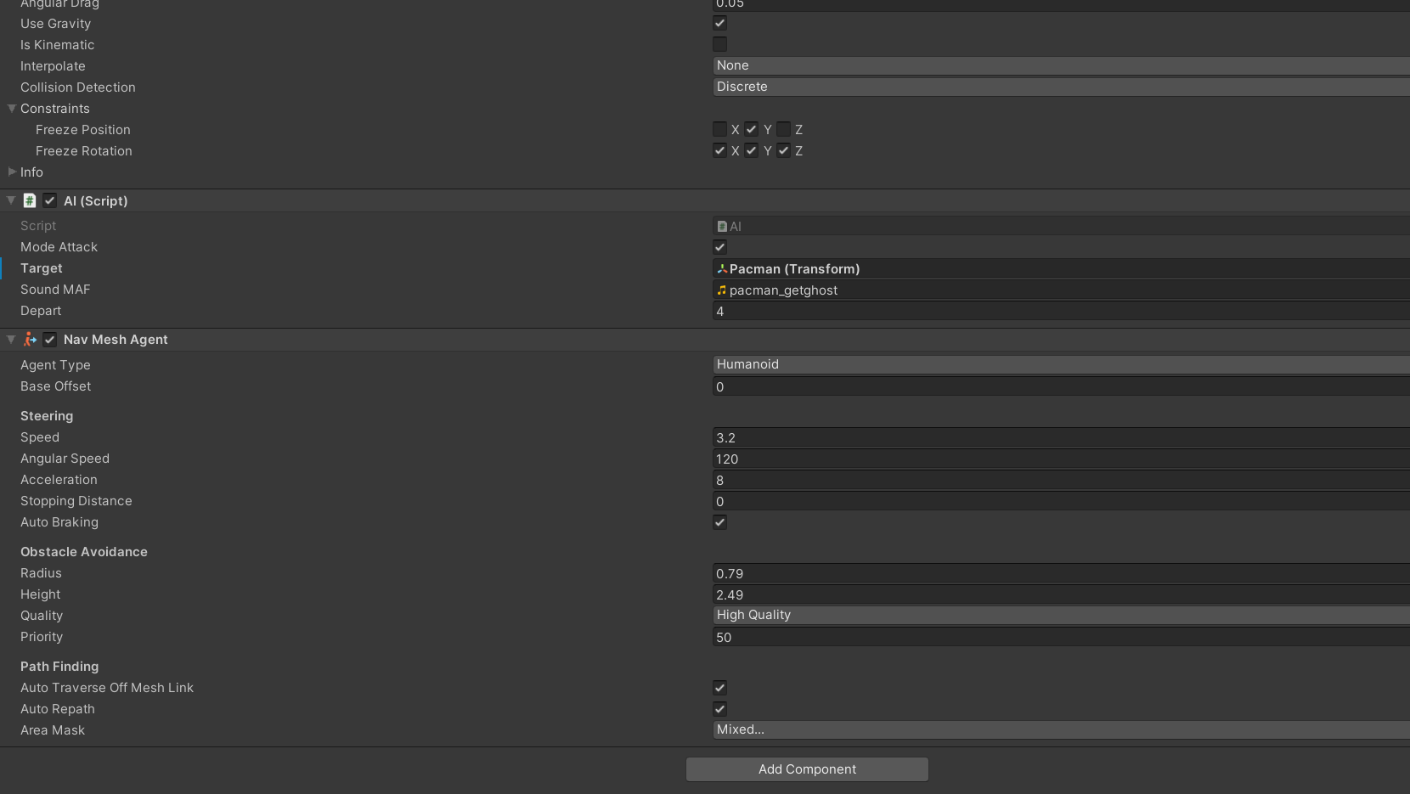
IA

