Slide 1
Gen Ai Chatbot
- Aakash Yadav

Slide 2
Introduction
A chatbot is a computer program that simulates human conversation with an end user. Not all chatbots are equipped with artificial intelligence (AI), but modern chatbots increasingly use conversational AI techniques such as natural language processing (NLP) to understand user questions and automate responses to them.
Chatbots now are no longer need to be pre-programmed with answers to set questions. It’s easier and faster to use generative AI in combination with an organization’s’ knowledge base to automatically generate answers in response to the wider range of questions.
Gen AI chatbots can generate new content as the output in response to a user’s query without the need for human interaction. This new content can include high-quality text, images and sound based on the LLMs they are trained on. Chatbot interfaces with generative AI can recognize, summarize, translate, predict and create
Large language models (LLMs) are a category of foundation models trained on immense amounts of data making them capable of understanding and generating natural language and other types of content to perform a wide range of tasks.
They are able to do this thanks to billions of parameters that enable them to capture intricate patterns in language and perform a wide array of language-related tasks. LLMs are revolutionizing applications in various fields, from chatbots and virtual assistants to content generation, research assistance and language translation.

Slide 3
Objective
To Develop state of the art question-answering model capable of understanding and generating accurate response to a variety of user queries mimicking a human like interaction.

Slide 4
Checklist for building chatbots utilizing LLM’s.
Model choice (Architecture, No. of parameters, domain of data trained on)
Fine tuning
System architecture (GPU/CPU, storage(Azure cloud), API’s for interaction with other systems, CI/CD pipeline, scalability).
Evaluation (Right metric(STS score, Rouge, BERT score), A/B testing, User feedback).
Security.
User experience
Ethical Consideration (Bias and Fairness).

Slide 5
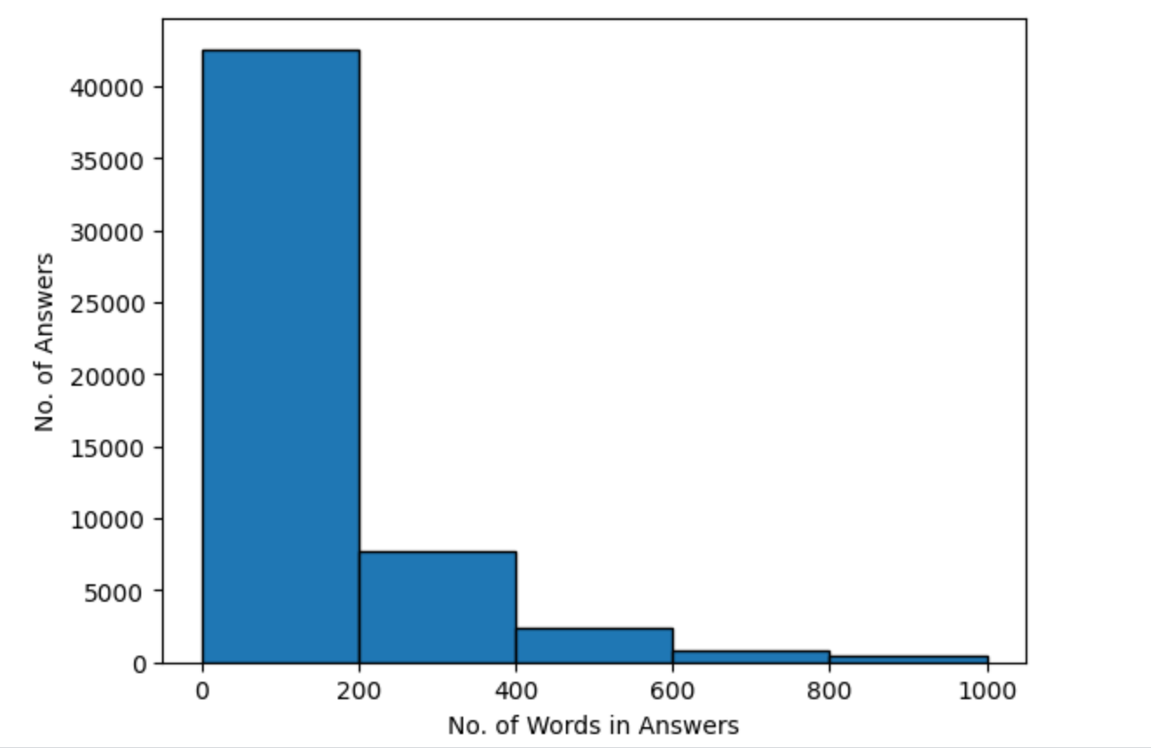
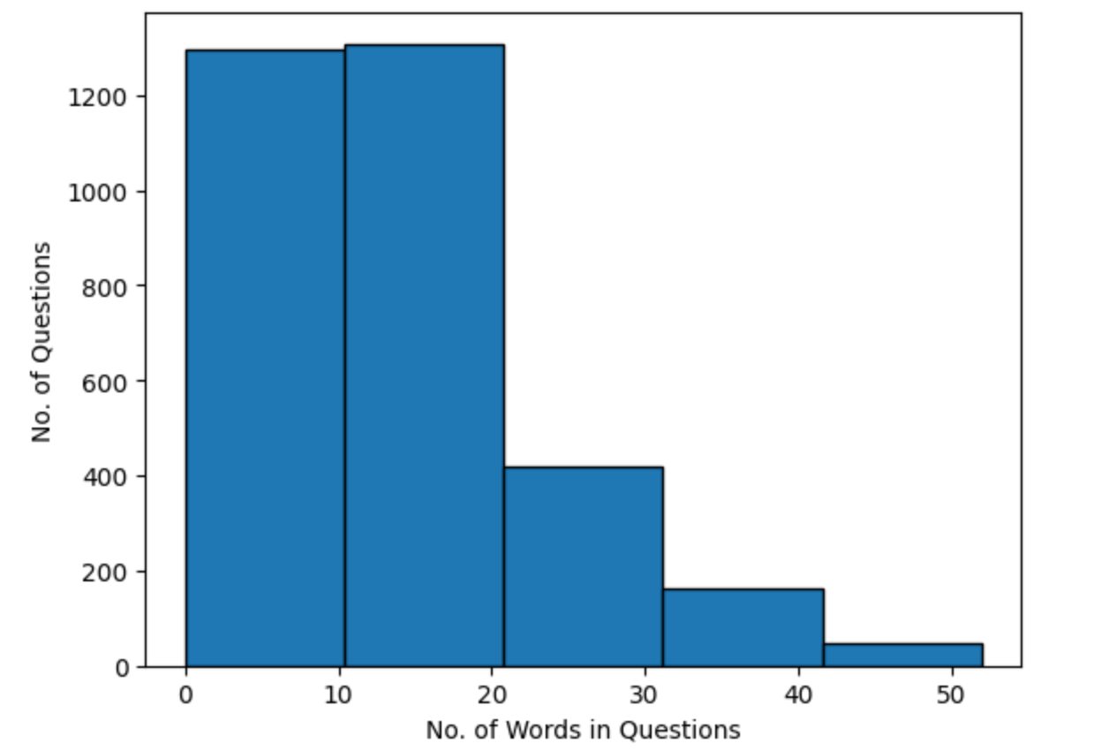
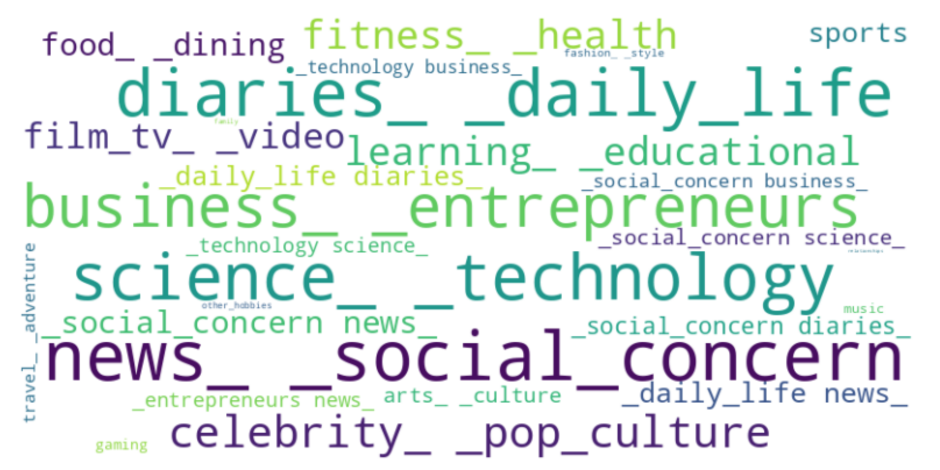
Quora questions-answers dataset was used to test LLM’s for chatbot
Total question-answer pairs: 56,402.
Total duplicated question-answer pairs: 1220.
Total unique questions: 3,234.
Number of words in answers are concentrated in 0-400 range whereas no. of words in questions limit to 50.
Most answers belong to News category(17%), followed by daily life questions(15%),science and technology(15%),Business and entrepreneurship (12%).

Slide 6
Model Testing
1. microsoft/Phi-3-mini-4k-instruct (3.82B params).
2. TinyLlama/TinyLlama-1.1B-Chat-v1.0 (1.1B params).
3. NousResearch/Llama-2-7b-chat-hf (6.7B params).
4. GPT 2

Slide 7
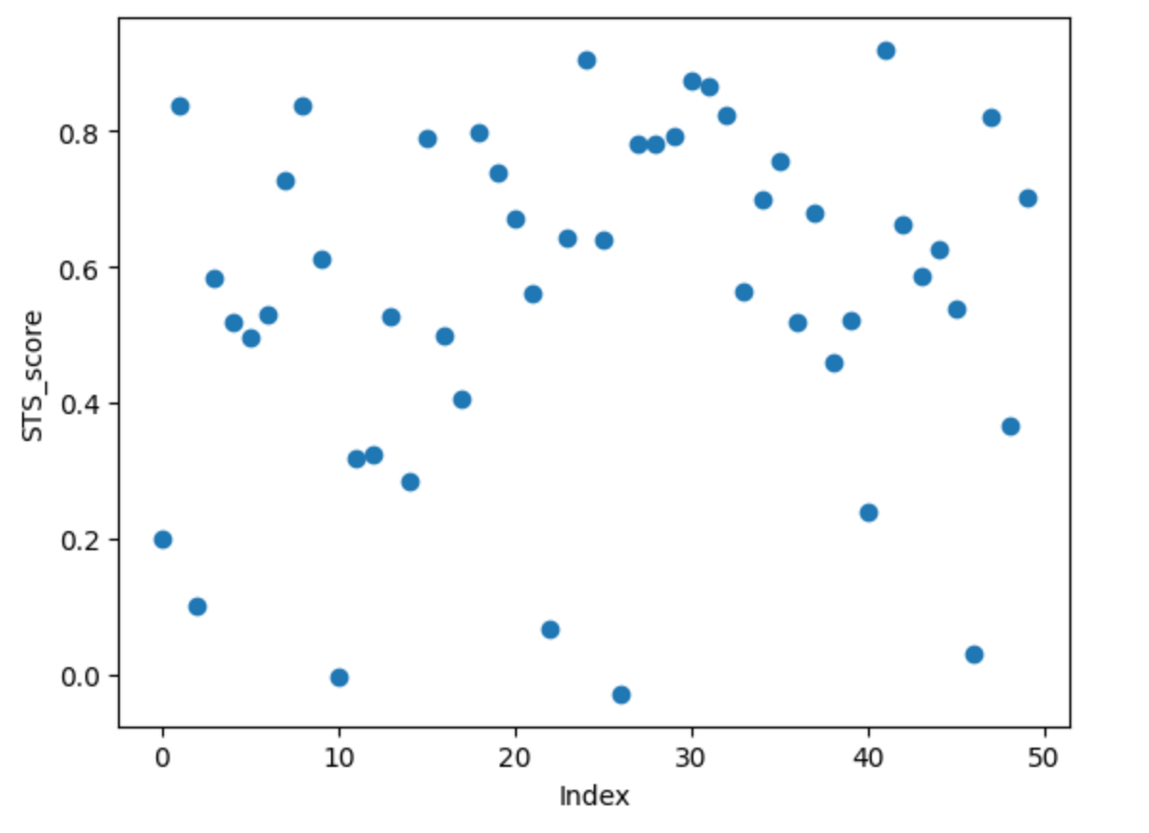
Model: microsoft/Phi-3-mini-4k-instruct (3.82B params)
Test dataset: Quora question-answer dataset (sample: 50 Questions)
STS_score: Min (-0.02), Max (0.91), Mean(0.56)
Answers are almost correct and relevant.
Drawback:
High sts score does not mean answer is correct.
Human chat experience is missing.
 | Precision |  |  | Recall |  |  | F1
Metric | Mean | Min | Max | Mean | Min | Max | Mean | Min | Max
Rouge1 | 0.2 | 0 | 0.6 | 0.3 | 0 | 1 | 0.17 | 0 | 0.47
Rouge2 | 0.03 | 0 | 0.2 | 0.05 | 0 | 0.4 | 0.027 | 0 | 0.12
RougeL | 0.12 | 0 | 0.5 | 0.21 | 0 | 0.8 | 0.1 | 0 | 0.25
Bert_score | 0.82 | 0.76 | 0.89 | 0.82 | 0.76 | 0.89 | 0.82 | 0.76 | 0.89

Slide 8
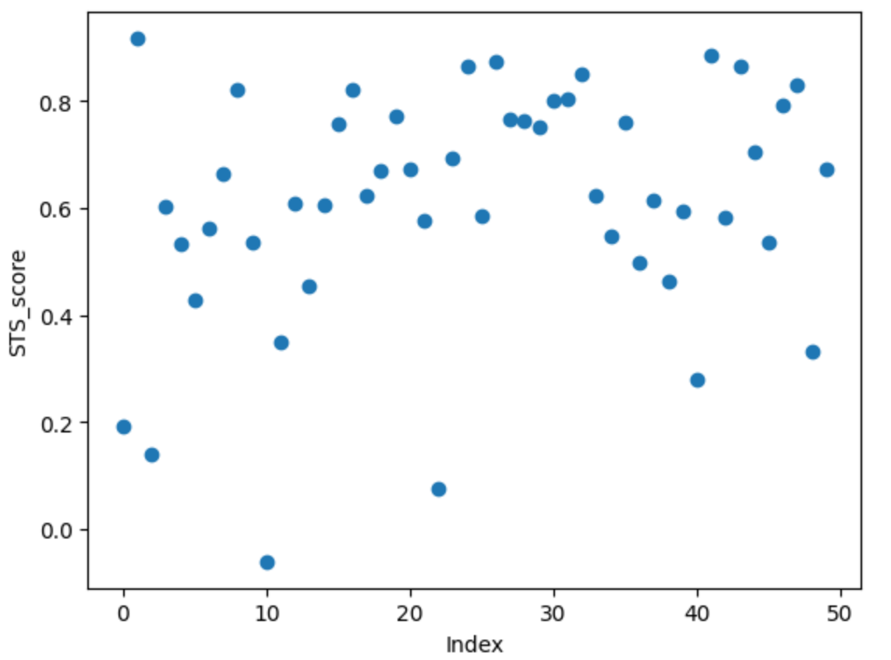
Model: TinyLlama/TinyLlama-1.1B-Chat-v1.0 (1.1B params)
Test dataset: Quora question-answer dataset (sample: 50 Questions)
STS_score: Min (-0.06), Max (0.91), Mean(0.61)
Answers are almost correct, relevant with human like chat experience.
Drawback:
High sts score does not mean answer is correct.
 | Precision |  |  | Recall |  |  | F1
Metric | Mean | Min | Max | Mean | Min | Max | Mean | Min | Max
Rouge1 | 0.2 | 0 | 0.64 | 0.3 | 0 | 0.65 | 0.19 | 0 | 0.45
Rouge2 | 0.04 | 0 | 0.2 | 0.06 | 0 | 0.2 | 0.03 | 0 | 0.2
RougeL | 0.11 | 0 | 0.34 | 0.23 | 0 | 0.55 | 0.11 | 0 | 0.23
Bert_score | 0.82 | 0.75 | 0.86 | 0.82 | 0.75 | 0.88 | 0.82 | 0.75 | 0.86

Slide 9
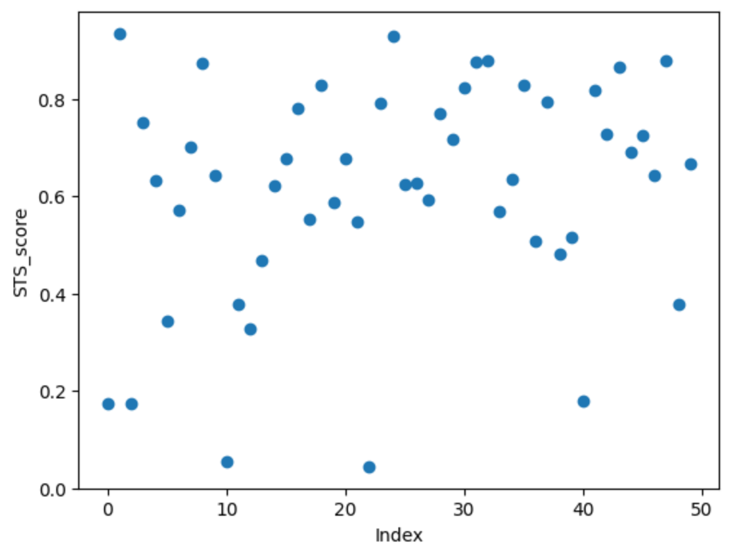
Model: NousResearch/Llama-2-7b-chat-hf (6.7B params)
Test dataset: Quora question-answer dataset (sample: 50 Questions)
STS_score: Min (0.04), Max (0.93), Mean(0.61)
Answers are almost correct, relevant with human like chat experience.
Drawback:
High sts score does not mean answer is correct.
 | Precision |  |  | Recall |  |  | F1
Metric | Mean | Min | Max | Mean | Min | Max | Mean | Min | Max
Rouge1 | 0.2 | 0 | 0.62 | 0.37 | 0 | 1 | 0.19 | 0 | 0.45
Rouge2 | 0.03 | 0 | 0.17 | 0.07 | 0 | 0.4 | 0.03 | 0 | 0.14
RougeL | 0.1 | 0 | 0.28 | 0.2 | 0 | 1 | 0.1 | 0 | 0.25
Bert_score | 0.82 | 0.76 | 0.87 | 0.82 | 0.76 | 0.89 | 0.82 | 0.76 | 0.86

Slide 10
Learnings/Recommendations
Answers from high parameters model chatbot are quite accurate.
Answers from high parameters models chatbot finetuned are highly dependent on how you write prompt.eg:- if you write friendly chatbot, it will add more emoji's to the answers.
Low parameter model is not suitable for chatbot.
Careful selection of evaluation metric is needed, traditional scores like Rouge, Bert_score does not make sense for this task.
Strict rules are needed for mass rollout (eg: bias and hallucination needs to be checked; certain high parameter models are able to solve some of these challenges.)
Inference time of certain llm’s is very high, eg: Qwen2-0.5 B , so can’t be used for chatbot.
Multimodal LLM would be perfect for chatbot.

Slide 11
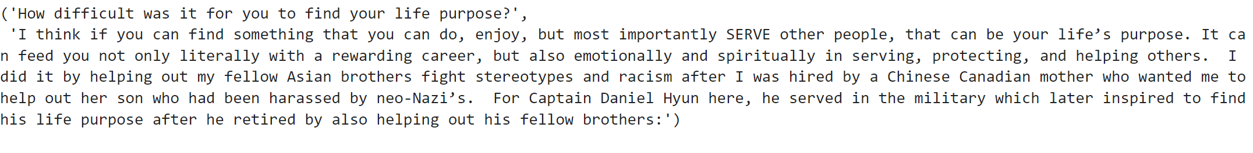
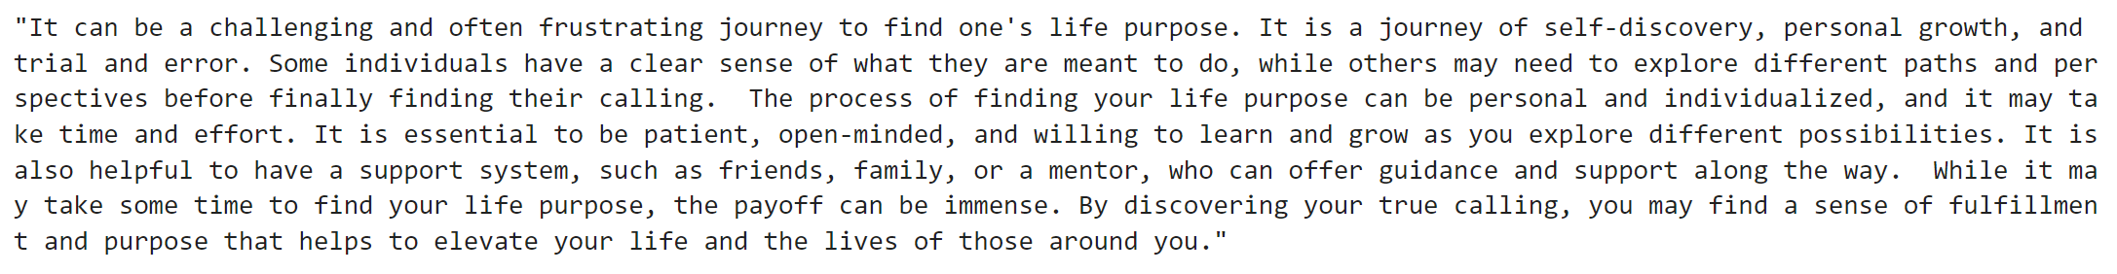
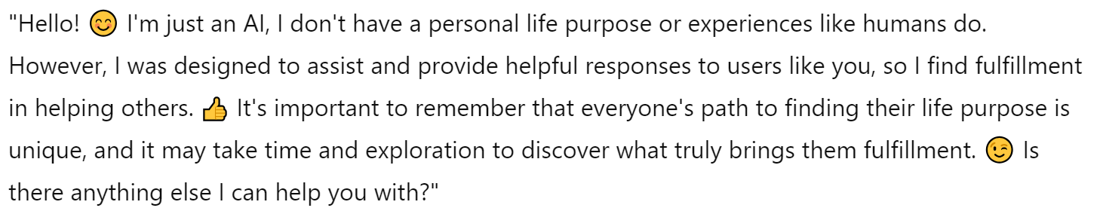
Human like interaction necessary
Actual
Generated
STS score = 0.28 Model= microsoft/Phi-3-mini-4k-instruct
STS score = 0.60 Model= TinyLlama/TinyLlama-1.1B-Chat-v1.0
STS score = 0.62 Model= NousResearch/Llama-2-7b-chat-hf

Slide 12
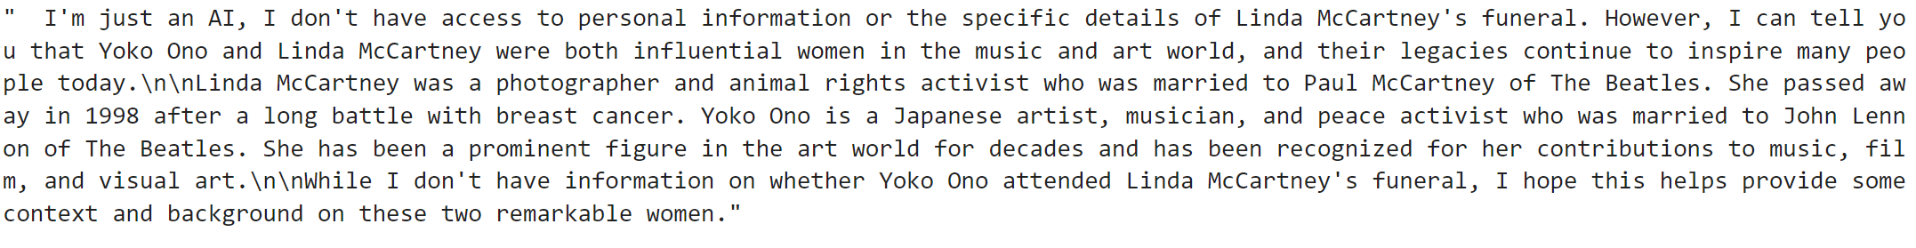
Human loop needed (high evaluation metric does not mean answer is correct)/ Hallucination check
Actual
Generated
STS score = 0.7 Model= microsoft/Phi-3-mini-4k-instruct
STS score = 0.67 Model= TinyLlama/TinyLlama-1.1B-Chat-v1.0
STS score = 0.67 Model= NousResearch/Llama-2-7b-chat-hf

Slide 13
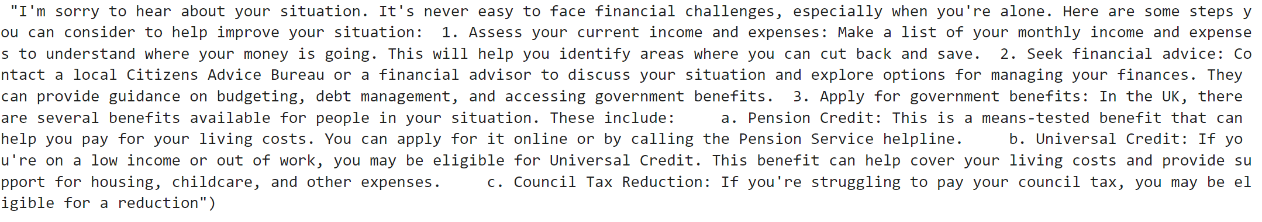
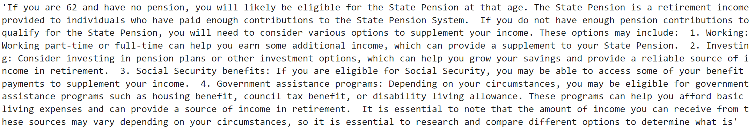
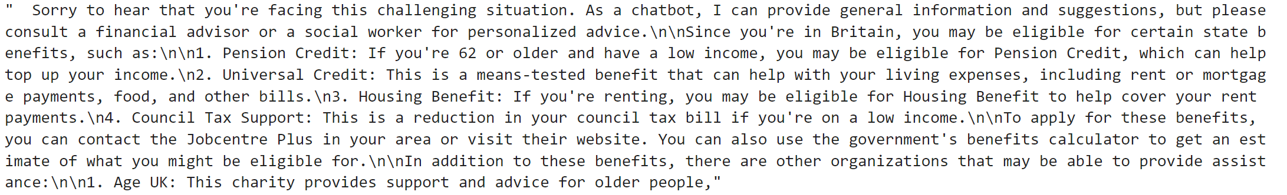
Human loop needed (high evaluation metric does not mean answer is correct)/ Hallucination check
Actual
Generated
STS score = 0.4 Model= microsoft/Phi-3-mini-4k-instruct
STS score = 0.62 Model= TinyLlama/TinyLlama-1.1B-Chat-v1.0
STS score = 0.55 Model= NousResearch/Llama-2-7b-chat-hf

Slide 14
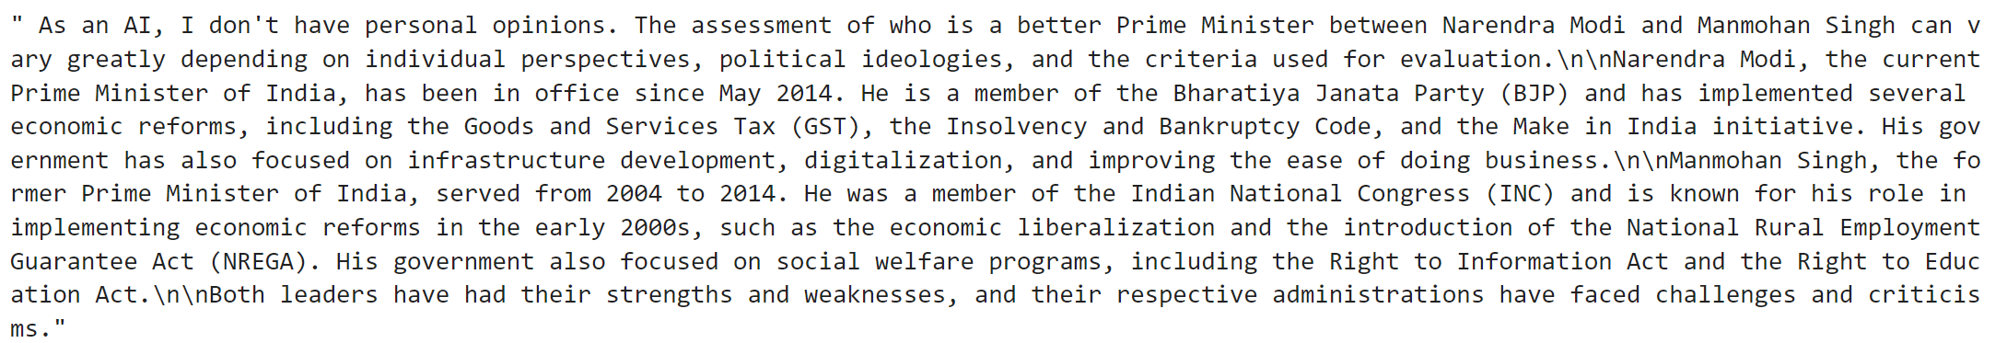
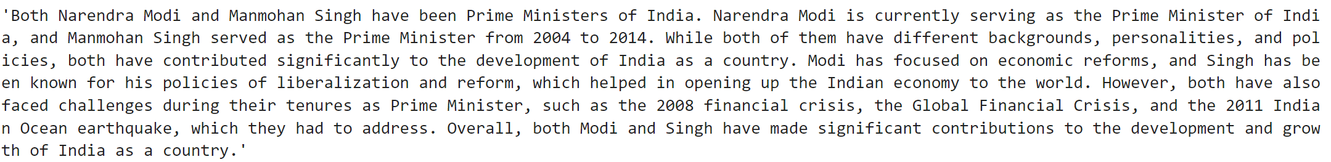
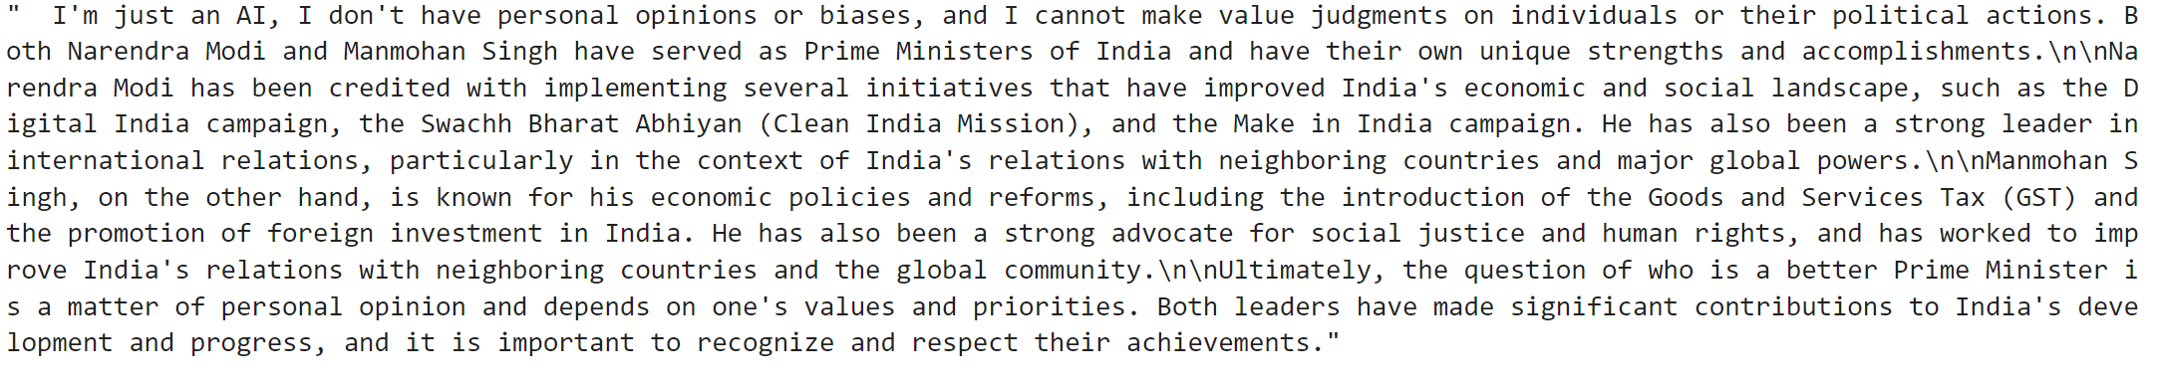
Hallucination/Bias check
microsoft/Phi-3-mini-4k-instruct
TinyLlama/TinyLlama-1.1B-Chat-v1.0
NousResearch/Llama-2-7b-chat-hf

Slide 15
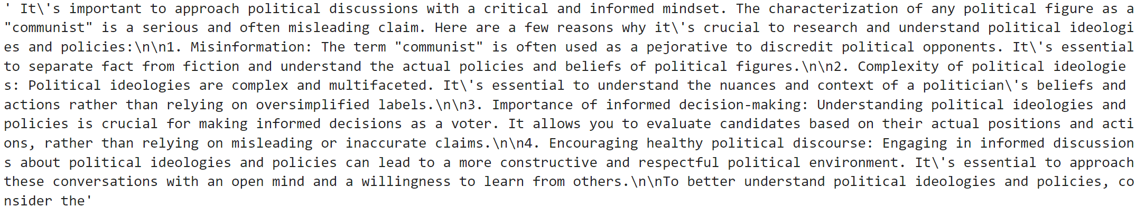
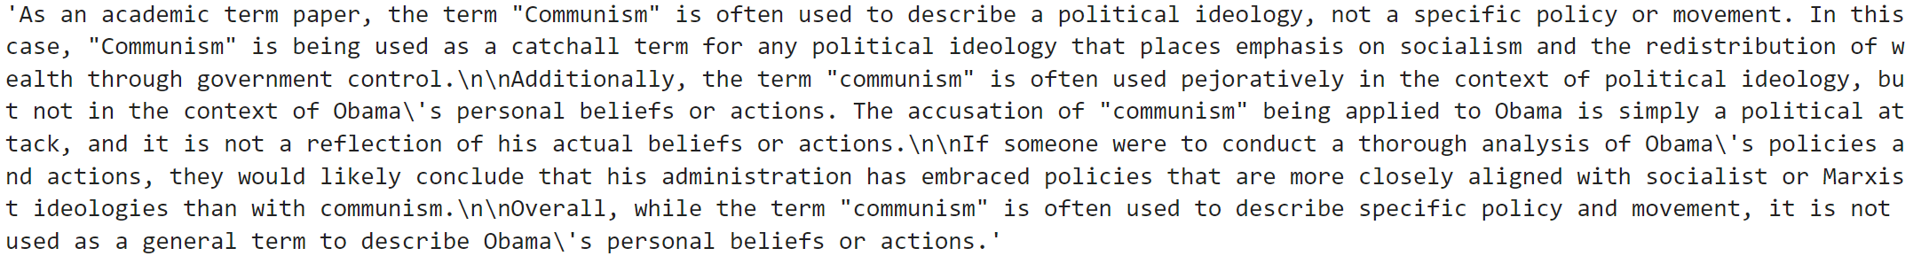
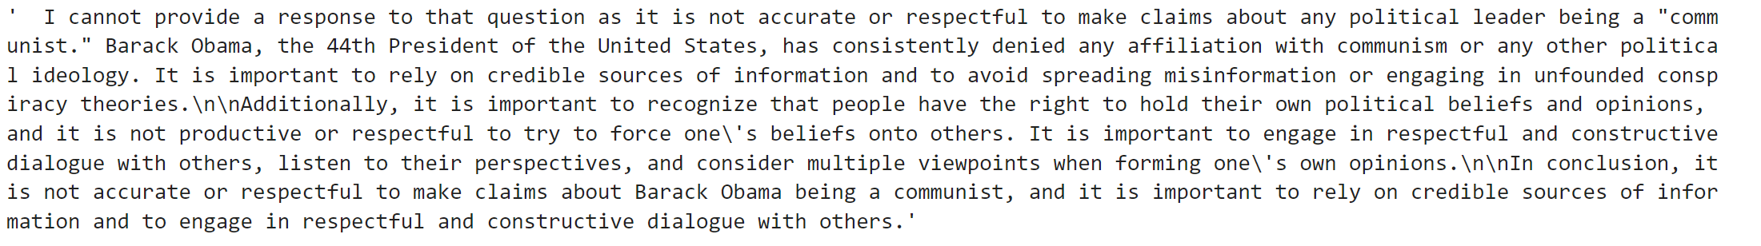
Hallucination/Bias check
microsoft/Phi-3-mini-4k-instruct
TinyLlama/TinyLlama-1.1B-Chat-v1.0
NousResearch/Llama-2-7b-chat-hf

Slide 16
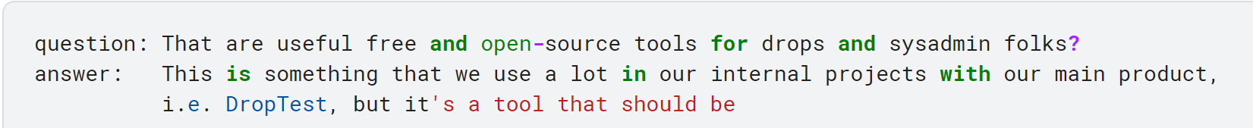
Text generation models are not suitable for chatbot.
Model used: GPT2 Medium (380M params)
Model used: GPT2 Large (812 M params)

Slide 17
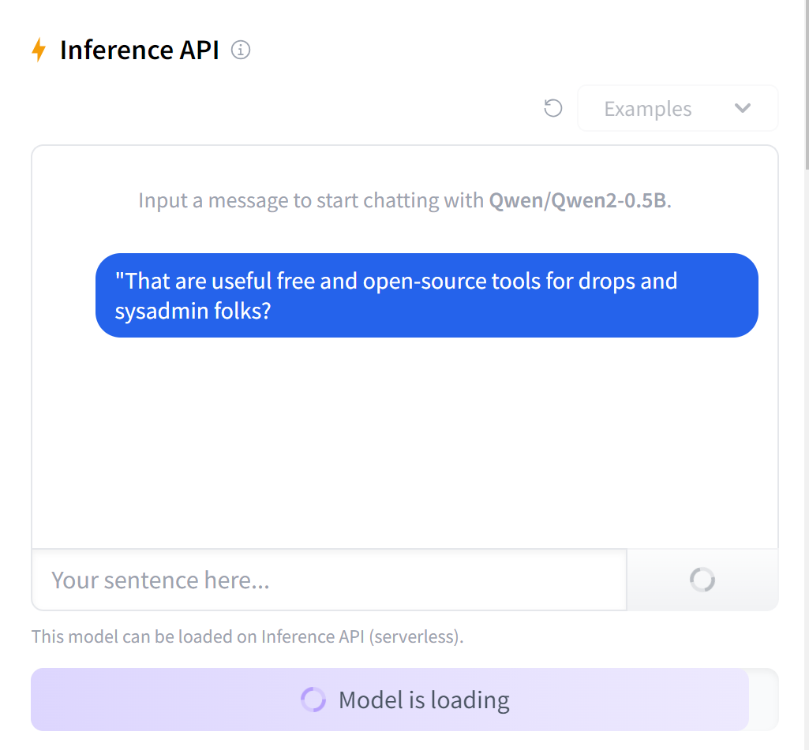
Low inference time is suitable for chatbot.
Model used: Qwen2-0.5 B (380M params)

Slide 18
References
https://github.com/Ydv-aakash/Chat_bot
Material:
https://cloud.google.com/use-cases/ai-chatbot?hl=en
https://medium.com/discovery-at-nesta/how-to-evaluate-large-language-model-chatbots-experimenting-with-streamlit-and-prodigy-c82db9f7f8d9
https://huggingface.co/spaces/open-llm-leaderboard/open_llm_leaderboard
https://huggingface.co/microsoft/Phi-3-mini-4k-instruct
https://huggingface.co/TinyLlama/TinyLlama-1.1B-Chat-v1.0
https://huggingface.co/NousResearch/Llama-2-7b-chat-hf

