Slide 1

CAPSTONE PROJECT Budget Predictor
PRESENTED BY
STUDENT NAME: DHIRAJ YADAV
COLLEGE NAME: VIGNAN’S INSTITUTE OF INFORMATION TECHNOLOGY
DEPARTMENT: COMPUTER SCIENCE & ENGINEERING
EMAIL ID: YDHIRAJ1487@GMAIL.COM
AICTE STUDENT ID: STU6712a94f44b3c1729276239

Slide 2
OUTLINE
Problem Statement (Should not include solution)
Proposed System/Solution
System Development Approach (Technology Used)
Algorithm & Deployment
Result (Output Image)
Conclusion
Future Scope
References

Slide 3
PROBLEM STATEMENT
•⁠ ⁠Tracking monthly expenses manually can be tedious and prone to error.
•⁠ ⁠Lack of insights into future spending makes budgeting difficult.
•⁠ ⁠Individuals need a predictive tool to help plan finances smarter.

Slide 4
PROPOSED SOLUTION
The proposed system aims to tackle the challenge of predicting future monthly spending trends to enhance personal financial planning and budgeting. This solution leverages historical expense data and machine learning techniques to generate reliable forecasts and actionable insights. The system will consist of the following components:
Data Collection:
Collect historical personal spending data, categorized by type (e.g., groceries, utilities, entertainment) and timestamp.
⁠Store data in structured format (CSV) for analysis, ensuring consistent tracking across months.
Data Preprocessing:
Remove duplicate or missing entries to improve accuracy
Aggregate total spending per month to simplify input structure
Machine Learning Algorithm:
Train a Linear Regression model using MonthIndex as the predictor
Target variable is total monthly spend
Deployment:
Output predictions for future months into a new CSV file
Create line plots showing actual vs. predicted amounts
Evaluation:
Use Mean Squared Error (MSE) to measure average forecast error
Use R² Score to evaluate model’s explanatory strength
Result:
CSV file: future predictions for next six months
Graph: side-by-side visualization of actual and predicted monthly spend

Slide 5
SYSTEM APPROACH
System Approach
This section outlines the overall strategy and methodology used for developing the budget prediction system.
System Requirements
•⁠ ⁠Operating System: Windows 10 or higher
•⁠ ⁠Software: Python (3.8+), Jupyter Notebook or any compatible IDE
•⁠ ⁠Memory: Minimum 4GB RAM for smooth data processing
•⁠ ⁠Storage: Sufficient space to store CSV files and output visualizations
Libraries Required to Build the Model
•⁠ ⁠pandas – For data manipulation and aggregation
•⁠ ⁠numpy – For numerical operations
•⁠ ⁠scikit-learn – For implementing the Linear Regression model and performance metrics
•⁠ ⁠matplotlib – For visualizing actual and predicted spending trends
•⁠ ⁠os – For checking and managing file paths

Slide 6
ALGORITHM & DEPLOYMENT
In the Algorithm & Deployment section for your Budget Predictor project, based on the style and structure you provided:
Algorithm Selection:
Linear Regression is used for its simplicity and effectiveness in modeling spending trends over time.
Data Input:
Linear Regression is used for its simplicity and effectiveness in modeling spending trends over time.
Training Process:
Data split chronologically; model trained on earlier months and evaluated using metrics like MSE and R².
Prediction Process:
Forecasts next 6 months’ expenses, outputs CSV and visualizes results with a line plot.

Slide 7
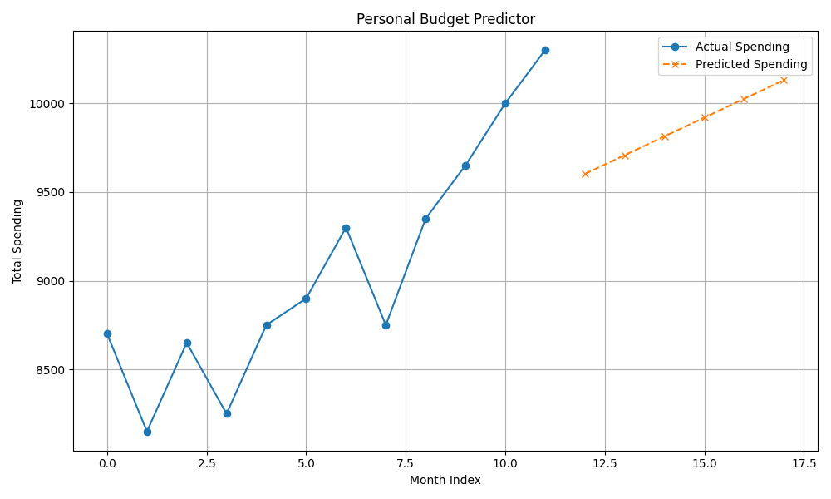

RESULT

Slide 8
CONCLUSION
The Budget Predictor effectively uses machine learning to forecast future expenses, helping users make smarter financial decisions. While the model performs well, challenges like limited features and simple algorithms suggest room for improvement. Future upgrades could include more advanced models and external data. Accurate spending forecasts are just as essential for financial stability as demand predictions are for urban planning.

Slide 9
FUTURE SCOPE
•⁠ ⁠Integrate category-based predictions (e.g., groceries, transport)
•⁠ ⁠Use time-series models like Prophet or ARIMA for better accuracy
•⁠ ⁠Deploy as a web/mobile app with real-time tracking
•⁠ ⁠Add alerts, dashboard view, and customizable budget goals

Slide 10
REFERENCES
•⁠ ⁠pandas documentation
•⁠ ⁠scikit-learn documentation
•⁠ ⁠matplotlib documentation
GitHub Link: https://github.com/Ydvdhiraj/Budget-Predictor

Slide 11
Thank you

