Slide 1
Car Price Dashboard
Task 4 Project Summary

Slide 2
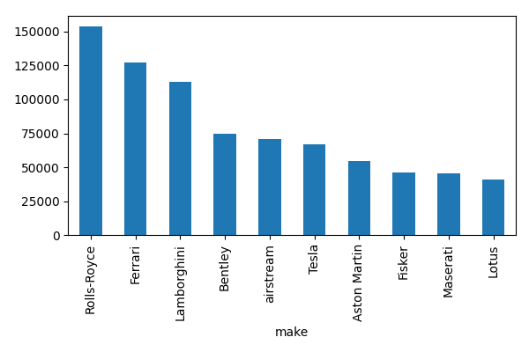
Price by Brand

Slide 3
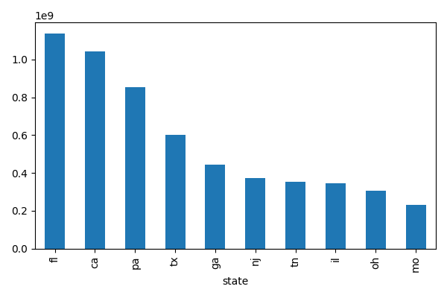
Sales by State

Slide 4
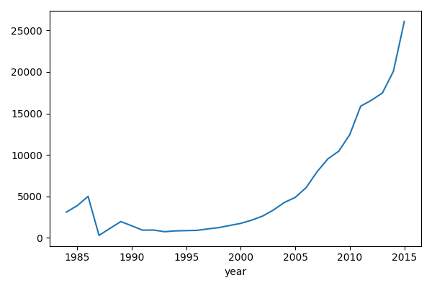
Year-wise Price Trend

