Slide 1


PROTOTYPING MODULE · HSHL
Autonomous Line-Following Robot
with Ultrasonic Obstacle Avoidance
An Arduino-based robot car built entirely from the project kit
Ibrahim · Hochschule Hamm-Lippstadt (HSHL) · June 2026
Notes:
Good morning. My project is an autonomous line-following robot, built on an Arduino Uno, that also detects and drives around obstacles — using only the parts in our project kit. I'll cover it in four short parts: what it had to do, the hardware and wiring, the software, and the challenges and results.

Slide 2




PART 1 · INTRODUCTION & OBJECTIVES
What the Robot Has to Do
Follow the line
Avoid obstacles
Stop at stop lines
Track a marked path through straight and curved sections.
Detect an object, drive around it, then return to the line.
Recognise a stop line and come to a clean halt.
One rule shaped every decision: only components supplied in the kit — no extra batteries, no external regulators, no swapped-in parts.
Notes:
The robot has three jobs. First, follow a marked line through both straight and curved sections of the track. Second, detect an obstacle placed in its path, drive around it, and then get back on the line on its own. Third, recognise a stop line and come to a clean halt. The one rule that shaped every decision: we could only use the components supplied in the kit — no extra batteries, no external regulators, no swapping in different parts.

Slide 3
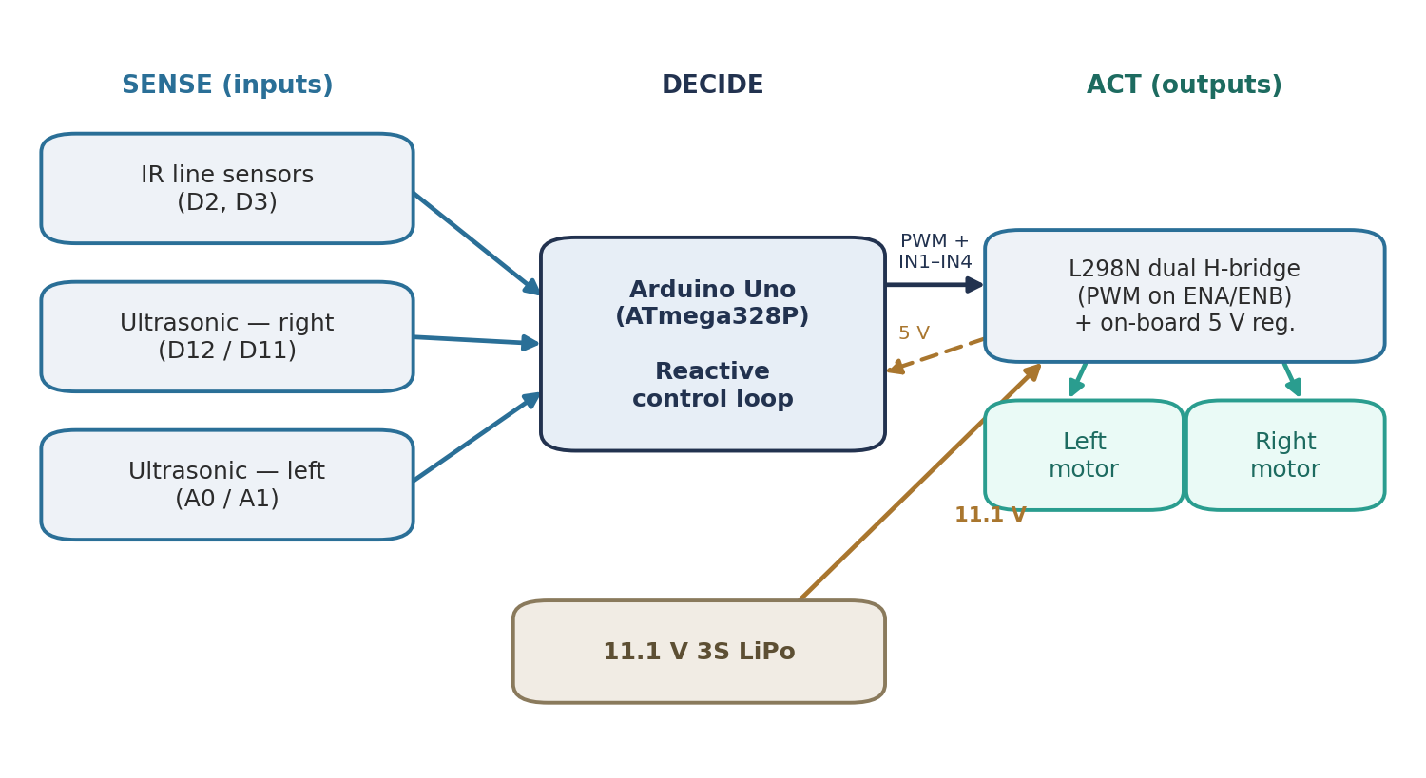





PART 1 · INTRODUCTION & OBJECTIVES
The System at a Glance
Built around a simple reactive loop
Arduino Uno — runs the control logic
2× IR sensors — read the line
2× HC-SR04 — watch for obstacles
L298N + 2 motors — differential drive
11.1 V LiPo — powers everything
Sense → Decide → Act data flow
Notes:
Here's the system as a whole. It follows a simple sense–decide–act loop. Two infrared sensors read the line and two ultrasonic sensors watch for obstacles ahead. All of that feeds into the Arduino Uno, which runs the control logic and drives two geared motors through an L298N motor driver. A single 11.1-volt lithium battery powers everything. The chassis is differential drive — it steers by running the left and right wheels at different speeds, with no steering servo.

Slide 4

PART 2 · HARDWARE & WIRING
Wiring and Pin Configuration
Function | Arduino pin(s) | On
Motor A — speed (PWM) | D5 (ENA) | L298N
Motor A — direction | D6, D7 (IN1/IN2) | L298N
Motor B — speed (PWM) | D10 (ENB) | L298N
Motor B — direction | D8, D9 (IN3/IN4) | L298N
Left IR line sensor | D2 | digital
Right IR line sensor | D3 | digital
Right ultrasonic | D12 / D11 | trig / echo
Left ultrasonic | A0 / A1 | trig / echo
Organised into three groups
Motors
driven via the L298N
Line sensing
two IR sensors
Ranging
two HC-SR04 units
Clean, labelled wiring made debugging far easier.
Notes:
A big part of this project was getting the wiring right. This table is the actual pin map. The two motors are driven through the L298N: pins D5 and D10 set their speeds with PWM, and four direction pins, D6 to D9, control which way each motor turns. The two line sensors sit on D2 and D3. The right ultrasonic sensor uses D12 and D11, and the left one uses the analog pins A0 and A1. Every connection had to be deliberate and consistent for the code to work.

Slide 5


PART 2 · HARDWARE & WIRING
How the Hardware Shaped Everything
One battery, one power chain
Jumpers removed for PWM
Wiring set the steering
11.1 V LiPo → L298N → on-board 5 V regulator → Arduino. Stays kit-only while supplying the motors' stall current.
Pulling the L298N enable jumpers is what makes variable speed control — and smooth turning — possible at all.
Motor wiring made the turn directions physically reversed, so the inversion is documented as intentional in the code.
Notes:
The hardware configuration didn't just support the software — it shaped it. Three examples. One: a single battery feeds the L298N, and the driver's own regulator sends a clean 5 volts back to the Arduino — that's what let us stay kit-only while still supplying the motors' stall current. Two: we removed the L298N's enable jumpers; that one physical change is what makes PWM speed control — and smooth turning — possible at all. Three: the motor wiring made the turn directions physically reversed, so we documented that inversion as intentional in the code so a later edit wouldn't ‘fix’ it and reverse the steering.

Slide 6
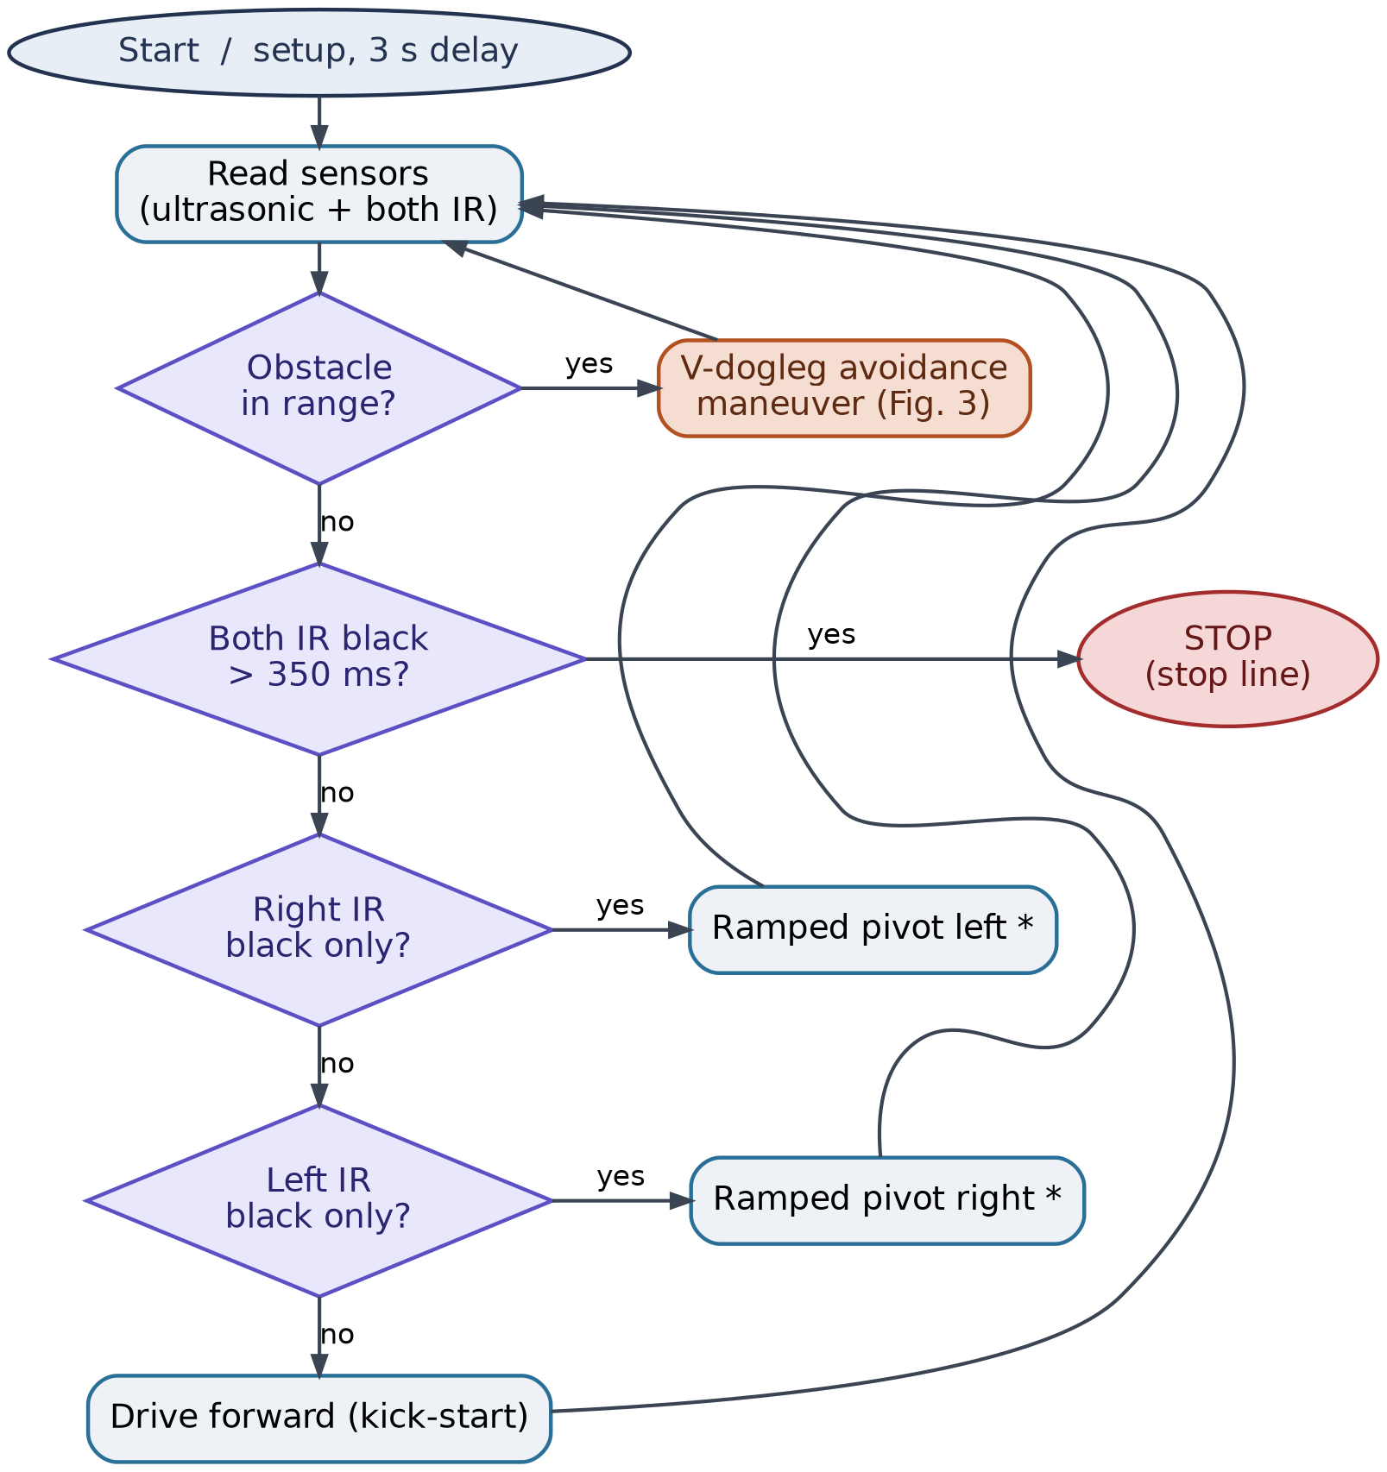
PART 3 · SOFTWARE & CONTROL
The Reactive Control Loop
Checked in priority order, every loop
1
Obstacle? — if yes, run the avoidance maneuver
2
Stop line? — both IR dark — come to a halt
3
Line following — steer toward whichever IR sees the line
Bang-bang steering with a ramped pivot — the longer the line is lost, the harder it corrects; motors get a kick-start to break friction.
Notes:
The firmware is one reactive loop that always checks things in priority order. First, is there an obstacle? If yes, it runs the avoidance maneuver. If not, are both sensors on dark — a stop line? If yes, it stops. Otherwise, it follows the line. Line following is bang-bang with a twist: the longer the line is lost, the harder it steers back, which keeps it smooth on gentle curves and sharp when it really drifts. One more detail — the motors get a short high-power kick to start moving, because below about forty PWM they won't turn at all.

Slide 7
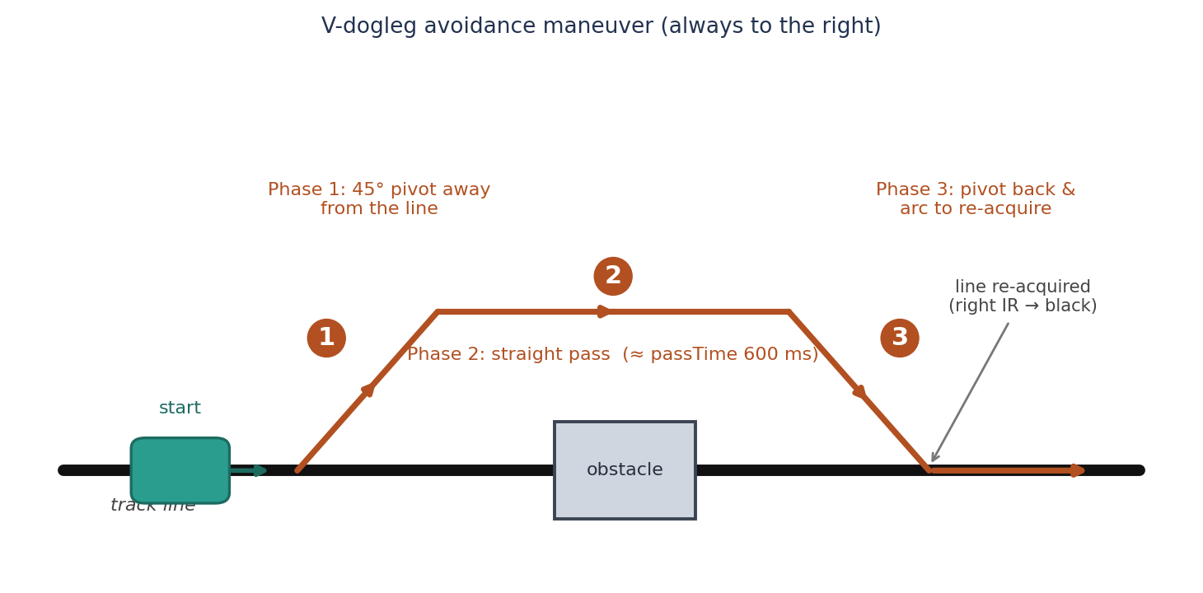

PART 3 · SOFTWARE & CONTROL
Obstacle Avoidance — the V-Dogleg
Three phases
1
Pivot away
turn ~45° off the line, clear of the obstacle
2
Straight pass
drive past the side of the obstacle
3
Turn back
re-acquire the line, then resume following
Closed-loop return — stops turning the instant the line is found. Beat a half-circle arc and a box detour on the floor; a timeout failsafe prevents endless circling.
Top-down path; the robot always steps to the right of the obstacle
Notes:
For obstacles, we use a three-phase V-dogleg. Phase one, it pivots about forty-five degrees away from the line and clears the obstacle. Phase two, it drives straight past it. Phase three, it turns back and keeps going until the IR sensor re-acquires the line — that last phase is closed-loop, so it stops turning the instant it finds the line again. We tried a half-circle arc and a boxy detour first; on the floor, the V-dogleg was the most repeatable, and a timeout failsafe keeps it from circling forever.

Slide 8



PART 4 · CHALLENGES & RESULTS
Problems We Solved on the Floor
Motor dead-zone
Inverted steering
Below ~40 PWM the motors stalled. A kick-start burst breaks static friction — it was friction, not a weak battery.
Turns ran backwards. Fixed in software and documented as an intentional chassis quirk.
Counter-intuitive arc
No realistic simulator
A wider speed gap between the wheels gives a tighter turn — the opposite of our first guess. Corrected by testing.
The kit's quirks don't appear in idealised sim, so everything was validated on the real track.
Notes:
Most of the real work was solving problems on the floor. The motors had a dead-zone — below about forty PWM they wouldn't move — so we added a kick-start burst to break static friction; it was friction, not a weak battery. The steering ran backwards, which we fixed in software and documented. We also found that a wider speed gap between the wheels gives a tighter turn — the opposite of what we expected. And because the kit's quirks don't show up in an idealised simulator, we tested everything on the real track.

Slide 9


PART 4 · CHALLENGES & RESULTS
Results & What's Next
Achieved
Future improvements
Reliable line tracking on straights and curves
PID control for smoother tight curves
Repeatable obstacle avoidance
Wheel encoders for distance-based moves
Dependable stop-line halting
Adaptive IR thresholds for changing light
Full report, diagrams and source code
Ultrasonic width sensing per obstacle
65
150 / 60
600
~14
PWM cruise
kick PWM / ms
ms straight pass
cm trigger
Notes:
To wrap up: the robot meets all three goals — it tracks the line reliably, drives around obstacles repeatably, and stops at stop lines — and it's fully documented with a report, diagrams, and code. The tuned settings are on screen. Looking ahead, a PID controller would smooth out tight curves, wheel encoders would allow precise distance-based moves, adaptive sensor thresholds would handle changing light, and ultrasonic width sensing could tailor the avoidance to each obstacle. Thank you — I'm happy to take any questions.

